Slide 1
Was the American Revolution a Product of Hope and Grit?
By: Yanni Agrotis, Christopher DeRita, Michael Durkin, Sarah Espinal, Jaron Greenidge, Jacqueline O’Reilly, Carly Spadafora, and Christopher Weber

Slide 2
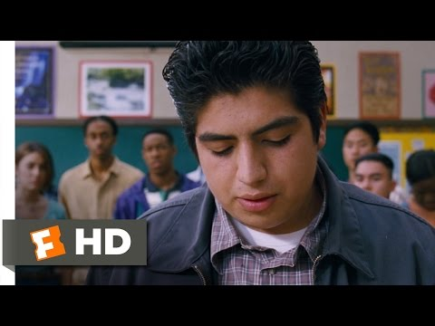
Lets watch this clip to start off...

Slide 3
Hope is...
The way = pathways to know what you have to do
+
The will = the agency = desire that will lead you to the pathways

Slide 4
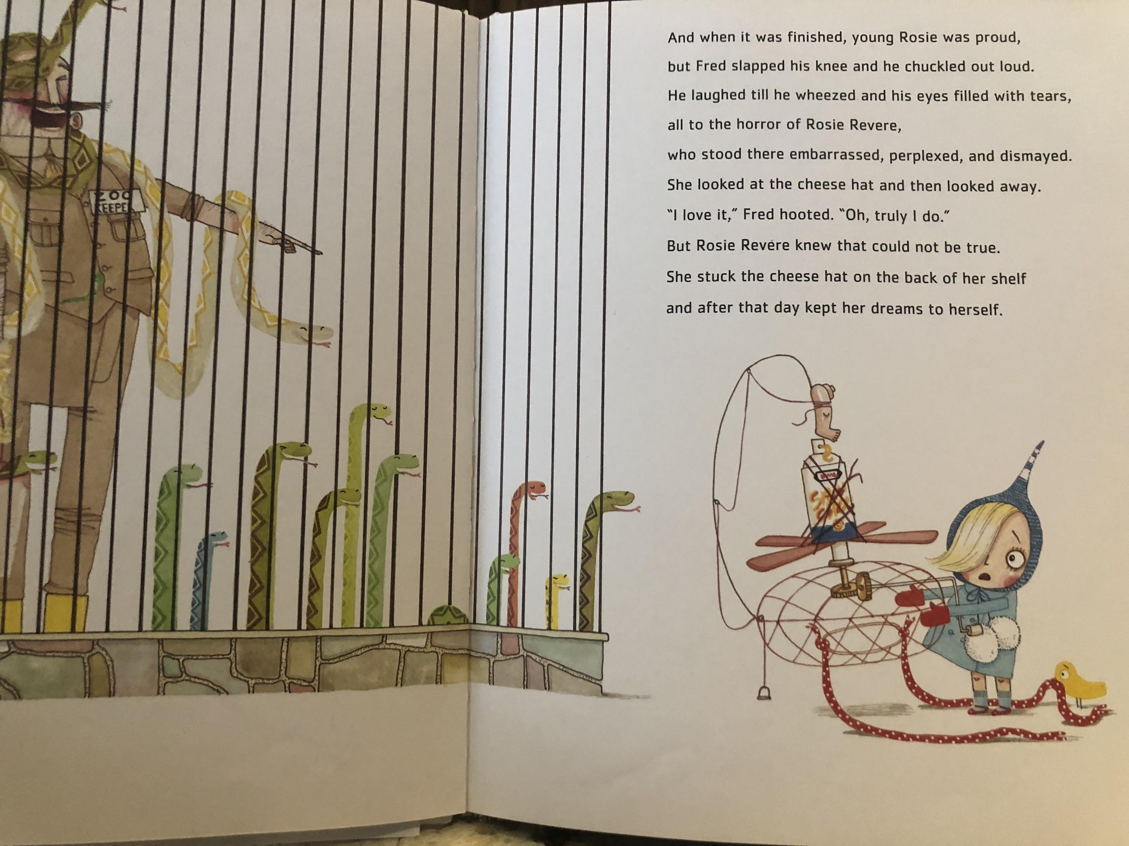

Slide 5
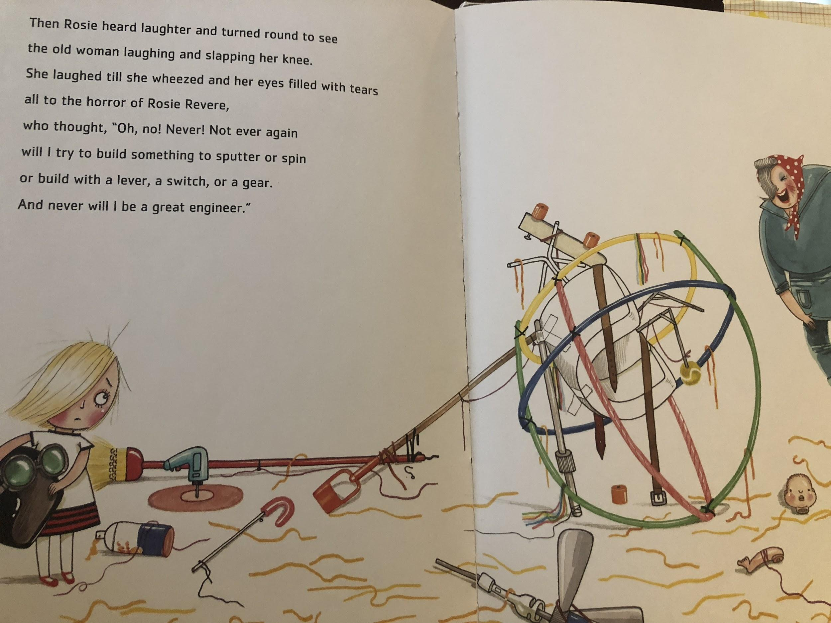

Slide 6
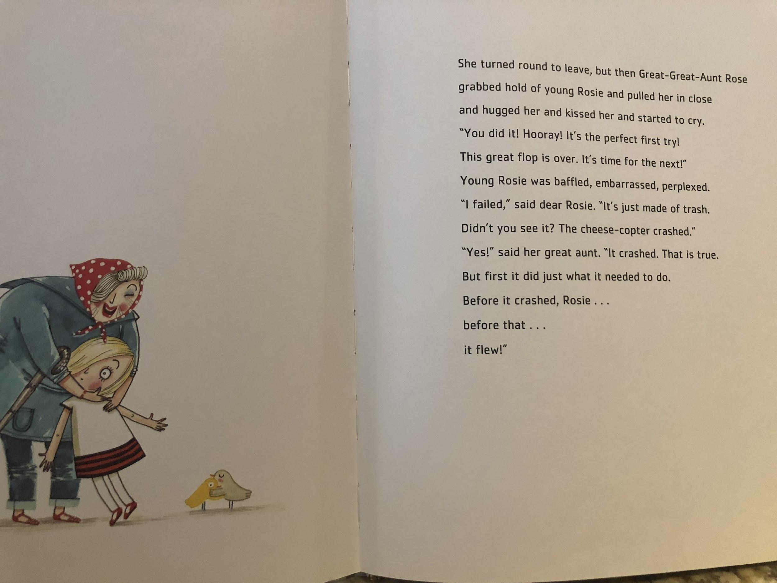

Slide 7
Factors that increase and decrease HOPE
Hope Creators
Success
People in our lives that encourage us
Our “tribe” or group of people and their collective attitude
Hope Crushers
Failure
People in our loves who destroy our belief that we can succeed
A tribe that discourages us from our goals

Slide 8
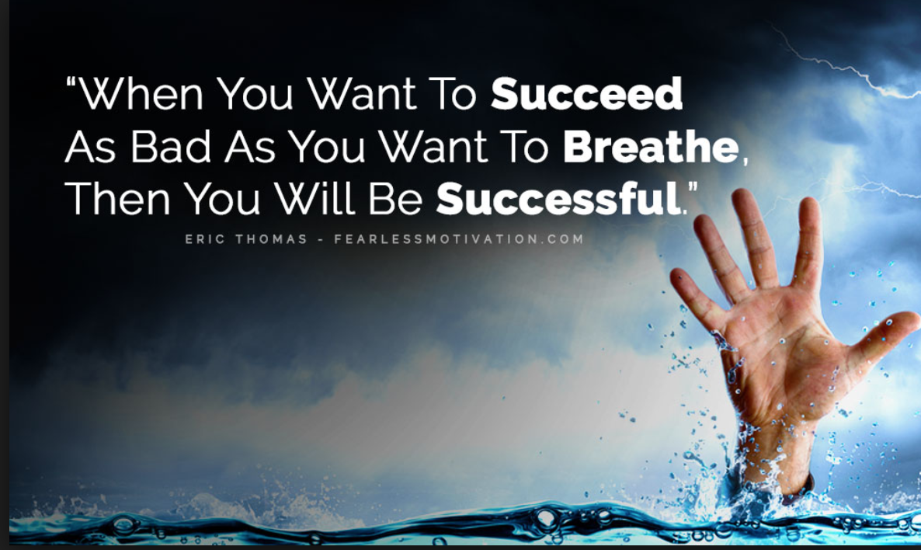
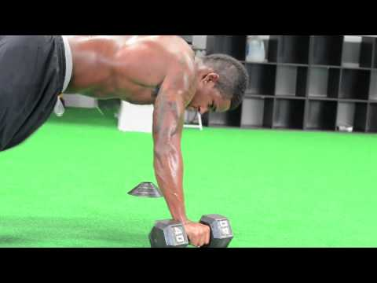
A Story on Grit- Chris Weber

Slide 9
What is Grit?
-Passion for a long term goal.
-Perseverance: Willing to endure whatever it takes.
-Grit= Passion + Perseverance

Slide 10
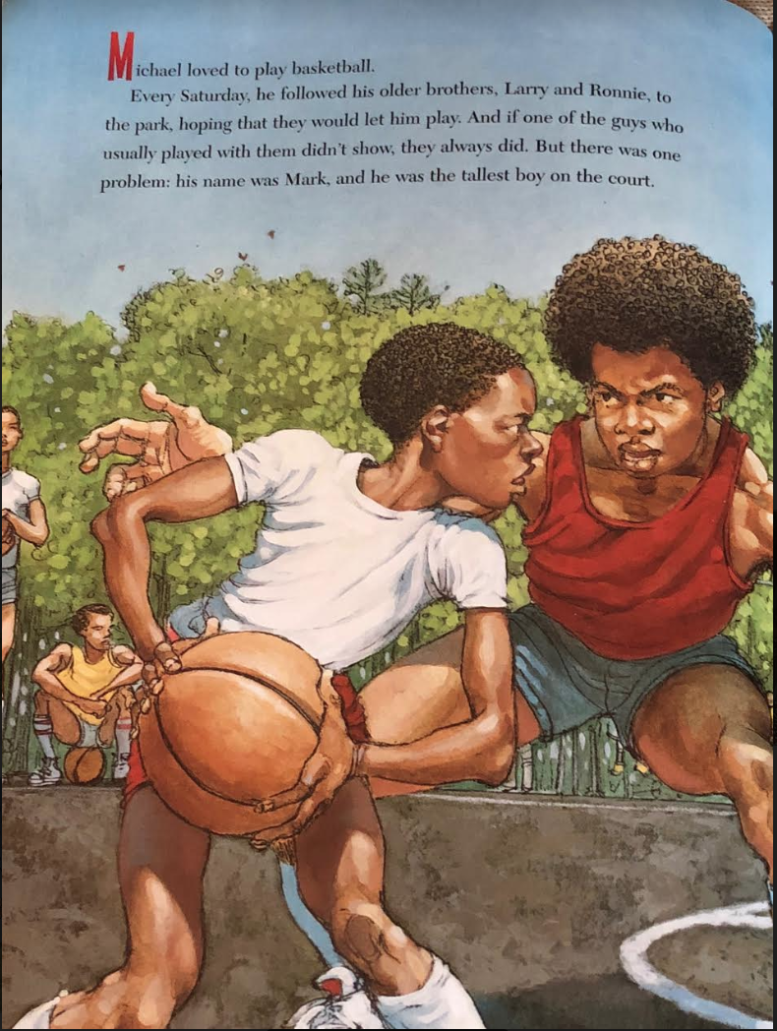

Slide 11
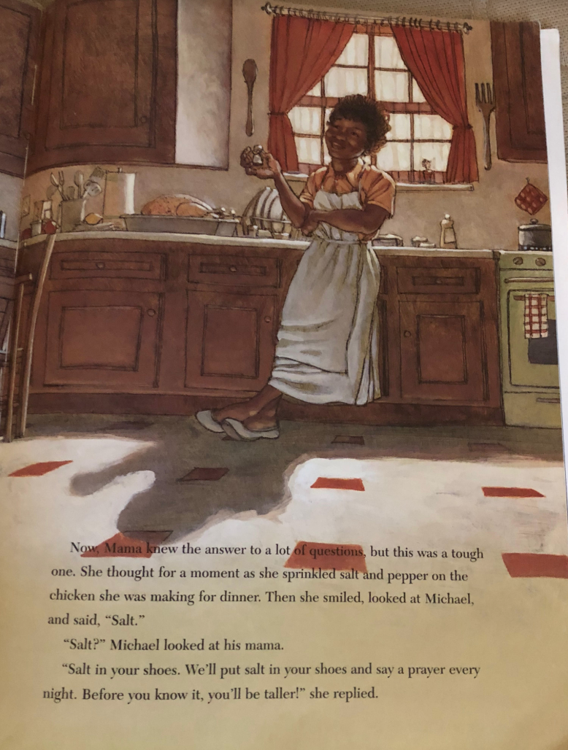

Slide 12
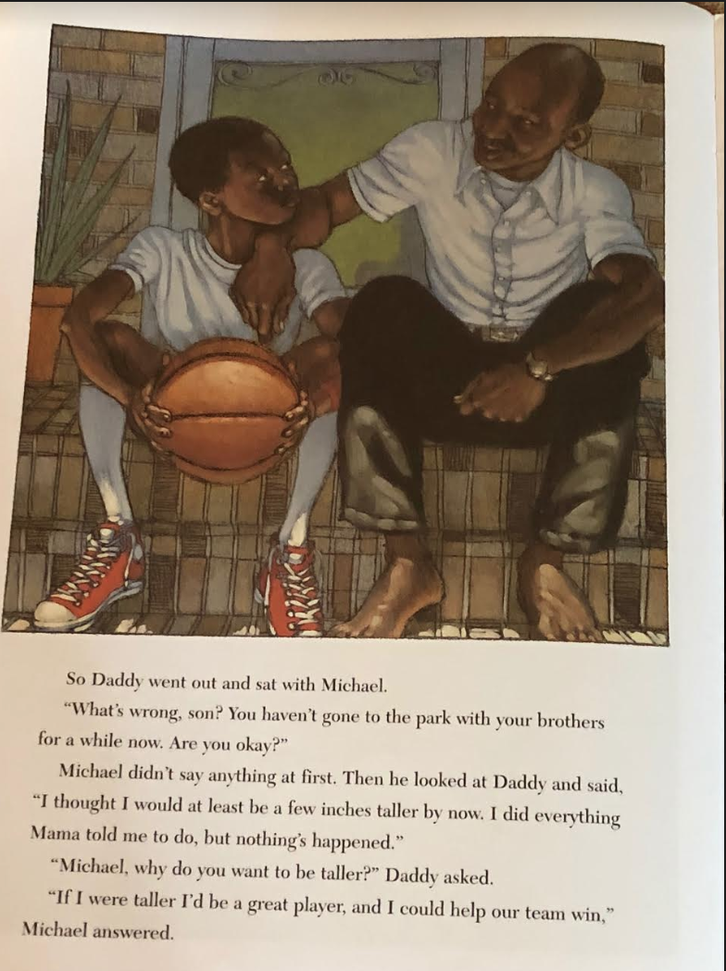

Slide 13
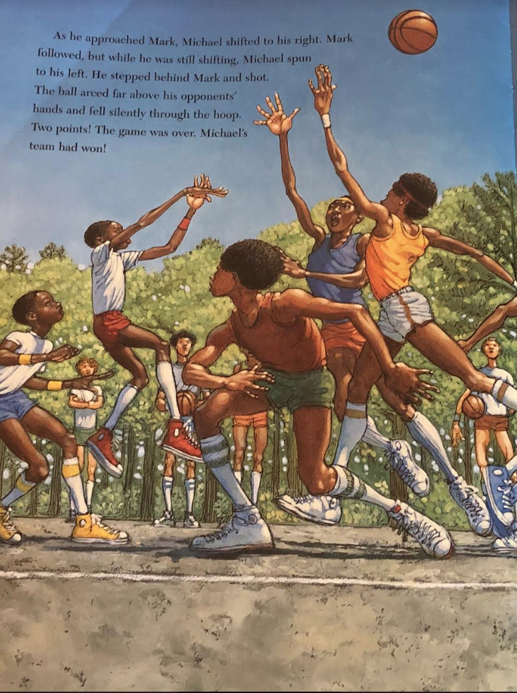

Slide 14
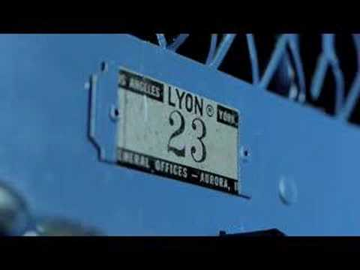
Michael Jordan

Slide 15
Salt in His Shoes
How and where is grit seen in this book?
How did Michael Jordan’s grit lead to his success?
Do you think Michael’s talent or grit had more to do with his success?

Slide 16
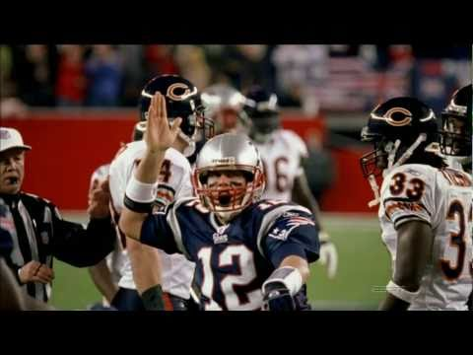
Tom Brady

Slide 17
Exit Ticket
-Identify and explain something you are passionate about.
-Explain how and why you are passionate about it.
-Explain what you do in order to be good at this passion you have.

Slide 18
Do Now
What is an example of Geography?
Geo-The Earth
Graphia-To write/draw

Slide 19
What is Geography?
The study of Earth’s physical features, atmosphere, and human activity
Location- Position on Earth’s surface (Absolute/Relative)
Place- Physical Characteristics
Human/Environmental interactions- Shaping landscape
Movement- Telecommunication or by ship
Regions- Deserts and Mountain Ranges

Slide 20
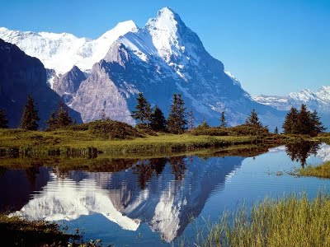
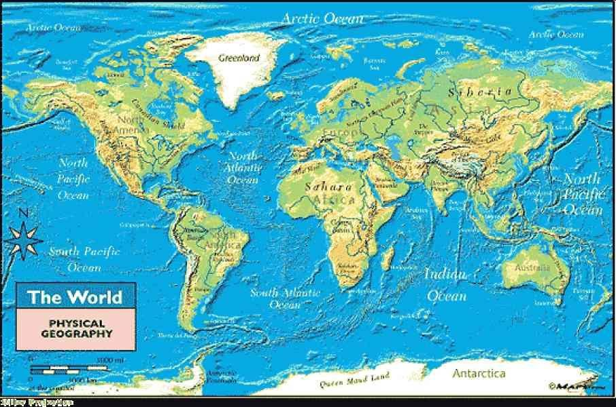
How did Geography affect the American Revolution?

Slide 21
The British Plan to divide the colonies
General John Burgoyne will travel from Canada to Albany and meet an army led by General Howes, cutting the colonies in two.
Native American Tribes helped the British navigate through the dense forests that were 5x larger than all of England.
The Americans used a tactic called Guerrilla Warfare to ambush the British and retreat suddenly.
The Americans attacked the Native Americans first, to limit the red coats’ ability to navigate through the thick forests.
General Howes attacked the Patriot capital located in Philadelphia instead of meeting Burgoyne in albany as planned.

Slide 22
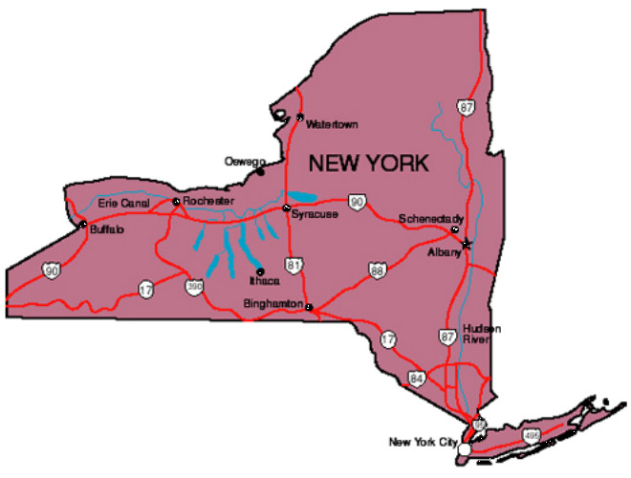
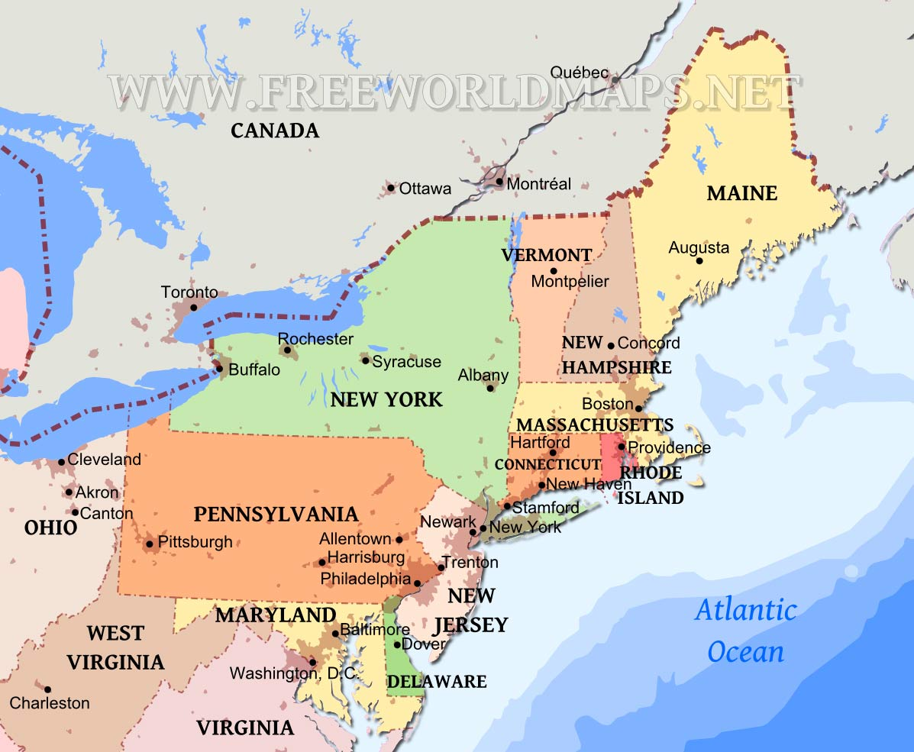

Slide 23
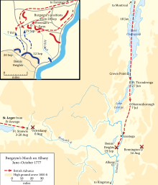
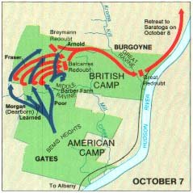
Saratoga

Slide 24
Name 5 things that you have/use that protect you from the cold.

Slide 25
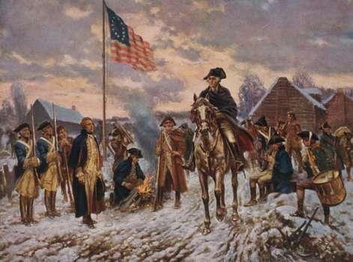
Valley Forge
The long winter led to starvation, low moral, and spread of diseases
Soldiers were promised rations but were given water and flour mixed together
Most soldiers had no shoes or coats
Around 2,000 soldiers died but surprisingly few men deserted the army
Everything turned around when Friedrich Von Steuben arrived at camp
He started to train the men and a spark of hope spread through the camp

Slide 26
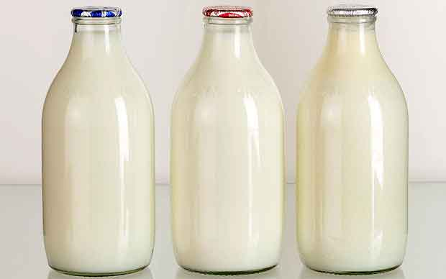
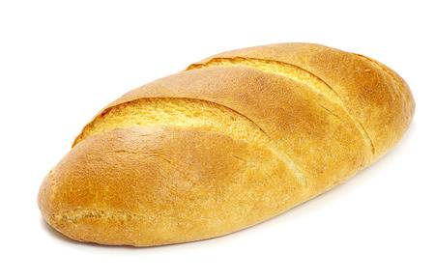
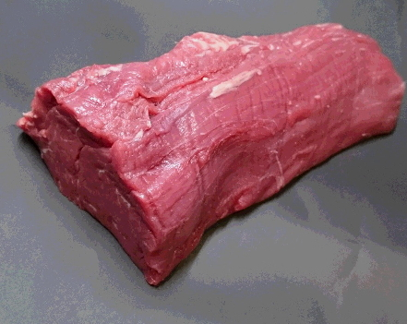

Slide 27
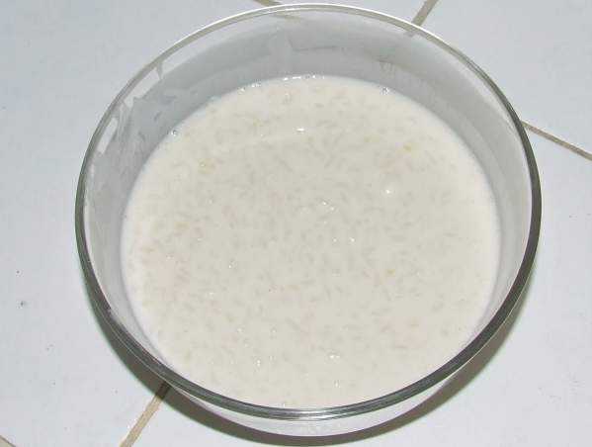

Slide 28
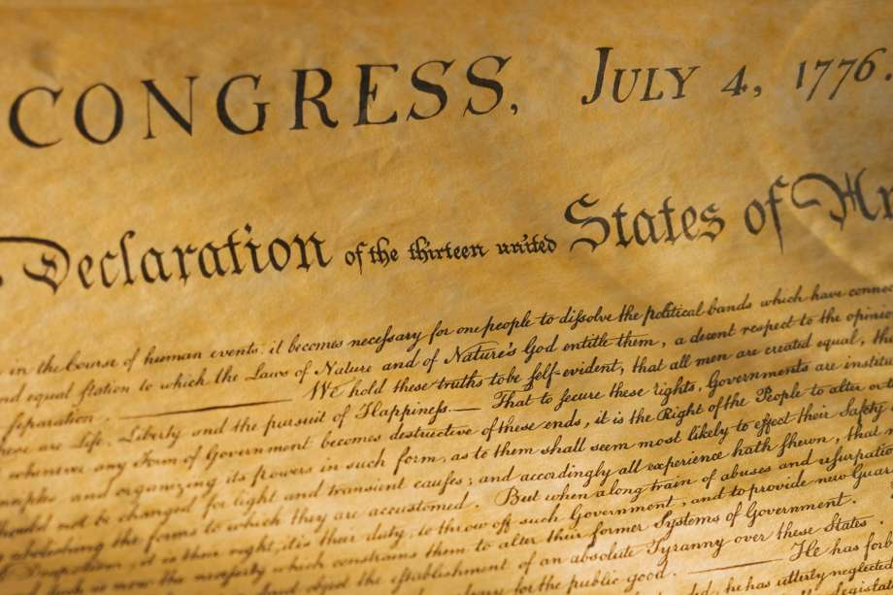
The Declaration of Independence
They debated indoors with the windows shut during the summer heat
Signed in Philadelphia
In the middle of the colonies so it is equal distance for everyone
Occurred during the summer so everyone is able to travel safely

Slide 29
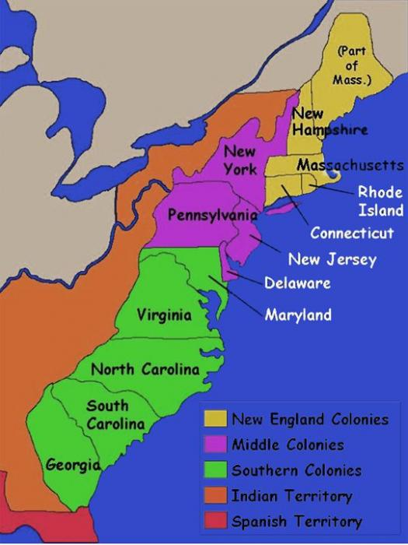

Slide 30
Exit Activity
Name three different ways geography affected the American Revolution.

Slide 31
Hope & Grit
How It Shaped the American Revolution

Slide 32
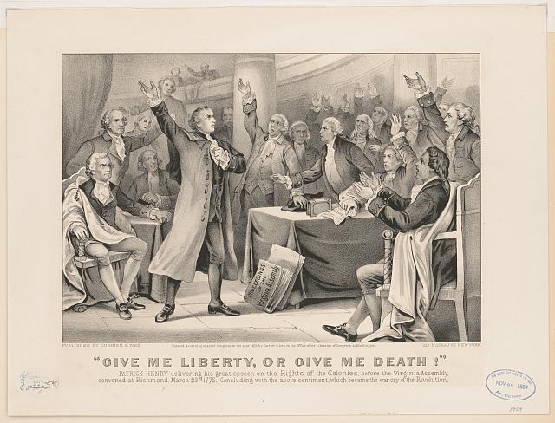
Give me Liberty or Give me Death!

Slide 33
What is Read and Retell?

Slide 34
Exit Ticket
Pick one event. Briefly explain in one to two sentences how the hope and grit of the American people during this event led to success of the American Revolution.

Slide 35
Hope & Grit
Christopher DeRita

Slide 36
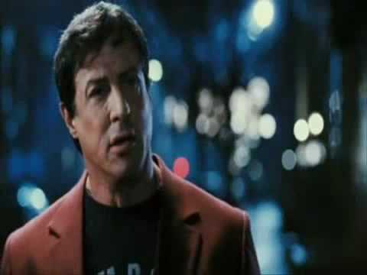
Do Now:

Slide 37
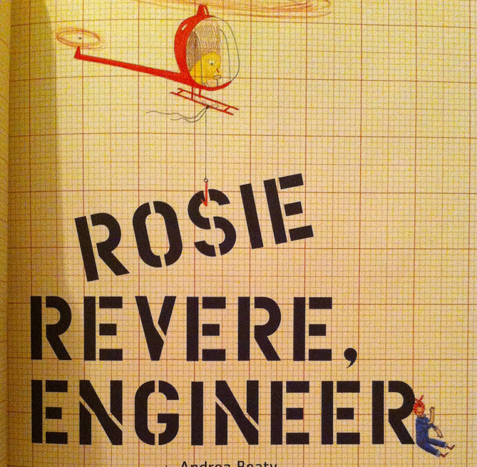
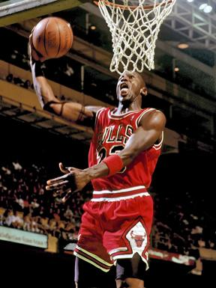
What is hope?
What is grit?

Slide 38
A Quick Reminder!
Always be politeful to your classmates
Raise your hands if you’d like to speak
Respect what your classmates have to say, even if you disagree
Remember to have fun as a team!

Slide 39
Planning Page
Actor | Details | Possible Quote
 | 1) 2) | “ “
 | 1) 2) | “ “
 | 1) 2) | “ “
 | 1) 2) | “ “
 | 1) 2) | “ “

Slide 40
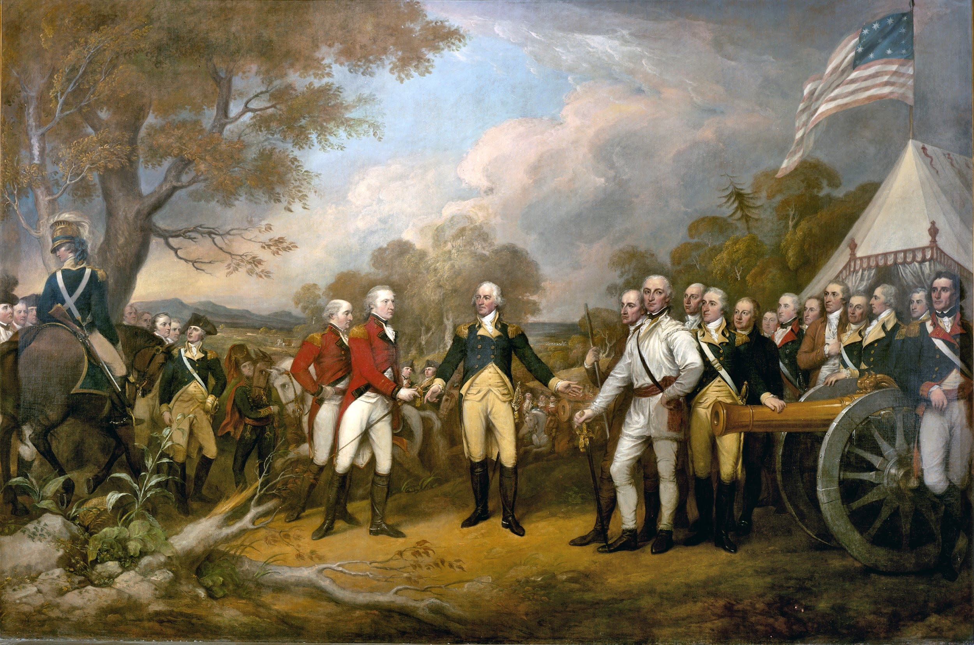
Background: The Battle of Saratoga started with the powerful British trying to split the Americans, but were unable to. The Americans pushed back the British, and kept adding pressure without giving the British time to recover. The Revolutionaries eventually forced the British into a shocking surrender at Saratoga. This victory helped prove that the Americans were stand up to the British, which convinced the French to join the fight against the British.

Slide 41
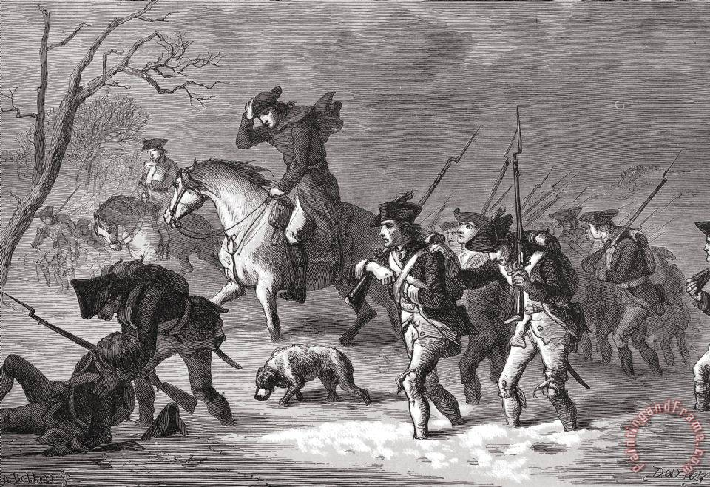
Background: The American troops, with little food or clothing, had to suffer through the brutal winter because of their lack of supplies or money. They barely had a shelter to survive, or a fire to keep themselves warm and dry. The British, on the other hand, had plenty of food and drinks. They enjoyed the heat of fires and sat through the winter comfortably. However, the Americans would make it through the winter and continue on against the war with the British!

Slide 42
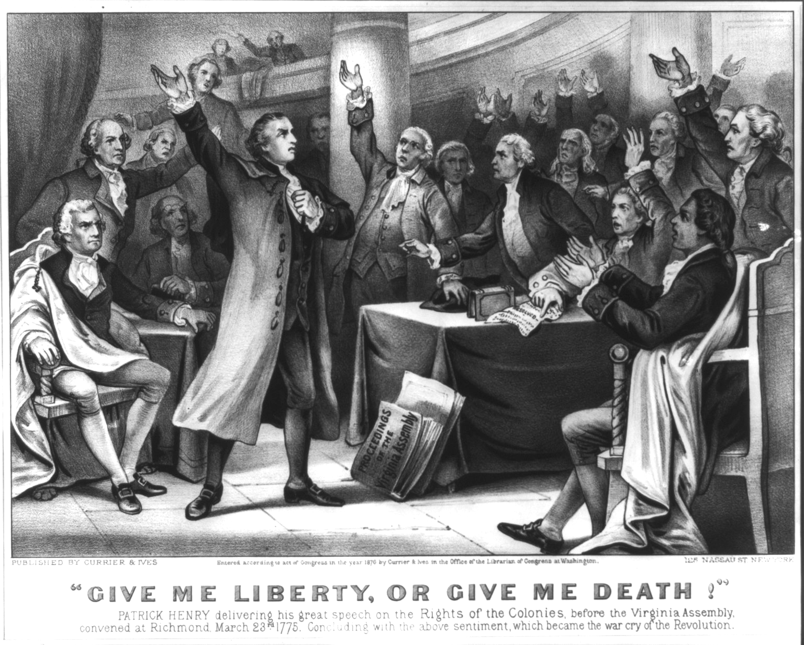
Background: The Founding Fathers, such as Thomas Jefferson and Patrick Henry, wanted to break free from Tyranny. They were upset with the way the British commanded their way of life, and without any representation in government. After years of frustration, the Founding Fathers got together to declare their independence; setting themselves for a difficult path to freedom. Most importantly, those revolutionaries were willing to die for the freedoms and liberties they felt they deserved.

Slide 43
Is it
VALID?

Slide 44
What do CHAMPS look like in our class?
C- Conversation: Students will collaborate with peers to complete SCIM-C
H- Help: If students need assistance, they will raise their hand quietly or turn to a group member.
A- Activity: Our goal is to use the SCIM-C method to analyze documents
M- Movement: Please remain in your seats while participating in class discussion and during group work. If you need to get out of your seat, please raise your hand quietly.
P- Participation: All students are expected to participate, especially during group work.
S- Success: Students will answer SCIM-C questions using primary sources about the Declaration of Independence, Valley Forge and the Battle of Saratoga to determine if the American Revolution was a product of hope & grit.

Slide 45
What is the SCIM-C?
Contextualizing:
THIS IS THE "C"
1. Who produced the source?
2. When, why, and where was the source produced?
3. What was happening locally and globally at the time the source was produced?
4. What summarizing information can place the source in time, space, and place?
Inferring:
THIS IS THE "I"
1. What is suggested by the source?
2. What conclusions may be drawn from the source?
3. What biases are indicated in the source?
4. What contextualizing information, while not directly evident, may be suggested from the source?
Summarizing:
THIS IS THE "S"
1. What type of historical document is the source?
2. What specific information, details, and/or perspectives does the source provide?
3. What are the subject, audience, and/or purpose of the source?
4. What does the source directly tell us?
Corroborating: THIS IS THE "C"
1. What similarities and differences exist between the sources?
2. What factors could account for the similarities and differences?
3. What gaps appear to exist that hinder the final interpretation of the source?
Monitoring:
THIS IS THE "M"
1. What ideas, images, or terms need further defining from the source in order to understand the context or period in which the source was created?
2. How reliable is the source for its intended purpose in answering the historical question?
3. What questions from the previous stages need to be revisited in order to analyze the source satisfactorily?

Slide 46
CASE: Was the American Revolution a Product of Hope and Grit?

Slide 47
Document #1
CASE: Is lacrosse better than baseball?
“Lacrosse is a better sport than baseball because you are more active and you are able to hit people with your stick. Baseball you just stand around for half the game and do nothing. Lacrosse is clearly the better sport”
– College Lacrosse Player

Slide 48
Document #2
CASE: Does homework improve overall classwork?
BRYAN, T. (1994). DOING HOMEWORK - PERSPECTIVES OF ELEMENTARY AND JUNIOR-HIGH-SCHOOL STUDENTS. JOURNAL OF LEARNING DISABILITIES, 27(8), pp. 488-499.

Slide 49
Your Task...
Does the evidence help solve to the case? (Y/N)
How does the evidence relate to the case?
Rank each piece of evidence based on its credibility.
CONVINCE ME!

Slide 50
Time to Answer our Question: Was the American Revolution a Product of Hope and Grit?
Filling out the TDFC graphic organizer

Slide 51
Topic: Do you believe that the American Revolution was fueled by hope and grit?

Slide 52
Next: Supply at least three sources reasons why you think the American Revolution was fueled by hope and grit

Slide 53
Next: Provide citations from the documents that you gained your information from in the “follow ups” section

Slide 54
Lastly: Supply a closing statement or conclusion statement that really “grabs” the attention of your reader to make them believe the claims backed by sound evidence you made

Slide 55
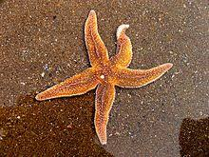
Day Nine

Slide 56
The Global Goals

Slide 58
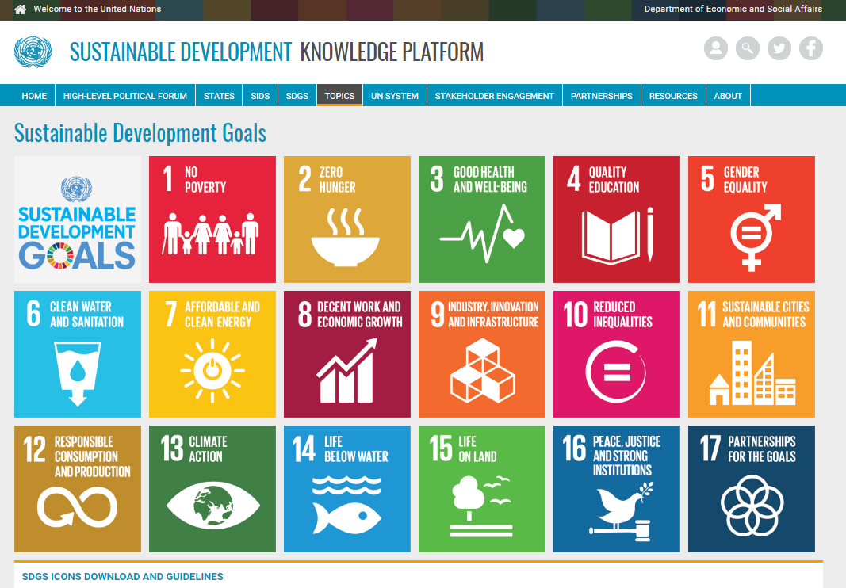
Notes:
Ban Ki-moon, the United Nations Secretary-General from 2007 to 2016, has stated that: "We don’t have plan B because there is no planet B."^{[5]} This thought has guided the development of the Sustainable Development Goals (SDGs).
The 17 goals[edit]
There are 169 targets for the 17 goals. Each target has 1-3 indicators used to measure progress toward reaching the targets. In total, there are 304 indicators that will measure compliance
http://www.undp.org/content/undp/en/home/news-centre/news/2015/09/24/undp-welcomes-adoption-of-sustainable-development-goals-by-world-leaders.html
On 25 September 2015, the 193 countries of the UN General Assembly adopted the 2030 Development Agenda titled "Transforming our world: the 2030 Agenda for Sustainable Development".

Slide 59
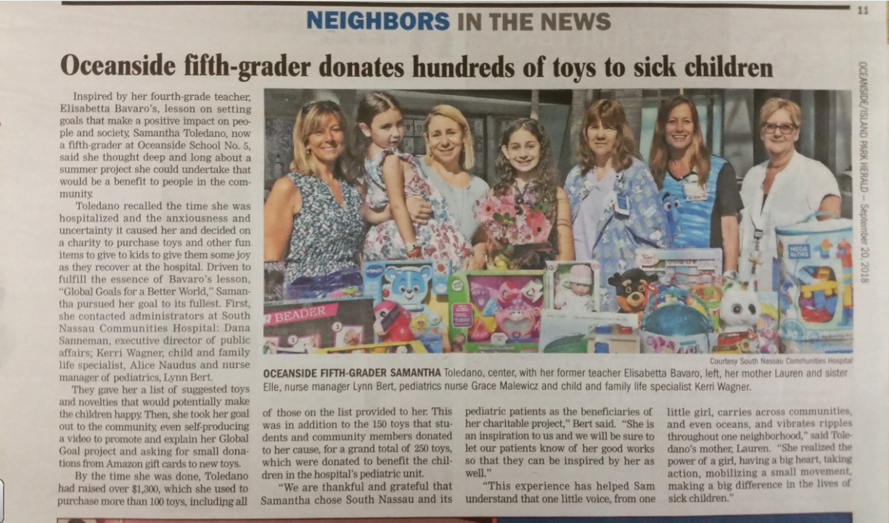

Slide 60
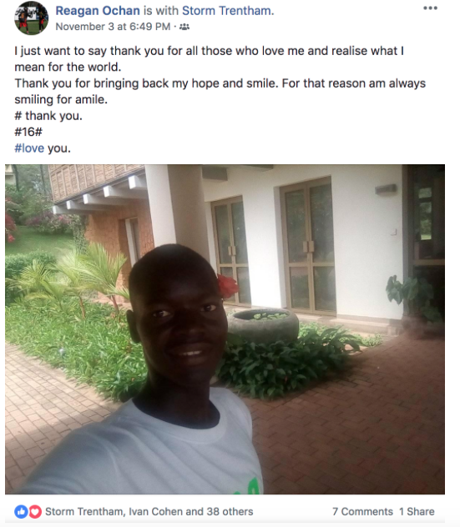

Slide 61
I CAN Make a Difference
▪ One way that you can help is to give your TIME to help a cause.
▪ A second way that they can help is to give their TALENT to help a cause. Sometimes projects need people with special talents in order to be completed.
▪ A third way is to give TREASURE.
▪ A fourth way is to TEACH people about the cause to try to get more people to help out!

Slide 62
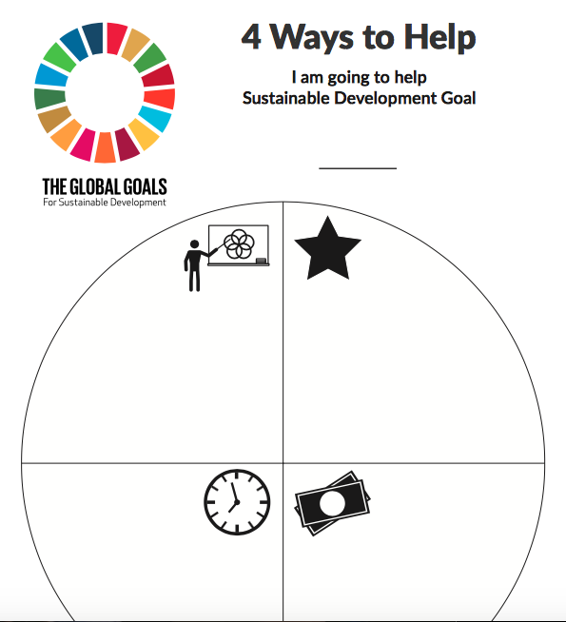

Slide 63
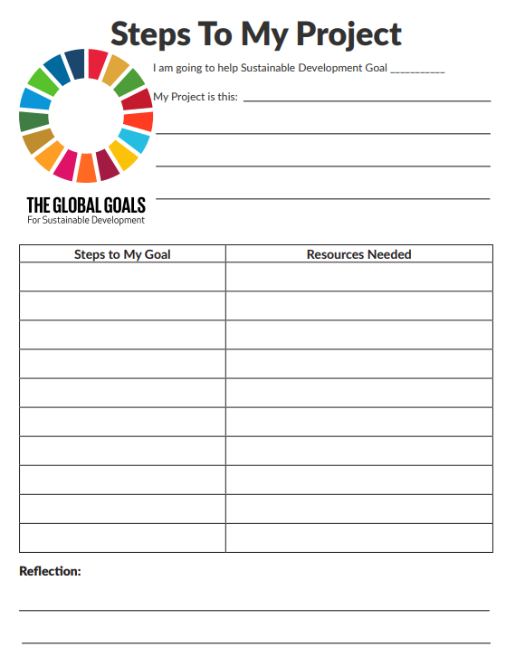

Slide 64
MY Heart Power to Serve
Identify the goal you feel most strongly about
Write your aim for your chosen goal
: My aim for Goal 14 is to refuse to drink with a plastic straw
Link them together

