Slide 1
Does Where You Live in the Western Hemisphere Determine Your Happiness?

Slide 2
Lesson #1: The Pursuit of Happiness
Ms. Soldano & Mr. Ferrara

Slide 3
Some Things to Remember
When moving around, please do so quickly and quietly
If you need help, raise your hand, and someone will be over to assist you
Stay on topic in discussions with your classmates
Never hesitate to ask a question
Try and take this lesson as serious as possible but do not be afraid to have fun!

Slide 4
Happiness is Helping Others

Slide 5
What In Your Life Makes You Happy ?
Today’s Big Question

Slide 6
Rules For Our Warm Up Activity
If the picture makes you happy, raise your hand.
If the picture doesn’t make you you happy, don’t raise your hand.

Slide 7
Do Puppies Make You Happy ?

Slide 8
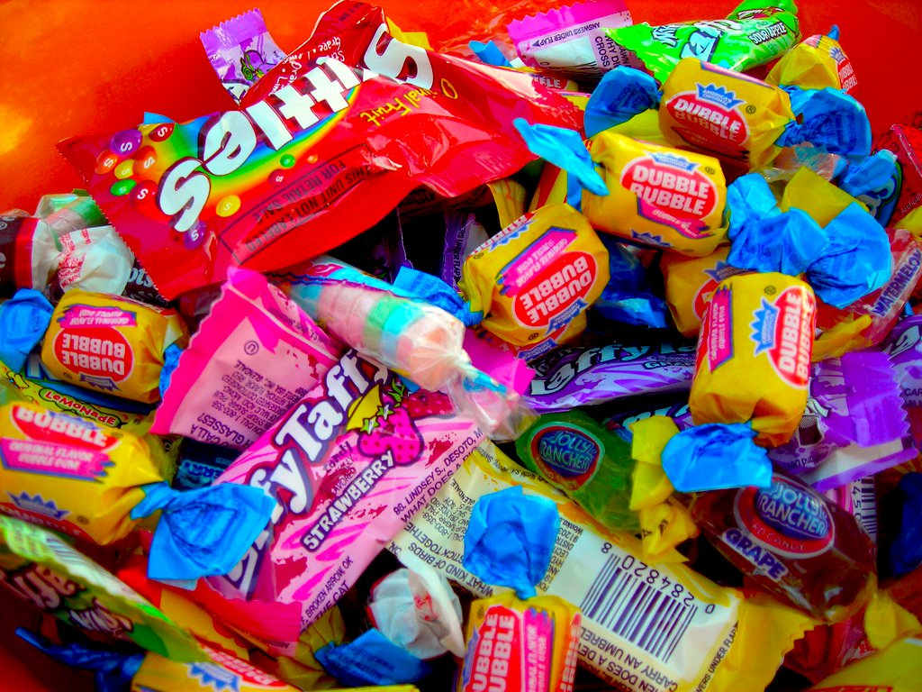
Does Candy Make You Happy ?

Slide 9
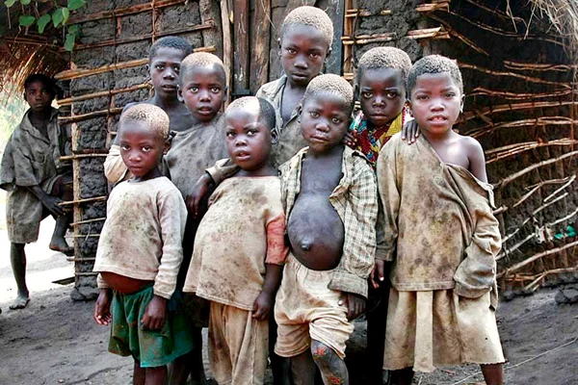
Does Poverty Make You Happy ?

Slide 10
Does Fortnite Make You Happy ?

Slide 11
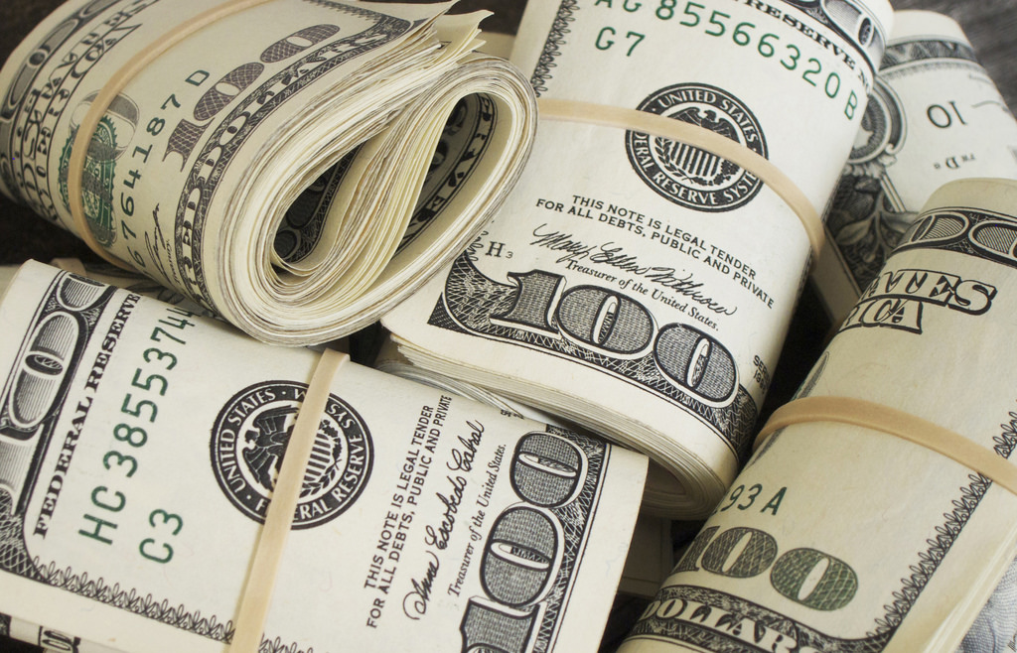
Does Money Make You Happy ?

Slide 12
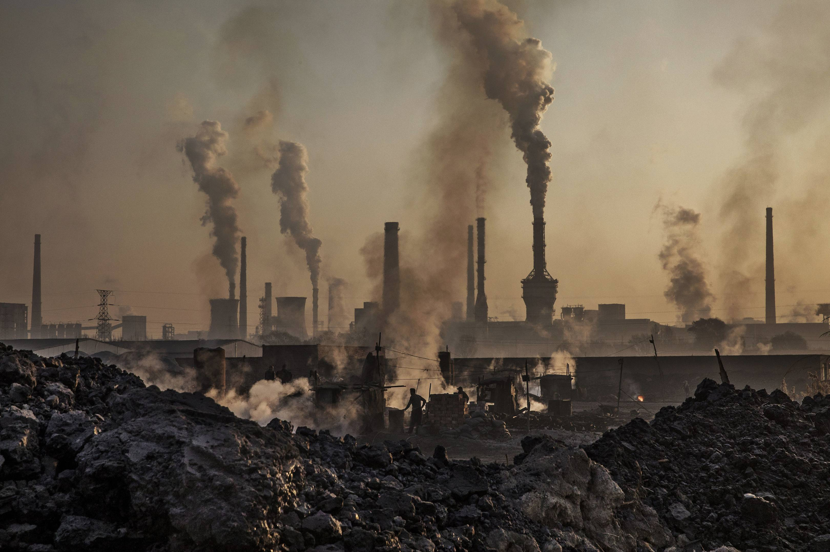
Does Pollution Make You Happy ?

Slide 13
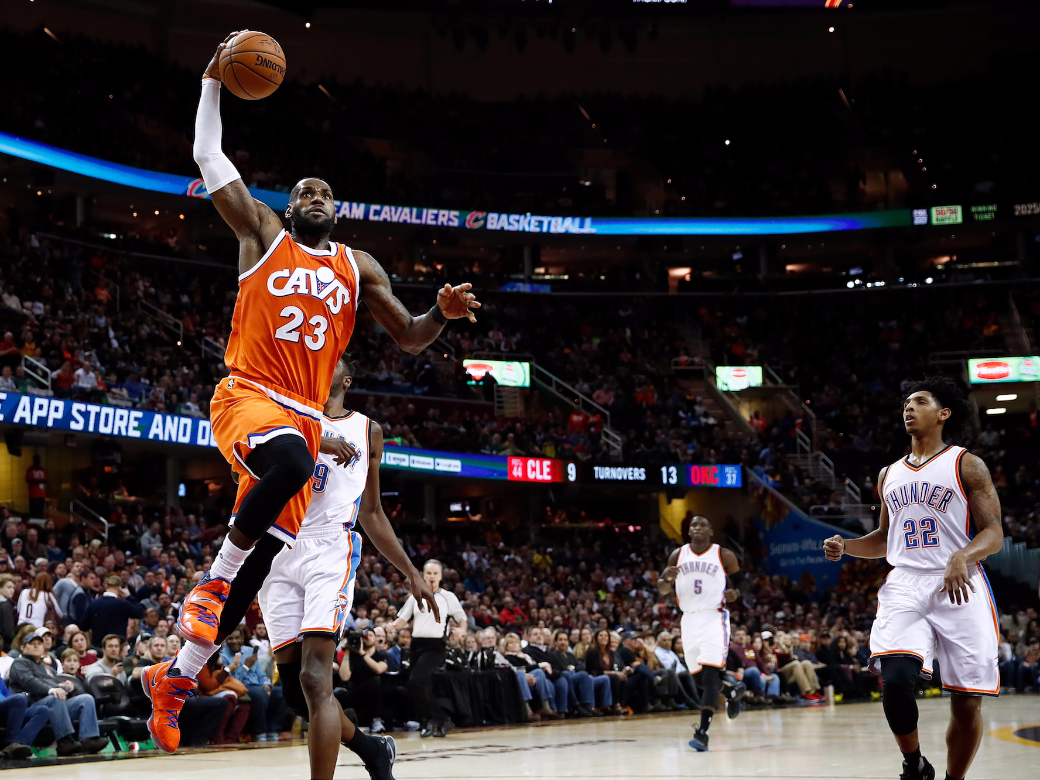
Does Basketball Make You Happy ?

Slide 14
The Wise Woman and Her Secret
The wise woman listened, and laughed. “My dear child, you have found the secret.”
Jenny was puzzled. “How can I have found it?”
“Because, you see, the secret of wisdom is to be curious--to take the time to look closely, to use all your senses to see and touch and taste and smell and hear. To keep on wandering and wondering.”
“Wandering and wondering,” Jenny repeated softly.
“And if you don’t find all the answers, you will surely find more to marvel at in this curving, curling world that spins around and around amid the stars.”

Slide 15
Our Master List of Gratitude

Slide 17
Lesson 2: Montreal and New York City Trip!
By Ms. Katie and Amanda

Slide 18
Pass forward the Homework!

Slide 19
The Five Themes of Geography
Location
Where is this country? Where is it located Latitude and longitude or point of reference?
Regions
What are their unifying features and how do they form and change over time?
Place
What is it like? Physical characteristics and human characteristics?
Human/environment interaction
How do people interact with and change their environment?
Do they adapt to their environment or do they modify or change it?
Movement
How are people and places linked by communication and the flow of people, ideas and goods? Transportation, communication and trade?

Slide 20
Let’s be CHAMPs!
Conversation- Students will share their ideas and thoughts about the different places they have visited with their peers. Let’s remember to be respectful of other people’s ideas and thoughts!
Help-Students may raise their hand is they need help, they can also turn and ask their peers for help as well.
Activity-We will be writing a postcard back home including information we learned on the tour, so don’t forget to listen up and take great notes!
Movement- Please keep your hands and feet in the vehicle and on the plane at all times. Also keep your hands to yourself, we don’t want to distract the driver! Please act appropriately when eating our snacks!
Participation-Participation is vital to ensure all passengers get the most out of their tour!
Success- Students will write a postcard back home telling their family or friends about a place they visited!

Slide 21
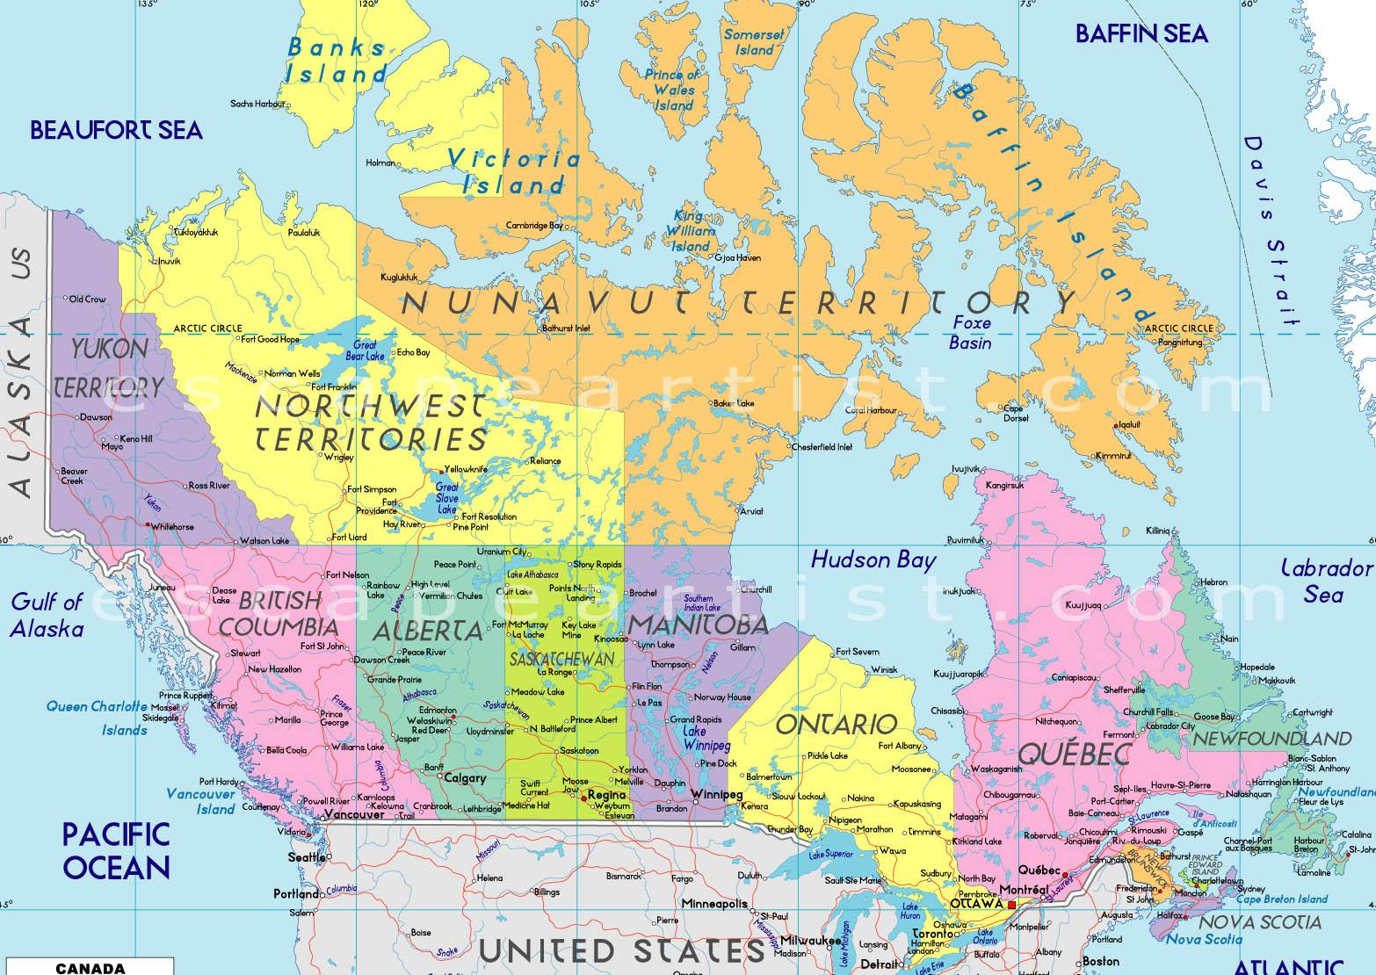
Canada
Canada is located north of the United States of America.
Canada extends from the Atlantic to the Pacific oceans and northward into the Arctic Ocean.
Unlike the U.S., Canada does not have states. However, Canada is broken up into ten provinces and three territories.

Slide 22
Lets go to… Habitat 67

Slide 23
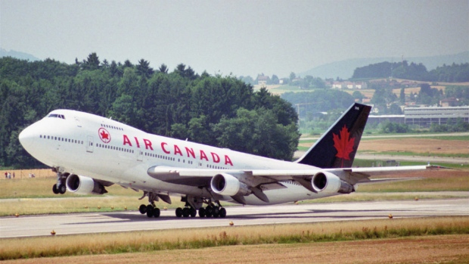
Let’s go to -Olympic Stadium - Mount Royal - Montreal Casino - La Ronde - Old Montreal/ statue of liberty

Slide 24
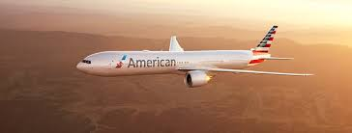
Lets go to… -Madison square garden/ Rockefeller center. -Central Park - Empire state building - Coney island - Statue of liberty

Slide 25
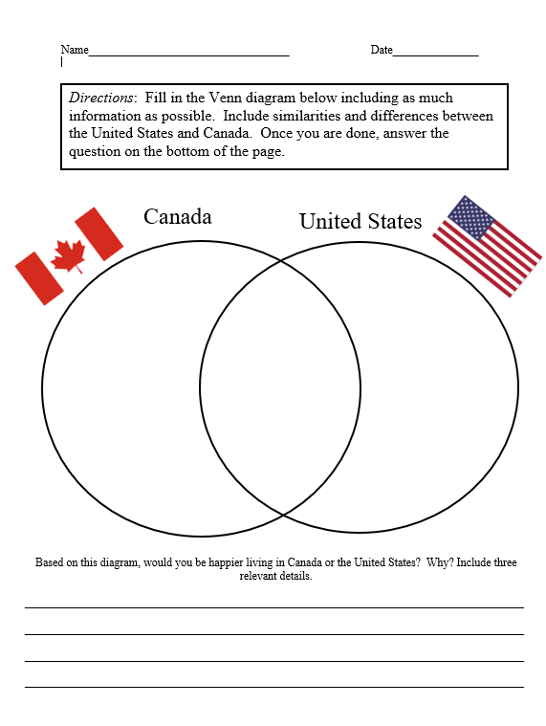

Slide 26
Lesson 3: Who's happier: Mexico City or NYC?
Ms. Cassidy and Ms. Yearwood

Slide 27
Please pass forward your homework!

Slide 28
The Five Themes of Geography
Location
Where is this country? Where is it located Latitude and longitude or point of reference?
Regions
What are their unifying features and how do they form and change over time?
Place
What is it like? Physical characteristics and human characteristics?
Human/environment interaction
How do people interact with and change their environment?
Do they adapt to their environment or do they modify or change it?
Movement
How are people and places linked by communication and the flow of people, ideas and goods? Transportation, communication and trade?

Slide 29
Let’s be CHAMPs!
Conversation- Students will share their ideas and thoughts about the different places they have visited with their peers. Let’s remember to be respectful of other people’s ideas and thoughts!
Help-Students may raise their hand is they need help, they can also turn and ask their peers for help as well.
Activity-We will be writing a postcard back home including information we learned on the tour, so don’t forget to listen up and take great notes!
Movement- Please keep your hands and feet in the vehicle and on the plane at all times. Also keep your hands to yourself, we don’t want to distract the driver! Please act appropriately when eating our snacks!
Participation-Participation is vital to ensure all passengers get the most out of their tour!
Success- Students will write a postcard back home telling their family or friends about a place they visited!

Slide 30
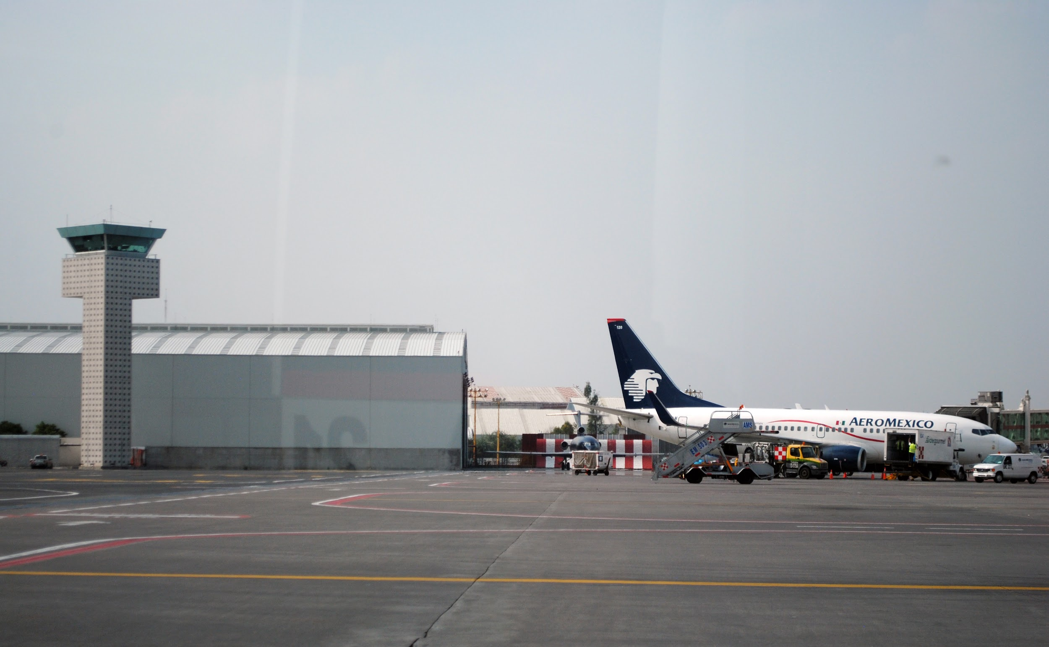
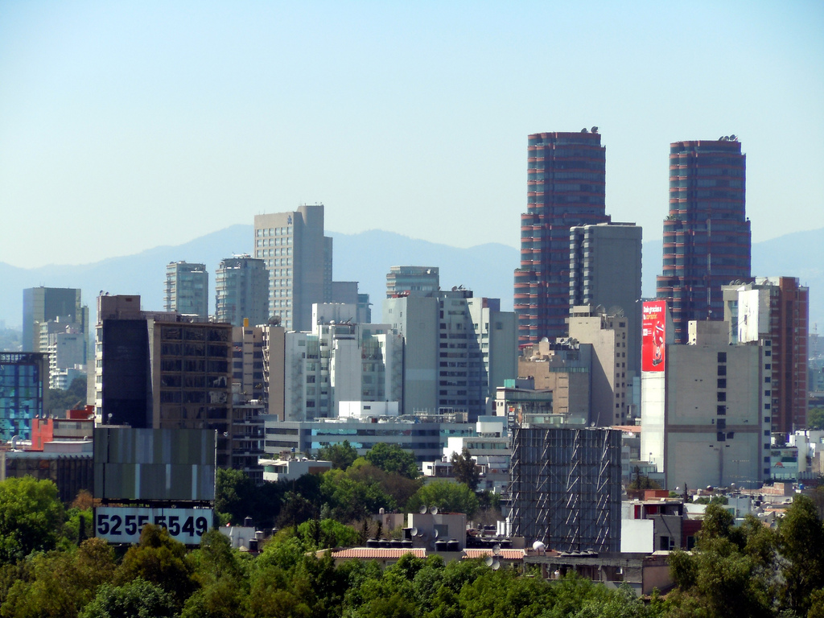
Our flight has just landed. Welcome to Mexico City!
Mexico City has a subtropical highland climate! This means they have warm summers and mild winters.
The annual average climate is 64 degrees. Today there is a high of 80 degrees and a low of 50 degrees.
Mexico city is located in a valley called the Basin of Mexico. It is located on the Trans-mexican Volcanic Belt in the high Plateaus of south Central Mexico.

Slide 31
Let’s Get into Groups
Group 1
Carl
Jayden
Cobby
Steven
Group 2
Carlos
Aiden
Victor
Jordan
Group 3
Wilmer
Anthony P.
Anthony G.
Edison
Group 4
Karim
Stanley
Walther
Jason

Slide 32
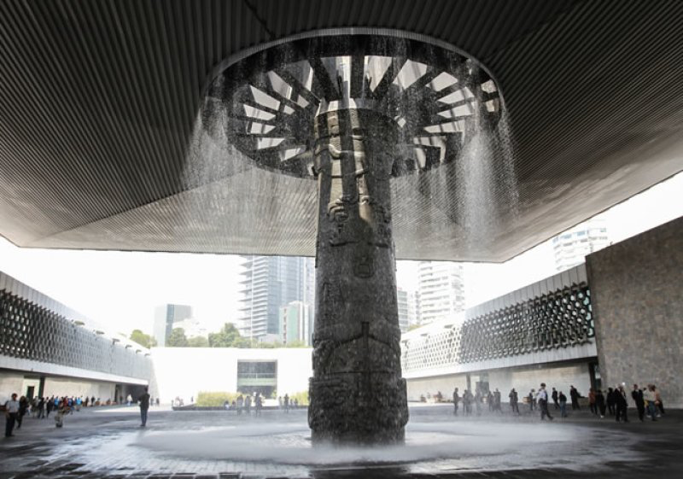
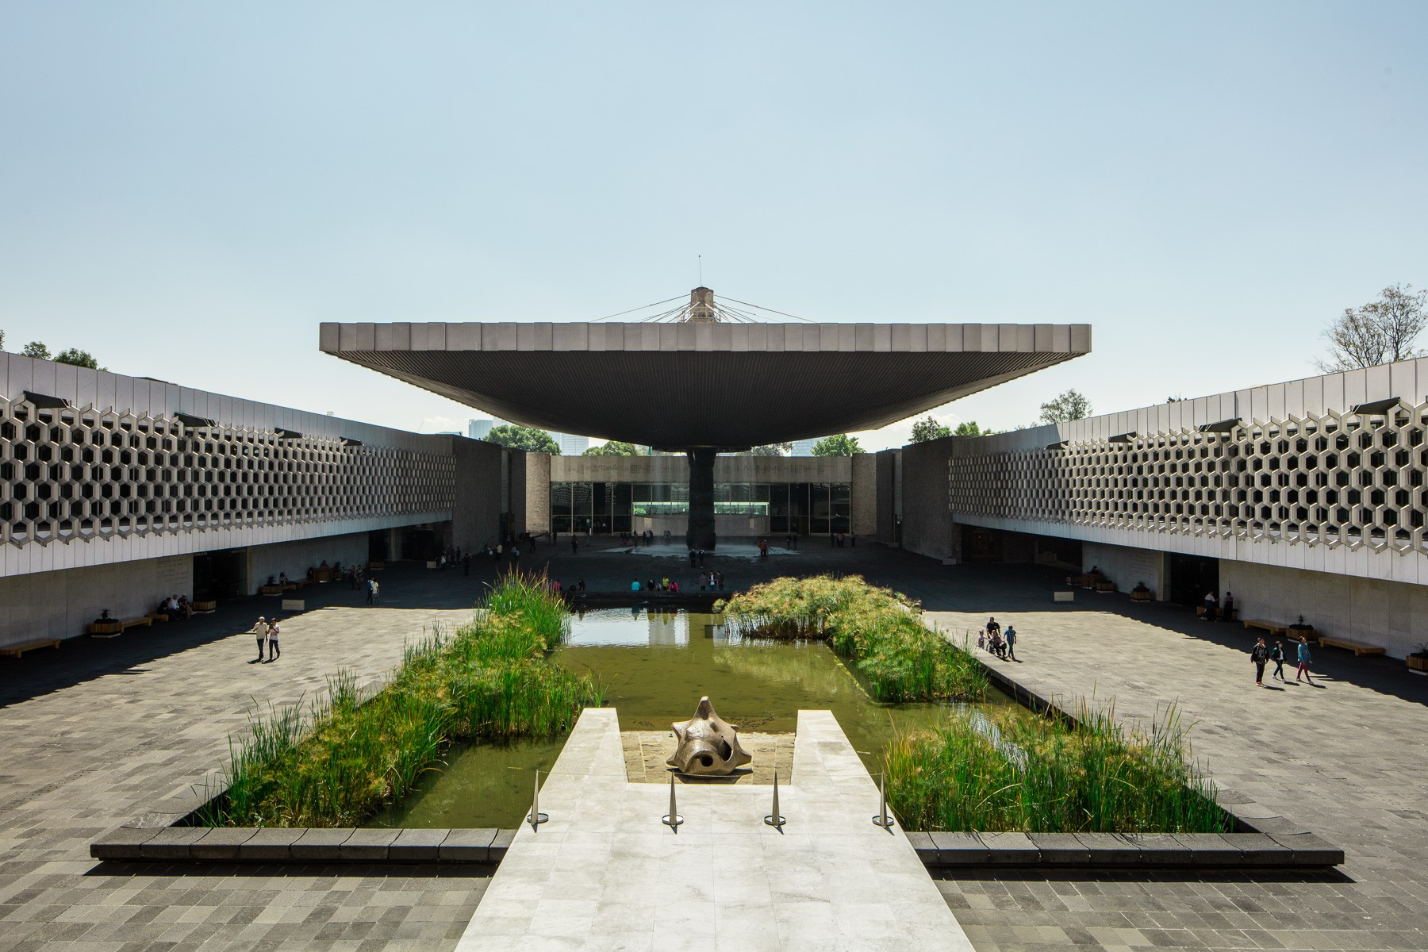
Our first stop: Museo Nacional de Antropología (National Museum of Anthropology)
Coordinates: 19.426°N 99.186°W

Slide 33
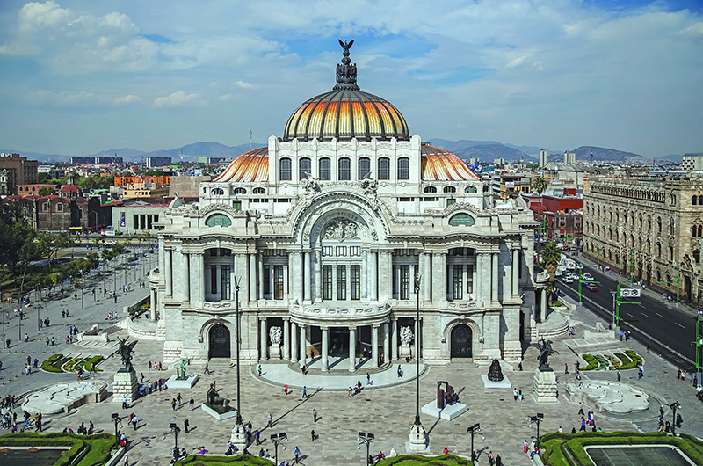
Our second stop: Palacio de Bellas Artes (Palace of Fine Arts)
Coordinates: 19°26′8.3″N99°8′28.6″W

Slide 34
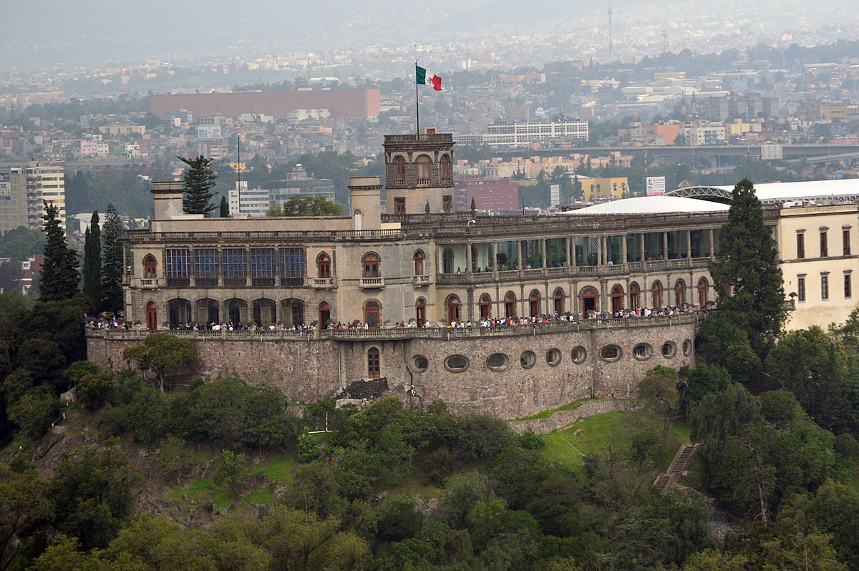
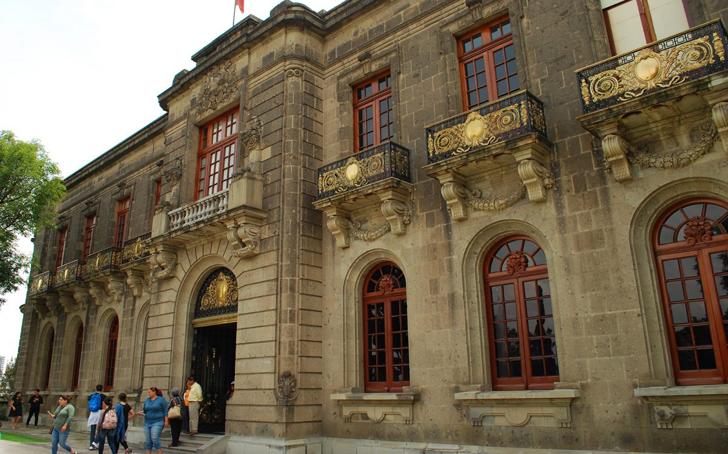
Our third stop: Castillo de Chapultepec (Chapultepec Castle)
Coordinates: 19°25′14″N99°10′54″W

Slide 35
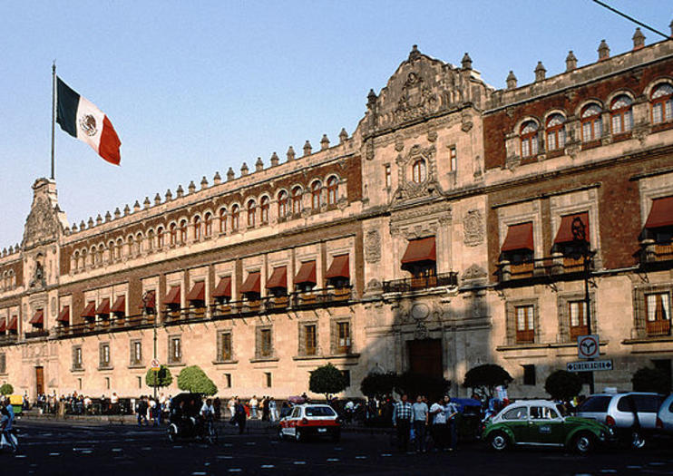
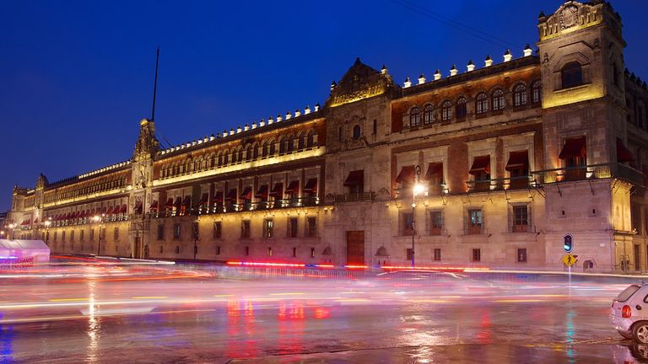
Our fourth stop: Palacio Nacional (National Palace)
Coordinates: 19°25′57″N 99°7′52″W

Slide 36
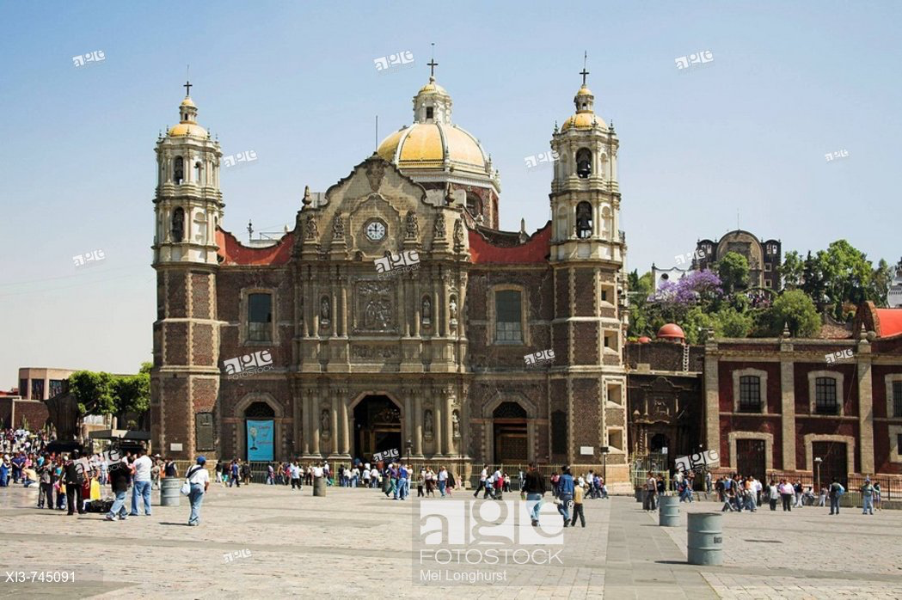
Our fifth stop: Basílica de Nuestra Señora de Guadalupe (Basilica of Our Lady of Guadalupe)
Coordinates: 19°29′2.4″N99°7′1.2″W

Slide 37
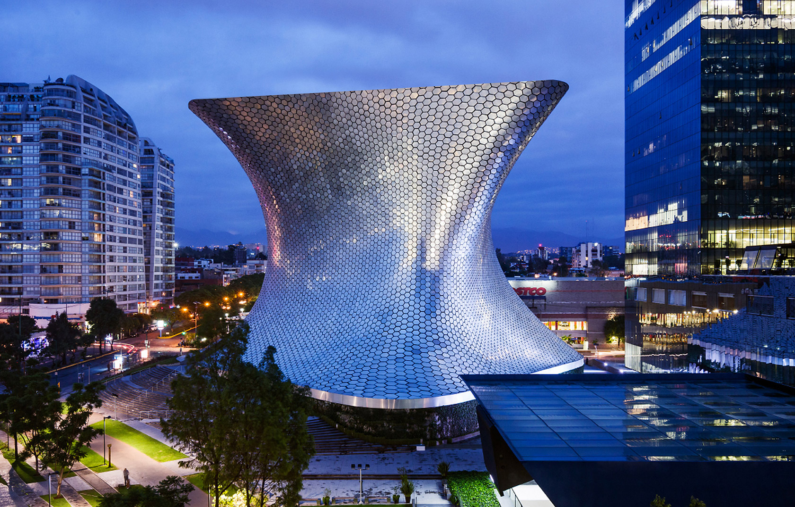
Our sixth stop: Museo Soumaya
Coordinates: 19.440806°N 99.204583°W

Slide 38
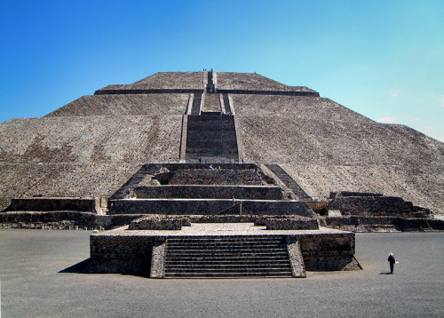
Our seventh stop: Pyramid of the Sun
Coordinates: 19° 41′ 34.8″ N, 98° 50′ 38.4″ W

Slide 39
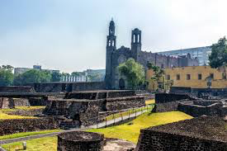
Our eighth stop: Plaza de las Tres Culturas (Square of the Three Cultures)
Coordinates: 19° 27′ 4″ N, 99° 8′ 14″ W

Slide 40
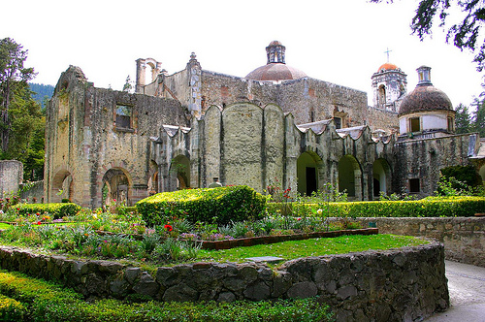
Our ninth stop: Desierto de los Leones (Desert of the Lions National Park)
Coordinates: 19.31264°N 99.30628°W

Slide 41
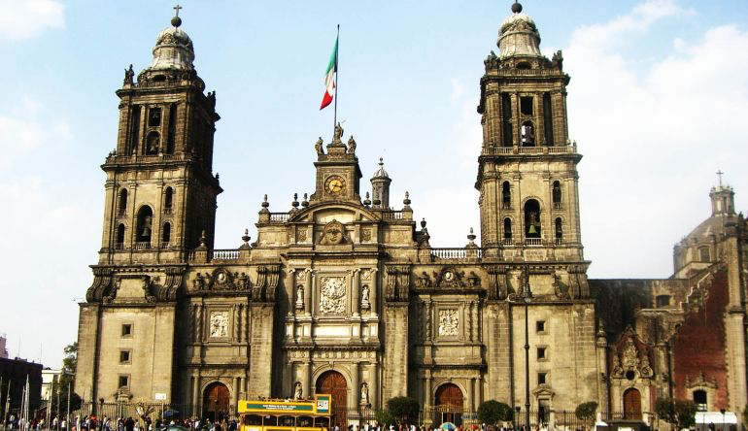
Our tenth stop: Catedral Metropolitana (Metropolitan Cathedral)
Coordinates: 19°26′4″N99°7′59″W

Slide 42
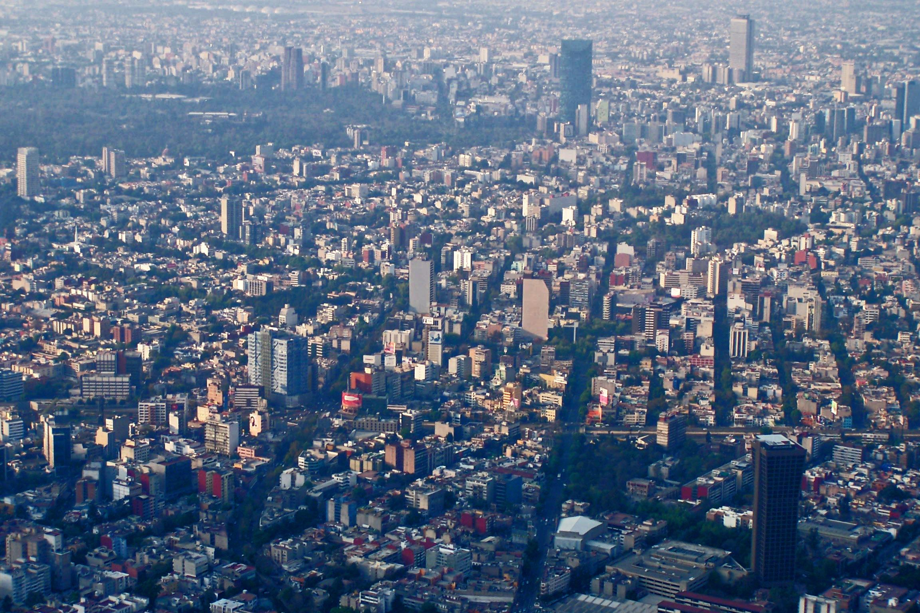
Please hand in your Postcard from Mexico City Homework!

Slide 43
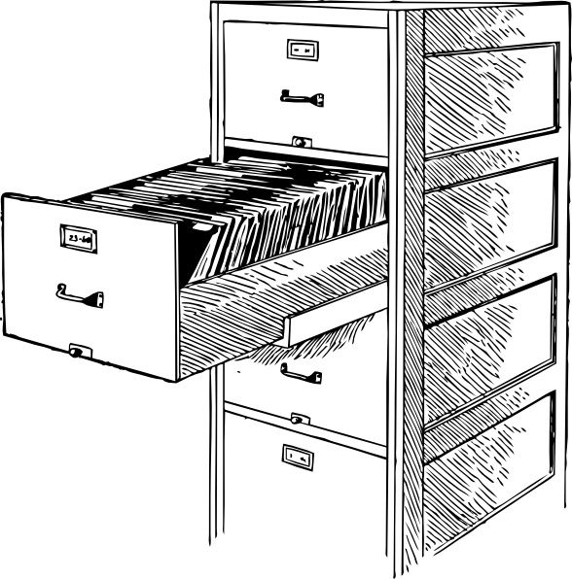
Lesson 4: Let’s fill the filing cabinet!
A metaphor: let’s gather the information we need so that we are better equipped to answer the essential question.
Ms. Timko, Ms. Efferson, and Mr. O’Keefe

Slide 44
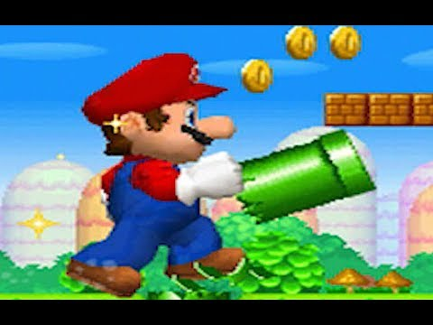
First, let’s look at something familiar:

Slide 45
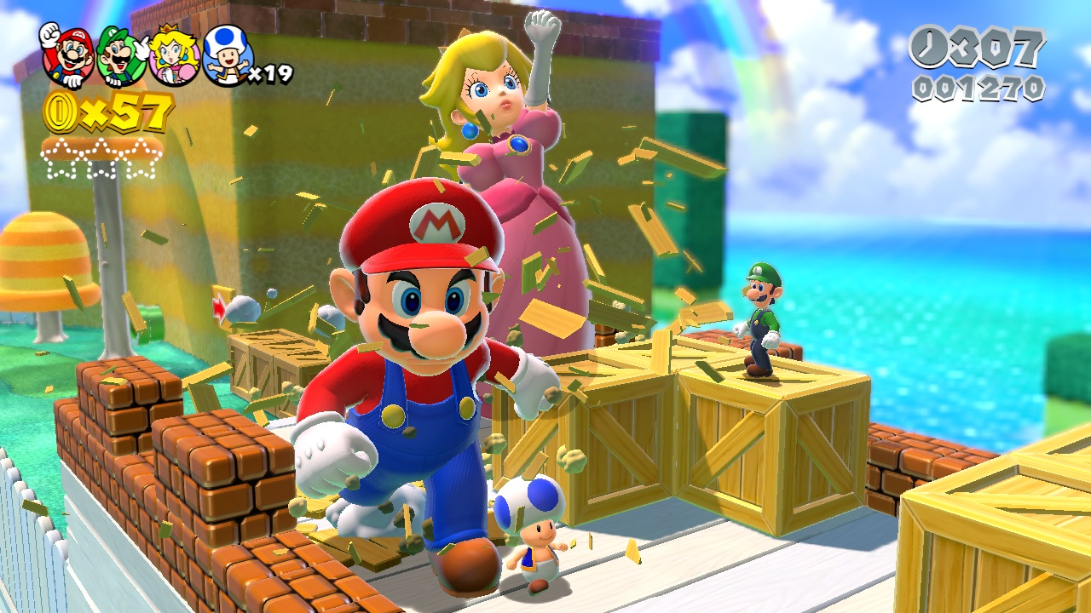
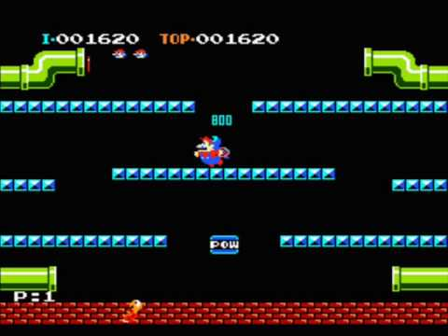
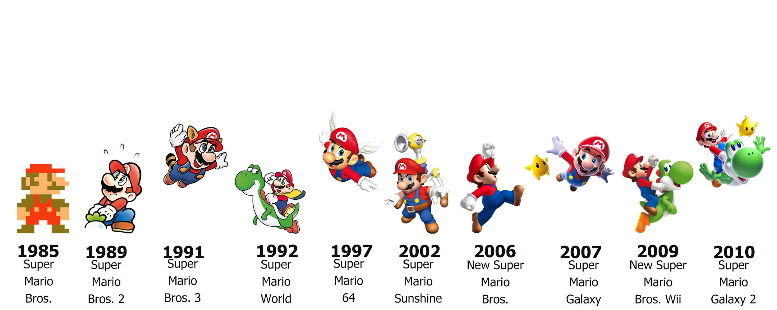
So, how did we get from this….
..to this?!
https://www.funstockretro.co.uk/news/30-years-of-super-mario/

Slide 46
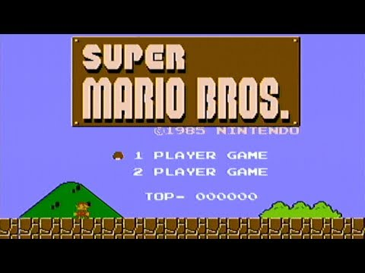
But, this was what the game was like in 1985

Slide 47
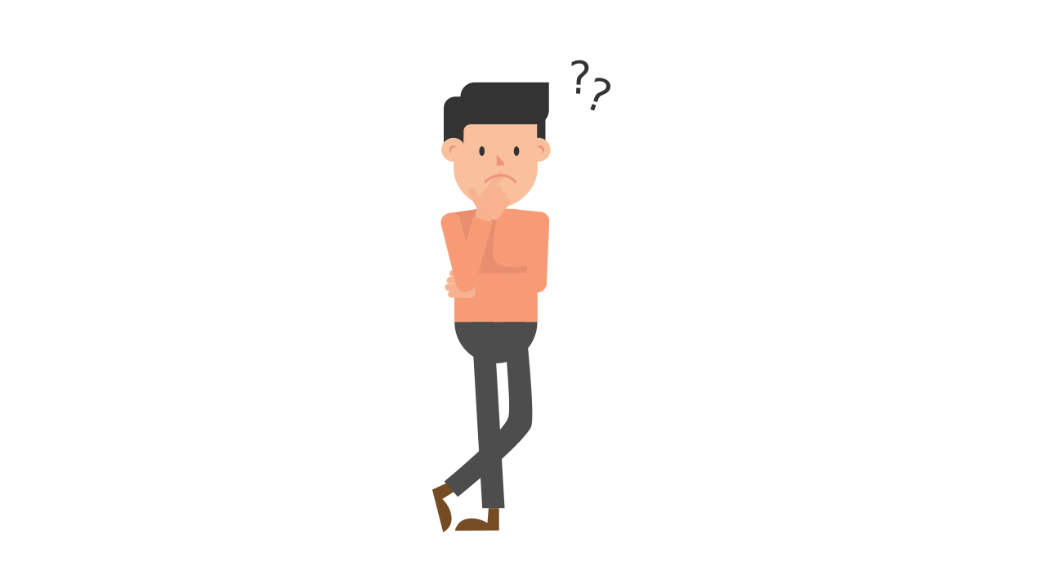
What were the major historical events that shaped modern-day Mexico City, Montreal, and New York?

Slide 48
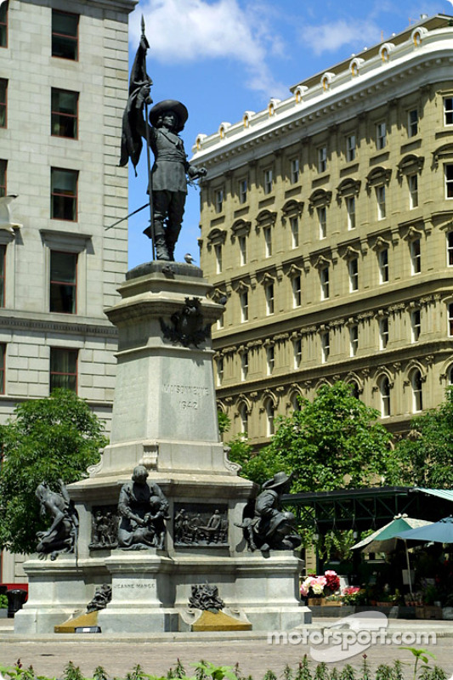
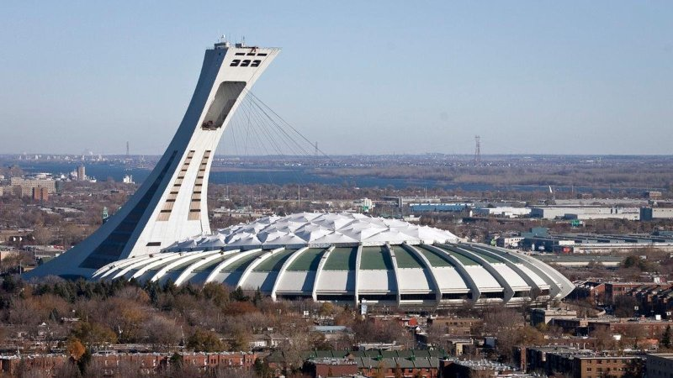
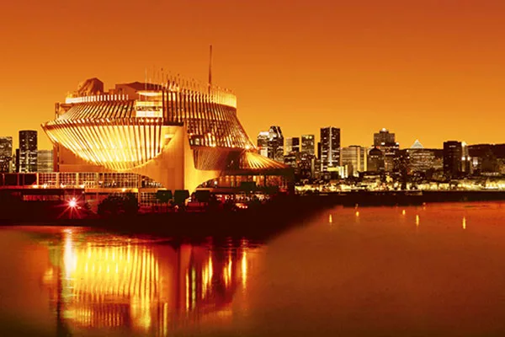
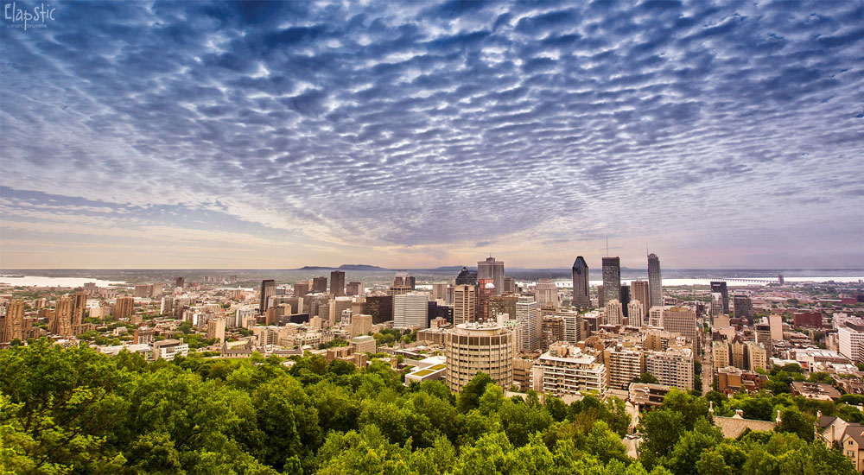
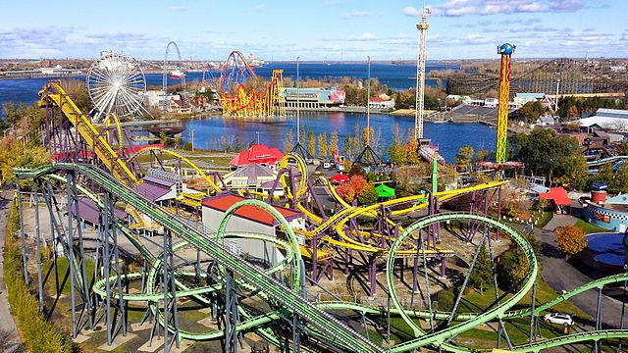
Montreal / Canada
Olympic Stadium
Old Montreal: Statue of Maisonneuve
Montreal Casino
Mount Royal
La Ronde

Slide 49
Mexico City
Metropolitan Cathedral
Basilica of Our Lady of Guadalupe
Pyramid of the Sun
Palace of Fine Arts
National Museum of Anthropology
Chapultepec Castle

Slide 50
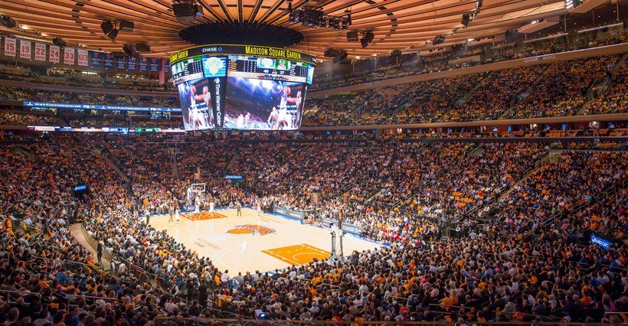
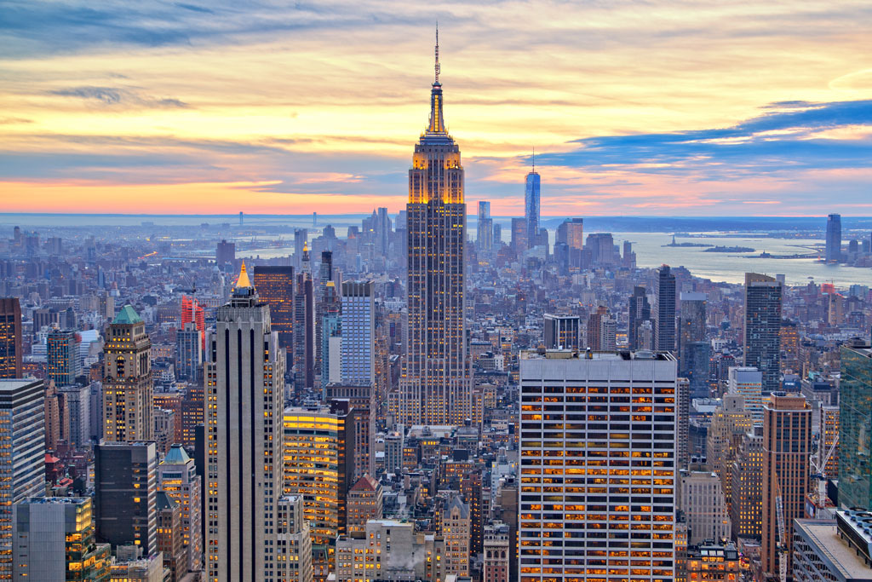
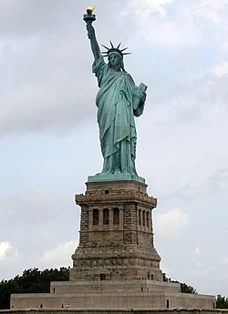
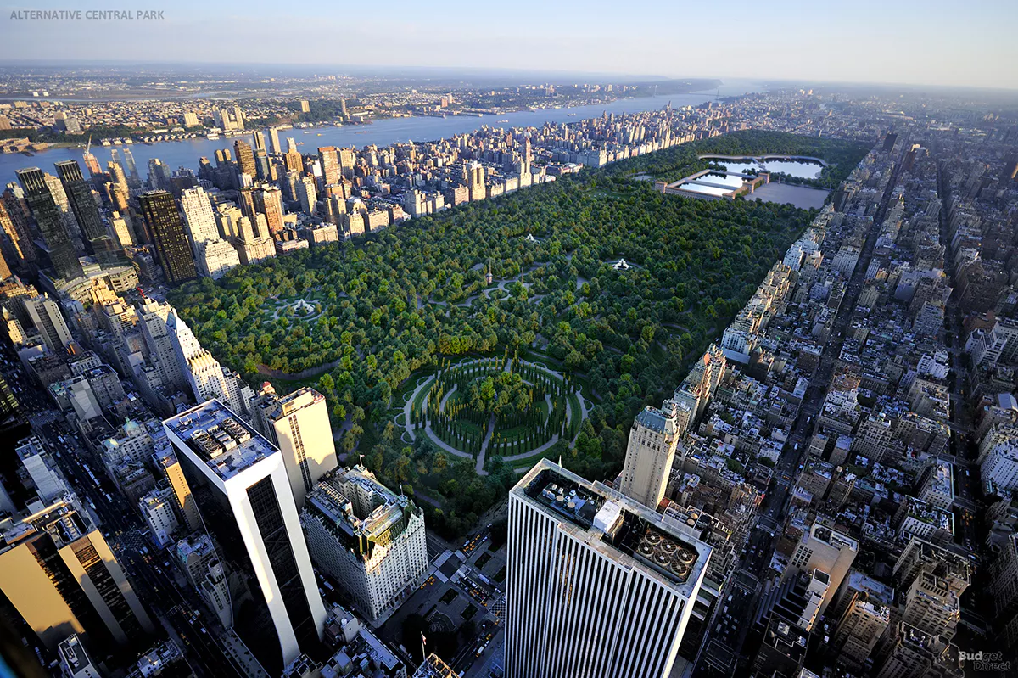
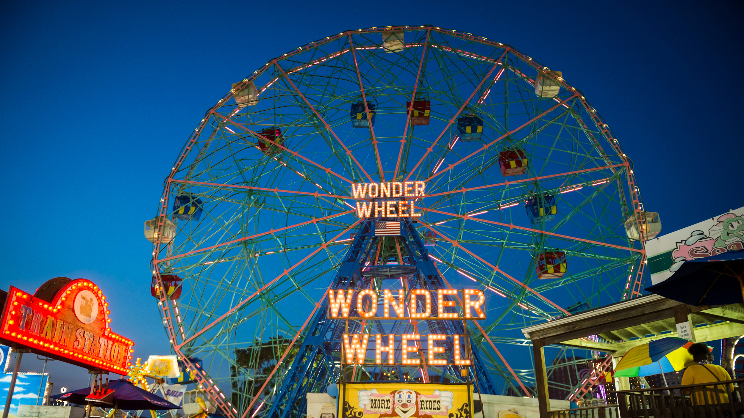
New York City
Madison Square Garden
The Empire State Building
Central Park
The Statue of Liberty
Coney Island

Slide 51
Let’s be CHAMPs!
Conversation- Let’s remember to be respectful of other people’s ideas and thoughts!
Help-Students may raise their hand is they need help, they can also turn and ask their peers for help.
Activity- We will be reading documents and reacting to statements about them, remember to support your opinions with evidence from the document.
Movement- Don’t abandon your groupmates! They need you. If you need help, please politely remain in your seat and raise your hand.
Participation-Participation is vital to ensure all of us are able to fill our cabinets with information to answer the compelling question!
Success- After we’ve reacted to statements about our documents, we will be considered experts on the historical events. Newly crowned experts will travel to new groups to share about what they’ve learned.

Slide 52
F.U.N. Strategy
F- Find
U- Underline
N- Number

Slide 53
Let’s Get into Groups
Group 1
Carl
Jayden
Cobby
Steven
Group 2
Carlos
Aiden
Victor
Jordan
Group 3
Wilmer
Anthony P.
Anthony G.
Edison
Group 4
Karim
Stanley
Walther
Jason

Slide 54
Lesson 5: Statue Scene
Ms. Bloecker &
Ms. Fuscaldo

Slide 55
CHAMPS
Conversation: Stay on topic when working in groups
Help: Raise your hand if you need help or have a question
Activity: We will be acting out a museum statue scene today! Get ready to be creative!
Movement: We are here to help! If you have a question raise your hand. Don’t run around the room, be as still as a statue!
Participation: Equal involvement
Success: After you have performed your statue scene, the other groups will guess what event you were portraying!

Slide 56
Guess what scene we are creating!

Slide 57
Now it’s your turn!
Use your planning sheets to help you create your statue scene.
Each student must have one line prepared that expresses how their character was feeling or something they might have said at the time.
Be sure to include at least 3 facts in your presentation!
You can use any of the props or costumes to help build your scene.
Be creative and have fun!

Slide 58
History Alive!

Slide 59
Extra Credit Chance!

Slide 60
Lesson 6: How do we know what we learned is true?
Ms. Stoll & Ms. Chadli

Slide 61
CHAMPS!
C - Conversation: We need to be respectful of everyone. if someone else is talking, listen and then raise your hand to add to the conversation.
H - Help: Please raise your hand, and we will either call on you during our discussion or come to you during our activity. Ask questions if you need help!
A - Activity: The activity is called Thinking Like a Historian. We will be making a decision on whether we think the history we learned yesterday was valid or not using the SCIM-C strategy.
M - Movement: We will be moving around the room during the activities.! When we move we will go quietly, and we need to be careful and watch out for others. Please be as quick and efficient as possible!
P - Participation: Please participate in our discussions and activities! The more students participate the more fun the lesson will be!
S - Success: Once you learn about SCIM-C and the documents you will be Thinking Like a Historian, and then you will be successful!

Slide 62
What is SCIM-C?
S- Summarizing
C- Contextualizing
I- Inferring
M- Monitoring
C- Corroborating

Slide 63
Summarizing
SCIM-C
1. What type of historical document is the source?
2. What specific information, details, and/or perspectives does the source provide?
3. What are the subject, audience, and/or purpose of the source?
4. What does the source directly tell us?

Slide 64
Contextualizing
SCIM-C
1. Who produced the source?
2. When, why, and where was the source produced?
3. What was happening locally and globally at the time the source was produced?
4. What summarizing information can place the source in time, space, and place?

Slide 65
Inferring
SCIM-C
1. What is suggested by the source?
2. What conclusions may be drawn from the source?
3. What biases are indicated in the source?
4. What contextualizing information, while not directly evident, may be suggested from the source?

Slide 66
Monitoring
SCIM-C
1. What is missing from the source in terms of evidence that is needed to answer the guiding historical question?
2. What ideas, images, or terms need further defining from the source in order to understand the context or period in which the source was created?
3. How reliable is the source for its intended purpose in answering the historical question?
4. What questions from the previous stages need to be revisited in order to analyze thesource satisfactorily?

Slide 67
Corroborating
SCIM-C
1. What similarities and differences exist between the sources?
2. What factors could account for the similarities and differences?
3. What gaps appear to exist that hinder the final interpretation of the source?
4. What other sources are available that could check, confirm, or oppose the evidence currently marshaled?

Slide 68
SCIM-C
Summarizing
Monitoring
DOCUMENT
Contextualizing
Inferring

Slide 69
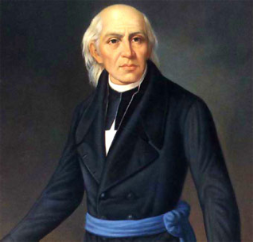
Document #1: Mexico-Mexican Independence from Spain.
Mexican War of Independence lead
by Miguel Hidalgo y Costilla
Background: Hidalgo was a Catholic priest in Dolores, Mexico. He felt that the only way to help his people was to end Spanish control of Mexico. His speech. “Cry of Dolores,” began the War for Independence.
Mexico Wins Independence from Spain: “Come march with us for country and religion…” -Quote by Miguel Hidalgo from his speech “Cry of Dolores” on September 16, 1810

Slide 70
Document #2: Montreal-English taking over French in Canada.
No one can rejoice more sincerely than I do on the [defeat] of Canada by the English; and this, not merely as I am a Colonist, but as I am a Briton citizen of the British Empire. I have long been of Opinion that the Foundations of the future (Greatness) and Stability of the British Empire lie in America . . . Benjamin Franklin to Lord Kames, 3 January 1760

Slide 71
Document #3: United States-Declaration of Independence
It was an official act taken by all 13 American colonies in declaring independence from British rule.
We hold these truths to be self-evident(obvious), that all men are created equal, that they are endowed(given) by their Creator with certain unalienable(unable to be taken) Rights, that among these are Life, Liberty and the pursuit(search) of Happiness. -Declaration of Independence, 1776
Background:This source was written by our Founding Fathers as a declaration of our freedom from Britain. It was written and signed by members of the Second Continental Congress in order to show Great Britain that we would be recognized as an independent nation. This excerpt focuses on the main idea that all people under this new American government would be considered equal and that they are owed their rights as citizens of this new country. These were rights that not even the Crown could take from them.

Slide 72
Document #4: Representatives of the United States
We, therefore, the Representatives of the united States of America, in General Congress, Assembled, appealing to the Supreme Judge of the world for the rectitude of our intentions, do, in the Name, and by Authority of the good People of these Colonies, solemnly publish and declare, That these united Colonies are, and of Right ought to be Free and Independent States, that they are Absolved from all Allegiance to the British Crown, and that all political connection between them and the State of Great Britain, is and ought to be totally dissolved;

Slide 73
Let’s Get Into Groups!
Group 1.
Carl
Jayden
Cobby
Steven
Group 2.
Carlos
Aiden
Victor
Jordan
Group 3.
Wilmer
Anthony P.
Anthony G.
Edison
Group 4.
Karim
Stanley
Walther
Jason

Slide 74
Homework!
Thinking Like a Historian
Directions: Now that you know how to think like a historian, it is your job to see if this document is valid or not! Use the SCIM-C method to help you. Good luck, historian!
In addition to establishing the Rio Grande as the border between the two countries, the territory acquired by the U.S. included what will become the states of Texas, California, Nevada, Utah, most of New Mexico and Arizona, and parts of Colorado and Wyoming. In exchange Mexico received fifteen million dollars in compensation for the territory and the U.S. agreed to assume claims from private citizens of these areas against the Mexican government.
-Treaty of Guadalupe Hidalgo, February 2, 1848
Summarizing:What specific information, details, and/or perspectives does the source provide?
Contextualizing:Why was the source produced?
Inferring: What interpretations may be drawn from the source?
Monitoring:What additional evidence beyond the source is necessary?

Slide 75
Lesson 7: History Mystery
Ms. Capolongo & Ms. Vasquez

Slide 76
History Mystery
Discussion about last night's homework.
Questions: How can you think like a historian? Why do you think it is important to think like this?
What makes something credible?… What makes something not credible? How can we determine if the information we are reading is real (sourcing)? Why can’t we believe everything we read? Is it possible for some articles to be more credible than others?
Discussion about rules for this lesson.
Time to become detectives!
Pink Panther Theme Song! https://www.youtube.com/watch?v=9OPc7MRm4Y8

Slide 77
Let’s Get into Groups
Group 1
Carl
Jayden
Cobby
Steven
Group 2
Carlos
Aiden
Victor
Jordan
Group 3
Wilmer
Anthony P.
Anthony G.
Edisona
Group 4
Karim
Stanley
Walther
Jason

Slide 78
Jobs
Distributor
Organizer
Leader
Communicator

Slide 79
History Mystery
Organize from MOST credible to LEAST credible.
Create a claim determining which city is the happiest, Mexico City, Montreal, New York City, using evidence from the history mystery.
Post on the poster board.
Share with the class!

Slide 80
Homework
The Relevant Song: Don’t worry, Be Happy
https://www.youtube.com/watch?v=d-diB65scQU
Answer the TWO questions connecting to the song.

Slide 81
Final Discussion
Compelling question:
Which City is the happiest and why?

Slide 82
Lesson # 8:
How Do We Effectively Express What We Believe in Writing?
Ms. White & Ms. Torres

Slide 83
What is CHAMPS?
C H A M P S
Conversation
There will be multiple opportunities for discussion with your classmates. Please do not speak over us or any of your friends.
Help
If you need any help at all during the lesson, please raise your hand and we will assist you!
*Activity*
Our goal today is to learn how to use TDFC as a writing strategy to apply to a DBQ! You will be working with the teachers and fellow students to complete the TDFC.
Movement
We will be working in small groups of 4 as we try to find details in the documents to use in our pre-writing exercise.
Participation
You are expected to participate during discussions! Please speak quietly to one another during small group discussions.
Success
Once you have completed all the parts to the TDFC, you will tie it all together to form an essay!

Slide 84
Why do we need Social Studies?
To create informed citizens who make decisions based on sound evidence.
What is a DBQ?
DBQ stands for Document Based Question. During this task you will have to analyze various sources of information and collect evidence to answer a question.

Slide 85
What is does TDFC stand for?
A TDFC consists of:
Topic
Details
Follow up (support your details)
Clincher

Slide 86
Let’s get into groups!
Group 1
Carl
Jayden
Cobby
Steven
Group 2
Carlos
Aiden
Victor
Jordan
Group 3
Wilmer
Anthony P.
Anthony G.
Edison
Group 4
Karim
Stanley
Walther
Jason

Slide 87
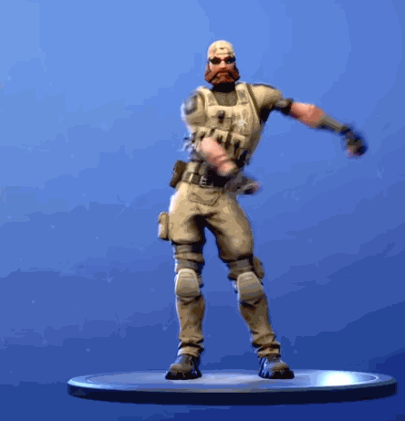
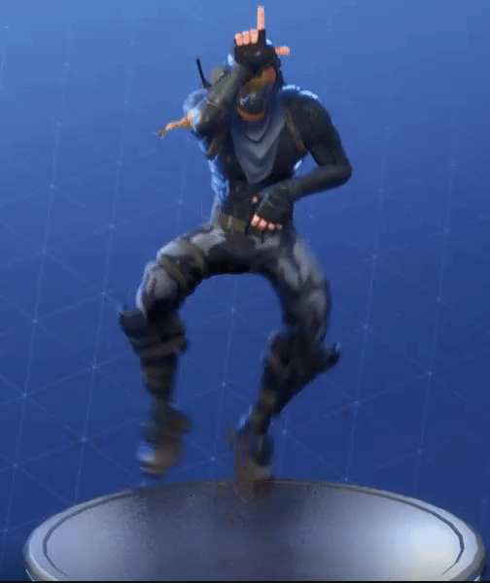
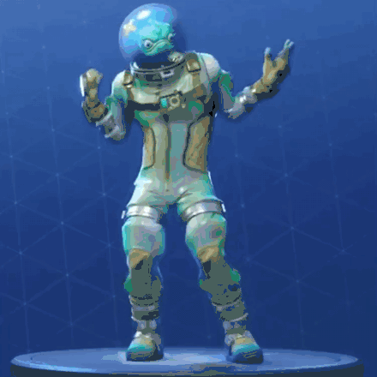
Your turn: Is Fortnite worth the time we put into it?
Use the TDFC graphic organizer to help you answer the question.
Remember, you need a topic sentence, two details, two follow-ups, and a clincher

Slide 88
TDFC: Topic
Step 1: Write a Topic Sentence
State your opinion and give the reader a “sneak peek” of what you will be writing about.
General: Fortnite is not worth our time.
Cluing: Fortnite is not worth our time because it is unhealthy.
Specific: Fortnite is not worth our time because it is unhealthy and can have lifelong effects if played for long periods.

Slide 89
TDFC: 1st Detail / 1st Follow-up
To support your response, you will need to write two details (evidence) that prove your point and two follow-ups.
Detail one: Introduce the detail
Example:
More than two hours of screen time can have negative effects on a child’s development.
Follow-up one: Give more information about the detail
CONVINCE US!!!!!!!
Example:
Unlimited screen time can affect memory, attention, and language/cognitive skills.

Slide 90
TDFC: 2nd Detail / 2nd Follow-up
Introduce a second detail with a second follow-up
Example of 2nd detail:
Allowing too much screen time can also lead to obesity.
Example of 2nd follow-up:
While playing Fortnite, children are seated. Spending hours sitting down on an electronic device can lead to becoming overweight because of the lack of movement/exercise.

Slide 91
TDFC: Clincher
A clincher sentence is a concluding sentence that ties everything together.
Example:
As you can see, [by the evidence provided] allowing children to spend an excessive amount of time playing Fortnite can result in long lasting negative effects.

Slide 92
TDFC: All together
Fortnite is not worth our time because it is unhealthy and can have lifelong effects if played for long periods. More than two hours of screen time can have negative effects on a child’s development. Unlimited screen time can affect memory, attention, and language/cognitive skills. Allowing too much screen time can also lead to obesity. While playing Fortnite, children are seated. Spending hours sitting down on an electronic device can lead to becoming overweight because of the lack of movement/exercise. As you can see, [by the evidence provided] allowing children to spend an excessive amount of time playing Fortnite can result in long lasting negative effects.

Slide 93
What does our DBQ look like?
You’re going to answer the question “Does where you live in the western hemisphere determine your happiness?”
Use the TDFC: DBQ graphic organizer to help you write your topic sentence, three details (from the documents), three follow-ups (CONVINCE ME!), and your clincher.
Choose three documents that are the most useful to your argument!
Notes:
Give it to them & discuss

Slide 94
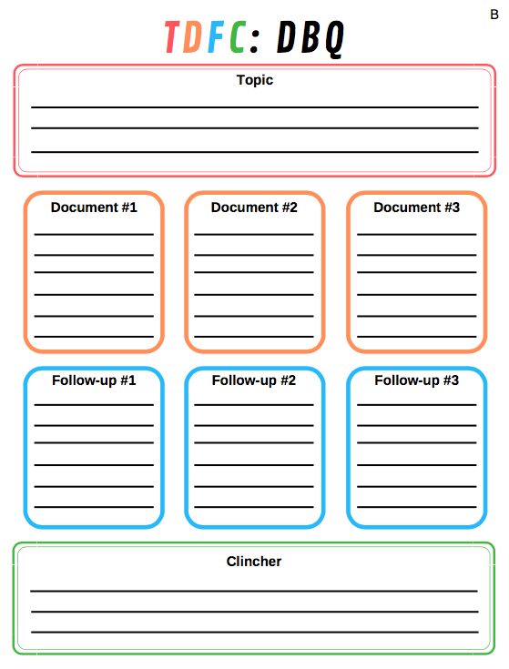
Notes:
Point out differences *3 Ds → Documents instead of details*

Slide 95
Enjoy your break!
Come back well rested and ready to tackle the DBQ!

