Slide 1
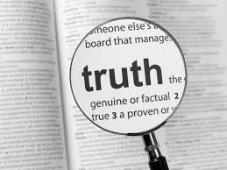
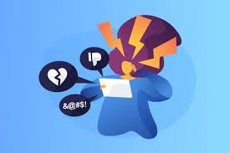
Cyberbullying, Social and Historical Literacy and the Search for Truth
Is What we Have Learned About the Mexico True?

Slide 2
Lesson One: Interactive Drama
Anna Bassolino, Kathleen Jensen, Colin Kotarski

Slide 3
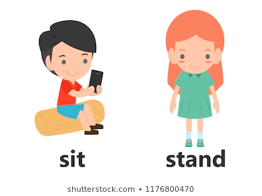
Stand Up, Sit Down Activity
Stand up if you have a smartphone, tablet, or laptop
Sit down if you have any social media (Instagram, tik tok, twitter, Facebook, Snapchat)
Stand up if you play a sport
Sit down if you have ever lived somewhere other than New York
Stand up if you like animals
Sit down if you have ever heard a backhanded comment (When someone says something to you and it hurts you but they think it is funny)
Stand up if you have ever seen bullying either online or in person
Sit down if you have ever stood up to a bully before
Stand up if you are brave
Sit down if you’re ready to learn about how bullying affects our friend Harper right here on Long Island.

Slide 4
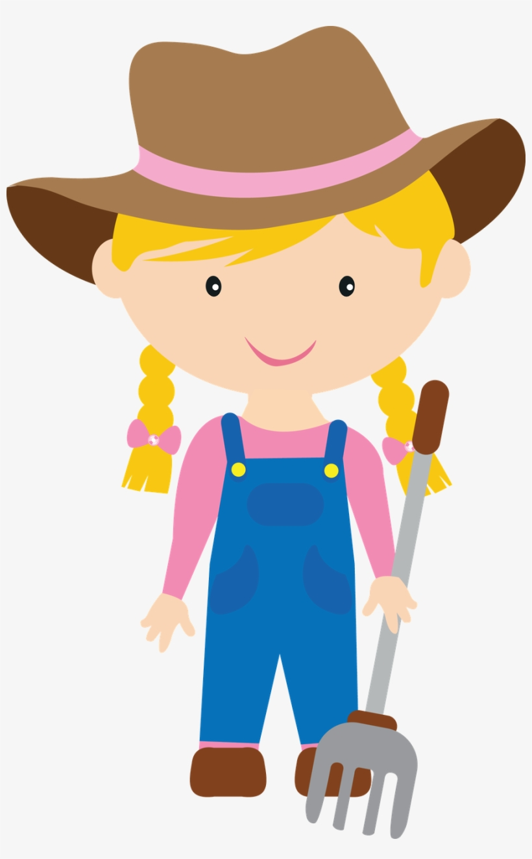
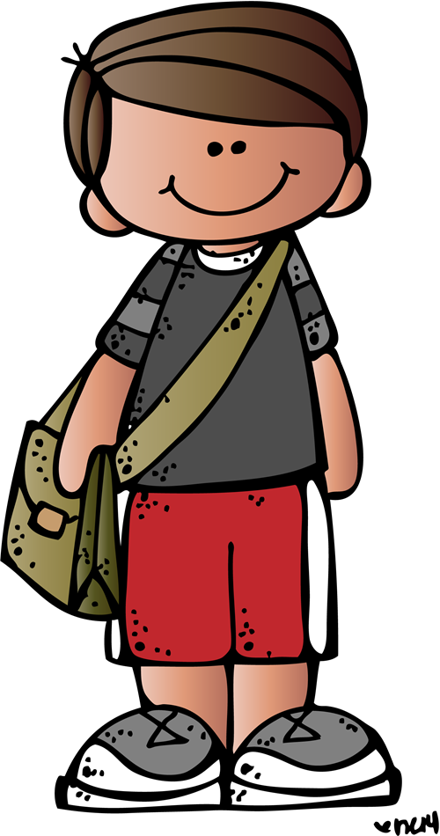
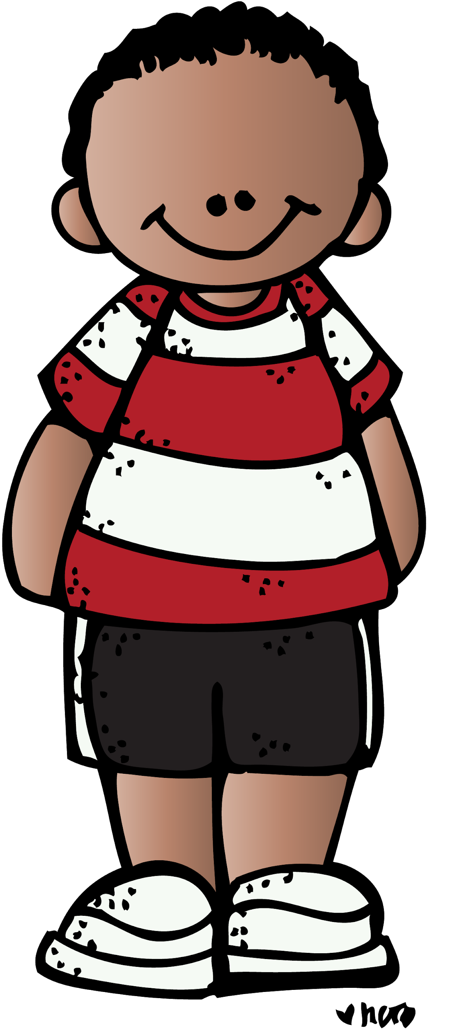
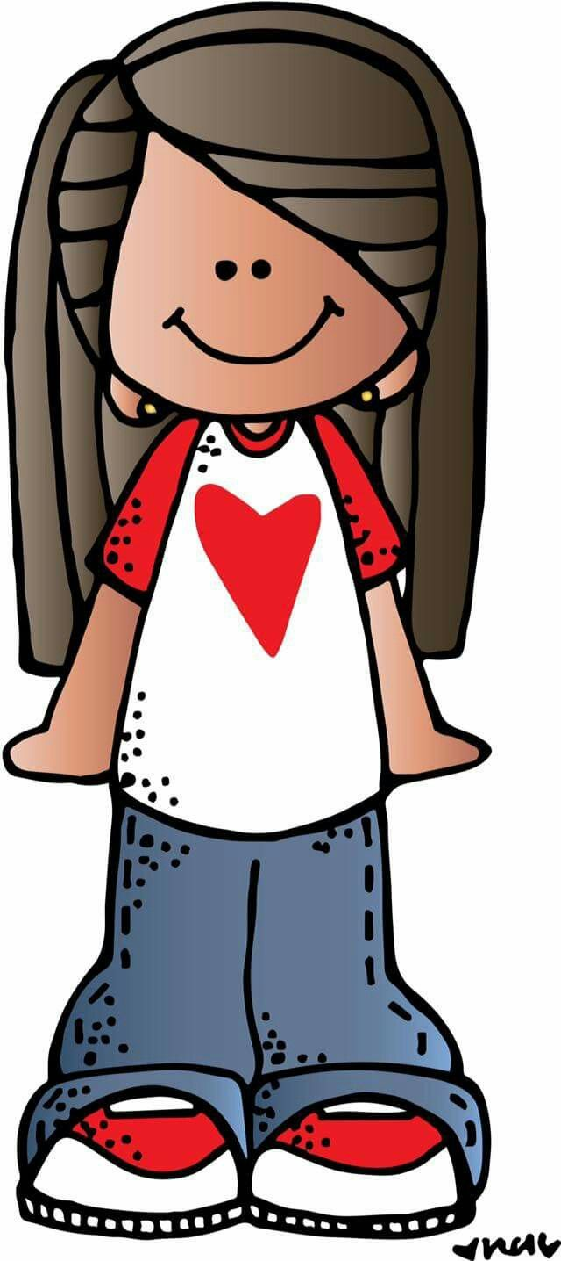
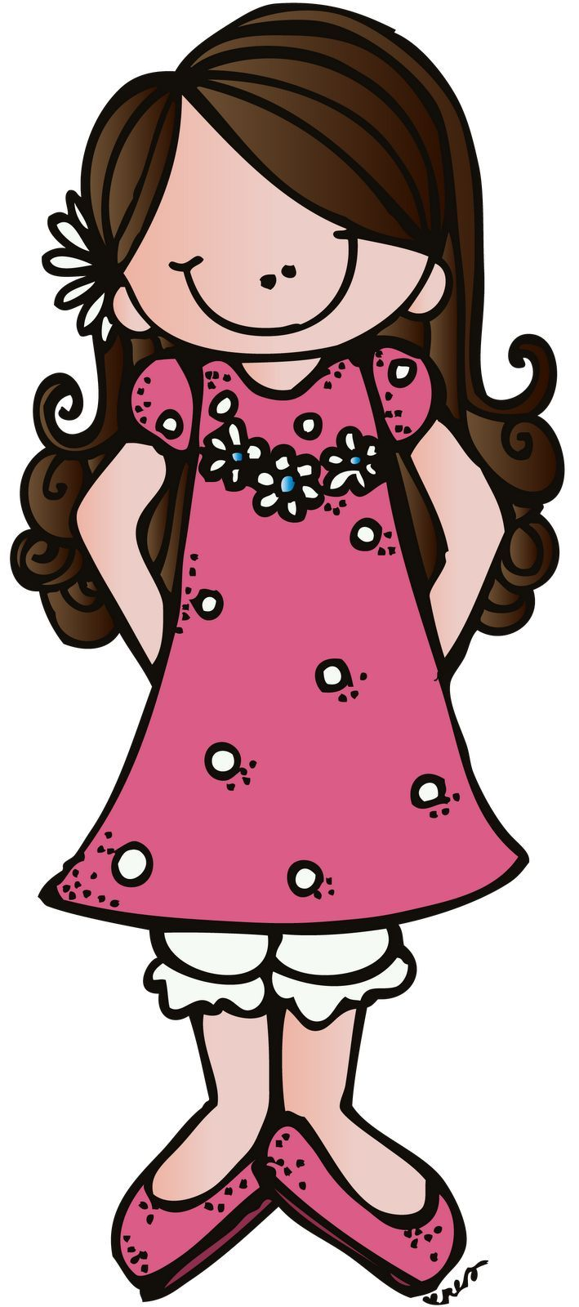
Hay Bale Harper Skit
Harper
Dylan
Kelly
Alex
Nick

Slide 5
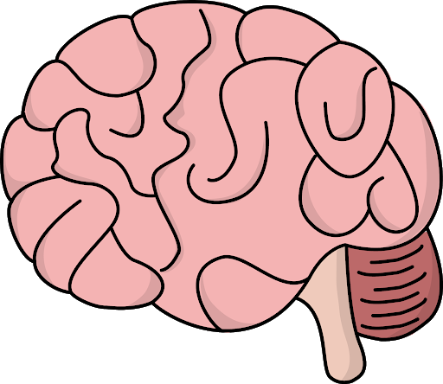
Brain Break!/Discussion
5 minute break

Slide 6
Discussion
How did the skit make you feel?
If you were a character in this skit what would you do?
Can you relate to this skit?
What character do you relate to the most?
Has anyone ever seen something like this before?

Slide 7
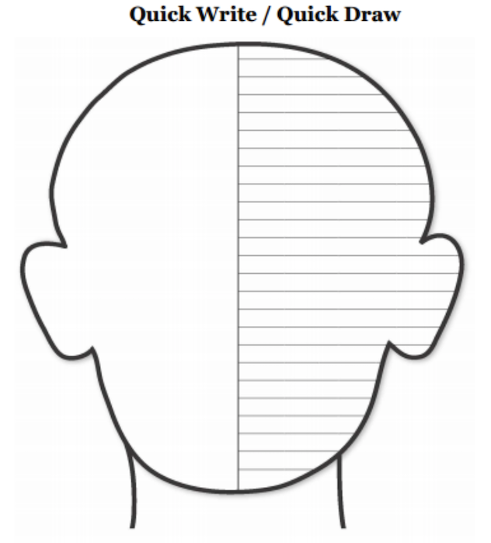
Quick Draw / Quick Write

Slide 8
Setting the stage: Sourcing
By: Alyssa amodio & Leann jaghab

Slide 9
Zoom!

Slide 13
What is Sourcing?

Slide 14
Sourcing asks readers to consider:
Who wrote the document?
What is the author’s perspective?
What is the author’s purpose?
Why was it written?
When was it written?
Is the source reliable?
Is the source credible?

Slide 15
Mr.
Peabody’s
Apples

Slide 16
Now it’s your turn!

Slide 17
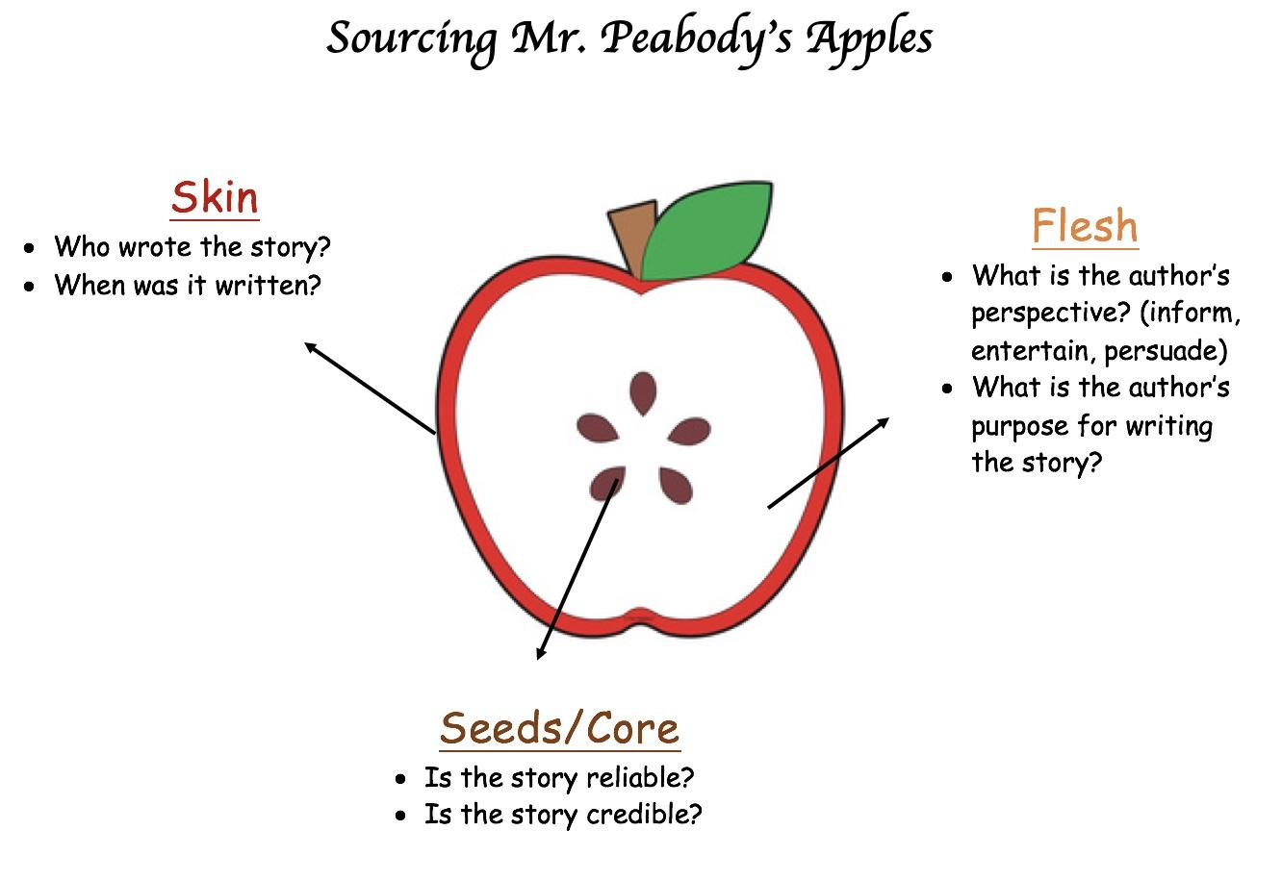

Slide 18
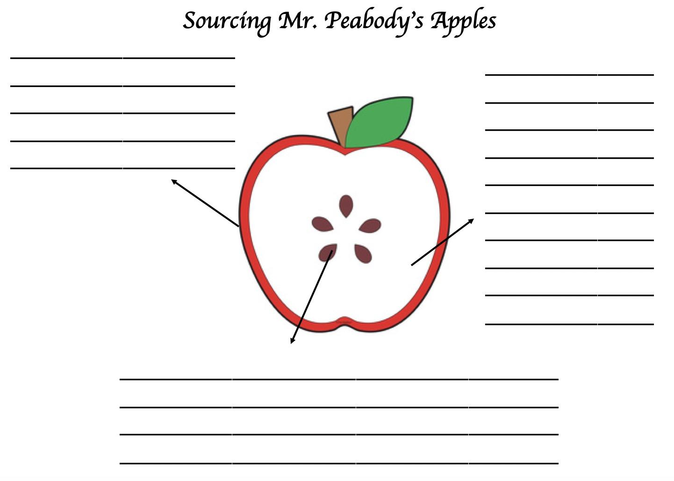

Slide 19
Create an alternate ending!

Slide 20
History Mystery
Lesson Three
Shannon Atwell and Hailey Wehr

Slide 21
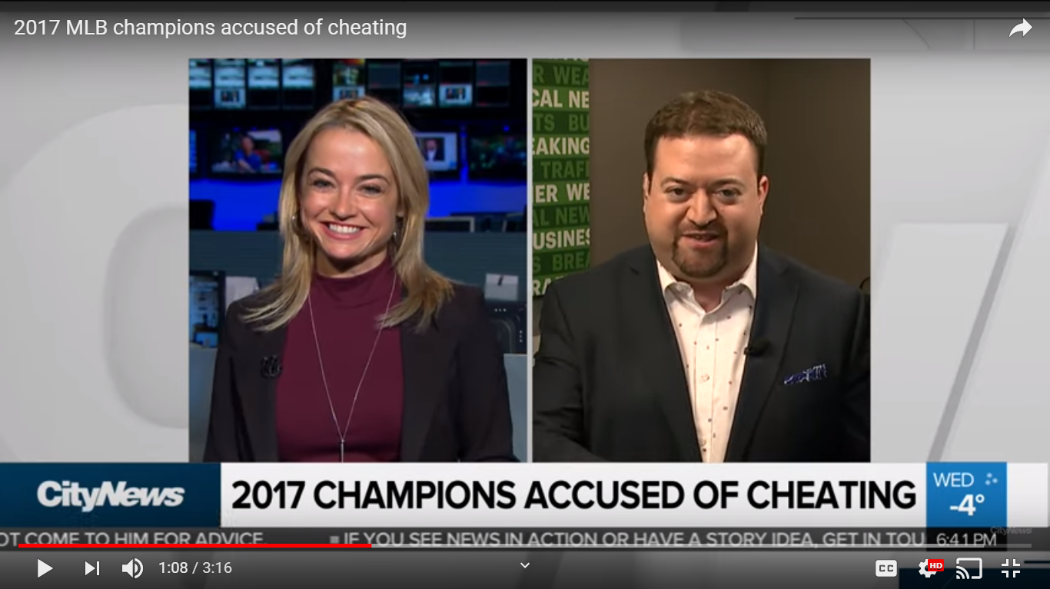
Introduction to Mystery...

Slide 22
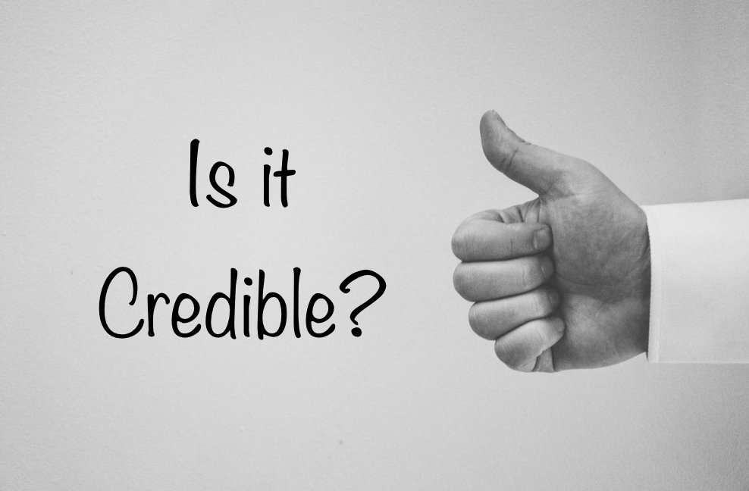

Slide 23
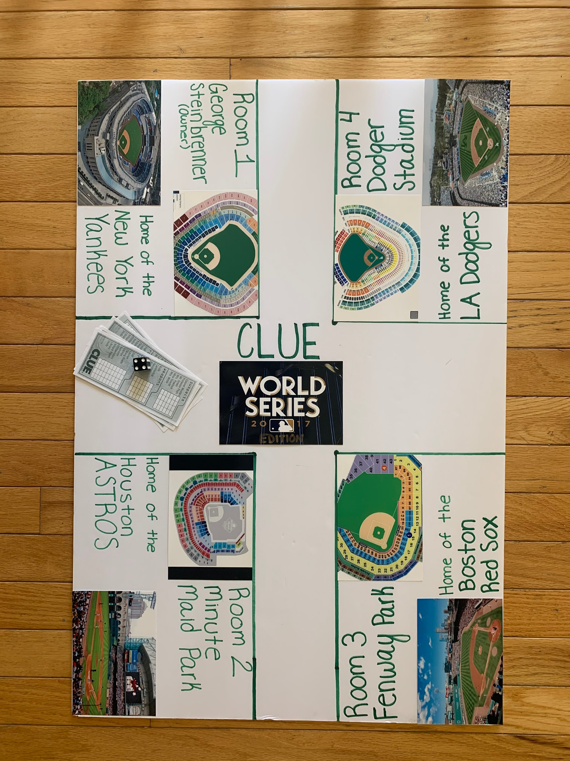
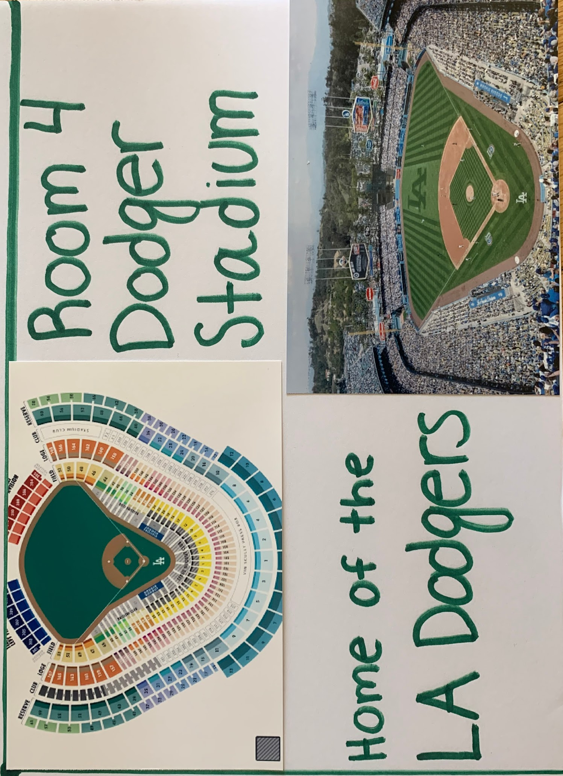

Slide 24
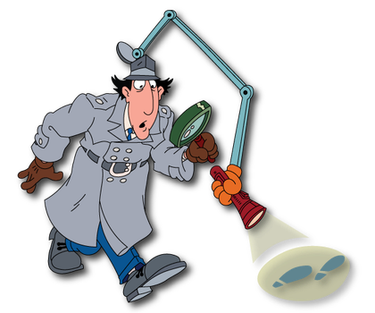
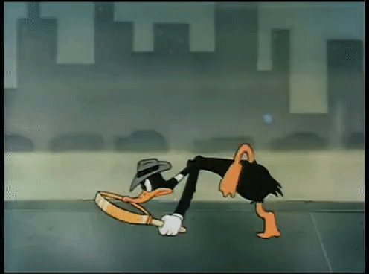
Detectives:Share your Claim with the Class using Evidence!

Slide 25
Lesson 4:
SPACE Strategy
Nora Miller & Amanda Reyes

Slide 26
ourcing
Urpose & Point of View
Who wrote this article?
When was it written?
Does the author have experience in what they are talking about?
Is the author a reliable source in general?
Why the author tweet this? (What is the author’s purpose?)
What is the author’s perspective on what they are tweeting about?
Does the author present 1 point of view or is their tweet balanced?

Slide 27
udience
orroboration
Is there a specific audience for this tweet?
Why might the author be tweeting to this audience?
Has an event happened in the world that caused the author to tweet this?
What does the author want the audience to think after reading this tweet?
Is the information presented fact or opinion?
Can the information tweeted be corroborated in other sources/accounts?
WHere could you go to corroborate this information in the article?
Have you tried to corroborate this source? What did you find?

Slide 28
valuation
When you review all of the questions, does this information seem credible? Which concept led you to that conclusion?
When you review all of the questions, is the information unreliable?
Are you unable to determine reliability and credibility based on the information provided?

Slide 29
Let’s try it out!

Slide 30
Lesson 6 -What is true About Mexico Using the SPACE Strategy
Morgan Schamberg and Victoria Vaglica

Slide 32
Time to Work in Groups!
Facebook post about Selena
Miguel Hidalgo
Article VIII of the Treaty of Guadalupe Hidalgo
Hernan Cortes

Slide 33
Present your findings to your classmates!
When you reviewed all of the questions above, is the information reliable or trustworthy?
How did you determine your answer?
Was your source valid? Why or why not?
Which letter of SPACE did you find most useful?

Slide 34
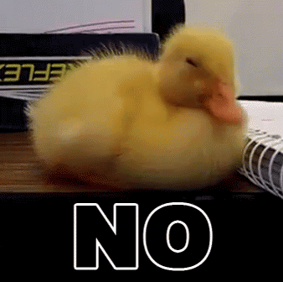
“Is what we learned about Mexico’s history true?”
Do you believe that all of the information that you have been told about Mexico’s history is true?
Is there any information that you doubt the validity?

Slide 35
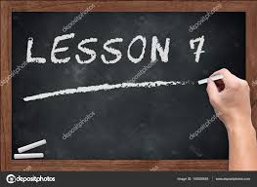
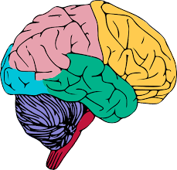
MEETING OF THE MINDS:
SHAPING MEXICO
ANNMARIE SIVERT AND LAUREN CZARNECKI

Slide 36
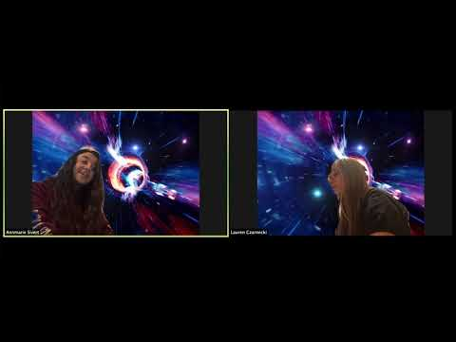

Slide 38
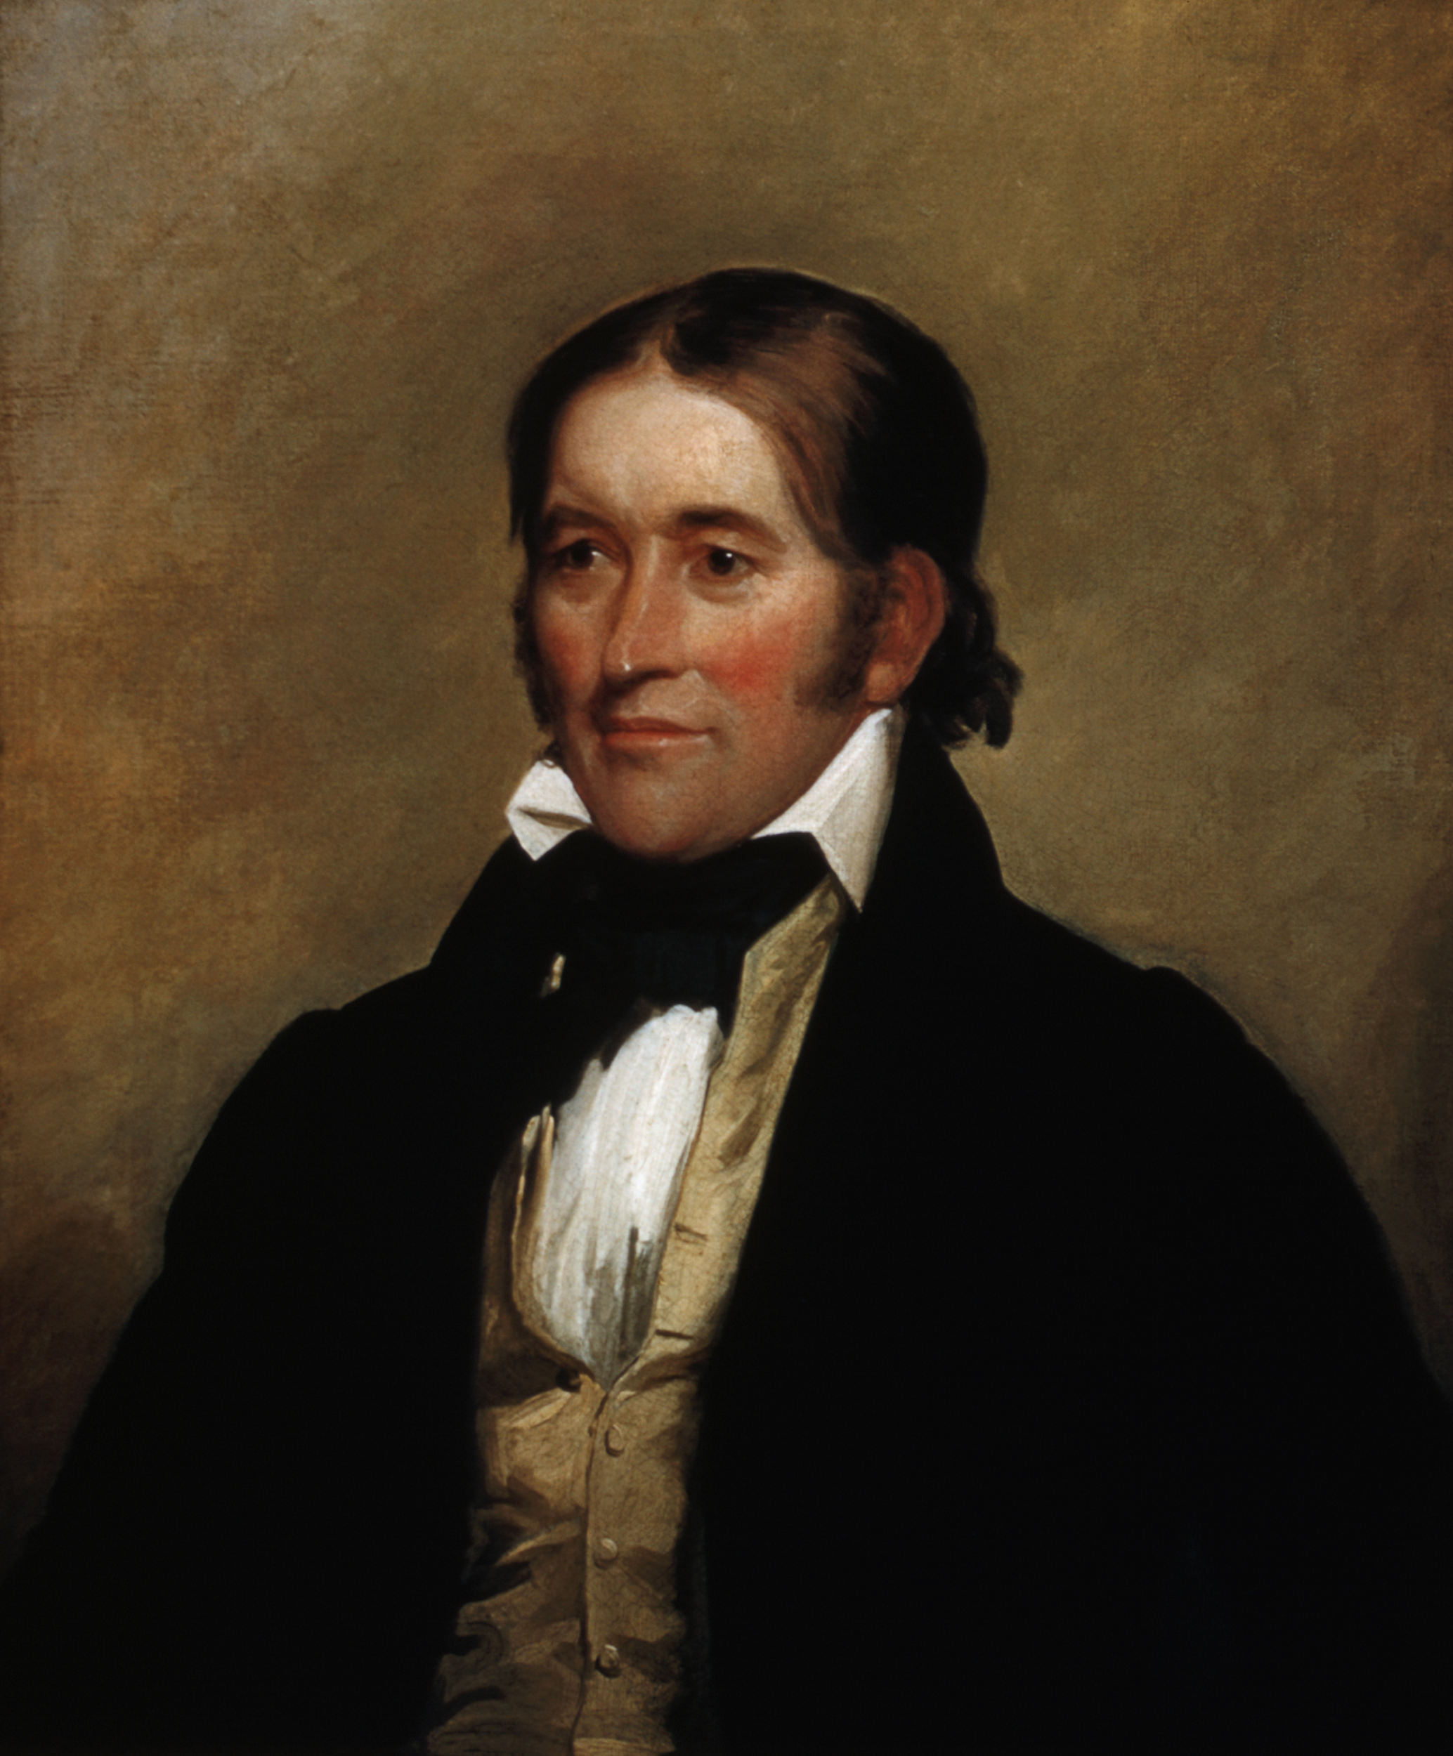
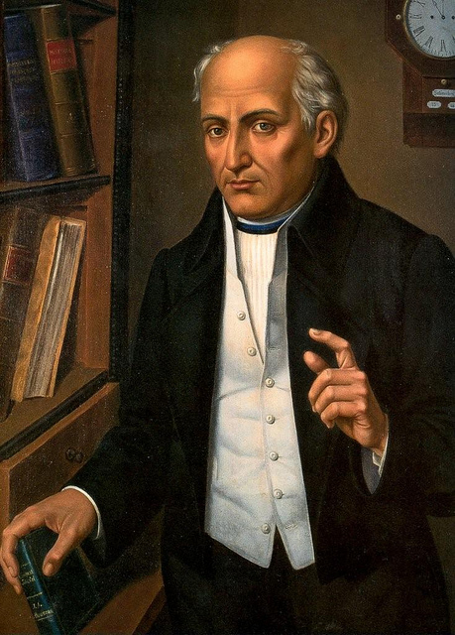
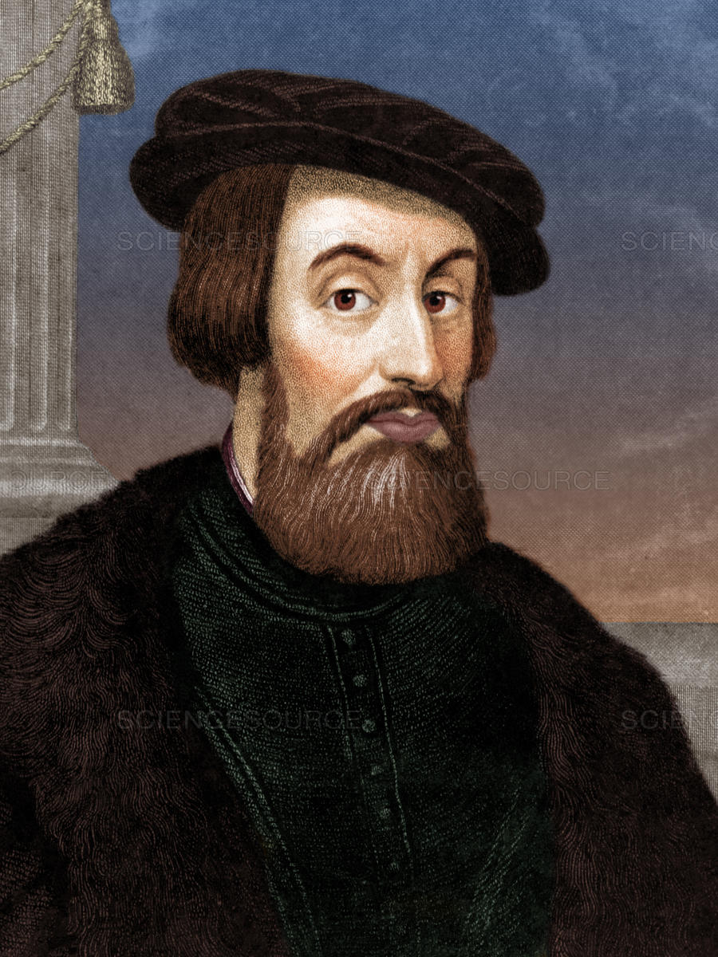
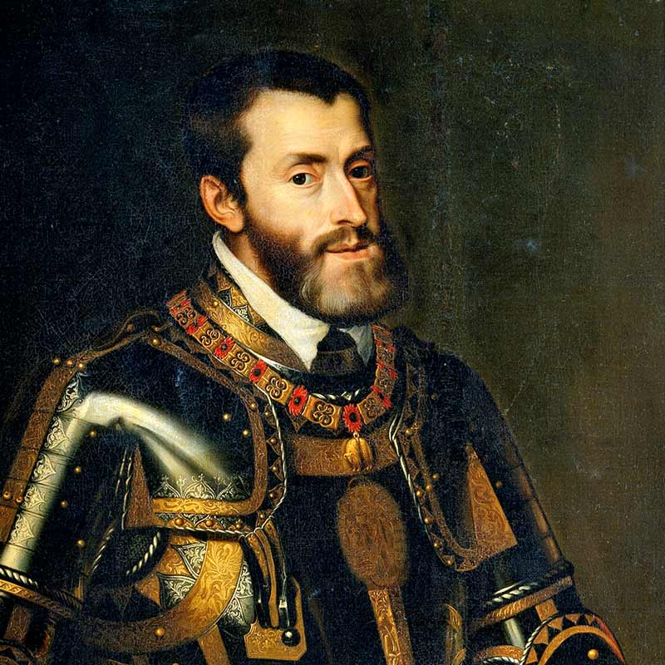
Meet our Historical Figures
Davy Crockett
Father Hidalgo
Hernan Cortes
King Charles V

Slide 39
Who was your historical figure?
When and where was the historical figure born?
What is your historical figure known for?
What were their contributions to Mexico?
How did this person impact Mexico?
Did this individual positively or negatively impact Mexico? Why?
WHAT
TO
KNOW

Slide 40
Lesson 7: Developing a Constructed Response Using TDFC
Megan Herder and Arianna Anzano

Slide 41
CHAMPS: Classroom Expectations
Conversation: Can students talk to each other during this activity?
Help: How do students get the teacher’s attention and their questions answered?
Activity: What is the task/objective? What is the end product?
Movement: Can students move about during this activity?
Participation: How do students show they are fully participating? What does work behavior look/sound like?
Success: When students meet CHAMPS expectations, they will be successful!

Slide 42
What is TDFC?
T - Topic Sentence
D - 2 Details
F - 2 Follow-ups
C - Clincher

Slide 43
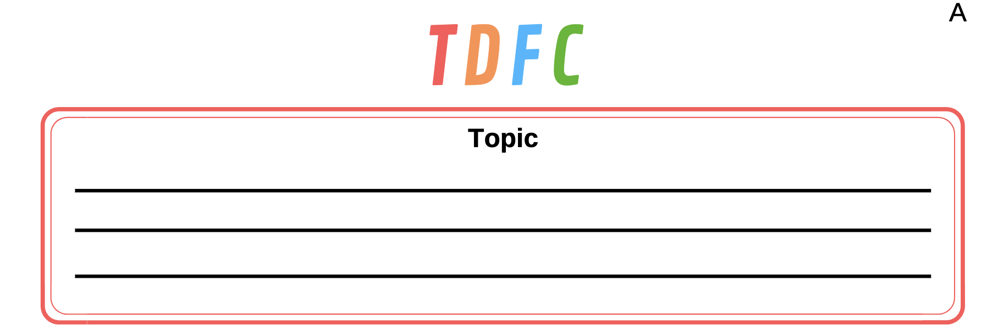

Slide 44
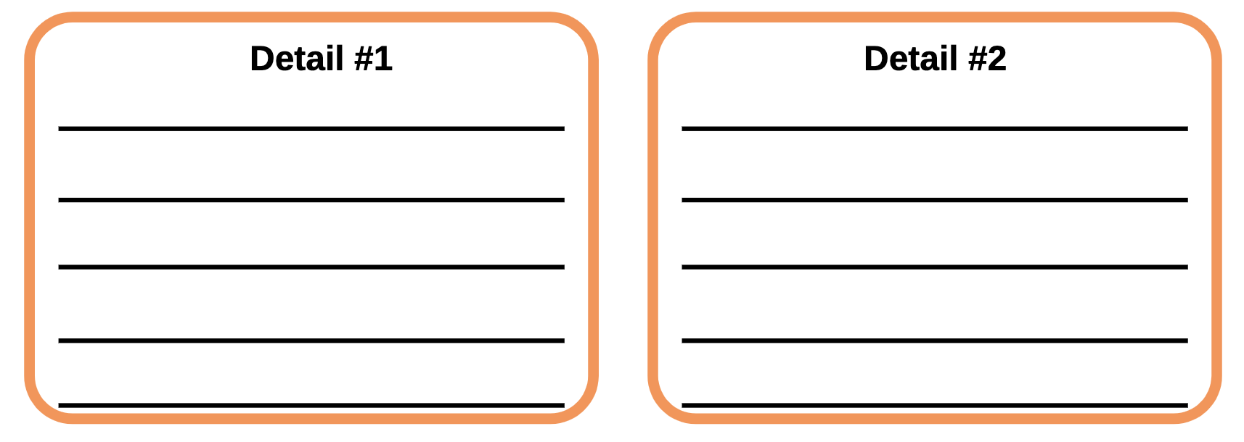

Slide 45
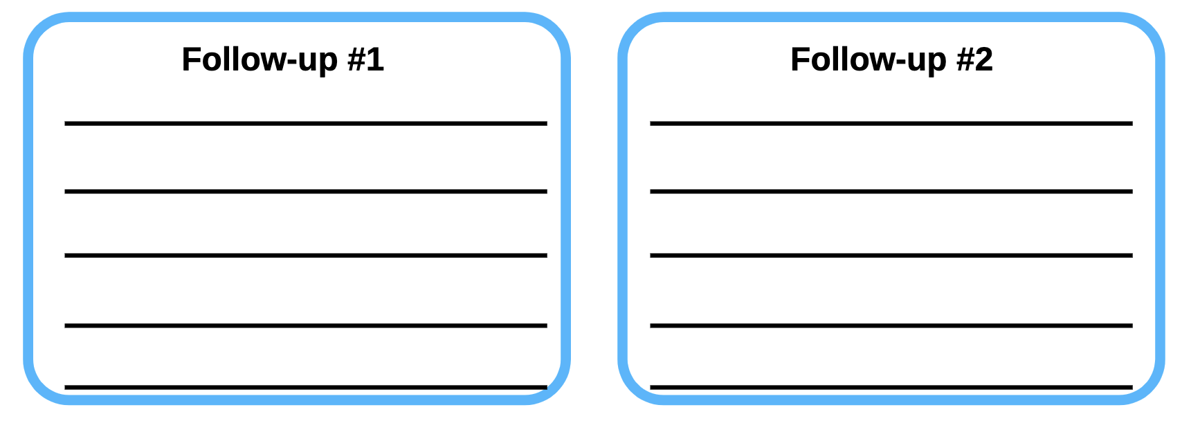

Slide 47
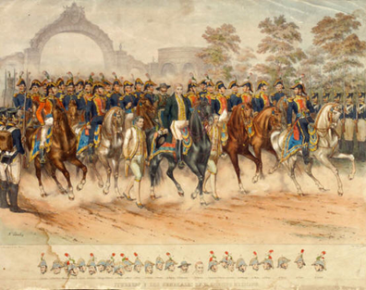
Your Turn!
Create your own constructed response to the question:
“Is What We Have Learned About Mexican History True?”
Make sure to use each component of TDFC.

