Slide 1
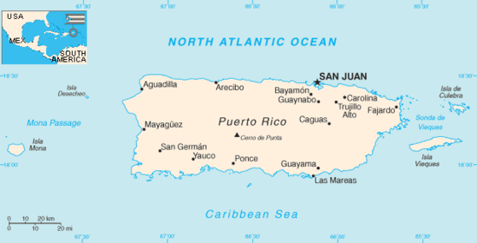
Does where you live in the Western Hemisphere determine your happiness?
Brianna Abatelli, Stefanie Amendoeira, Jackie Christenson, Natalie Ciminera, Taylor Keteltas, Cassidy Richards, Michelle Grant

Slide 2
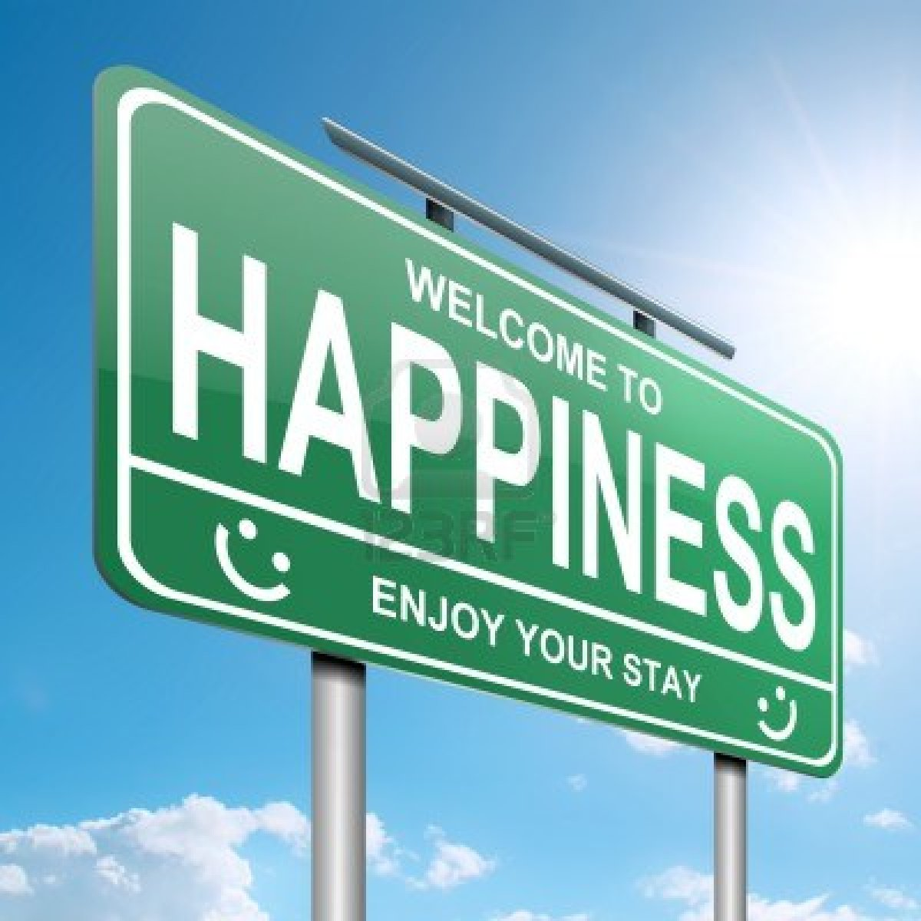
Lesson #1: Happiness
Does where you live in the hemisphere determine your happiness?
What determines happiness?

Slide 3
CHAMPS
C- Conversation: You will discuss the book, It’s Okay to Make Mistakes, with your peers. We will also discuss the idea of happiness and optimism with one another.
H- Help: If you needs assistance, please raise your hand quietly.
A- Activity: We are going to read the book, It’s Okay to Make Mistakes, and complete a “Book, Head & Heart” activity to reinforce what you learned. We will also learn the research that has been done on happiness, as well as discover the key to happiness through an exciting hands-on activity.
M- Movement: Please be mindful of your classmates when you move from your desks to the carpet, as well as when you come up to the board to participate.
P- Participation: Everyone is expected to participate in all activities. Everyone should also be taking notes and/or answering questions.
S- Success: We will learn about what happiness is and discover what the key to happiness is. This will teach you how to flip problems around so that you can see what the positive side of these problems are.

Slide 4
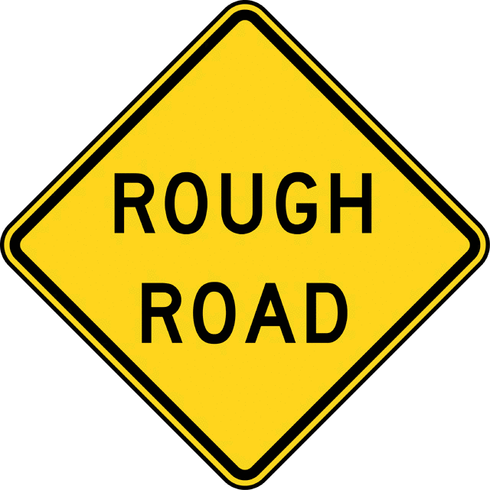
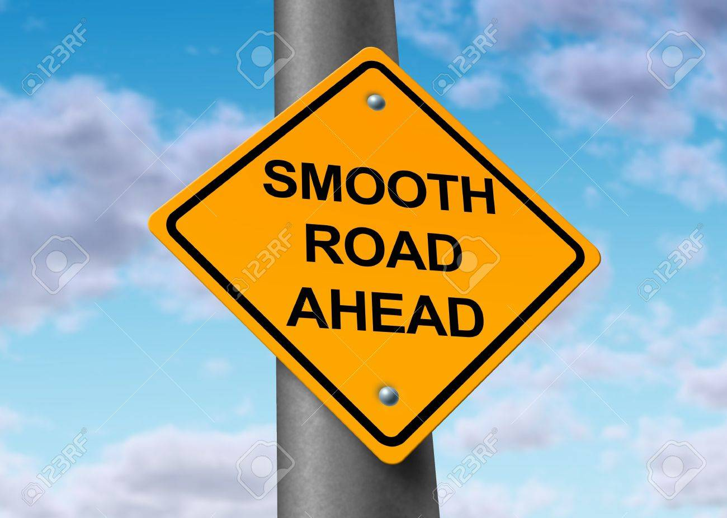
My Transition to Sixth Grade & College
Sixth Grade:
I would be in a new environment with new students and a new schedule.
I dreaded having to go to middle school.
Thought I wouldn’t do well and I wouldn’t make new friends.
I had a rough transition.
I refused to go to school.
It two months for me to successfully transition.
College:
I would be in a new environment with new students and a new schedule.
I told myself that even though the material may be harder, I would push through it & be successful.
Even though it may take time to find friends, I will eventually find lifelong friends.
I had a good transition.
I received good grades and meet my best friend.

Slide 5
It’s Okay to Make Mistakes!
Why is it okay to make mistakes?
Let’s read this story to find out!

Slide 6
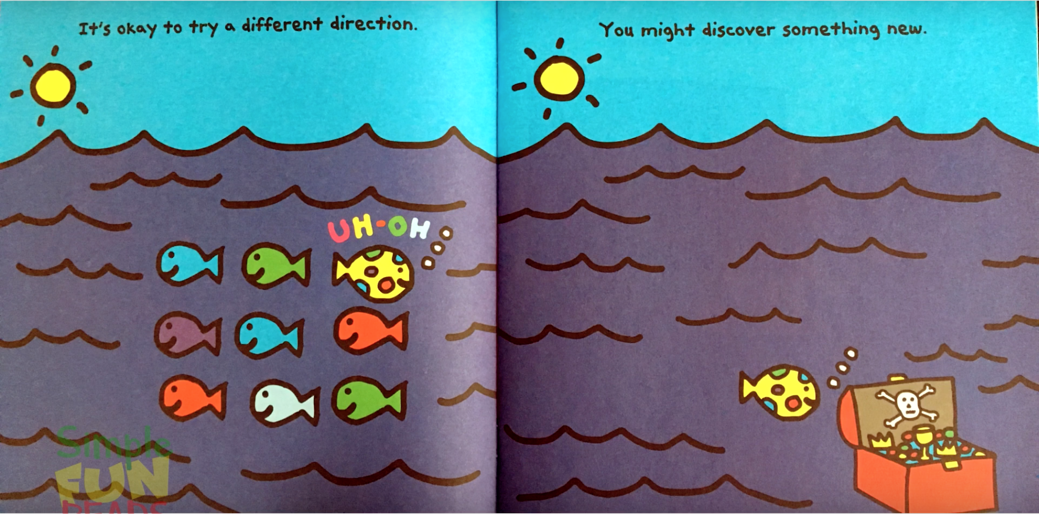
Discover!
Ask Questions!

Slide 7
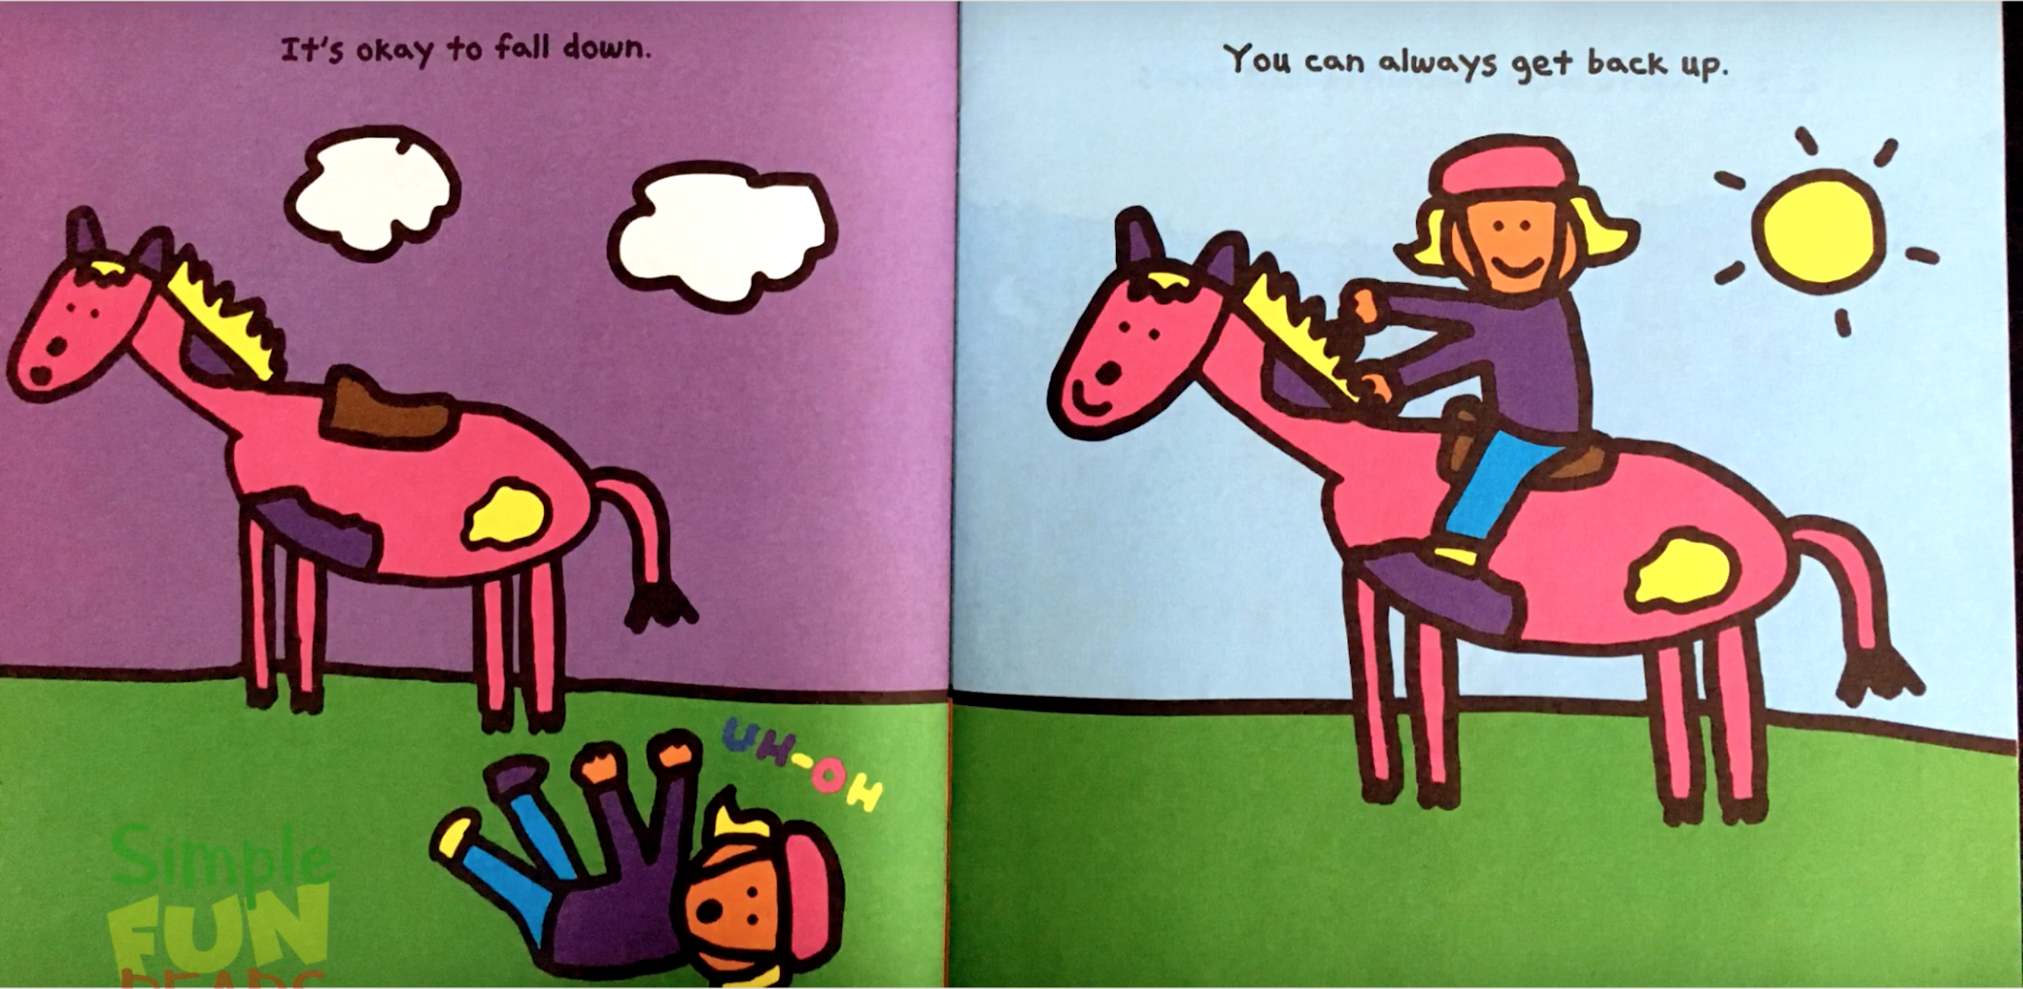
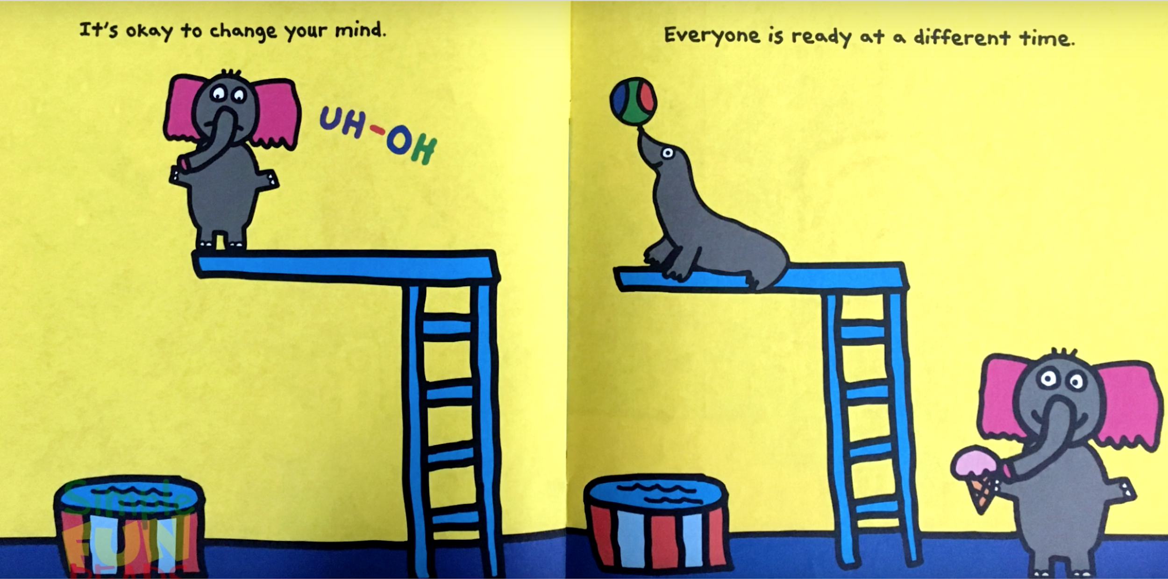
Get back up!
Everyone is different!

Slide 8
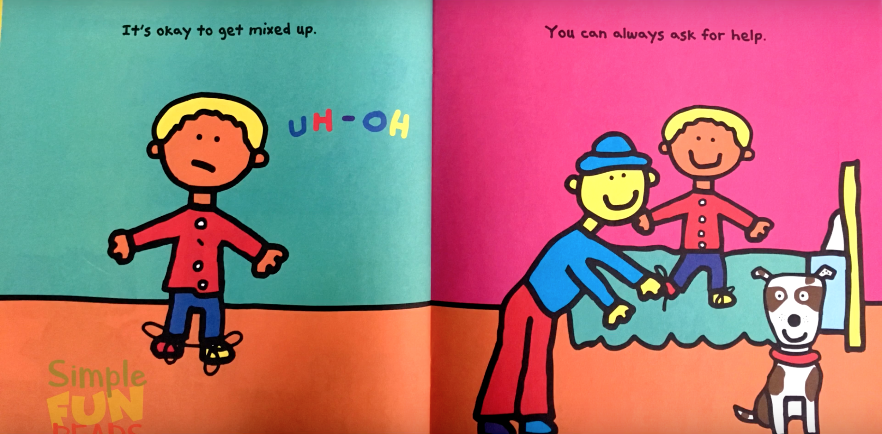
Ask for Help!
Be Yourself!

Slide 9
Why is it Okay to Make Mistakes?

Slide 10
Book, Head & Heart Activity
Directions: Write on your post-it note your response to the question you were assigned and then stick it on the correct poster board in the front of the classroom.
Book:
What is the book about?
Head:
What changed, challenged, or confirmed my thinking?
Heart:
What did I learn about me & how will this help me to be better?

Slide 11
Let’s Discuss the Book!
According to this book, what are two examples of mistakes we can make and why it is okay to make those mistakes?
Come up with your own example of a mistake you can make and why it is okay to make that mistake.
What is one mistake that you have made? How have you learned from that mistake?
According to this book, how should we react to the events that happen in our lives?
How does this book relate to the idea of optimism?
Why do you think optimism is the key to happiness?

Slide 12
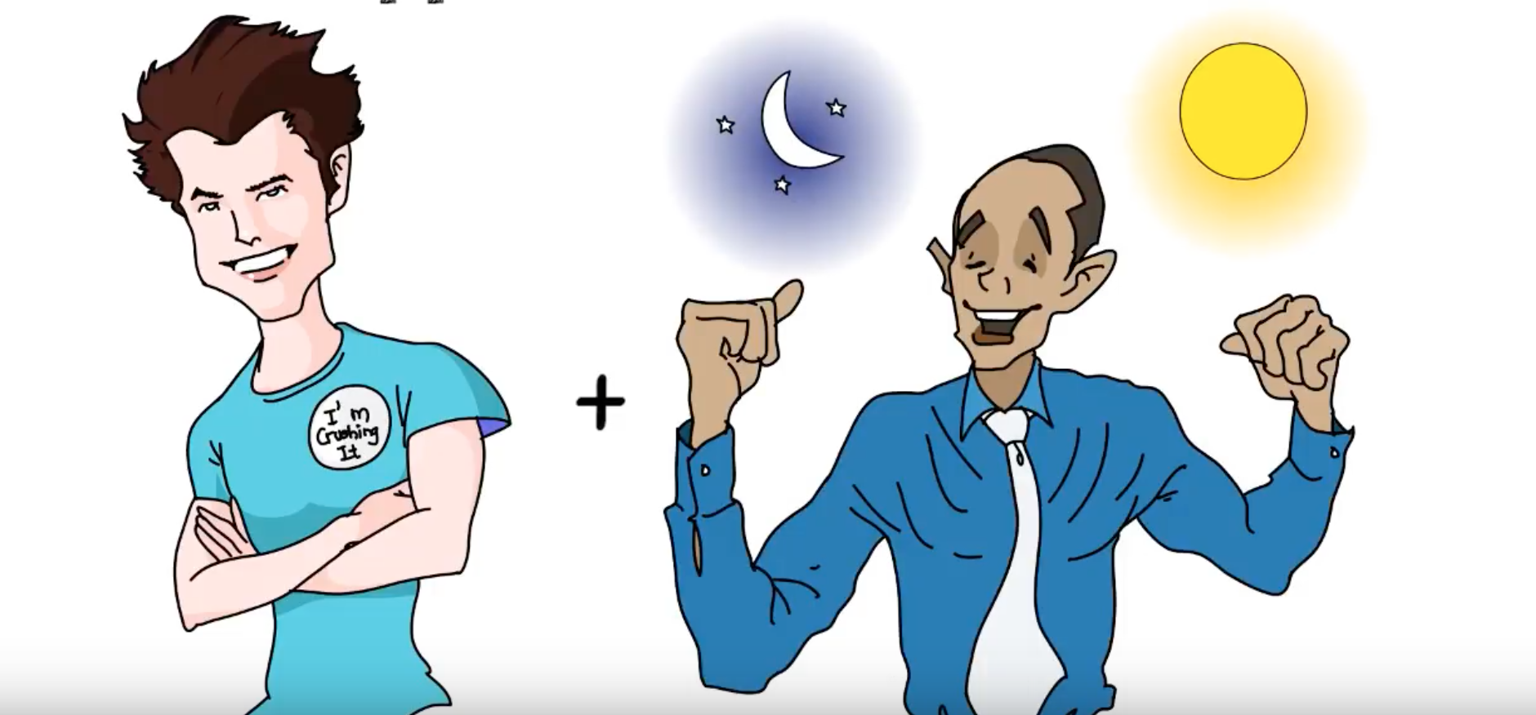
What is Happiness?
Happiness is a combination of . . .
You can build your happiness with consistent practice!

Slide 13
What is Happiness?
We get use to our circumstances over time!
50% Genetics
40% Thoughts, Actions & Behaviors
10% Circumstances

Slide 14
Happiness Is & Happiness Is Not Activity
Directions: Read the card you have been given and determine if this card describes what happiness is or what happiness is not. Then, put this card in the correct column on the board.

Slide 15
Happiness Is & Happiness Is Not Activity
What do you notice about all the cards that describe what happiness is?
What do you notice about all the cards that describe what happiness is not?

Slide 16
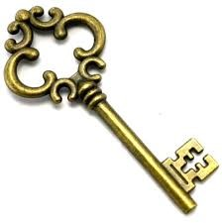
What is the Key to Happiness?
Optimism!

Slide 17
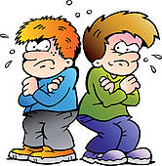
Exit Ticket:
The Flipside to Problems
Directions: Read the following four problems. Figure out how you can flip these problems into something positive. What virtue can you gain from these problems?
You failed a test because you did not have enough time to study.
You got into a fight with your friend because you and your friend could not see eye-to -eye.
You got detention because you kept forgetting to do your homework.
You got in trouble with your parents because you refused to clean your room.

Slide 18
Let’s Review & Extend Upon What We Learned About Today!
What did we learn about today?
Why is happiness such an important topic that should be talked about in the world we live in today?
What aspects of the United States physical environment make you happy? Does this mean that countries that do not have these environmental attributes are not happy? Explain.
What characteristics of the United States makes you happy? Does this mean that countries that do not have these characteristics are not happy? Explain.
Does where you live determine your happiness?

Slide 19
Homework:
Flipgrid With a Parent
Directions: Ask your parent about a time he or she overcame a difficult circumstance he or she was in with the help of optimism. Make a flipgrid to tell your parent's story. Be sure to include what you learned about happiness and optimism from listening to your parent's story.

Slide 20
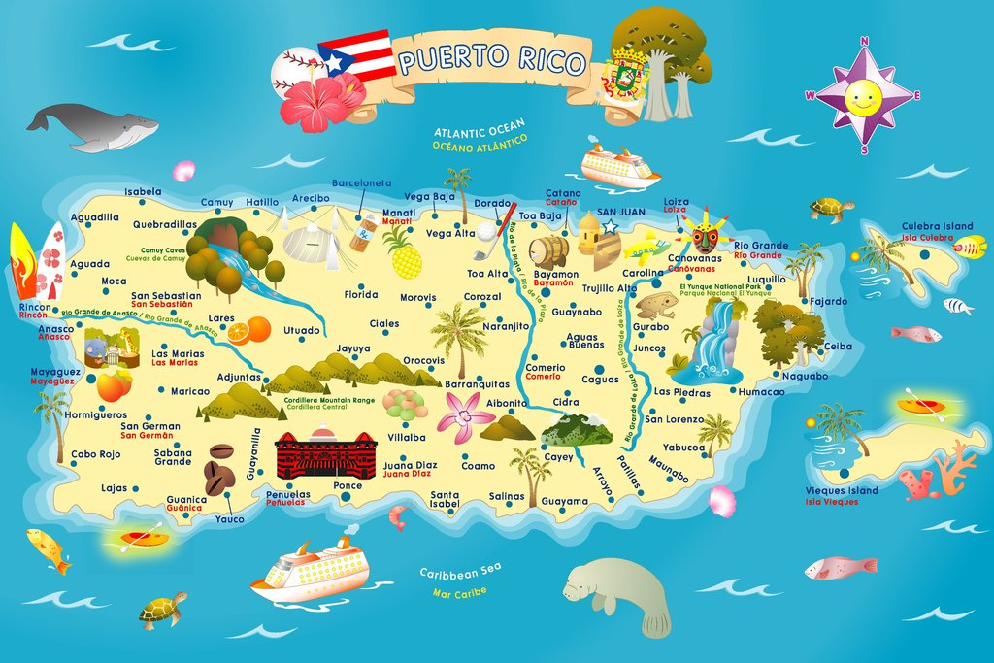
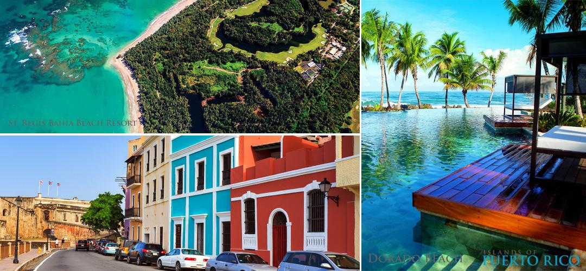
Lesson #2: Geography
Does the geography of Puerto Rico affect the life and happiness of the people living there?

Slide 21
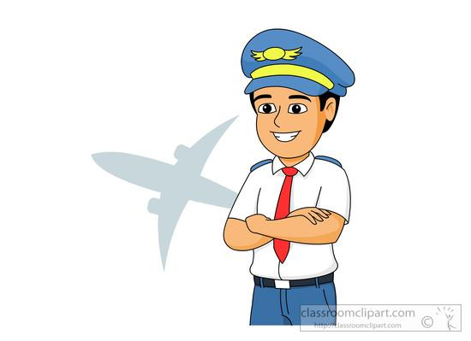
Location: Latitude and Longitude of a place.
Place: Human and Physical aspects.
Human-Environment Interaction: How humans adapt and interact with the environment.
Movement: Travel from place to place and exchange ideas.
Region: Uniform physical and human characteristics
Let's think of these themes as we travel throughout Puerto Rico!

Slide 22
CHAMPS
C- Conversation: Students will talk in their peers during the turn and talk.
H- Help: If you need assistance, raise your hand quietly.
A- Activity: Our goal is to take a bus tour and learn the geography of Puerto Rico.
M- Movement: Please remain in your seats throughout the plane ride and bus tour. If you need to get up please raise your hand quietly.
P- Participation: All students are expected to participate, whether it is taking notes and/or answering questions.
S- Success: Students will take notes about different cities in Puerto Rico and fill out a travel journal.

Slide 23
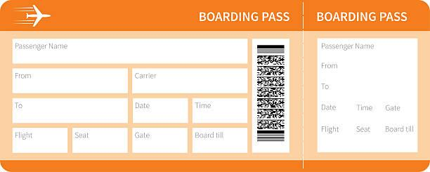
Time to Board!
Get your boarding pass ready and find your seat. Our first stop is San Juan, Puerto Rico.

Slide 25
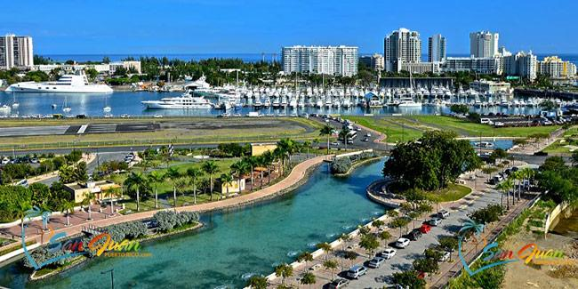
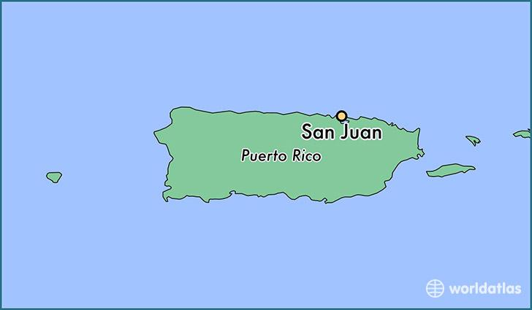
San Juan
Founded in 1521
Capital of Puerto Rico
Consists of Old San Juan and New San Juan
Located in the Caribbean
Has facilities for petroleum and sugar refining and brewing and distilling.
Produces cement, pharmaceuticals, metal products, clothing and tobacco.
San Juan is Puerto Rico’s financial capital and is one of the busiest ports in the Caribbean.

Slide 26
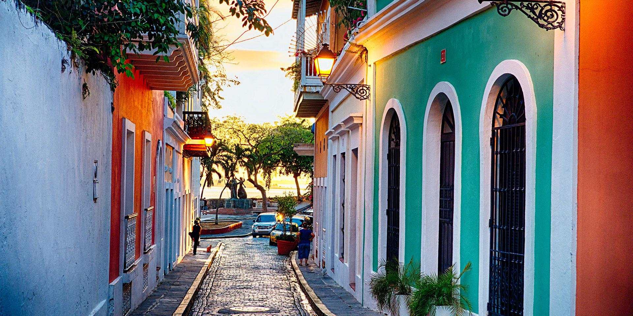
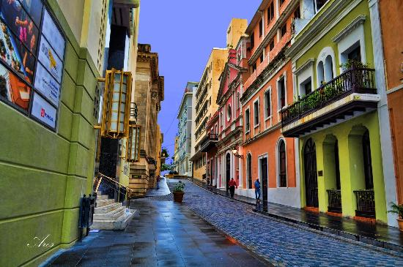
Old San Juan
Old San Juan includes Spanish colonial architecture including balconies, elegant doors, and colonial details
Old San Juan was originally used as a military stronghold
Plaza De Ballaja a building that housed Spanish soldiers and their families
Castillo de San Felipe del Morro (El Morro) is a six-level fort that rises 140 feet above the sea with its massive 18-foot-thick wall that proved a formidable defense.
Plaza the Armas, the main square in Old San Juan

Slide 27
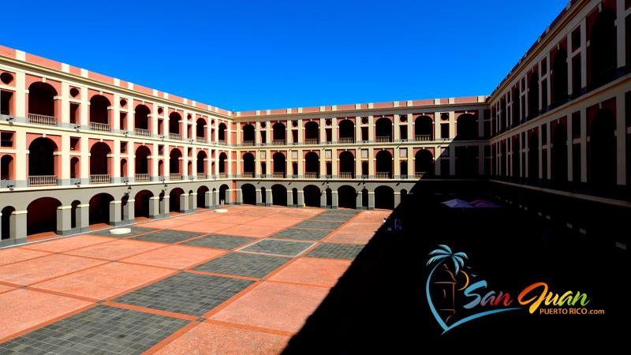
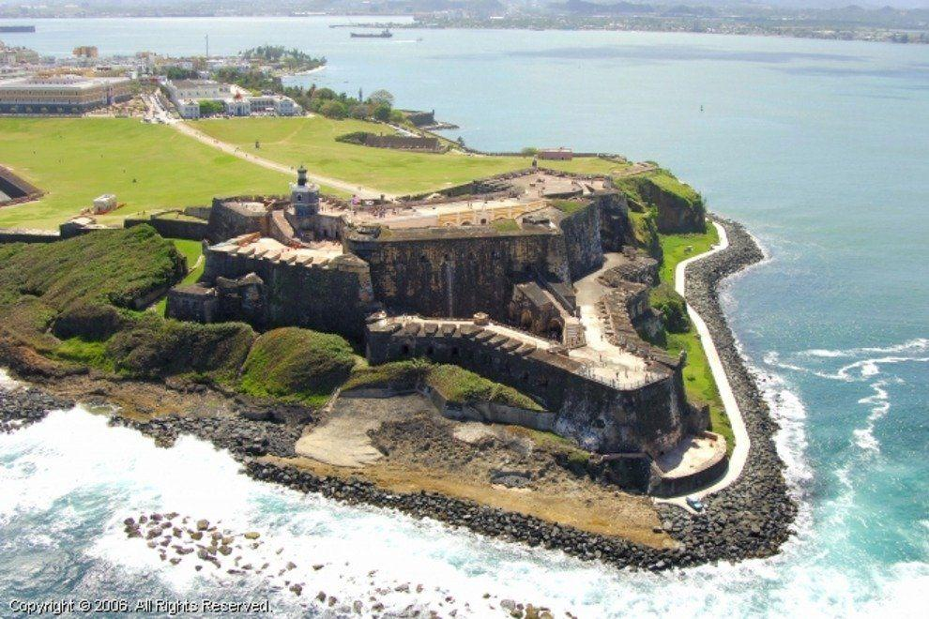
Plaza De Ballaja
Castillo de San Felipe del Morro (El Morro)

Slide 28
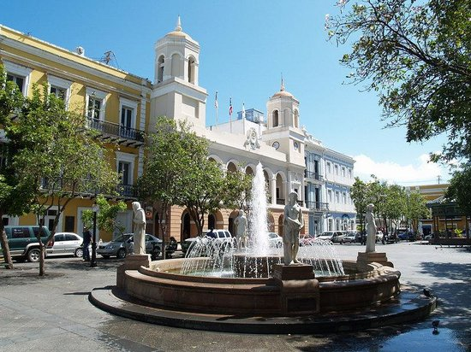
Plaza de Armas

Slide 29
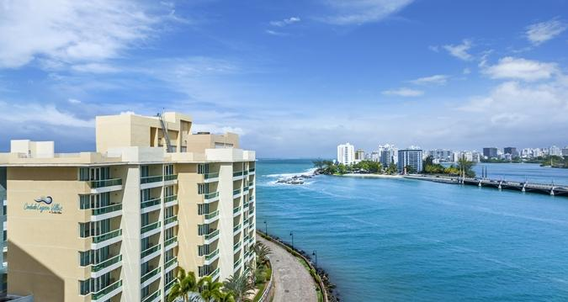
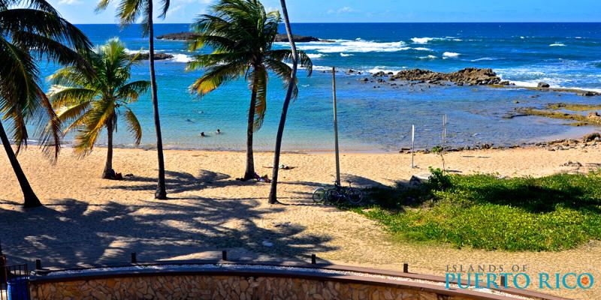
New San Juan
More modern part of San Juan
Includes beaches, hotels, nightlife, Condado Lagoon, parks and squares

Slide 31
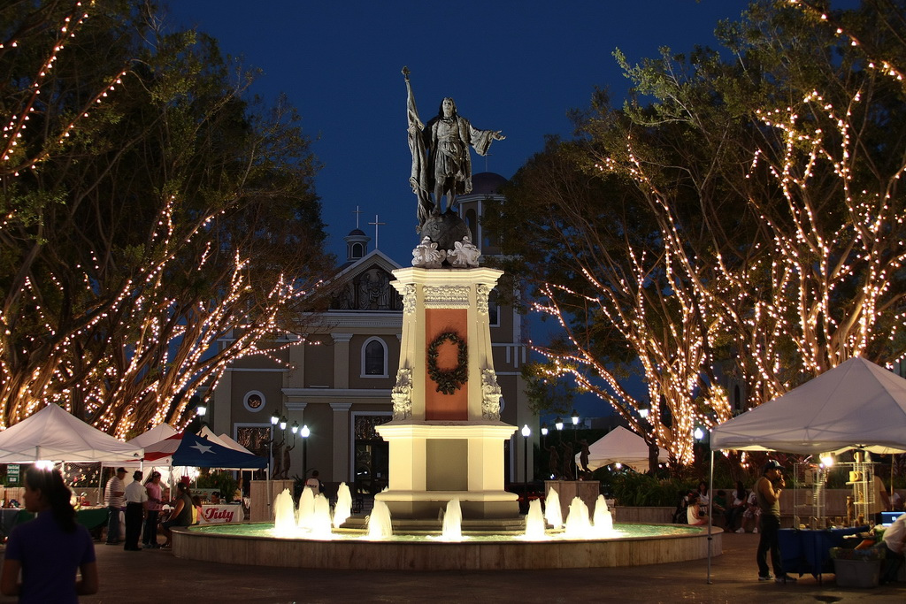
Mayagüez
Founded in 1760 and means “Land of the Clear Waters”
Was named after the river Yagüez River (meaning clear waters)
Located on the West coast and has a population of 89,080
It is the 5th largest city
Mayagüez is made up of 21 barrios or districts

Slide 32
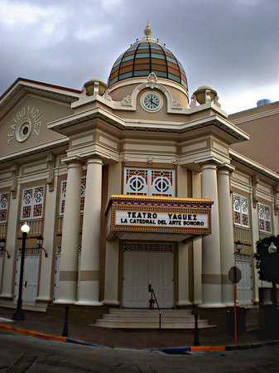
Important Places in Mayagüez
The city itself is centered around the impressive Spanish-style Plaza Colon, a tribute to Christopher Columbus, whose statue stands in the middle of the square.
The Yagüez Theater and Mayagüez Post Office, which are considered historic landmark buildings, both located on McKinley Street.

Slide 33
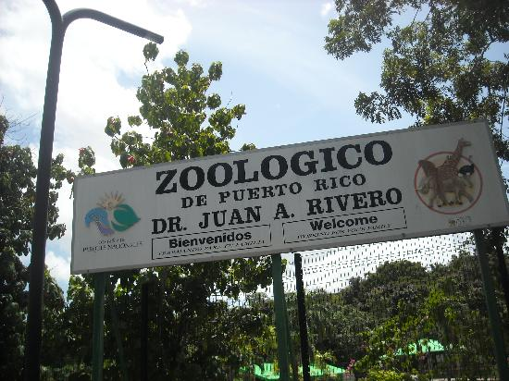
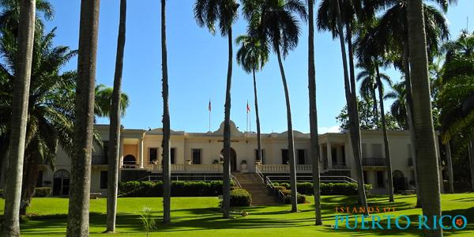
Important Places in Mayagüez
Mayagüez is the home of the only zoo on the island, Juan A. Rivero Zoo (commonly known as Mayagüez Zoo).
The Tropical Agriculture Research Station is also located in Mayagüez, where they host many exotic plants and trees
Two colleges are also located in Mayagüez: the Eugenio Maria de Hostos Law School and the Pontiff Catholic University of Puerto Rico.

Slide 35
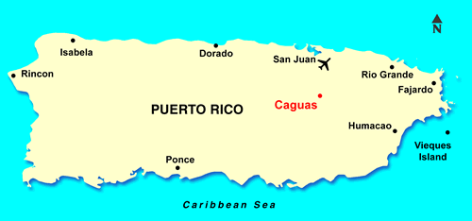
Caguas
Founded in 1775
Caguas is located in the Central Mountain Range, south of San Juan
Some rivers are Cagüitas, Turabo, Bairoa, Cañas, Grande de Loíza and Cañabonsito.
Caguas name comes from a local Indian chief (Caguax) who was an early Christian convert.
Cagua is made up of 11 barrios or districts.
Cagua is known for diamond cutting, tobacco processing, and the manufacture of leather goods, glass and plastic products, electronic equipment, clothing and bedding.

Slide 36
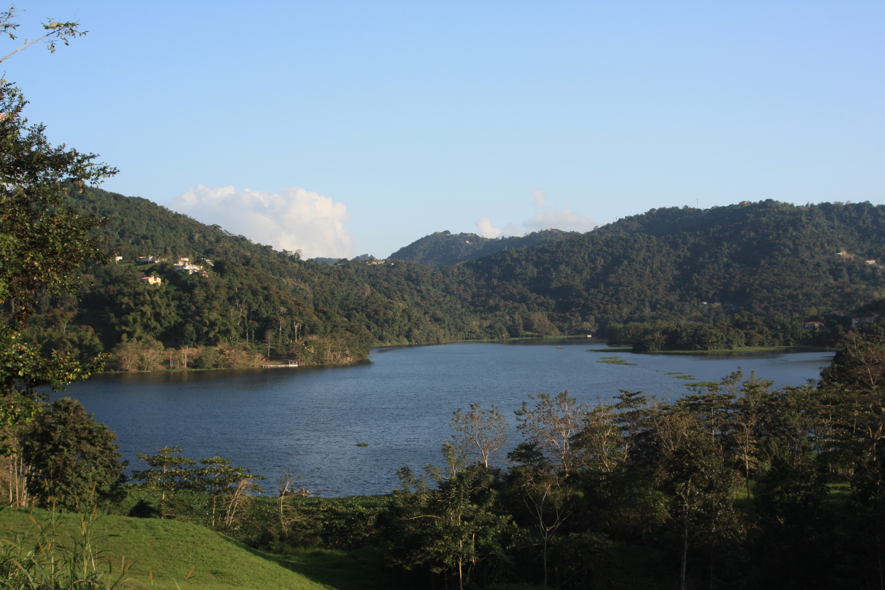
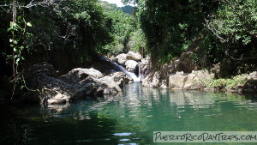
Important places in Cagua
Carraizo Lake: Largest lake in Puerto Rico
Carite Forest Reserve: 6,000-acre reserve with a dwarf forest that was produced by the region's high humidity and moist soil

Slide 37
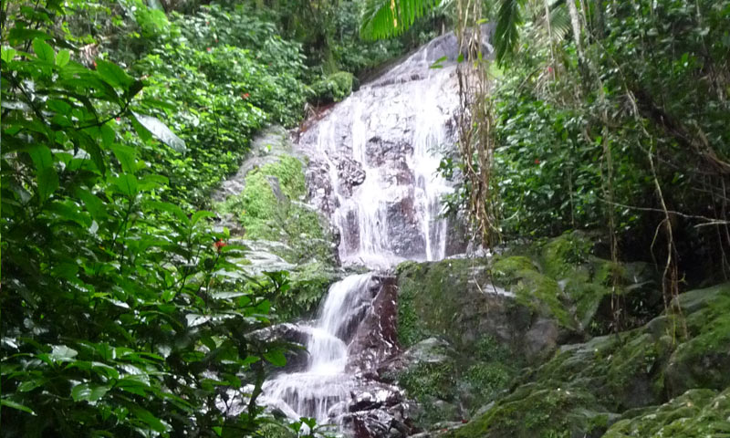
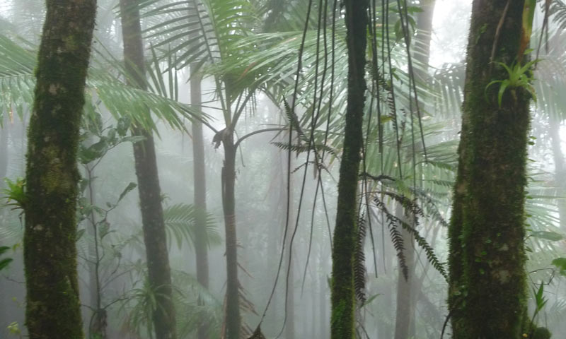
Important places in Cagua
Sotomayor del Toro Reserve:This 63-acre reserve on the steep slopes of Cerro La Santa. This l forest shelters numerous wildlife species, and streams here nourish the headwaters of the Turabo River.

Slide 38
Time to go home!
On your plane ride home, fill out your travel journal by writing why you would want to live in Puerto Rico and include 3 reasons why

Slide 39
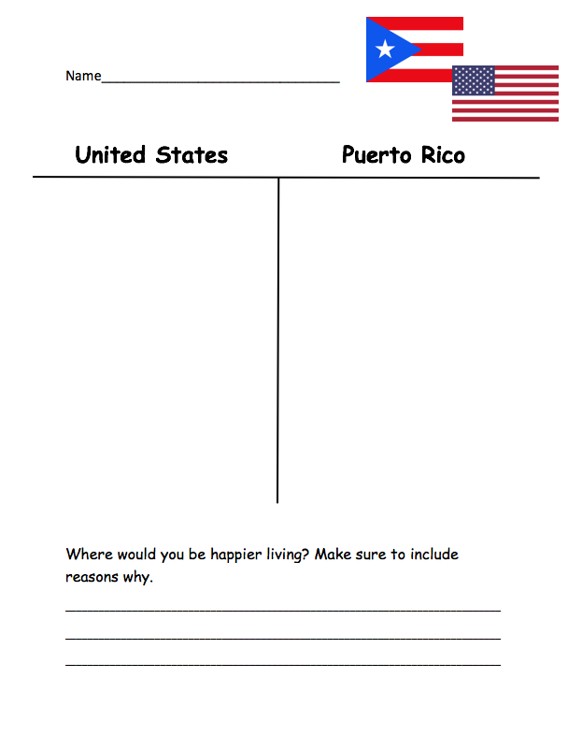
Homework
Compare Puerto Rico to the United States and write where you would be happier living.

Slide 40
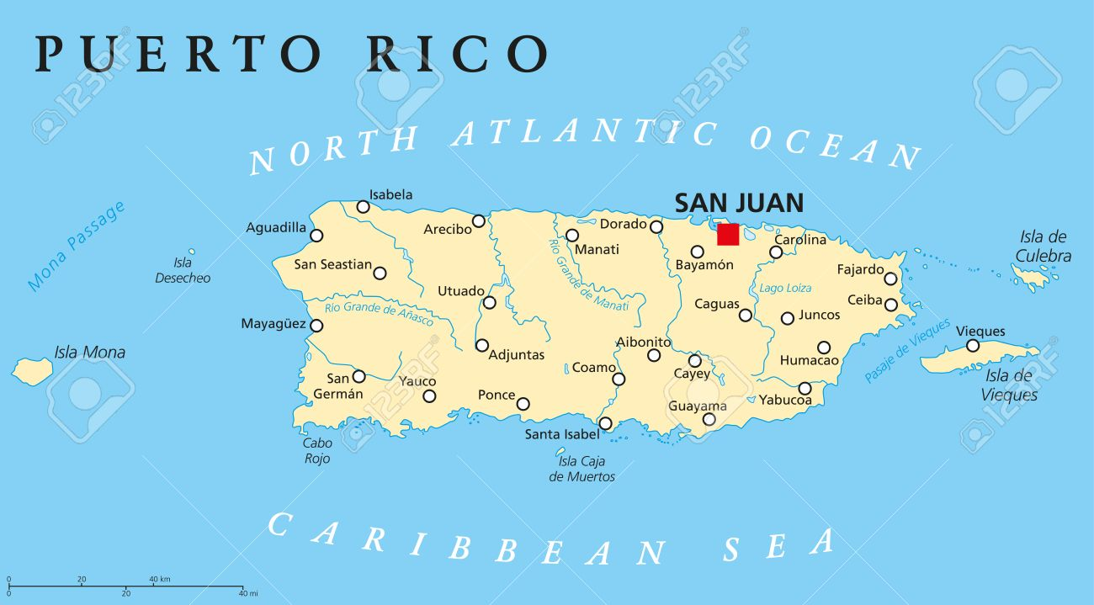
How did Puerto Rico come to be Puerto Rico?
What historical events have shaped the country?
Lesson# 3: Time Machine

Slide 41
CHAMPS
C- Conversation: students will talk with one another when participating in the read and retell as well as discussing, planning, and performing their Act it Out.
H- Help: If you need help, raise your hand and I will come over to assist you.
A- Activity: Our goal is to learn about three different historical events that have shaped Puerto Rico, and go back in time to experience those events.
M- Movement: Please remain in your seats while working with your groups on the read and retell. You may move from your seats with my instructions to prepare your Act it Out and when we go into our time machine.
P- Participation: All students are expected to participate, during read and retell and during Acti it out.
S- Success: Students will determine what event mostly shaped Puerto Rico Today and why

Slide 42
We’re going on a trip in our favorite rocket ship…… back in time!!

Slide 43
BUT FIRST… WE HAVE TO BECOME EXPERTS!
Founding with Columbus and the River of Gold
Spanish American War
Movement to make Puerto Rico a state

Slide 44
Listen and Retell
You will be broken up into groups of 3
Each group will be given a passage of a historical event that happened In Puerto Rico
With a partner in your group one person will read the passage while the other listens and writes down 5 key details
The person listening will then retell the story using their 5 key words to help them
Once completed partners will switch roles
After you finish, we will reconvene as a class and share our findings

Slide 45
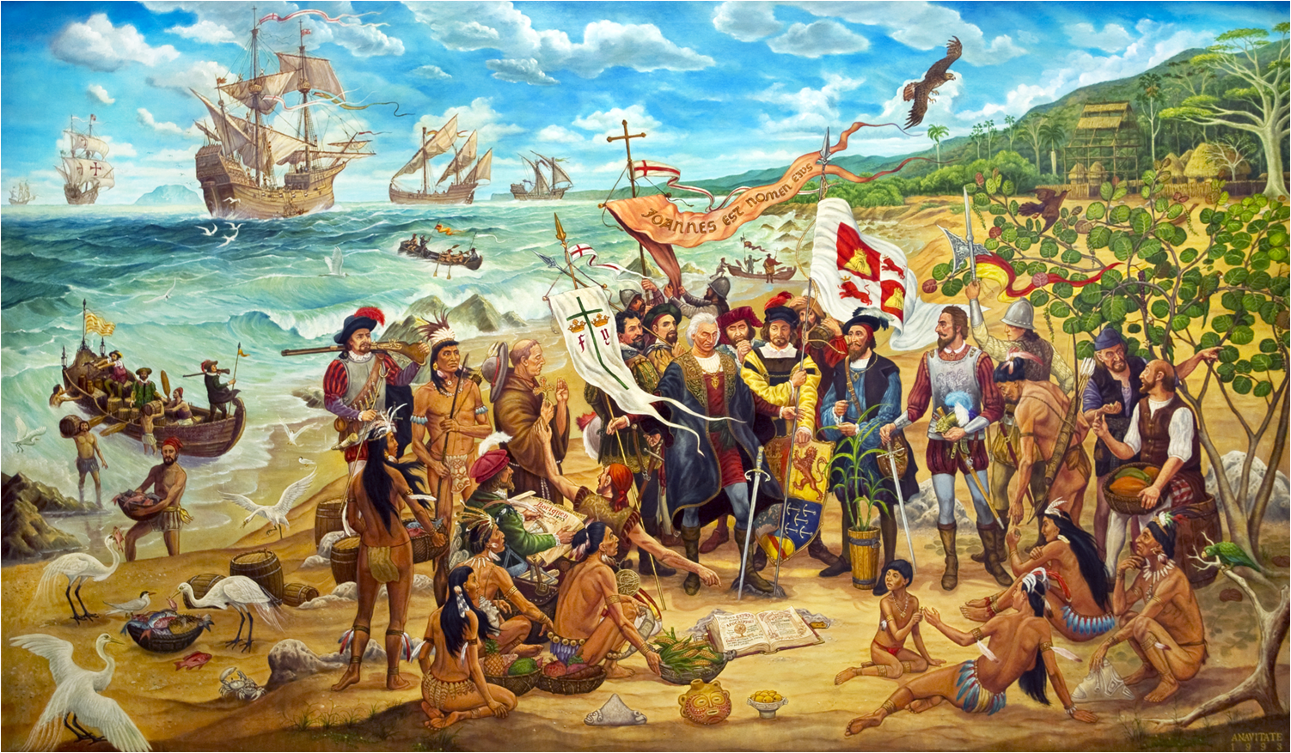
Founding with Columbus and The River of Gold
On November 19, 1943 Christopher Columbus discovered the island of Puerto Rico in his second voyage to the New World. He found the island populated by as many as 50,000 Taíno or Arawak Indians. The Taíno Indians who greeted Columbus made a big mistake when they showed him gold nuggets in the river and told him to take all he wanted.
The Island gained its name Puerto Rico ("rich port") for its abundance of natural resources, especially gold and its excellent location. During this time, the Spanish explorers were all throughout the Caribbean and Latin America in search of gold, and they were finding that gold was being used by nearly all of the civilizations that they encountered. After several years of mining so much gold sources said there was no more gold to be found.
Today In Puerto Rico there is most certainly still gold that can be found here today. Using modern mining methods that the early miners did not have could help a modern day gold prospector to recover gold in areas that have been mined in the past.

Slide 46
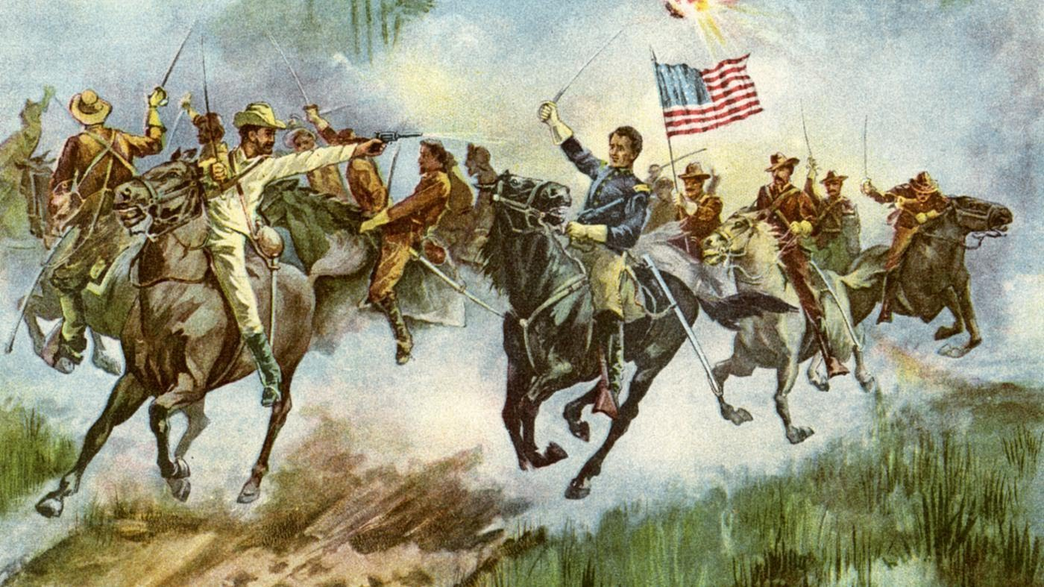
Spanish-American War
The Spanish-American War was a conflict between the United States and Spain that ended Spanish rule in the Americas and resulted in U.S. possession of territories in the western Pacific and Latin America. The war began with Cuba’s struggle for Independence from Spain. On April 21, 1898, the United States declared war against Spain. It would be the first overseas conflict fought by the U.S.
The reasons for war were many, but there were two immediate ones: America's support for the ongoing struggle by Cubans and Filipinos against Spanish rule, and the mysterious explosion of the battleship U.S.S. Maine in Havana Harbor.
The war ended with the signing of the Treaty of Paris when Spain surrendered over their colonies left in the western Pacific. Cuba, Puerto Rico, and the Philippines were all given to the possession of the United States.

Slide 47
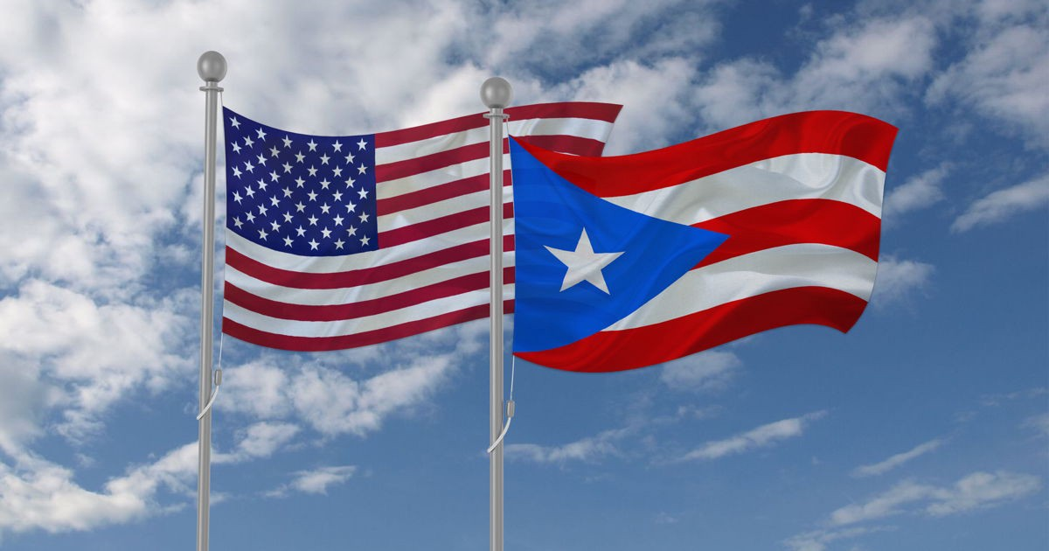
Movement to make Puerto Rico a state
The United States won control of Puerto Rico in 1898 following the Spanish-American War. In the first three decades of its rule, the U.S. government made efforts to Americanize their new territory. In 1917 they announced that all people born in Puerto Rico would be U.S. Citizens. The United States wanted to make Puerto Rico just like America, but a popular democratic party lead a movement that opposed that. In 1952 the U.S. Congress approved a new Puerto Rican constitution that made the island a U.S. commonwealth. Puerto Rico has their own government and governor but do not have a vote in congress or all the same rights as Americans in the USA.Throughout the years people in Puerto Rico have taken votes on the question of statehood and have rejected it. In June 2017, 97% of the people voted for statehood but the decision is up to congress.

Slide 48
History Alive
Act it Out Directions
-You will get into your same groups as yesterday, and will be asked to analyze additional document regarding the historical event you read yesterday.
-You will perform and Act Out the scene from the document, including information you learned about the event from the listen and retell activity
- It is important to get into character and take into account the time period you are portraying for your classmates to understand

Slide 49
LET’S GET INTO OUR TIME MACHINE!!

Slide 50
First Stop on our Time machine: …..1493 Puerto Rico
Voyager Christopher Columbus discovers the island of Puerto Rico and claims it as a colony for Spain. The island of Puerto Rico had an abundance of gold in its rivers which native inhabitants were forced to mine and to give to the spanish.

Slide 51
Second Stop…..1898 The Spanish American War
The Spanish-American War was an important turning point in history as the United States emerged as a world power. Spain surrendered over their colonies left in the western Pacific. Cuba, Puerto Rico, and the Philippines were all given to the possession of the United States.

Slide 52
third Stop... . The Movement to make Puerto Rico a State
“There’s this perception that we are our own nation,” “And yet, there is this reality that we’re not really a part of the United States, but we don’t own ourselves either. We’ve always been in-between.” - Vagabond Beaumont

Slide 53
Exit Ticket & Homework
Exit Ticket
How did your historical event help shape Puerto Rico today? Include 3 key details
Homework
Write a Journal Entry:
In your own words, how did each historical event help shap Puerto Rico today? which historical event do you feel most helped shape Puerto Rico to be what it is today and why? Be sure to include 3 key details.

Slide 54
Lesson #4: SCIM-C Method
Was the history discussed yesterday valid?

Slide 55
CHAMPS
C- Conversation: Students will talk in their peers during group discussions.
H- Help: If you need assistance, raise your hand or ask your group members.
A- Activity: Our goal is to use the SCIM-C method to analyze documents.
M- Movement: Please remain in your seats when working in your groups, you will eventually have time to move around and speak to other groups about their documents.
P- Participation: All students are encouraged and expected to participate, especially during group discussions.
S- Success: Students will answer SCIM-C questions do determine if the information from yesterday was valid.

Slide 56
What is the SCIM-C method?
Corroborating: THIS IS THE "C"
1. What similarities and differences exist between the sources?
2. What factors could account for the similarities and differences?
3. What gaps appear to exist that hinder the final interpretation of the source?
4. What other sources are available that could check, confirm, or oppose the evidence
currently marshaled?
Inferring: THIS IS THE "I"
1. What is suggested by the source?
2. What conclusions may be drawn from the source?
3. What biases are indicated in the source?
4. What contextualizing information, while not directly evident, may be suggested
from the source?
Summarizing: THIS IS THE "S"
1. What type of historical document is the source?
2. What specific information, details, and/or perspectives does the source provide?
3. What are the subject, audience, and/or purpose of the source?
4. What does the source directly tell us?
Contextualizing: THIS IS THE "C"
1. Who produced the source?
2. When, why, and where was the source produced?
3. What was happening locally and globally at the time the source was produced?
4. What summarizing information can place the source in time, space, and place?
Monitoring: THIS IS THE "M"
1. What is missing from the source in terms of evidence that is needed to answer the
guiding historical question?
2. What ideas, images, or terms need further defining from the source in order to
understand the context or period in which the source was created?
3. How reliable is the source for its intended purpose in answering the historical
question?
4. What questions from the previous stages need to be revisited in order to analyze the
source satisfactorily?

Slide 57
"Gold is a treasure, and he who possesses it does all he wishes to in this world, and succeeds in helping souls into paradise." ~ Christopher Columbus

Slide 61
Exit Ticket and Homework
Exit ticket: “Was the information taught about Puerto Rico valid, why or why not? Include two examples from the document to support your answer.”
Homework: Students will be asked to compare two of the documents discussed in class and determine their similarities and differences.

Slide 62
Lesson #5 History Mystery
Are Puerto Ricans Happier Than Americans?

Slide 63
CHAMPS
C- Conversation: For this project, you can talk in small groups while working to solve the mystery.
H- Help: If you need assistance, raise your hand and I will be right over. While you wait, continue to brainstorm and discuss with your group.
A- Activity: Our goal today is to solve the mystery “Are Puerto Ricans happier than Americans?” and write a claim to support your answer.
M- Movement: Please remain in your seats at all times unless given direction or permission otherwise. You will be given the opportunity to move around when solving the mystery.
P- Participation: All group members are expected to participate. When I come around to your group, I will ask to hear the responsibilities of each group member.
S- Success: Once you solved the mystery, make sure you write your supporting claim to support you findings.

Slide 64
Motivation
· The Case of the Broken Vase! An EvanTubeHD Detective Story” video https://www.youtube.com/watch?v=m-zgsuwshIU

Slide 65
History Mystery

Slide 66
Mystery Worksheets

Slide 67
Puerto Rico America
Most Credible
Least Credible
Most Credible
Least Credible

Slide 68
Homework

Slide 69
Lesson #6: Taking Informed Action
How can we take informed action?

Slide 70
CHAMPS
C- Conversation: For this project, you can talk while in small groups.
H- Help: If you need assistance, raise your hand and I will come to you when I can. While you wait, continue to brainstorm with your group.
A- Activity: Our goal today is to discuss and plan your informed action project.
M- Movement: Please remain in your seats at all times unless given direction or permission otherwise. You will be given the opportunity to move around when you work in your informed action groups.
P- Participation: All group members are expected to participate. When I come around to your group, I will ask to hear the responsibilities of each group member.
S- Success: Students will construct plans of informed action to help people in Puerto Rico affected by Hurricane Maria.

Slide 71
Hurricane Maria Video and Notetaking Guide

Slide 72
What does informed action mean?
Let’s take informed action to help Puerto Rico!
Informed: having or showing knowledge of a particular subject or situation.
Action: the fact or process of doing something; a thing done.

Slide 73
Informed Action Groups
Group One: Make informative flyers and posters displaying the needs of the people in Puerto Rico.
Group Two: Plan a fundraiser to raise money and supplies to send to the people in Puerto Rico.
Group Three: Create a social media account (twitter, instagram, facebook, etc.) and post pictures and facts about Puerto Rico and the devastation caused by Hurricane Maria. This will ensure that people are informed of the long-lasting effects caused by the hurricane.
Group Four: Create an informational video about the devastation in Puerto Rico caused by Hurricane Maria.

Slide 74
Genius Hour
For the next several weeks, you will rejoin your informed action groups every Friday.
You will continue to brainstorm and work on how you will take informed action to help the people living in Puerto Rico that were affected by Hurricane Maria.

Slide 75
Exit Ticket and Homework
For homework, you will record a Flipgrid addressed to students in Puerto Rico. You should tell the students in Puerto Rico about the plan of informed action you are developing to help them.
Exit Ticket
Homework

Slide 76
Lesson #7: Writing and DBQ Skills
In what ways is life in Puerto Rico different than life in United States? Are Americans happier than Puerto Ricans?

Slide 77
CHAMPS
Conversation: Students will talk within their groups when creating the essay in the air
Help: If students need help they will first ask their group members, then raise their hand and I will assist them.
Activity: The task is to participate in the Fishbowl activity and to create an essay in the air
Movement: Students in one group will be sitting creating the essay in the air while the other group will be standing watching and then the groups will switch positions
Participation: Each student will be provided a role and is expected to complete their roles

Slide 78
Fishbowl Activity
Each person in the groups will be assigned a role
Group 1: Will sit and create an essay in the air based on the DBQs
Leader
Note taker
Time keeper
Fact Checker
Group two: Will stand around group 1 and complete the peer evaluation rubric
See how many documents are used
Talk about if they use outside info
How well did they answer the question
How well do they divide the time
Then switch groups!

