Slide 1
GROWTH MINDSET LITERACY
Ms. Farsijany & Dr. Sheehan

Slide 2
WHAT DOES IT MEAN TO MAKE A MISTAKE?
SHARE A MISTAKE THAT YOU HAVE MADE.
Use the chat box

Slide 3
ARE MISTAKES GOOD OR BAD?
CAN A MISTAKE EVER BE A GOOD THING?
Use the chat box

Slide 4
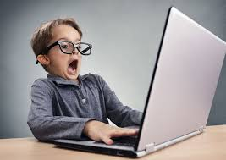
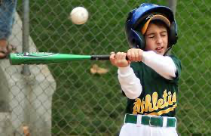
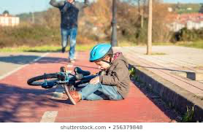
HAVE YOU EVER MADE ANY OF THESE MISTAKES WHEN YOU WERE YOUNGER?

Slide 5
DID YOU TRY AGAIN AFTER YOU MADE THESE MISTAKES? WHAT HAPPENED AFTER YOU TRIED AGAIN? DID YOU SUCCEED?

Slide 6
USE THE CHATBOX
ARE MISTAKES SOMETIMES
PART OF LEARNING?

Slide 7
WHAT DO WE USE TO LEARN?
MISTAKES ARE PART OF LEARNING IF WE FAIL WELL!
MISTAKES ARE NOT PART OF LEARNING IF WE FAIL BADLY
WHAT DOES IT MEAN TO FAIL WELL AND WHAT DOES IT MEAN TO FAIL BADLY

Slide 8
“FAILING WELL” & “FAILING BADLY”
Failing Well Failing Badly
Taking Responsibility for Failure: Blaming Blaming Others or Circumstances:
No One Else for Your Failure Not taking Responsibility for
Failure:
Learning Valuable Lessons Not Learning Valuable Lessons
From Failure From Failure: Repeating the
Same Mistake Over and Over
Having a Positive Attitude on Failure Having a Negative Attitude on Failure

Slide 9
LET’S SEE IF WE CAN IDENTIFY FAILING WELL AND FAILING BADLY?
LET’S TRY SOME AS A CLASS

Slide 10
REMEMBER FAILING WELL IS
Failing well means to have a positive attitude towards failing as part of learning
Take responsibility
Learn from my mistakes
I know failure is an important part of my success
I do not let setbacks keep me from accomplishing my goals

Slide 11
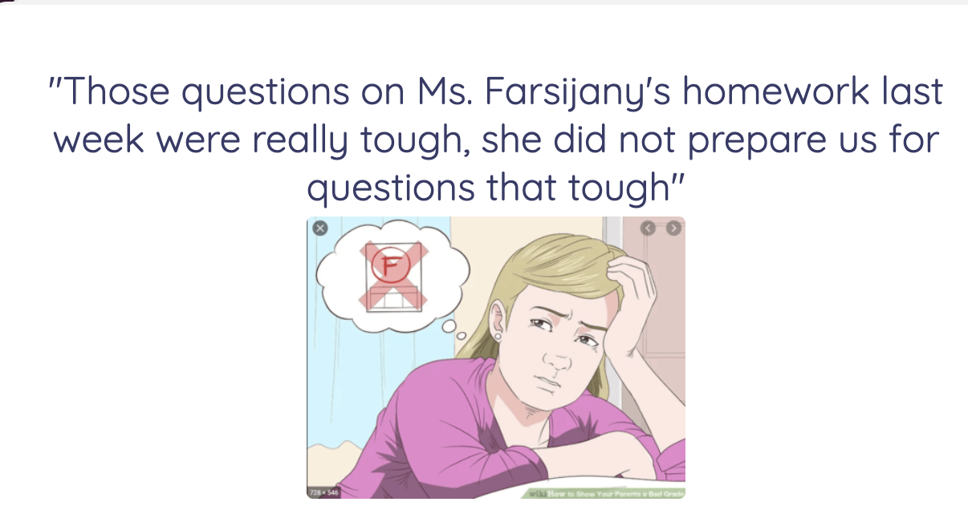
FAILING WELL OR FAILING BADLY? WHY?
WRITE YOUR ANSWER IN THE CHAT BOX

Slide 12
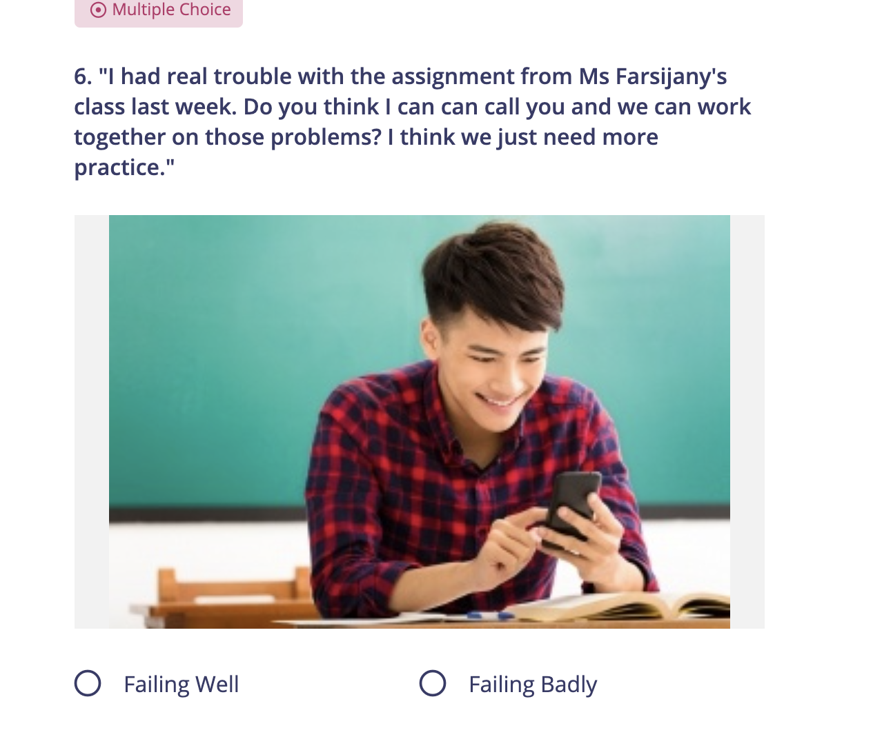
FAILING WELL OR FAILING BADLY? WHY?

Slide 13
FAILING WELL OR FAILING BADLY? WHY?

Slide 14
FAILING WELL OR FAILING BADLY? WHY?

Slide 15
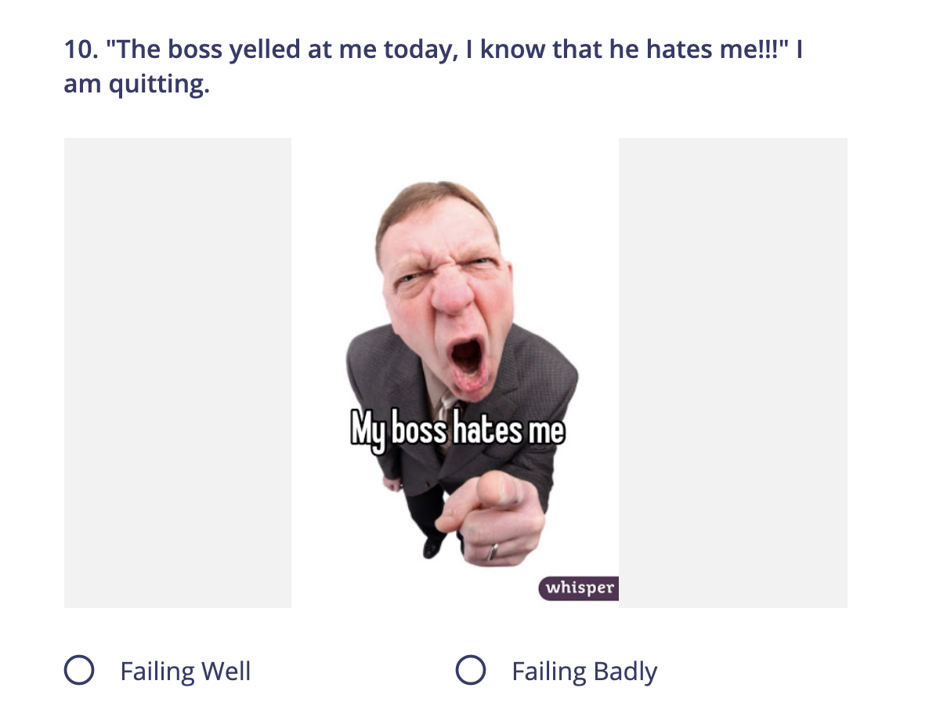
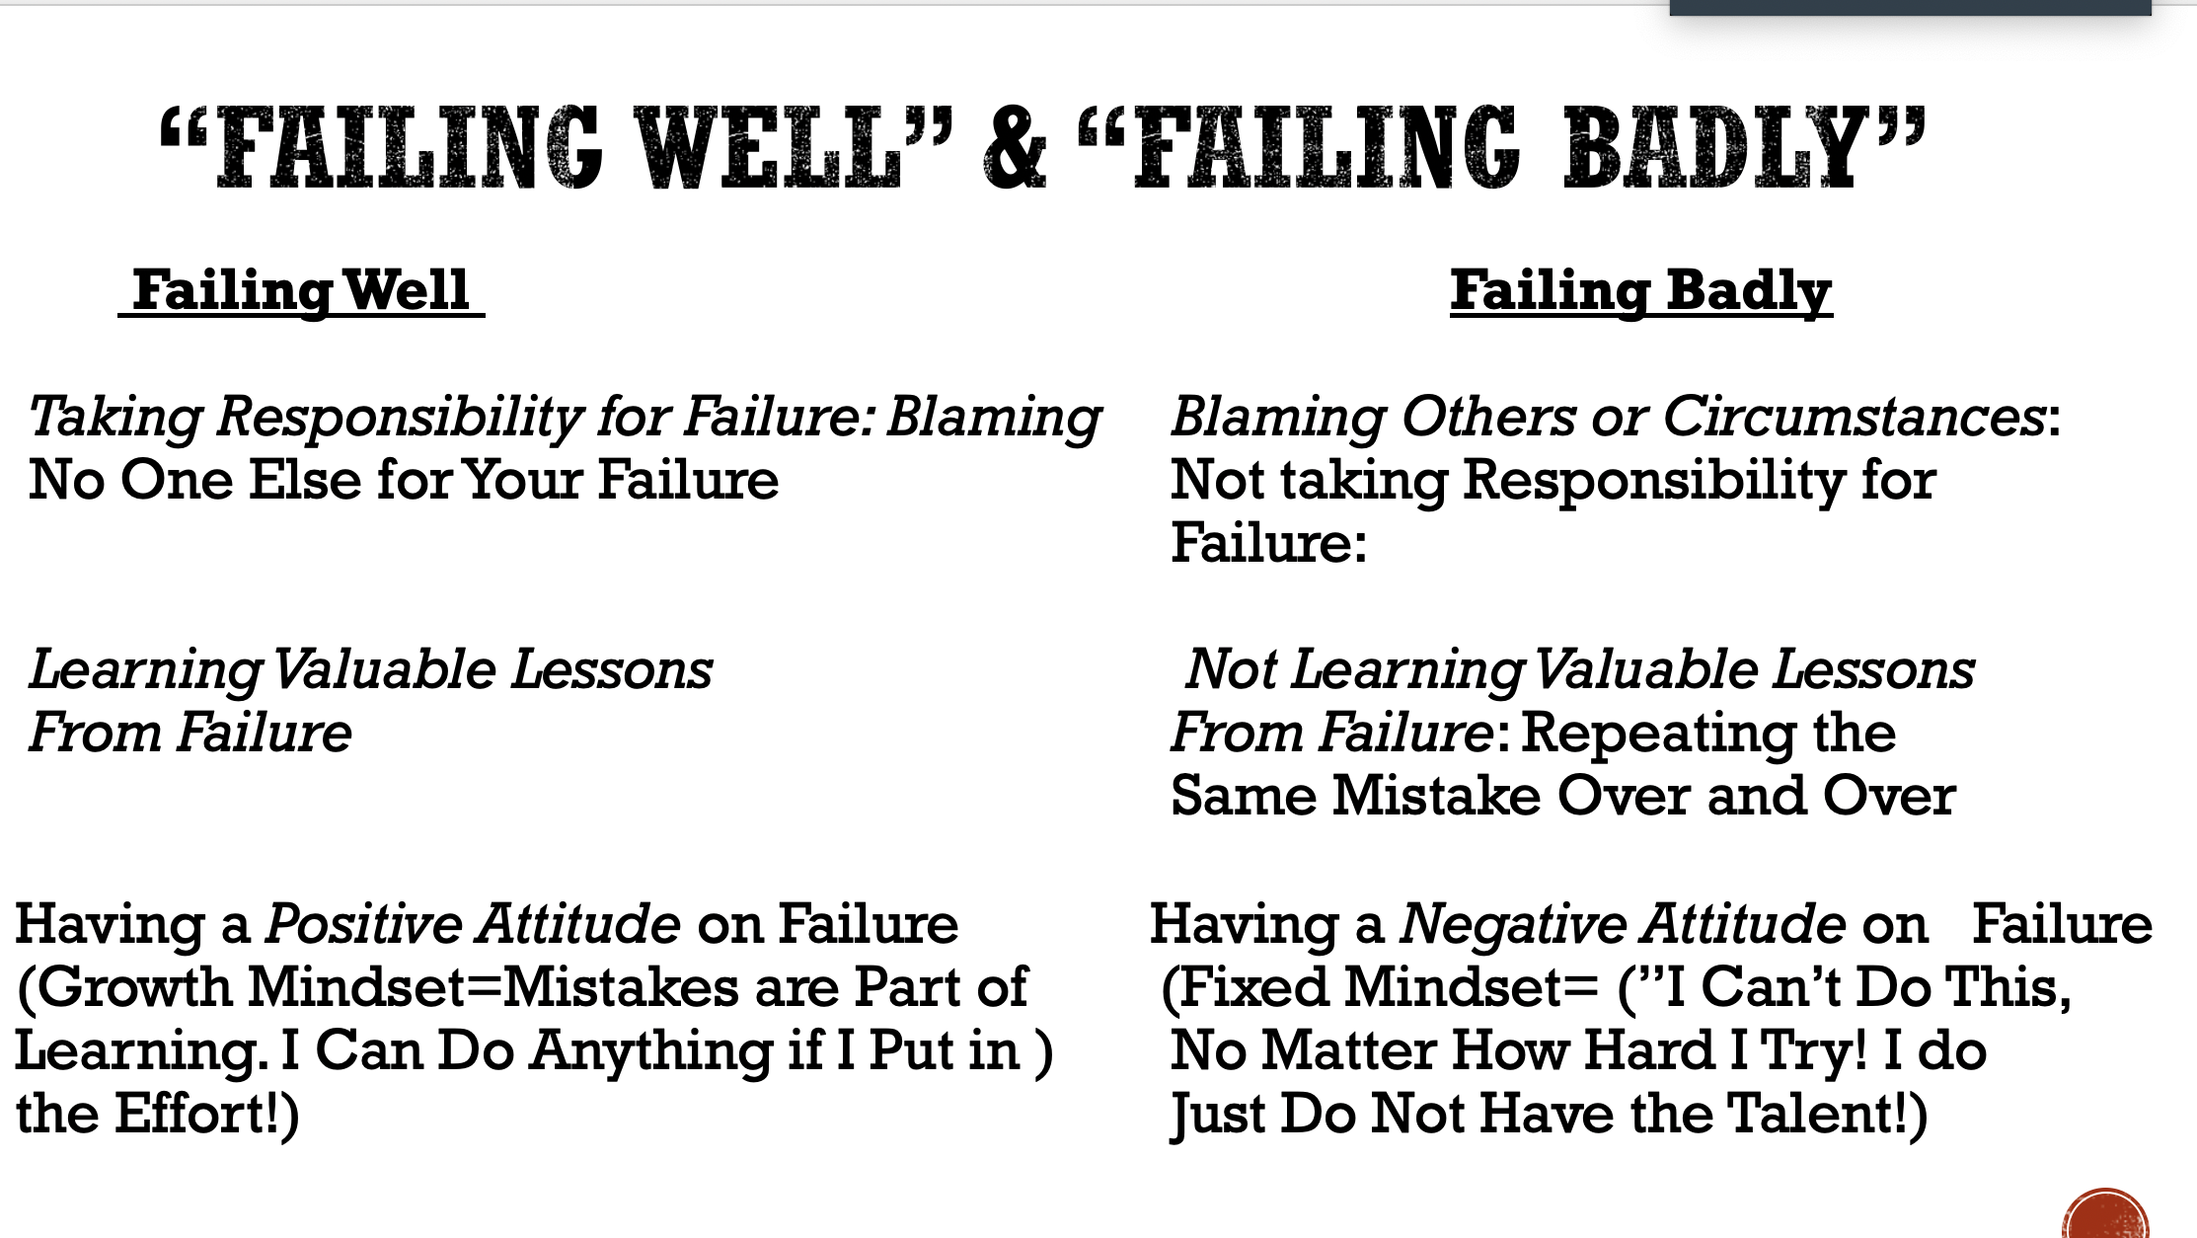

Slide 16
ATTENDANCE CHECK IN
When you hear your name, please type it into the chat box to show you are present.

Slide 17
Growth Mindset Mystery for Homework:
Due this Thursday
Click on the picture and click on play to enjoy this fun Quizizz* and see how well you understand the difference between failing well and failing badly!
*Quizizz is an online site that has self-paced, interactive quizzes to review, assess, and engage students—in class and at home.

Slide 18
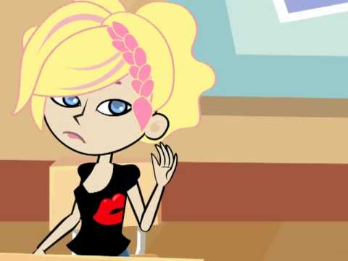
Click on the photo to watch the video!
WHY IS THIS GIRL AFRAID TO ANSWER THE QUESTION IN CLASS?

Slide 19
THE GIRL WHO NEVER
MADE MISTAKES
WHAT DO WE THINK THIS BOOK IS ABOUT?
USE CHAT BOX

Slide 20
MAKING PREDICTIONS
Who do we think this book is about?
What does it look like she is doing in this picture?
What does the title mean?
What colors does the illustrator use?
Do you think it was a good thing that this girl never made mistakes?

Slide 21
THE GIRL WHO NEVER
MADE MISTAKES

Slide 22
ABOUT BEATRICE
Who is our main character?
Beatrice
Why is Beatrice afraid to make mistakes?
She didn’t want to embarrass herself.
What did Beatrice learn from her mistake?
Beatrice learned it’s okay to make mistakes

Slide 23
ABOUT BEATRICE
Who is our main character?
Beatrice
Why is Beatrice afraid to make mistakes?
She didn’t want to embarrass herself.
What did Beatrice learn from her mistake?
Beatrice learned it’s okay to make mistakes

Slide 24
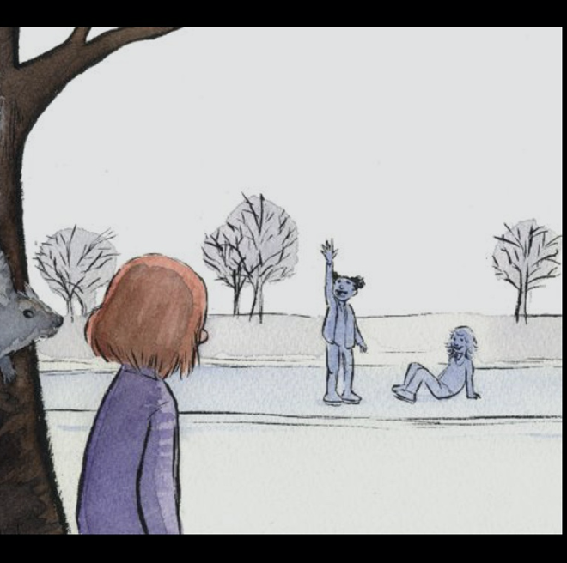
WHY DOESN’T BEATRICE GO ICE SKATING AT THE BEGINNING OF THE BOOK?

Slide 25
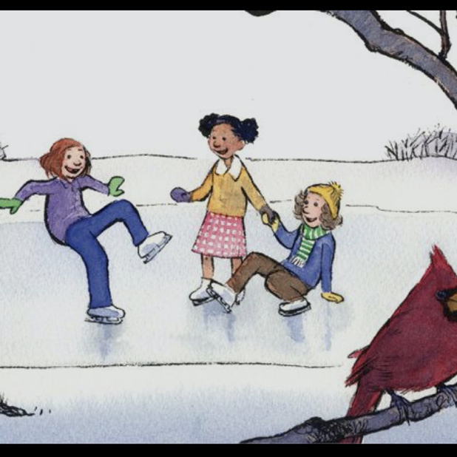
WHY DID SHE CHANGE HER MIND AT THE END OF THE BOOK?

Slide 26
NATURE OF COLLEGE
DOING WORK AFTER CLASS IS YOUR CHANCE TO DEMONSTRATE WHAT YOU HAVE LEARNED!
NOT A JUDGEMENT ON YOU
BUT
FEEDBACK ON LEARNING FOR US
GETTING HOMEWORK
TO FOLLOW UP CLASS INSTRUCTION
IS A KEY PART OF COLLEGE

Slide 27
LET’S FIND OUT MORE
How did making a mistake change Beatrice?

Slide 28
EMAIL RESPONSES
MAKING A MISTAKE CHANGED BEATRICE…
She was happier
She didn’t need to worry about making mistakes
She realized it was okay to make mistakes.
She realized she can learn from her mistakes
She realized that people would not judge her if she made a mistake
She was happier at the end of the book because she learned it is okay to make mistakes

Slide 29
EMAIL ETIQUETTE
Using a professional email address
Addressing the reader
Including a signature
Writing in complete sentences
Using period and comma correctly

Slide 30
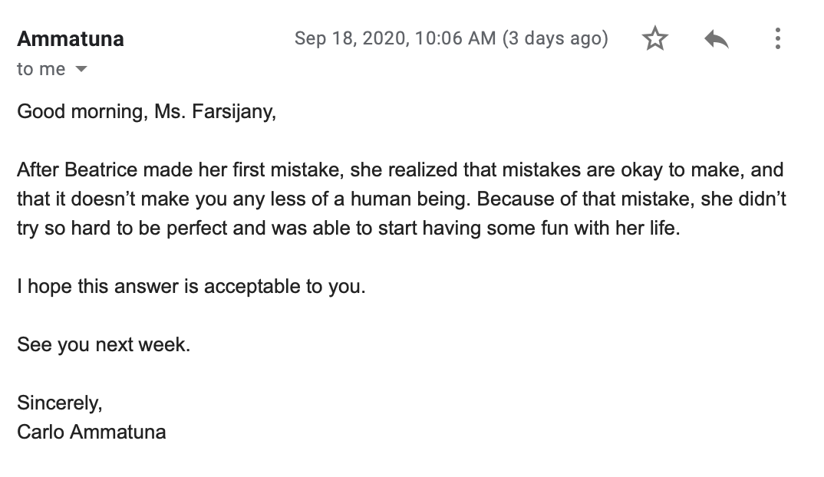
WHAT MAKES THIS A GOOD EMAIL?
Ammatuna@optonline.net

Slide 31
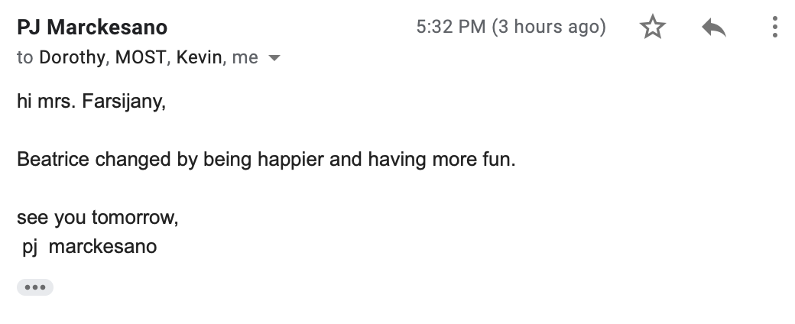
WHAT MAKES THIS A GOOD EMAIL?
Pjmarckesano6@gmail.com

Slide 32
WHAT IF WE GOT TO TALK TO THE AUTHOR?
What would you want to ask?
Use chat box

Slide 33
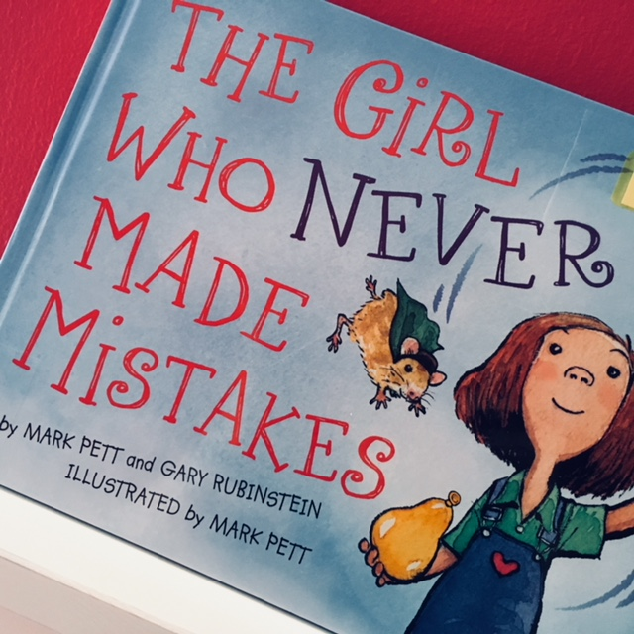
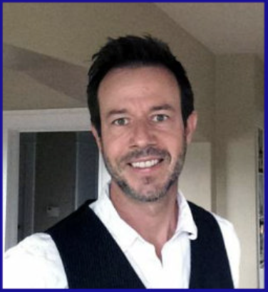
MEETING MR. PETT:
The “authorstrator”

Slide 34
QUESTIONS FOR MR. PETT
YOUR QUESTION FOR THE AUTHOR
What inspired you to write this story? Joe, Beth
Do you have any children? –Sean
How long did it take you to write this book? - Jenna
Do you know someone who never makes mistakes? – Sandy
Where did you go to school? –Jake
When did you write this book? –Britt
What made you have Beatrice juggle a balloon, hamster and saltshaker as her talent? –PJ
Where did you come up with the name Beatrice? –Julia
Do you have any siblings? –Connor
Any advice to someone trying to be too perfect? -Carlo

Slide 35
INTERVIEW ETIQUETTE
Ask question, and wait…
Follow up with a comment or question
Saying thank you after your question is answered
Dress to impress

Slide 36
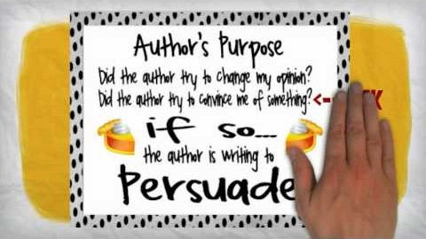
WHY DOES AN AUTHOR WRITE ANYTHING?????

Slide 37
PURPOSE: LET’S INVESTIGATE WHY AN AUTHOR WRITES…
1. Persuade
Did the author try to change my opinion?
2. Inform
Did the author try to teach me something?
3. Entertain
Did the author try to tell me a story?
This Photo by Unknown Author is licensed under CC BY-NC-ND

Slide 38
LET’S TURN AND TALK AGAIN!
Persuade
Then…..
Predict how Mark Pett might finish this sentence:
I wrote The Girl Who Never Made Mistakes to…………….
Inform
Entertain

Slide 39
VOTE RESULTS
Who presented the best argument for Persuade?
Who presented the best argument for Inform?
Who presented the best argument for Entertain?
To Persuade =
To Inform =
To Entertain =

Slide 40
What does our class think?
Then……
Vote
Persuade Why?
Inform Why?
Entertain Why?
Use your Chat Box!

Slide 41
ATTENDANCE CHECK IN/ REHEARSAL FOR INTERVIEW
When you hear your name, please type it into the chat box to show you are present.

Slide 42
TODAY OUR SCHEDULE IS DIFFERENT, WE WILL FIRST REVIEW THE ORDER OF OUR QUESTIONS…
MARK PETT

Slide 43
THE MOST PROGRAM PRESENTS
MARK PETT
AUTHOR/ILLUSTRATOR
THE GIRL WHO NEVER MADE MISTAKES

Slide 44
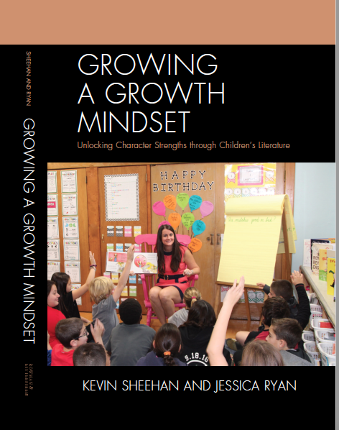
HOW I MET MR. PETT AND BEATRICE!

Slide 45
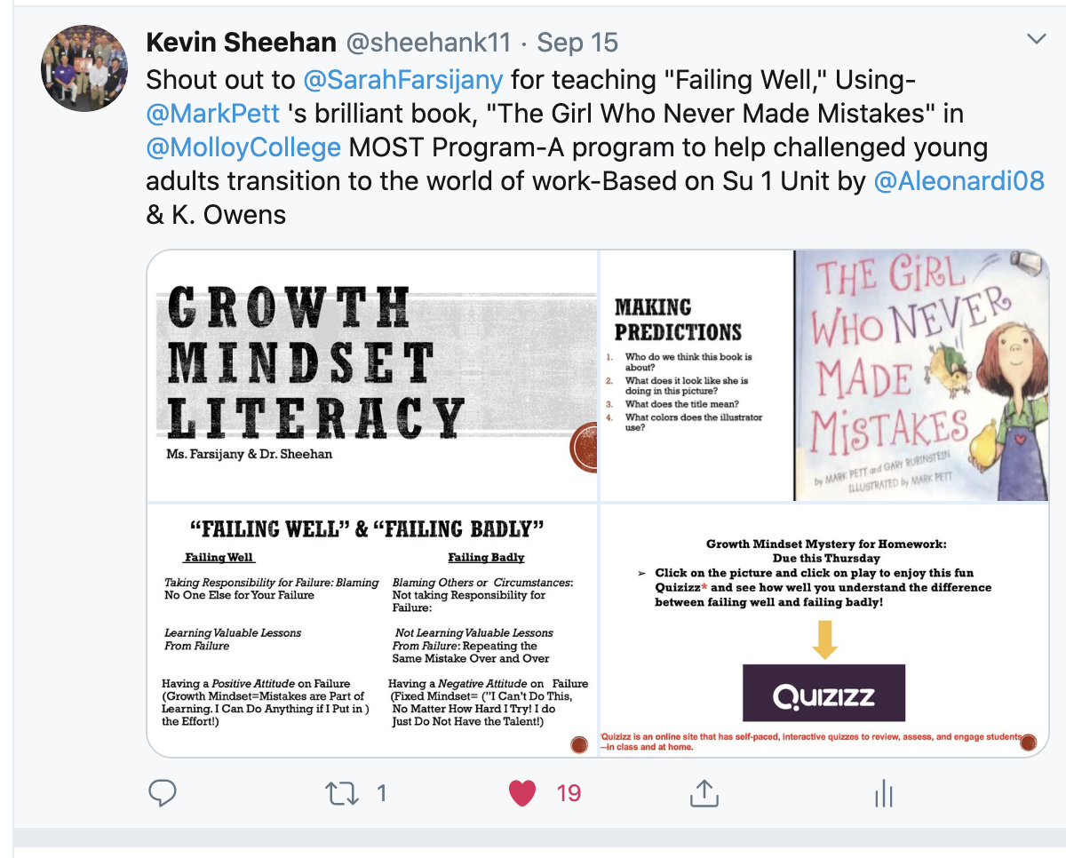
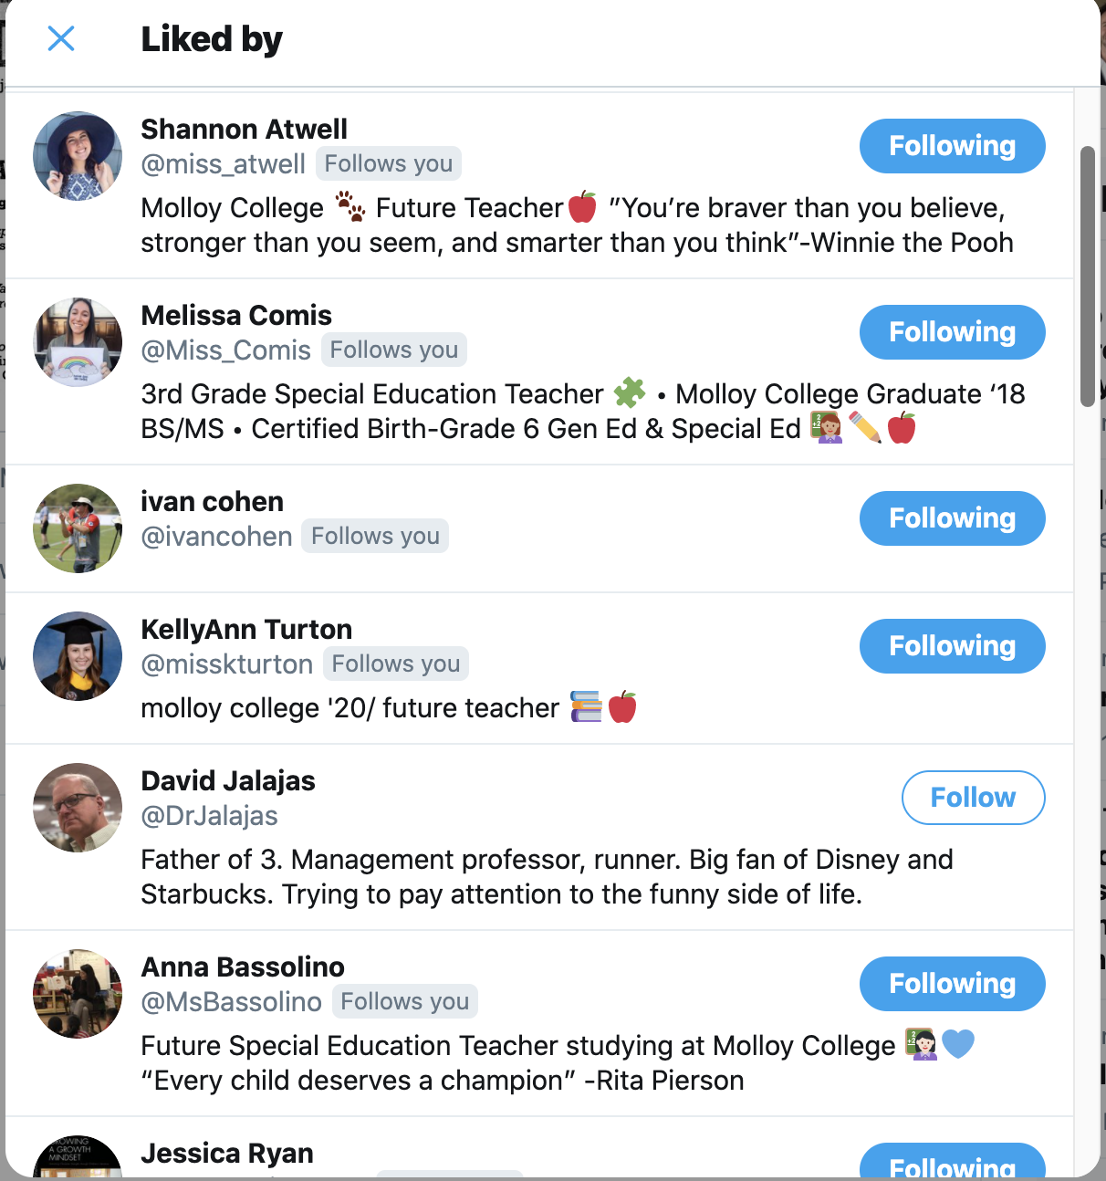
I ASKED ON TWITTER, WHAT ARE THE BEST BOOKS TO TEACH GROWTH MINDSET?

Slide 46
NOW FOR OUR QUESTIONS…
MARK PETT

Slide 47
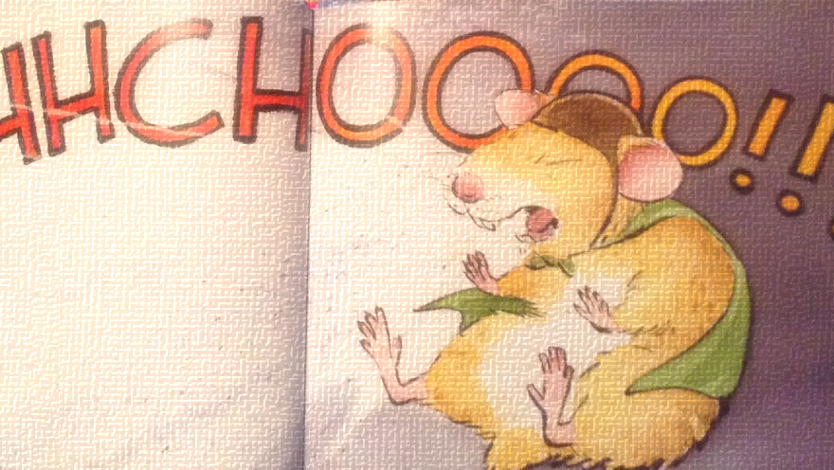
QUESTION #1
What inspired you to write this story?
-Joe & Beth

Slide 48
QUESTION #2
Do you have any children? –Sean

Slide 49
QUESTION #3
How long did it take you to write this book? - Jenna

Slide 50
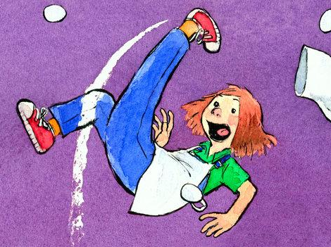
QUESTION #4
Do you know someone who never makes mistakes? -Sandy

Slide 51
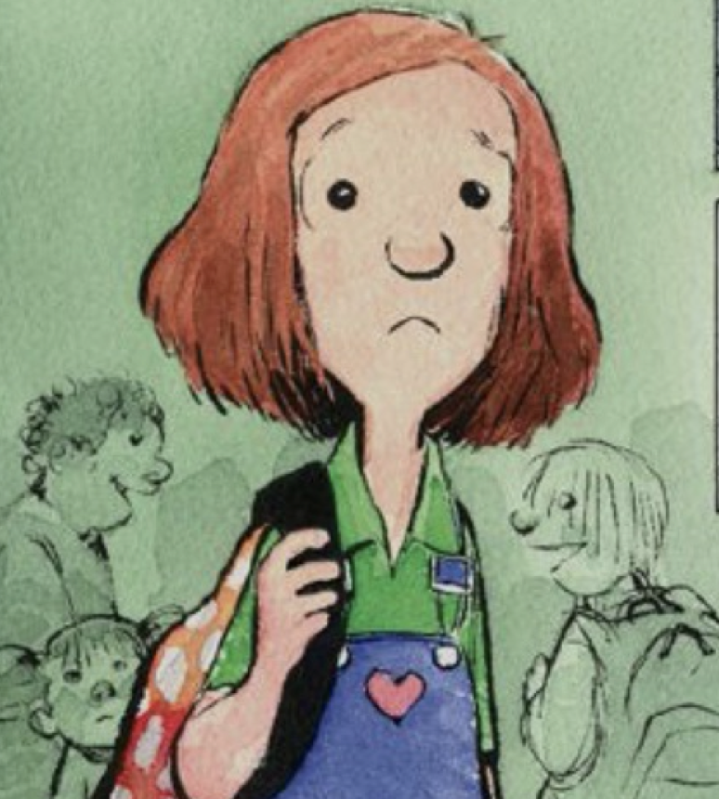
QUESTION #5
Where did you go to school?
-Jake

Slide 52
QUESTION #6
When did you write this book?
–Britt

Slide 53
QUESTION #7
What made you have Beatrice juggle a balloon, hamster and saltshaker as her talent? –PJ

Slide 54
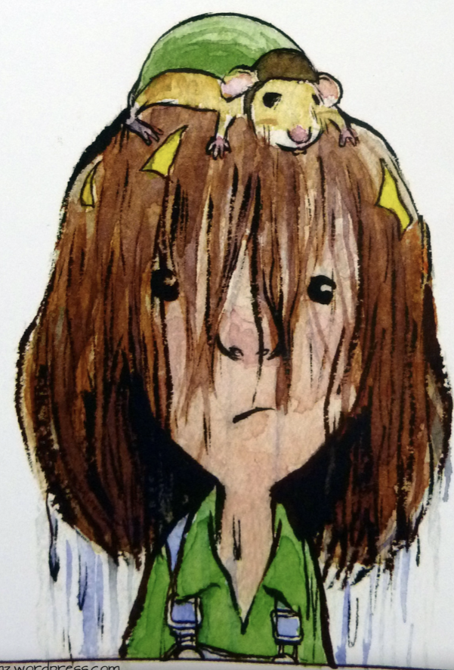
QUESTION #8
Where did you come up with the name Beatrice?
–Julia

Slide 55
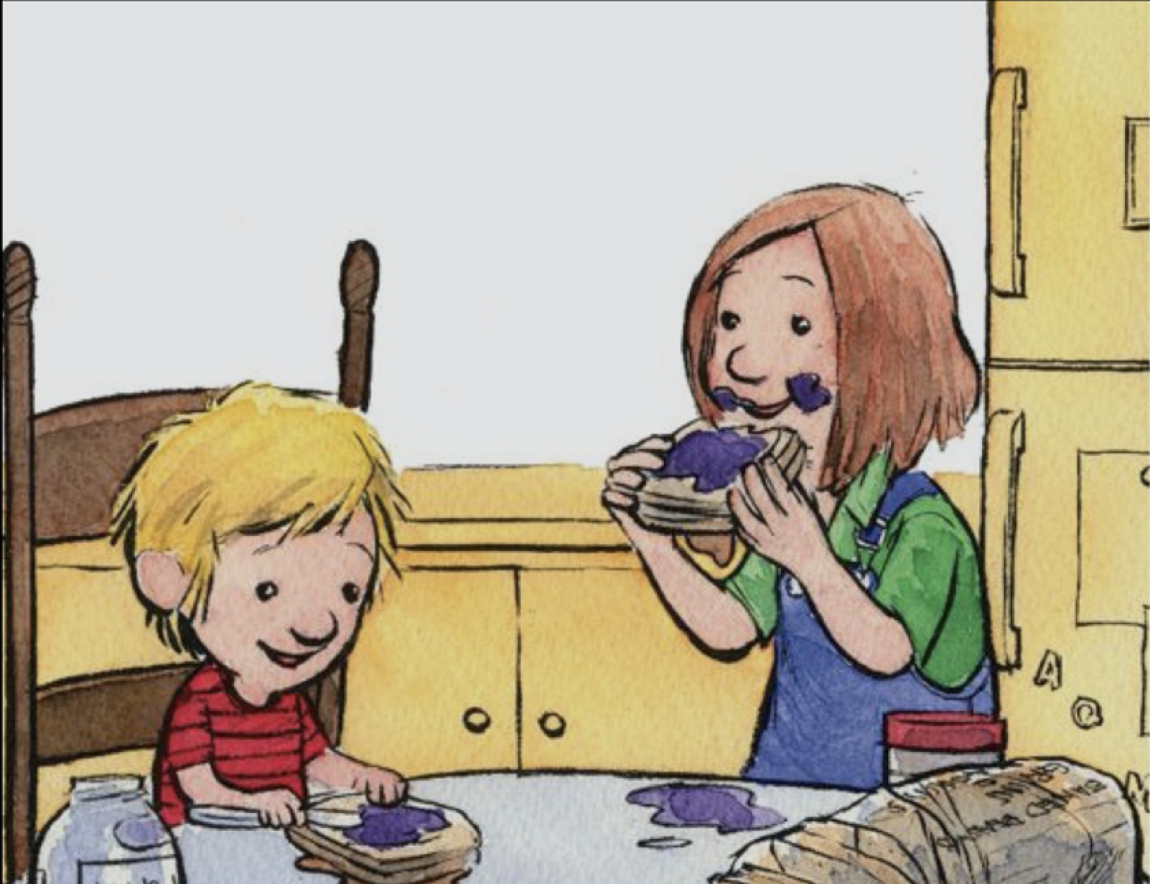
QUESTION #9
Do you have any siblings?
–Connor

Slide 56
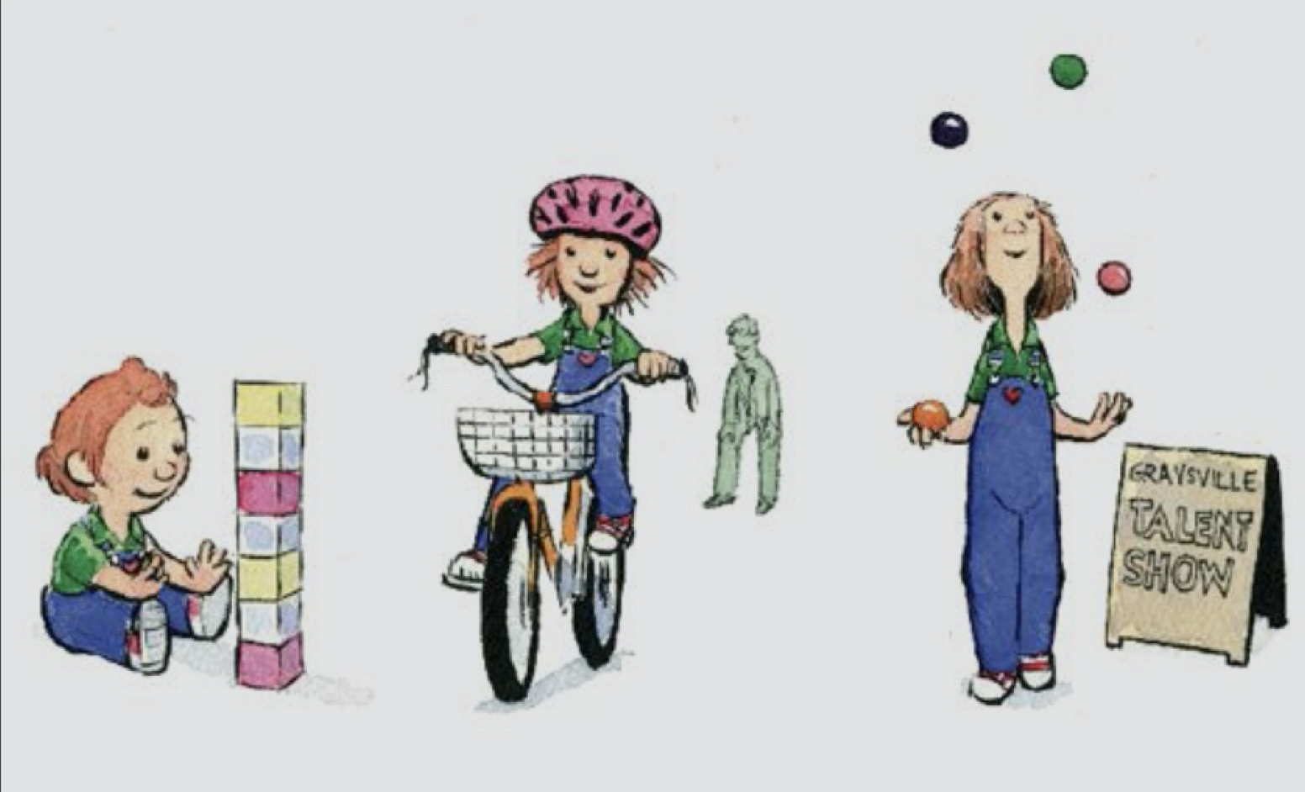
QUESTION #10
Any advice to someone trying to be too perfect? -Carlo

Slide 57
WHAT WAS YOUR PURPOSE IN WRITING THIS STORY?
Persuade
Entertain
Inform

Slide 58
THE MOST PROGRAM SINCERELY THANKS YOU
MARK PETT
WE HOPE THAT YOU WILL CONTINUE TO WRITE BOOKS THAT TEACH US SO MUCH AND THAT YOU WILL KEEP IN TOUCH WITH US IN THE FUTURE

Slide 59
FlipGrid: OUR NEWEST TOOL
A FlipGrid is a tool that will allow us as a class to communicate via video messages. We create a grid of videos to help facilitate discussions with one another.
Create a FlipGrid introducing to the class and sharing a fun fact about yourself.
Click on the Link or the Magic Green Plus Sign or the Green Link below
https://flipgrid.com/mistakes00
You will have to sign in by using a Google or Microsoft Email.
IF YOU HAVE TROUBLE, BE A BEATRICE
AND LEARN FROM YOUR MISTAKES!!!!

Slide 60
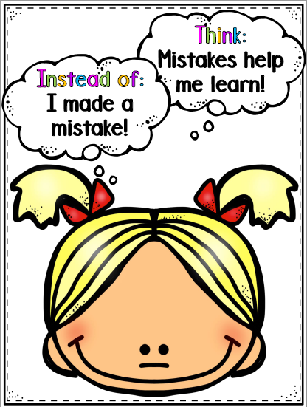
HOMEWORK: FIND A PARENT AND ASK!
Ask a parent and discuss what a mistake is and if they have ever made a mistake before.
1. Have you ever made a mistake where you
learned a valuable lesson?
Did you learn from this mistake?
Is a mistake a good thing or a bad thing?
Did you learn anything from this mistake?

Slide 61
TUESDAY CHALLENGE: FlipGrid Interview
A FlipGrid is a tool that will allow us as a class to communicate via video messages. We create a grid of videos to help facilitate discussions with one another.
CLICK ON THE GREEN PLUS SIGN TO GET TO FLIPGRID
OR CLICK ON THE LINK BELOW (HAVE TO JOIN WITH
A GOOGLE OR MICROSOFT EMAIL)
https://flipgrid.com/39f63ed6
BEFORE MONDAY, CONDUCT YOUR OWN INTERVIEW ON FlipGrid
Are Mistakes Part of Learning
Ask or interview a parent ( or guardian ) to discuss what a mistake is and if they have ever made a mistake before. Have they ever made a mistake where they learned a valuable lesson? 1. Have you ever made a mistake that you learned a valuable lesson from? What did you learn from this mistake? 2. Are mistakes a good thing or a bad thing? Are mistakes a part of learning?

Slide 62
NEXT SESSION: WHAT IS A GROWTH MINDSET?

Slide 63
ATTENDANCE CHECK IN/ How did you do on Flipgrid? Were you able post a video? How did you like it?
When you hear your name, please type it into the chat box to show you are present.

Slide 64
How did you like our interview with MARK PETT?
Share your thoughts in our chat box

Slide 65
VIDEO: FIXED VS. GROWTH MINDSET

Slide 66
“Growth Mindset” & “Fixed Mindset”
Growth Mindset Fixed Mindset
Ability is based on my Ability is based on my
Effort Inborn Ability
(With Effort, I Can Do Anything “It Cannot Be Changed”
(Why Bother Working Hard?)
Welcome Feedback/Coaching Threatened by Feedback/Coaching
Welcome Challenges Fear Challenges
See Obstacles/Mistakes as a See Obstacles/Mistakes as
Chance to Grow, Embarrassing,
A SIGNAL TO WORK HARDER A SIGNAL TO QUIT

Slide 67
DID BEATRICE HAVE A FIXED
OR GROWTH MINDSET?
CAN YOU CHANGE YOUR MINDSET?

Slide 68
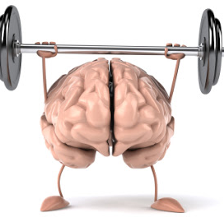
WHAT IS LIFE LIKE WHEN YOU HAVE A . GROWTH MINDSET

Slide 69
GROWTH OR FIXED MINDSET:
LET’S DO TOGETHER
Click on the picture and click on play to enjoy this fun Quizizz* and see how well you understand the difference between failing well and failing badly!
*Quizizz is an online site that has self-paced, interactive quizzes to review, assess, and engage students—in class and at home.

Slide 70
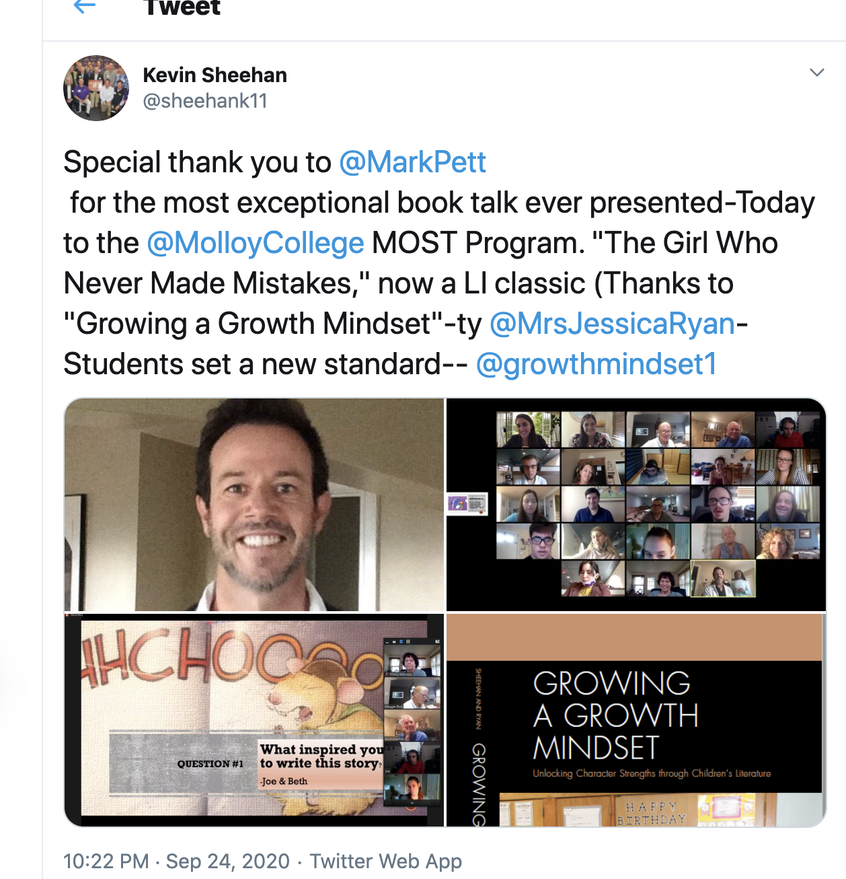
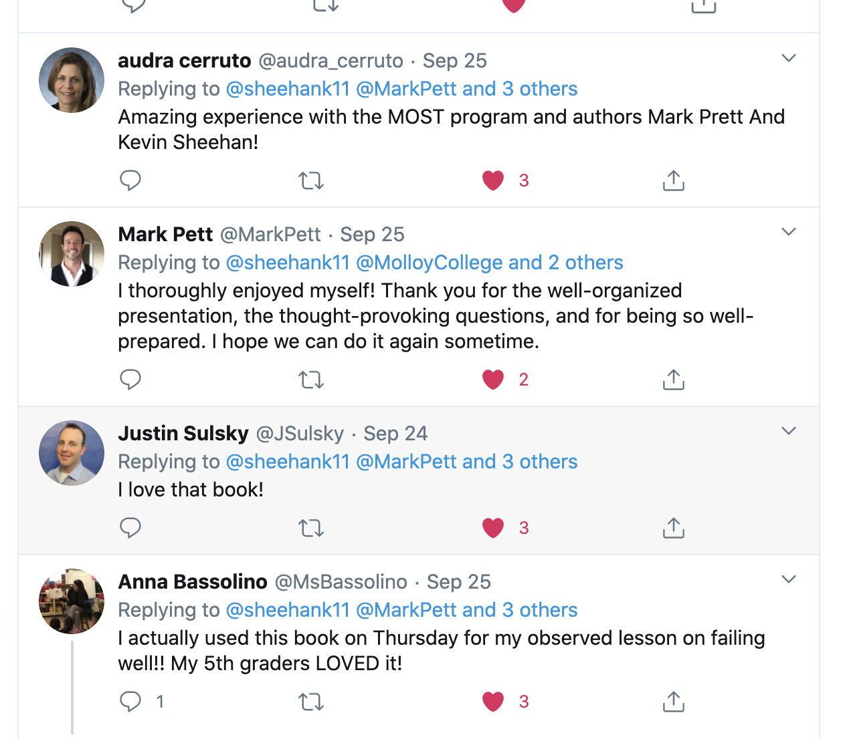
Last Week, on Twitter, you were
“What’s Trending?”

Slide 71
Let’s review Growth vs Fixed Mindsets?

Slide 72
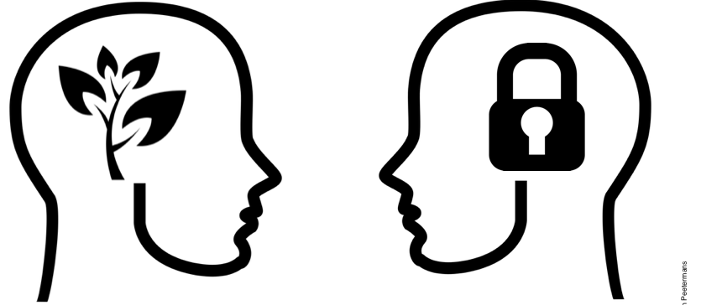
WHICH MINDSET?
LET’S GO TO THE MOVIES

Slide 73
What if you could be the interviewer: FIND A PARENT/GUARDIAN AND ASK!
Ask a parent and discuss what a mistake is and if they have ever made a mistake before.
1. Have you ever made a mistake where you
learned a valuable lesson?
Did you learn from this mistake?
Is a mistake a good thing or a bad thing?
Did you learn anything from this mistake?

Slide 74
FlipGrid: OUR NEWEST TOOL
A FlipGrid is a tool that will allow us as a class to communicate via video messages. We create a grid of videos to help facilitate discussions with one another.
Create a FlipGrid introducing to the class and sharing a fun fact about yourself.
Click on the Link or the Magic Green Plus Sign or the Green Link below
https://flipgrid.com/39f63ed6
You will have to sign in by using a Google or Microsoft Email.
This week, please film a response to one of
Your classmates!!!!

Slide 75
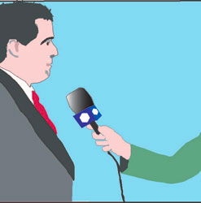
ATTENDANCE CHECK IN/ Did you like being the interviewer on Flipgrid? Would you rather be the interviewer or the interviewed?
.

Slide 76
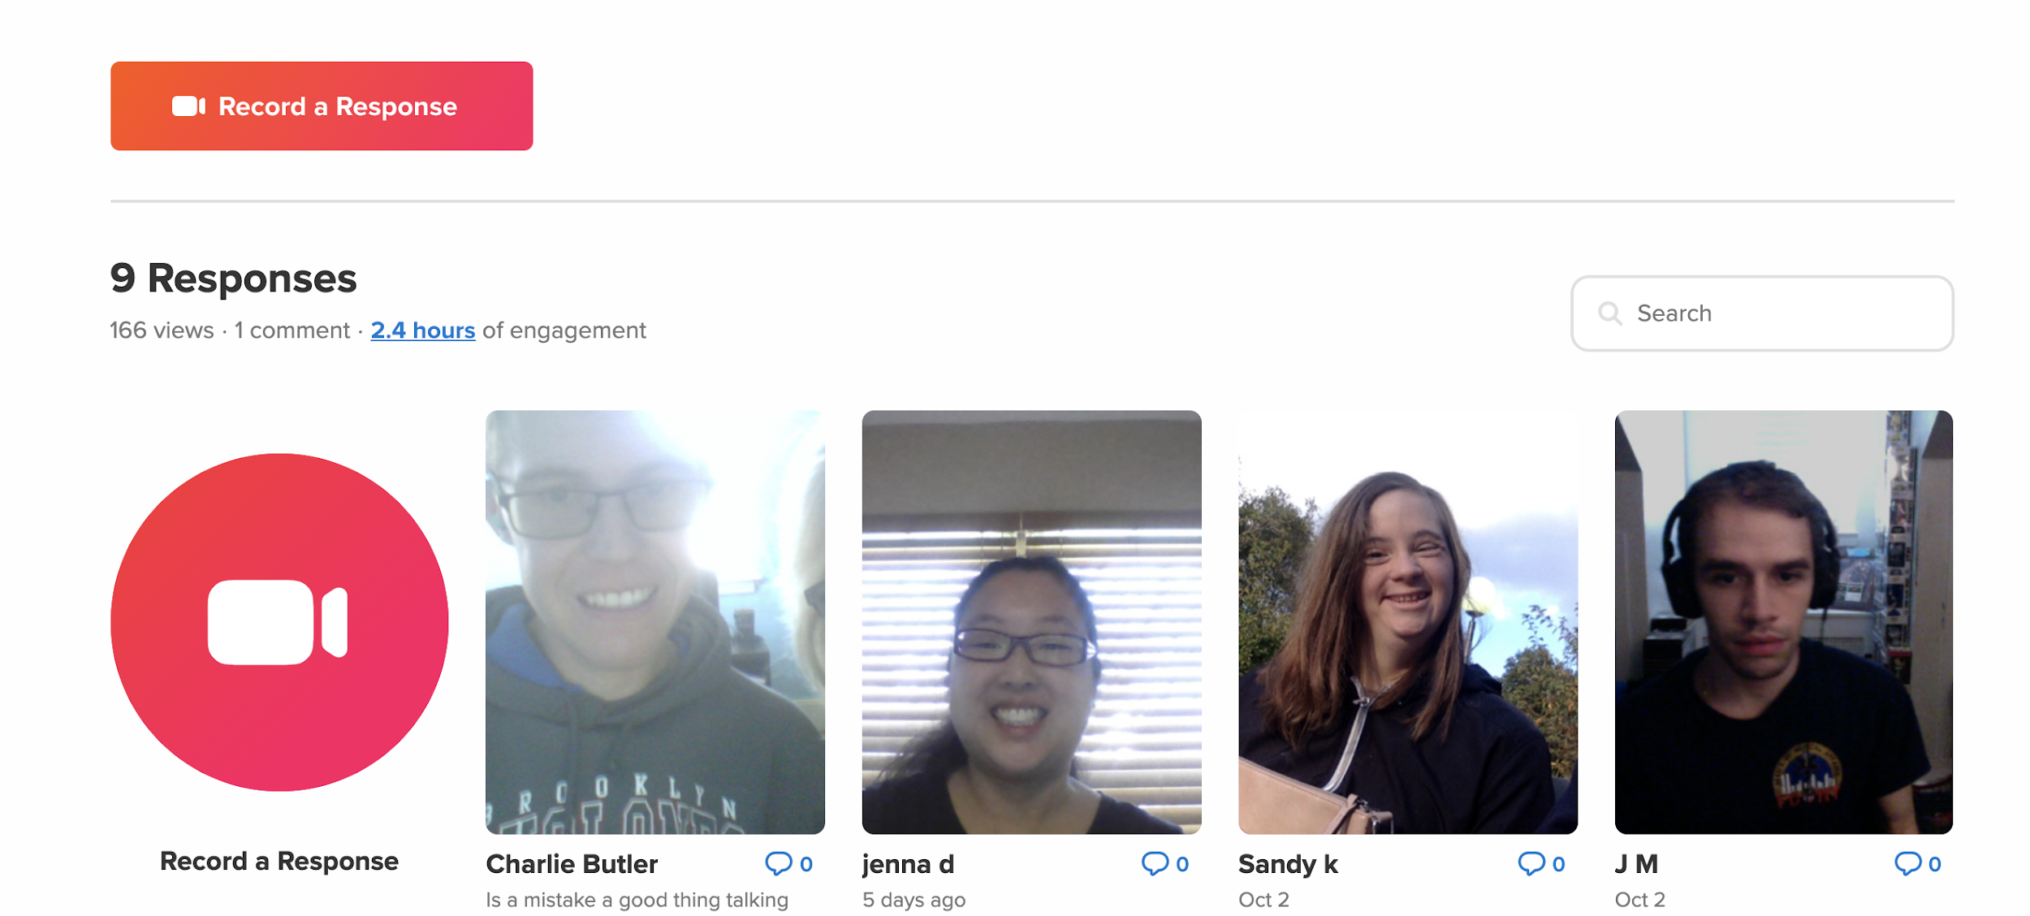
FLIPGRID FOLLOW UP

Slide 77
BEATRICE CHANGED HER BELIEFS-
SHE MOVED FROM A FIXED MINDSET TO A
GROWTH MINDSET
DO YOU THINK IT IS POSSIBLE TO MOVE FROM A GROWTH MINDSET TO A FIXED MINDSET? HOW?

Slide 78
ROSIE REVERE: ENGINEER TEXT VERSION

Slide 79
“Growth Mindset” & “Fixed Mindset”
REMEMBER OUR WORK ON GROWTH MINDSET AND BEATRICE?
Growth Mindset Fixed Mindset
Ability is based on my Ability is based on my
Effort Inborn Ability
(With Effort, I Can Do Anything “It Cannot Be Changed”
(Why Bother Working Hard?)
Welcome Feedback/Coaching Threatened by Feedback/Coaching
Welcome Challenges Fear Challenges
See Obstacles/Mistakes as a See Obstacles/Mistakes as
Chance to Grow, Embarrassing,
A SIGNAL TO WORK HARDER A SIGNAL TO QUIT

Slide 80
“Growth Mindset” & “Fixed Mindset”
THIS CHART IS NOT JUST ABOUT BEATRICE AND ROSIE
BUT IS ABOUT YOU?
Growth Mindset Fixed Mindset
Welcome Feedback/Coaching Threatened by Feedback/Coaching
Welcome Challenges Fear Challenges
See Obstacles/Mistakes as a See Obstacles/Mistakes as
Chance to Grow, Embarrassing,
A SIGNAL TO WORK HARDER A SIGNAL TO QUIT

Slide 81
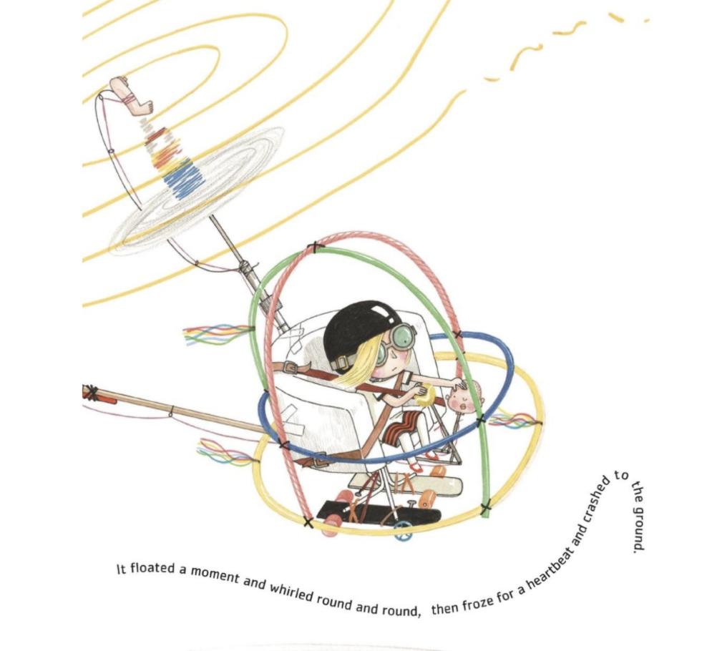
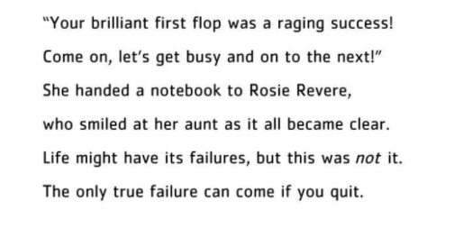
IF YOUR FLIPGRID VIDEO IF YOUR FLIPGRID VIDEO WAS GREAT, CAN NEEDED IMPROVEMENT, YOU DO EVEN BETTER? WITH FEEDBACK, CAN YOU DO EVEN BETTER?
MOVING A GROWTH MINDSET INTO YOUR LIFE

Slide 82
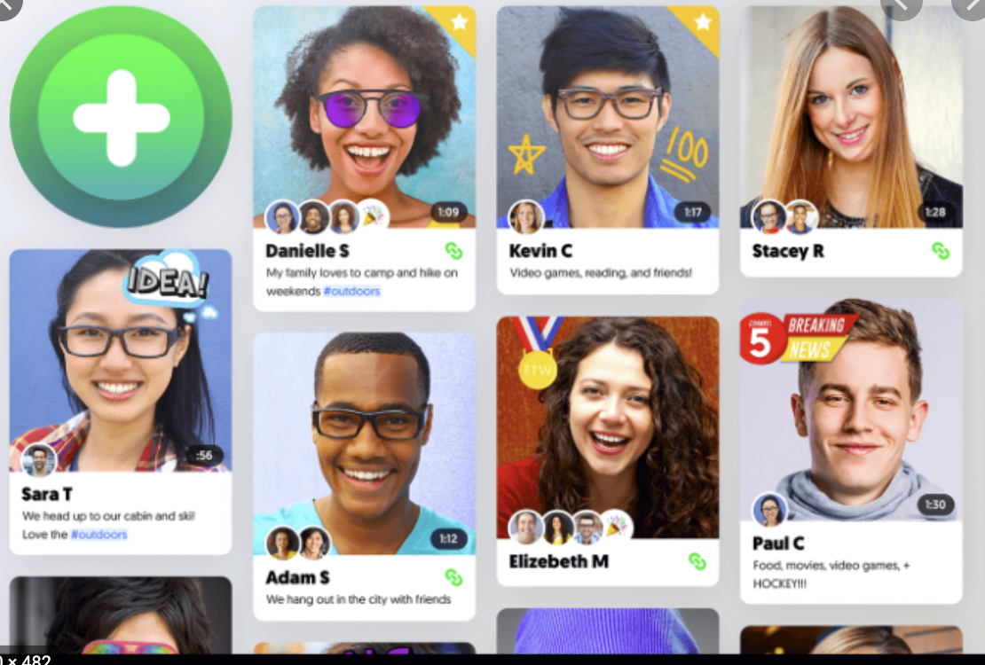
“Growth Mindset”
AFTER READING OUR STORY ON ROSIE, CAN YOU LOOK
IT YOUR FLIPGRID INTERVIEW AS A “FIRST TRY”?
Growth Mindset
Welcome Feedback/Coaching
Welcome Challenges
See Obstacles/Mistakes as a
Chance to Grow,
A SIGNAL TO WORK HARDER

Slide 83
ATTENDANCE CHECK IN/ Were you to improve your Flipgrid interview?
When you hear your name, please type it into the chat box to show you are present.

Slide 84
LOOKING OVER YOUR NEW FLIPGRIDS YOU POSTED,
IT SEEMS AS IF YOU HAVE LEARNED A LOT FROM
FROM ROSIE’S GREAT GREAT AUNT ROSE ABOUT \THE IDEA OF A FABULOUS“FIRST TRY”?
Growth Mindset
Welcome Feedback/Coaching
Welcome Challenges
See Obstacles/Mistakes as a
Chance to Grow,
A SIGNAL TO WORK HARDER

Slide 85
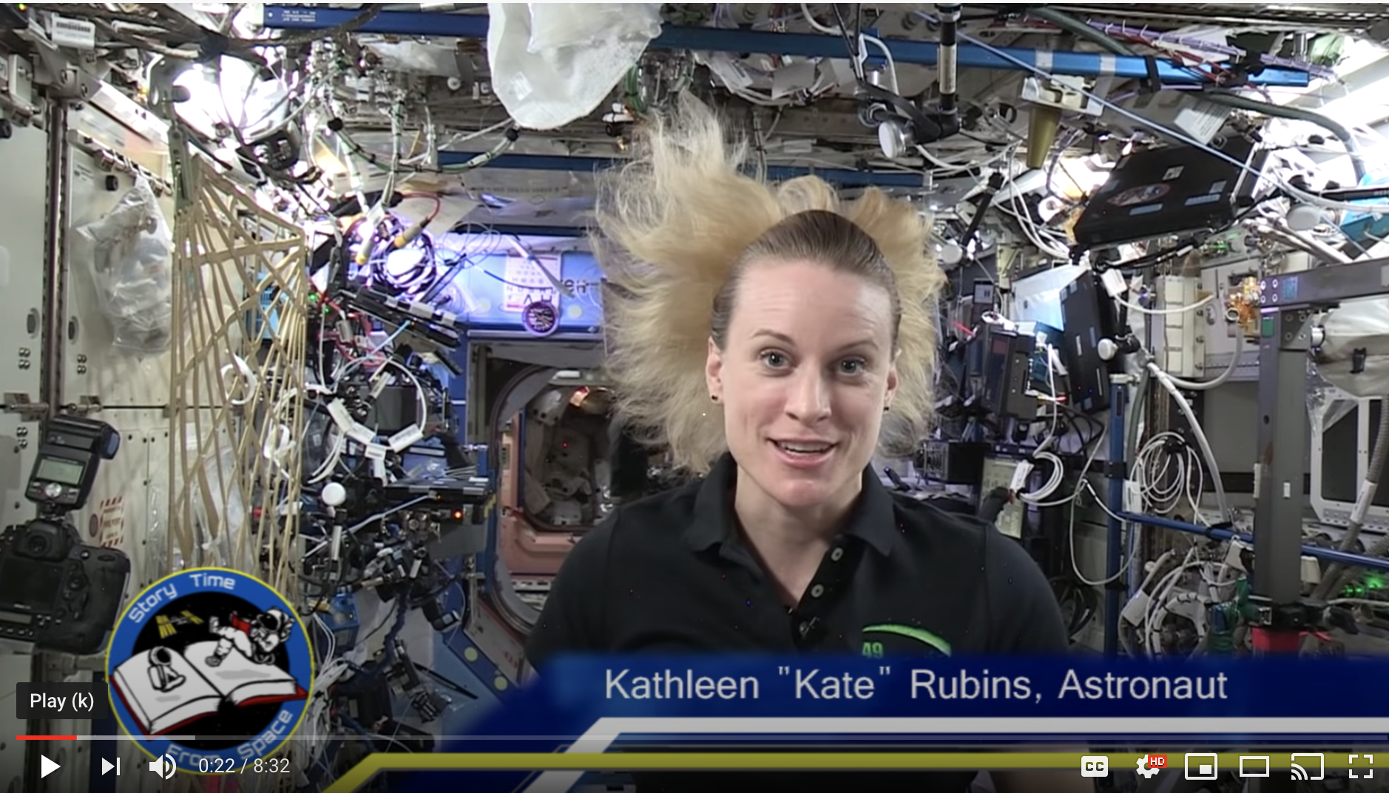
Welcome to the Space Shuttle for our Next Challenge!
Kate Rubins Will Read Our Next Story From THE Space Shuttle in Outer Space
(Click on Picture)

Slide 86
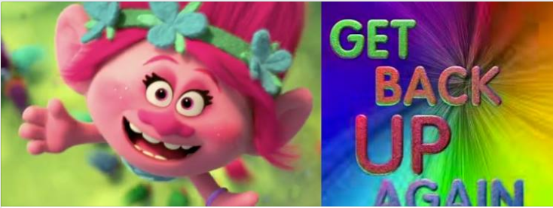
A hope creator is…
Someone who believes in you. They are kind and positive even if you fail.

Slide 87
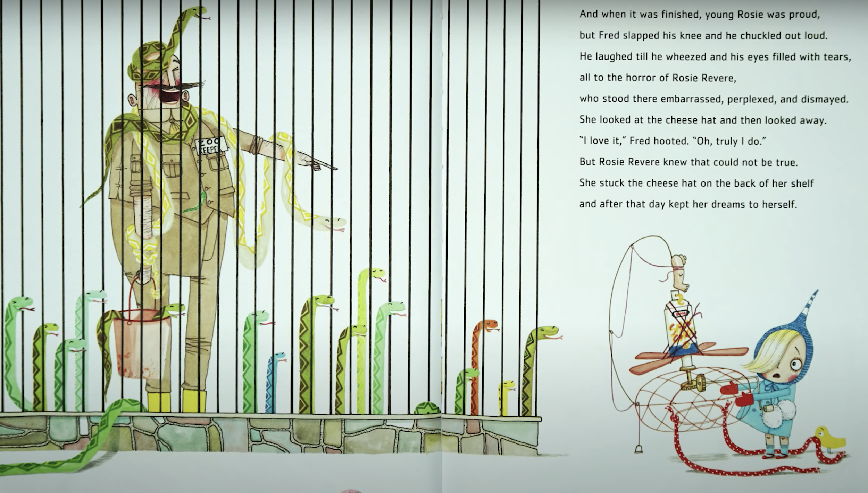
A hope crusher is…
Someone who does not believe in you and what you are capable of doing.

Slide 88
Who is the hope crusher in Rosie’s life? Who the hope creator in Rosie’s life?
Rosie’s Uncle Fred
Rosie’s Great, Great Aunt Rose.

Slide 89
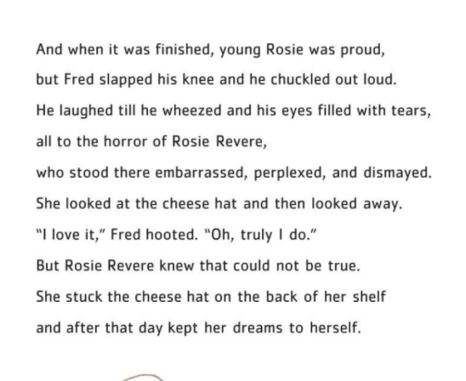
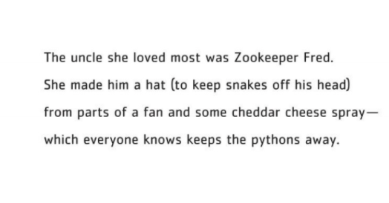
Can you find evidence in the text to support your claim that Uncle Fred is a hope crusher or hope creator? (write answer and proof in chat box)

Slide 90
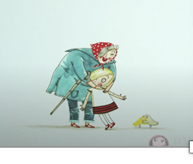
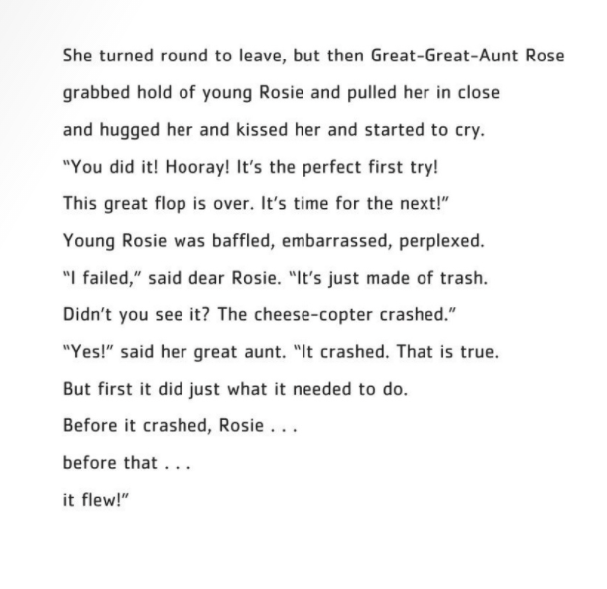
Can you find evidence in the text to support your claim that Great Aunt Rose is a hope crusher or hope creator? (write answer and proof in chat box)

Slide 91
HOPE IS ABOUT OUR BELIEFS ABOUT THE FUTURE..
Other people can affect our
beliefs about the future with
their “words.” Words matter!
Be a hope creator!

Slide 92
Do you think Uncle Fred meant to crush Rosie’s Hope?..
What do you think the author, Andrea Beatty would say about
Uncle Fred?

Slide 93
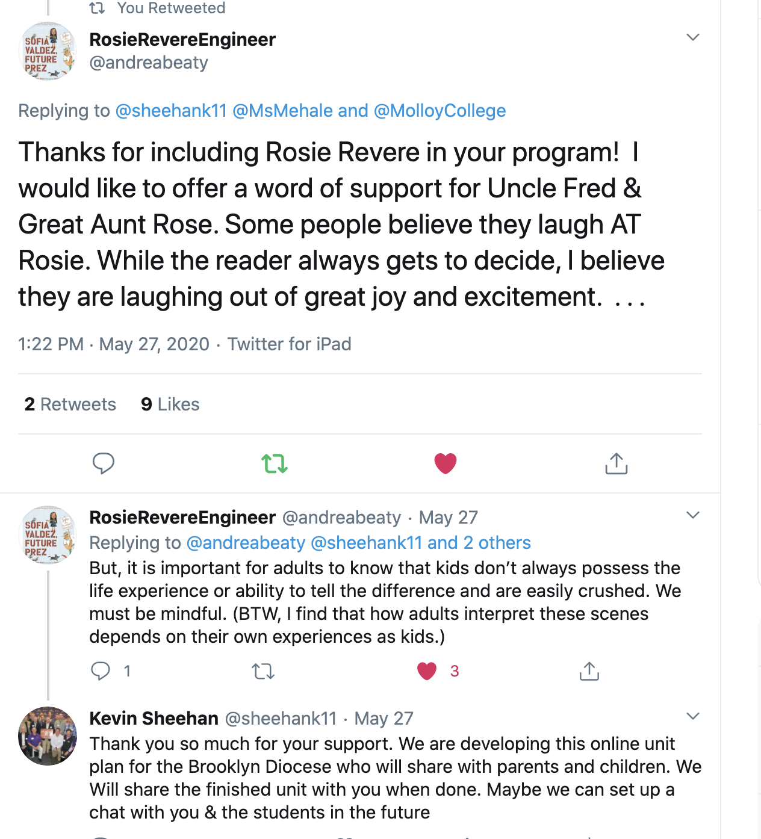

Slide 94
This is why we have to be careful with our words! We can be a hope crusher without meaning to be one.

Slide 95
QUESTIONS TO THINK ABOUT:
1. Write about a time when you were successful. Who supported you? How?
2. When was a time you thought of yourself as a failure? 3. Did anyone crush you? How?
4. Are you a Hope Creator or a Hope Crusher for yourself? word for “Hope”?

Slide 96
Discuss with a parent:
WHO IS THE MOST IMPORTANT HOPE CREATOR IN YOUR LIFE?
POST YOUR ANSWER ON’
HOPE CREATOR FLIP GRID!
CLICK HERE TO GO TO PADLET

Slide 97
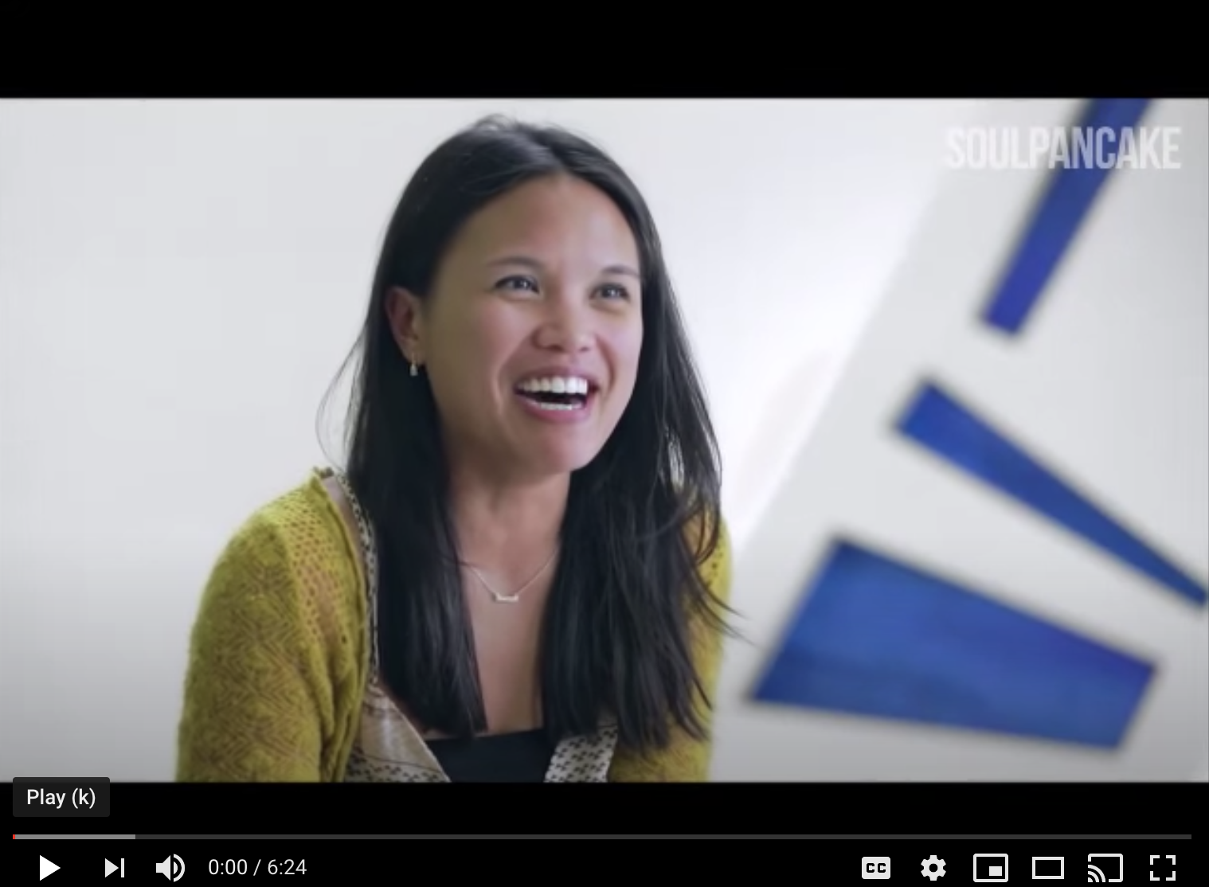
WATCH THIS VIDEO ON GRATITUDE AND HAPPINESS

Slide 98
CAN WE SEND A TEXT, LETTER, OR VIDEO TO THANK THE HOPE CREATOR IN OUR LIVES

Slide 99
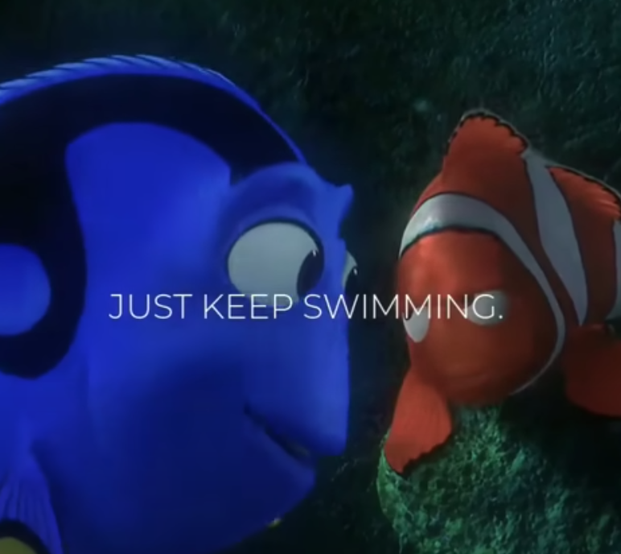
Watch this youtube video.
Discuss with a parent all of the positive self talk statements you have heard.

Slide 100
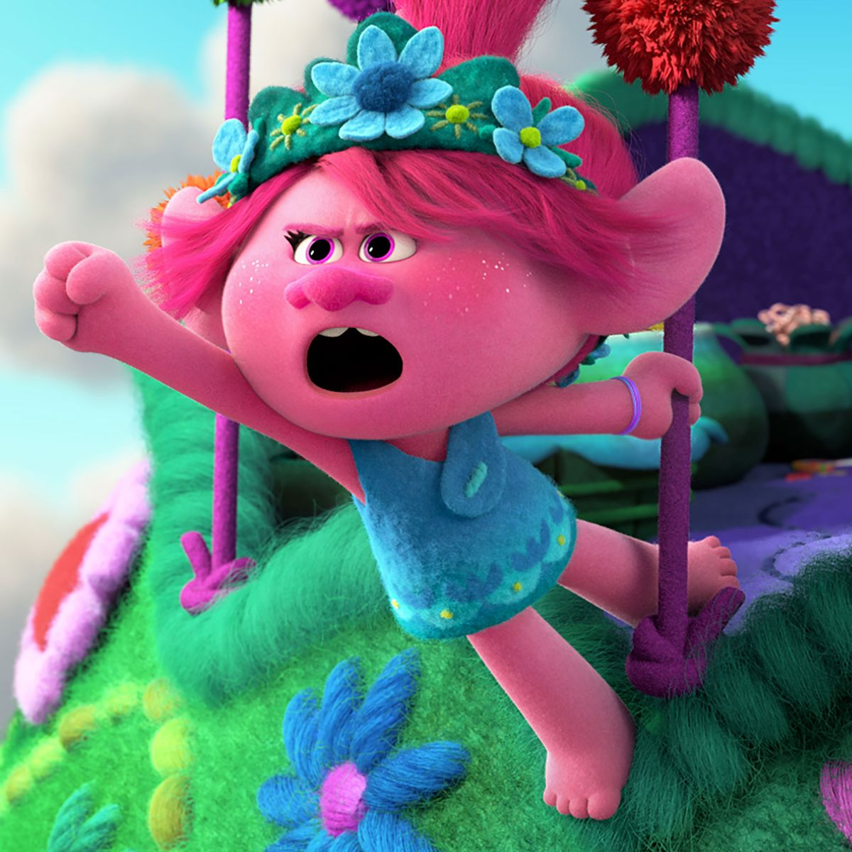
Discuss:
What did the girl in the song say to keep going? What is her positive self talk?

Slide 101
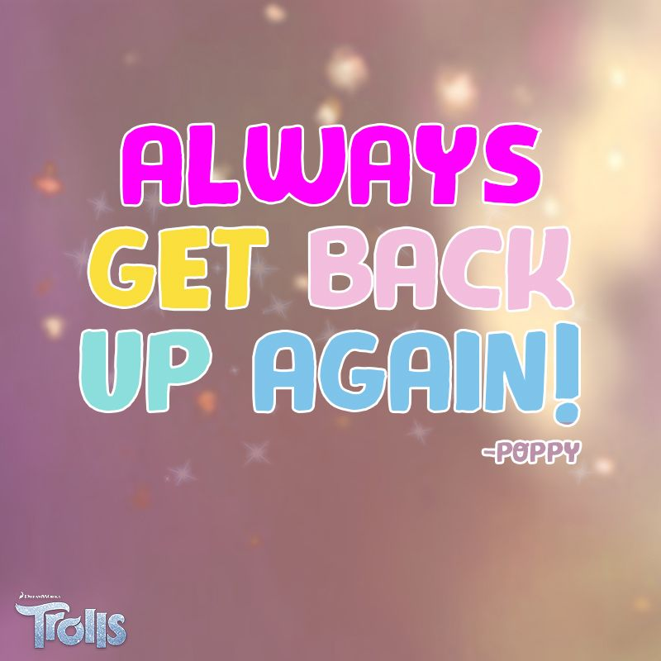
HERE ARE SOME EXAMPLES OF POSITIVE SELF TALK STATEMENT ON OUR PSOTIVE SELF TALK STATEMENT:
I ALWAYS GET UP.
I CAN DO THIS.
YOU CAN’T STOP ME.

Slide 102
WITH YOUR MENTOR OR PARENT…
CAN YOU CREATE A POSITIVE SELF TALK STATEMENT TO USE WHEN SOMEONE BRINGS YOU DOWN?
Examples are on the next slide!

Slide 103
To Motivate You...
Watch this Youtube Video called, Color Your World.
How does being kind make us feel?
Or

