Slide 1
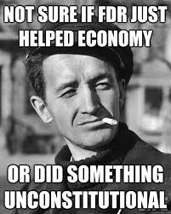
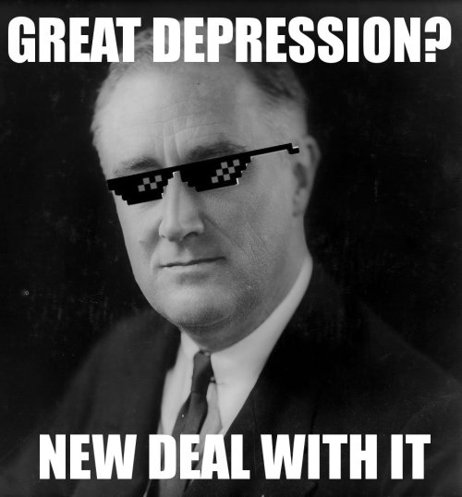
Franklin Delano Roosevelt:
Hope and Economics
Robert Sconone, Samantha Valentine,
Erin Dougan, and Dane Nordland

Slide 2
Lesson 1: Hope
“The sky takes on shades of orange during sunrise and sunset, the color that gives you hope that the sun will set only to rise again”-Ram Charan

Slide 3
C - Conversation: We will be opening the floor to discussions, thoughts and questions. All of us must remain respectful and mindful of others as they speak. When someone is speaking, you are not.
H - Help: If you have ANY questions, please raise your hand. All questions should pertain to the topic at hand and should be appropriate. Please remember to be attentive to others when they speak.
A - Activity: We will have a story worksheet to go along with the read out loud of Rosie Revere, Engineer that will follow the discussion on hope. Students will be called on to read their responses out loud and explain their thoughts and feelings.
M - Movement: Students will need to be seated during the lesson. If a student has to use the facilitates or has an emergency they must raise their hand to inform the teacher before being excused.
P - Participation: All students must be participating in the lesson. From the beginning of the lesson (be attentive to the personal story) to the taking of notes on the story worksheet.
S - Success: When students can roughly identify hope and if it was FDR’s economic policies or hope that got the US out of the great depression.

Slide 4
Does anyone know what Superman symbolizes?
As you attempt to define hope, watch the following YouTube clip regarding hope:
https://www.youtube.com/watch?v=4CFrwHXYotI

Slide 5
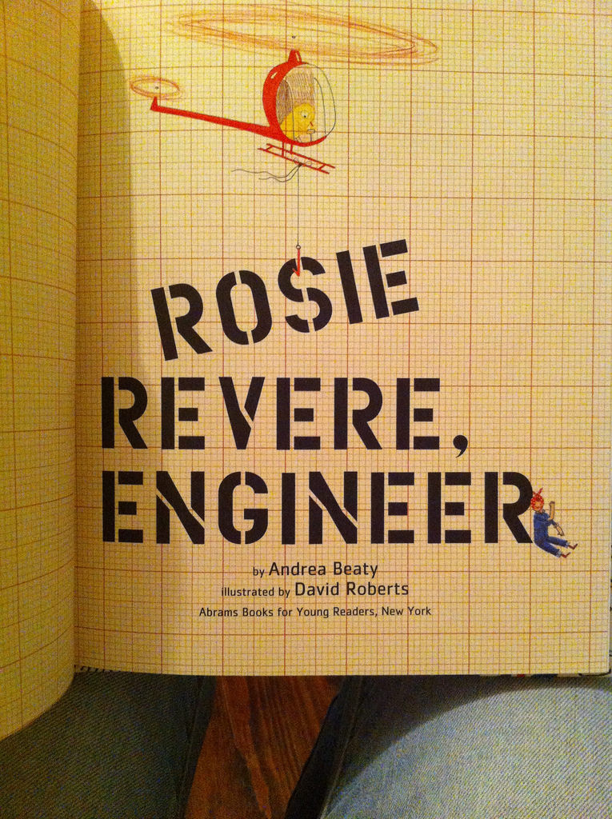
Rosie Revere, Engineer
Students will read an excerpt from the book Rosie Revere, Engineer.
After students have completed reading their excerpt, students will break into think-pair-share groups and discuss how they felt about hope and Rosie.

Slide 6
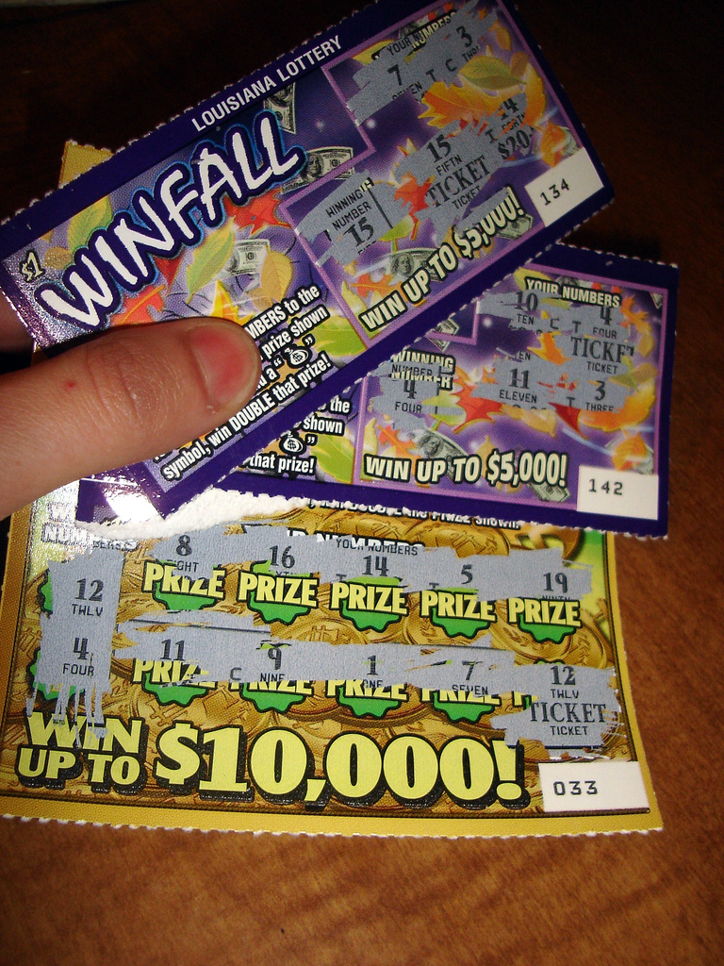
What does it mean to have hope?
Students will engage in a open conversation regarding hope. A few questions that will be answered will include:
If you have a lotto ticket, are you hoping to win or expecting to lose?
Can hope be given to you?

Slide 7
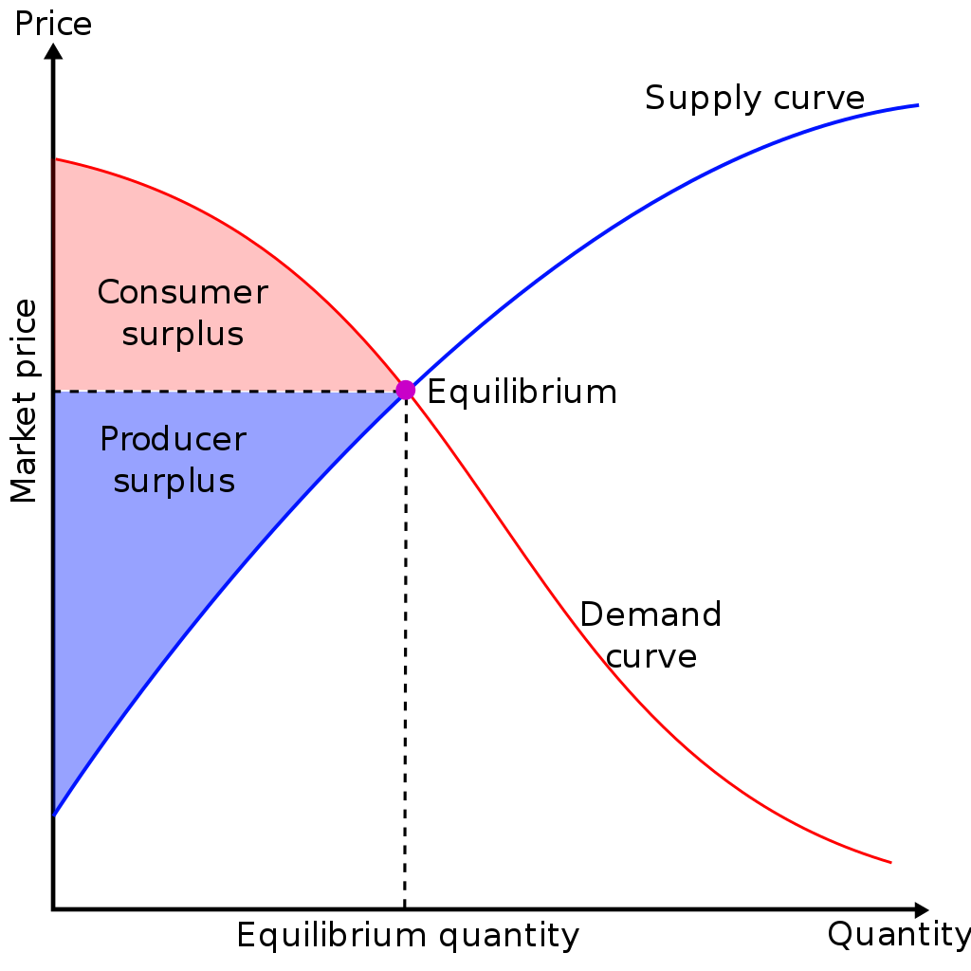
Keynesian Economics and FDR’s Economic Policies
Students will learn about Keynesian Economics and parts of the New Deal that potentially could have gotten the US out of the Great Depression. Some of the questions will be:
Could the President really borrow money from the future?
What did plans such as social security and unemployment provide for people?

Slide 8
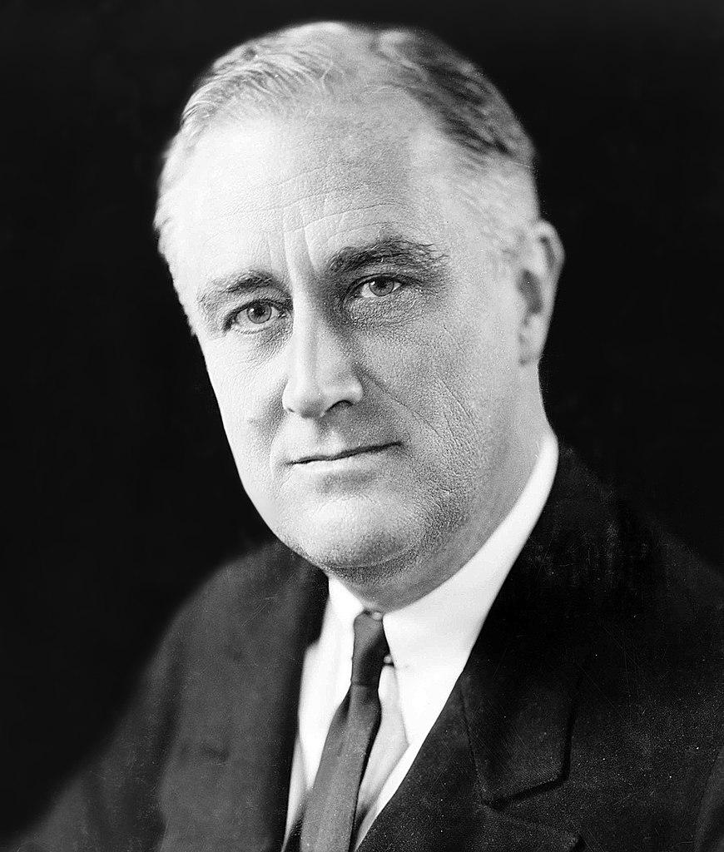
Did Franklin Roosevelt Get Us Out of The Depression by Creating Hope or Sound Economic Policy?
After students finish the multiple discussions on hope, Keynesian economics, and FDR’s economic policies, students will write a thesis statement taking a stance on how the US got out of the Great Depression. This assignment is titled “FIRST IMPRESSIONS”.

Slide 9
Lesson Two: Bus Tour of Life During the Great Depression
Todays Aim:
How were living conditions during the Great Depression?
How did living conditions change throughout your journey?

Slide 10
C.H.A.M.P.S… CHAMPS, CHAMPS CHAMPS!

Slide 12
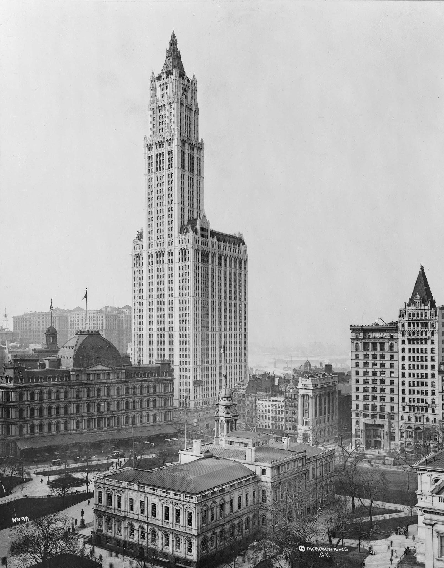
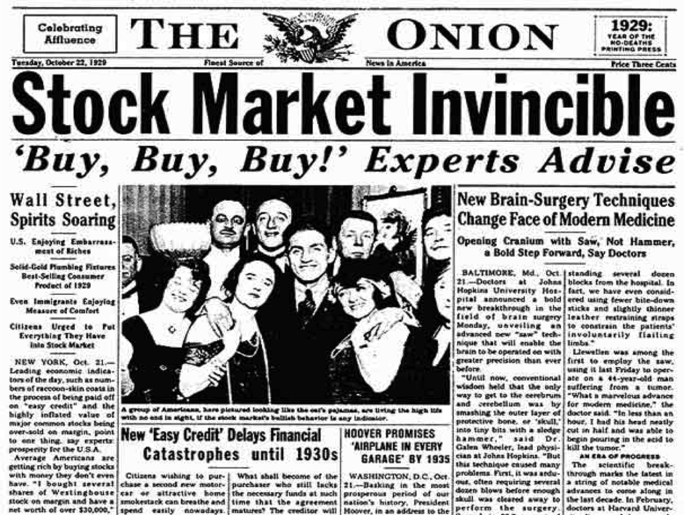
First Stop: New York City, 1929

Slide 13
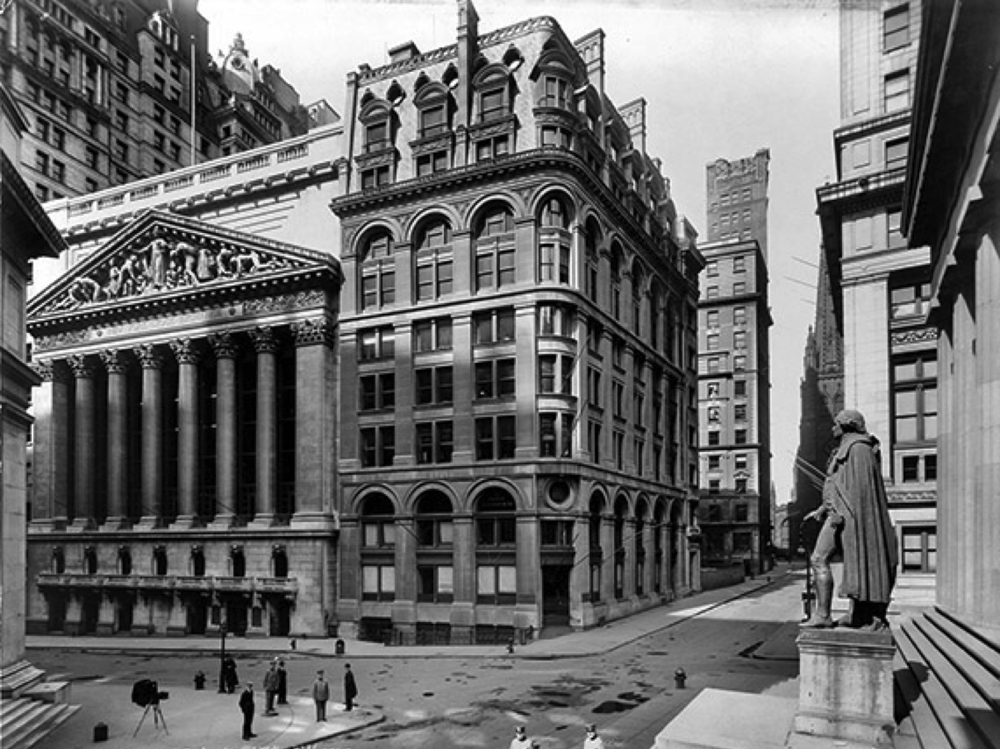
The Great Depression Begins
The Stock Market crash signaled the beginning of the Great Depression
The Great Depression is generally defined as the period from 1929 – 1940 in which the economy plummeted and unemployment skyrocketed

Slide 14
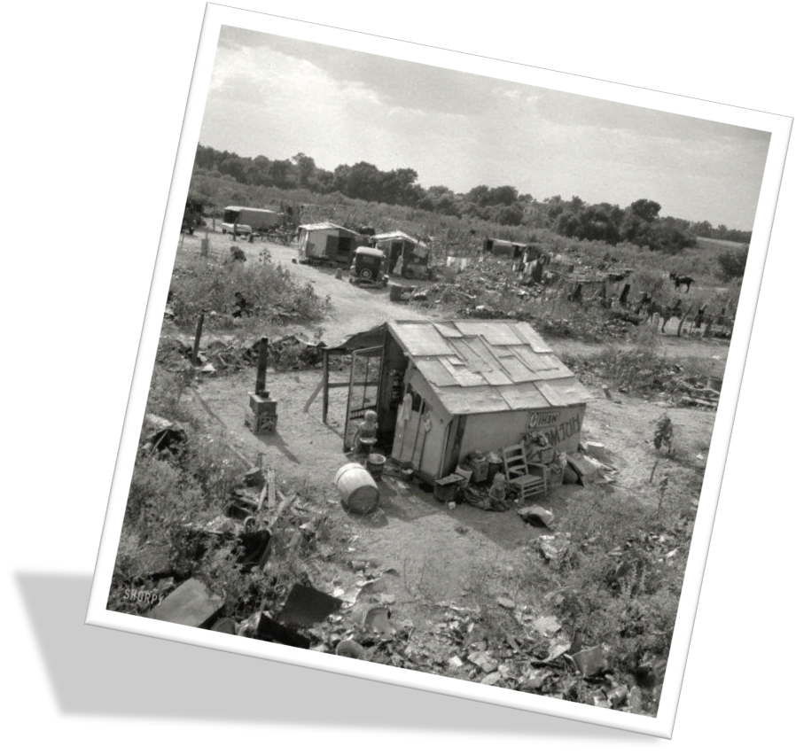
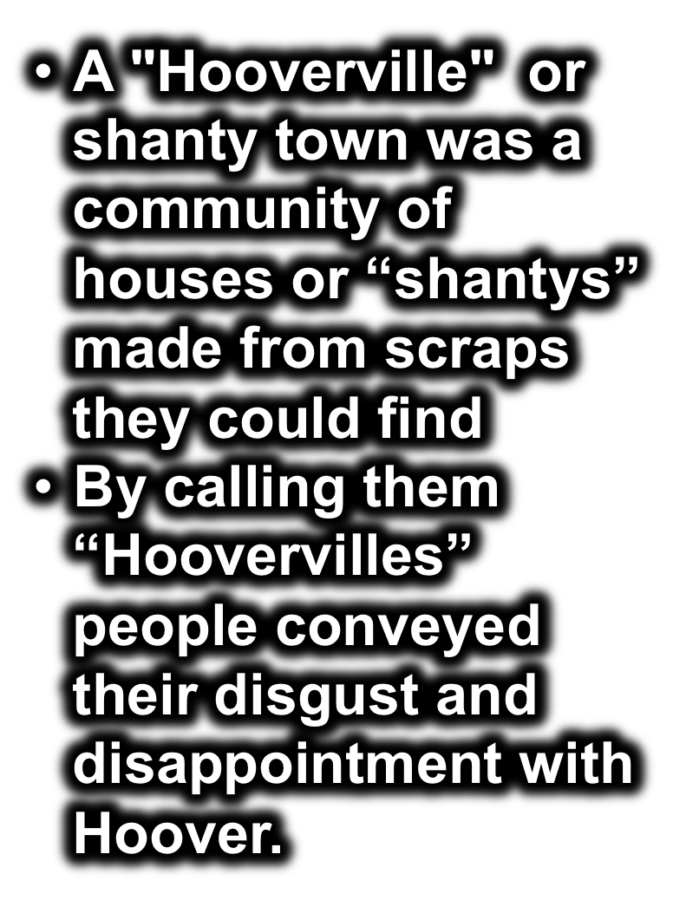
Next Stop:Washington DC, Hoovervilles!

Slide 15
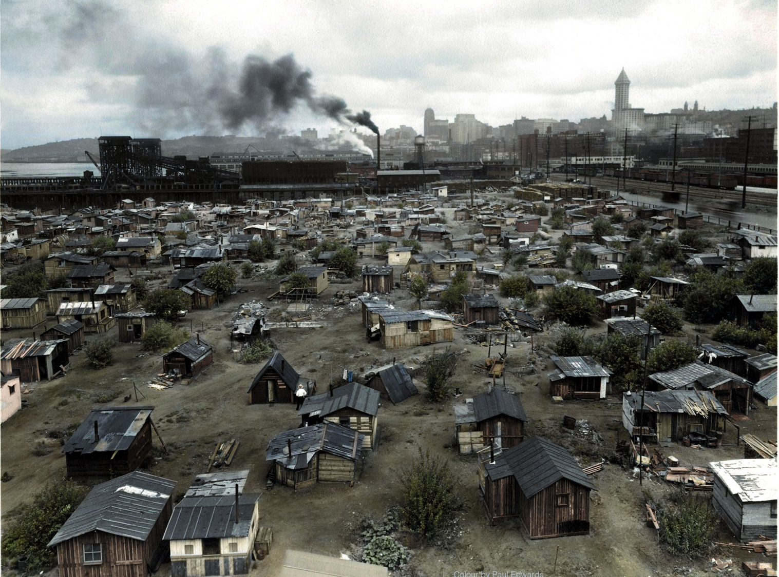

Slide 16
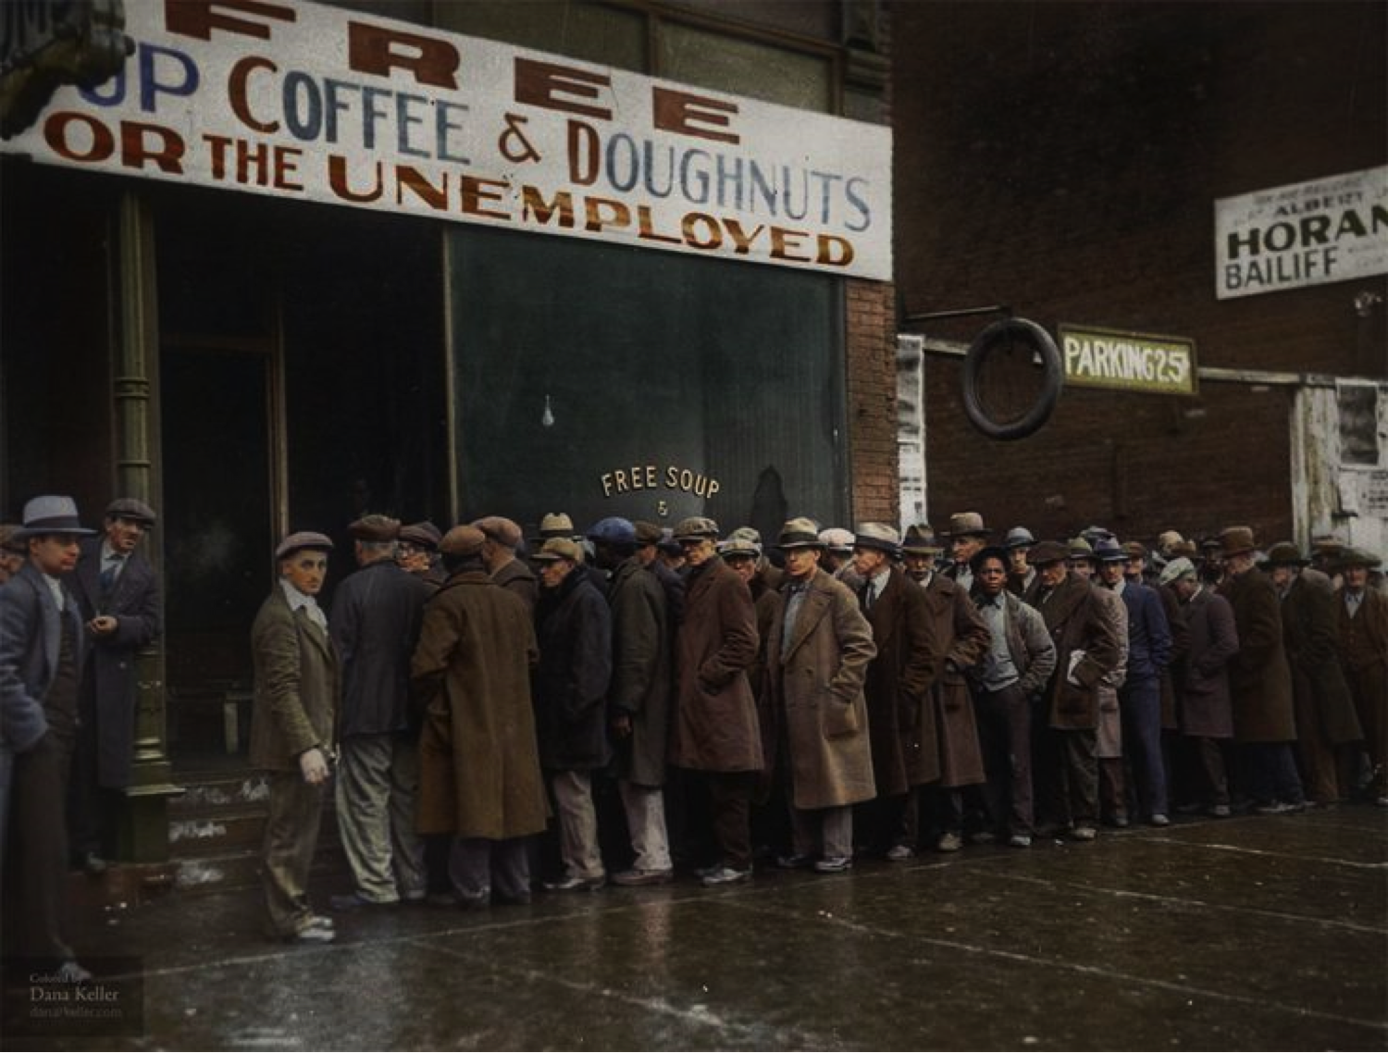
Hungry?
Let's get in line for your serving of bread!

Slide 17
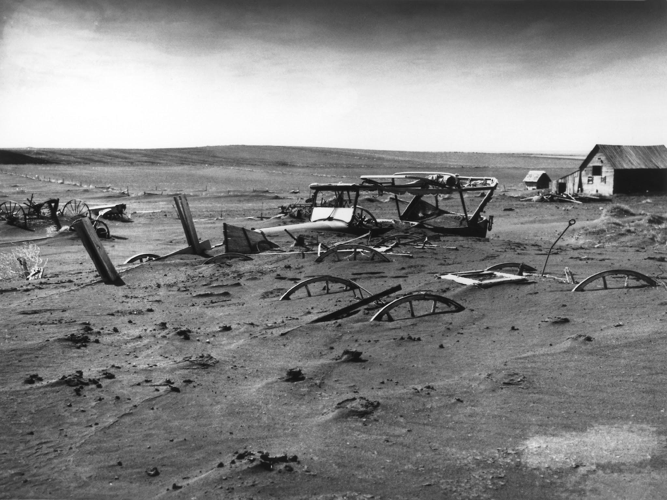
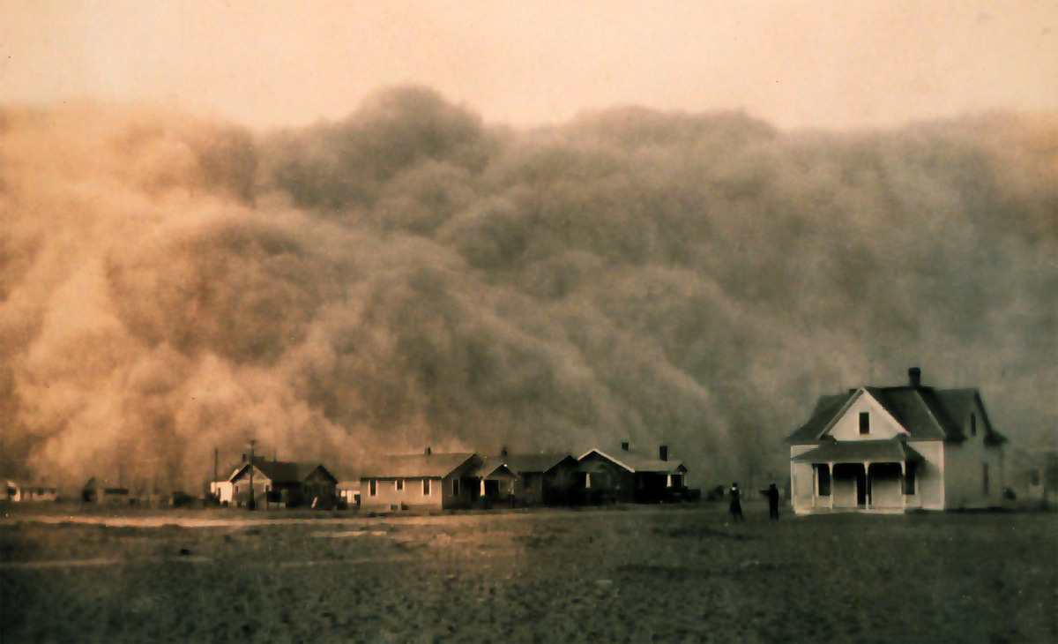
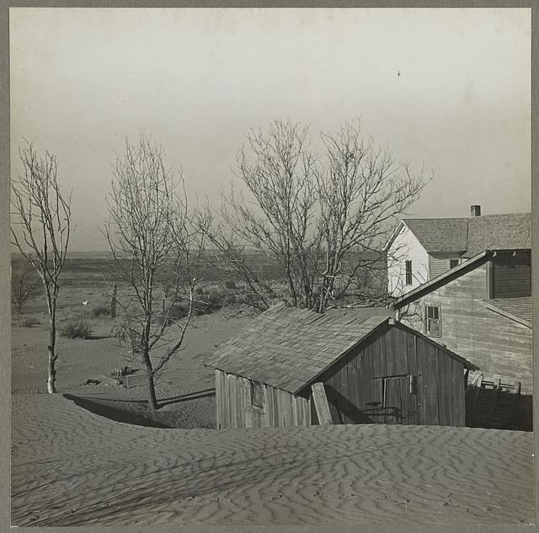
Third Stop: Oklahoma

Slide 18
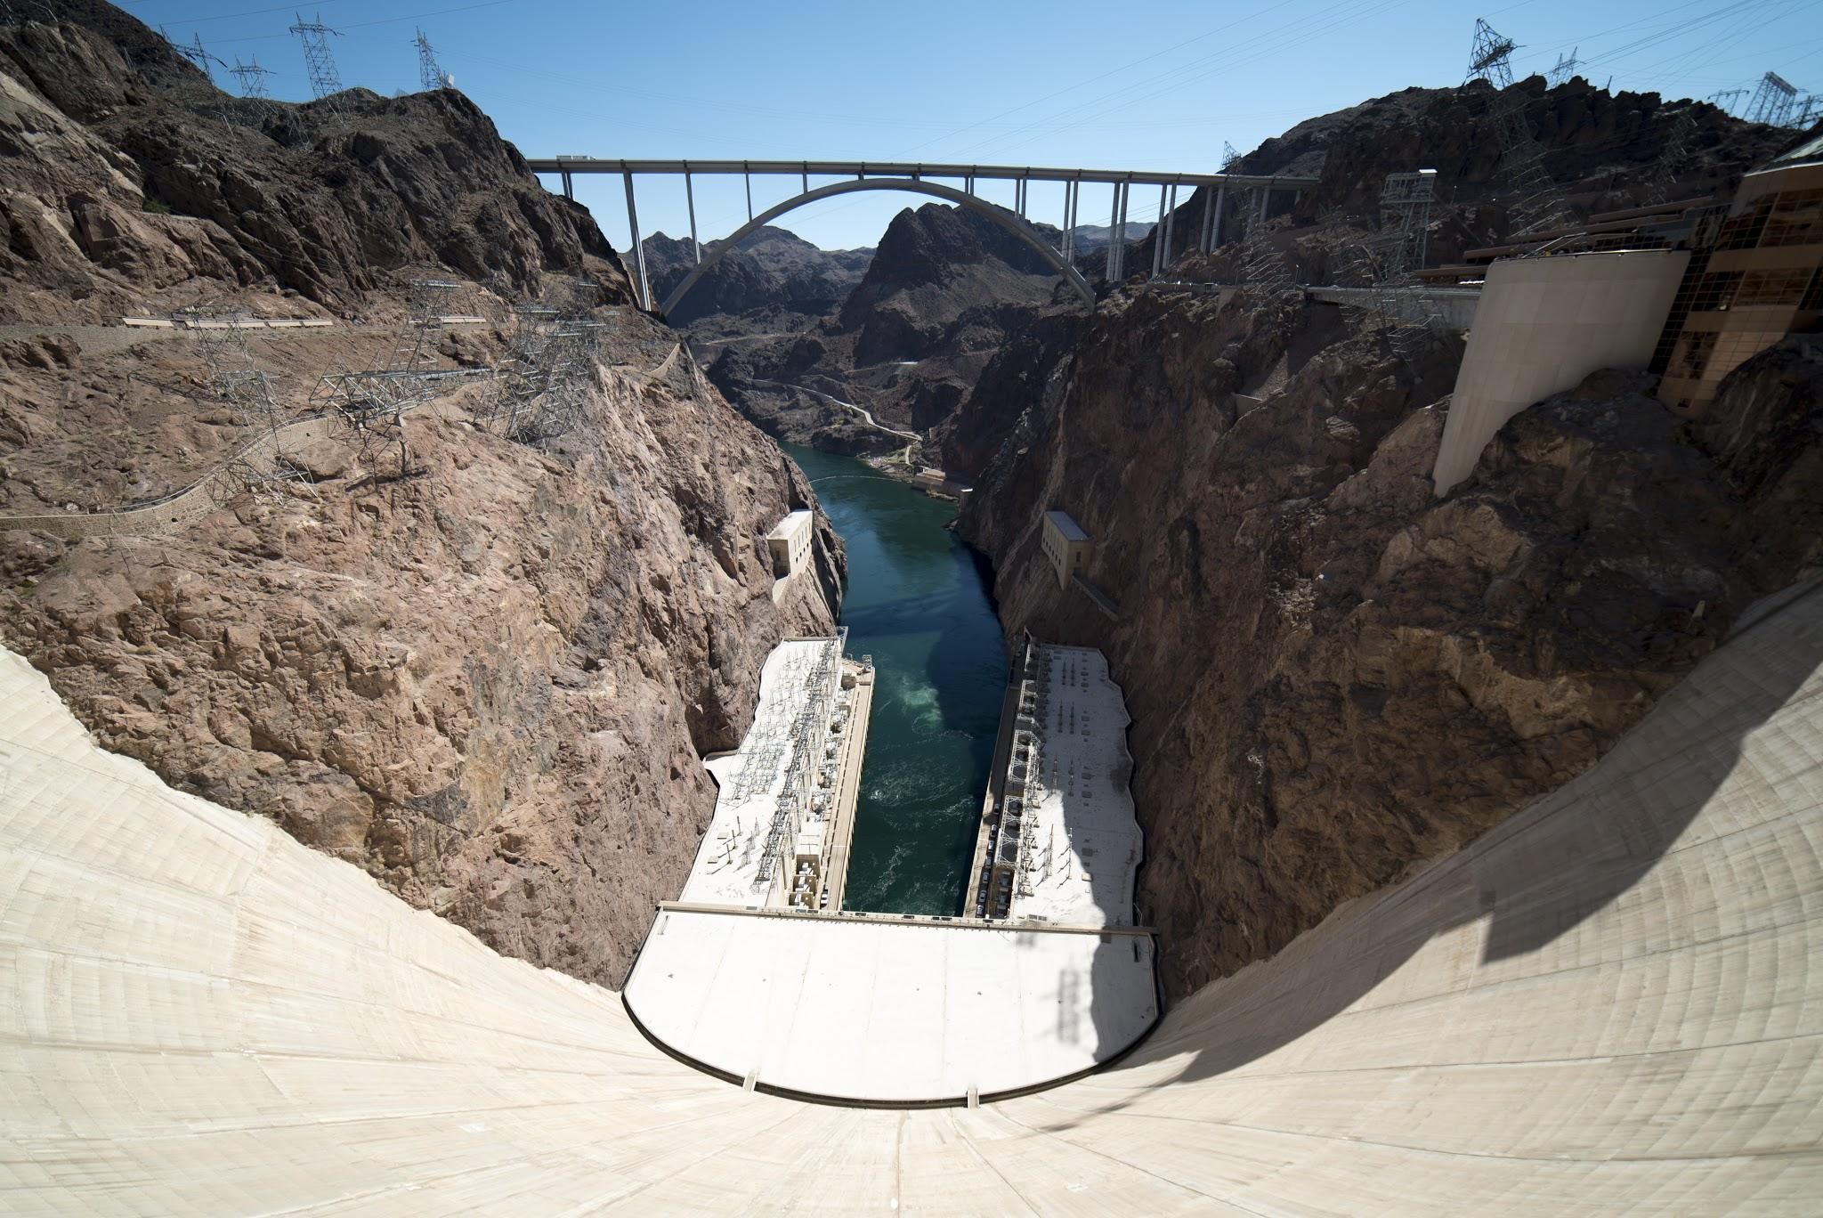
Mystery Stop: What am I?

Slide 19
The Hoover Dam!
Building Hoover Dam required more than 5 million barrels of concrete. The finished dam contains enough concrete (4.5 million cubic yards) to build a two-lane highway from Seattle, Washington to Miami, Florida

Slide 20
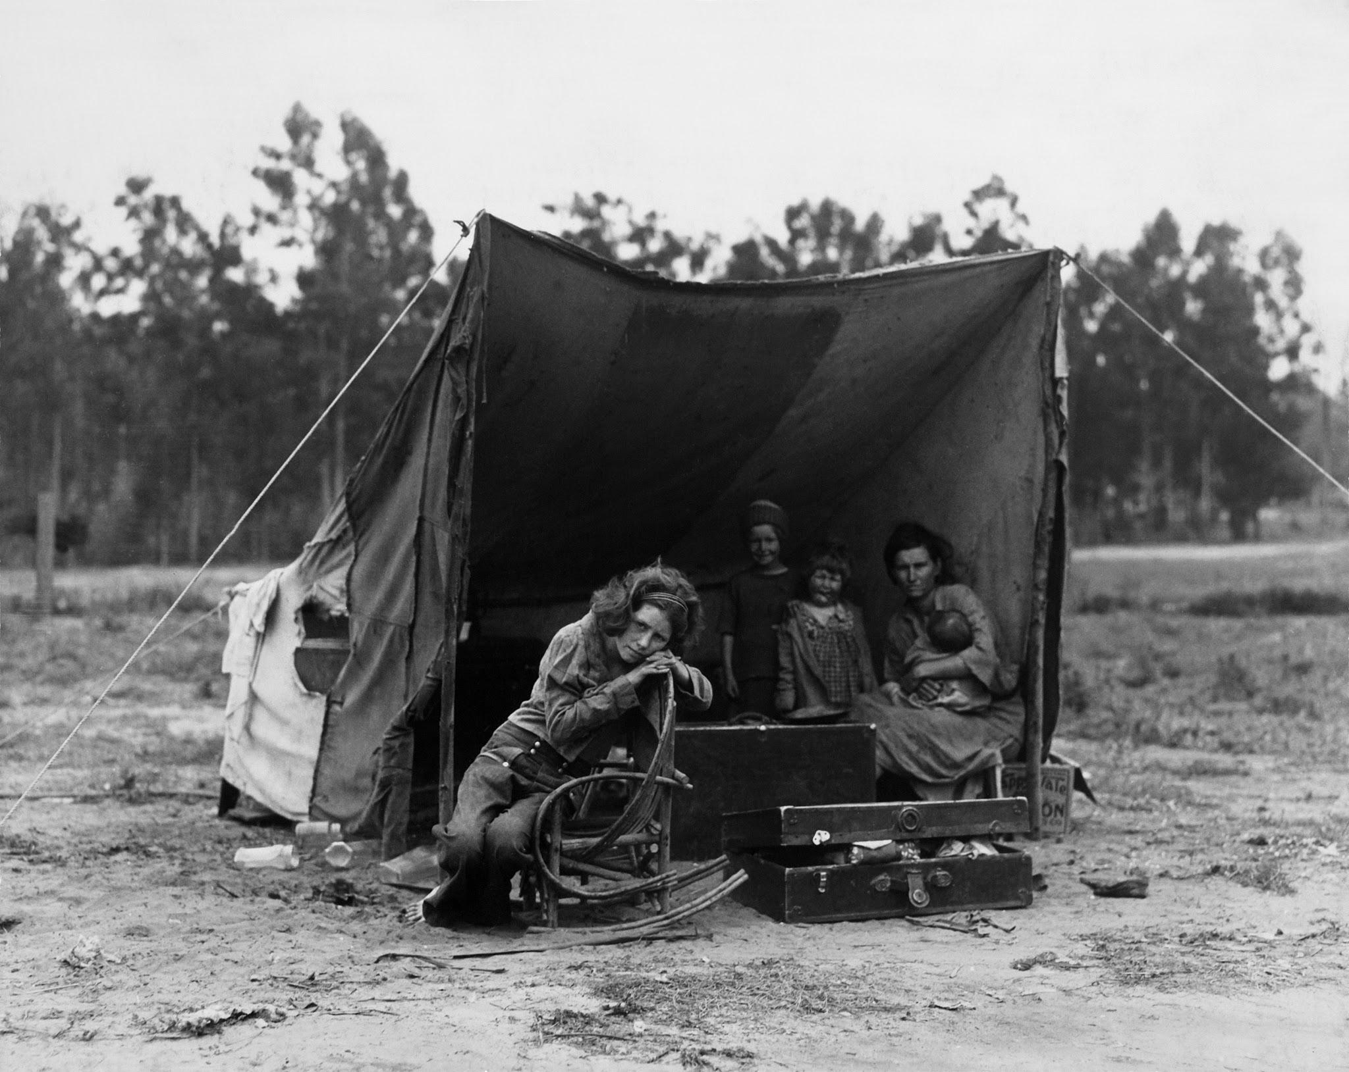
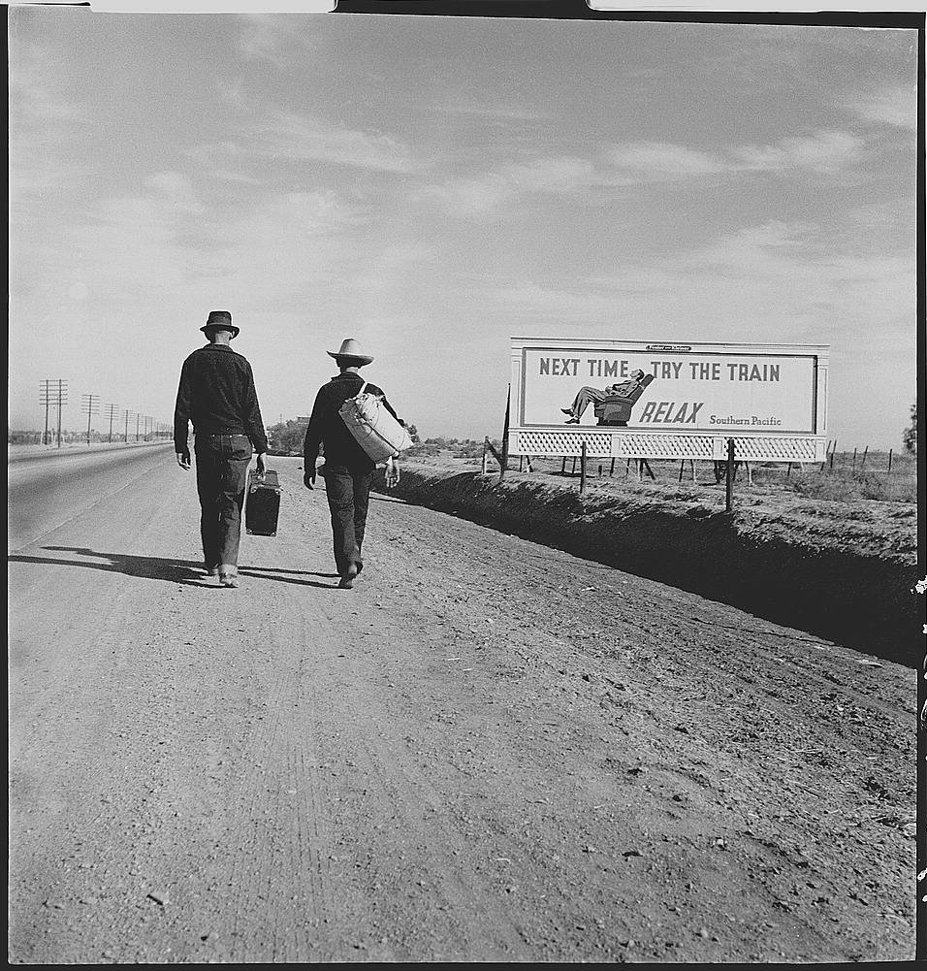
Final Stop: California

Slide 21
Homework:
Students will complete a “Homework Sheet”. This includes two parts
Part I: Venn Diagram comparing and contrasting President Hoover & President Roosevelt during the Great Depression
Part II: Write a short letter to the President of there choosing(either Hoover or Roosevelt) explaining their journey through the Great Depression.

Slide 22
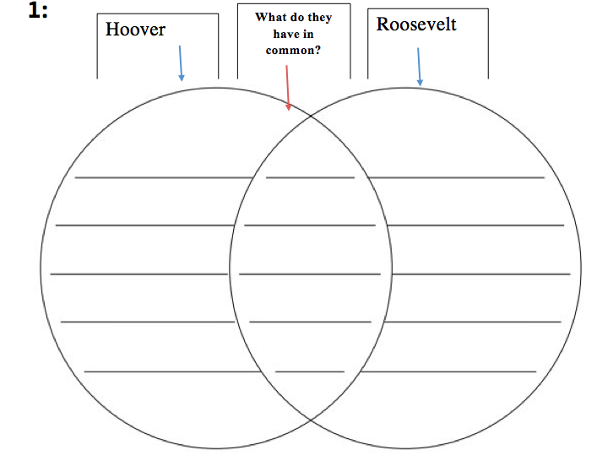

Slide 23
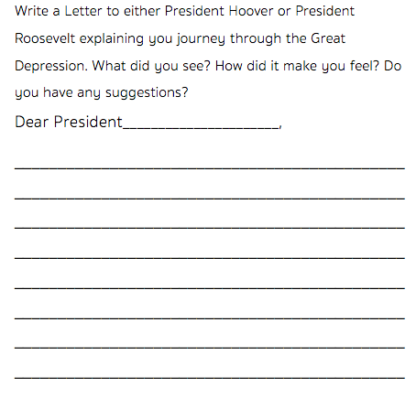

Slide 24
C.H.A.M.P.S.
C - Conversation: Let’s talk about this lesson! We need to be respectful of everyone, so if someone else is talking, listen and then raise your hand to add to the conversation!
H - Help: Please do not hesitate to ask me any questions! I am here to help. Please raise your hand, and I will either call on you during our discussion or come to you during our activity.
A - Activity: Our activity today is called Thinking Like a Historian. We will be making a decision based on evidence we find from primary and secondary source documents.
M - Movement: We will be moving around the room! When we move we will go quietly, and we need to be careful and watch out for others and things on the floor.
P - Participation: Please participate as much as possible! We are here to have fun and the more you participate, the more fun we are going to have.
S - Success: Once you learn about historical thinking skills and the documents you will be Thinking Like a Historian, and therefore you will be successful!

Slide 25
Lesson Three: Thinking Like a Historian
Aim: What can we learn about FDR’s presidency and the Great Depression from primary and secondary source documents, Like A Historian?
Motivation Do Now: “Write down a time that you felt hopeless. How did you get over the feeling, did anyone help you? If so, how?”

Slide 26
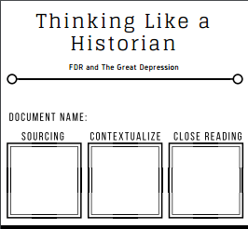
Lesson Three: Thinking Like a Historian
Pair Up!
Each student will be given a document (of three possible documents) and then paired with someone with the same document.
Each pair will be given a “Thinking Like a Historian” Task
Sourcing
Contextualizing
Close Reading

Slide 27
Lesson Three: Thinking Like a Historian
Move into 6 groups of 3!
Students will separate from their partners and come together in groups of three. Everyone in the group will have had the same document but a different task.
Students will share what they discovered with their group mates to fill in the rest of the boxes for their document.

Slide 28
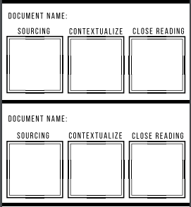
Lesson Three: Thinking Like a Historian
Move into 2 groups of 9!
Students will join groups where all three documents and all three tasks are represented. Everyone will share what they found about their document and continue to take notes on their worksheet.
Then all together they will complete the corroboration section by comparing the documents.

Slide 29
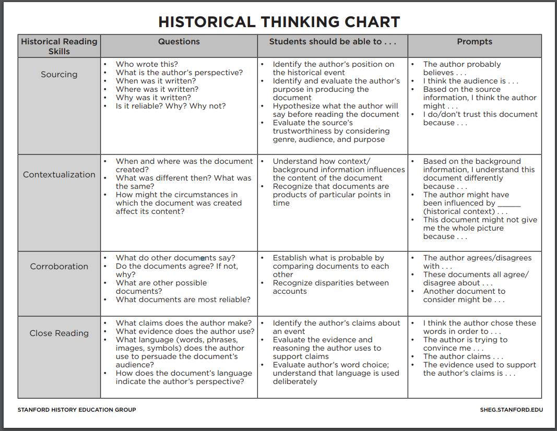

Slide 30
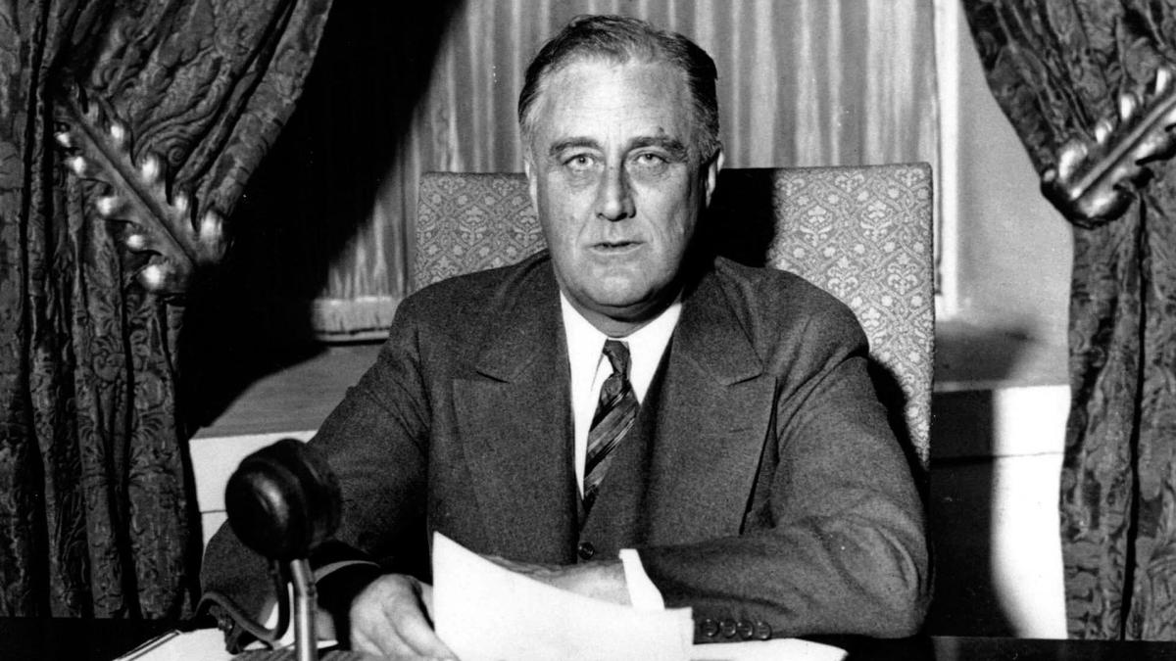
Lesson Four: History Mystery
Did Franklin Roosevelt Get Us Out of the Depression by Sound Economic Theory or by Creating Hope?

Slide 31
CHAMPS
C- Conversation: There will be plenty of time for conversation! Please respect everyone's thoughts and opinions when sharing!
H- Help: Asking for help is a big part of learning! Do not be scared to ask questions!
A- Activity: Our activity will be called History Mystery. We will solve the mystery of how Roosevelt got out of the Great Depression.
M-Movement: Remain seated at all times. You will eventually be given the opportunity to move around the room.
P- Participation: You will be participating in group discussions and working collaboratively.
S- Success: Once the mystery is solved, be sure to include your claim to support your findings.

Slide 32
Mystery
Do Now: Think of what skills it takes to be a detective, turn and share with your partner.
In groups, students will use documents to form a claim stating which helped get us out of The Great Depression; economic theory or hope.
Students will determine the credibility of the evidence and decide which documents support either side.
Students will then create a claim supporting the side they found to be more impactful.

Slide 33
Job Responsibilities
Document Distributor - In charge of distributing the documents for all group members to view and examine.
Document Organizer- In charge of placing the documents onto the graphic organizer.
Group Leader- In charge of managing the group; time management. In charge of making sure everyone fulfills their job.
Great Communicator- In charge of sharing the groups findings with the class during the class discussion.

Slide 34
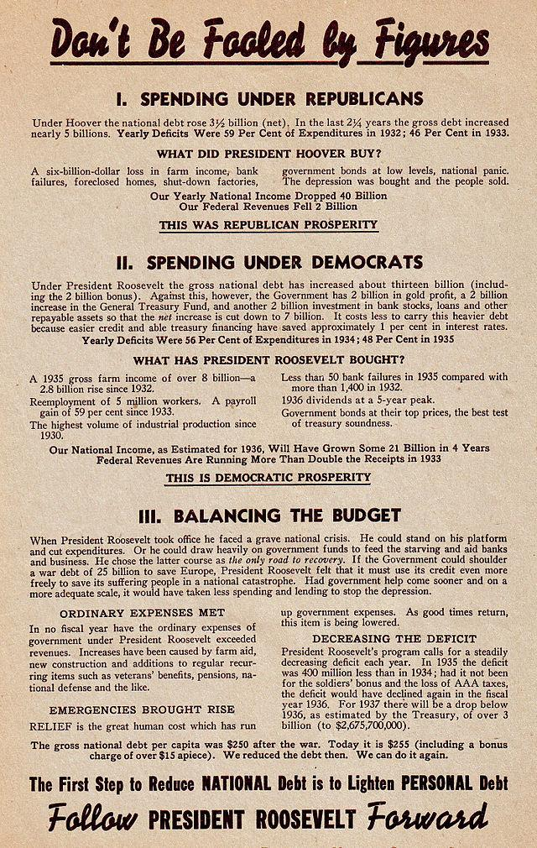
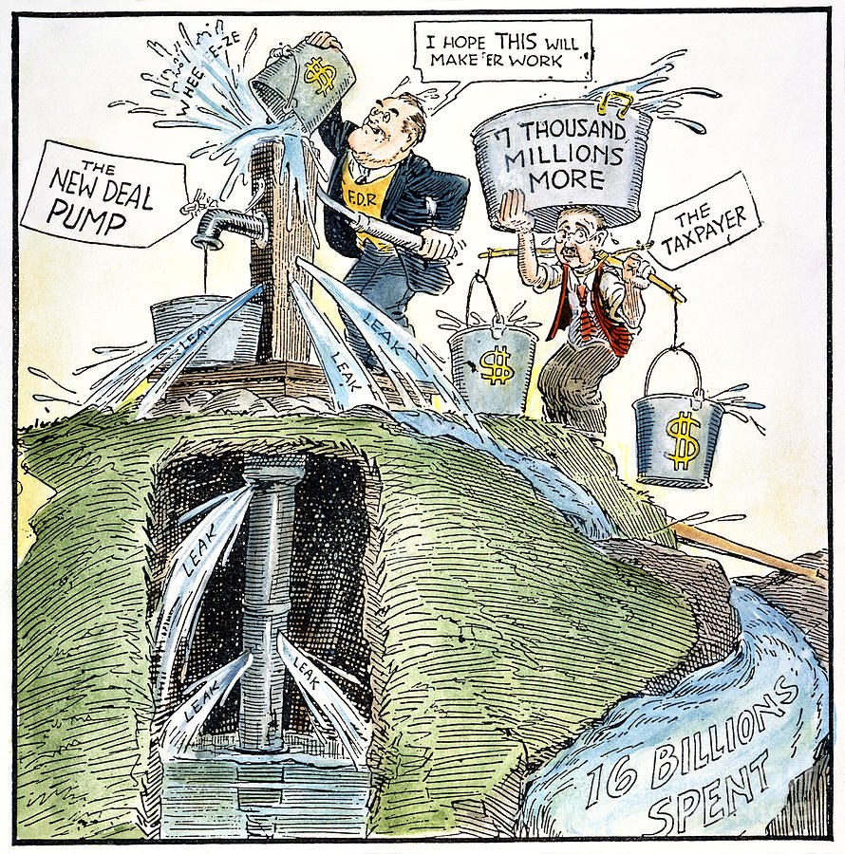
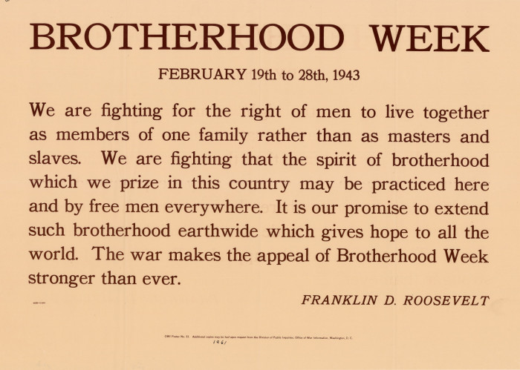
Documents
Students will examine the documents to determine whether economic theory or creating hope was the cause of getting us out of the depression

Slide 35
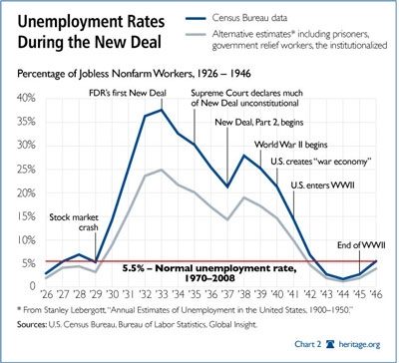
Documents
OCTOBER 24, 1933
Dear Mr. President,
Last Sunday evening six of our friends came in for dinner and contract [a bridge game]. The men were not so much depressed as thoroughly frightened – their wives were wonderful – pretending to make light of the situation with such remarks as “You know, John, always worries about the things that never happen,” etc. but in my dressing room after dinner they spoke differently – i.e. “I wonder if the President means to make a Soviet Russia of this country,” “Why the new tie-up?” “I don’t pretend to follow politics, I hope things ar’n’t a tenth as bad as John imagines” –
At ten o’clock all playing ceased, while each and everyone strained forward to catch the least inflection of your magnetic, inspiring voice. As you finished, the effect was a combustion of gaiety – taut nerves let loose. The men fairly jumped up and down like happy children, the women were inwardly thanking God, and one dear soul let loose the flood gates of tears of relief.
Mr. President, I’m sure that scene was duplicated in thousands of homes the length and breadth of the land, and I can’t help writing you to thank you. You said you couldn’t perform miracles – but you have…
With the assurance of my highest regard,
(Mrs. H. Howard Harper) Marguerite Harper
New York
OCTOBER 1, 1934
Dear Mr. President,
Everybody who has any sense and was able to get to a radio heard your speech last night. I desire to add my firm approval to every utterance which came from your lips.
Surely under the guidance of your great constructive genius the country is gaining. It is well that you take us into your confidence and tell us Mr. President; your address reveals what we had not heard. There is such a welter of publicity about the alphabetized programmes that much wisdom is lost in confusion, but when you speak everybody understands.
You know what your government is doing. You know how to explain it. You know where you are heading and you are on your way.
God bless and keep you strong for the battle Mr. President is the sincere wish of a red-hot, jet-black Democrat.
Melvin J. Chisum
(Field Secretary of the National Negro Press Association)
Philadelphia, Pa.

Slide 36
Detective Work (Organizer)
Economics
1.
2.
3.
Hope
1.
2.
3.

Slide 37
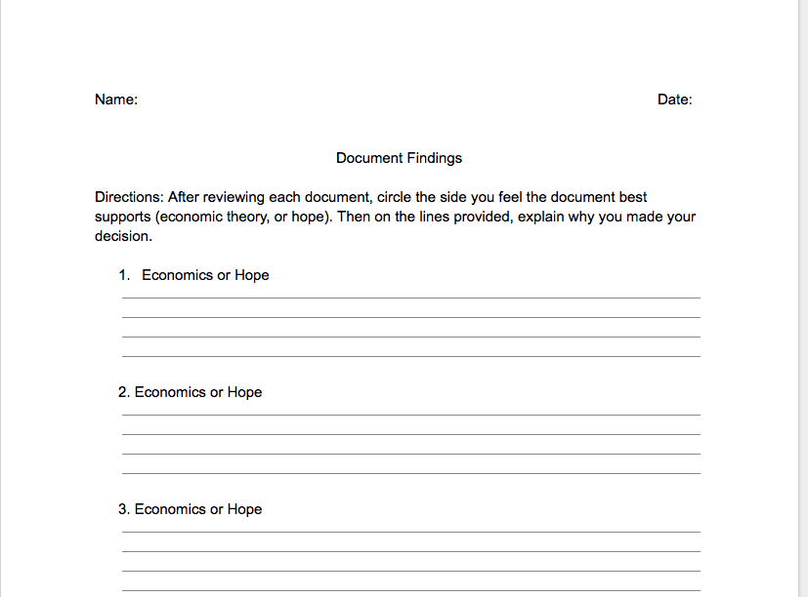
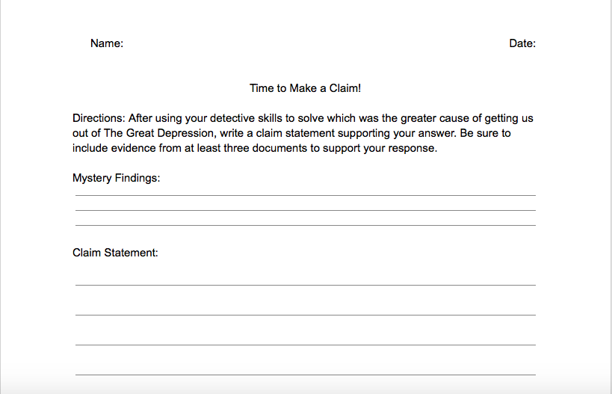
Claim Worksheets
Students will create a claim either supporting FDR’s economic policy or the creation of hope as the bigger cause to help get us out of the depression

