Slide 1
Does Where You Live in the Hemisphere Determine Your Happiness? Grade 3
Elise Henriquez, Danielle Valente, Alexis Correa, Scott Stiene, Alexa Lerman, Nicole Amato, Billy Bushell, Jessica Trinidad

Slide 2
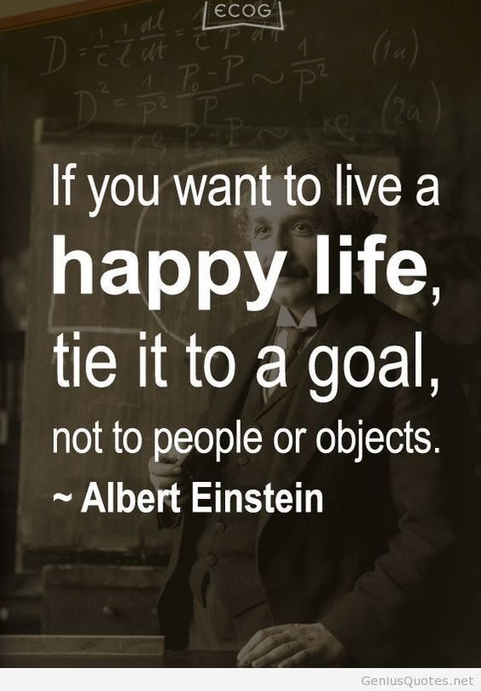
Lesson #1: Happiness
Does where you live in the hemisphere determine your happiness?
What determines happiness?

Slide 3
CHAMPS
C- Conversation: You will discuss the book, It’s Okay to Make Mistakes, with your peers. We will also discuss the idea of happiness and optimism with one another.
H- Help: If you needs assistance, please raise your hand quietly.
A- Activity: We are going to read the book, It’s Okay to Make Mistakes, and complete a “Book, Head & Heart” activity to reinforce what you learned.
M- Movement: Please be mindful of your classmates when you move from your desks to the carpet, as well as when you come up to the board to participate.
P- Participation: Everyone is expected to participate in all activities. Everyone should also be taking notes and/or answering questions.
S- Success: We will learn about what happiness is and discover what the key to happiness is. This will teach you how to flip problems around so that you can see what the positive side of these problems are.

Slide 4
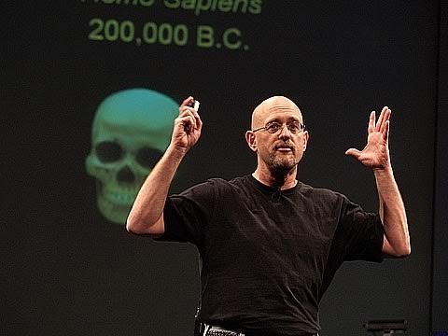
What determines happiness?
TED Talk on Happiness.

Slide 5
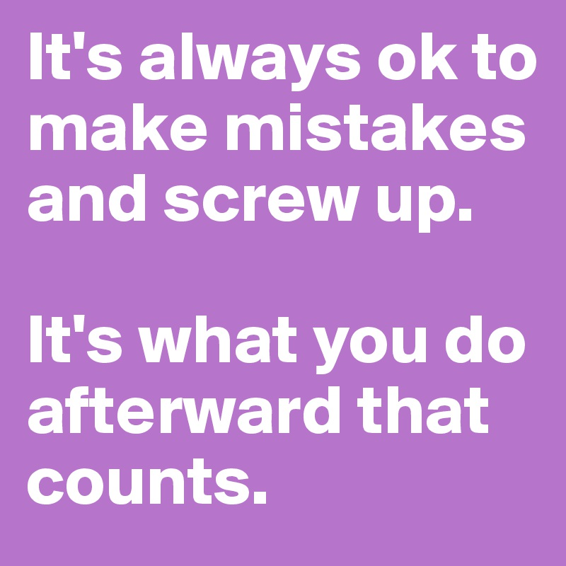
It’s Okay To Make Mistakes!
Why do you think it’s okay to make mistakes?

Slide 6
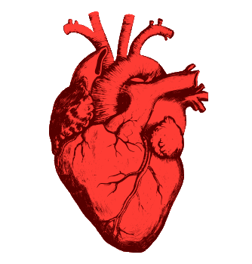
Tweet about it!!!!
#Happiness
Using the book, head and heart method, students will divided into three groups.
Each group will get a different question (either a book, head or heart question.) Students will have to answer the question on a post-it and “tweet” their response on the correct poster paper.
Book: Head: Heart:
What is the story about? What changed, challenged or confirmed my thinking? What did I learn about me and how will this help me to be better?

Slide 7
Let’s talk!!!
According to the book, what are some examples of mistakes the characters made?
How did they handle the situation?
Can you think of a time you made a mistake and what did you learn from it?
Why do you think our happiness is shaped by our thoughts?
Can you think of a word that can relate with happiness?
Why do you think optimism is the key ingredient to to living a happy life?

Slide 8
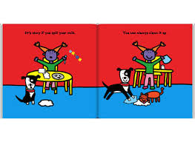
Gallery Walk
Students will walk (without talking) and observe four pictures of negative events.
The goal is to have students think about the positive outcomes from these negative events.
Students will go back to their seats and draw four pictures with a positive outcomes to these negative events.

Slide 9
HW with the parents.
For your assignment, write a letter to someone who was there for you when you made a mistake.
How did that person support you?
Write about how this person plays a role in your happiness and how your thoughts changed when you made a mistake.
You will then read it on Flipgrid.
Have fun!!

Slide 10
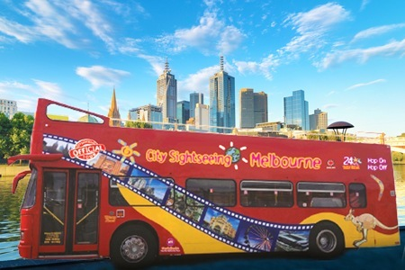
Bus Tour of Melbourne, Australia Happening Today!

Slide 11
How does the geography of life in Melbourne affect life there?

Slide 12
DO NOW!!!
Do we think happiness can be affected by where we live?
Is there anything about where you live now that makes you happy?
Brainstorm about what makes you happy!

Slide 13
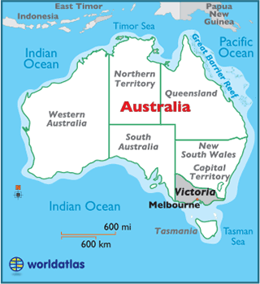
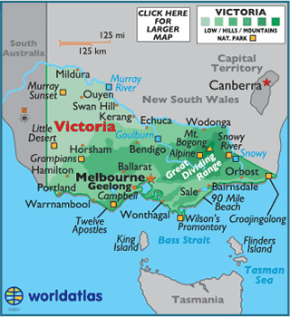
What is geography?
location, place,
human/environment interaction,
movement and regions.
How can geography affect life?
Weather/climate
Landforms (mountains, lakes, oceans)
Natural disasters (hurricanes, tornadoes)

Slide 14
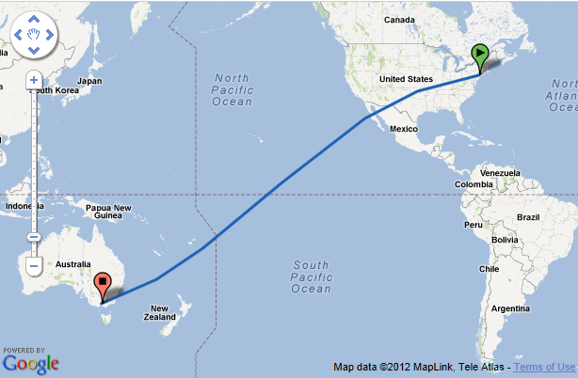
After traveling for 24 HOURS! To Melbourne, Australia, we will be picked up at the airport by bus to BEGIN OUR TOUR!!!

Slide 15
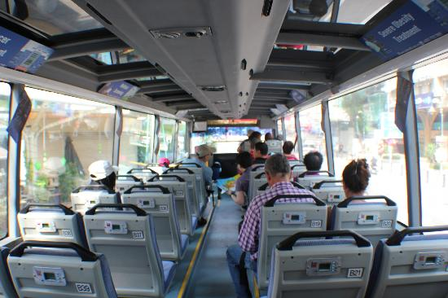

Slide 16
C
Conversation: Please do not talk during the bus ride. There will be multiple opportunities to talk at each stop, AFTER the tour guide is done speaking.
H
Help: If you have ANY questions, please raise your hand and wait to be called on. Write down your questions so you do not forget!
A
Activity: The goal is to fill-up our travel journals during our journey! We will be learning about the geography and culture of Melbourne! Make sure to take notes during the ride.
M
Movement: Students riding the bus will be seated at all times! Make sure to keep all body parts in the vehicle! During snack and chat, students will be allowed to get up and move around.
P
Participation: By bus we will visiting many parts of the city of Melbourne.
***Think: Would I be happy living in the city we visited? WHY?***
S
Success: Once the tour is over, we are going to write postcard to a friend back home about our experience!

Slide 17
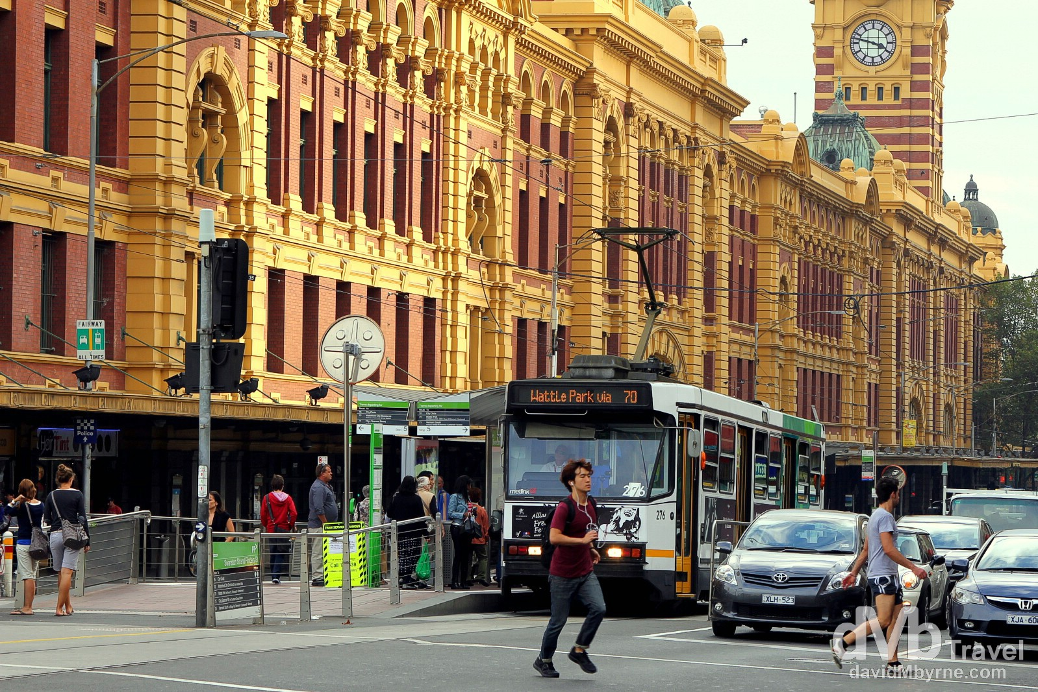
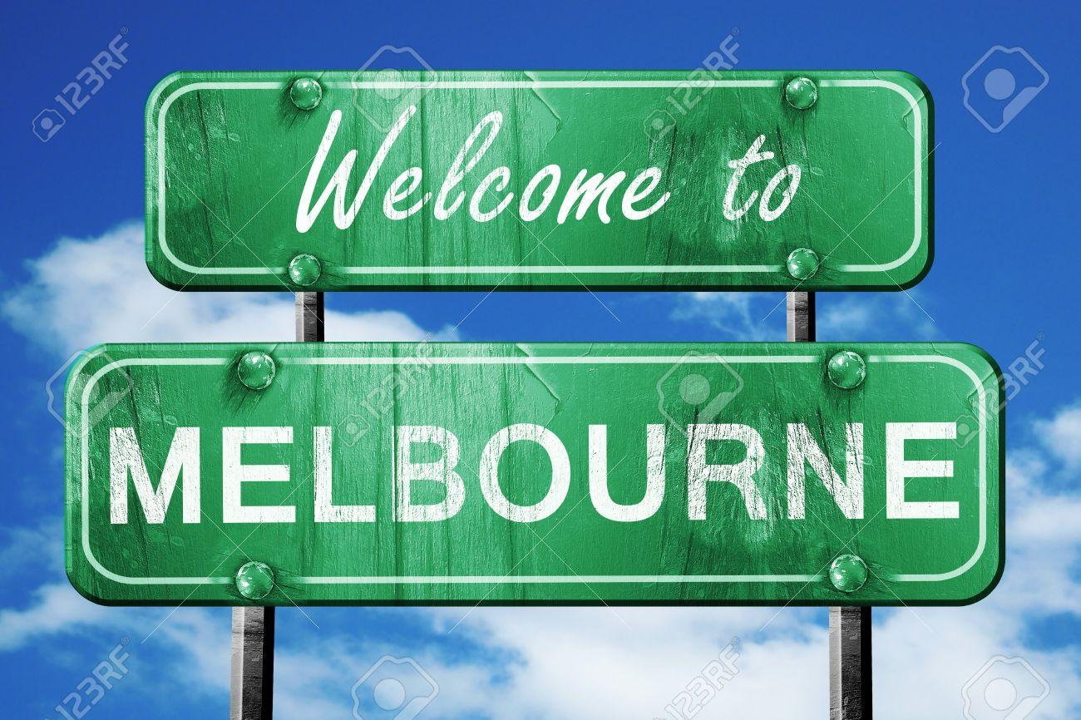
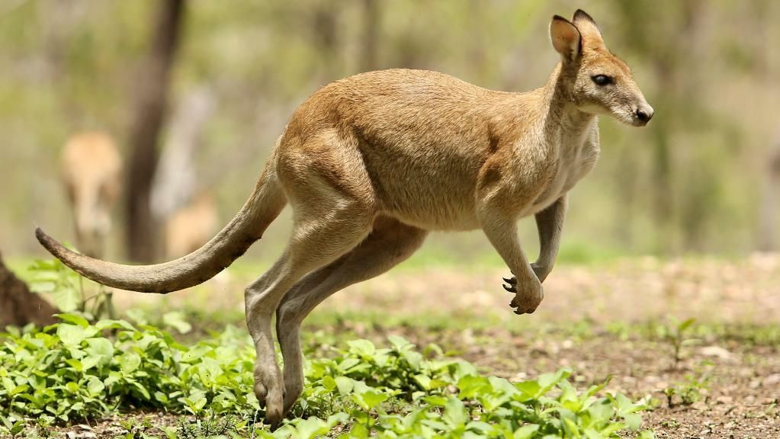
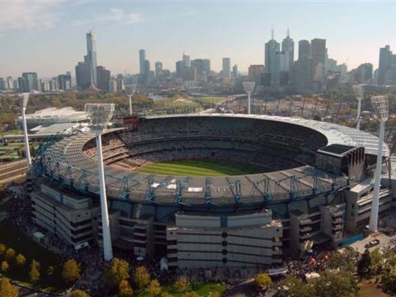
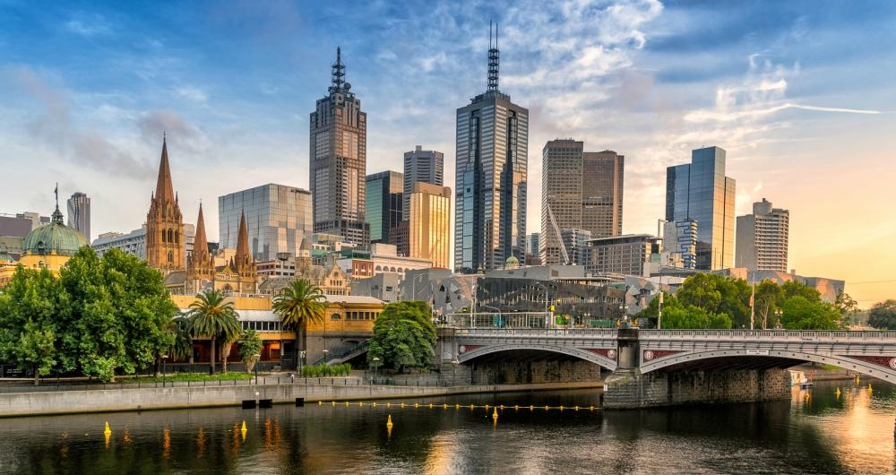
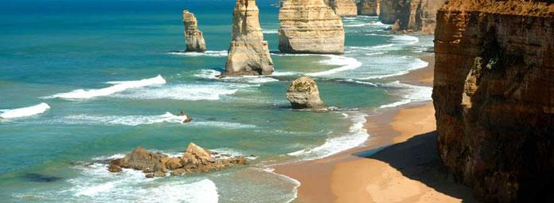
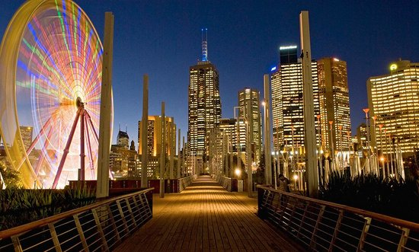

Slide 18
What's the forecast?
Summer (December – February) Winter (June-August)
Autumn (March – May) Spring (September – November)
Australia is a truly amazing country with beautiful beaches, sunny weather, and an incredible outback for the more adventurous. The large continent offers a diversity of landscape, climate and habitat, however along with that, also comes some dangers, bushfires, floods and earthquakes.

Slide 19
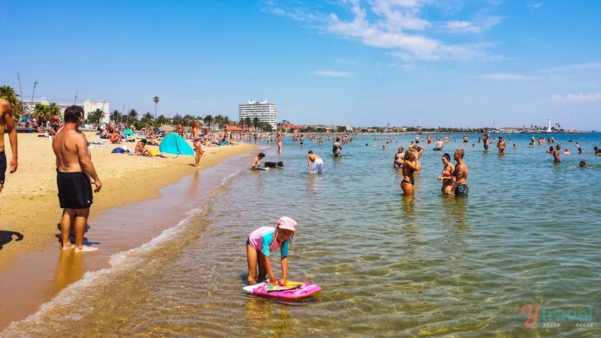

Slide 20
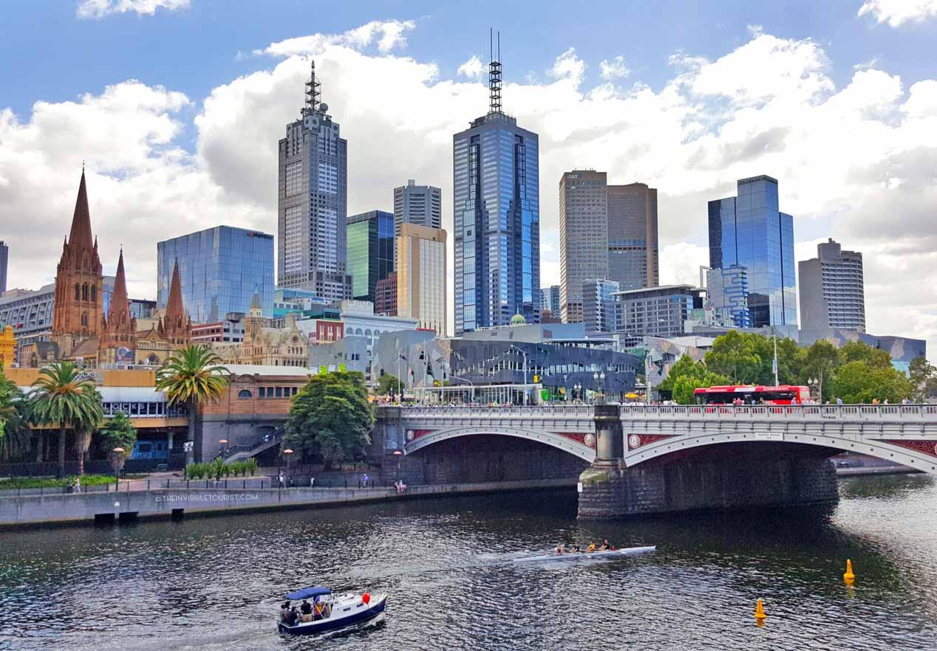

Slide 21
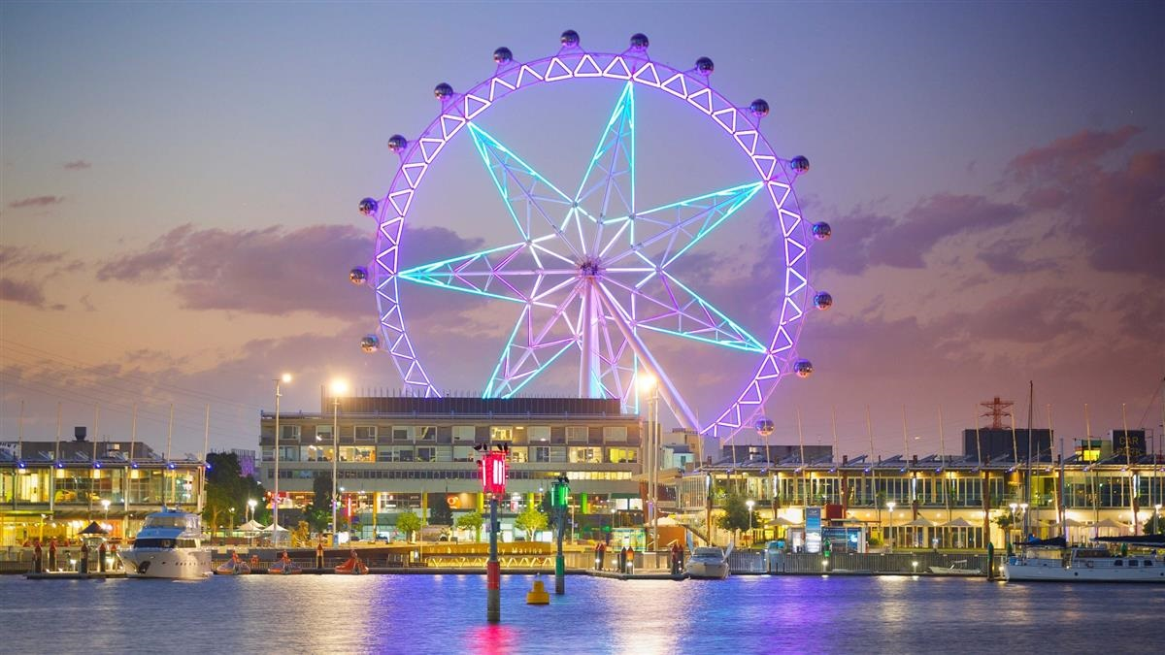

Slide 22
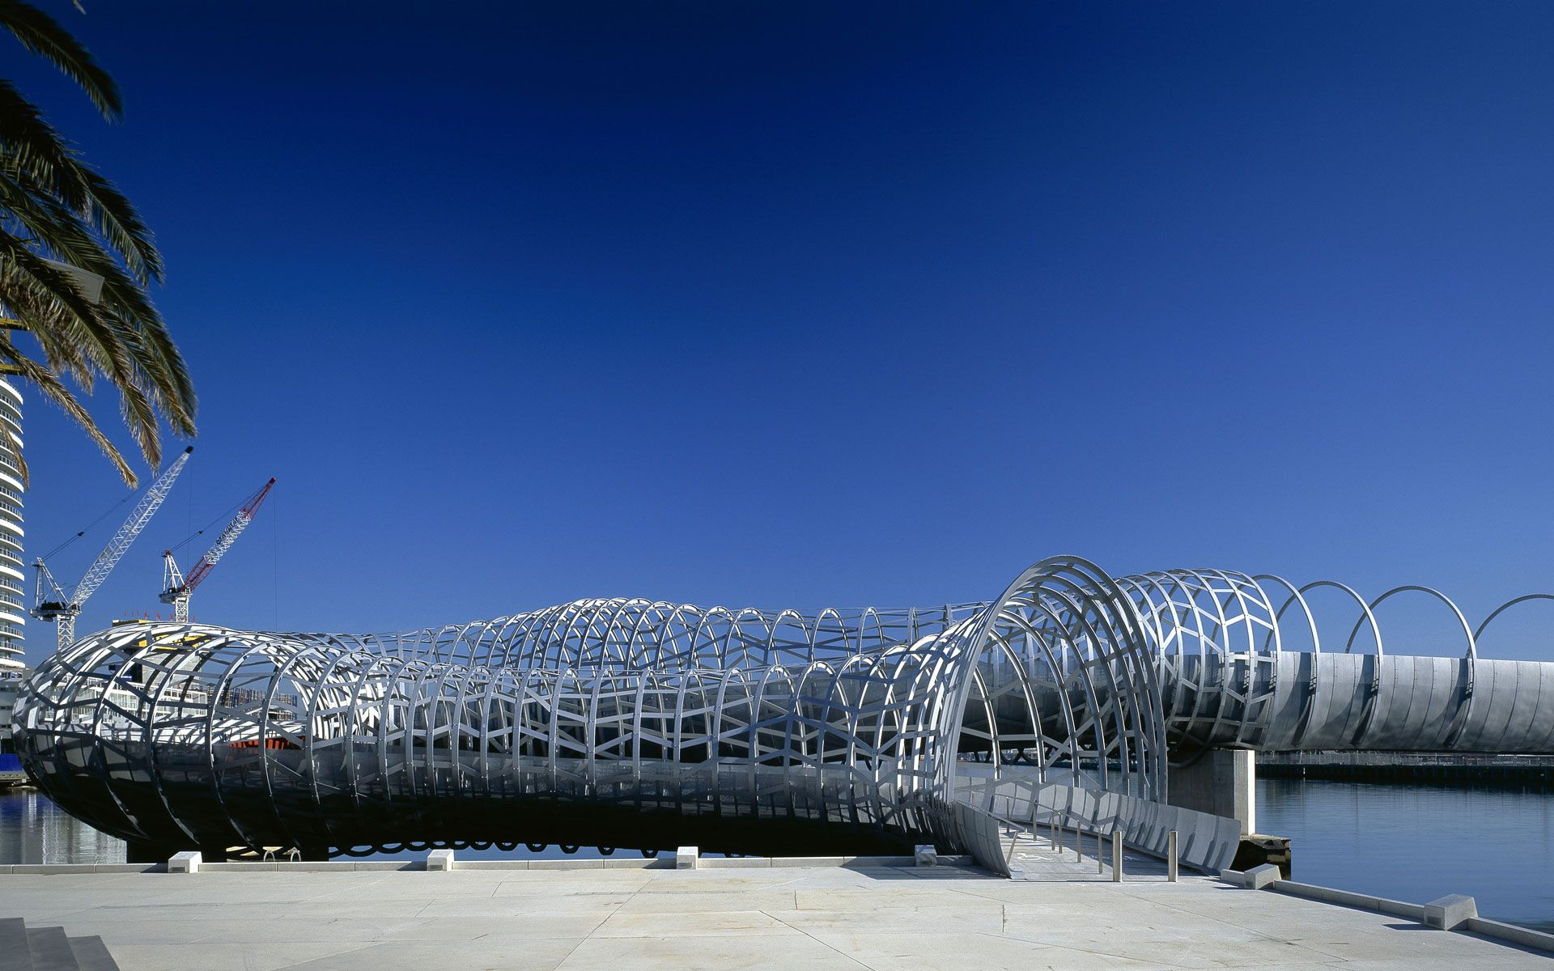

Slide 23
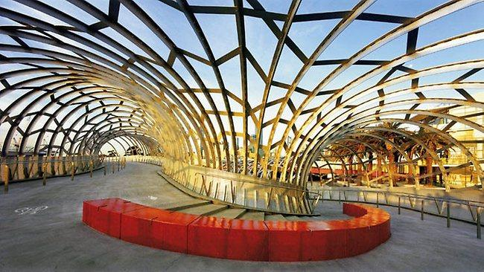

Slide 24
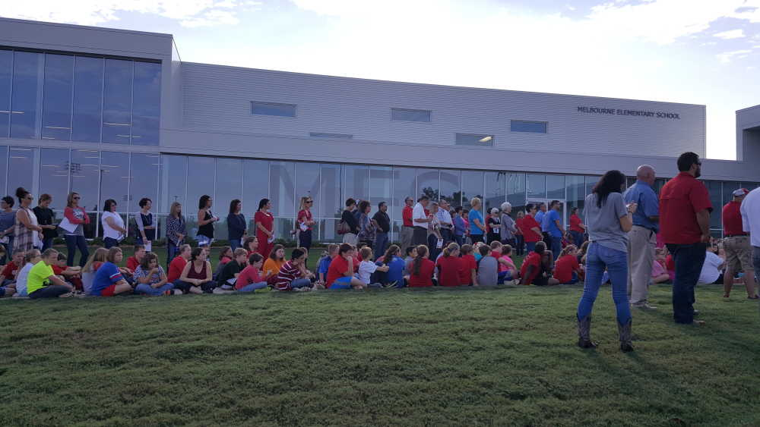

Slide 25
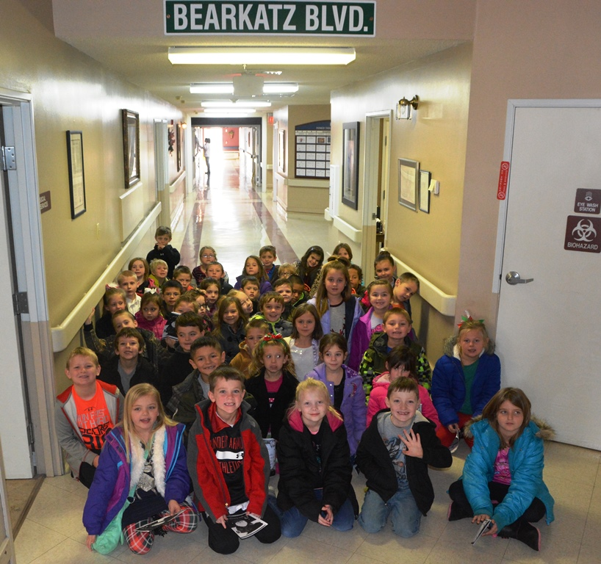

Slide 26
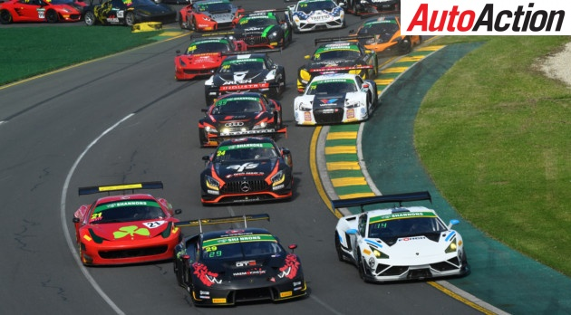

Slide 27
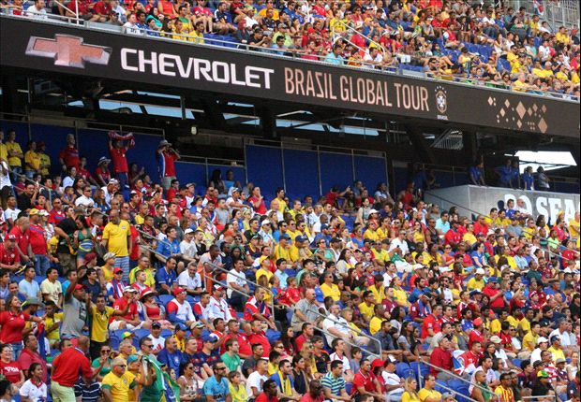

Slide 28
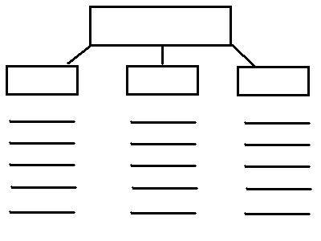
Melbourne
Ex. 1
Ex. 2
Ex. 3
One thing you learned!
One thing you noticed!
One thing you liked!

Slide 29
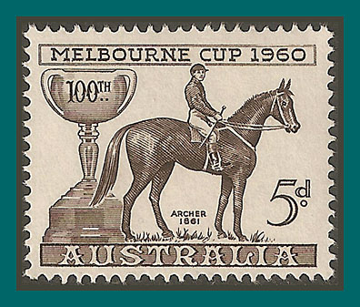
Send a Postcard!
Greetings from Melbourne, Australia!
I’m having so much fun in Melbourne! The weather is beautiful and I loved seeing all the buildings. My favorite part was walking through the web tunnel. Everyone is so happy here! Be home soon!
Love,
Miss Dani
To: Mom and Dad

Slide 30
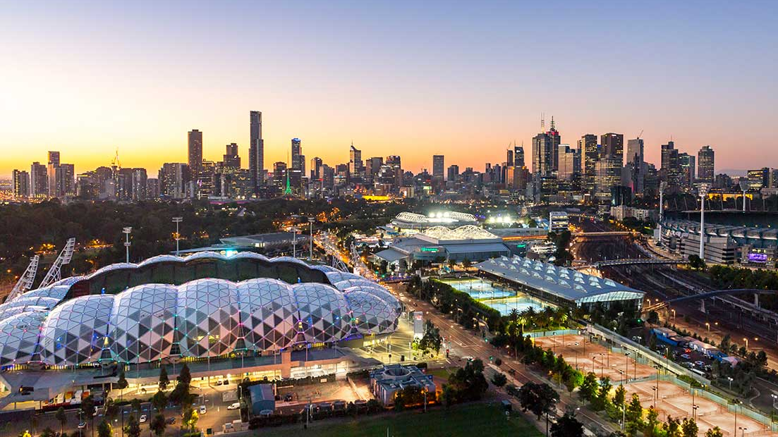
How did Melbourne, Australia come to be Melbourne, Australia?
What historical events have shaped the country?
Lesson 3

Slide 31
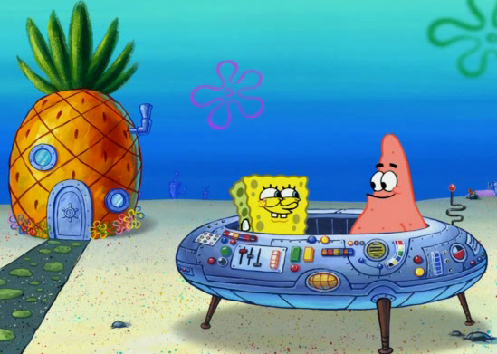
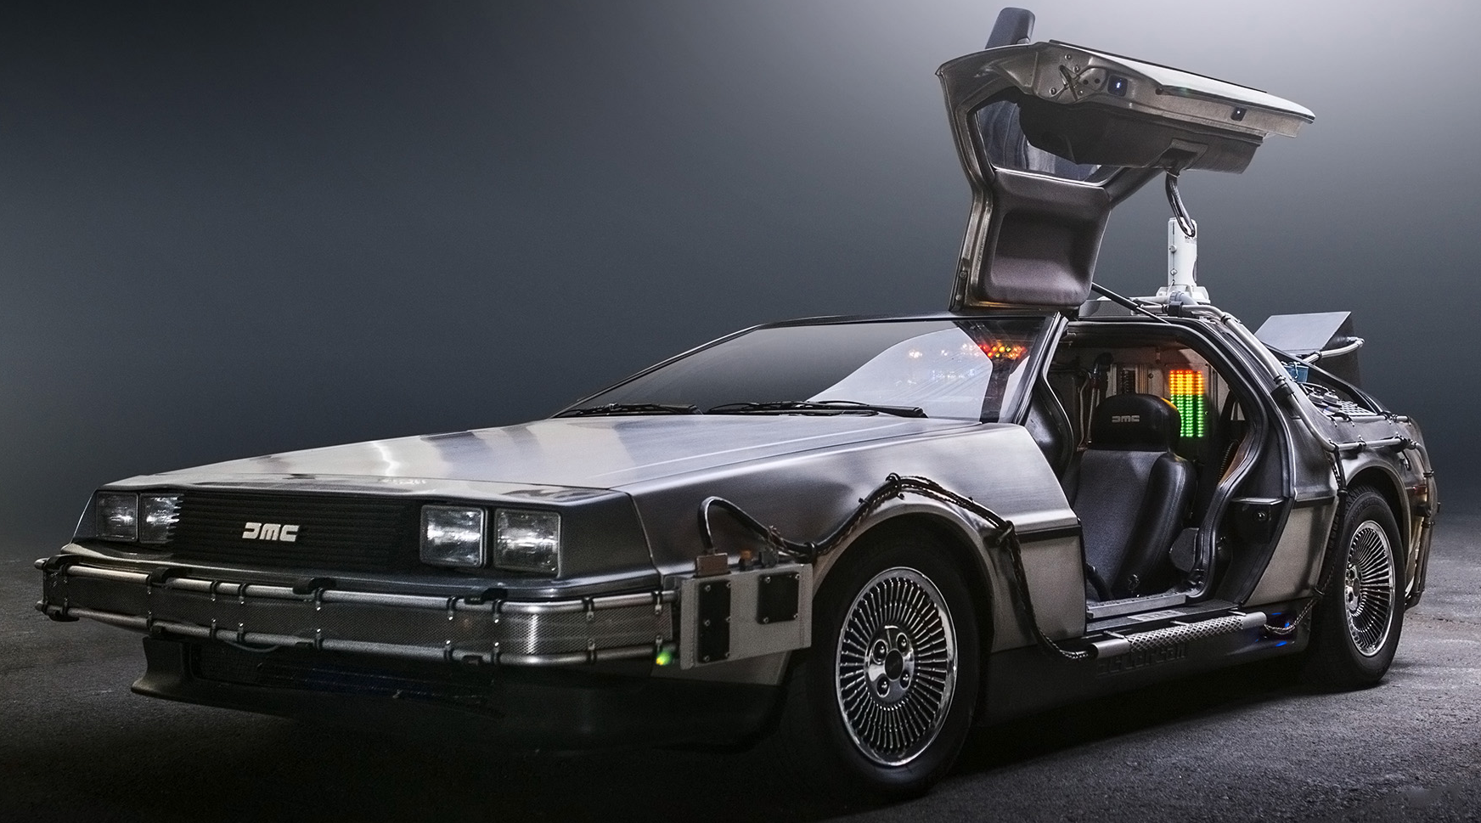
Let’s visit melbourne’s history
Choose Your Time Machine!!!!!

Slide 32
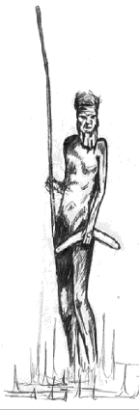
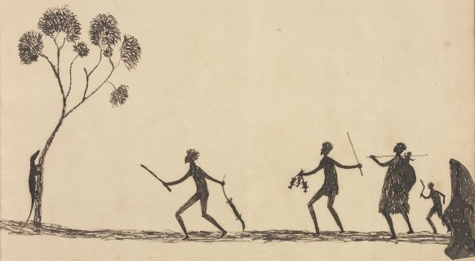
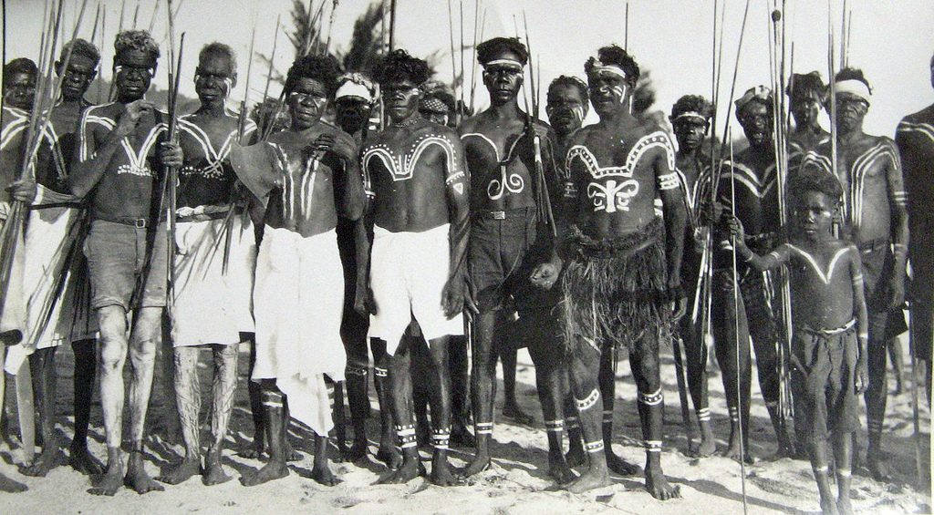
1st Stop: The founding of Australia by Aborigines
60,000 years ago - Before contact with the rest of the world

Slide 33
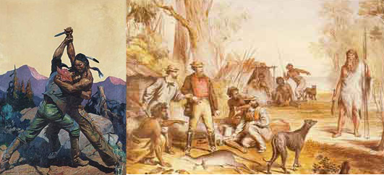
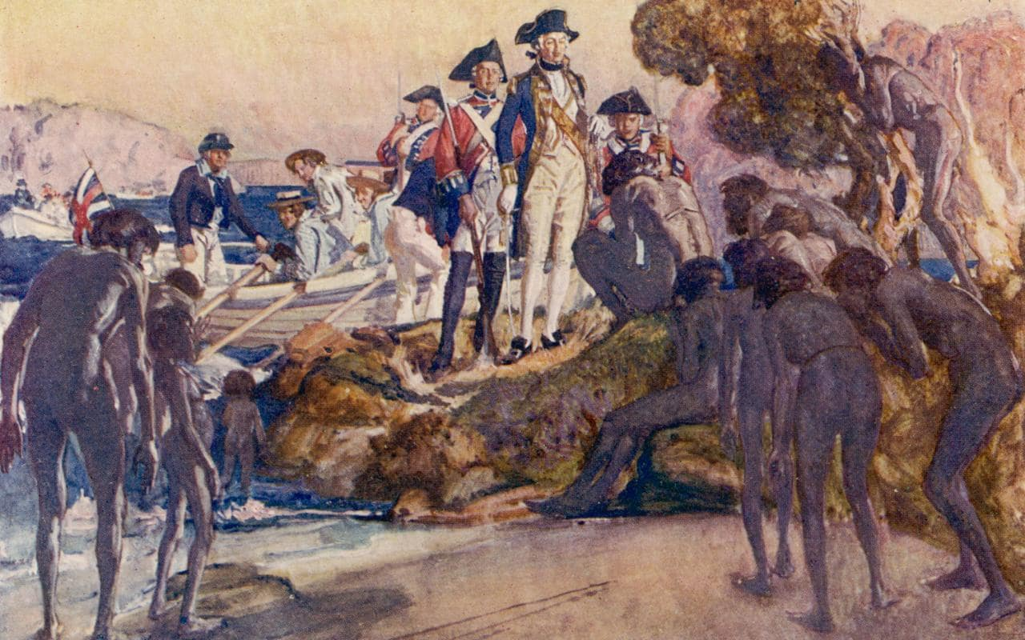
2nd Stop: 1770 Australia was made
part of the British Empire.

Slide 34
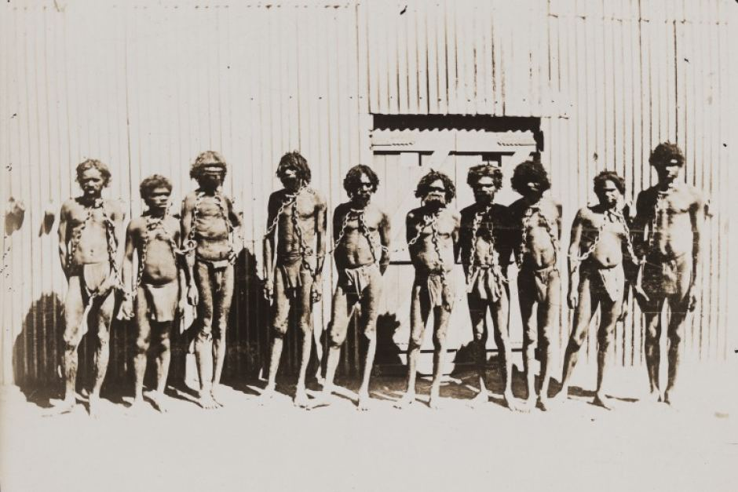
3rd Stop: Establishing a Penal Colony by England in 1788

Slide 35
Now ACT IT OUT!

Slide 36
Lesson 3 - What History Shaped Melbourne Today?
Three Step Approach:
Time Machine / Visual Discovery (See, think, and feel)
Read and Retell (3 passages) Literacy Strategy
Journal Entry reflection
Enrichment:
Agree or disagree to statements citing document based evidence

Slide 37
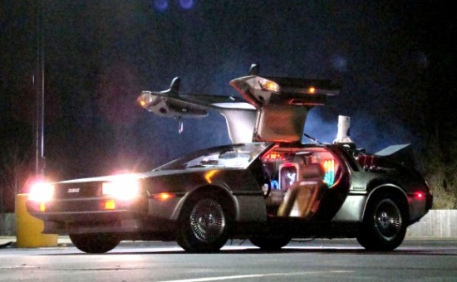
Remember Doc Brown from Back to the Future?
Click here!: http://tinyurl.com/ycr9u7ug
He’s our time travel guide!
Doc will be taking us to see 3 Stops:
1. Australia first settled by Aborigines
2. Establishment by England as a penal colony
3. Australia made part of British Empire
Check this out! : https://prezi.com/view/xJ8xJd3m708Y3nXZ2yvq/
(See, Think, and Feel Exercise and use handouts)

Slide 38
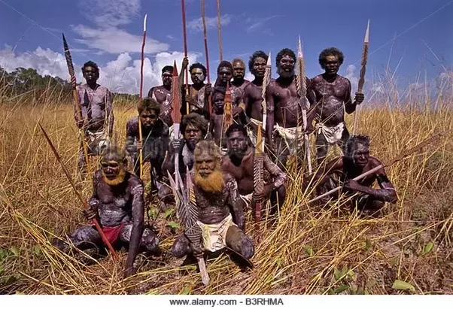
Document 1: The Founding of Australia by the Aborigines
Document 2: Establishing a Penal Colony by England
Document 3: Made Part of British Empire
What do I see, think, and feel exercise (handout)
Read and retell exercise with three passages (handout)
After doing the exercises, respond to these questions:
Statement: The Aborigines of Australia are very different from Native Americans in the United States and kept their land when the white colonists came. Agree _______ Disagree _______
Statement: England established a colony in Australia as a vacation spot. They liked Australia for its warm climate and nice beaches. Agree ___________ Disagree _____________
Statement: The British faced intense opposition when they landed at Australia. The Dutch, Spanish, and French explorers all claimed ownership of the land.
Agree _________ Disagree ____________

Slide 39
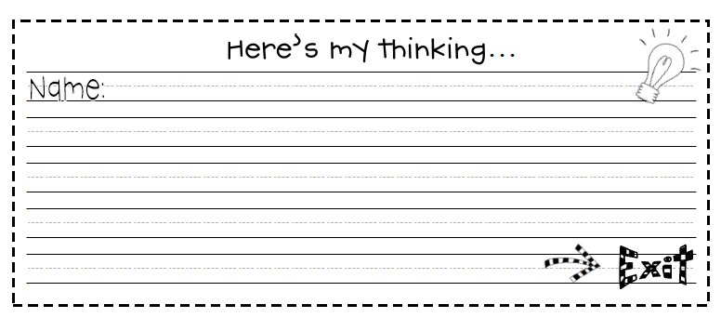
Journal Entry - Summing it All Up
In your own words, how did each historical event shape Australia today? Which historical event do you feel most shaped Australia to be what it is today and why? Be sure to include 3 key details. Use information discussed in class during visual discovery and read and retell!

Slide 40
Lesson 4: Document Analysis
Let’s Think Like a Historian!
How do we know what we know what we have learned about Melbourne, Australia is true?
SCIM-C

Slide 41
C - Conversation: Let’s talk about this lesson! We need to be respectful of everyone, so if someone else is talking, listen and then raise your hand to add to the conversation!
H - Help: Please do not hesitate to ask me any questions! I am here to help. Please raise your hand, and I will either call on you during our discussion or come to you during our activity.
A - Activity: Our activity today is called Thinking Like a Historian. We will be making a decision on whether we think the history we learned yesterday was valid or not.
M - Movement: We will be moving around the room! When we move we will go quietly, and we need to be careful and watch out for others and things on the floor.
P - Participation: Please participate as much as possible! We are here to have fun and the more you participate, the more fun we are going to have.
S - Success: Once you learn about SCIM-C and the documents you will be Thinking Like a Historian, and therefore you will be successful!

Slide 42
What is SCIM-C?
S- Summarizing
C- Contextualizing
I- Inferring
M- Monitoring
C- Corroborating

Slide 43
Summarizing
1. What type of historical document is the source?
-Primary(original document, artifact, diary etc. created by the person themself)
-Secondary(articles, journals etc. created later by someone who did not experience the event first-hand)
2. What specific information, details, and/or perspectives does the source provide?
3. What are the subject, audience, and/or purpose of the source?
4. What does the source directly tell us?

Slide 44
Contextualizing
1. Who produced the source?
2. When, why, and where was the source produced?
3. What was happening locally and globally at the time the source was produced?
4. What summarizing information can place the source in time, space, and place?

Slide 45
Inferring
1. What is suggested by the source?
2. What conclusions may be drawn from the source?
3. What biases are indicated in the source?
4. What contextualizing information, while not directly evident, may be suggested from the source?

Slide 46
Monitoring
1. What is missing from the source in terms of evidence that is needed to answer the guiding historical question?
2. What ideas, images, or terms need further defining from the source in order to understand the context or period in which the source was created?
3. How reliable is the source for its intended purpose in answering the historical question?
4. What questions from the previous stages need to be revisited in order to analyze thesource satisfactorily?

Slide 47
Corroborating
1. What similarities and differences exist between the sources?
2. What factors could account for the similarities and differences?
3. What gaps appear to exist that hinder the final interpretation of the source?
4. What other sources are available that could check, confirm, or oppose the evidence currently marshaled?

Slide 48
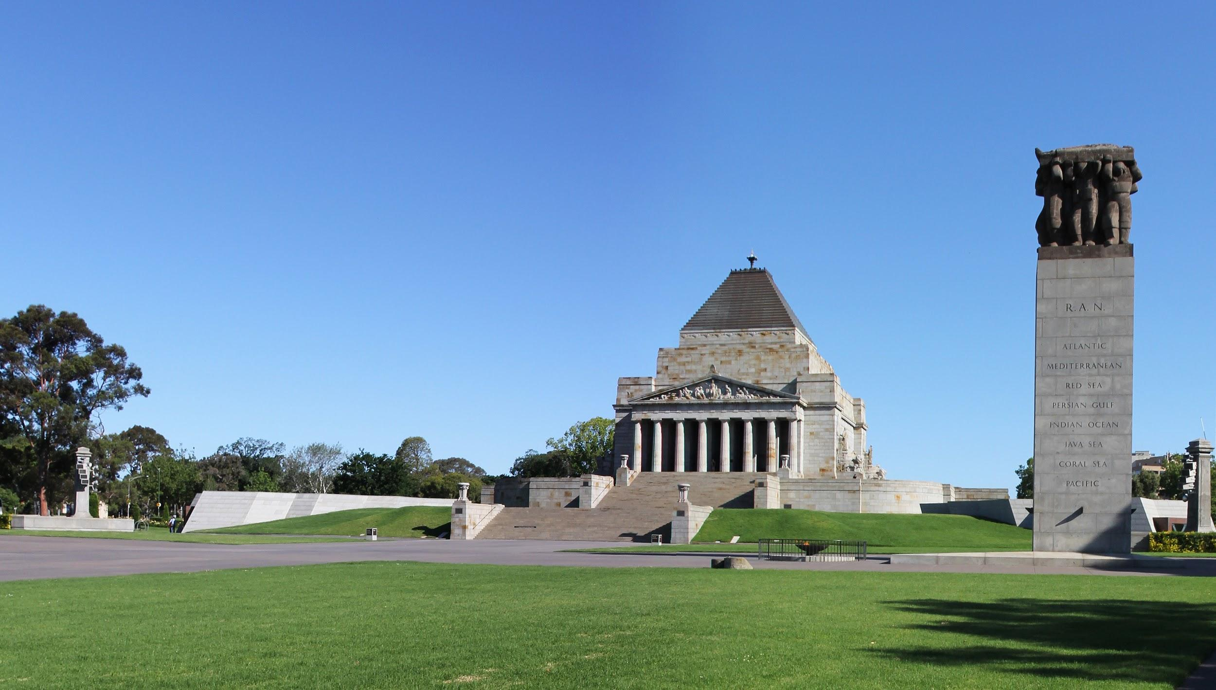
Shrine of Remembrance
“The Shrine of Remembrance served to honor those who went off to fight for their country in World War I, and for those families to have a place to grieve.” (The Shrine of Remembrance, 2011).

Slide 49
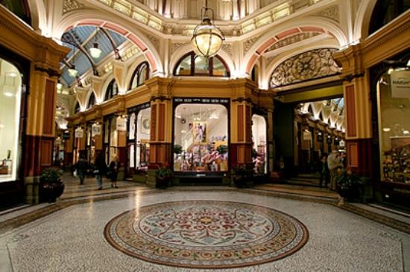
Block Arcade
The Block Arcade is a popular hangout area in town, that was built between 1891-1893. (Block Arcade, 2018).

Slide 50
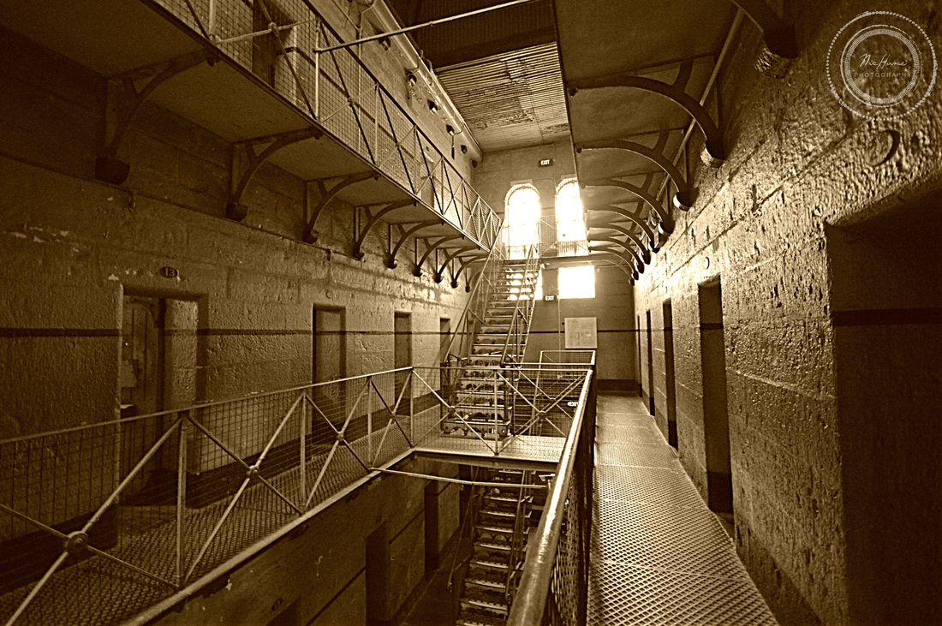
The Old Melbourne Gaol
The Old Melbourne Gaol was built in the mid-1800’s where dangerous criminals, petty offenders, the homeless, and the mental ill stayed for many years.
(The Old Melbourne Gaol, 2018).

Slide 51
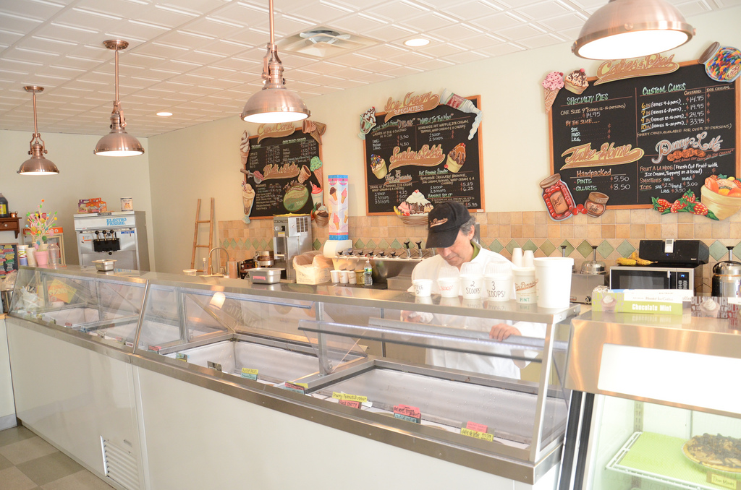
Five Pennies Creamery
Dan Levine, the creator of Five Pennies Creamery has owned this storefront ice cream parlor for more than 40 years. (Five Pennies Creamery, 2018).

Slide 52
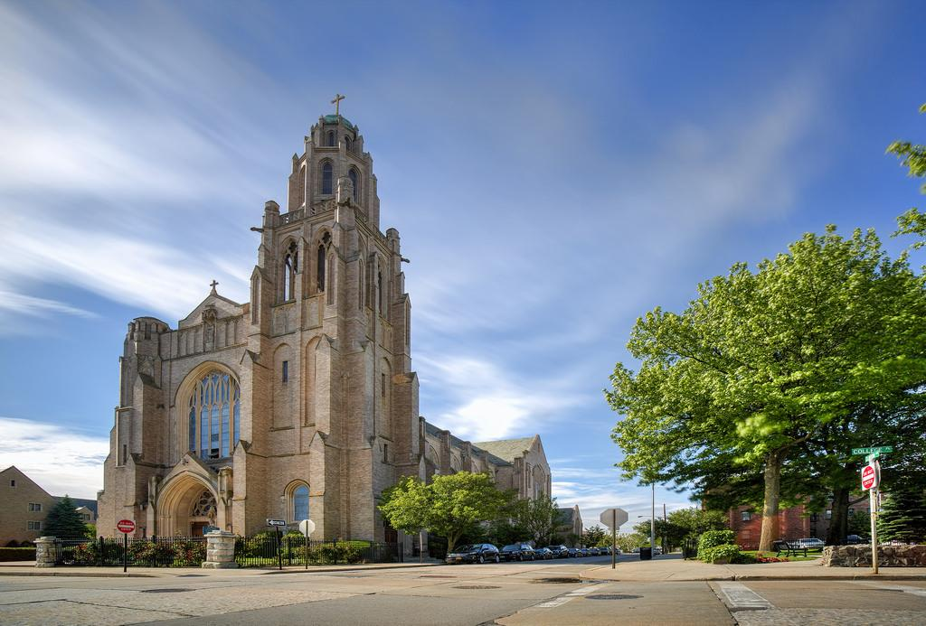
St. Agnes Cathedral
St. Agnes Cathedral is popular in town. It is remained Catholic, and still has offerings for many masses, religious instruction, and gatherings. (St. Agnes Cathedral, 2018).

Slide 53
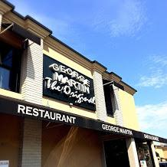
George Martin, The Original
George Martin, RVC’s genuine American Bistro has been around since 1989.
(George Martin, 2018).

Slide 54
Now it’s your turn! Exit ticket Valid? Or Not?
Historians, please use the ‘Document Review’ sheet of the photographs and statements we discussed as a class to determine which document you think is most valid, or not valid. Use the SCIM-C method to help you answer the choice you made for the photograph and statement that you chose. This should be about 3-4 sentences along with two facts explaining why you feel this way.
Good luck!!

Slide 55
Historian HOMEWORK!!
Historians, now that you have all decoded these pictures for both Melbourne and Rockville Centre, your next job is to figure out if this quote/document is valid? Based upon what we have learned today, use the SCIM-C method to help you. Good luck historian!!
“We’re definitely urbanized...I believe in people living in the downtown and being able to walk to places.”- said by Francis X. Murray (Mayor of Rockville Centre) during an interview for the Wall Street Journal, April 1st, 2016.
Summarizing: What does the source directly tell us?
Contextualizing: Who produced the source?
Inferring: What conclusions may be drawn from the source?
Monitoring: What additional evidence beyond the source is necessary?

Slide 56
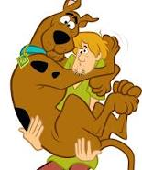
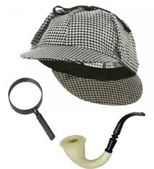
Lesson 5: History Mystery
Calling all detectives! Grab your magnifying
glasses, put on your trench coats, and get
ready to find some clues because….
It’s time to SOLVE A MYSTERY!!!

Slide 57
Filling Our Detective Tool Kit
What is a mystery?
What do detectives do?
What is evidence?
What tools do detectives use?
Can you think of anyone you know that solves mysteries?
What makes evidence
a good “clue”

Slide 58
Let’s Solve the Mystery Like CHAMPS Today !
C- CONVERSATION: Please talk only if you raised your hand and have been called on. You will have the opportunity to talk with your group when it comes time to solve the mystery.
H- HELP: If you need assistance raise your hand and I will be right over. While working in your groups ask the other members of your group your questions and see if you can answer it before calling me over.
A- ACTIVITY: Our goal today is to solve the mystery “Are the people of Melbourne Australia happier than the people of your own community in America?” and write a claim to support our answer
M- MOVEMENT: Please remain in your seas at all time unless given direction or permission otherwise. You will be given the opportunity to move around when solving the mystery.
P- PARTICIPATION: You are expected to participate in class discussion. While working in groups you should offer help to your group. Be sure to fulfill your responsibility.
S- SUCCESS: Once the mystery is solved, be sure to write your supporting claim to support your successful finding!

Slide 59
Dear 3rd Graders,
We have been searching for the best detectives to solve an important mystery about the happiness of two communities. The first, is your very own community of Rockville Centre, NY, and the second is the community of Melbourne, Australia.
As a special detective, you will be given clues to help you solve this important mystery. This job will require you to look at the evidence given to you and decide as a group which community is happier.
This mission will ask you to determine “what is happiness” to you. It is important to remeber that there is no right or wrong answer. This is a difficult task so you must work together to solve this mystery!
Notes:
source

Slide 60
Jobs Responsibilities
JOB NAME | RESPONSIBILITY
Scooby-Doo | Give out information and make sure everyone understands what happiness means
Shaggy (everyone) | This is everyone’s responsibility. Share your thoughts!
Fred | Manage group (time, jobs, etc.)
Daphne | Make sure your chart is ready to present to the class.
Velma | Share your group’s findings with the class

Slide 61
Remember To Use Your C.L.U.E.S.
C onsider all of the evidence given to you.
L ook for important information on each piece of evidence
U tilize everyone’s thoughts and skills
E valuate the evidence about each of the communities
S olve the mystery!

Slide 62
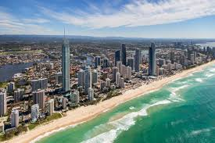
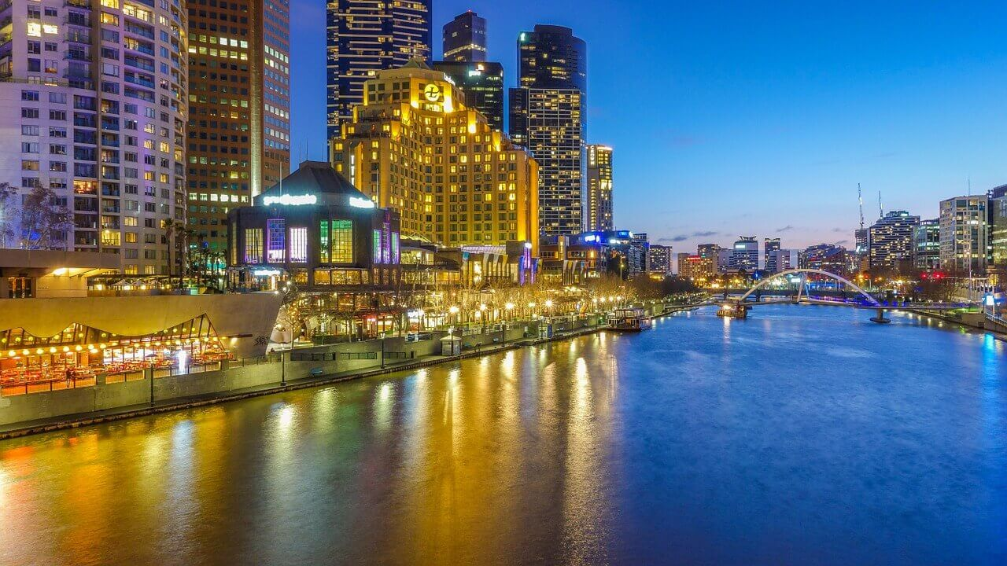
Some of the first images that come up on Google image search of “Melbourne, Australia”
Picture This!
What do you think of these images?
Would you like to live in a place that looked like this?
Is this different from how your community looks?

Slide 63
2. And Now a Word From Our Mayor….
In a yearly letter sent out to the community of Rockville Centre, the town’s mayor said:
“Rockville Centre remains one of the most desirable communities to live in and raise a family on Long Island.”
What does the mayor think of his town?
What does he say the town has to offer?
Do these things impact the happiness of a community?

Slide 64
3a. But What Do They Really Think? (Rockville Centre)
Daniella from Rockville Centre says….
“I like living here because there is so much to do here are so many ways to get involved, whether it be with the church or sports. I like the stores, the restaurants, and the schools. I like going out to lunch with my friends, going shopping, getting my nails done and also playing soccer in RVC. I'm typically busy with sports and school. I go to a school that Is not in RVC now, but that has given me the chance to meet so many people. There is so much to love about RVC and I'm so grateful to live in such a great town.”
What does Daniella think about her community?
Is she happy where she lives?

Slide 65
3b. But What Do They Really Think? (Melbourne)
Dean from Melbourne says……
Melbourne has 4 seasons but even though it gets really hot in the summer, in the winter it doesn’t get that cold and it doesn’t really snow. Melbourne is the sports center of Australia. The grand final for Australian football (different than American football), the Australian Open (tennis tournament), and The Melbourne Cup (greatest horse race in the world) happen here! There’s also so many great places to eat. One of my favorite places in Melbourne in Port Phillip Bay where you can go see penguins coming out of the water. We also have an awesome zoo here. I love living here and I can’t imagine living anywhere else!
What does Dean think about his community?
Is he happy where he lives?

Slide 66
4. How’s The Weather?
The sun shines about 185 days a year in Melbourne
The sun shines about 170 days a year in Rockville Centre
Do things like the weather change our happiness?
Are the amount of sunny days similar?

Slide 67
5. Population
In 2016 there were 24,571 people living in Rockville Centre
In 2016 there were 4,353,514 people living in Melbourne
Which community has more people?
Would you like living in a community with a lot of people?

Slide 68
Homework
Now that you have solved the mystery, let’s make our own piece of evidence to show the things that make us happy in our community.
Create a “Happiness Collage” of pictures and words that remind you of your community! Write 1-3 sentences describing your community and the pictures you chose.

Slide 69
Taking Informed Action: How can we help our school and community?
Third Grade
Can we make a difference?
YES!

Slide 70
CHAMPS
C- CONVERSATION: Please talk only if you have your hand raised and you have been called on. Be respectful of other classmates as they are talking. You will have the opportunity to talk with your team when it is time to plan your informed action projects.
H- HELP: If you need help raise your hand and I will call on you or come over to your desk. While working in your teams ask the other members your questions and see if you can answer it before calling me over.
A- ACTIVITY: Today we are going to look at issues that we face in our school and community. You will work in small teams to brainstorm school and community problems or concerns, you will choose one of your ideas as a team, and come up with a plan to take action.
M- MOVEMENT: Please remain sitting during class discussion and also when working with your team. If you need to get up and move please ask for permission. Absolutely no running in the classroom or
P- PARTICIPATION: You are expected to share your thoughts and be an active member of the class during class discussion as well as when working with your team.
S- SUCCESS: After choosing and planning your informed action project, be sure to fill out the exit slip questions.

Slide 71
What does taking informed action mean?
Informed action means having or showing understanding of a subject or situation and doing something about it.
Let’s take informed action to help our school and community!

Slide 72
Change the World in 5 Minutes
Watch what other students are doing to take action in their school and communities!
Begin to brainstorm ideas how you would like to take action to help your school and community.

Slide 73
Brainstorm with your peers how you would like to take informed action your school and community.
Fill in the graphic organizer as you brainstorming and discuss your ideas with your team!
After you are finished one member from each group will come up to the white board and list their groups ideas.

Slide 74
Planning and Taking Action
As a team choose one school or community informed action idea and plan how your team is going to take action. Be sure to write down your plans in the journal!
You will be given 40 minutes once a week for 3 weeks to take action. As you are taking action make sure to write in your journal your teams progress and your thoughts about the project!

Slide 75
Exit Ticket and Homework
Homework: draw an illustration how you think you informed action project will turn out. Make sure to put detail in your illustrations

Slide 76
Essay in the air
Fishbowl Lesson 7
Third Grade
Can we express what we have learned in writing?
Yes, we can!

Slide 77
champs
C- CONVERSATION: This is a speaking activity, so make sure to speak up and fulfill the role you play in your group! Make sure to give everyone a chance to speak and listen closely to what each group member has to say.
H- HELP: Raise your hand if you have any questions or need assistance during our activity - I will come over to help out!
A- ACTIVITY: Our goal today is answer an “essay in the air” on the question “Are the people of Melbourne Australia happier than the people of your own community in America?” Make sure to look at each document closely so you and your group can answer the question to the best of your ability!
M- MOVEMENT: This activity is a seated activity. Please stay seated for the duration of the activity.
P- PARTICIPATION: You are expected to participate in class discussion. While working in groups you should offer help to your group. Be sure to fulfill your responsibility and your role as a group member.
S- SUCCESS: We’ll walk away from this activity with a better understanding of how our community’s influence us and our happiness.

Slide 78
PICTURE A FISHBOWL...

Slide 79
The Time keeper
The Note TAKER
The Leader
The Fact Checker
The Four Roles...
Keeps a log of who is speaking and when.
Writes down the ideas that each person brings up.
Takes notes on the ideas that are discussed and the group’s opinions on each document, as well as the final question.
Identify concrete details and supporting commentaries.
Ensure the rest of the group stays on task and addresses the question and documents appropriately.
Allots time for each document. Ensures the group does not spend to much time on a document.
Checks that all of the group’s information is correct.

Slide 80
Lets Review!
Look at each document closely before answering the question.
Do your best to take on your role - think of it as your job!
Give each group member a chance to speak and voice his or her opinion.
Listen closely to make sure all information your group is talking about is right!
Speak up!

Slide 81
“Are the people of Melbourne, Australia happier than the people of your own community (Rockville Center) in America?”
Make sure to look at the documents closely before answering!

Slide 82
Homework
Choose two of the documents and search for outside information on them. In a brief journal entry (about five sentences) talk about…
Similarities and differences between the documents and the sources you find.
Where you found your sources. Search on the internet or through books, newspapers, and magazines. You never know where you might come across some useful information!
Think - do these sources match what the documents in the DBQ seem to convey? Or do they send a different message?

