Slide 1
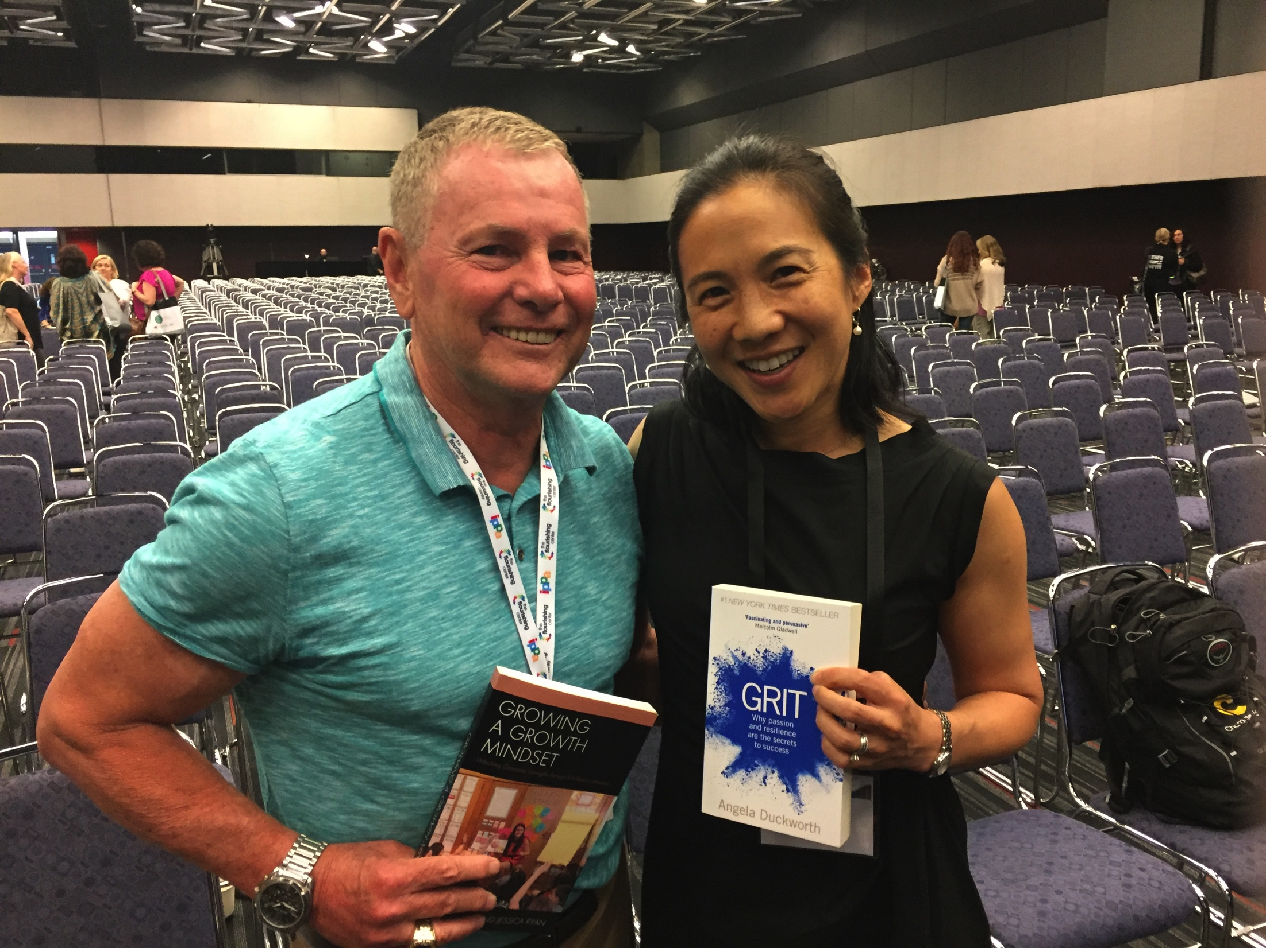
Positive Psychology Research:
KEY CONCEPTS
WHAT ARE THE SEL SKILLS YOU NEED FOR SUCCESS IN LIFE IN THE WORLD OF WORK?
Dr. Kevin Sheehan
Ksheehan1@molloy.edu
Molloy College
Twitter: @sheehank11
(516) 323 3129

Slide 2
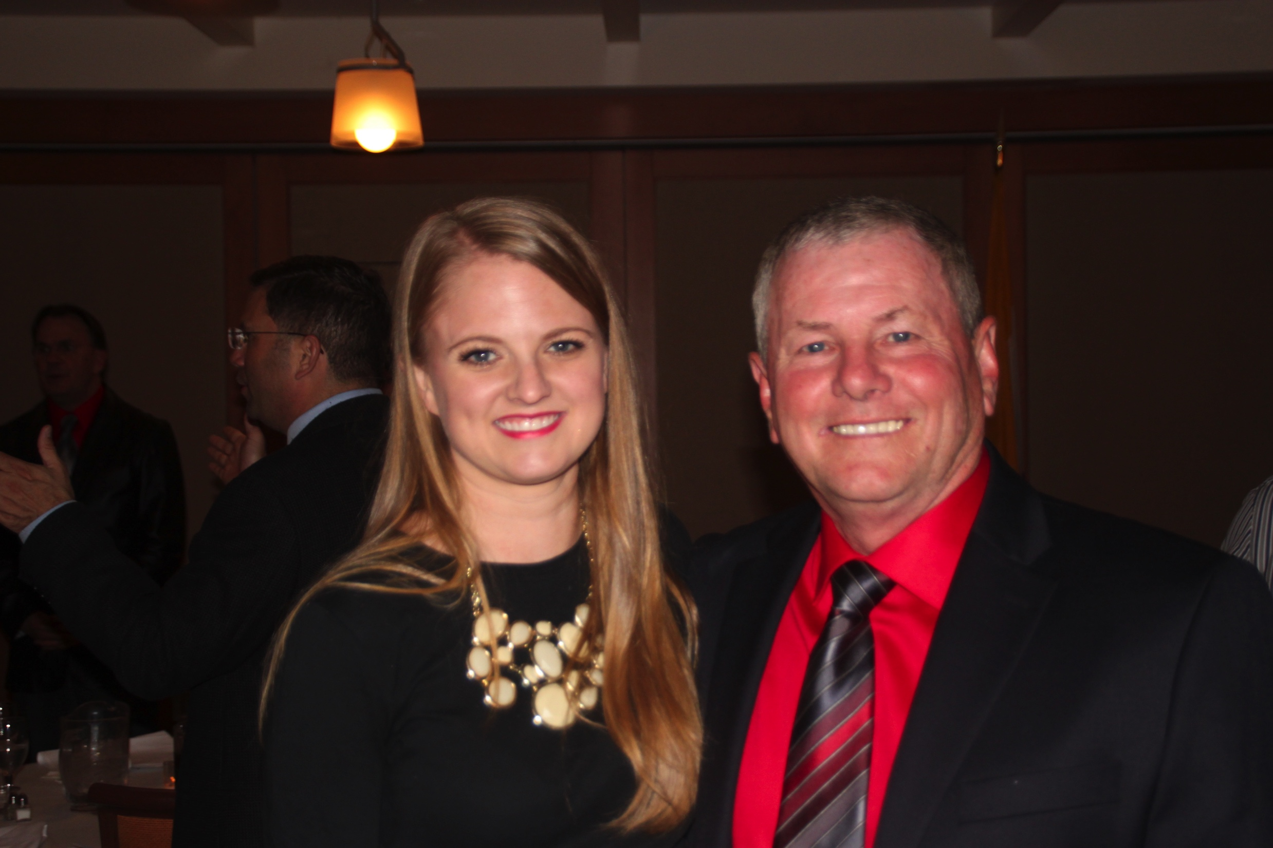
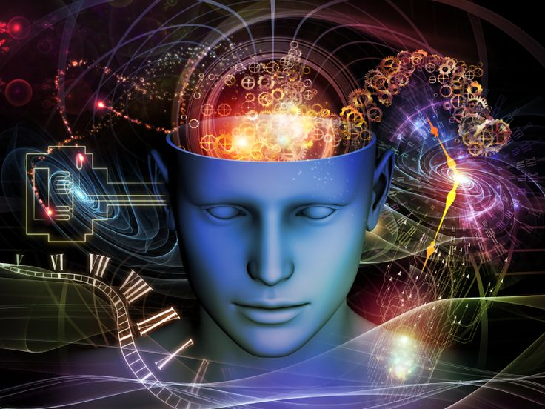
The Conversation in Our Heads:
My Hope Creator Dr. Sage Rose
ONE PERSON CAN CHANGE EVERYTHING
Hope and the Conversation in Our Head

Slide 3
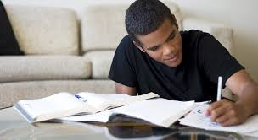
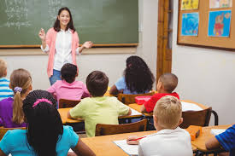
THE ACTIONS THE ACTIONS
OF THE LEARNER OF THE TEACHER
Which factor most is most affects
learning?

Slide 4
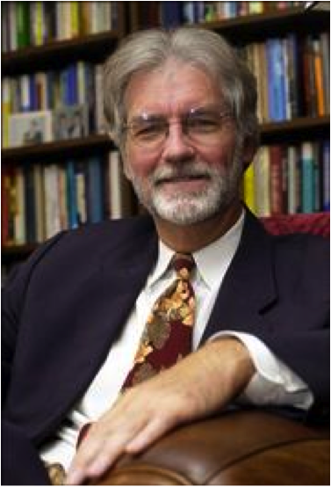
THE OTHER SIDE OF EXCUSES: C. R. SNYDER
The OG Hope Creator
HOPE (BELIEF)
THE WAY AND THE WILL
is the measure of our will to achieve a goal, our agency, added to our knowledge of what we have to do to achieve that goal, pathways, the ways to achieve a goal

Slide 5
Self Belief: Hope Theory:
Children’s Hope Test: The Will and the Way
1. I think I am doing pretty well.
2. I can think of many ways to get the things in life that are most important to me.
3. I am doing just as well as other kids my age.
4. When I have a problem, I can come up with lots of ways to solve it.
5. I think the things I have done in the past will help me in the future
6. Even when others want to quit, I know that I can find ways to solve the problem.
None of A little of Some of A lot of Most of All of
the time the time the time the time the time the time

Slide 6
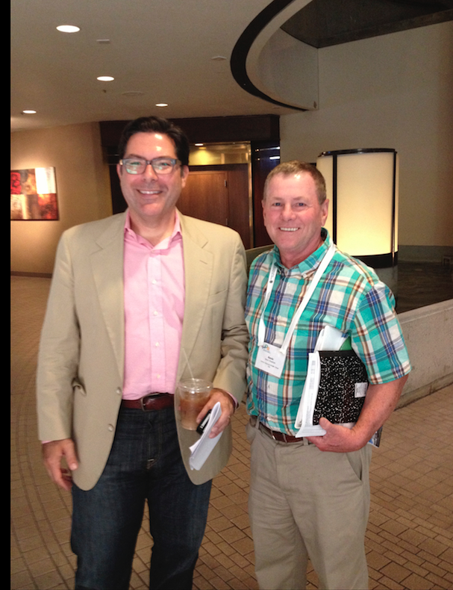
Shane Lopez’
THE RESEARCH ON HOPE
Better predictor of college completion than the SAT, ACT, HS GPA
Four times more likely to not finish college with low hope than low ability
Research of Dr. Rose and Dr. Seirup confirms this statistic locally demonstrating that low hope students on probation are at greatest risk of dropping out.
Shane Lopez Gallop Poll 2012

Slide 7
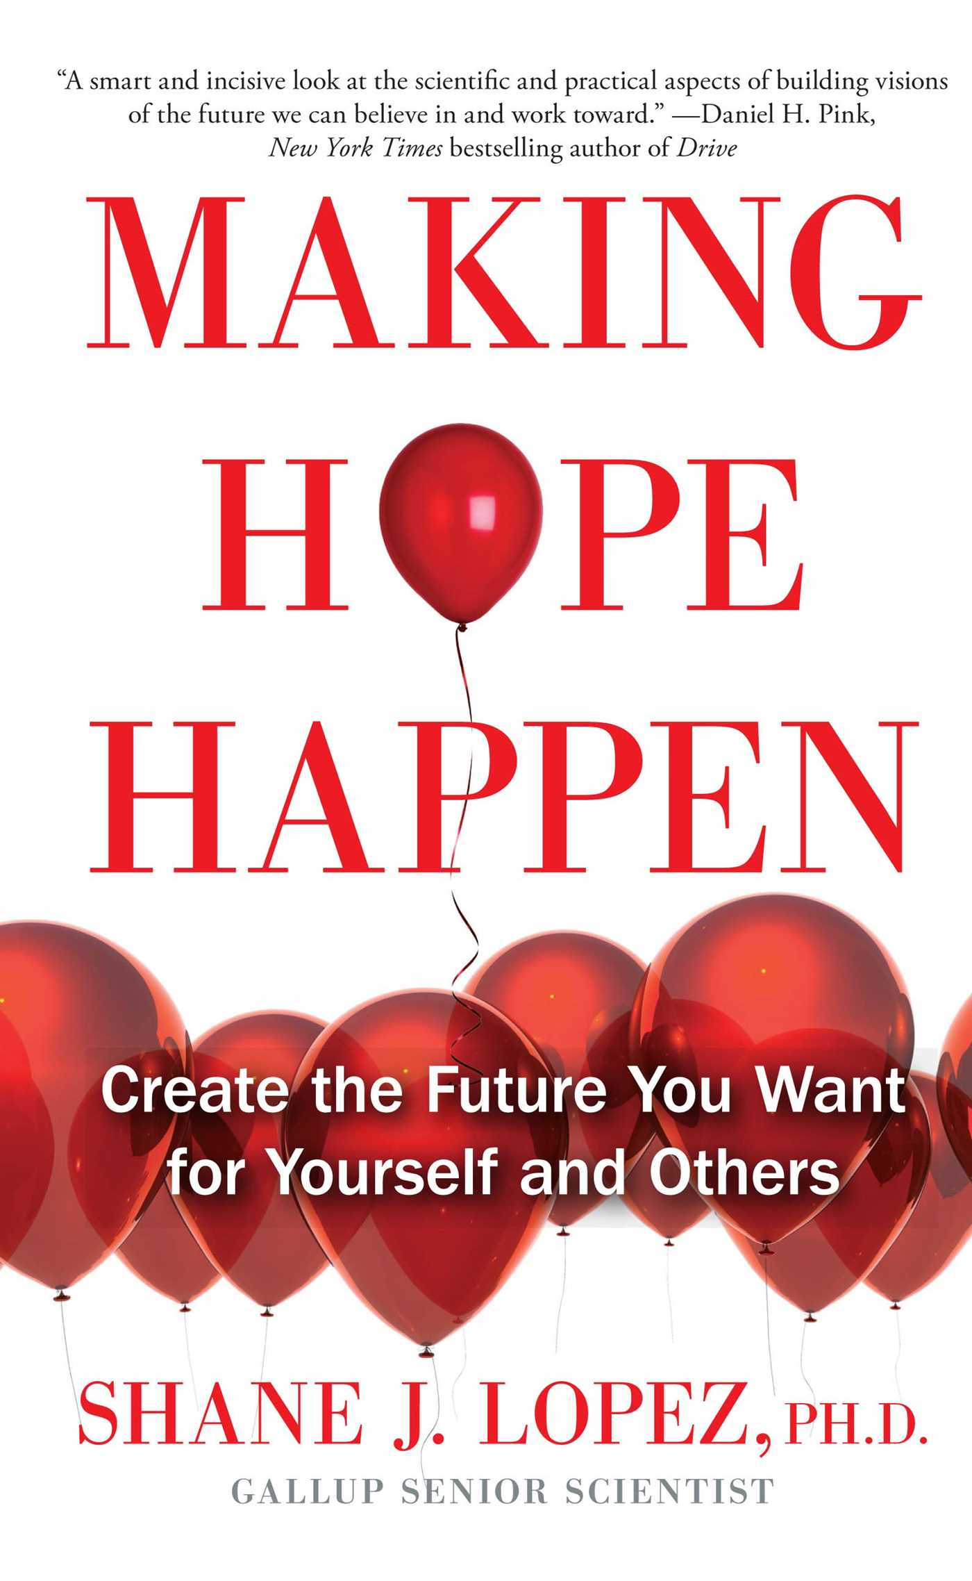
The Good News is Hope is a Way of Thinking:
If we can change our thinking, we can change belief
McDermott and Snyder (2000) worked with culturally diverse students in grades one to six, presenting the students with high hope stories and asking the students to identify goals and relate stories to their own life experiences. The pre and post test results indicated increases in students’ levels of hopeful thinking.
Making Hope Happen for Kids (Edwards and Lopez, 2000) was a five session program developed to increase hope in fourth graders. This program involved active learning approaches in which students acted out scenes of hope, created hope cartoons, played a hope game and reacted to hope stories. Again results on pre and post tests indicated significant increases in hope levels in the children involved in the program
Pedrotti , Lopez and Krieshok (2000) developed a version of this same program for seventh graders based on the Making Hope Happen program.

Slide 8
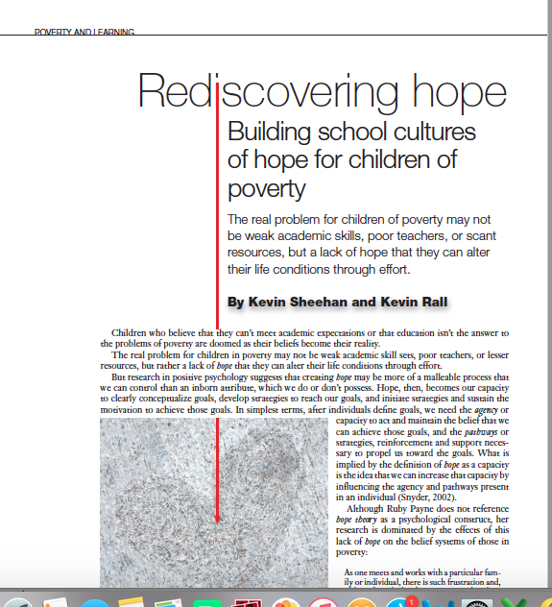
THEN I MET DUCKWORTH AND BECAME THE FLAVOR OF THE MONTH...
HER COMMENT THAT SHOCKED ME!

Slide 9
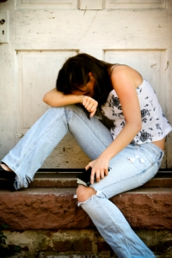
Oceanside Entreaty:
Outgrowth of Hope Research
America’s alternative school problem-little research
Over one million students in alternative settings (schools) who can do the work but don’t…
Oceanside approached me about their problem after my article on hope…
Oceanside
Castleton
academy

Slide 10

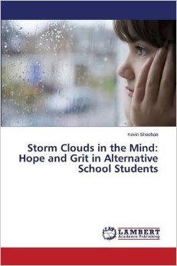
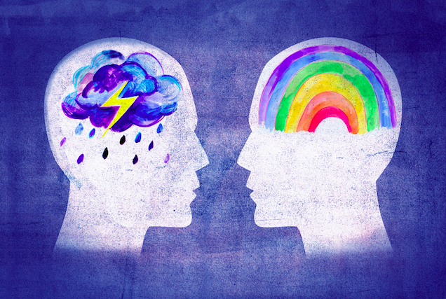
INITIAL RESEARCH:
THE ELEPHANT IN THE ROOM—
DOCTORAL STUDY
Have alternative school students lost hope?

Slide 11
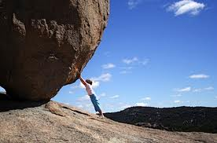
Sometimes, when we face obstacles, our hope is tested, our self-belief (hope) is truly tested!

Slide 12
“GRIT IS THE MEASURE OF HOW BADLY WE WANT A GOAL AND IT GIVES RISE TO OUR PERSEVERENCE ”

Slide 13
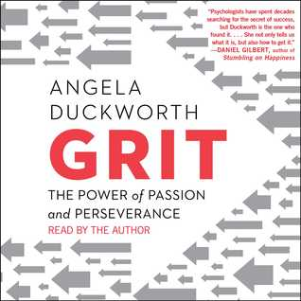
Grit and Dr. Angela Duckworth
Research Partner in My Doctoral Study
WHAT IF THE SECRET OF SUCCESS
IS FAILURE?
Is grit hope on steroids?…

Slide 14
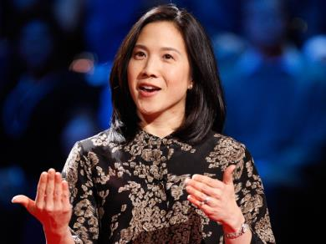
Dr. Angela Duckworth
Fails Well
Freshman at Harvard
Two Years at Penn meets with Dr. Seligman
What is it that makes us successful in life?

Slide 15
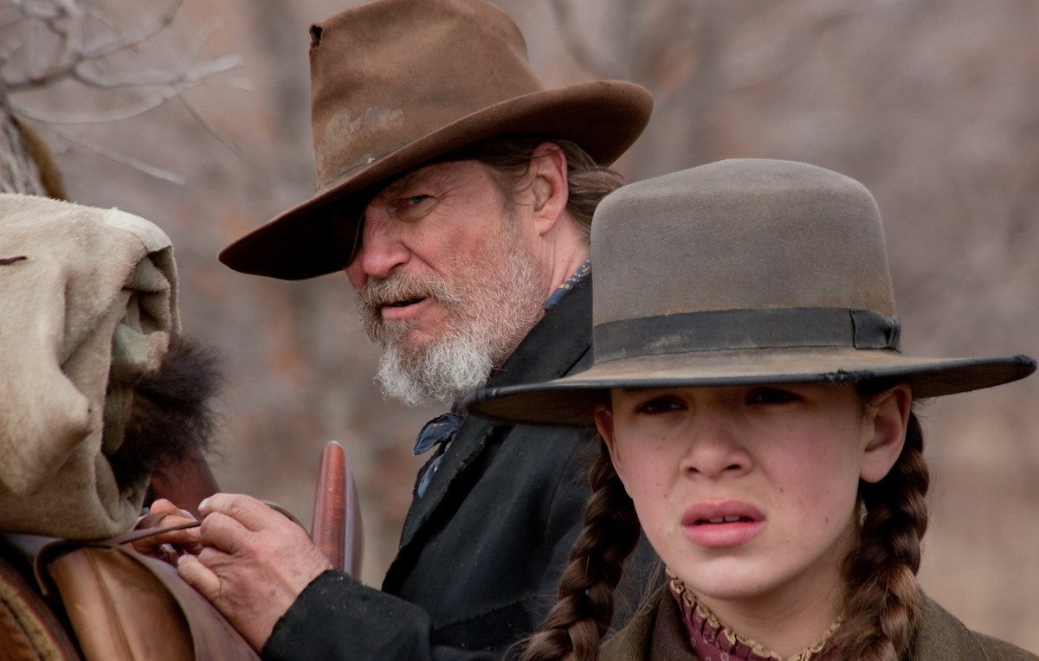
TRUE GRIT: THE MOVIE
GRIT IS WHAT HAPPENS WHEN OUR HOPE
IS TRULY TESTED
Grit means that you maintain hope over time, no matter what the obstacles you face.

Slide 16
Hope Feedback and Feedforward Model
Grit
Passion for the
Goal
Perseverance
for the Goal
Notes:
It might be interesting to make a new feedback model that includes grit to follow this. Maybe even happiness and life satisfaction?

Slide 17
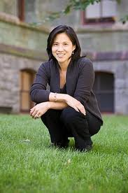
Dr. Angela Duckworth
Grit
Passion for a goal (How Bad Do You Want It?)
Perseverance for long term goals to Endure what is necessary to achieve a goal

Slide 18
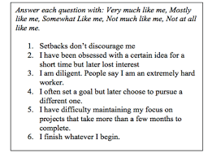
Dr. Angela Duckworth
Eight Questions
Passion=Consistent Goals
Perseverance—Not Giving Up in the Face of Obstacles
Her Doctoral Research: Resented in the World of Positive Psychology

Slide 19
Dr. Angela Duckworth
Grit:
A Measurable Research Construct
West Point Cadets
Spelling Bee Champs
Ivy League Graduates
NYC Teachers STAY FIVE YEARS
Duckworth Failed Well
At University of Pennsylvania
Passion for Long Term Goals
Perseverance to Achieve Long Term Goals

Slide 20
What is deliberate practice?
• Setting a specific stretch goal
• Concentrating 100%
• Get immediate and informative feedback
• Practicing repetitively until fluency
Deliberate Practice is hard and not that much fun!

Slide 21
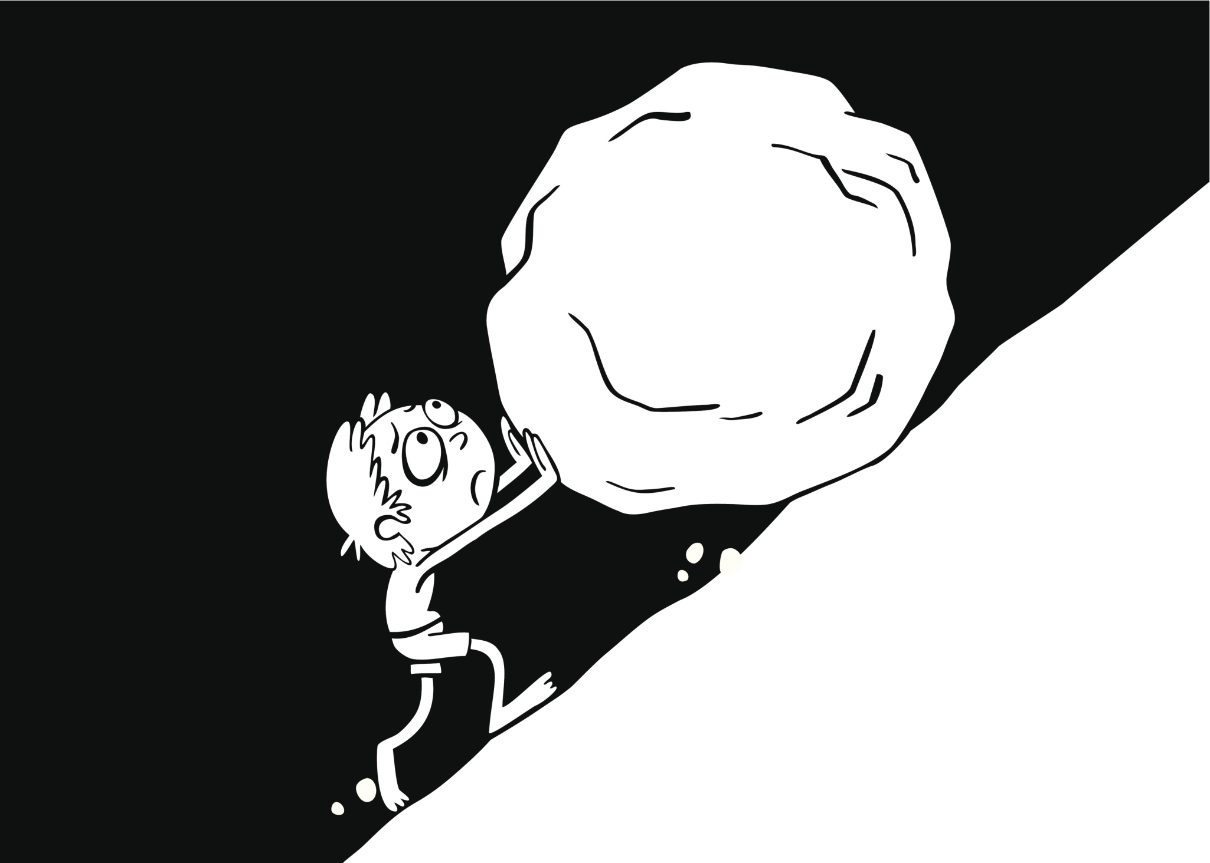
Grit Became a Simple Answer to Complex Academic Problems:
Politics of Grit
Notes:
It might be interesting to make a new feedback model that includes grit to follow this. Maybe even happiness and life satisfaction?

Slide 22
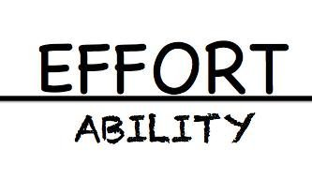

Slide 23
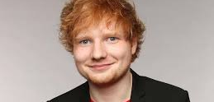
ED SHEERAN: FAILED WELL

Slide 24
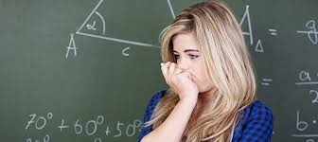
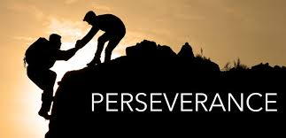
Is this correct?
Stop complaining and be more GRITTY.
I KNOW YOU HATE MATH, BUT SUCK IT UP AND DO IT!
Notes:
It might be interesting to make a new feedback model that includes grit to follow this. Maybe even happiness and life satisfaction?

Slide 25
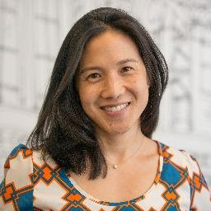
Was she right?
“I am the least gritty person that you know. I was a speech writer, worked in a think tank, a financial analyst, taught math in a charter school and worked for a non-profit. I did not start my doctorate until I was nearly 40!

Slide 26
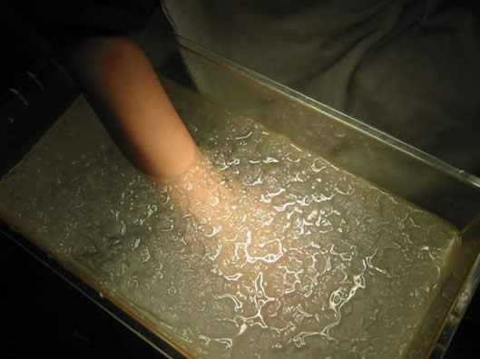
What happens when our hope is tested?
What is the Cold Presser test?
What does it mean?

Slide 27
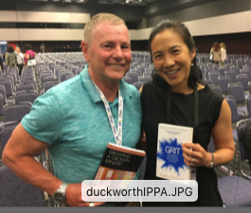
We need to shift our focus…
Character Strengths:
THE FLIP SIDE OF GRIT
There is a Flip Side to Grit. Grit instills in students the idea of deliberate practice. We have to work hard at those things that are most difficult for us. We need this to be successful in life or to be experts in our field.
The Flip Side is that all of us have strengths that define who we are and flow as part of our character.
These character strengths are often telling us what life is calling us to do, if only we are listening.

Slide 28
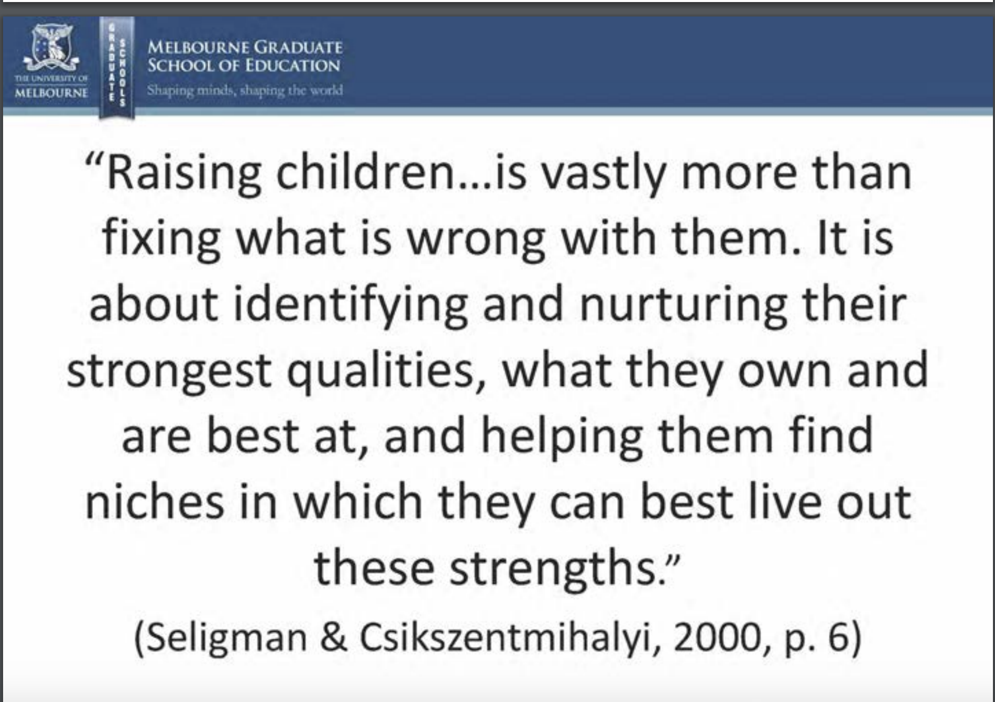

Slide 29
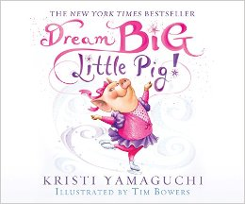
CHARACTER STRENGTHS:
Megan Pavlick
This book frames the story and creates
a cognitive map for the lesson to follow. The pig finding his strength is a metaphor that each student must find their own music
(Strengths: Viame.org)..

Slide 30
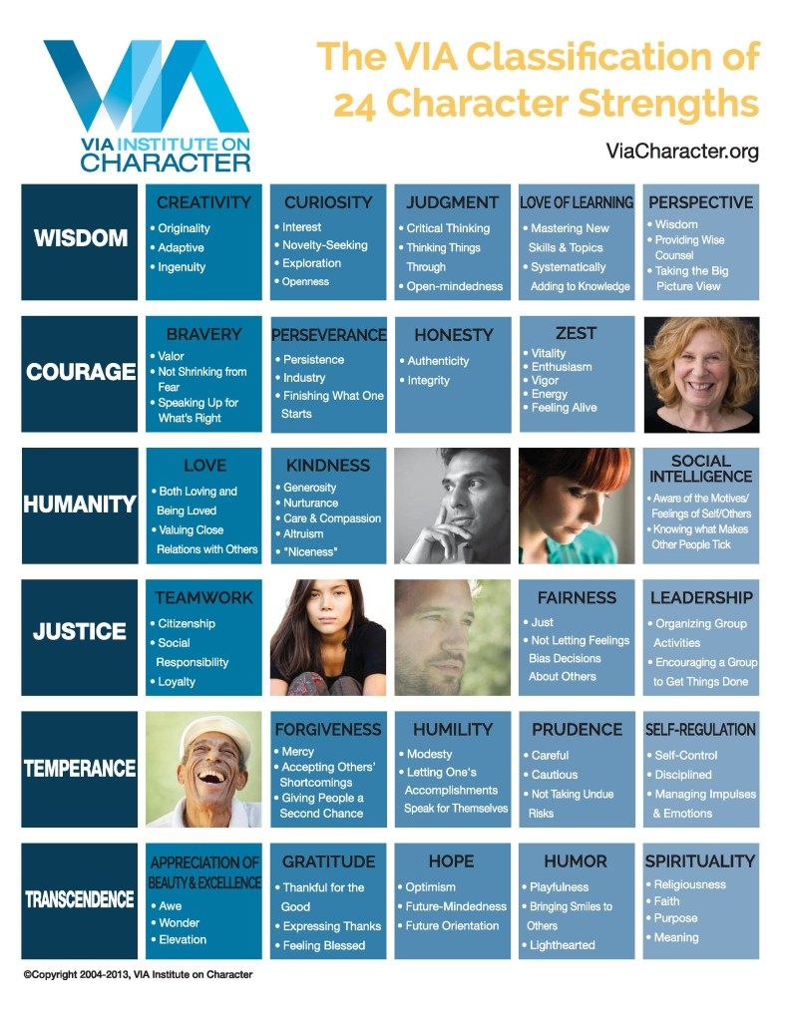
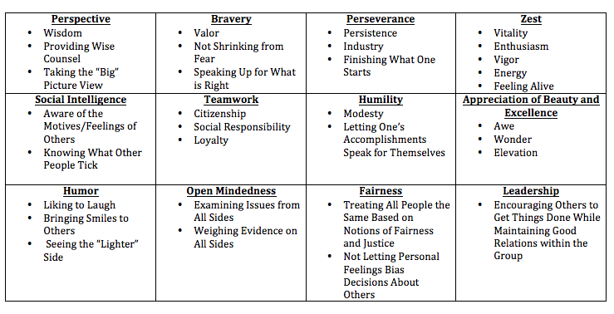
Maybe your strengths and your students’ strengths are more important than their weaknesses
(VIAME.ORG—FREE ANALYSIS OF STRENGTHS)

Slide 31
Let’s Do an Example: Hamilton vs. Jefferson

Slide 32
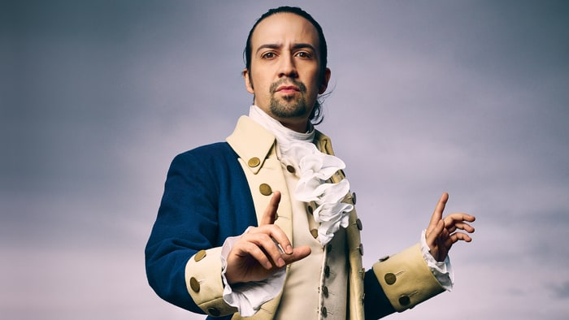
Click on the picture and the song plays

Slide 33
Students first discuss and use evidence from the documents to reveal Hamilton’s strengths in small groups...

Slide 34
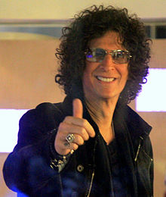
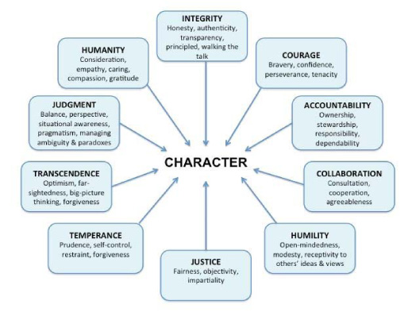
There is a flip side to grit, suck it up and work harder at what you struggle with, is our character strengths, what we are naturally good at and directed towards.
In the end, these strengths define, not only who we are, but the quality of our life...

Slide 35
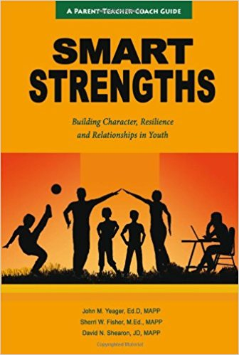
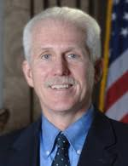
Helping Your Students
Discover Their Strengths

Slide 36


t
SMART Strengths
Spotting | When you know your own strengths, you are better observers of strengths in others and are more attentive to spotting what is good instead of trying to find fault.
Managing | Your strengths are a family of traits that can be combined, tapped, and promoted for bringing out the best in you and others.
Advocating | Learning how to advocate with your strengths will help you to build a bridge from yourself to others. When you put your learning into your own words, you can effectively convey both your strengths and needs.
Relating | Good relationships are about using strengths while connecting with and appealing to others. Sometimes strength buttons get pushed when other people’s strengths are in conflict with your own.
Training | Once you have tools, approaches, exercises, and techniques to use in helping you spot, manage, articulate, and relate your strengths individually and in relationships, you will want to use them to develop these skills in others.
Copyright © 2011 J. Yeager, S. Fisher, and D. Shearon
Notes:
Connect SMART Strengths to the development of resilience, relationships: Training and living the model

Slide 37
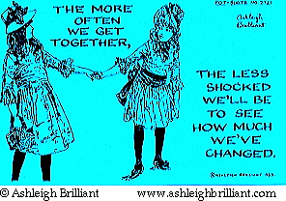
SMART Strengths
Identify enabling conditions that make creating a strengths-based culture possible.
School Climate

Slide 38

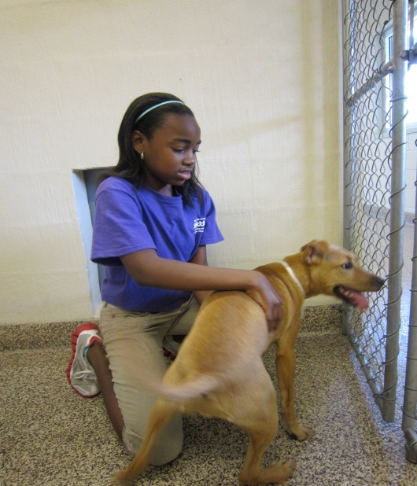
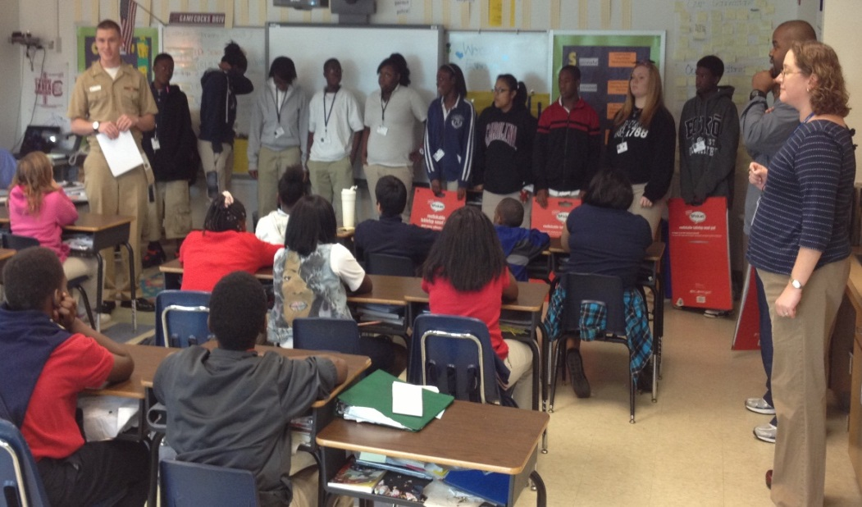
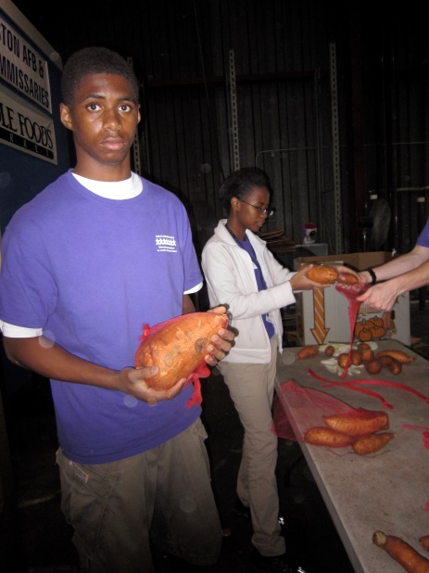
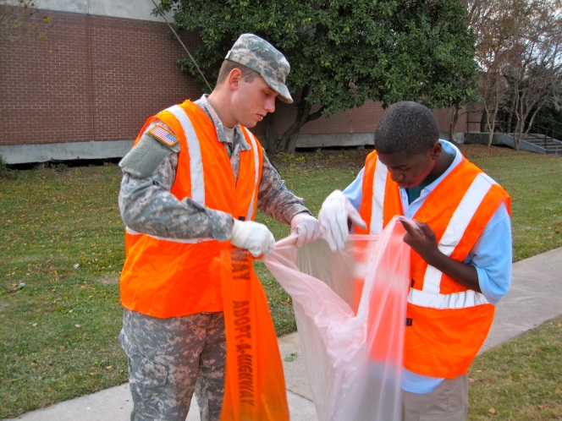
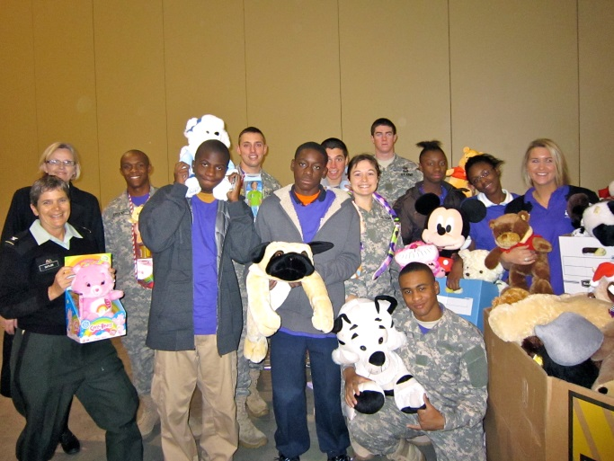
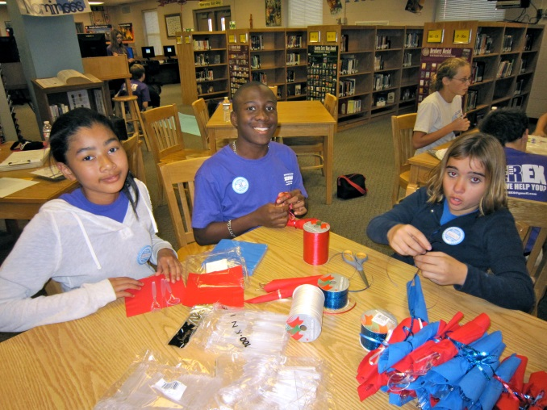
Applying strengths to help others

Slide 39

SMART Strengths
Incorporate a focus on strengths into the school mission.
“Culver educates its students for leadership and responsible citizenship
in society by developing and nurturing the whole individual – mind, spirit,
and body – through integrated programs that emphasize the cultivation
of character. “

Slide 40
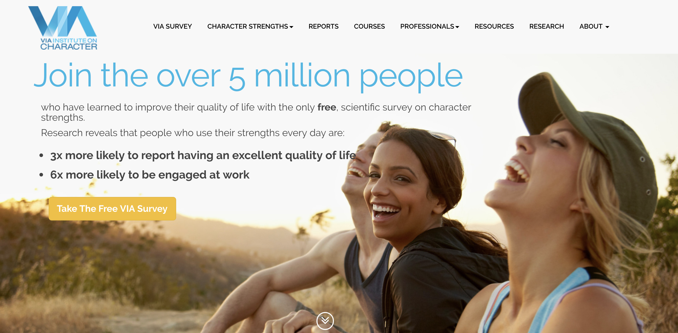
Viame.org (University of Pennsylvania)

Slide 41
The people who we study in history are people made up of character strengths and flaws?
(VIAME.ORG—FREE ANALYSIS OF STRENGTHS)

Slide 42
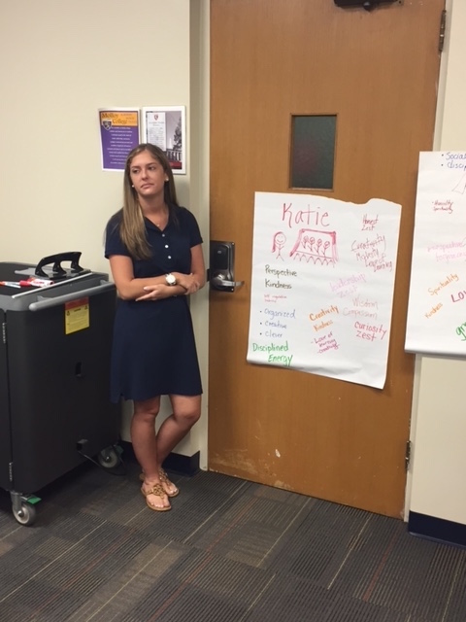
Strengths 360-
Helping Your Students
Discover Their Strengths

Slide 43
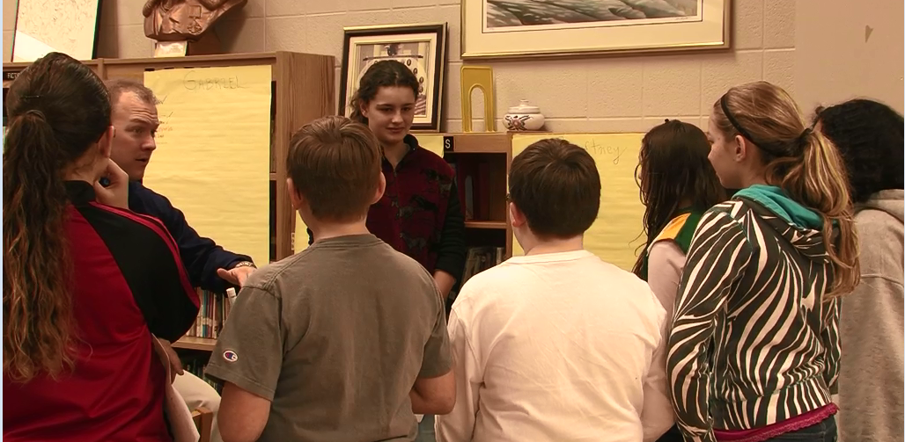
Strengths 360: For Next Tuesday
ONLINE

Slide 44
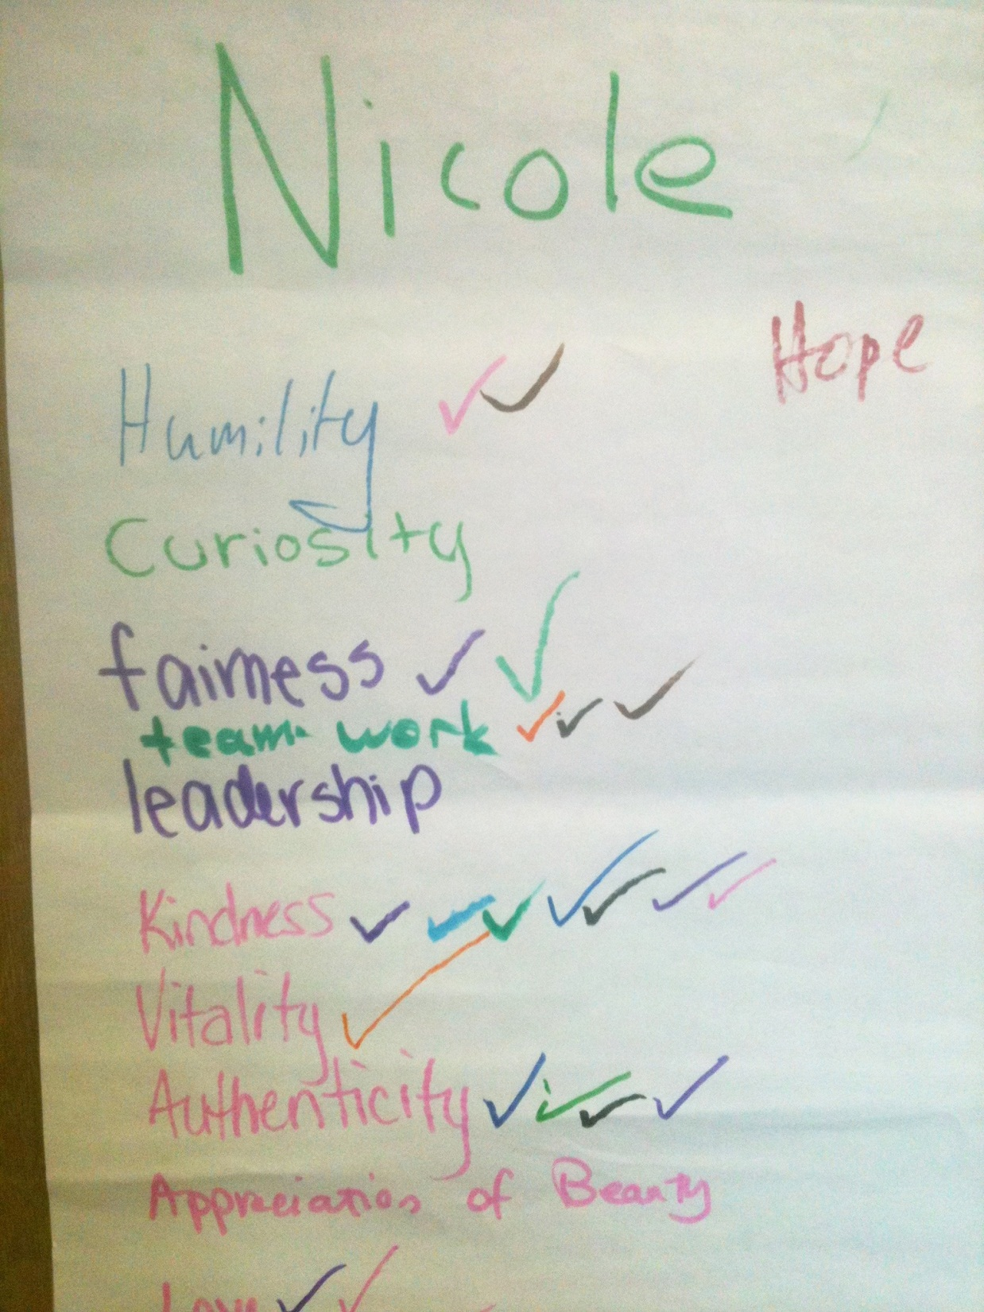

Slide 45
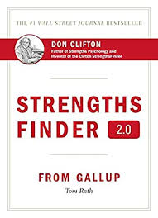
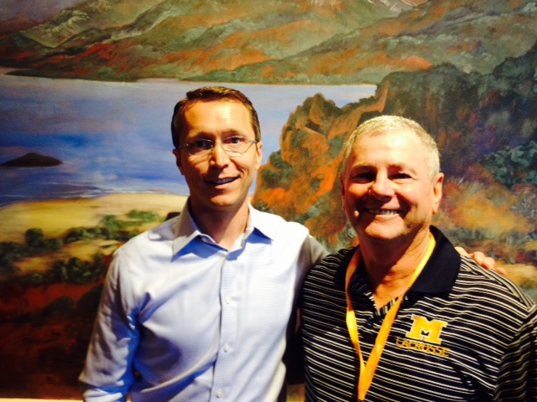
Gallup Poll: Clifton Strengths Finder
Costs Money

Slide 46
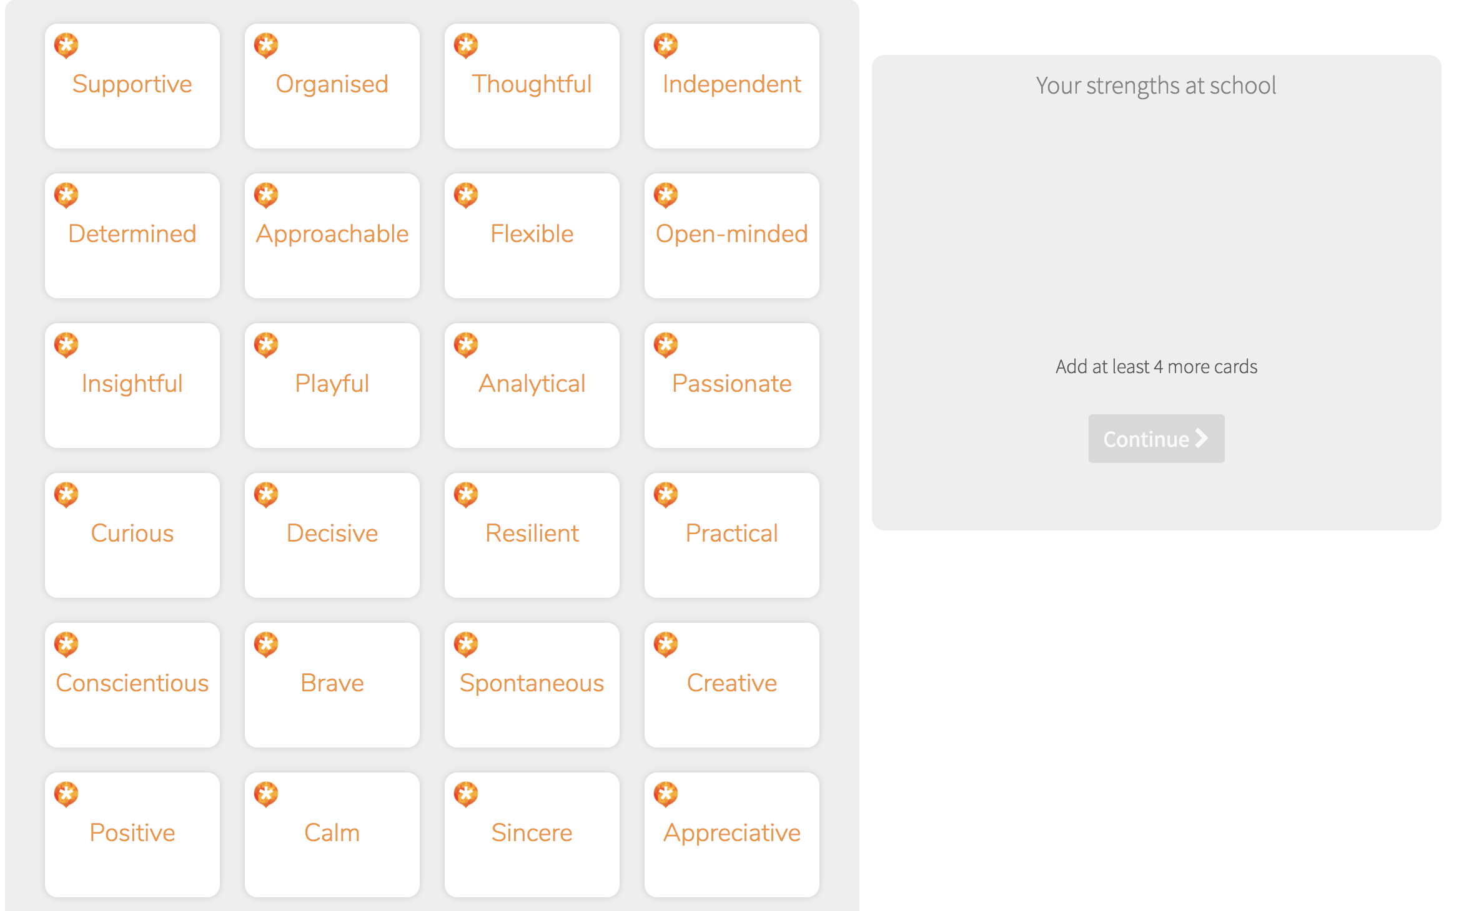
More Elementary Approach:
AtMyBest.Com (England)

Slide 47
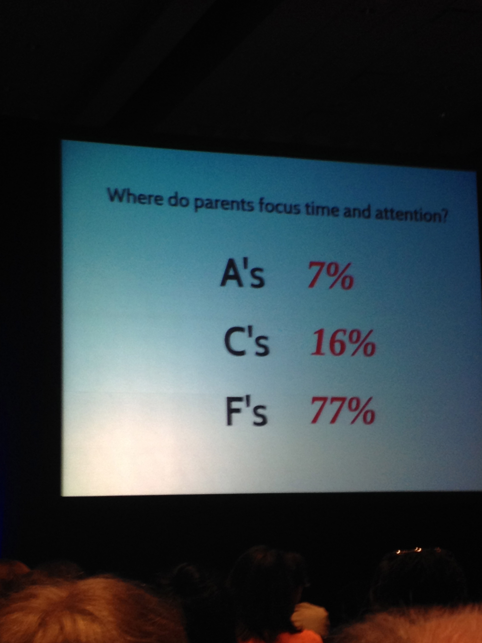



Slide 48

Why Do We Focus So Much on our Weaknesses?

Slide 49

Where Does Negativity Bias Come From?

Slide 50

What negativity bias feels like to our kids

Slide 51


Of all the research that we have
done in education, less than 4% deals with how
to successfully parent?
Dr. Lea Waters has done most of it!
There is a flip side to grit and growth mindset,
Nothing is more dangerous than an idea, when it is the only one you have…

Slide 52

Help for Teachers and Parents

Slide 53

Newest Book that Challenges Grit

Slide 54
SUSTAINING GRIT: How You Can Teach It?
PERSERVERANCE
Students made strong connections with a young reader as they listened to the story of Justin Allen.

Slide 55



WHAT IS THE SECRET INGREDIENT IN GRIT?
PASSION-DRIVEN BY
OUR STRENGTHS
  THREE STORIES TO TEACH ABOUT CHARACTER STRENGTHS…
STRENGTH FINDING
GIRAFFES CAN’T DANCE
DREAM BIG LITTLE PIG
IGGY PECK: ARCHITECT
COMBINING STRENGTHS: SYNERGY
GOING PLACES

Slide 56

MY GOALS FOR SOCIAL STUDIES
WHY?: PUTTING CHILDREN IN FRONT OF CURRICULM
EMPATHY
HOW?: CREATING A BRAIN BASED LESSONS
ENGAGEMENT
WHAT OUTCOME IS HOPED FOR?:
REDISCOVERING HOPE-CHANGING THE WORLD
EMPOWERMENT
CREDIT: SIMON SINEK

Slide 57

WINNING THE GAME OF BELIEF (2017)

Slide 58

In his own words: Before the 2015 National Championship…..Charley Sullivan….Belief Creator

Slide 59


Slide 60
THE PURPOSE OF THIS THING WE CALL TEACHING…..
THE MAIN ROLE OF A TEACHER IS TO CREATE BELIEF IN OUR STUDENTS THAT THEY CAN LIVE ACHIEVE THEIR GOALS AND LIVE OUT THEIR DREAMS
STRONGLY AGREE AGREE DISAGREE STRONGLY DISAGREE

Slide 61
Remember to Check on the Conversations in
Your Students Heads…Teachers Are Hope Creators
Naïve Assumption on
the role of a Teacher

Slide 62



Martin Seligman
University of Pennsylvania
MAPP
The goal today is to share with you the most current research in the field of positive psychology to inform your practice. These findings have the power to transform your classroom as they did in the Seaford Manor School. What we are discovering in the field of positive psychology can positively affect the conversations in the heads of your students and can inform parents of the struggle that comes with learning and the fragile nature of belief.

