Slide 1
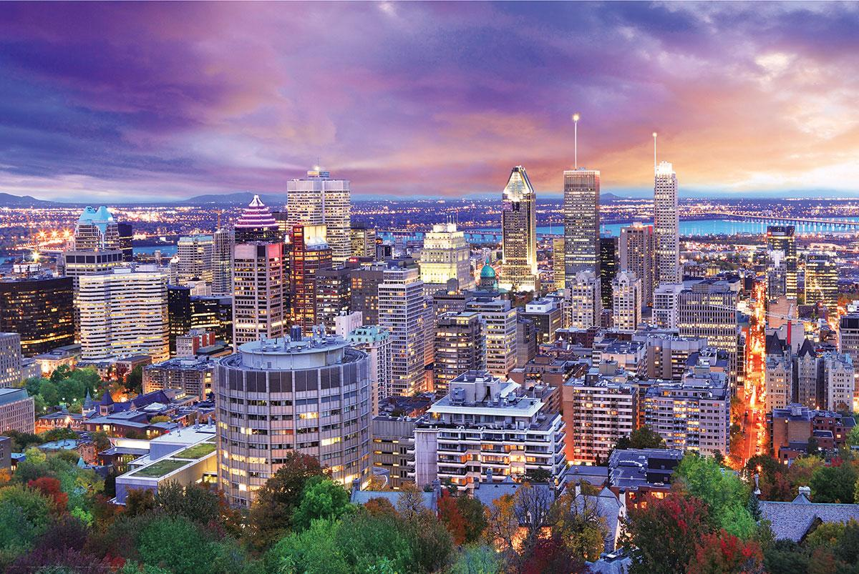
MONTREAL, CANADA
MARISSA CROCE, LAURA DREW, MARINA FOLEY, ANNIE JABLONSKI,
VICTORIA PALAZZO, ALEXANDRA RINCK, KATHERINE SCANDIFFIO

Slide 2
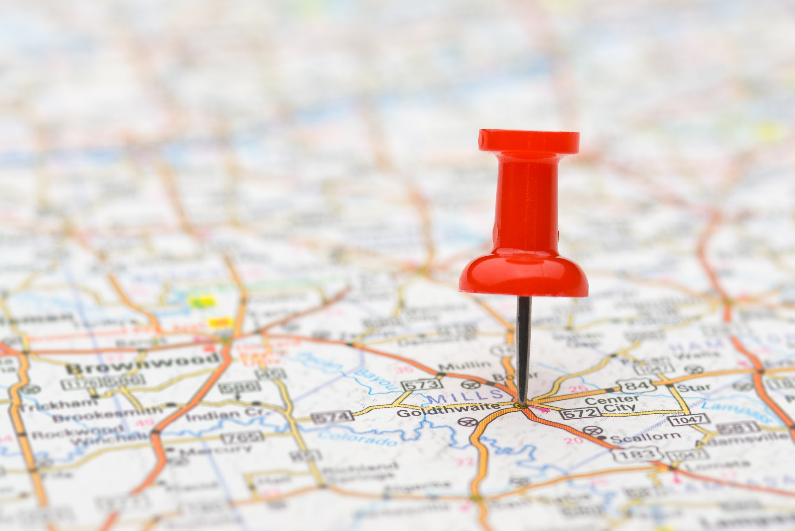
Lesson #1: Happiness
Ms. Palazzo
Does where you live in the Western Hemisphere determine your happiness?
What determines happiness?

Slide 3
We are CHAMPS!!!
Conversation: You will discuss the book How Full is Your Bucket for Kids and students will figure out what truly makes them happy: gaining material possessions or helping others.
Help: Students may raise their hands and ask questions if they are having a difficult time understanding the task.
Activity: We are going to read the book How Full is Your Bucket for Kids and as a class, we will complete a Book, Head, Heart activity to demonstrate what we learned. We will also learn about several types of happiness and discover what makes you really happy.
Movement: Students will come to the carpet before the teacher start reading the book. The students will be allowed to move around when necessary, such as to sharpen a pencil or asking a question.
Participation: Students will participate in a discussion about happiness and are expected to participate in all activities.
Success: Students will write the letter of gratitude to someone in their life who has made an impact in their life. Students will explain why they felt impacted and share what makes this person important, thus reinforcing why helping other people brings true happiness.

Slide 4
Let’s Look at a few scenarios where I felt happy!
The time I volunteered at the Mary Brennan Inn Soup Kitchen
For one of my classes at Molloy, we were required to volunteer at the local soup kitchen.
Each student was given a certain task to accomplish, whether you were preparing food or organizing clothes
This was a very eye-opening experience
Question is: Do you think this is true happiness?
The time I got a new cell phone
Cracked my old phone screen on a school field trip and had to wait for my upgrade to get a new one
Freshman year of college: I got the iPhone 6 and I was so happy that I replaced the phone with the cracked screen.
Question is: Do you think this is true happiness?

Slide 5
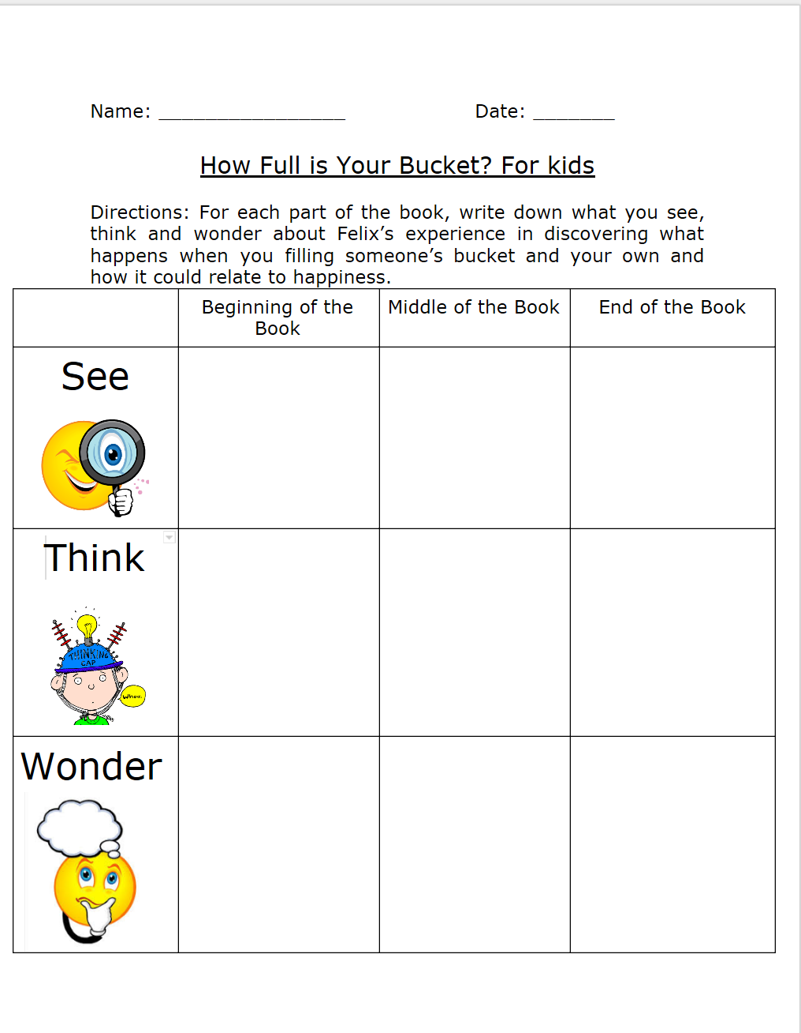
Let’s read the book to see if we can figure out what makes people truly happy!

Slide 6
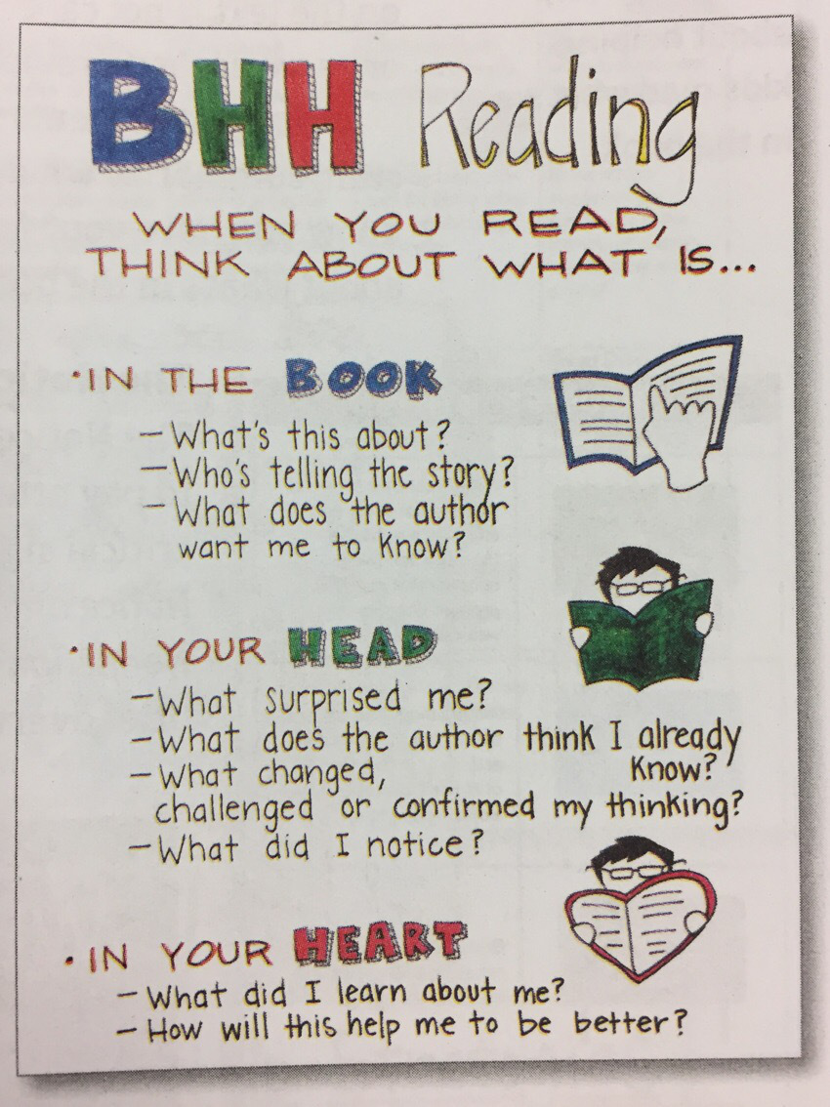
Book, Head, Heart Activity
Directions: After reading the book, How Full is Your Bucket? For kids, students will receive post-it notes and will answer the question(s) as posted and students will stick the post-its on the correct piece of chart paper.

Slide 7
Now let’s talk about the book!
Why do people feel bad when their invisible buckets are empty? Why do people feel good when their invisible bucket is full? What determines if the bucket is full or not?
What do we notice about Felix at the beginning of the day and how does it change by the end of the day?
How does filling someone’s bucket with positivity determine your happiness? Why is this occurring?
Name an example from the book that shows Felix’s bucket being filled from helping someone else?
How does the main idea from the book relate to happiness?
Why does helping other people make us happy?

Slide 8
What is happiness?

Slide 9
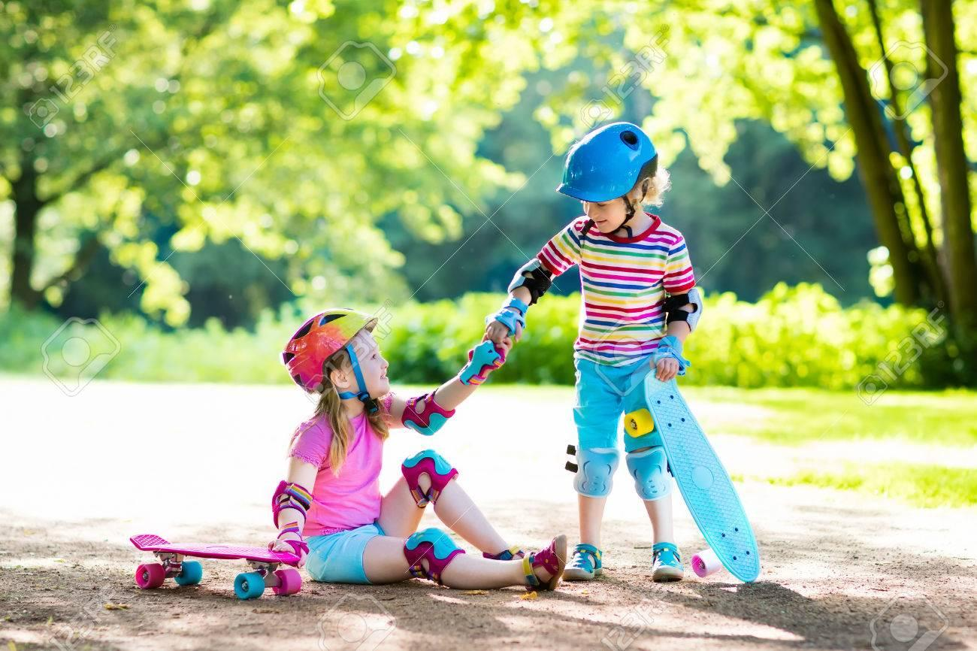
Happiness in relation to this lesson is...
Eudemonic Happiness vs Hedonic Happiness
(helping others) (gaining possessions)
*After reading the book, why do you think helping others is better than gaining possessions?

Slide 10
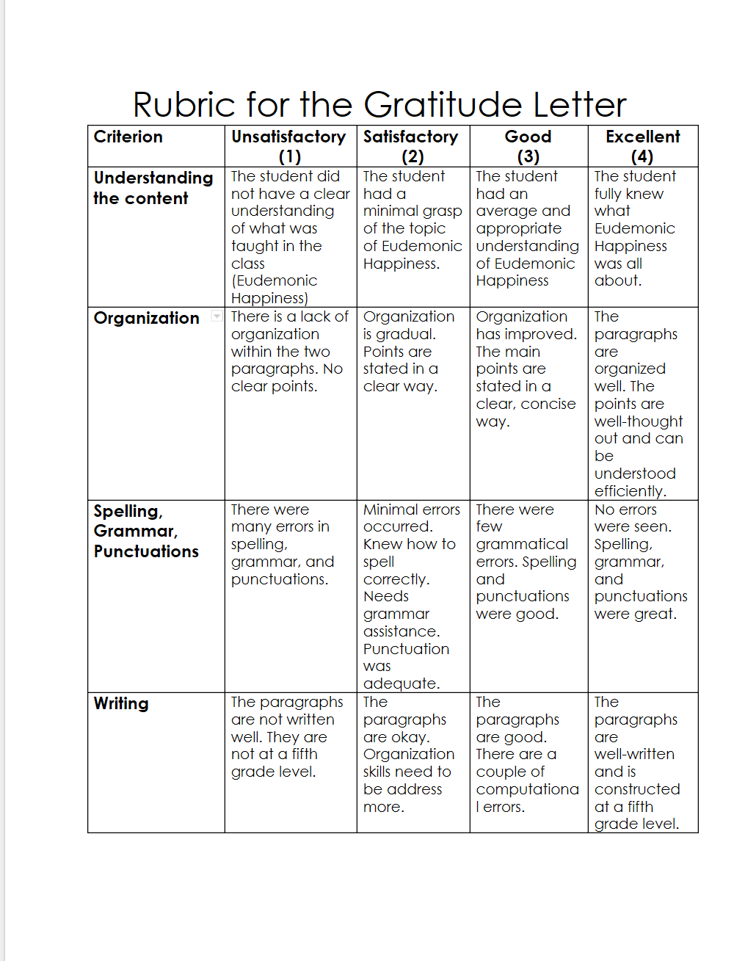
Time to spread some gratitude towards others

Slide 11
Let’s take this lesson a step further...
Why is it important that we discuss happiness in our social studies unit and in our everyday lives?
How does one’s happiness in Canada differ from someone’s happiness in the United States?
Name something about the United States and explain why it makes you happy? Can we experience a similar happiness in other countries in the Western Hemisphere? Why or why not?
What determines happiness?
h

Slide 12
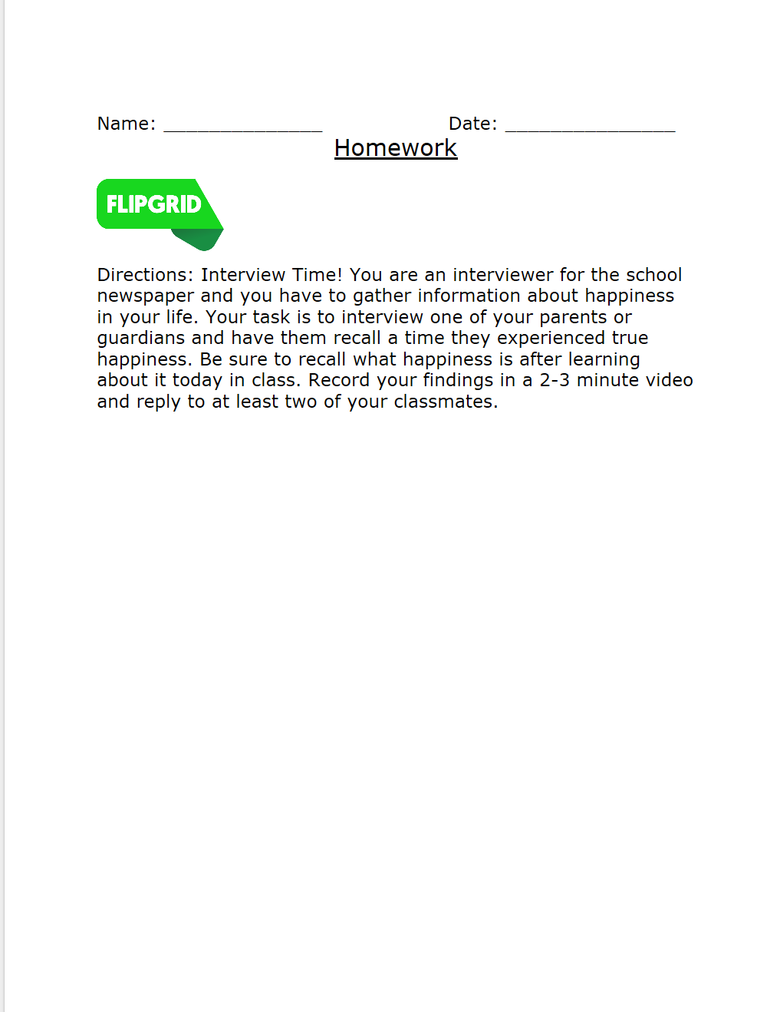
Flipgrid Homework Assignment

Slide 13
Lesson 2: Canadian Bus Tour!
Ms. Jablonski

Slide 14
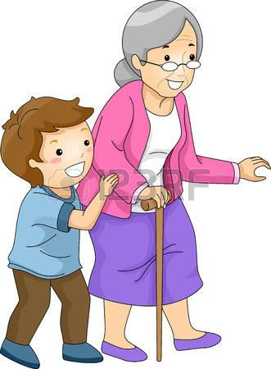
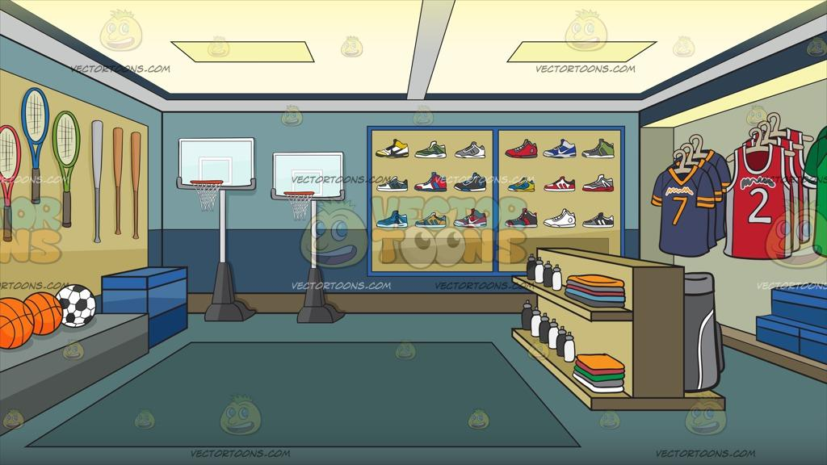
Let’s Review!
Let’s review last night’s homework and yesterday’s classwork! What is happiness? What does it mean to be truly happy?
Today we are going to determine if where someone lives affects or determines their happiness!

Slide 15
The Five Themes of Geography
Location
Where is this country? Where is it located Latitude and longitude or point of reference?
Regions
What are their unifying features and how do they form and change over time?
Place
What is it like? Physical characteristics and human characteristics?
Human/environment interaction
How do people interact with and change their environment?
Do they adapt to their environment or do they modify or change it?
Movement
How are people and places linked by communication and the flow of people, ideas and goods? Transportation, communication and trade?

Slide 16
Let’s be CHAMPs!
Conversation- Students will share their ideas and thoughts about the different places they have visited with their peers. Let’s remember to be respectful of other people’s ideas and thoughts!
Help-Students may raise their hand is they need help, they can also turn and ask their peers for help as well.
Activity-We will be writing a postcard back home including information we learned on the tour, so don’t forget to listen up and take great notes!
Movement- Please keep your hands and feet in the vehicle and on the plane at all times. Also keep your hands to yourself, we don’t want to distract the driver! Please act appropriately when eating our snacks!
Participation-Participation is vital to ensure all passengers get the most out of their tour!
Success- Students will write a postcard back home telling their family or friends about a place they visited!

Slide 17
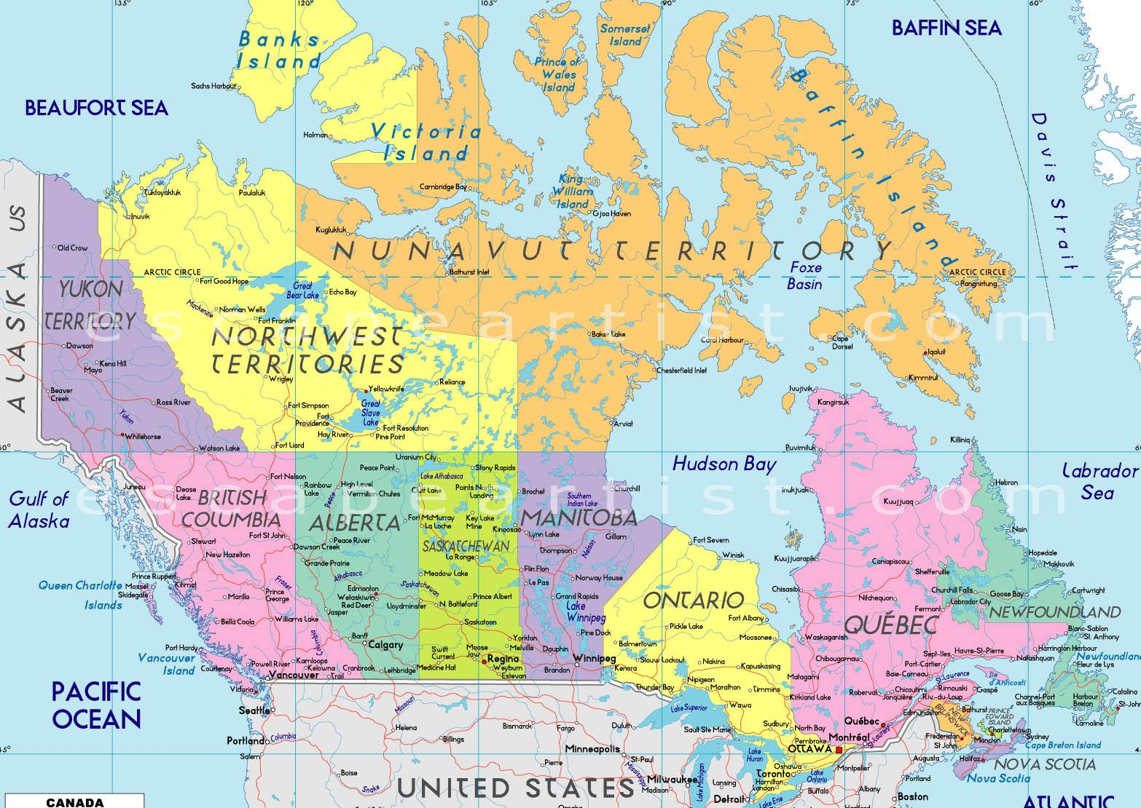
Canada
Canada is located north of the United States of America.
Canada extends from the Atlantic to the Pacific oceans and northward into the Arctic Ocean.
Unlike the U.S., Canada does not have states. However, Canada is broken up into ten provinces and three territories.

Slide 18
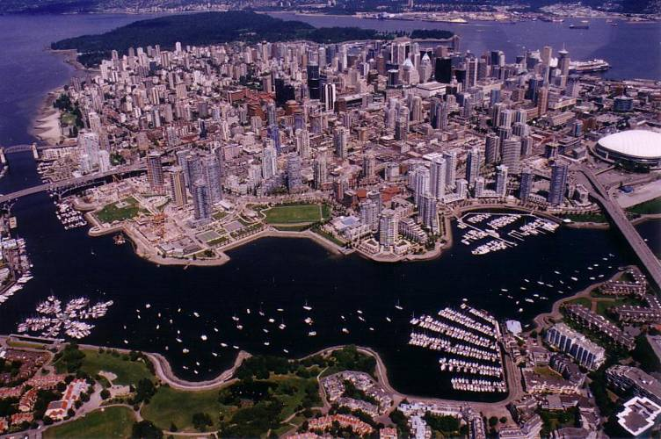
Vancouver

Slide 19
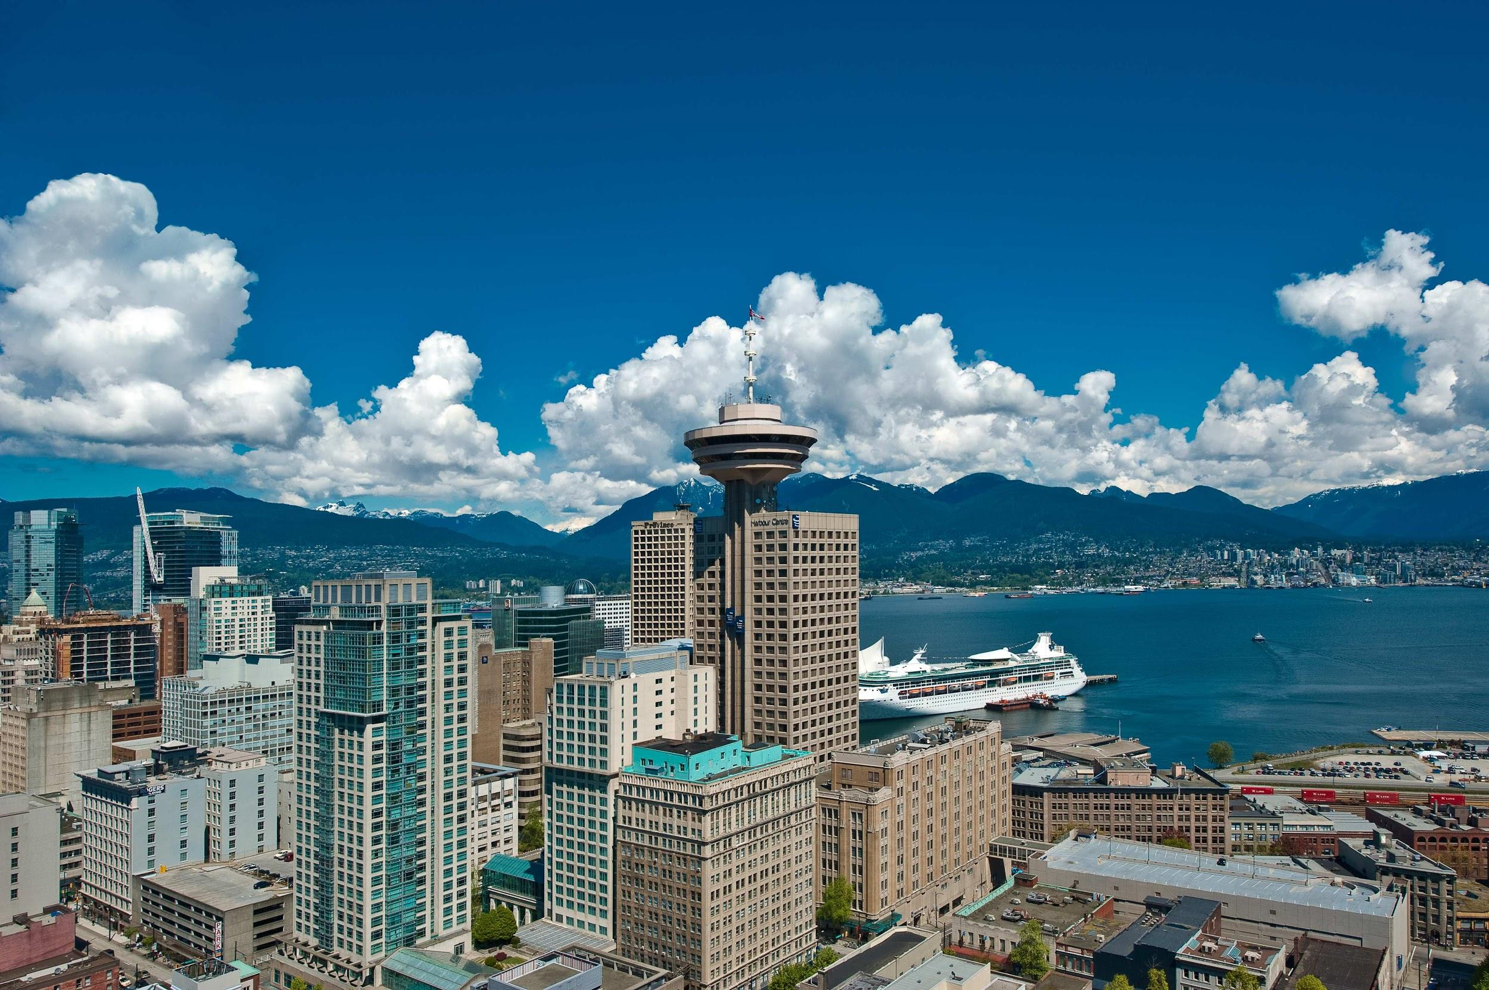
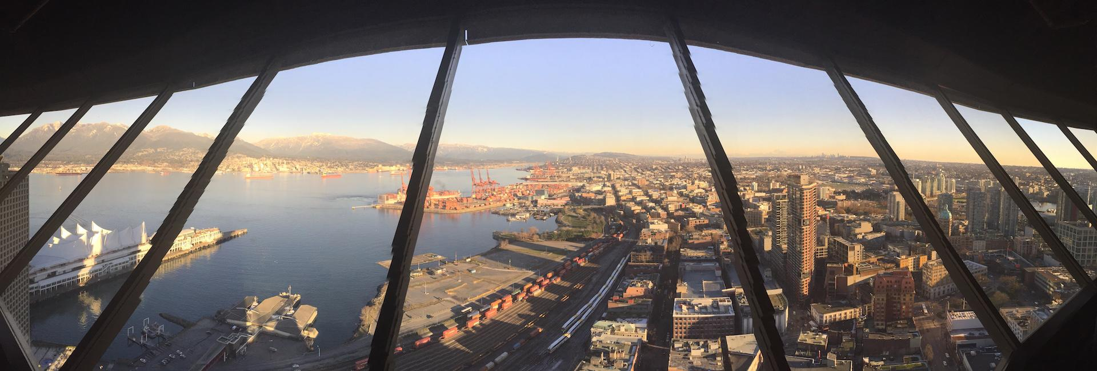
Vancouver Lookout
Located on the 55th floor of the Harbour Centre building in downtown Vancouver, visitors ride more than 550 feet to the floow in an elevator and can enjoy a 360 degree view of the city below. Visitors can see the olympic peninsula mountains as well as the north shore and stanley park.

Slide 20
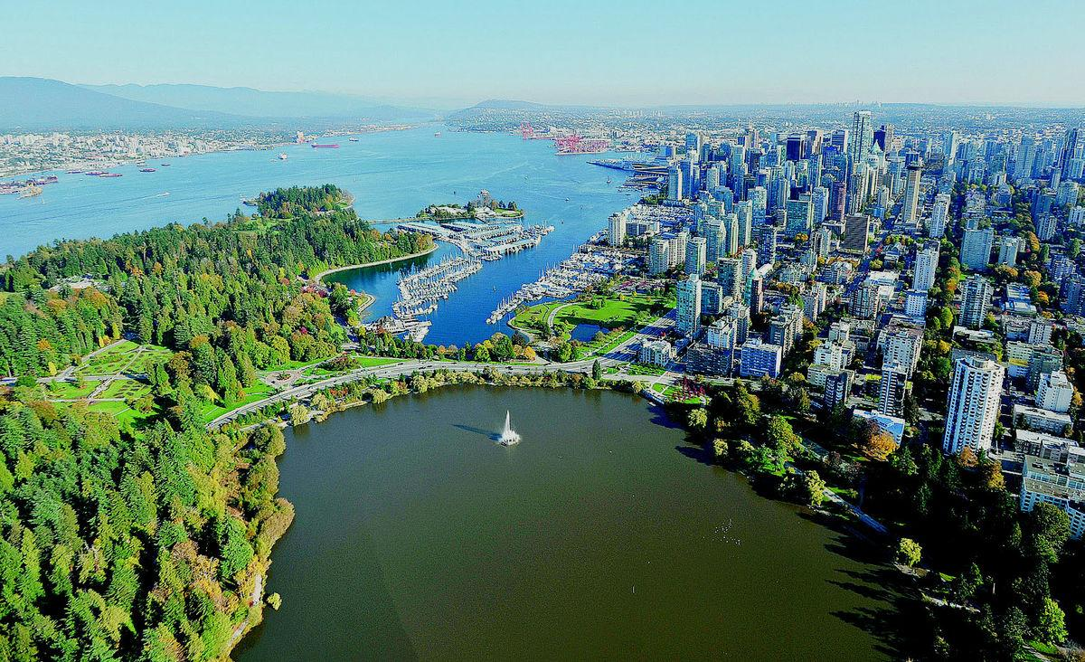
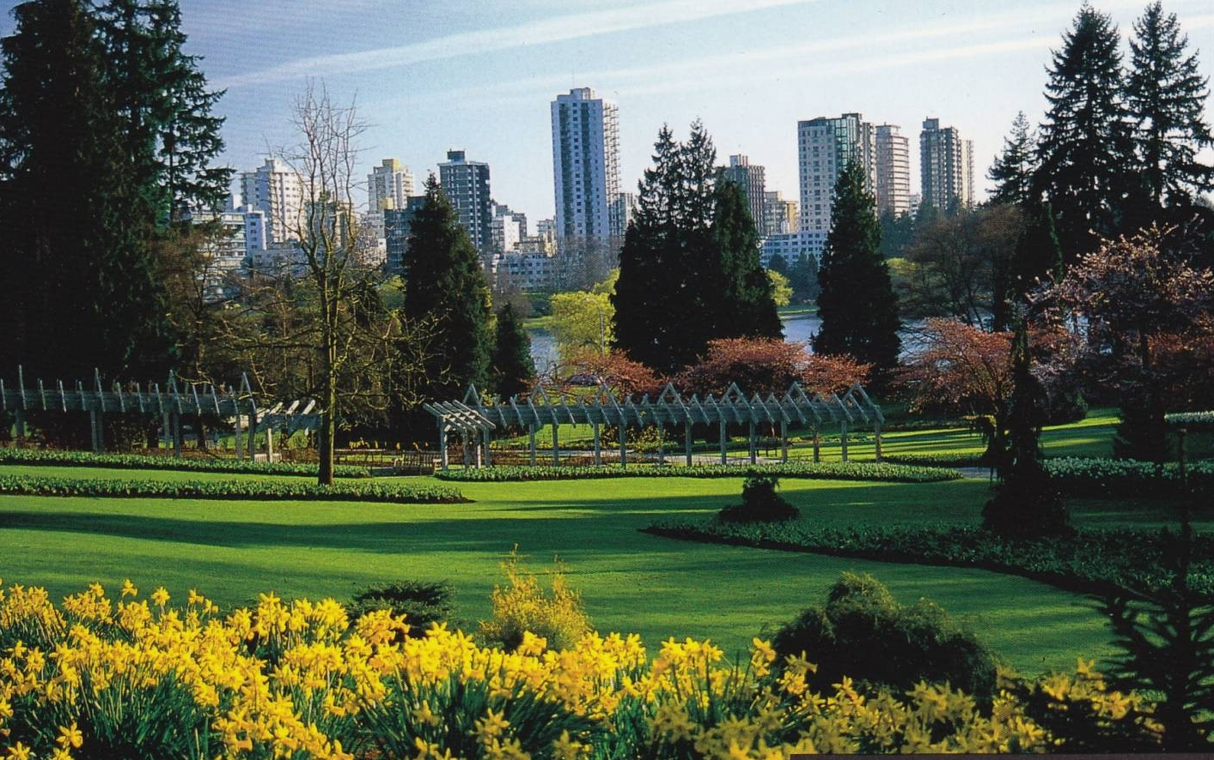
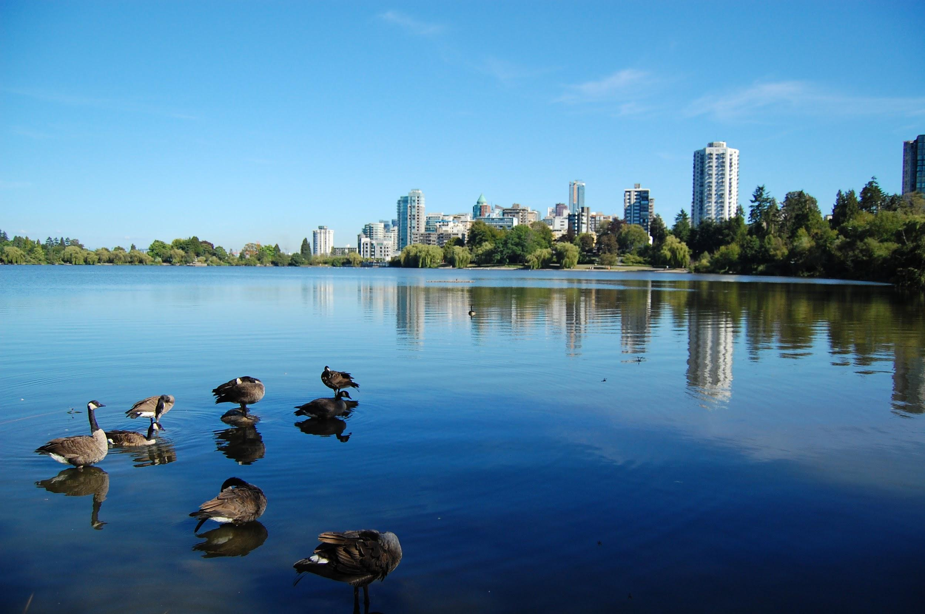
Stanley Park
Stanley Park is a 1001 acre public park that borders the downtown of Vancouver and is almost entirely surrounded by waters of Vancouver Harbor and the English bay. It is the evolution of a forest and urban space over many years
Stanley park was named top park in the entire world by tripadvisor in 2014.

Slide 21
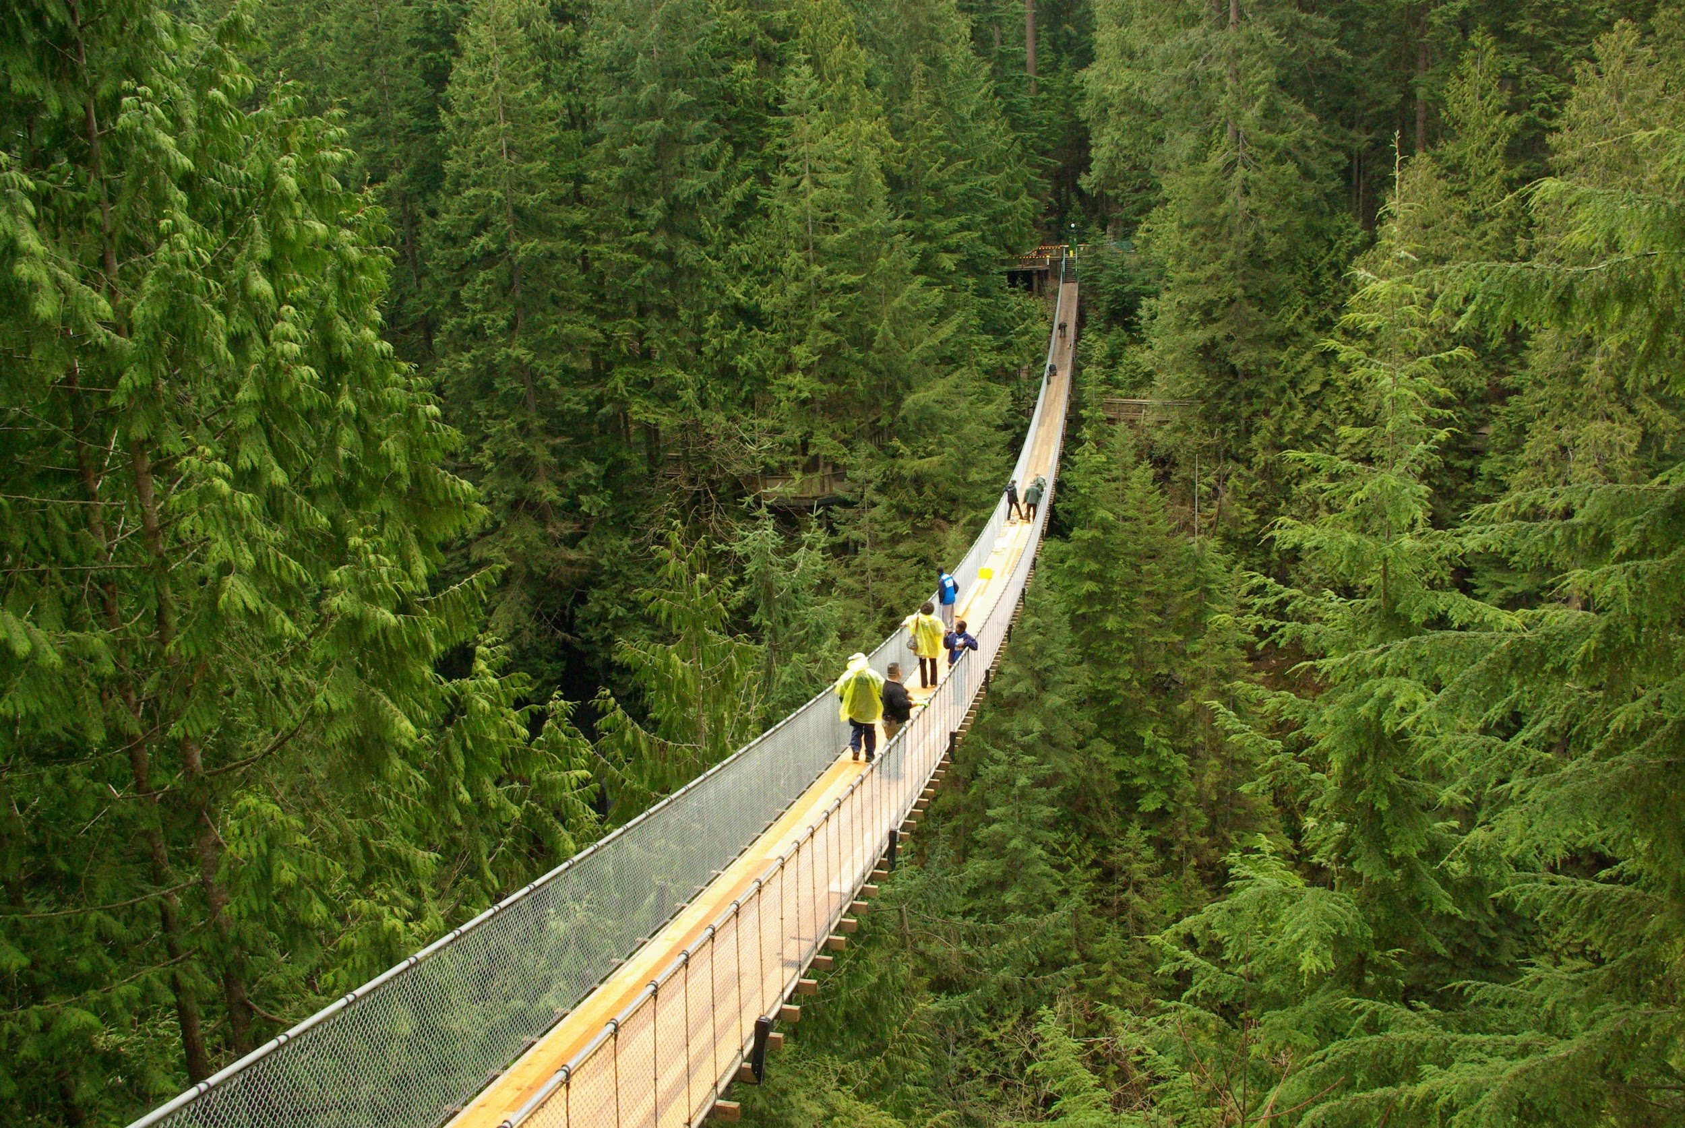
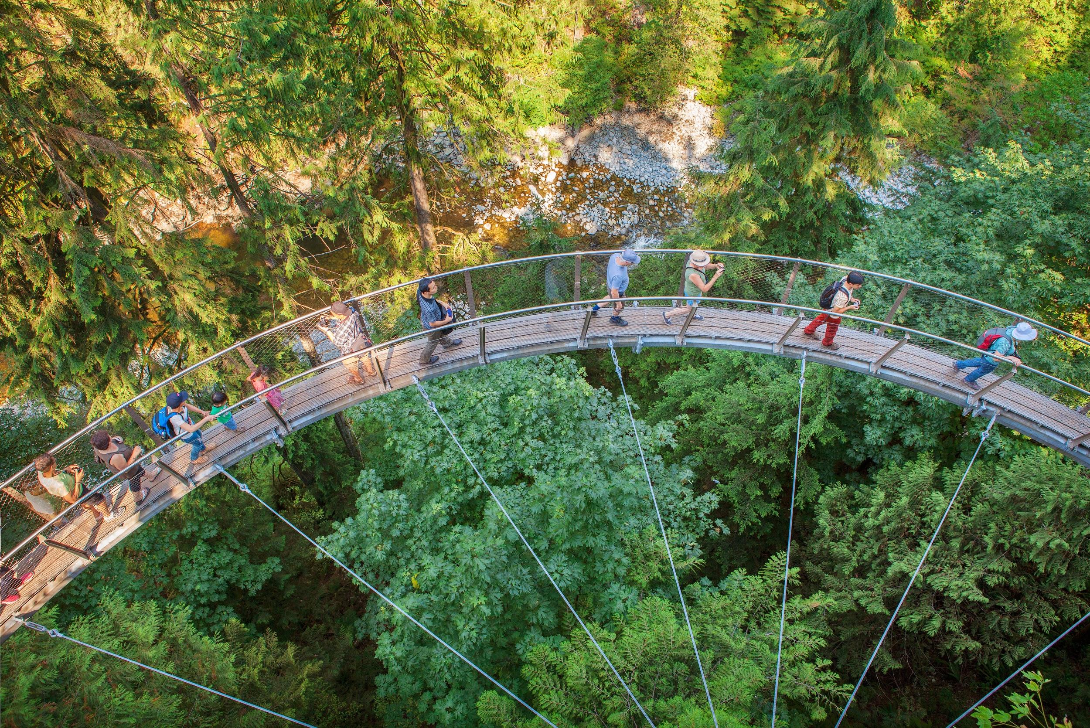
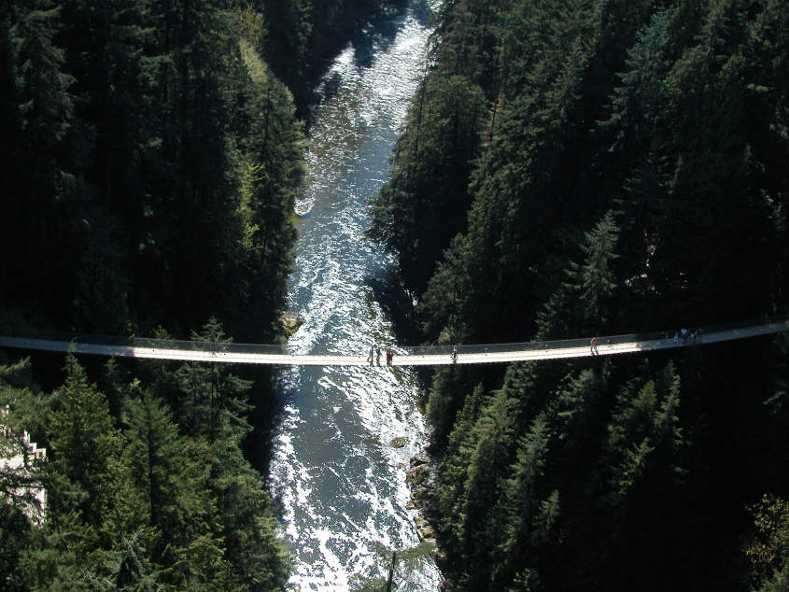
Capilano Suspension Bridge Park
Travelers are drawn to the park to walk out onto the the 450-foot (137-meter) suspension bridge as it sways between the temperate rainforest trees over the rushing Capilano River below.

Slide 22
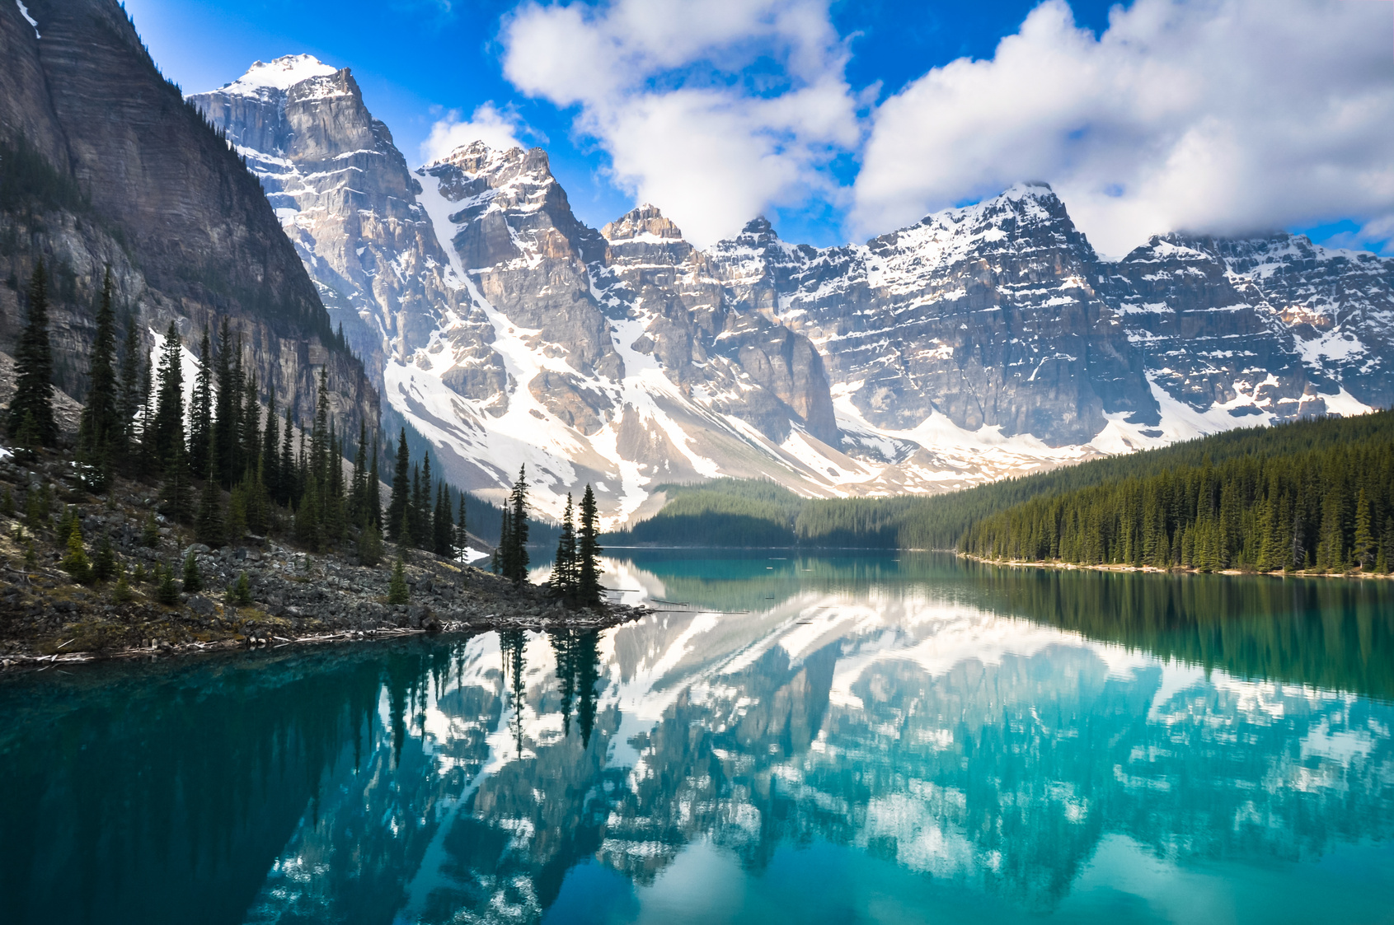
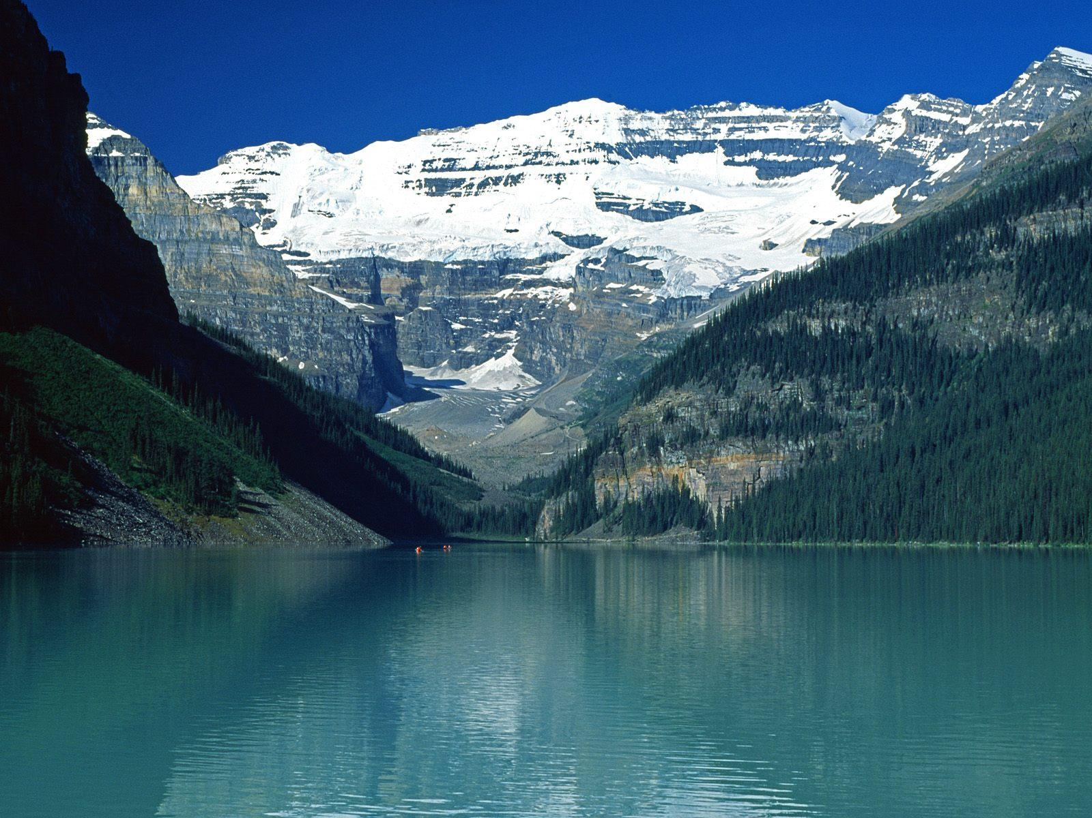
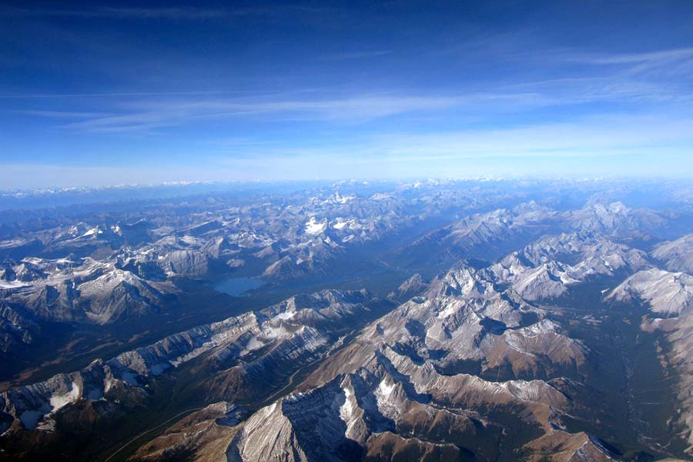
Canadian Rockies
The Canadian Rockies comprise the Canadian segment of the North American Rocky Mountains. The highest peak of the Canadian Rockies is Mount Robson which is nearly 13,000 feet high, but is not the highest point in the province of British Columbia.

Slide 23
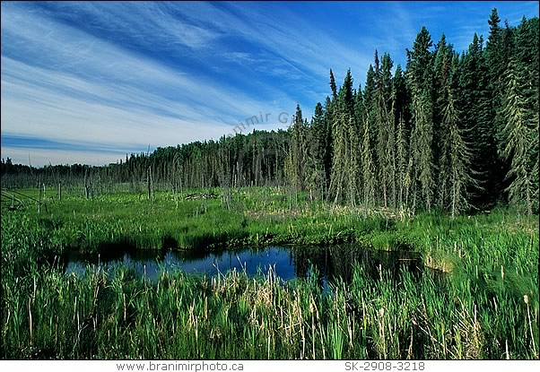
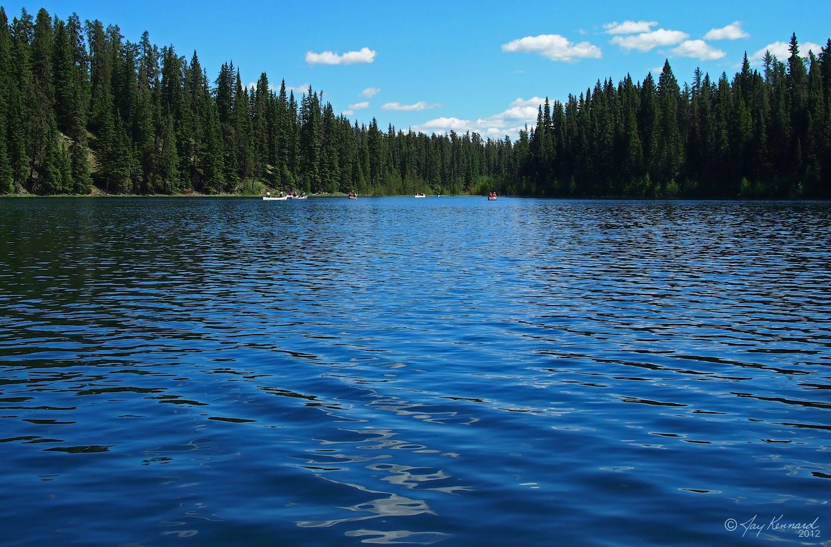
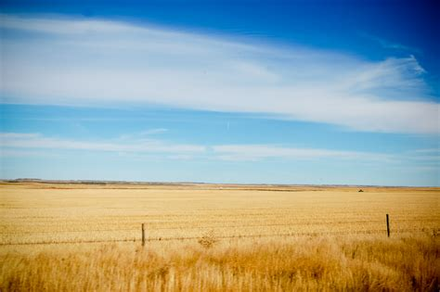
Saskatchewan
Saskatchewan is a landlocked province in the middle of Canada. The Northern part of the province is sparsely populated because it consists mostly of forests, as opposed to the southern half of the province is part of the canadian prairies.

Slide 24
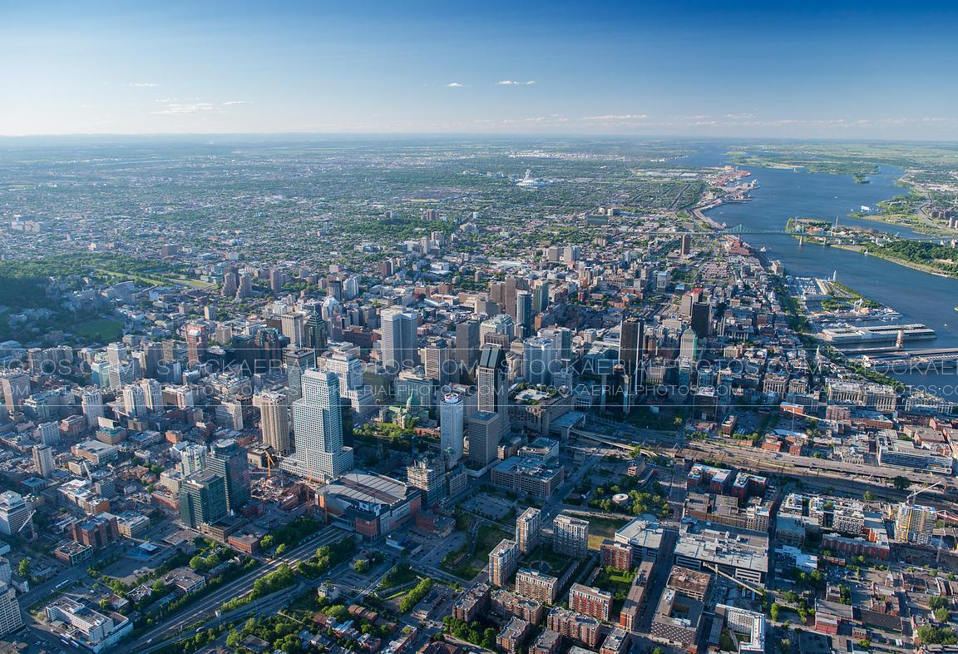
Montreal

Slide 25
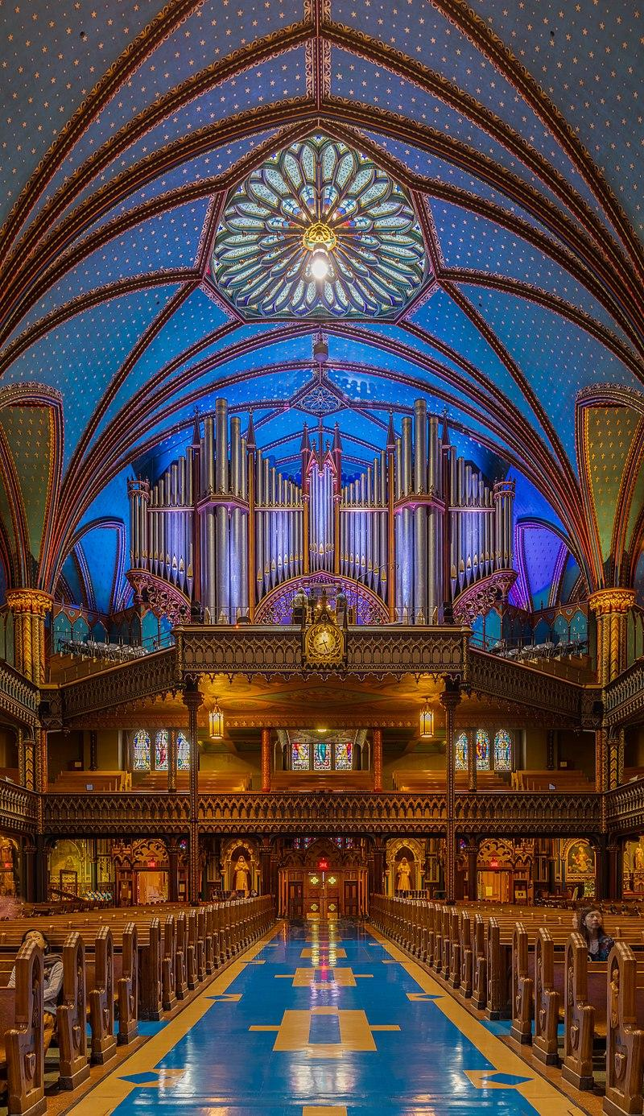
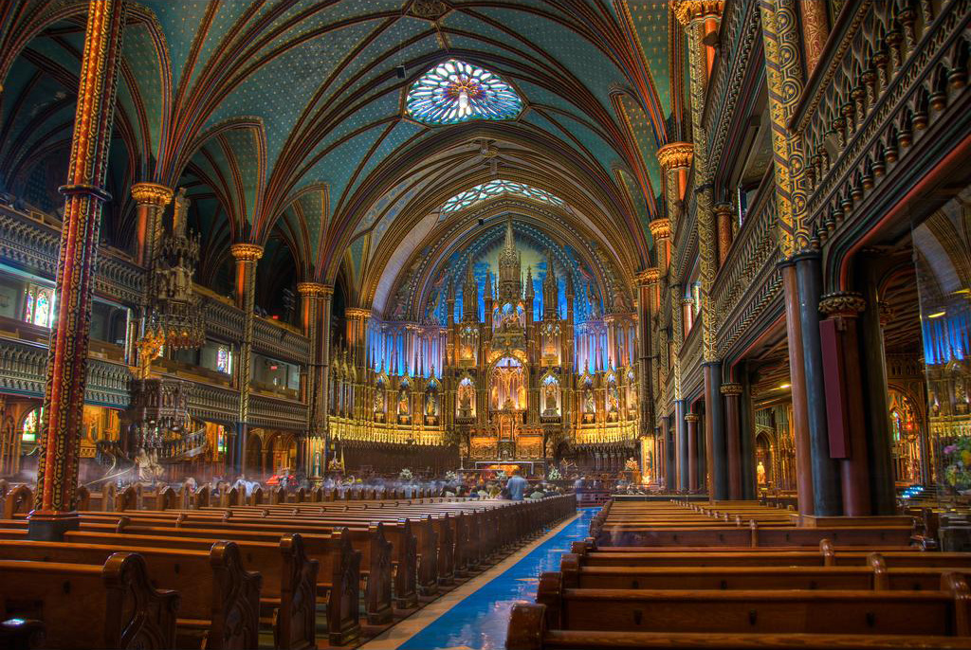
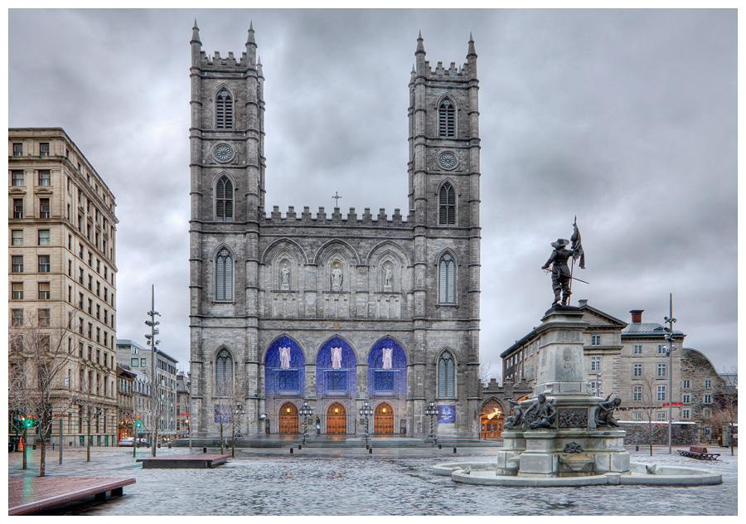
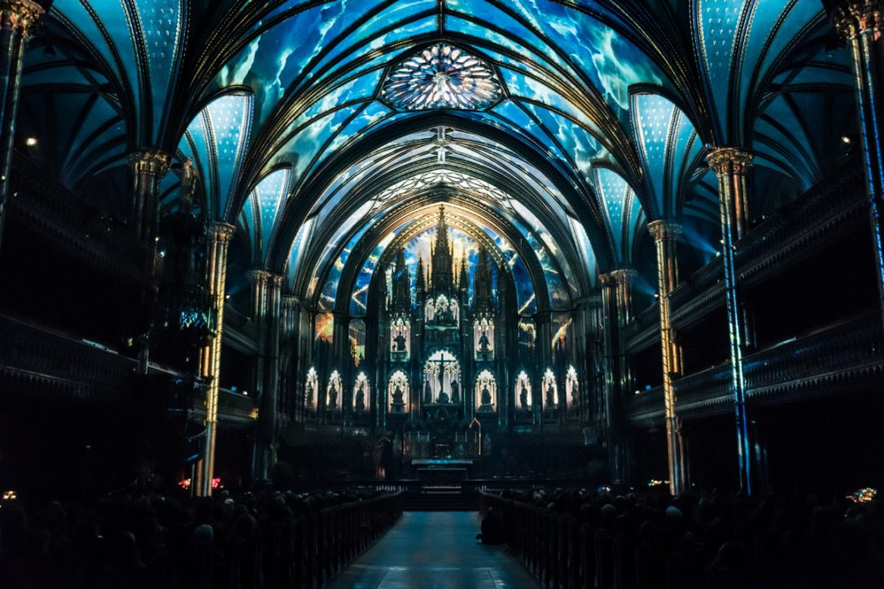
Notre-Dame Basilica
The Notre-Dame Basilica is a Roman Catholic Church built in the Gothic Revival style. The construction of the church began in 1823 but did it was not finished until 1832. The church is filled with hundreds of intricate wooden carvings and several religious statues.

Slide 26
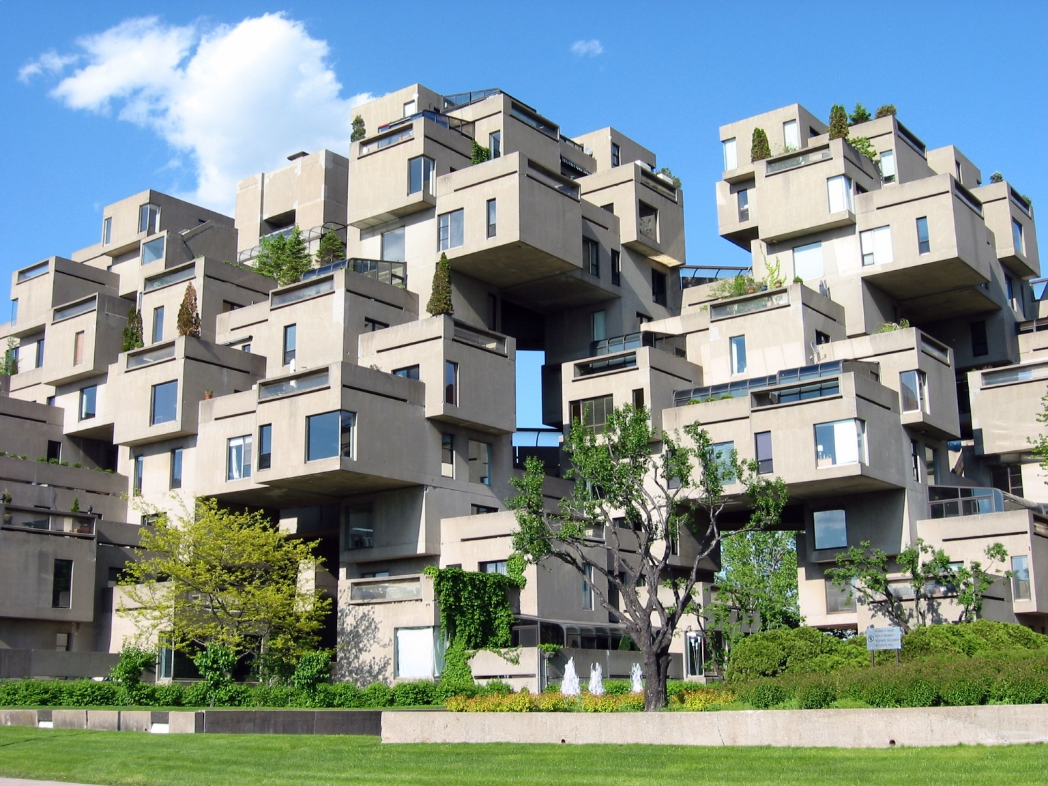
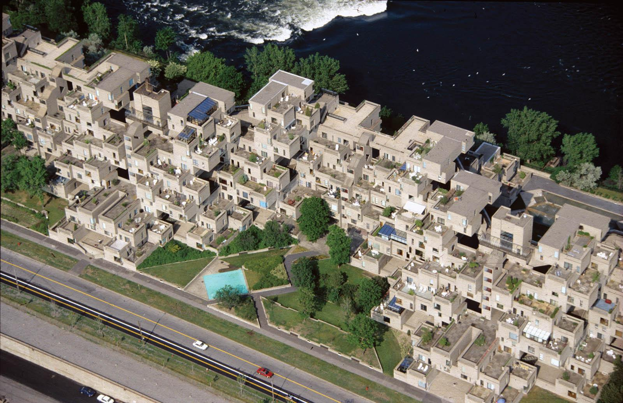
Habitat 67
This landmark was designed by Moshe Safdi as his masters thesis at McGill University. It was then built as Expo 67 for the 1967 World’s Fair. This structure comprises 354 identical prefabricated concrete forms arranged in various combinations reaching up to 12 stories in height. It houses 146 residences.

Slide 27
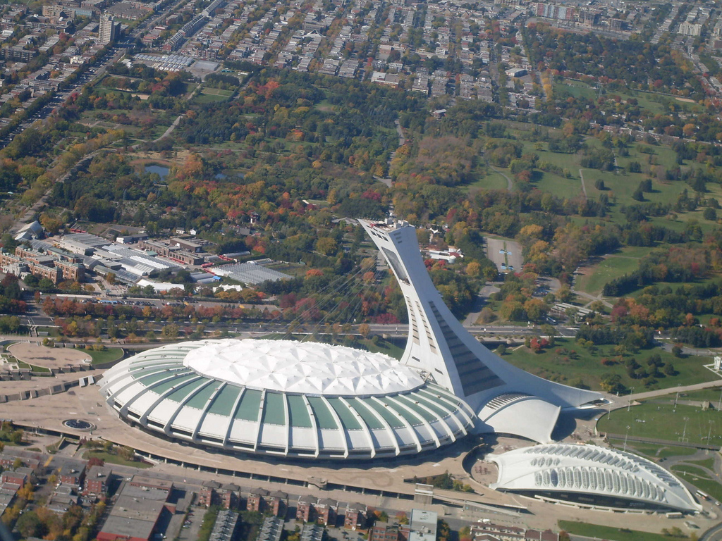
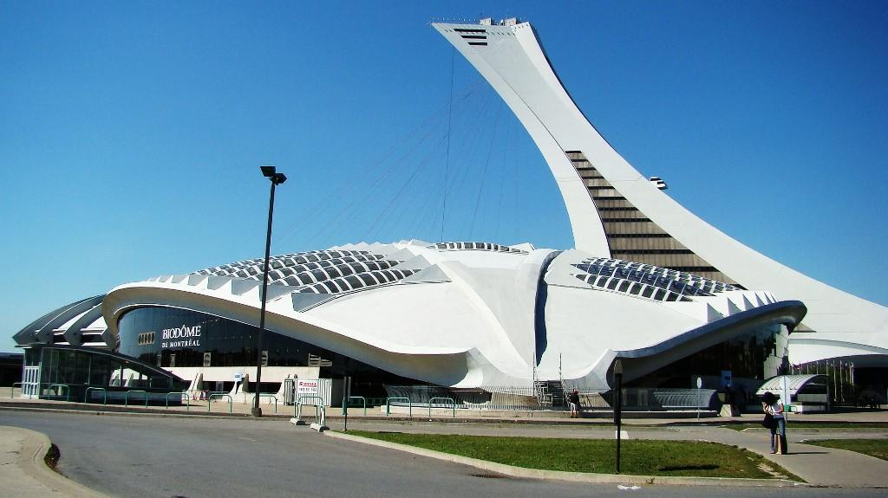
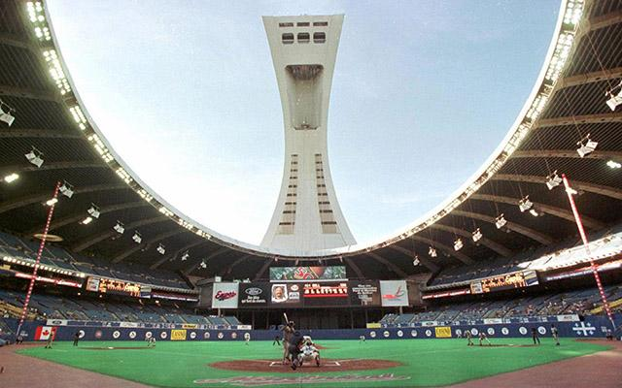
Montreal Olympic Stadium
Built in the mid 1970’s this iconic stadium was the home to the 1976 Summer Olympics. It features a retractable roof that is opened and closed by cables suspended from a 574 foot tower, which is the tallest inclined structure in the world.

Slide 28
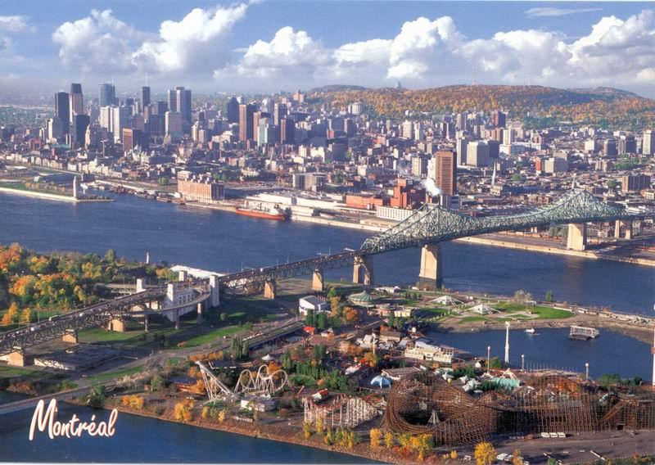
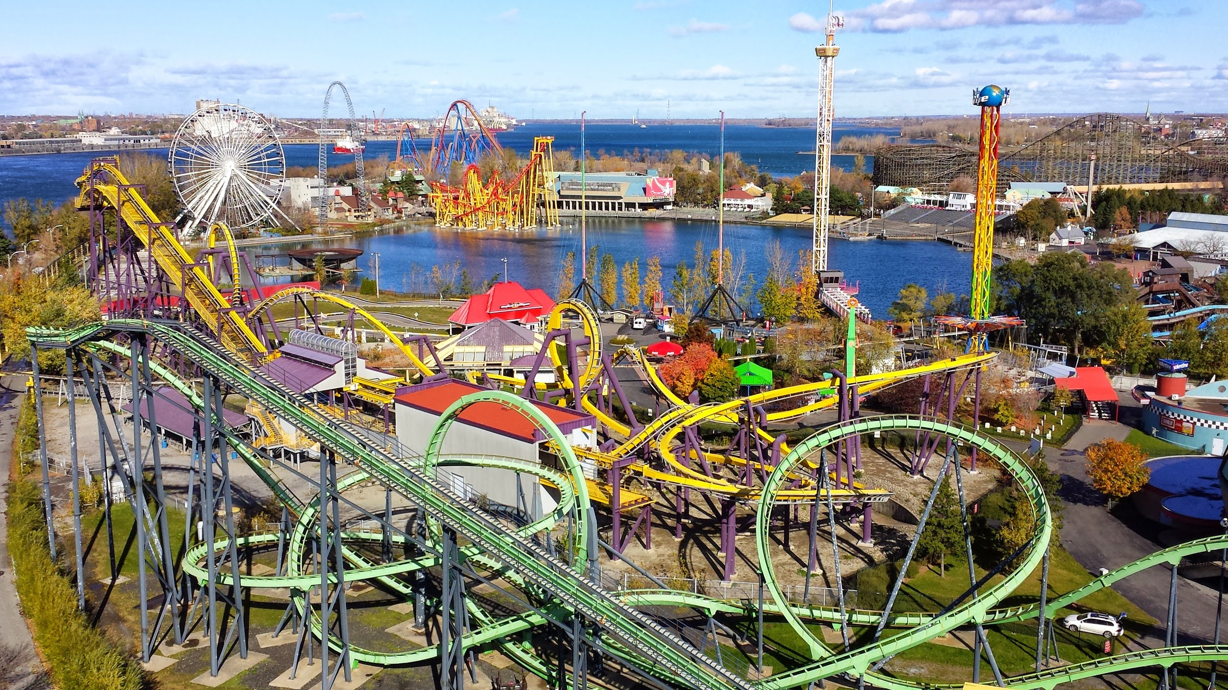
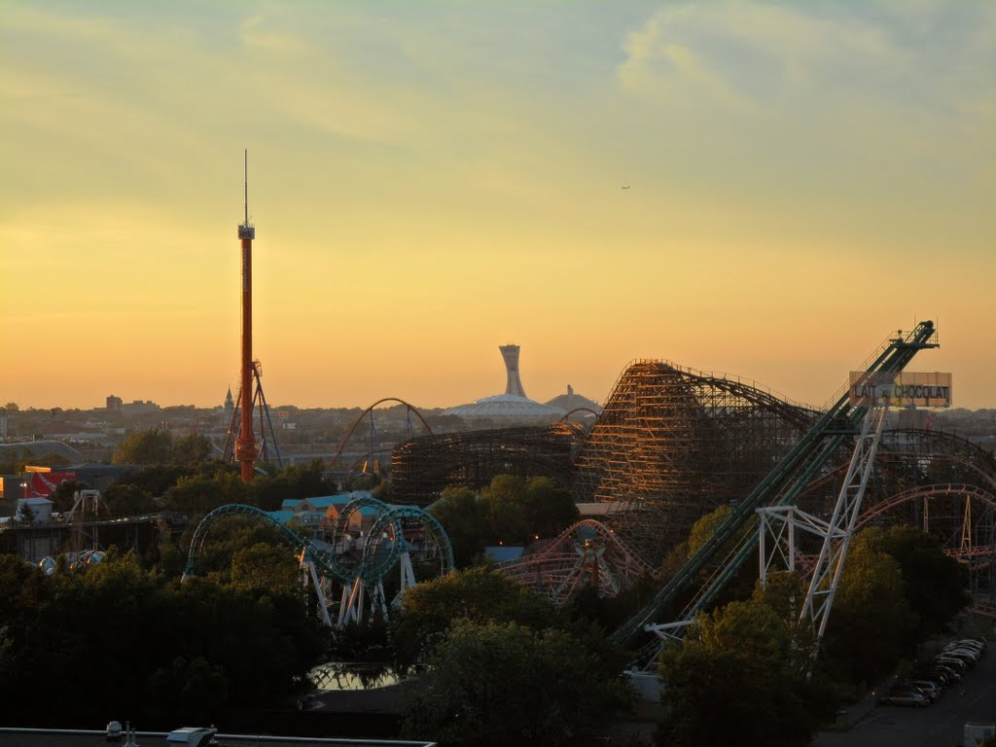
La Ronde Amusement Park
Originally built for the 1967 World’s Fair, La Ronde is now owned and operated by Six Flags. The amusement park is located on the northern tip of St Helen’s Island and is 146 acres. It is the largest amusement park in Quebec and the second largest in Canada.

Slide 29
LESSON 3
Ms. Drew

Slide 30
Lesson Question:
What historical events have shaped Canada?
Hold on Kids! Let’s Get Ready to…..
TIME TRAVEL!!!

Slide 31
We are CHAMPS!
Conversation: You will be talking with other members of your group to come up with an ACT IT OUT!
Help: Raise your hand if you need help from the teacher!
Activity: You will be working in pairs to complete a read and retell based on the passage and then work in groups do perform an Act It Out using 3 relevant facts from the passage!
Movement: Only the groups presenting should be moving about the classroom!
Participation: Everyone will be able to participate in the Act It Out skit!

Slide 32
Read and Retell
With a partner in your group, read the passage
Each of you will write 5 key terms from the passage
Taking turns, you each will retell the passage by summarizing it using the 5 key terms, while the other partner tries to guess the terms you chose
Then switch!

Slide 33
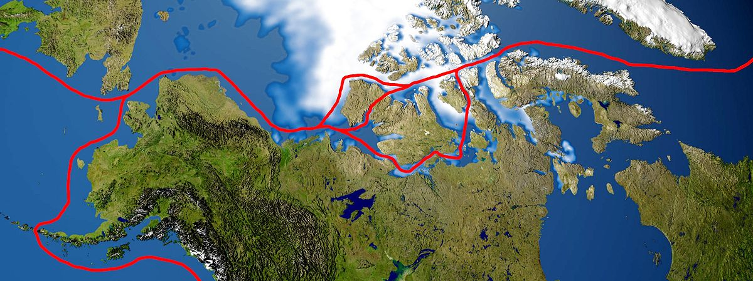
The Northwest Passage!
In the 1400s, many Europeans believed there was a water route across North America to Asia that would aid in trading goods such as spices, jewels and silk. The search for this water route occurred in Northern Canada, through arctic waters. Explorers called this route the Northwest Passage, but it was never made successfully. For over 300 years, European Explorers tried to make the journey, all ending in failure. In 1835, Sir John Franklin of Britain attempted to lead a team through the Northwest Passage. Neither he, or any of his crew members survived the journey.
The Northwest Passage was finally navigated in the 1900s, however the ship that made the journey was an icebreaker. Today, there is a debate over which country owns the claims to the Northwest Passage. While Canada claims the arctic waters, other countries like the U.S. and European nations believe the passage is an international strait.

Slide 34
French Explorers!
In the 1500s, European Explorers who wanted to find a new water route to Asia found Canada and began to claim land. France claimed the area around the St. Lawrence River in 1534 and called the area New France. The French sent explorers, settlers, and missionaries to New France and they founded several cities. The first was the trading post at Quebec. The traded with the Natives for beaver furs, which the French sold in Europe for a lot of money. The French fur traders were called voyageurs, which means “travelers” in French. The voyageurs traveled by canoes across the Great Lakes to trade fabrics, guns, and other goods for beaver fur. The fur trade became very popular and everyone back in Europe wanted to wear a beaver hat.
Many of the cities and waterways in Canada still have French roots today. Lake Champlain, the St. Croix River, Montreal, and Quebec are some that have French influence. Also, about 20% of Canada’s population speaks French today.

Slide 35
French Loss to the British!
During the 1600s and 1700s, the English and French were fighting each other for territory around the globe. While the French ruled New France in Canada, the English controlled the 13 colonies to the south. Soon, conflict erupted between the two nations known as the Seven Year’s War from 1754 to 1763, also known as The French and Indian War. The French asked the Natives for assistance during the war, called an ally. However, warfare and disease killed many of the Natives by this time. Many of the fighting and battles occurred in the New France area, and south into the northern colonies. While the French won some of the beginning battles of the war, the British ultimately took the upper hand towards the end at the Battle of Quebec in 1759 and the Battle of Montreal in 1760.
The French lost the war to the British, and the Treaty of Paris was signed in 1763. This treaty not only ended the war but ended the French control of Canada. Britain now controlled Canada and all French land east.

Slide 36
Get Ready Kids!

Slide 37
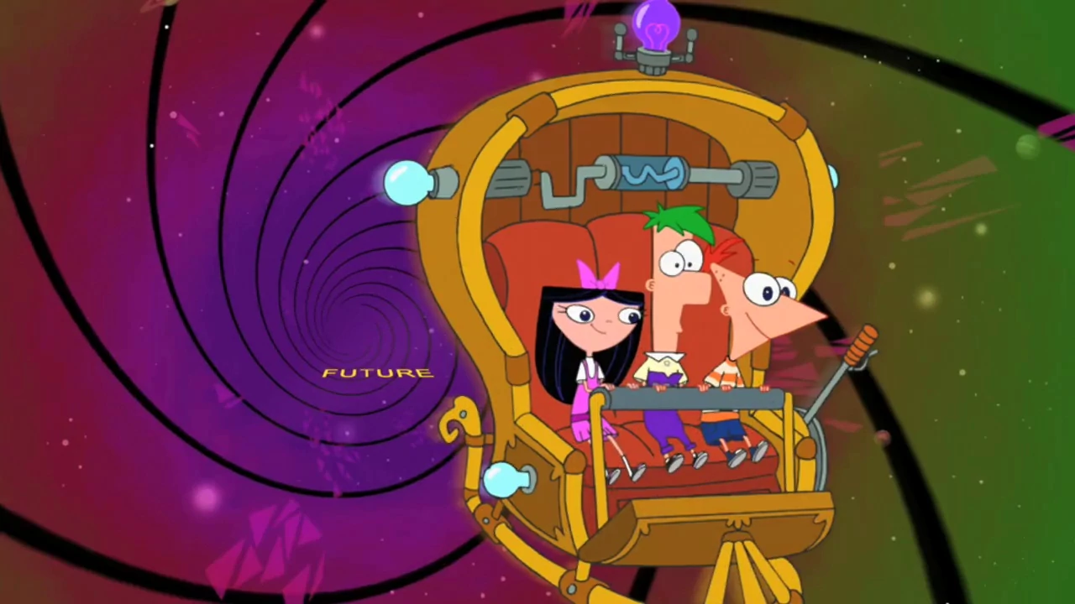
Time Machine!
Ready?

Slide 38
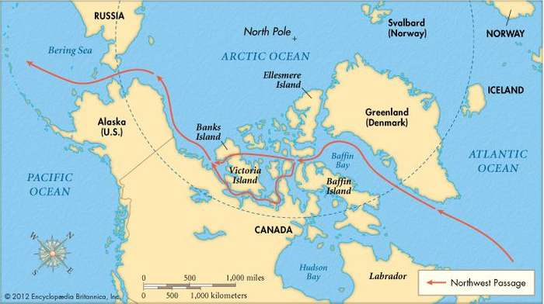
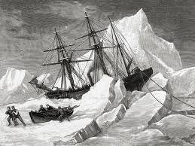
The Quest for the Northwest Passage! (1400s)

Slide 39
Time Machine!
Ready?

Slide 40
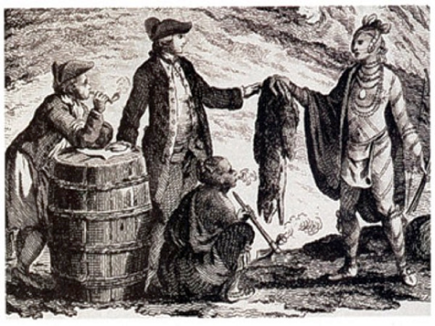
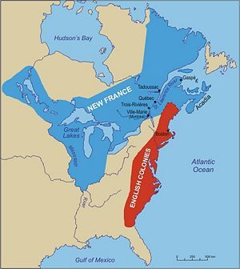
French Explorers (1534)

Slide 41
Time Machine!
Ready?

Slide 42
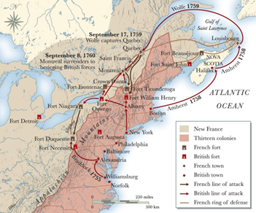
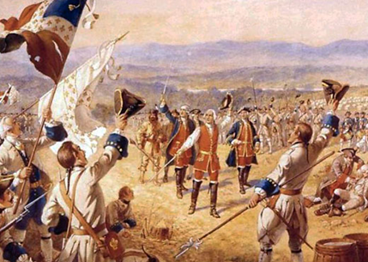
Loss to the English (1763)

Slide 43
Homework Time!
Your job is to answer the following question on Flipgrid:
In your opinion, which historical event was the most important in shaping Canada’s history today? Cite evidence from the Act It Out performances and/or the read and retell passages! Be sure to respond to one classmate!

Slide 44
Historical Thinking
LESSON 4
Ms. Foley
How do we know what we have learned about Canada is true?

Slide 46
CHAMPS
C - Conversation: There will be so much wonderful conversation between you and your peers today when we analyze our documents on Canada. Remember to listen, respond, and be respectful of your peers!
H - Help: Please raise your hand if you have any questions and I would be more than happy to help!
A - Activity: Today you will all be thinking like a historian to analyze documents using the SCIM-C method!
M - Movement: There will be plenty of movement in our groups today. Remember to keep a calm body and stay on task!
P - Participation: Participation is key to being successful Let’s have fun participating as historians!
S - Success: You will all be thinking like historians today. By the end of our lesson, you will be successful at determining if the sources we analyzed are valid on the history of life in Canada!

Slide 47
SCIM-C
S- Summarizing
C- Contextualizing
I- Inferring
M- Monitoring
C- Corroborating

Slide 48
Summarizing
What type of historical document is the source?
What specific information, details, and/or perspectives does the source provide?
What are the subject, audience, and/or purpose of the source?
What does the source directly tell us?

Slide 49
Contextualizing
Who produced the source?
When, why, and where was the source produced?
What was happening locally and globally at the time the source was produced?
What summarizing information can place the source in time, space, and place?

Slide 50
Inferring
What is suggested by the source?
What conclusions may be drawn from the source?
What biases are indicated in the source?
What contextualizing information, while not directly evident, may be suggested from the source?

Slide 51
Monitoring
What is missing from the source in terms of evidence that is needed to answer the guiding historical question?
What ideas, images, or terms need further defining from the source in order to understand the context or period in which the source was created?
How reliable is the source for its intended purpose in answering the historical question?
What questions from the previous stages need to be revisited in order to analyze the source satisfactorily?

Slide 52
Corroborating
What similarities and differences exist between the sources?
What factors could account for the similarities and differences?
What gaps appear to exist that hinder the final interpretation of the source?
What other sources are available that could check, confirm, or oppose the evidence currently marshaled?

Slide 53
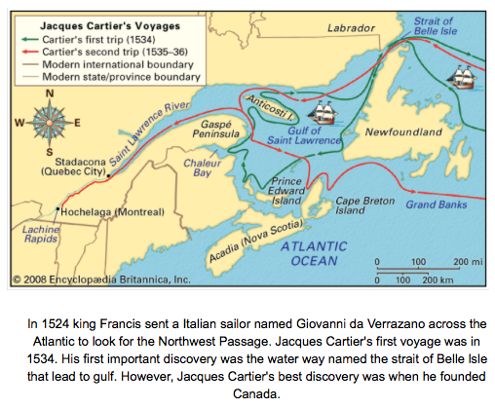
Documents
SCIM-C

Slide 54
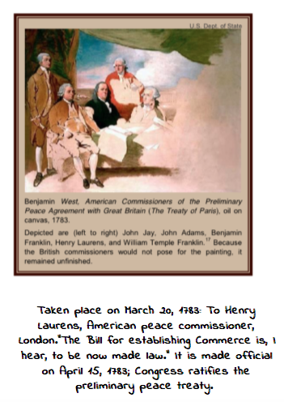
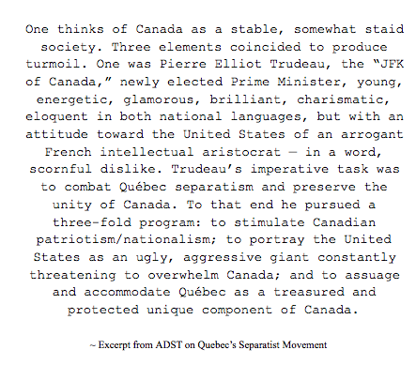
Documents
SCIM-C

Slide 55
Let’s Corroborate!
Everyone's an expert now! All students who have the same role (Summarizer, contextualizer, inferrer, and monitor) become a new group
Compare documents with your peers!

Slide 56
IS THIS VALID?
How do we know what we have learned about Canada is true?

Slide 57
Lesson 5
History Mystery
Ms. Scandiffio
Are Canadians happier than Americans?

Slide 58
What are detectives?
Are detectives important?
What do detectives do?
Today, we are all detectives!

Slide 59
In this classroom, we are CHAMPS!
Conversation: Today there will be a lot of opportunities to talk with our classmates about Canada and America during the History Mystery activity. Please be respectful of everyone’s thoughts and opinions!
Help: Don’t forget to raise your hand if you need help from the teacher!
Activity: Today we will be participating in a History Mystery. Don’t forget your detective hats!
Movement: Please remain in your seat at all times unless told otherwise. You will be given the opportunity to move around!
Participation: Be sure you are participating in the History Mystery. You are expected to contribute to class discussions and do your part! Don’t forget to fill out the Evidence Worksheet.
Success: When your group has solved the mystery, make sure you write your claim on the Who’s Happier worksheet and use supporting evidence! I’m excited to hear all of your hard work!

Slide 61
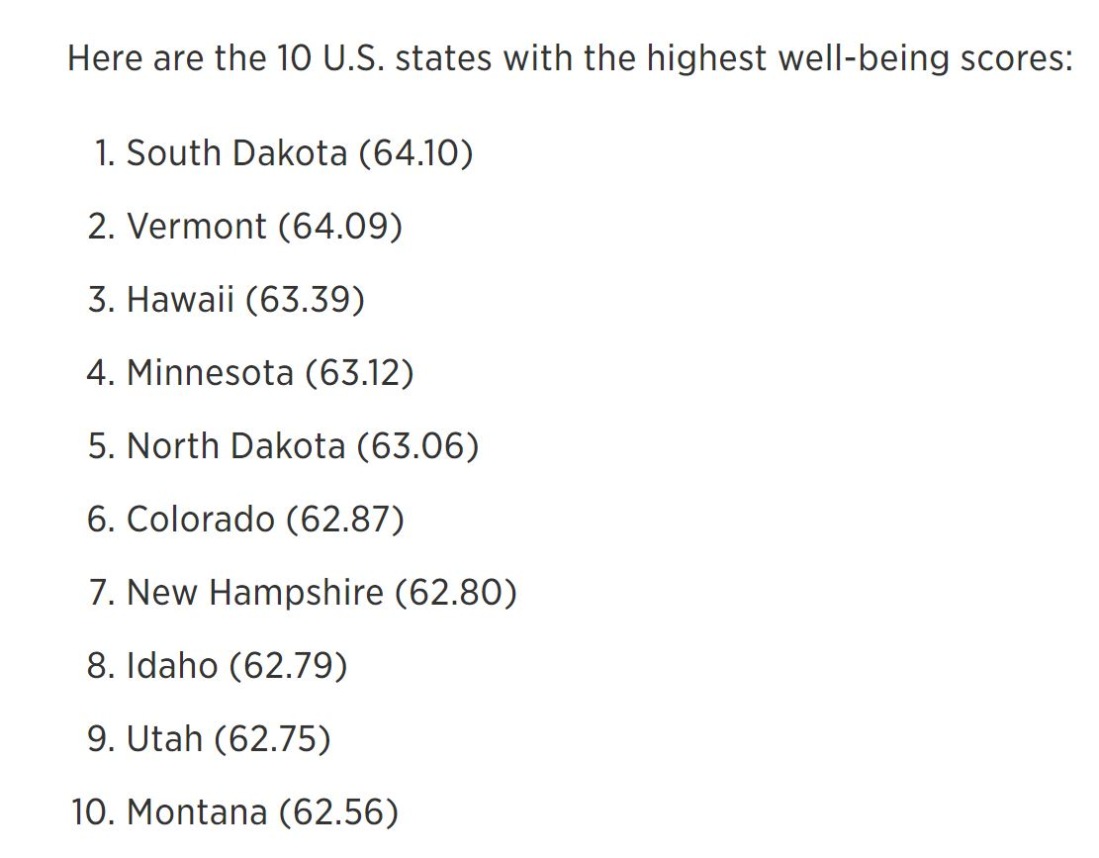
Documents
(ordered least to most credible)

Slide 62
Documents
(ordered least to most credible)

Slide 63
Evidence Worksheet

Slide 64
“Who’s Happier?” Claim Worksheet

Slide 65
Graphic Organizer
Least
Credible
Most
Credible
USA
Montreal

Slide 66
Happiness Homework

Slide 67
LESSON 6
Taking Informed Action!
Ms. Rinck

Slide 68
CHAMPS
Conversation- You will be talking with the students in your class during a turn and talk activity, group work, and class discussion. We must be respectful of others thoughts and ideas, and listen while others are talking.
Help- Raise your hand if you need help from the teacher!
Activity- You will take create projects to take informed action in Nunavik Canada.
Movement- You will be working in groups during this activity.
Participation- It is important to be active members of your groups, contribute ideas, and effort in your informed action projects.
Success- You will will engage effectively in a range of collaborative discussions with diverse partners on building on others’ ideas and expressing their own clearly and creating a plan for taking informed action to aid students in Nunavik.

Slide 69
Nunavik Canada

Slide 70
Life in Nunavik

Slide 71
About Nunavik Canada
Located in the Northernmost part of Quebec
Lies in both the arctic and subarctic climate zones
Long bitterly cold winters
Summer high= 55 ℉
Winter low= -6 degrees℉
Average temperature is 14℉
Population: 12,000 people
Indigenous communities

Slide 73
Problems in Nunavik
Poor
Drug/Alcohol Abuse
Limited Resources
Limited school supplies
High suicide & depression rate

Slide 74
WHAT IS...

Slide 77
Informed Action Group Projects
Create posters with informative information on Nunavik regarding a bake sale, to help raise money for Nunavik.
Organize a supply/book drive to gather resources to send to help enrich school life in Nunavik.
Create and informative video to educate the rest of the school on life in Nunavik Canada including different ways that we can help as a school. .

Slide 79
Homework

Slide 80
LESSON 7
“Meeting of the Minds”
Ms. Croce

Slide 81
Why is talking to others so important?

Slide 82
People of the World:
Here are 3 different countries; they have similarities and differences.
MEXICO CANADA PUERTO
RICO

Slide 84
Lesson Expectations: CHAMPS
Conversation: Students will converse with each other. Use inside voices and appropriate, respectful language.
Help: If you need help, raise your hand. Students can work together to help each other.
Activity: You will be people from different countries sharing information about your given country and determining how your countries can work together, live in peace, and create a better future.
Movement: You will be moving to new groups when the teacher jigsaws the class.
Participation: Your participation is critical. Have open discussions with your groups.
Success: Students will use their findings to write an essay answering the prompt: “Does where you live in the Western Hemisphere determine your happiness?”

Slide 85
Meeting of the Minds:
Individual Country Groups
Jigsaw Groups

Slide 86
Homework:
Write an essay answering: DOES WHERE YOU LIVE IN THE WESTERN HEMISPHERE DETERMINE YOUR HAPPINESS?
(Be sure to include facts and relevant information from your notes, your own opinions/experiences, and possible solutions in your essay)

