Slide 1
What is grit? Was “grit” the secret sauce that fueled the Industrial Revolution?

Slide 2
Lesson One: Story on Grit
No You Can’t, Yes I Can

Slide 3
What is grit?
Passion and perseverance for long-term goals
a goal you care about so much that it organizes and gives meaning to almost everything you do
Even when you fall down. Even when you screw up. Even when progress toward that goal is halting or slow.
What it is NOT → Talent, luck

Slide 4
Angela Duckworth: Grit - The Power of Passion and Perseverance
Justin Allen: Grit - No You Can’t, Yes I Can Video
2:47-4:07 (Ted Talk) https://www.ted.com/talks/angela_lee_duckworth_grit_the_power_of_passion_and_perseverance?language=en#t-237755
Justin Allen Testimony (0:51-1:22)
https://www.kickstarter.com/projects/chasemypassion/no-you-cant-yes-i-can-inspirational-childrens-book

Slide 5
G | Goal What goal do you have?
R | Reasons Why do you want to reach this goal? What is motivating you to reach this goal? Who can be affected when you reach this goal?
I | I Can… What can you do to reach this goal? What can you already do that will help you reach your goal?
T | To-do’s What are the daily/weekly/monthly tasks you need to reach your goal?

Slide 6
Lesson Two: Story on Passion and Perseverance
“Maybe It’s My Fault” by Michael Jordan
https://www.youtube.com/watch?v=9zSVu76AX3I
“Salt in His Shoes” by Deloris Jordan

Slide 7
The Perseverance Walk
Consists of 3 parts:
The Goal
The Obstacles
The Payoff

Slide 8
What is the relationship of passion for a goal to perseverance?
Passion is what drives people to push themselves in order to accomplish their goal.
Without passion, there is no perseverance!
What are you passionate about?

Slide 9
Lesson 3
Jaclyn Scorce & David Robbins

Slide 10
“Was the industrial revolution fueled by Natural Resources
or Grit?”

Slide 11
I CAN...
I can create my own Google Earth tour using two of the five themes of geography to answer the given question “Was the industrial revolution fueled by natural resources of grit?”.

Slide 12
What you need to know before our journey...

Slide 13
The Five Themes of Geography
Location
Human/Environment Interaction
Place
Movement
Region

Slide 14
Location
Where is it on a map?
Use cardinal direction words to describe location(N, S, E, W, NE, SW, NW, SE)
Lines of latitude and longitude

Slide 15
Human /
Environment Interaction
Clothing, Housing
Natural events/disasters
Reservoirs, bridges, tunnels, irrigation
Pollution, deforestation, recycling

Slide 16
Place
Landforms (mountains, plains, hills…)
Bodies of water (rivers, lakes, oceans…)
Climate/weather
Animals/plant life
Natural resources
Ethnic groups, language, resources, food, music

Slide 17
Movement
Transportation (Bus, trains, cars, airplanes, walking, bike)
Goods (import or export)
Ports (Shipping, airports)
Communication (email, telephone, postal service, radio)

Slide 18
Region
Political information (Government)
Tourism (What can you do or see when you visit?)
Economy (selling and trading, jobs)

Slide 19
ALL ABOARD!
Use your bus ticket to board the Google Earth Bus Tour! This tour is designed to take you on a journey, help you become informed citizens, and allow you to gain a new perspective needed to make decisions based on sound evidence!

Slide 20
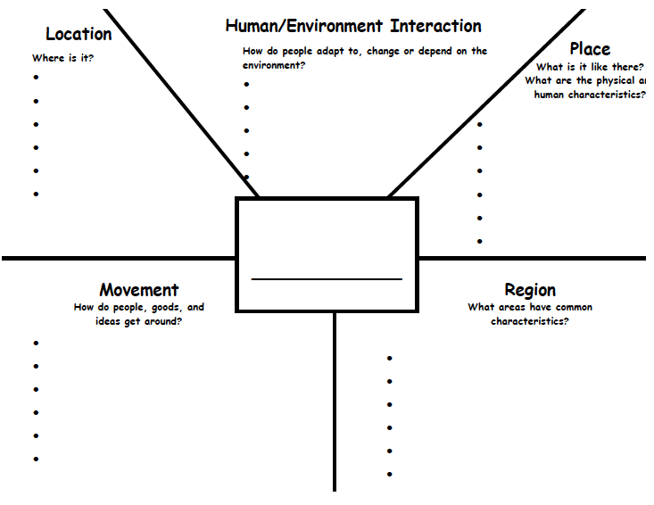
Use the worksheet below throughout the tour to help gather evidence in support of your answer.

Slide 21
Stop #1
Guten Tag Class!
(Good day!)
Welcome to Germany! Our first stop on the bus tour.
Germany, despite vast resources of coal and iron, did not begin its industrial expansion until after national unity was achieved in 1870. Once begun, Germany’s industrial production grew so rapidly that by the turn of the century that nation was out producing Britain in steel and had become the world leader in the chemical industries.

Slide 22
GERMANY
Before 1850 Germany lagged behind the leaders in industrial development, United Kingdom, France and Belgium.
Despite this, the country had considerable assets: a highly skilled labor force, a good educational system, a strong work ethic, good standards of living and a sound protectionist strategy.
By mid-century, the German states were catching up, and by 1900 Germany was a world leader in industrialization, along with Britain and the United States.

Slide 23
LOCATION - GERMANY
Germany is located in central Europe
Germany is positioned in both the northern and eastern hemispheres.
Germany is bordered by the countries of Denmark, Poland, Czech Republic, Austria, Switzerland, France, Luxemburg, Belgium and Netherlands, and by the Baltic Sea and North Sea.
https://earth.app.goo.gl/wFZWdk

Slide 24
HUMAN INTERACTION - GERMANY
Germany's middle class (based in the cities) grew rapidly, but it never gained the political power like it had in France, Britain or the United States.
In the 1880s old age pensions, accident insurance, medical care and unemployment insurance that formed the basis of the modern European welfare state were introduced.

Slide 25
PLACE - GERMANY
Elevation ranges from the mountains of the Alps in the south to the shores of the North Sea (Nordsee) in the northwest and the Baltic Sea (Ostsee) in the northeast.
The north German states were for the most part richer in natural resources than the southern states. They had vast agricultural tracts from Schleswig-Holstein in the west through Prussia in the east. They also had coal and iron in the Ruhr Valley.
The south German states were relatively poor in natural resources and those Germans therefore engaged more often in small economic enterprises.

Slide 26
MOVEMENT - GERMANY
Political conflict between German states did not allow railroad construction on a national level.
Coincidentally, German engineers did not have enough advanced knowledge to build railroads at this time.
By 1850 Germany was self-sufficient in meeting the demands of railroad construction and railways allowed for major economic growth.
https://earth.app.goo.gl/835VHa

Slide 27
REGION - GERMANY
The vast majority were farmers, typically in a state of serfdom under the control of nobles and monasteries.
https://earth.app.goo.gl/RAJkSX
Notes:
Serfdom is a legal and economic system. A serf is a worker who has to stay in one area. Serfs were the lowest social class of the feudal society.

Slide 28
Stop #2
Konnichiwa Class!
(Hello!)
The industrial revolution in Japan lasted from roughly 1890 to 1930. Factories were built, infrastructure was developed, and the Japanese economy quickly transitioned. While Japan did build a diverse range of industries, from textiles to steel, one of their most prominent focuses was on building an industrial military.
Place your screenshot here

Slide 29
JAPAN
Japan adopted steam power, began constructing steel works and built a national railroad system.
Japan’s silk manufacturing process was mechanized when it moved from family farms to factories.
Japan then exported its silk abroad in exchange for foreign goods like modern weapons.

Slide 30
LOCATION - JAPAN
Japan is an island nation along East Asia's Pacific coast.
Japan extends from 20° to 45° north latitude and from 122° to 153° east longitude.
Japan is east of Siberia, the Korean Peninsula and Taiwan.
https://earth.app.goo.gl/dBkfJN

Slide 31
HUMAN INTERACTION - JAPAN
Meiji (Emperor) molded Japan into a global industrial and modern power.
The Japanese economy allowed for mass production and complex infrastructure.
The Bank of Japan, founded in 1877, used taxes to fund model steel and textile factories.
Education was expanded and japanese students were sent to study abroad in the West.
https://earth.app.goo.gl/ryC2Bm

Slide 32
PLACE - JAPAN
About 73% of Japan is mountainous, with a mountain range running through each of the main islands.
Japan's forest cover rate is 68.55% since the mountains are heavily forested.
The only other developed nations with such a high forest cover percentage are Finland and Sweden.
Many hills and mountain sides at lower elevations around towns and cities are often cultivated.

Slide 33
MOVEMENT - JAPAN
The government built railroads and improved roads.
Japan inaugurated a new Western- based education system for the youth, sent thousands of students to the United States and Europe, and hired more than 3,000 Westerners to teach modern science, mathematics, technology, and foreign languages in Japan.
https://earth.app.goo.gl/JSS2ib

Slide 34
REGION - JAPAN
The terrain is mostly rugged and mountainous with 66% forest.
The population is clustered in urban areas on the coast, plains and valleys.

Slide 35
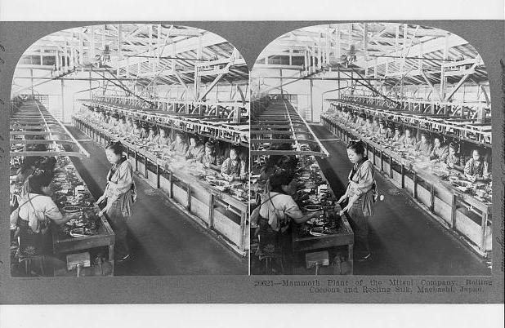

Slide 36
Stop #3
Приве́т.
(HELLO PREEVYET)
The initial phase of the Russian segment of the Industrial Revolution began in the 1880s with the establishment of large scale factories that produced textiles and steel, while coal mining became increasingly important. The steel was used to construct railways while textiles were used for uniforms for the Russian military. The Trans-Siberian Railway, a vast railroad project carried out by the Russian government and provided a more efficient process for the Russian domestic trade and military, was constructed from 1891 to 1916.

Slide 37
RUSSIA
The Industrial Revolution hit the Russian Empire later than most other European and Western nations.
The emancipation of the serfs in 1861 aided Russia in its transition from a predominantly agricultural society to a more industrialized society. The newly feed commoners looked toward the cities for jobs.

Slide 38
RUSSIA
A key factor in Russia’s early industrial revolution, along with increasingly focused government planning and railway development, involved foreign entrepreneurs, from whom Russia gained much-needed capital and technical knowledge.
Foreign capital was absolutely essential to Russian industry. It constituted at least 20% of all capital invested before the 1890s and then began to expand even further.

Slide 39
LOCATION - RUSSIA
Russia, country that stretches over a vast expanse of eastern Europe and northern Asia.
The Russian border is the world's longest. Russia has boundaries with 14 countries: Norway, Finland, Estonia, Latvia, Lithuania, Poland (via the Kaliningrad Oblast), Belarus, Ukraine, Georgia, Azerbaijan, Kazakhstan, Mongolia, the People's Republic of China and North Korea.
https://earth.app.goo.gl/yxjXCs

Slide 40
HUMAN INTERACTION - RUSSIA
The initial phase of the Russian segment of the Industrial Revolution began in the 1880s with the establishment of large scale factories that produced textiles and steel, while coal mining became increasingly important.
The steel was used to construct railways while textiles were used for uniforms, mainly for the Russian military.
https://earth.app.goo.gl/7kQzPj

Slide 41
PLACE - RUSSIA
Due to its size, Russia displays both monotony and diversity. As with its topography, its climates, vegetation, and soils span vast distances.
From north to south the East European Plain is clad sequentially in tundra, coniferous forest, mixed and broadleaf forests, grassland, and semi-desert as the changes in vegetation reflect the changes in climate.

Slide 42
MOVEMENT - RUSSIA
The Trans-Siberian Railway, a vast railroad project carried out by the Russian government in order to bolster a more efficient process for the Russian domestic trade and military, was constructed from 1891 to 1916.
https://earth.app.goo.gl/jkUPVE

Slide 43
REGION - RUSSIA
With the outbreak of World War I in 1914 and the immediate Russian involvement, the Russian military and government needed an abundant supply of goods and money for the war effort.
Employees were subjected to bad working conditions and low wages that to eventually led to reform and to the formation of radical political parties.

Slide 44
Hi Class!
Now it is your turn to get creative!
Show me what you know by creating a Google Earth of your own. Your job is to take your classmates on a journey while identifying two out of the five themes of geography and provide sound evidence support your opinion! Have fun!

Slide 45
References
E. (2017, February). New York State K-8 Social Studies Framework. Retrieved from
http://www.p12.nysed.gov/ciai/socst/documents/ss-framework-k-8a2.pdf
Essay on The Industrial Revolution in Russia. (n.d.). Retrieved from https://www.bartleby.com/essay/The-Industrial-Revolution-in-Russia-P3CUEXFYTC
Five Themes of Geography Graphic Organizer. (n.d.). Retrieved from https://www.teacherspayteachers.com/Product/Five-Themes-of-Geography-Graphic-Organizer-915619
Google Earth. (n.d.). Retrieved from https://www.google.com/earth/
National Curriculum Standards for Social Studies. Retrieved from file:///C:/Users/Acer/Downloads/NCSS%20National%20Themes%20(3)%20(5).pdf
Young, R. (2014, April 11). The Industrial Revolution in Europe, Russia, and Japan. Retrieved from https://prezi.com/nohdiij0rdiu/the-industrial-revolution-in-europe-russia-and-japan/
Main Page. (2019, March 24). Retrieved from https://en.wikipedia.org/wiki/Main_Page

Slide 46
Lesson 4
What challenges were faced by inventors Henry Ford, Nicholas Tesla and Thomas Edison?
By: Leah Dwyer & Amanda Maglione

Slide 47
Teaching the Lesson
After the teacher presents students with images of a light bulb, Model T and the Tesla coil and listening to short biographies about Ford, Tesla and Edison, students will paraphrase portions of a text read aloud or information presented in diverse media and formats by completing a listen and retell on the inventors and identifying the obstacles faced by the inventors. Students will be able to identify three accurate obstacles that the inventors faced.

Slide 48
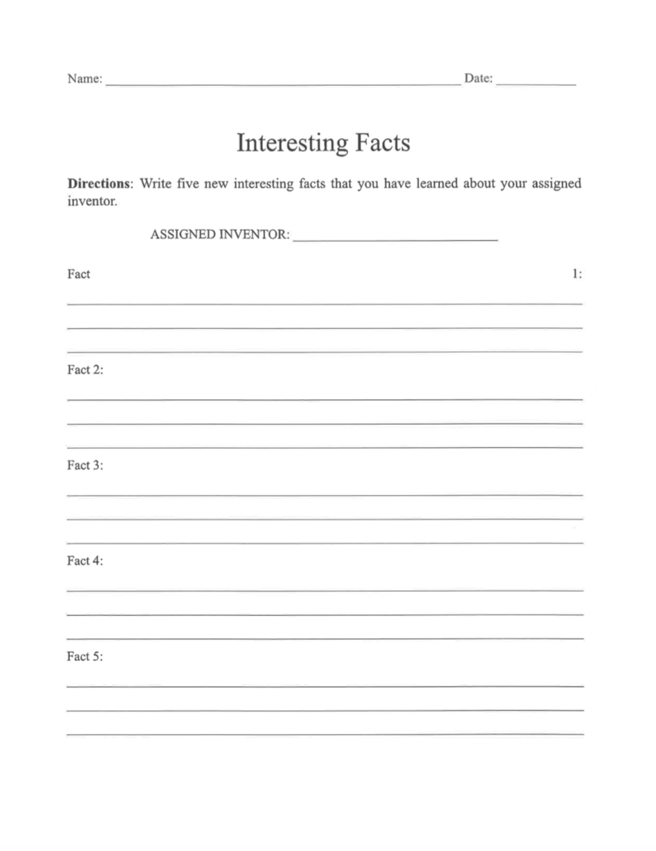
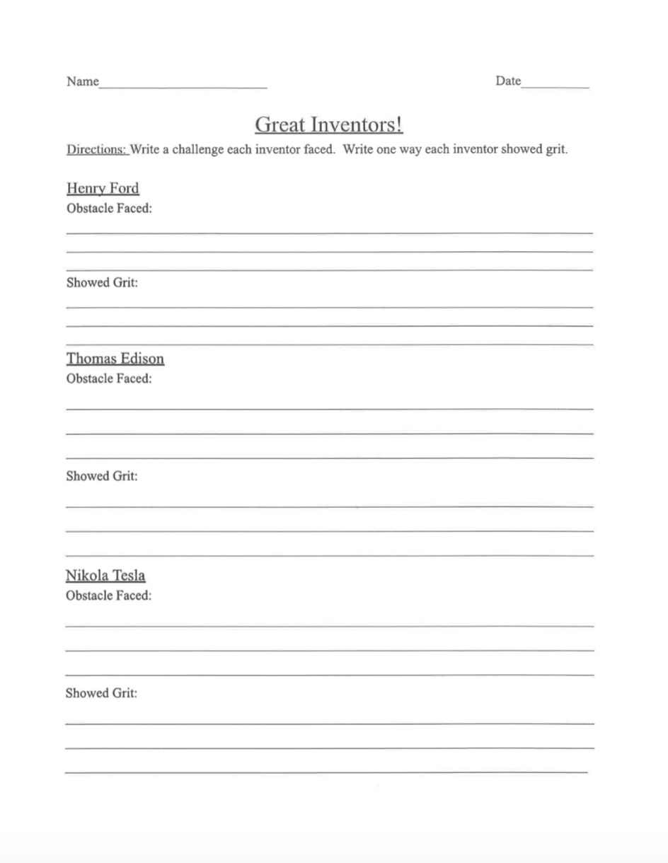
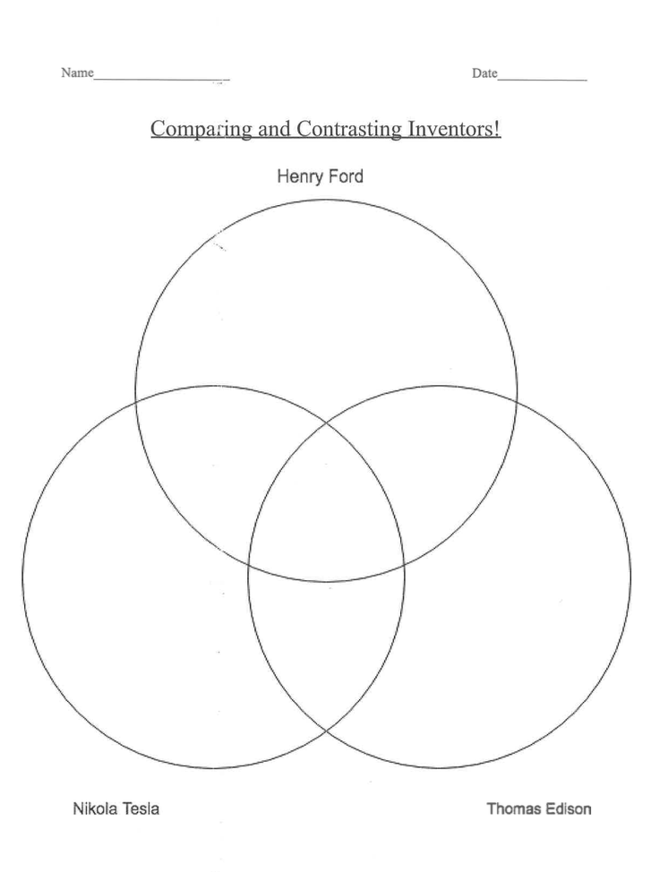
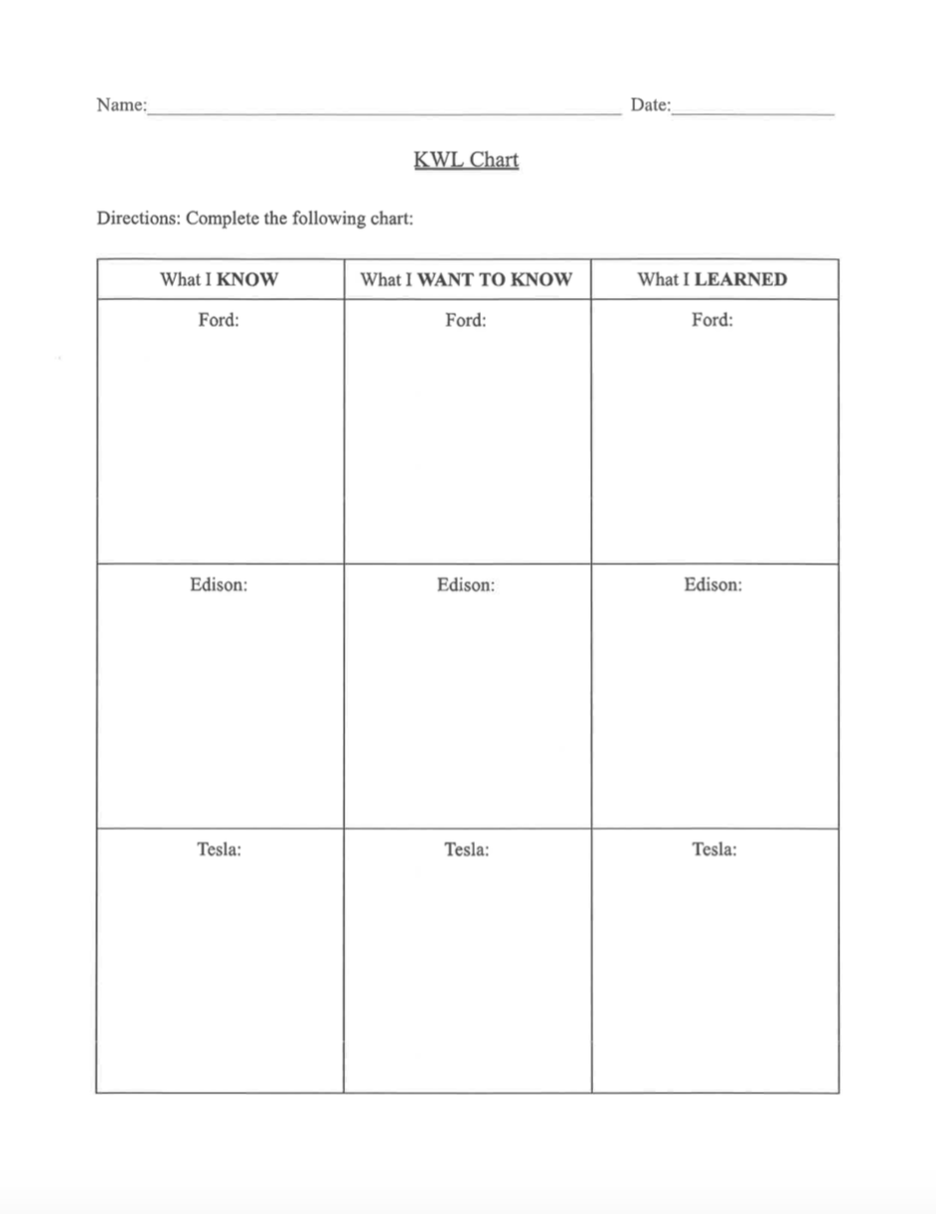
Assessment & Other Worksheets

Slide 49
Lesson 4b
What challenges were faced by entrepreneurs john D. Rockefeller, Andrew Carnegie, and Milton Hershey.
By: Sarah Kirkup and Deniz Goksen

Slide 50
Teaching the lesson
After students watch a video and read short passages about the entrepreneurs John D. Rockefeller, Andrew Carnegie, and Milton Hershey, students will read closely to determine what the text says explicitly and to make logical inferences using the read and retell strategy to fill the filing cabinet, students will identify three accurate, relevant obstacles faced by the entrepreneurs.
Video: https://www.youtube.com/watch?v=TfneVr_o4Bw

Slide 51
DEVELOPMENTAL PROCEDURES
To introduce the lesson, students will watch a YouTube video called The Story of Milton Hershey.
Following the video, students will participate in a read and retell activity as a literacy strategy. Students will read passages independently regarding the three entrepreneurs focused on and record five key words that they believe describe these individuals.
Students will then do a turn and talk about what they have written down from the passages during the read and retell. They will compare their information gathered with the other students in their group and talk about why specific information may or may not be important to know about each entrepreneur.
Students will finish an activity that asks students to identify three accurate, relevant obstacles faced by the entrepreneurs.
Students will meet back with the teacher to follow up on their three entrepreneurs that they have learned about for a read and retell activity.
Students will share one thing that they learned about John D. Rockefeller, Andrew Carnegie, and Milton Hershey. They will also compare them to the other entrepreneurs that they learned about during the previous lesson.

Slide 52
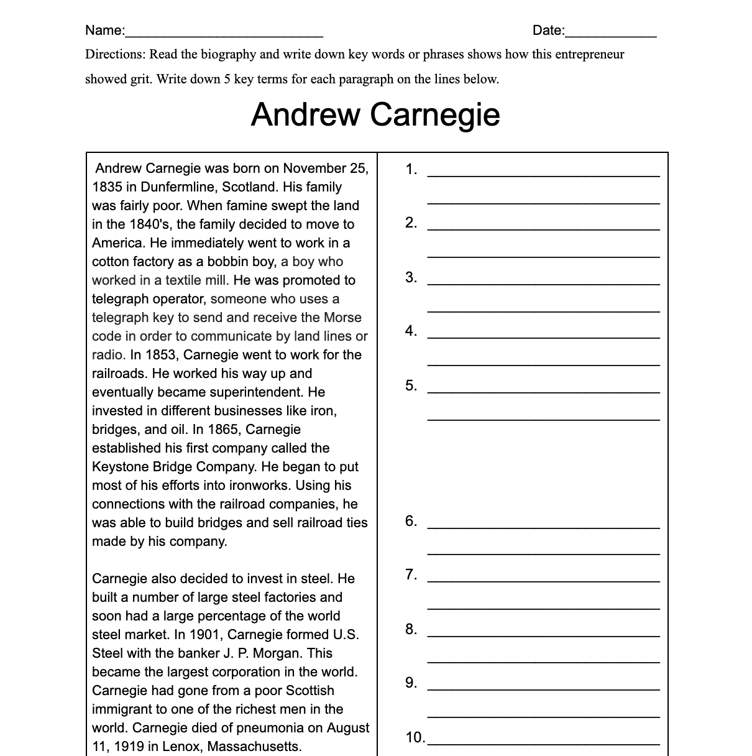
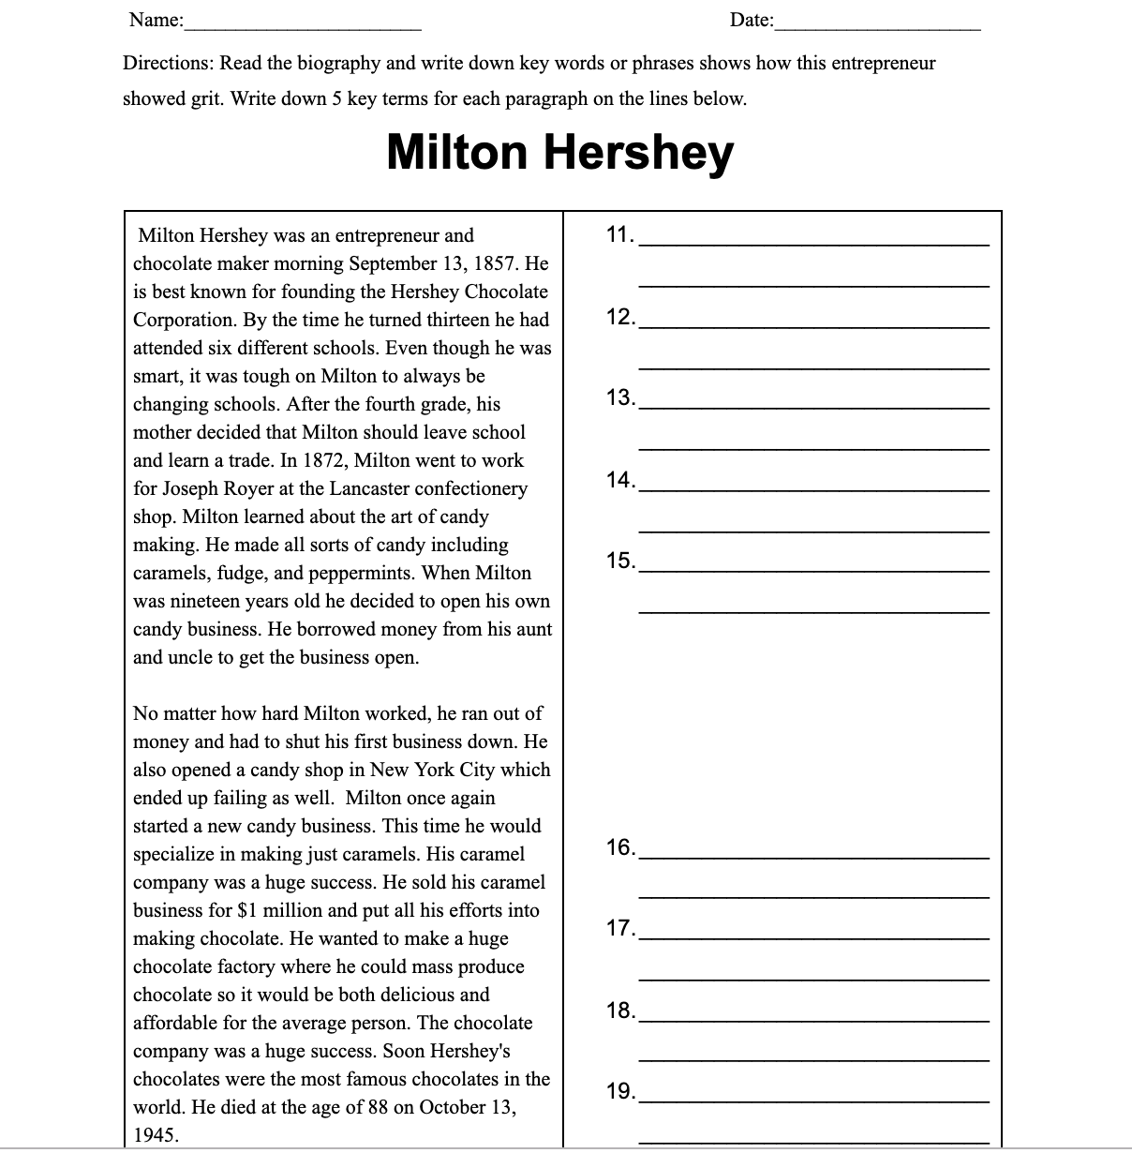
Activity Sheets/Assessments

Slide 53
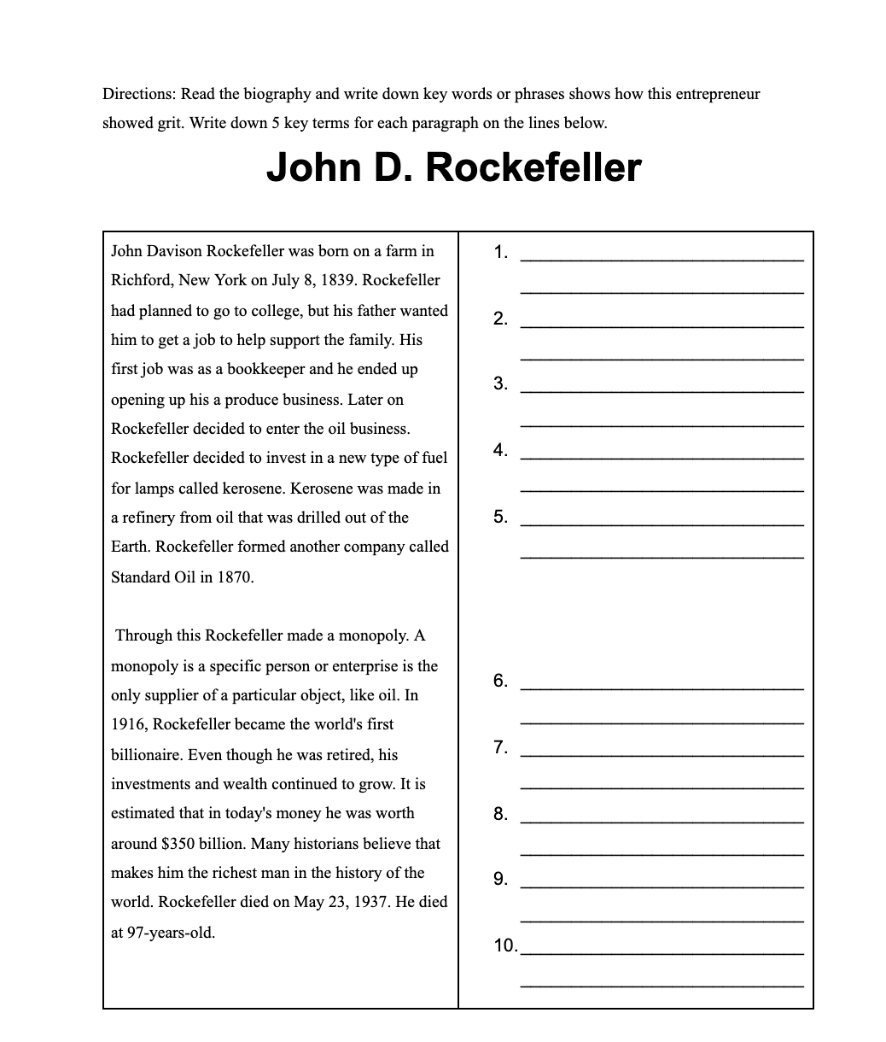
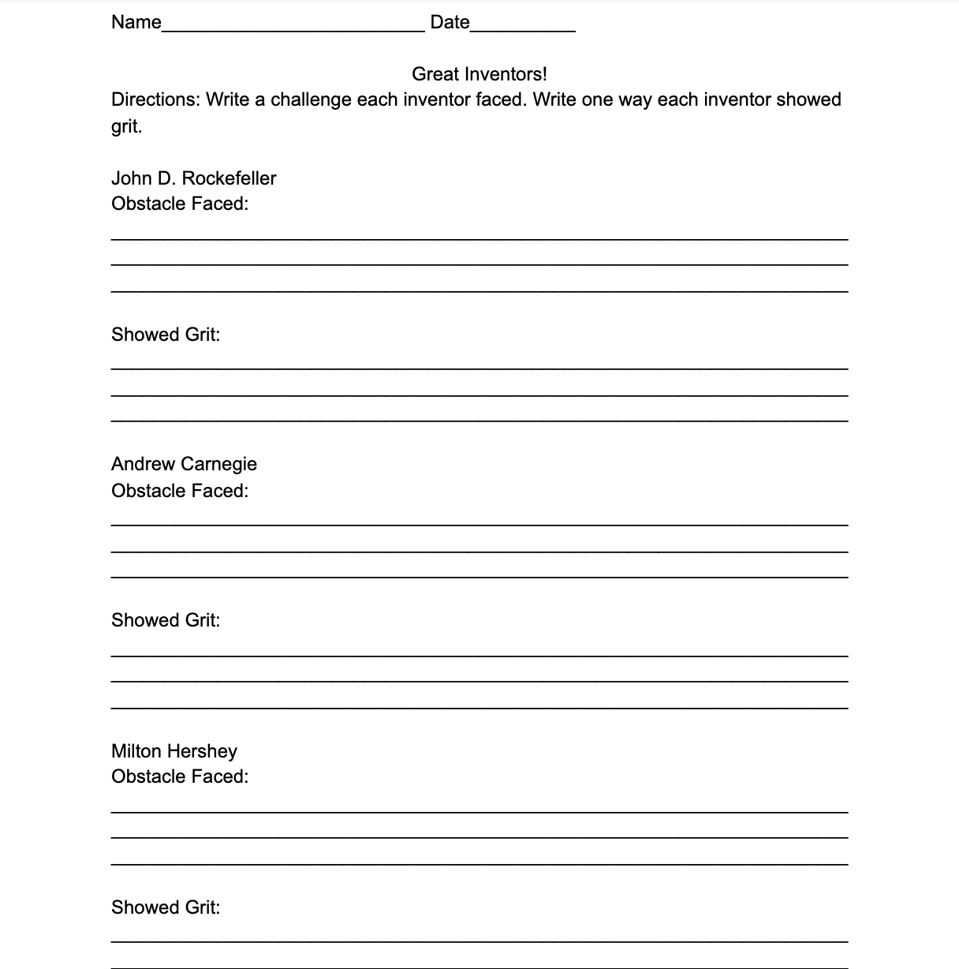
Activity Sheets/Assessments

Slide 54
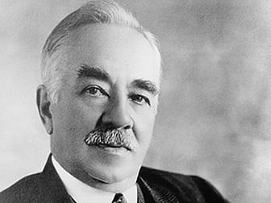
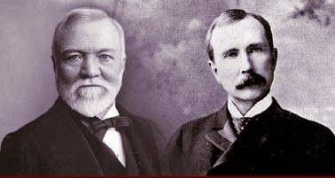
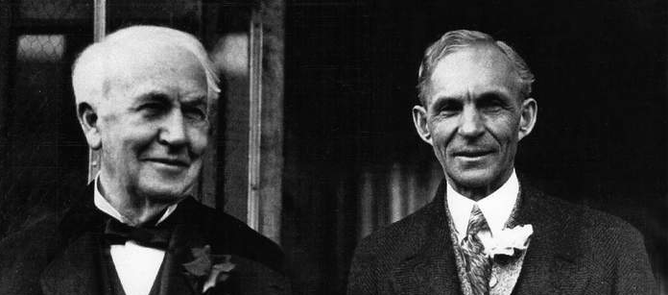
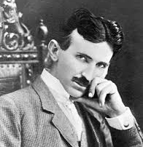
Lesson 5
VS
Industrial Revolution Edition
Jerry Redondo & Caroline Nickels

Slide 55
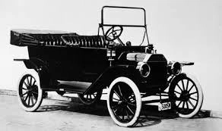
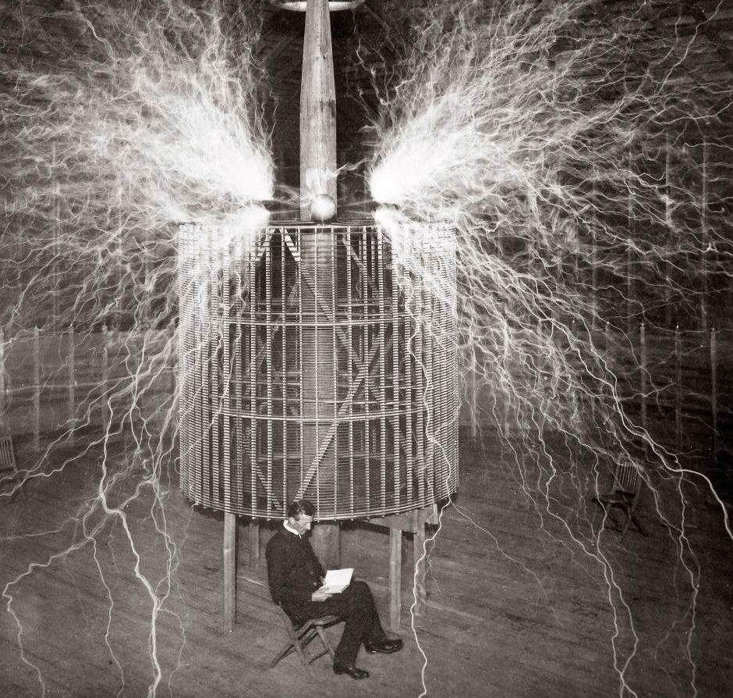
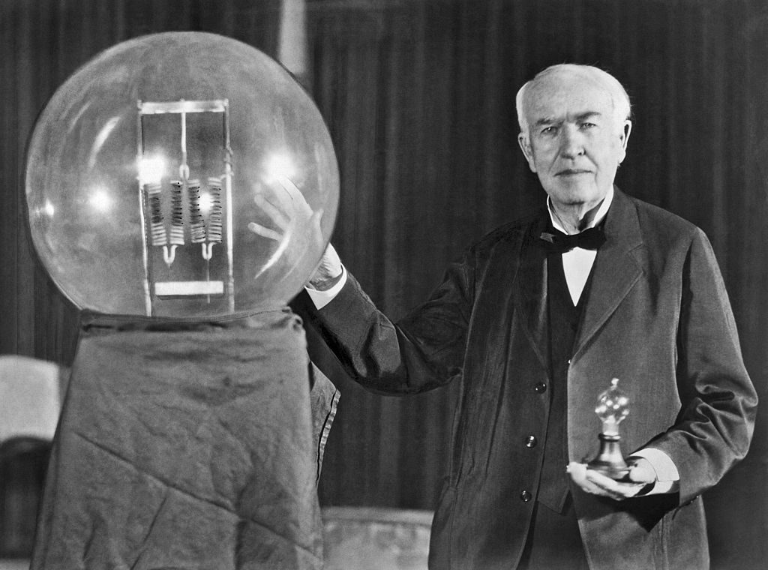
Shark Tank Simulation
After​ ​a​ ​brief​ ​class​ ​discussion,​ ​viewing​ ​a​ ​video​ ​on​ ​​Shark Tank, ​​ ​preparing​ ​a​ ​presentation​ ​on their​ ​assigned​ ​inventor​ ​or​ ​entrepreneur​ ​of​ ​the​ ​Industrial​ ​Revolution,​ and filling in a K-W-L chart, ​students​ ​will​ ​​prepare​ for​ and participate effectively​ in​ a range of conversations​ and collaborations by​ ​participating​ ​in​ ​a​ ​​Shark Tank simulation,​ ​scoring​ ​3​ ​out​ ​of​ ​4​ ​on​ ​the​ ​history​ ​alive​ ​rubric.

Slide 56
Developmental Procedures
The teacher will hold a brief discussion with the class before beginning the lesson.
Q:Does anyone know what the difference is between an investor and an inventor?
Q: Can anyone tell me who these people are?
*Based on previous lessons, the faces of entrepreneurs and investors from the Industrial Revolution should be familiar to most students.*
Q: Has anyone ever seen the TV Show shark tank?
Q: If so, who can briefly tell me what it’s about?
Students will now be given a K-W-L chart of specific investors and entrepreneurs from the Industrial Revolution in which they will be filling out throughout the lesson and after.
Students will be shown a clip from the television show Shark Tank.
Q: Who can summarize what is going on during the video?
Q: What is the goal of the entrepreneur? What is the goal of the Sharks?
Q: Identify what makes a good product or a good business?
Q: In the clip we’ve seen, does the product sell itself or does the entrepreneur sell the product?
Q: Did the entrepreneur succeed at getting the sharks to invest in the product?

Slide 57
Developmental Procedures continued -
Students will be divided into pre-selected groups in which they will be assigned a role.
Roles include three sharks (investors) and three entrepreneurs from the Industrial Revolution. Sharks include, Milton Hershey, John D. Rockefeller, and Andrew Carnegie (two students per entrepreneur.) And three inventors include, Thomas Edison, Nikola Tesla, and Henry Ford (two students per entrepreneur).
In their preparation groups, students will complete the “Shark Tank” packets in which they will read about their specific character and answer the questions provided and K-W-L chart to prepare them for the Shark Tank simulation.
‘Don't cry about the money. It never cries for you!’

Slide 58
What do you know? What do you want to know? What did you Learn?

Slide 59
Investor or Inventor? Do you have what it takes?
What is Shark Tank ?
Background to Shark Tank: Shark Tank is an American reality TV show on ABC that features a panel of business executives and investors (called 'Sharks') who consider offers and listen to pitches from entrepreneurs and small business owners seeking funding for their business, products, or services. The panel includes Barbara Corcoran, Kevin O'Leary, Daymond John, Robert Herjavec, Mark Cuban, and Lori Greiner.
Industrial Revolution – Shark Tank Activity
We will be conducting our own in-class version of Shark Tank using the most significant inventions of the Industrial Revolution which include invention by Thomas Edison, Henry Ford and Nikolas Tesla . You will be selected as either a member of the Shark Tank (investors) or to make a pitch as an inventor from the past.

Slide 61
Developmental Procedures - Part Two
‘You're not an entrepreneur; you're a want-repreneur.’
Students will complete the Shark Tank simulation.
The lesson will conclude with a brief discussion and completion of their K-W-L chart.
Task for Shark Tank Members:
Do initial research on the inventions and create a preliminary chart of what you would like to invest in and how much in % you would like to invest.
Create a list of at least 2 questions for each inventor
Task for Inventors:
Research your invention and put together a pitch that will get the Sharks to invest in your invention. You can use pictures, sound, film, props, etc. You need to understand your invention very well and be able to explain/show/prove how your invention is a necessity and worthy of the investment of the Sharks.
You need to state how much of their 100% you are asking for.
Anticipate questions that Sharks may ask and be prepared to answer them.

Slide 62
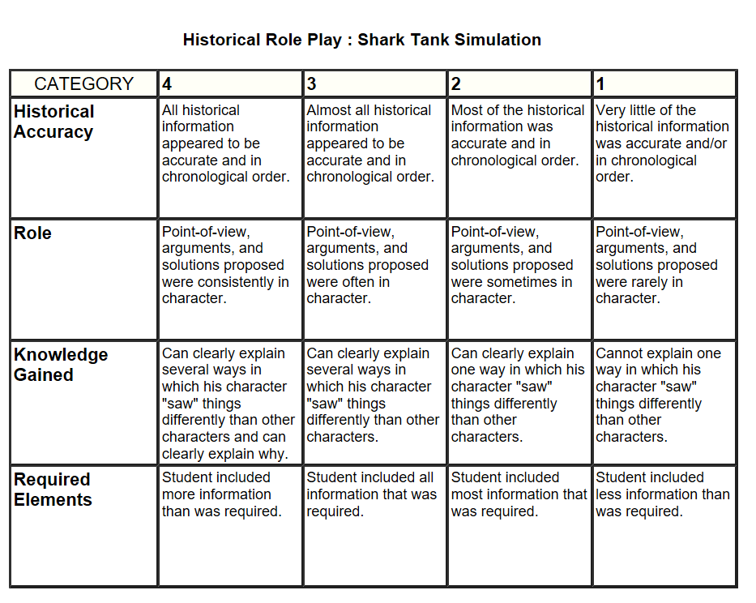
How are you graded?

Slide 63
Lesson 6
Using SCIM-C to Think Like a Historian
By analyzing documents from primary sources, is it valid that “grit” was the secret sauce in the success of three inventors and three entrepreneurs we have learned about from the Industrial Revolution?
By: Dan Savarino & Mary Stephani

Slide 64
What is a Primary Source?
“Voice of the Past”
Raw Materials of history
Original documents and objects which tell the story of people, places, events of the past from the time under study.
Examples:
Documents
Letters
Posters
FIlm
Artifacts
Photos
Secondary sources: created by someone who did not experience first-hand or participate in the event you are researching

Slide 65
Thinking Like A Historian:
SCIM-C Approach
Summarizing: Facts/Details/Observation
What type of doucment is this? (primary or secondary)
What does it directly tell us? (be specific)
Contextualizing: Placing the source in time and space
Who produced the source?
Why was the source produced? What was going on in that time or place?

Slide 66
Thinking Like A Historian:
SCIM-C Approach
Inferring: What is suggested?
What inferences can we make based on this source?
What inference can we make by looking at what is missing?
Monitoring: Have I lingered with the source-squeezed it?
What other questions do I have about this document?
What questions would you like to ask the person who created the source?
Corroborating: What conclusions can be drawn?
What similarities and differences exist between the sources?
What additional information or sources are necessary?

Slide 67
Now Let’s Get to Work!
Analyze the following documents in your assigned groups and use the SCIM-C Approach to prove whether or not the Industrial Revolution was fueled by “Grit”.
Good Luck Historians!

Slide 68
Thinking Like a Historian:
Document #1
Henry Ford:
"Be ready to revise any system, scrap any method, abandon any theory, if the success of the job requires it."
Source: Ford News, p. 2. Date: 1/15/1923

Slide 69
Thinking Like a Historian:
Document #2
Nikola Tesla:
Tesla was not a savvy businessman and suffered financially, despite his achievements. He lost financial backing from Morgan, who felt he couldn’t profit from Tesla’s wireless electricity concept, and sold his assets to make up for dual foreclosures on Wardenclyffe. The property was later sold to a film processing company. In 1917, the U.S. government demolished Tesla’s partially completed tower because it worried German spies would use it to intercept communications during World War I.
Despite these setbacks, Tesla went on to invent alternating current and the remote control.
Source: The life of Nikola Tesla 1993

Slide 70
Thinking Like a Historian:
Document #3
Thomas Edison:
“In years gone by, one Edison, the “Wizard”, was a laughing stock, but her has turned the laugh until it is now being ripped out all over the earth through the medium of the phonograph”
Source: Excerpt from Chronicle supplement 1901

Slide 71
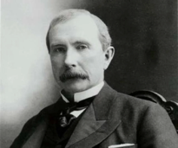
Thinking Like a Historian:
Document #4
John D. Rockefeller:
“I always tried to turn every disaster into an opportunity” - Rockefeller
Source: Titan: The Life of John D. Rockefeller by Ron Chernow

Slide 72
Thinking Like a Historian:
Document #5
Andrew Carnegie:
“All we can profitably or possibly accomplish is to bend the universal tree of humanity a little in the direction most favorable to the production of good fruit under existing circumstances.”
Source: The Gospel of Wealth - Autobiography of Andrew Carnegie

Slide 73
Thinking Like a Historian:
Document #6
Milton Hershey:
One of several letters written by Milton Hershey to his Uncle pleading for financial assistance before he officially filed for bankruptcy in 1882.
Dear Uncle, Philadelphia, Jan 14, 1881
You [wrote to me that you were sorry to have] disappointed me…. but money matters are so tight with me that it is impossible to comply with your request for(a loan)
Your Respects,
Nephew M S Hershey
(Milton’s Uncle)

Slide 74
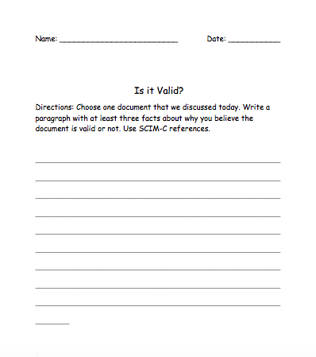
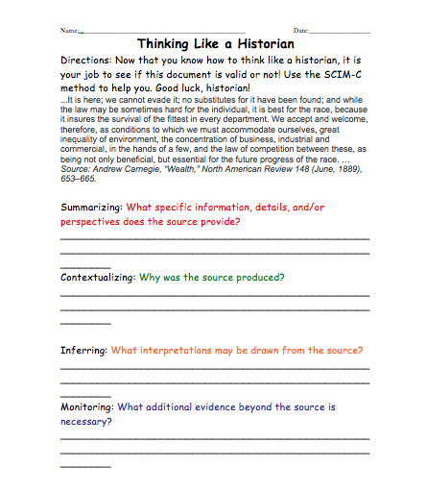
Assessment / Worksheet:

Slide 75
References
Andrew Carnegie, “Wealth,” North American Review 148 (June, 1889), 653–665
Chernow, R. (2004). Titan: The Life of John D. Rockefeller. New York, NY: Second Vintage Books Edition.
Colorado Department of Education (2019). Elementary primary source sets, Retrieved from: https://www.cde.state.co.us/cosocialstudies/pssets
Ford Motor Company. (1923, January 15). Ford News. p.2.
Hershey Community Archives. (n.d.). Retreived from: https://hersheyarchives.org/online-resources/
New York State Education Department. (2017). New York State Next Generation English Language Arts Learning Standards. Retrieved from http://www.nysed.gov/common/nysed/files/programs/curriculum-instruction/nys-next-generation-ela-standards.pdf
O’Neil, J. J. (1993). Prodigal Genius: The Life of Nikola Tesla. London, Great Britain: Neville Spearman LTD
The State Education Department & The University of the State of New York. (2017). New York State K-8 Social Studies Framework. Retrieved from http://www.nysed.gov/common/nysed/files/programs/curriculum-instruction/ss-framework-k-8a2.pdf

Slide 76
WHAT IS TDFC?
Lesson 9
BY: JOELLY & JILL

Slide 77
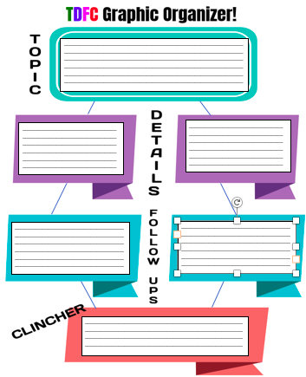

Slide 78
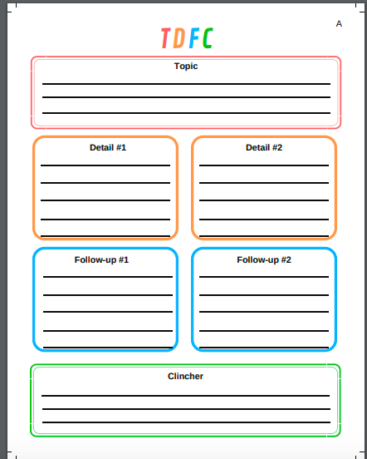

Slide 79
Topic: What is the topic/subject that is being discussed or written about?

Slide 80
Details: particular fact or piece of information about your topic.

Slide 81
Follow-Up: Confirms your details with text evidence.

Slide 82
Clincher: A short conclusion of all your thoughts (Includes parts of your details and follow-ups). This sentence should convince the reader.

Slide 83
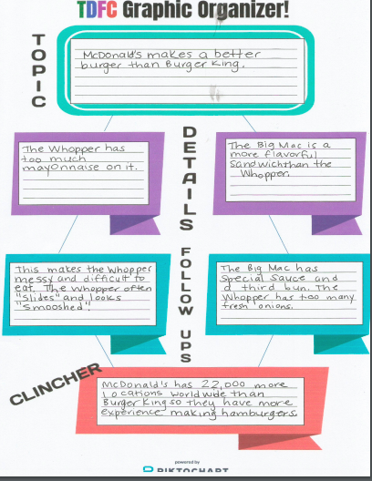

Slide 84
Industrial Revolution History Mystery
EDU 5090
Dr. Sheean
Melissa Torre & Belen Walston

Slide 85
What is a History Mystery?
-Today we will be acting as detectives to answer this question, “Was the Industrial Revolution fueled by a growth mindset?”
-Take a look at the video to the right to determine the kind
of detective work you will need to help you solve this
mystery.

Slide 86
How It’s Going To Work
-First we will be breaking all students into groups of four.
-Each student will be assigned a job. On each student’s desk will be a worksheet with each of the job descriptions and your role highlighted.
-Next we will distribute each groups’ case file. In the case file you will find your context clues to help you solve the mystery.
-You will discuss with your group the clues and discuss whether or not you believe the Industrial Revolution was fueled by a growth mindset.
-You will be working on deciding whether or not the source is credible and you will need to use at least three sources to support your final decision.

Slide 87
Let’s Get Going!

Slide 88
Wrapping Things Up
-Now you will use your Chromebooks to complete an individual exit ticket, in which you will discuss your feelings on today’s lesson and your final opinion. Remember in order to receive full credit you must use at least three sources to support your argument.

Slide 89
Lesson Ten: Taking Informed Action
Let’s watch this video on a girl who used GRIT to overcome a hardship in her life and persevere to achieve an important goal of hers.
https://www.youtube.com/watch?v=lrnihanwVos
What obstacles did she face? Did passion play an important part in achieving her goal? How so? Can we see how everyone, no matter what age can use grit to accomplish an important goal?

Slide 90
GRIT Review
What is grit & growth mindset?
How did it influence the Industrial Revolution?
What famous inventors and entrepreneurs used grit to become successful?
Why does someone who goes on SharkTank need to have grit?

Slide 91
Taking Informed Action for Ourselves!
Turn & Talk with a partner and discuss what you think “Informed Action” means.
Let’s watch this movie clip that explains why it’s important to start thinking about setting goals for ourselves, and how it will impact the rest of the world:
https://www.youtube.com/watch?v=nwP36w2074w
What did the teacher have students think about in the video? Why is this important? Do you think the students will need to use grit to accomplish any goals they set forth? Why do you think the teacher had students think about their lives in the future, past the 7th grade?

Slide 92
Power of Yet!

Slide 93
Putting your Goals into Action!
We are going to use the rest of class to start working on a Buncee Presentation outlining our goals.
You will be required to:
1. State your intended goal ( can be personal or global)
2. State why this goal is important and something you are passionate about.
3. List the steps you will need to follow through with this goal.
4. List at least 3 obstacles you might face and how you will use grit to overcome them.
5. List one person that inspires you and motivates you to complete your goal.
Create a flipgrid video of yourself in the future after having completed your goal. Describe what steps you took to get there and how it feels to have it accomplished.

