Slide 1
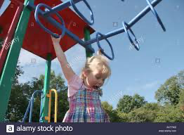
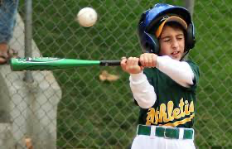
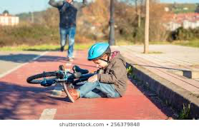
MISTAKES
= Failing well
Have you ever made any of these mistakes?
What did you learn from these mistakes?
Did you try again after you made these mistakes?

Slide 2
Have you ever made a mistake?
Think about a time you have made a mistake.
How did the mistake make you feel?
Go onto Padlet to post about your mistake
https://padlet.com/aleonardi1/n8fkmzw1ctg40skv

Slide 3
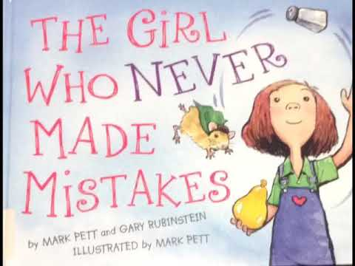
The Girl Who Never Makes Mistakes
Click on the link to listen to the story.

Slide 4
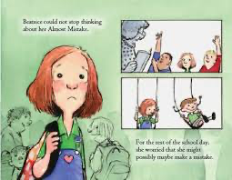
Questions on “The Girl Who Never Made Mistakes”
-What are some things that Beatrice does before she goes to school?
-What are some things that Beatrice’s brother Carl does?
-Do you think Beatrice is better than Carl?
-Why is Beatrice afraid to make mistakes?
-What do you think Beatrice misses because of her fear of making mistakes? Do you think her brother Carl has more fun?
-How do you feel about Beatrice?
-When Beatrice has her juggling mishap, she doesn't know what to do. How does she take control of the situation?
-Why do you think Beatrice's attitude changes the day after the talent show?
-How do you think Beatrice feels when her name changes from ''The Girl Who Never Makes Mistakes'' to just ''Beatrice?''
-Are Beatrice’s mistakes good or bad?

Slide 5
FlipGrid
A FlipGrid is a tool that will allow us as a class to communicate via video messages. We create a grid of videos to help facilitate discussions with one another.
Create a FlipGrid on a time that a mistake made you stronger or where you “failed well”.
https://flipgrid.com/mistakes00
Reply to at least one students FlipGrid and talk about how you think their mistake was “failing well”

Slide 6
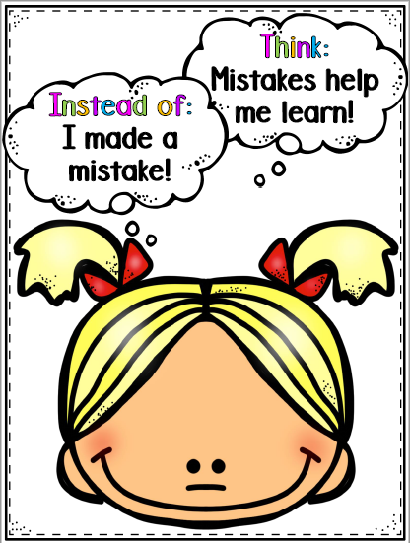
Find a parent and ask!
Ask a parent and discuss what a mistake is and if they have ever made a mistake before.
Did you learn from this mistake?
Is a mistake a good thing or a bad thing?
Did you learn anything from this mistake?

Slide 7
What is a growth mindset??

Slide 8
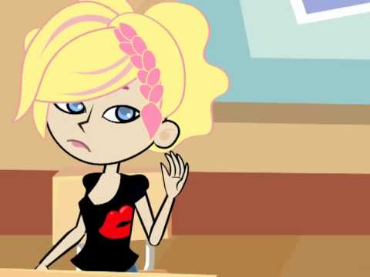
Click on the photo to watch the video!

Slide 9
Take a moment and think about these questions with your child after watching the video.
Why is the girl in the video afraid to make a mistake?
Why was Beatrice afraid to make a mistake?
How did Beatrice learn from her mistake?
Have you ever made a mistake and learned from it?
How did making a mistake change Beatrice?
Have you ever learned from a mistake that
changed you?

Slide 10
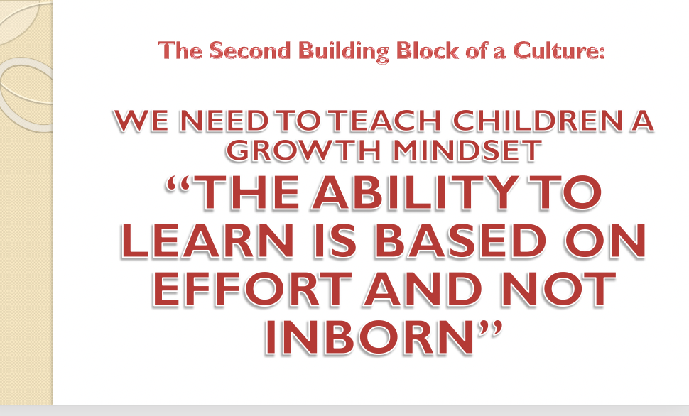
Making a mistake is a part of life. It is important that we help our students learn that making a mistake is okay and can help us learn something new!

Slide 11
Here is a chart of the difference between “Failing well” & “Failing badly”
Failing Well Failing Badly
Taking Responsibility for Failure: Blaming Blaming Others or Circumstances: Not
No One taking Responsibility for Failure:
Learning Valuable Lessons Not Learning Valuable Lessons
From Failure From Failure: Repeating the
Same Mistake Over and Over
Having a Positive Attitude on Failure Having a Negative Attitude on Failure
(Growth Mindset) (Fixed Mindset)

Slide 12
Growth Mindset Mystery
Click on the picture and play this fun Quizizz* and understand the difference between failing well and failing badly!
*Quizizz is an online site that has self-paced, interactive quizzes to review, assess, and engage students
—in class and at home.

Slide 13
Growth Mindset Challenge:
In a box on our padlet, write some things that you are good at. On another box, write the things that you are not good at now but would like to try. Pick one activity that you are going to do over quarantine.
As a parent, In a box, write things that you are good at. In another box, write the things that you are not good at but would like to try. Pick one activity that you are going to do over quarantine,
Click the picture to get to padlet!

Slide 14
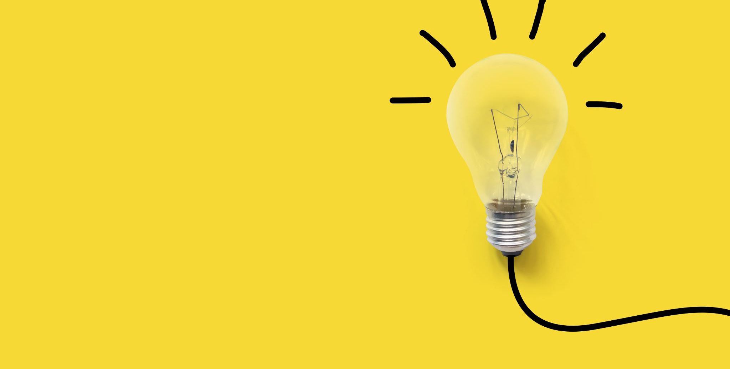
Success From Failing

Slide 15
Think about different examples of failing well and failing badly this past week.

Slide 16
Click to watch the video on engineers.

Slide 17
Think about these questions after watching the video.
Based on the video, what do engineers do?
Do you think engineers get things right the very
first time?
Does an engineer need to fail well?
Can success stories start out as failures? Think of an example.
Would you like to be an engineer?

Slide 18
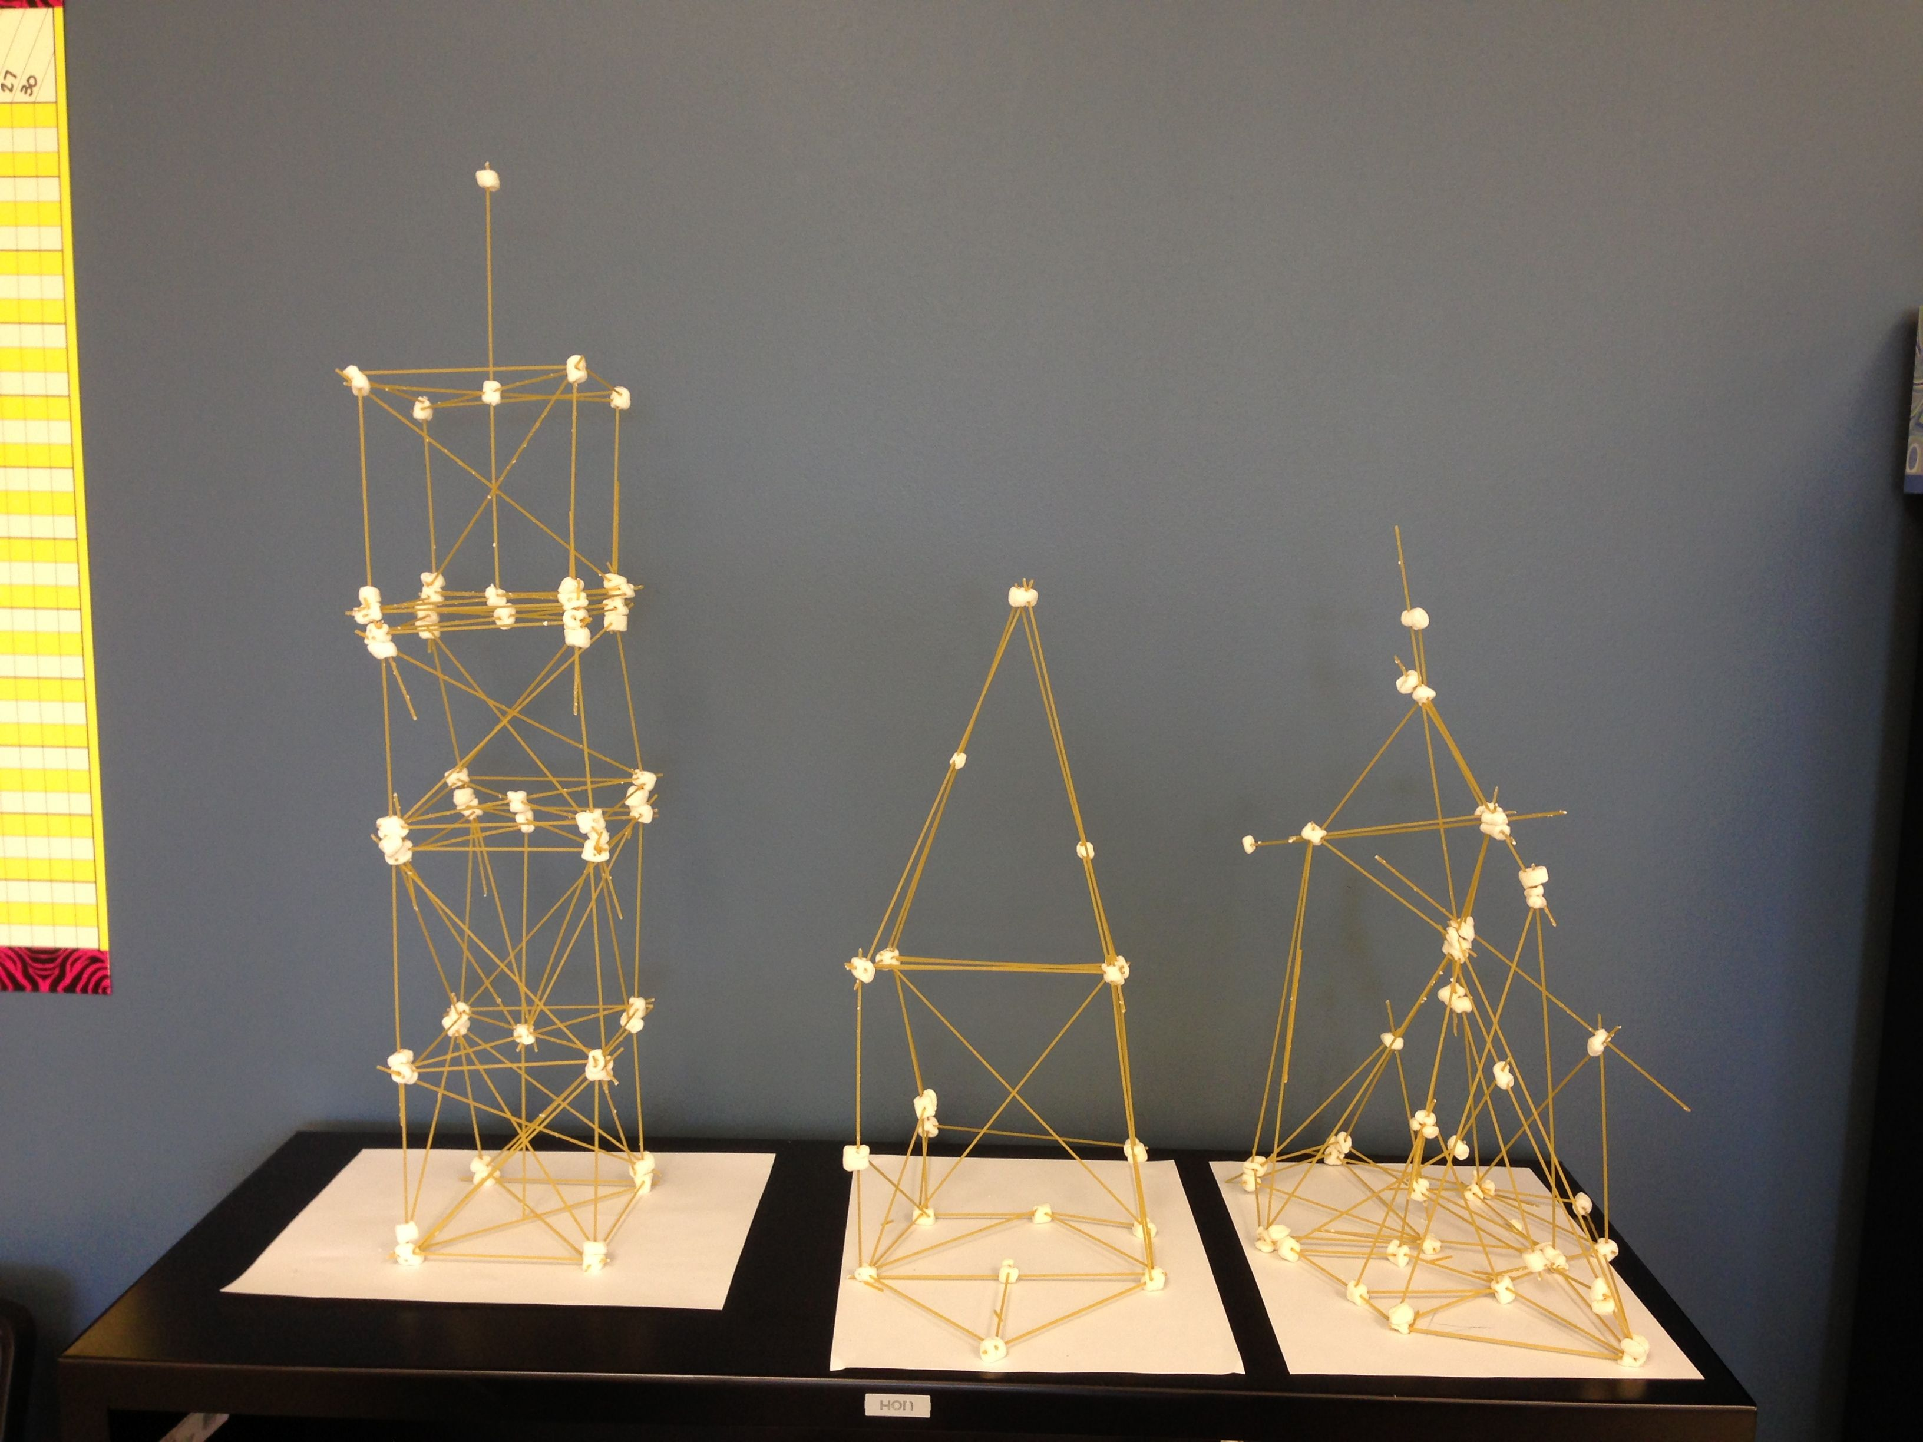
The Marshmallow Challenge
Students will build the tallest free-standing structure
Materials needed: 20 sticks of spaghetti,
one yard of tape,
one yard of string, and
giant marshmallows.
After their first attempt, the student can try a different pattern to see if they can make one higher than their first structure.
Here is a video for an example!
https://www.youtube.com/watch?v=WU8EvgP7EGk

Slide 19
Students will then share on FlipGrid what they learned from building the tower.
Scan QR code below to access the FlipGrid

Slide 20
Independent Practice
Students will watch the news this week and listen to the scientists as they talk about the current Pandemic. Students will predict whether scientists need to fail well or not.

Slide 21
What it's like having a
GROWTH MINDSET

Slide 22
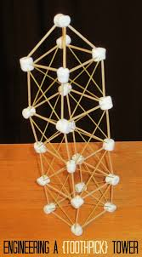
Having a growth mindset. *Think and talk*
Think and talk quick about when you built your marshmallow tower.
Share what you loved about it and what you struggled with.
Did you make any kind of mistakes while building your tower?
Did those mistakes help you grow in your success in building a new tower?

Slide 23
Today we will be reading a new book “Ada twist scientist.” Click on the picture to watch the video
Be sure to think about your experience building your tower while watching!

Slide 24
During the video read aloud, make sure you are discussing these questions with your child. Just briefly discuss and share your answers with one another.
What are some of the questions Ada had?
What kind of traits does Ada have that make her a good scientist?
What was the question Ada was trying to figure out the answer to?
What were some of the mistakes Ada made?
Did Ada find a final answer to her question?
Does that mean she failed?
How did Ada fail well?
How did Ada try and answer her question?
Was trying to answer Ada’s question easy or difficult?
Do scientists need to fail well to find results?

Slide 25
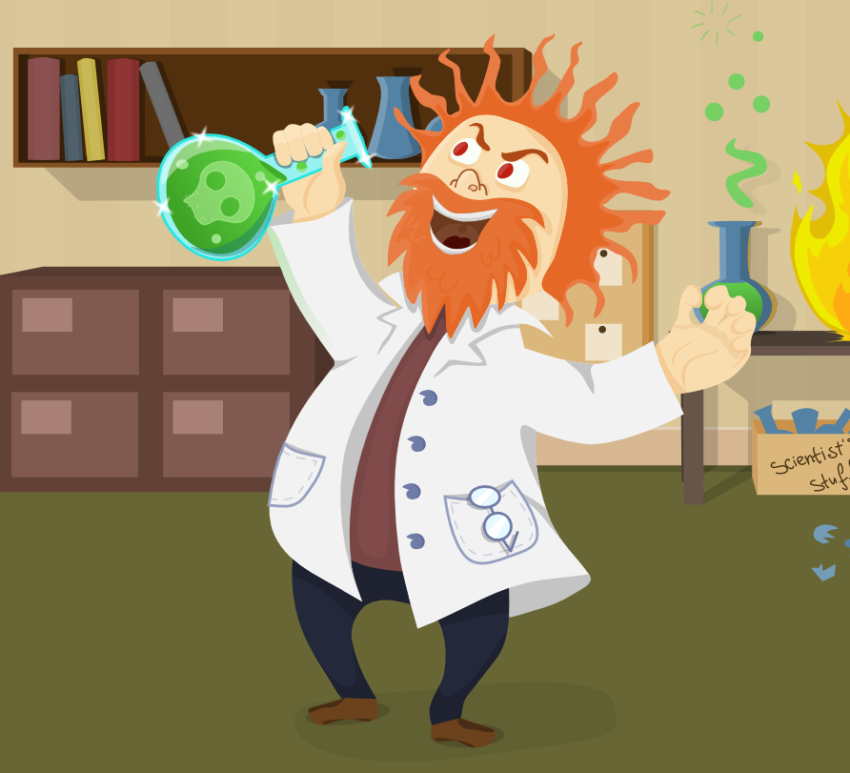
After going over the questions during the read aloud, come back to the question of, “Do scientists need to fail well?”
Does a Scientist need to fail well?
Why or why not?

Slide 26
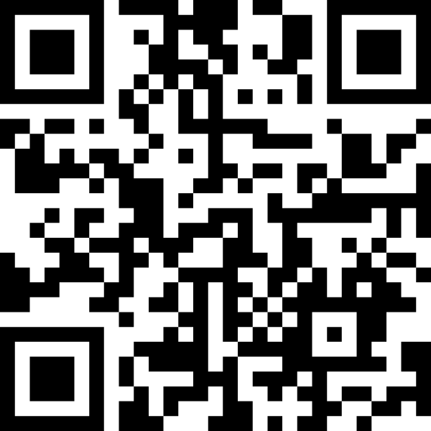
ON FLIPgrid, answer the question "Why is it necessary for a scientist to fail well?"
SCAN THE QR CODE ON THE FLIPGRID APP TO ACCESS THE GRID

Slide 27
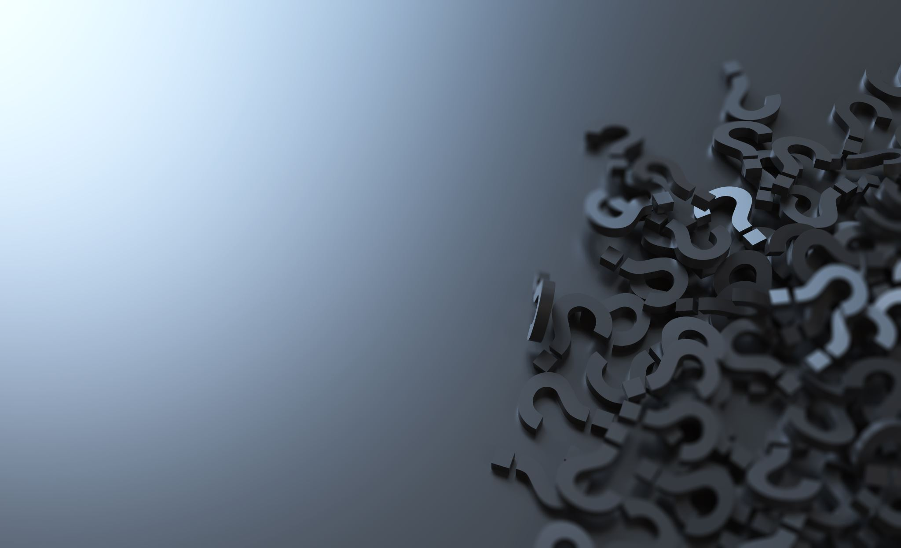
Independent practice!
Students will write letters to next year's first grade on all that they have learned about the need for a growth mindset in first grade and in science and engineering.
What having a growth mindset is,
What it means to fail well,
Ways that they have failed well in first grade, and
How we all make mistakes as we try out new ideas, just like scientists and engineers do.

