Slide 1
Third Grade
Lesson 1
By Celeste Magluilo and Ashley Mehale

Slide 2
Objective:
After participating in a Padlet activity and a read aloud with guided questions, students will respond to the question: “What is the role that the characters in the book play in creating Rosie's hope or crushing Rosie's hope?”

Slide 3
Discussion and Padlet Activity
Before reading the text, students will answer “How do other people affect our hope?” on Padlet.
Students will click on the Padlet link and be able to access the website without signing in.
This question will connect to the student’s lives, as well, as the story they will be reading shortly after.

Slide 4
Read Aloud Activities
Students will watch the YouTube video, ROSIE REVERE, ENGINEER and discuss with a parent which characters in the book gave Rosie hope and who crushed her hope.
Parents and students can discuss examples of hope creators and hope crushers in their own lives.

Slide 5
Some Questions To Consider:
How did characters in a story respond to major events and challenges?
Who encouraged Rosie and gave her hope?
Who discouraged Rosie, how, and crushed her dream?
Why did Rosie think her heli-o-cheese-copter failed?
How did Rosie respond to her mistake? Did she improve her plan?
Students can expand on their thoughts by posting another response on the Padlet to the prompt: What is the role that the characters in the book play in creating Rosie's hope or crushing Rosie's hope? after these discussions.

Slide 6
Third Grade
Lesson 2
By Celeste Magluilo and Ashley Mehale

Slide 7
Objective:
After participating in a Padlet review of the main characters in Rosie Revere Engineer by Andrea Beaty, completing a Compare/Contrast graphic organizer through the lens of Hope Creators and Hope Crushers for at least five of the characters from the video, Get Back Up Again, and having discussions with family members about Hope Creators and Hope Crushers, students will successfully identify themselves as Hope Creators by creating a “Self Talk” Statement for their personal use.

Slide 8
Please watch the video
Watch Get Back Up Again” Clip from the movie Trolls.
Please click on the words “Get Back Up Again” or click on the picture in the corner! It will take you to the song. Notice what the character, Poppy says when she falls down.

Slide 9
Discussion and Padlet Activity
Students will click on the Padlet activity here. Students will respond to four questions, as well as watch a short video clip about hope. Students will be able to connect the idea of hope to the story Rosie Revere, Engineer.

Slide 10
QUESTIONS TO THINK ABOUT:
Write about a time when you were successful. Who supported you? How?
When was a time you thought of yourself as a failure? Did anyone crush you? How?
Are you a Hope Creator or a Hope Crusher for yourself?
Can you think of another word for “Hope”?

Slide 11
A hope creator is…
Someone who believes in you. They are kind and positive even if you fail.

Slide 12
A hope crusher is…
Someone who does not believe in you and what you are capable of doing.

Slide 13
Discuss with a parent:
HAVE THERE BEEN HOPE CRUSHERS IN YOUR LIFE?

Slide 14
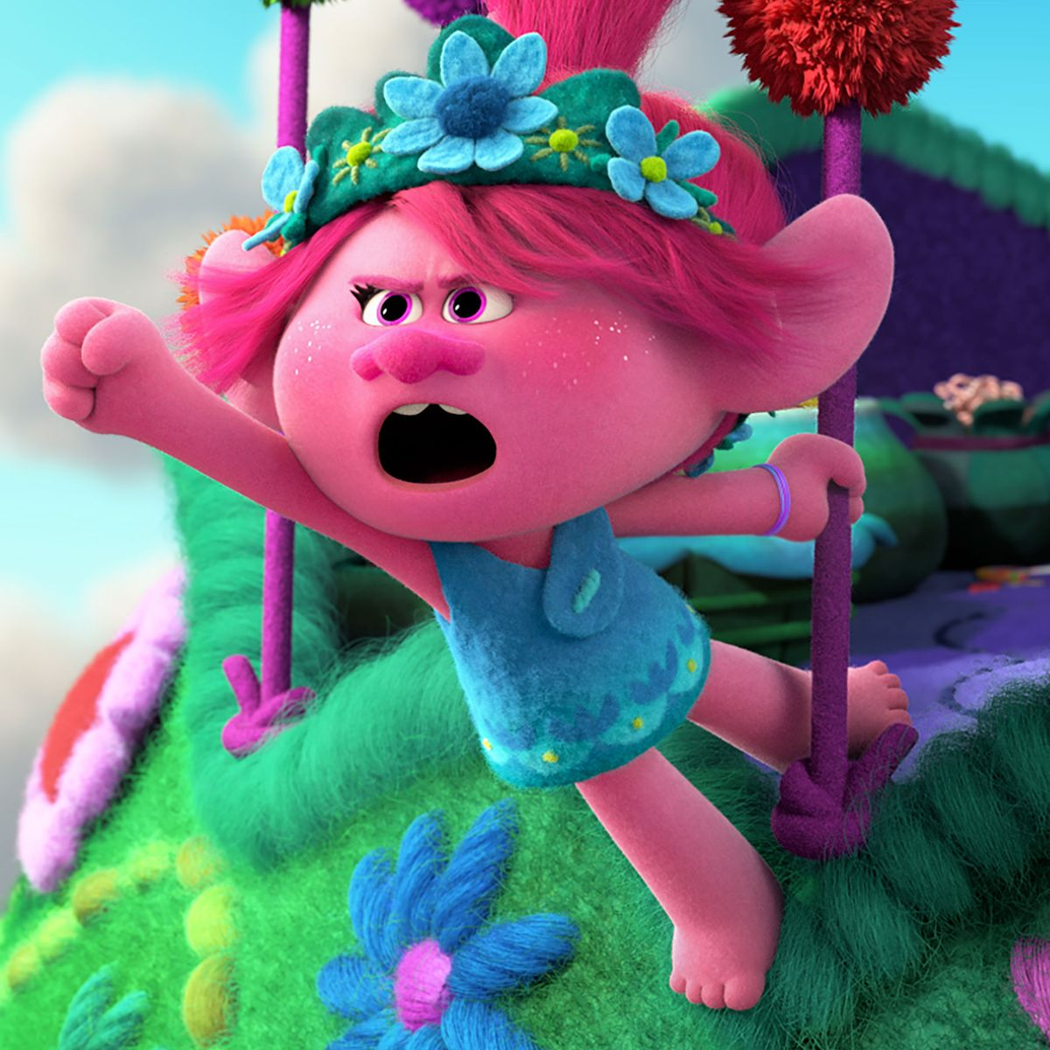
Discuss:
What did the little girl in the song say to keep going? What is her positive self talk?

Slide 15
WITH A PARENT…
CAN YOU CREATE A POSITIVE SELF TALK STATEMENT TO USE WHEN SOMEONE BRINGS YOU DOWN?
Examples are on the next slide!

Slide 16
HERE ARE SOME EXAMPLES OF POSITIVE SELF TALK:
I ALWAYS GET UP.
I CAN DO THIS.
YOU CAN’T STOP ME.

Slide 17
Third Grade
Lesson 3
By Celeste Magluilo and Ashley Mehale

Slide 18
Objective:
After active participation in a recap discussion about positive self-talk statements, students will explore forces and motion aligning the scientific concepts to the Push/Pull impacts of Hope Creators/ Hope Crushers. Understanding of this alignment will be assessed through students' cartoon drawing of superheroes where hope crushers are related to gravity and friction and hope creators are related to force.

Slide 19
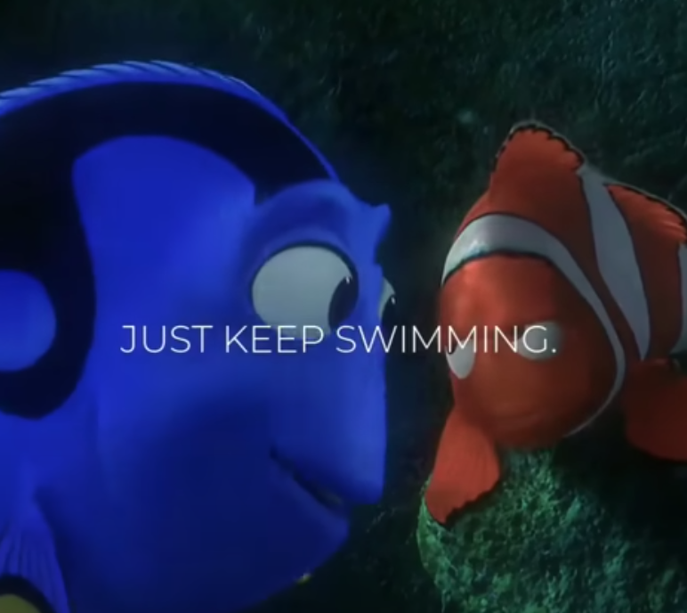
Watch this youtube video.
Discuss with a parent all of the positive self talk statements you have heard.

Slide 20
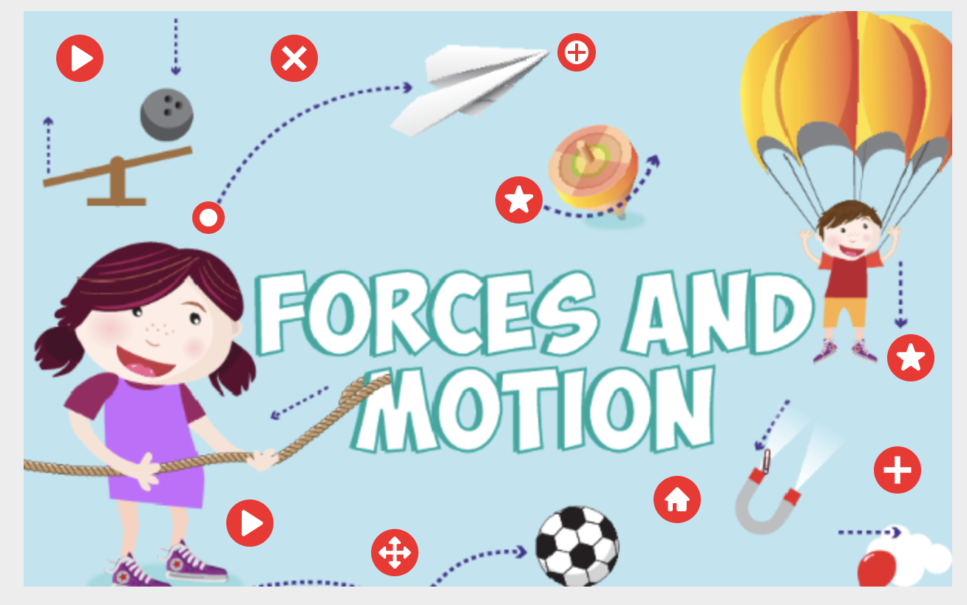
Thinglink
Open Thinglink. Click on the red buttons to view videos and websites to learn about forces and motion.

Slide 21
Please click on this video to learn about forces and motion.

Slide 22
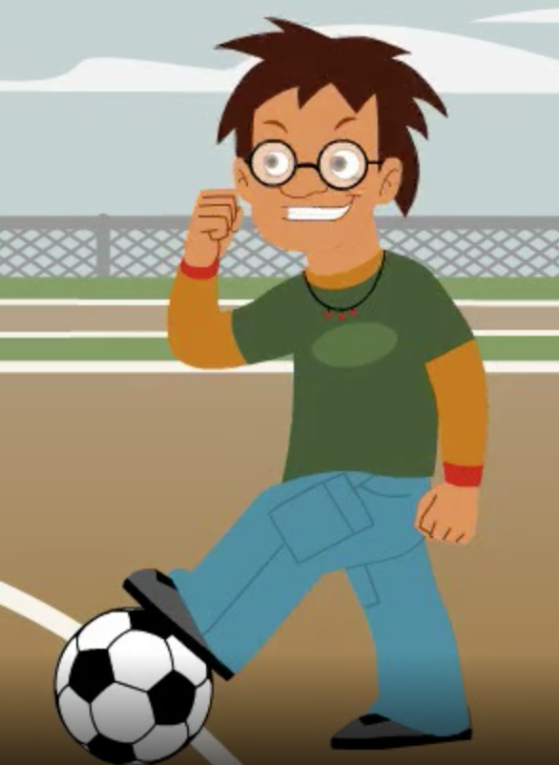
In the video you just watched, Sam said, “It’s not force I need. It’s skills. I’m just not so great at soccer.”
Turn Sam’s statement into a positive self talk statement. Share it with a parent.

Slide 23
An Example Could Be:
I am trying my best to improve at playing soccer. I am learning new skills each day.

Slide 24
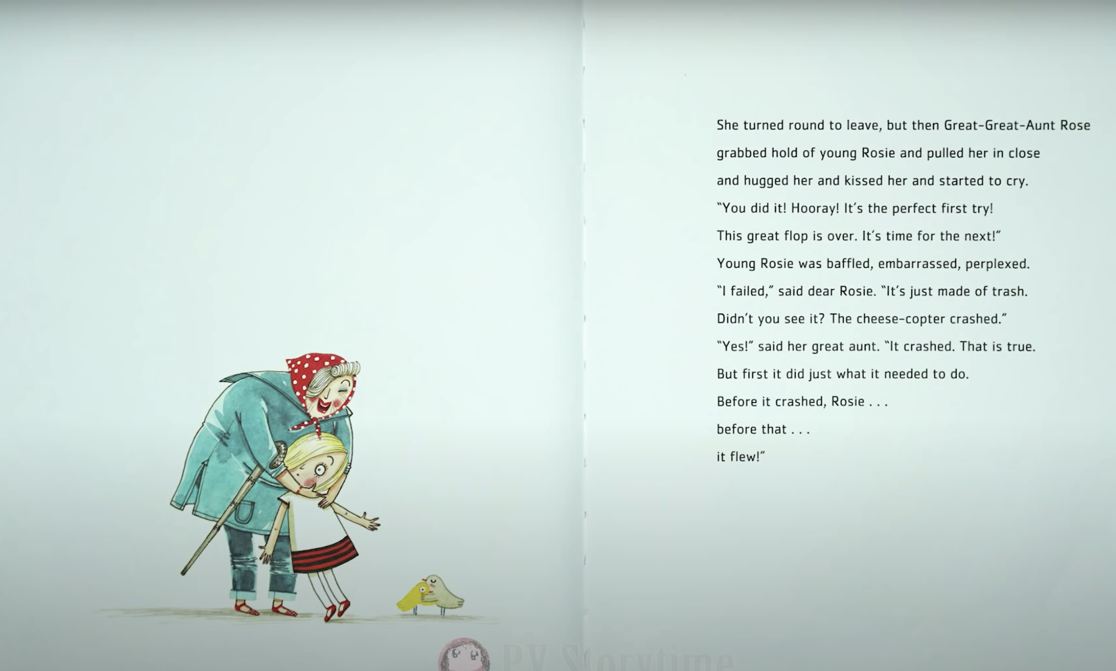
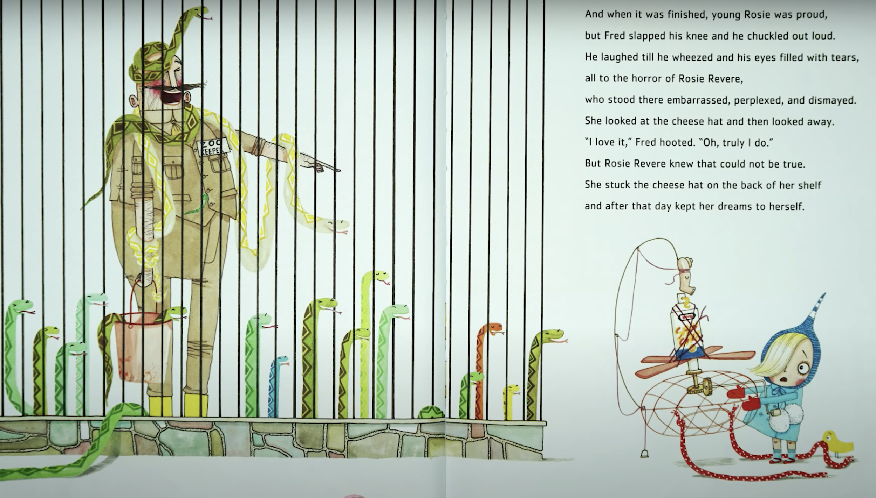
Hope Crushers Vs. Hope Creators
Rosie’s uncle laughed at her invention. He is a hope crusher.
Rosie’s aunt supports her invention. She is a hope creator.

Slide 25
How can we relate Science to what we have been talking about in regards to Hope Crushers and Hope Creators?
Hope Crushers can PULL you into thinking you are not good enough. Hope Crushers can PULL you away from your dreams.
Is there anything else they can PULL you away from?
Hope Creators can PUSH you to be your very best self. Hope Creators can PUSH you to follow and achieve your goals/dreams.
What else can Hope Creators PUSH you to do?

Slide 26
Create a Cartoon
It’s time to have fun!
Create a superhero cartoon where the Hope Crushers represent gravity and friction. Hope Creators represent force!
You get to name them!

Slide 27
Third Grade
Lesson 4
By Ashley Mehale and Celeste Magluilo

Slide 28
Objective:
After participating in a recap discussion of hope creators and hope crushers students will respond to the question, “Do you believe that someone can add force and direction to our lives by making a poster, Padlet, or Flipgrid.

Slide 29
To Motivate You...
Watch this Youtube Video called, Color Your World.
How does being kind make us feel?
Or

Slide 30
A hope creator is…
Someone who believes in you. They are kind and positive even if you fail.

Slide 31
A hope crusher is…
Someone who does not believe in you and what you are capable of doing.

Slide 32
Review of Relating Hope Creators/Crushers to Science:
Hope Creators = Force
Hope Crushers = Gravity and Friction

Slide 33
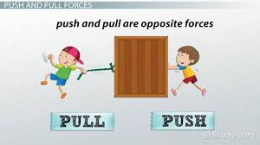
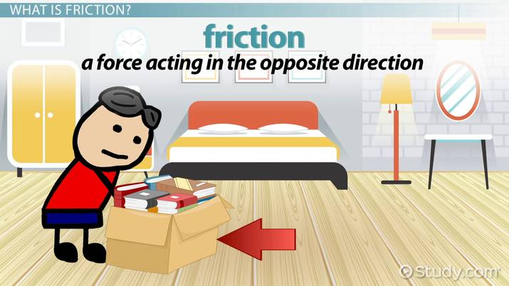
Defining Science Terms:
FORCE
GRAVITY
FRICTION

Slide 34
What we want you to know...
The idea of force and motion in science relates to the idea of force and motion of our beliefs in life.

Slide 35
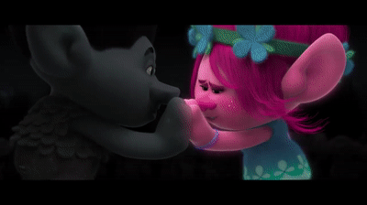
How does this relate?
Here are some examples:
Ms. Magluilo-
Force and motion affect my beliefs because I think that someone being kind to me makes me want to be kinder. Being kind brightens our world!
Ms. Mehale- I think the idea of force and motion affects beliefs in my life because I have had people who tried to push or pull me in the direction that I did not agree with. These are like gravity and friction. However, I kindly said, “I do not agree with you. I am going to do what is best for myself.” My belief is my force. Do not let anyone push or pull you to do something you don’t agree with! I will not let gravity and force get in my way!

Slide 36
DISCUSS WITH A PARENT:
HOW DOES THE IDEA OF FORCE AND MOTION AFFECT YOUR BELIEFS IN LIFE?

Slide 37
Do you believe that someone can add force and direction to our lives?

Slide 38
It’s time to create!
We want you to be inventors. You will include how you can be a Hope Creator in the world. What forces and actions would you take to be a Hope Creator? You may use the positive self talk statement you made from the previous lesson and create a POSTER. You can draw a poster, use Google Slides, Padlet, or you can talk about your self talk statement through Flipgrid.

Slide 39
Be sure to include:
Include the question: “Do you believe that someone can add force and direction to our lives?”
Include your response to the question.
Self talk statement
Visuals/Pictures of how you would use your self talk statement
If you are using Flipgrid, make sure you talk about your self talk statement and how you would use it if someone was affecting the force and direction in your life.

Slide 40
Poster Example:

