Slide 1
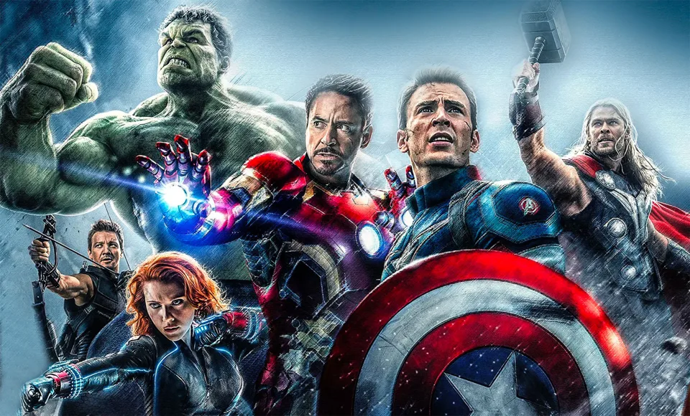
Synergy
“We’re all in this together!!”
Ms. Erin Keating & Mr. Bill Buith

Slide 2
Super Heroes!!
First watch the YouTube clip at the link below of the Fantastic Four:
Fantastic Four Working Together
Click on the Padlet link below and answer the two questions:
Super Heroes Padlet Questions

Slide 3
“Going Places” by Peter and Paul Reynolds
Next, we will be reading a short story called “Going Places”. You can follow along on this YouTube link that will read the story along for you and show you the pictures from it. Think about these questions while watching the story:
"Going Places" by Peter & Paul Reynolds
What were they supposed to build?
What were the reactions of the other kids when they saw what the main characters built?
What did the main characters learn in the end?
What do you think this story is trying to teach you?

Slide 4
Guided Questions *For Parents’ Use*
Right after reading along with the video of “Going Places” by Peter and Paul Reynolds with your child, here are a few questions to ask them:
What is Raphael’s reaction when he sees what Maya had built in her backyard?
What is a strength that Maya has?
Who won the race?
How do the other students react when they see Maya and Raphael’s “go-kart”?
How do you think the other students felt after Maya and Raphael won?
Why do you think Maya and Raphael won the race?
Would you want to be friends with Maya in real life?
Would Maya have won on her own?
Who would you model yourself after: Maya (who saw the potential of the go-kart), Raphael (who thought of combining their strengths to win the race), or the other students (who followed the go-kart instructions as they were written)?

Slide 5
Parents/Guardians Super Powers
Click on the link below for a Google Doc where you can either draw a picture OR write a paragraph OR do a FlipGrid video post about your parent’s or guardian’s Super Powers!! What do you believe makes them a superhero?
Super Parents Worksheet
Either download the document or you can Print it and take a picture when you are done.

Slide 6
Synergy
Ms. Erin Keating & Mr. Bill Buith
Click below for the link to today’s worksheets:
Lesson #2 Worksheets

Slide 7
We are Going Places!
Think back to the book we read last week, “Going Places”. Remember Raphael and Maya?
Using the Character Strengths Chart, assign character traits to Raphael and Maya.
(Ex: if you think one of Maya’s strengths is “bravery”, you will put a “M” next to the bravery icon on the chart)
In case you want to refresh your memory:
"Going Places" by Peter & Paul Reynolds

Slide 8
Who are Hamilton and Burr?
Listen to the song excerpts from Hamilton: the Musical below:
Alexander Hamilton
Aaron Burr, Sir
Now that you know a little bit more about Hamilton and Burr, assign them character traits on the Character Strengths Chart
(Ex: If you think the strength “curiosity” fits Hamilton, put an “H” in the same box as Curiosity)

Slide 9
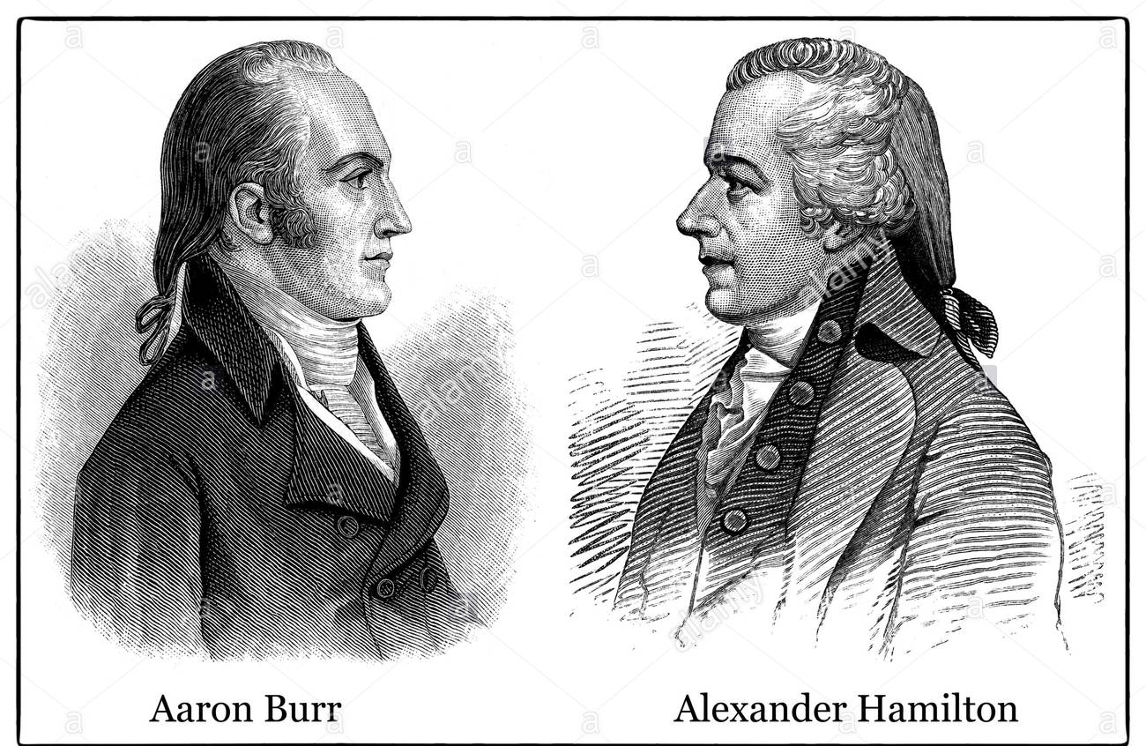
Hamilton vs. Burr
After completing the Character Strengths Chart and assigning Hamilton and Burr different character strengths, pick one of the following:
Choice 1: Fill out the Venn Diagram to compare and contrast the strengths of Hamilton and Burr (see Strengths Standoff Venn Diagram worksheet)
Choice 2: Write a short essay comparing the strengths of Hamilton and Burr (see Strengths Standoff Essay worksheet)
Choice 3: Create a FlipGrid post comparing the strengths of Hamilton and Burr ( access the FlipGrid here )

Slide 10
Superhuman Seventh Graders!!
It’s time to think about your own character strengths!! After learning about the many different character strengths someone can possess, what would be your character strengths? What would be your parents/guardians character strengths? You can use the last worksheet to fill in the muscle person with your character strengths (make it creative!!).
Follow-up activity: Parents can talk to your children about what they believe their character strengths are and why.

Slide 11
Synergy in History: Are our differences our strengths?
By Mr. Bill Buith and Ms. Erin Keating

Slide 12
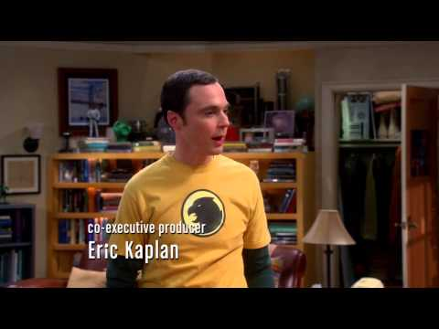
What is compromise?
Compromise is an agreement or settlement of a dispute that is reached by each side making concessions for each other.
Believe it or not, compromise is a large part of our lives.
Decisions, both big and small, are frequently made using compromise.
Here is a perfect example of the importance of compromise from the show, The Big Bang Theory:

Slide 13
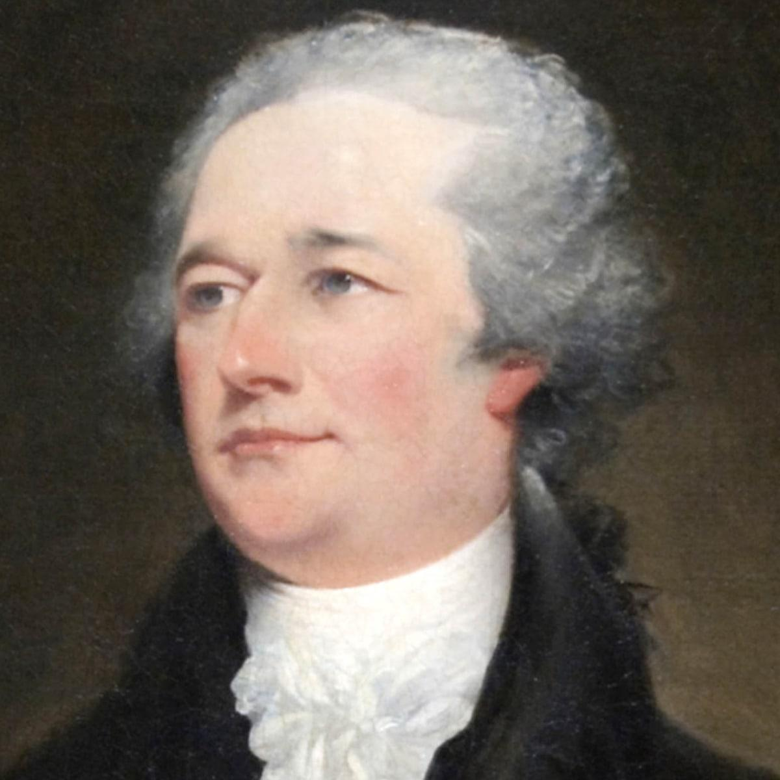
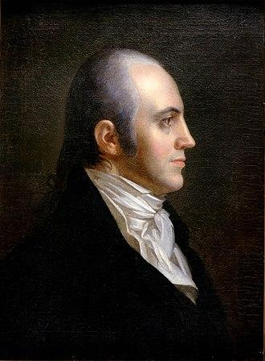
Hamilton vs. Burr
Dropped out of King’s College to join the Continental Army (bravery, teamwork)
George Washington called him “my boy” (kindness, sense of meaning)
Focused on “big picture” issues at the Constitutional Convention (perspective)
Pushed for unity as a country instead of individual states (judgment, hope)
Often thought of by historians the “creator of the United States” (leadership)
Ran for president of the U.S. against Jefferson (leadership)
Was a veteran and a lawyer, who shared a practice with Hamilton in 1783 (bravery, fairness)
Rebuilt his law practice even after gaining the reputation of a traitor (perseverance)
1789 - named Attorney general, 1791- was elected U.S. Senator (leadership)

Slide 14
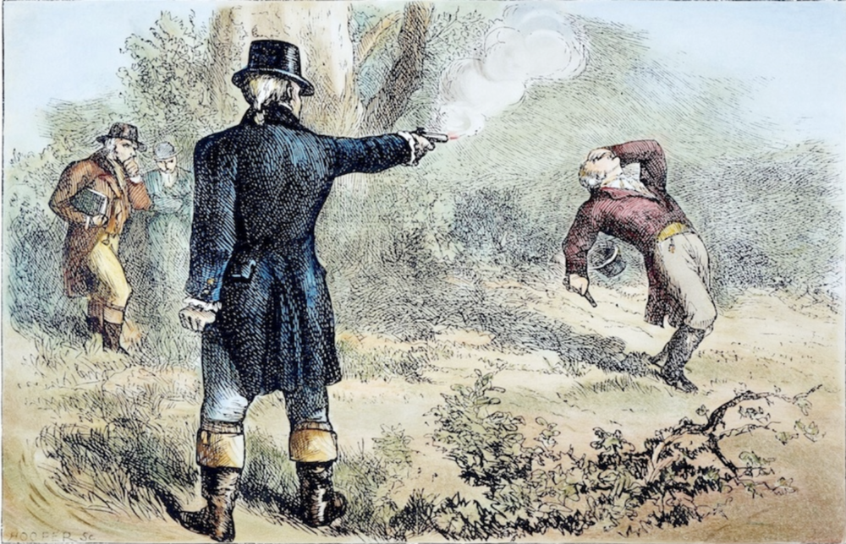
The Feud of Hamilton and Burr (Recap)
Hamilton and Burr were career-long enemies.
Hamilton was an entirely self-made man, whereas Burr was born into wealth and status.
Both men were brilliantly educated.
The rivalry heated up when Burr tied with Thomas Jefferson in the race for president in 1800.
Burr would have won but Hamilton thwarted his attempt to win the election by making a statement that Burr was a “dangerous man” who cannot be trusted with power.
Upon being confronted, Hamilton refuses to take back his statement so Burr challenges him to a duel.

Slide 15
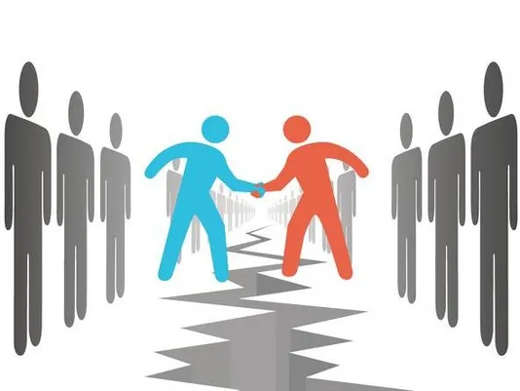
The Importance of Compromise
Hamilton and Burr meet in the outskirts of New Jersey to have their duel.
Hamilton fires first, thinking Burr would never shoot to kill, but then Burr shoots Hamilton square in the chest and Hamilton dies the next day.
Burr is not convicted of killing Hamilton, but is forever labeled the traitor who killed Alexander Hamilton.
**The takeaway here is: Hamilton probably would have survived if he and Burr decided to compromise for the sake of the country. Instead, one died and the other’s career was ruined**

Slide 16
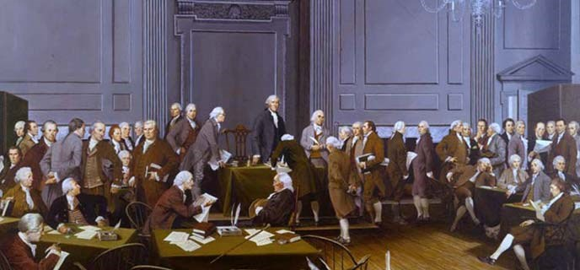
The Constitutional Convention
In 1787, America was trying to decide how it was going to be governed. The Constitutional Convention had 55 delegates from all over the 13 colonies. They all came from different states, from different backgrounds, and with different beliefs of how the United States should be governed.
Many different factors that were proposed:
small states vs. large states
slaveowners vs. abolitionists
small farmers vs. large farmers
rich vs. poor
state powers vs. federal powers

Slide 17
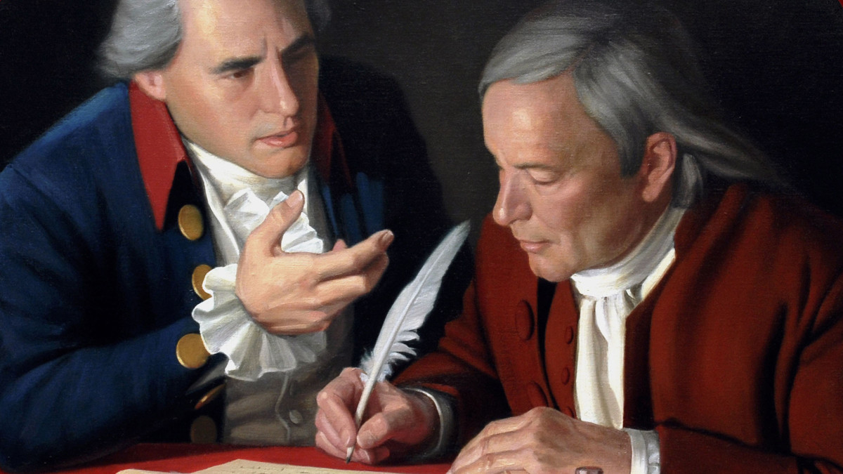
Virginia Plan vs. New Jersey Plan
There were two plans presented on how the nation should be governed:
The Virginia Plan: States with larger populations have more representation in the government / feared smaller states would have too much power in federal government
The New Jersey Plan: Equal representation for every state no matter what the population was / feared losing power in the federal government
What type of a compromise might you have drawn up?

Slide 18
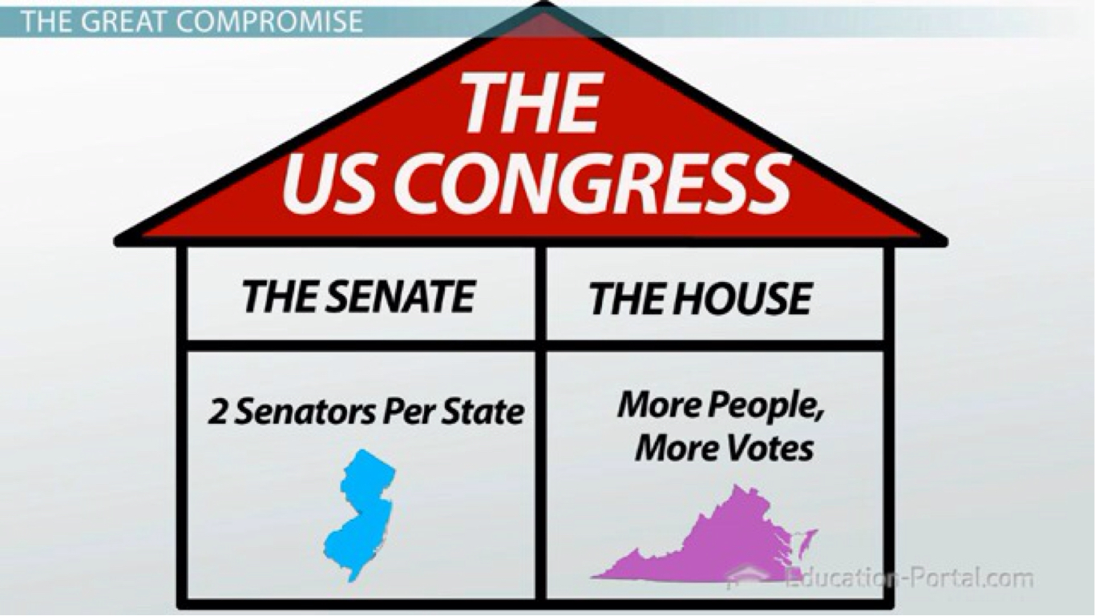
The Great Compromise!!!
The Great Compromise (also known as the Connecticut Compromise) established TWO houses to govern the states instead of one house. You know them best as:
The House Of Representatives - represent according to population
The Senate - 2 representatives per state no matter the population
Together, they work as the United States Congress

Slide 19
Review of The Great Compromise
Click on the Quizizz below to see what you have learned about The Great Compromise!!
The Great Compromise Quizizz

Slide 20
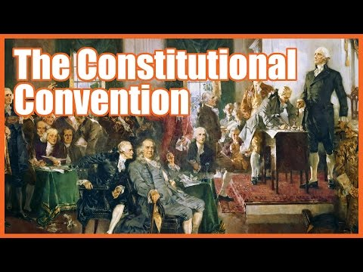
The Issue Of Representation was not the only issue at the Convention...
The video below is a preview to the compromises we will be studying next week! Take mental note of the numerous compromises mentioned and STAY TUNED next week for more info!

Slide 21
Connecting the Constitutional Convention to Today
Independent Practice:
Watch the news this week and identify two groups that need to compromise in order for society to move forward positively.

Slide 22
Synergy and Compromise: How Our Differences Can Make Us Stronger
By Mr. Bill Buith and Ms. Erin Keating

Slide 23
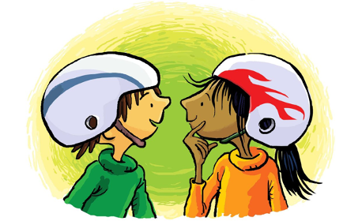
What is Synergy?
Synergy is when we combine our strengths, and ultimately come up with a solution better than what we would have come up with individually.
In Going Places, Raphael and Maya combined their strengths in order to build a better vehicle and win the race.
Science Example: Hydrogen is needed on its own, and oxygen is needed on its own… but combined, you get water, which is the basis for life!!

Slide 24
The Everyday Use of Compromise
Watch this clip from the television show, Stranger Things, to see how compromise is used in daily life.
After you watch, answer these questions on a piece of paper or discuss them with a parent/guardian:
What are the two positions in the argument?
What is the compromise they come to?
Think back to the last time you made a compromise with someone: what was it?
How do you feel before you make a compromise vs. after you have made a compromise?

Slide 25
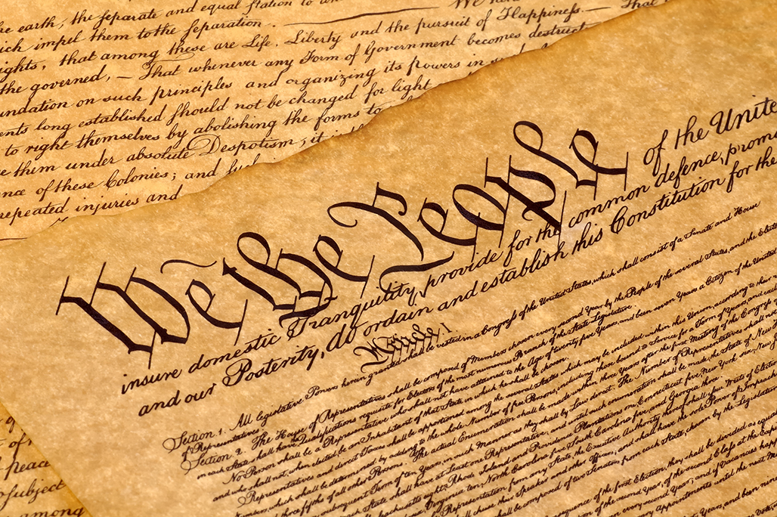
“A Bundle Of Compromises”
The Constitution is often referred to as “a bundle of compromises”. During the four month convention, there were many different positions by leaders all over the United States who wanted their fair say on what should be included in the Constitution. What people in the Northern States believed in differed from what people in the Southern States believed in. Bigger states believed differently from what smaller states believed in. So they had to come up with many different compromises that would work for all sides.

Slide 26
Organizing The Bundle!
Because there were so many different positions and compromises to the Constitution, we need help organizing it!
For this next activity, you will be doing something called a “Mess-to-a-Model”. What is it? I’m so glad you asked 😊
A Mess-to-a-Model is basically a click-and-drag activity where you sort the statements and put them in their “correct” category.
Essentially, you are taking a mess of boxes and information, and putting them into the correct column, making a model out of the mess.

Slide 27
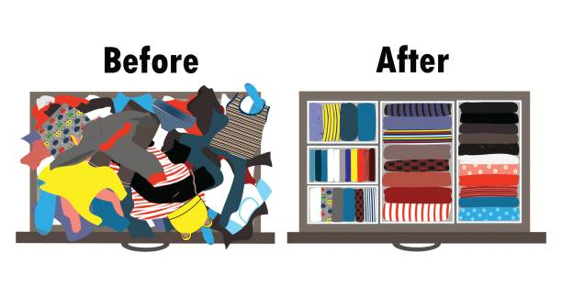
Mess-to-a-Model Directions
You will click here: Mess-To-A-Model: Compromises of the Constitutional Convention and you will see 2 columns titled “Different Positions Taken” and “Different Compromises”. Your job is to take the boxes in each of those two columns and click-and-drag them to the column that best fits them.
Be sure to take opposing positions and put them next to each other under “Position 1” and “Opposing Position”

Slide 28
Let’s see how you did!!
Click on the link below to see the answer key to the Mess-To-A-Model:
Mess-To-A-Model: Compromises of the Constitutional Convention ANSWER KEY

Slide 29
Time to spread your wisdom onto others!!
Write a letter for next year's seventh graders and explain what character strengths are and how they will need to focus on developing their strengths and combining their strengths with others.
Explain how the different strengths of your classmates have made for a stronger classroom experience for you this year, citing two or three different classmates and their strengths.
Include information about this unit and how you learned that it was the different opinions of the Founding Fathers that contributed to the strength of our Constitution.
Finally, relate the differences of opinions at the Constitutional Convention to the current differences in our nation on opening up after the pandemic and racial injustices.

Slide 30
Synergy in the World Today
Our Founding Fathers used synergy to create a document that we still use today! The compromises that they made hundreds of years ago still greatly influence the world around us.
That being said, we are going through a historical period in time with a strong need for compromise.
To put it simply, we all need to compromise just a little bit so everybody gets along. 😊

Slide 31
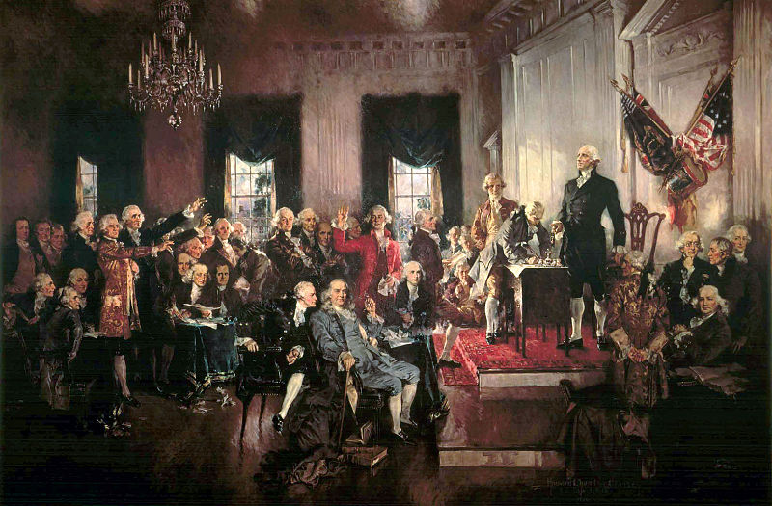
You have made The Founding Fathers so proud!
You are so wise!
WOW, you’re right! Our differences do make us stronger!
Excellent work!
Bravo!
Outstanding!
Superb!
That’s impressive!
Now, go! change the world with your wisdom and knowledge!

