Slide 1
GRIT UNIT PLAN PARENT GUIDED SLIDES
Grade 5
Amanda Gherardi, Jessica Kiedaisch, and Nicole Fochi

Slide 2
Lesson # 1
Objective: After participating in a brainstorming activity and an interactive read aloud on Iggy, students will identify and explain Iggy's passion by creating a list, write, draw activity activity.

Slide 3
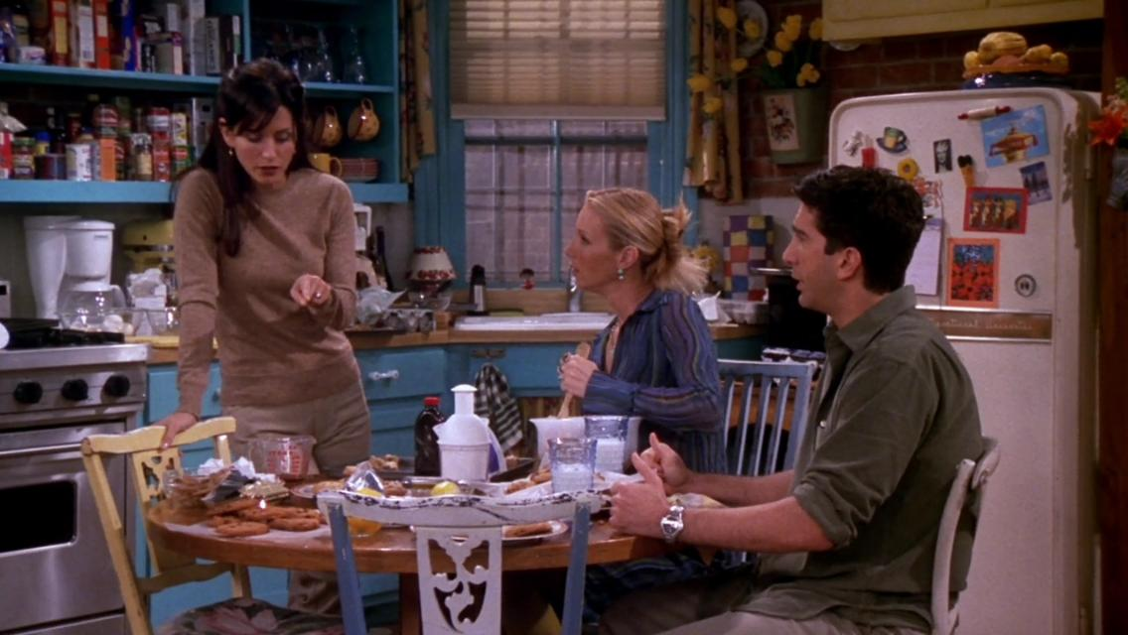
Discussion and Short Clip:
Before reading the text, students will watch a short clip of the episode of Friends where Monica and Phoebe try to recreate Phoebe's grandmother's secret chocolate chip cookie recipe.
The students will then have a discussion on recipes.
The students will ask a family member about their favorite recipe to cook or bake and then talk about the secret ingredient they use.
The characters in Friends kept eating the cookies they were baking even though they were getting sick and couldn’t remember which batch they liked….. Their passion (grit) was perseverance to solve the mystery of the secret ingredient!
The students will additionally discuss the question “Do you think the video clip was funny, why or why not?”

Slide 4
Flipgrid Activity:
TO COMPLETE YOUR FLIPGRID CLICK THIS LINK
To sign in the code to our classroom is kiedaisch3589
The password required is Molloy2020
Students will complete a Flipgrid* video where they will discuss their conversation with a family member about their “famous” recipe and the secret ingredient. Some questions for guidance on the conversation will include:
What is your family member's famous recipe?
Why is that recipe so famous in your family?
Is there a secret ingredient that makes it so delicious?
Do you know what the secret ingredient is?
Was it easy to find out what the secret ingredient is?
How did you get the answer?
After recording their flipgrid the students should watch two of their peers’ Flipgrid videos to get a sense of other famous recipes their classmates' families might have!
* Flipgrid is a social learning platform that allows educators to ask a question, then the students respond in a video.

Slide 5
Read Aloud Activities:
The students will listen to a YouTube read aloud of Iggy Peck, Architect By Andrea Beaty. The students will be given guided reading comprehension questions before, during, and after the story to guide their listening of the story. The students can work on the guided comprehension questions with a family member.
Before Reading Comprehension Questions:
What is something you love to do?
How do you feel when you are doing an activity that you love?
Do you continue to work on something you really like to do even if you did not succeed on your first try?

Slide 6
Read Aloud Activities:
During Reading (Stop and Jot):
While students are listening to Iggy Peck, Architect, they will pause the video at 2 minutes, 4 minutes, and the end of story.
Students will use that paused time to stop, think and write about what they have listened to within the story to check for understanding.
*Some things to write during your Stop and Jot include: characters, feelings of characters, things the main character builds, how he feels when he can’t build in class, what happens at the end of the story and any point that stands out to them (a part they enjoyed).
*Stop and Jot is an activity that has students stop, think, and write about what they are learning at specific points within a lesson to check for understanding. Stop and Jots help maintain student focus and promote retention and comprehension through active engagement.

Slide 7
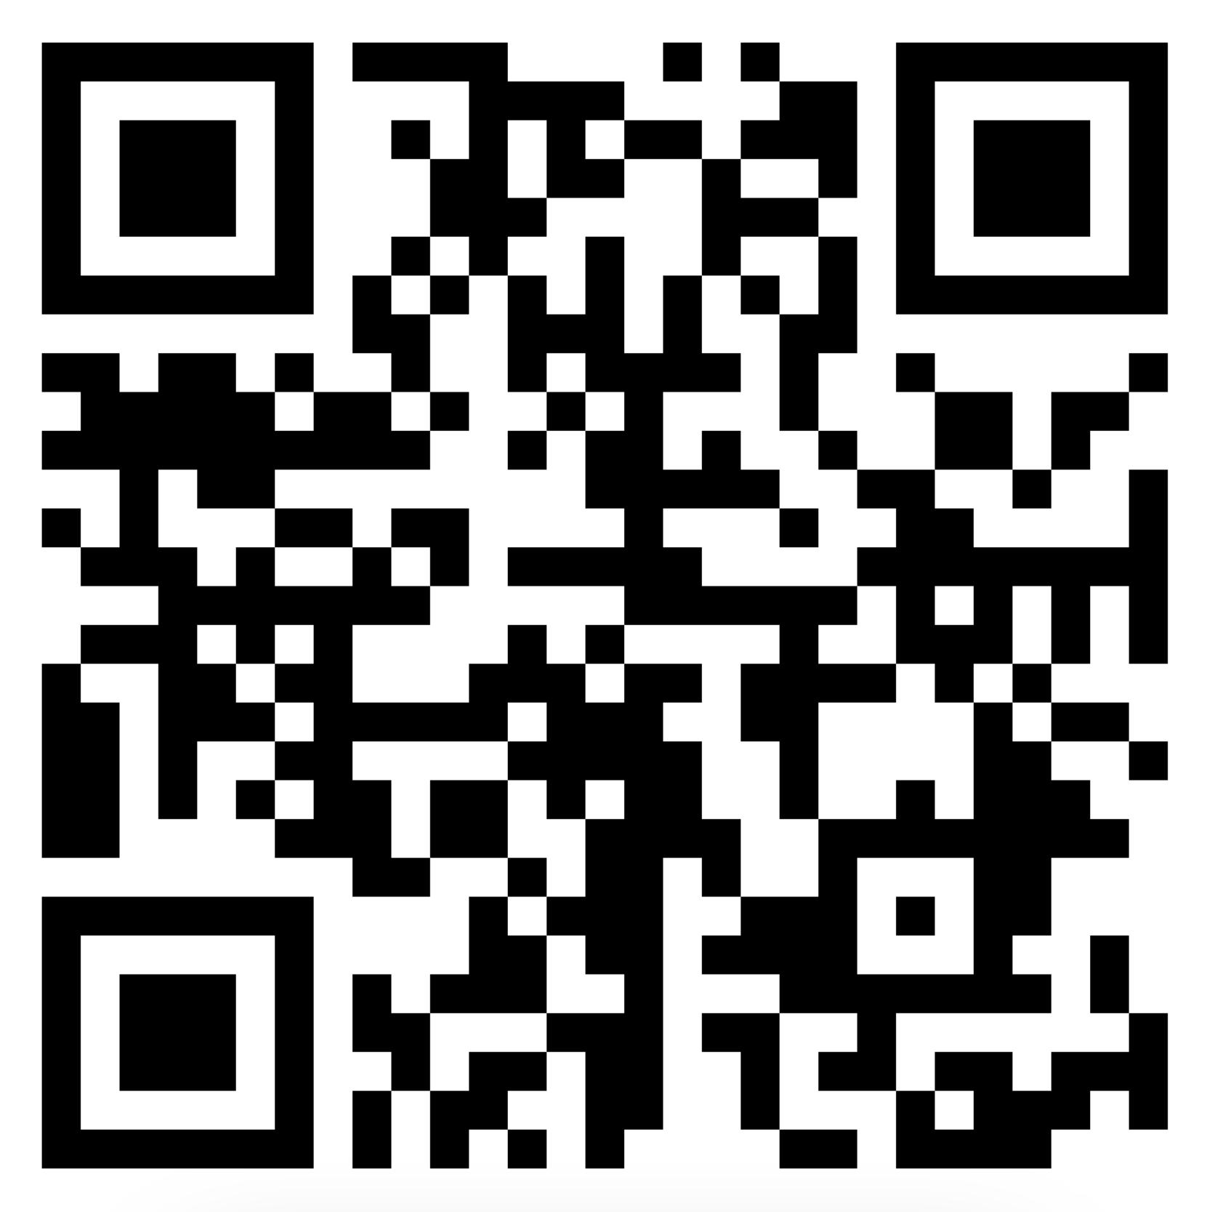
Read Aloud Activities Continued:
After Reading (Padlet Exit Ticket):
Students will complete an exit ticket through a padlet* where they will answer the following 3,2,1 question:
List 3 things that Iggy built
List 2 materials that Iggy used
1 important thing that I learned today from Iggy
To complete the Padlet you can either click this link or scan the QR code.
* Padlet is an easy to use online shared virtual bulletin board,where collaborators can easily add content.

Slide 8
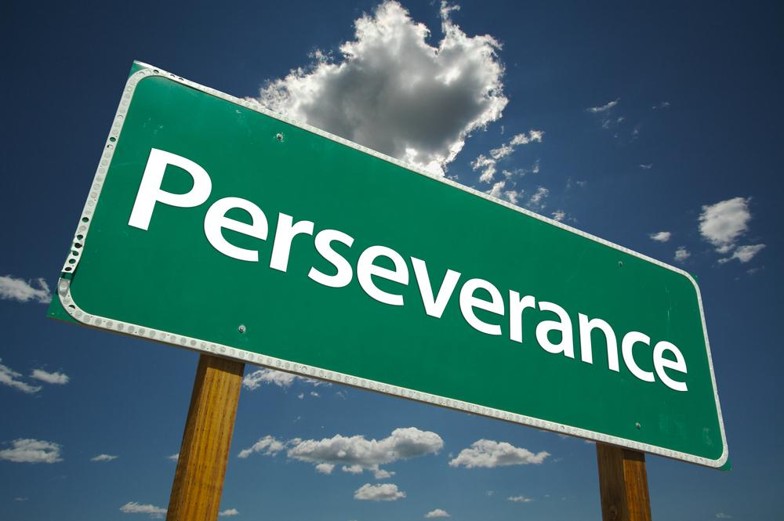
Post Assessment:
After Reading:
Students will be given 3 minutes to complete List, Write, or Draw examples of Iggy’s passions.
Parents/guardians please put a timer on during this activity so they will have 3 minutes!
Students will have the opportunity to select either listing, writing, or drawing.
For 3 minutes they will fill in their paper of Iggy’s passions in their selected method.

Slide 9
Lesson # 2
Objective: After interactive discussions on passion and grit and active participation in a ThingLink on the NFL draft, students will interview a family member on the topics of personal passion and the grit needed to overcome obstacles to achieve success. Students will creatively present a report on their interview.

Slide 10
Pre-Assessment:
Students will talk to an adult to discuss Iggy and his passions. Discussion questions include:
What was Iggy’s passion?
Did Iggy ever give up on his passion?
What happened when Iggy built the bridge?
Parent Guided Answers:
This discussion will lead to the idea that passion is the secret ingredient to grit

Slide 11
Activities:
Students will watch YouTube video about GRIT
After watching the video students will discuss the following questions: Was there ever a time you wanted to quit something? If so what? If you did not quit, what made you stick to it and not quit?
What is the missing word from this video?
Parent Guided Answers:
Question 1: This discussion should lead to the idea of passion holding them to it.
Question 2: The answer is passion.

Slide 12
Activities Continued:
Students will follow along on ThingLink* where it will explain the NFL Draft and lead them to becoming NFL Scouts for the day. Students will look at the combined scores chart and eliminate the quarterback that they would reject.
After students select their rejection, they will then find out the players behind the numbers. It will be likely for them to select Candidate # 6 who is Tom Brady.
With an adult, discuss the following: How did the NFL get it so wrong? What is the combined scores chart not showing?
*ThingLink uses interactive image, audio, and video technology containing embedded links to learning resources.
Parent Guided Answers:
This will lead to discussion on other attributes such as
personality and drive (GRIT).

Slide 13
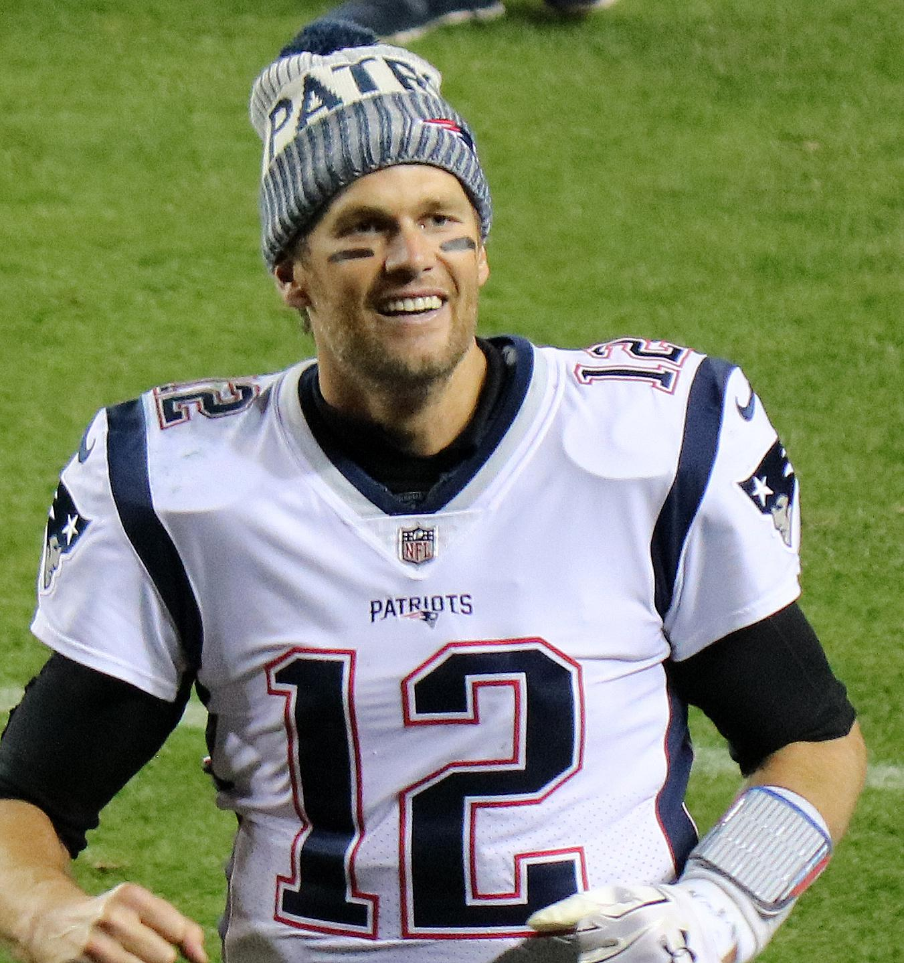
Activities Continued:
Everyone said Brady couldn’t make it but his passion was so strong that he preserved and made his dream a reality.
How could this be? How could he not make it? How could he be the worst quarterback?
What does this have to do with grit?
What does this have to do with football?
What does Iggy and Tom Brady have in common?
Parent Guided Answers:
Question 1: Answer: On paper his stats were not the best but it was his passion and grit that made him succeed.
Question 2: Brady had a passion for becoming a quarterback and he didn’t give up until that dream became a reality.
Question 3: There is more to the numbers that will give someone an understanding of the athlete.
Question 4: Both Iggy and Tom Brady had people tell them to give up but they were so passionate that they preserved

Slide 14
Post-Assessment:
Students will select a family member or adult in their life that they feel has GRIT. They will interview that person and ask them:
What are they passionate about?
Did they face any problems?
How did they overcome the problems to become successful?
What does grit mean to them?
Students can use comic strip drawings, writing, or video means to present their interview.
Parent Guided Answers:
When the student is selecting a person to interview they should be looking at these questions. If that person does not fit any/all of the question they should consider interviewing another person.

Slide 15
Lesson # 3
Objective: After interactive discussions on passion and grit and active participation in building a school structure, students will complete a flipgrid on the topics of overcoming challenges, personal passion and the grit needed to overcome obstacles to achieve success in building their structure.

Slide 16
Pre- assessment:
Students will talk to an adult to discuss Iggy and his passions. Discussion questions include:
What was Iggy’s passion?
What was the passion of the person you interviewed?
How did both Iggy and the interviewed person use grit to succeed?
What is something you have a passion about that shows grit?

Slide 17
Activities:
Students will assist Iggy Peck this week and create a building that would serve as another school on an island for the class to visit. They will be given the following materials:
5 Sheets of Cardstock Paper (8.5 X 11)
15 small paper or plastic cups (3 oz)
Parent Guided Note:
These materials are a guideline and since this is through distance learning, students and their adults will be given the liberty to be creative through what materials they use.

Slide 18
Activities Continued:
Adult will assist the student to complete the following:
A sketch of their school building that is supported by stilts and has at least two floors.
Creating the building with the paper and cups. (Parent/adult is encouraged to take photos of the process so the student can document their progress.)
Parent Guided Note:
Parent/adult is encouraged to take photos of the process so the student can document their progress
These materials are a guideline and since this is through distance learning, students and their adults will be given the liberty to be creative through what materials they use.

Slide 19
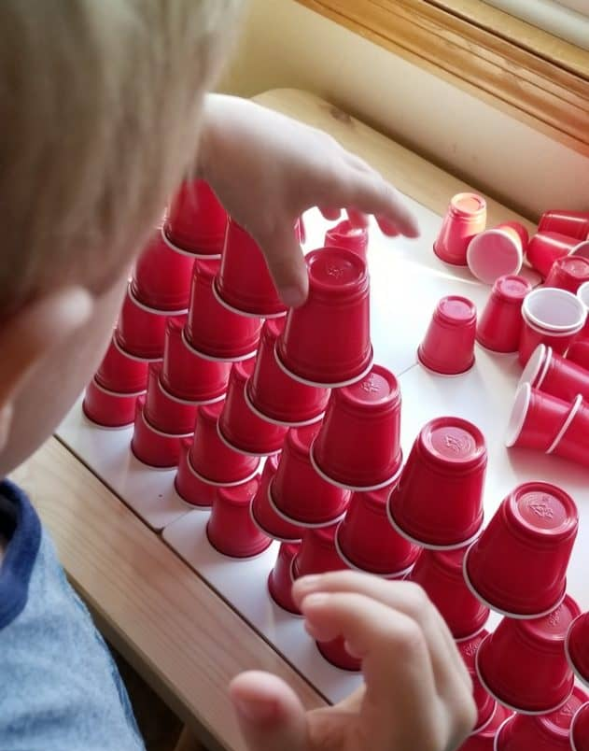
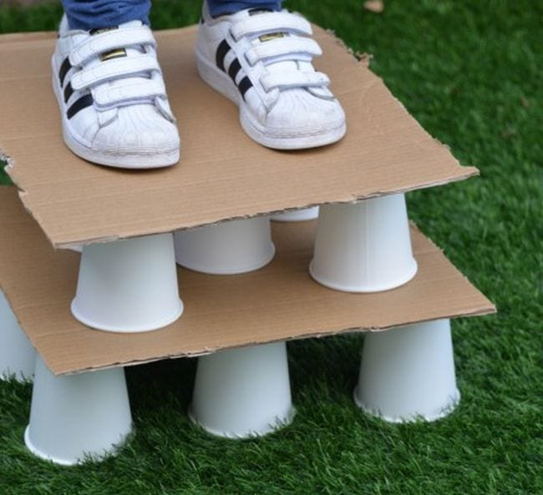
Activities Continued- Building activity images:
Some ideas to help you get started:
MATERIALS:
Parent Guided Note:
Parent/adult is encouraged to take photos of the process so the student can document their progress
These materials are a guideline and since this is through distance learning, students and their adults will be given the liberty to be creative through what materials they use.

Slide 20
Activities Continued:
Students will then test their school building structure by using a small object to act as the people (ex: hard pasta, dice, paper clips). Creativity is encouraged, these are recommendations for size and weight purposes.
If their building is not sturdy for their “people”, they will redesign their building in a sketch and try again. It is encouraged to keep trying until you reach success with this structure.
Parent Guided Note:
REMEMBER IT IS OKAY TO HAVE TO TRY THIS MORE THAN ONCE!!! IT IS THE PASSION/GRIT THAT SHOULD KEEP THE STUDENT TO WANT TO KEEP TRYING UNTIL THEY SUCCEED!

Slide 21
Post-Assessment:
The password required to enter the flipgrid is Molloy2020
Students will complete a flipgrid showing their successful structure and answer the following questions:
How many tries did it take to find success in your structure?
Did you ever want to give up? If so, what made you keep trying?
What challenges did you face?
What ways did you overcome the challenges?
Students will additionally watch and respond to at least two of their classmates videos.
Parent Guided Note:
This discussion on flipgrid and responding to classmates videos should lead to the idea that perseverance is nurtured by passion. Students who have the passion for building/architecture like Iggy would likely show more grit towards their final structure than those that do not have an architecture passion.

Slide 22
Lesson #4
Objective: After watching and discussing a Grit video and actively participating in a Thinglink activity, students will analyze and explain what Grit means to them and will share their personal thoughts on grit and success in fifth grade with an incoming 5th grade student.

Slide 23
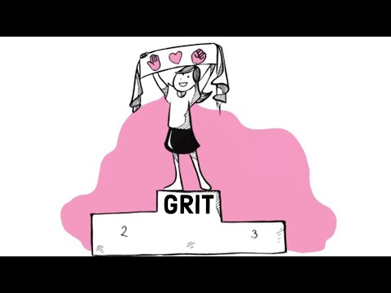
Pre-Assessment:
Students will watch YouTube video (ending at 2:25).
They will then have a discussion with a parent/adult on the question:
How did you need to use grit when you were building your school structures last week?
When was a time in your life that you needed to use grit to succeed?

Slide 24
ACTIVITIES:
Students will follow along to a Thinglink where it will show five scientists who showed grit. They will click through the interactive link where they will learn the success of the scientist as well as what the scientist needed to overcome in order to succeed.

Slide 25
POST-ASSESSMENT:
Students will complete a Flipgrid where they will select one of the scientists and explain how they had grit and how that grit can be applied to their own lives.
Students will additionally watch and respond to at least two of their classmates videos.
The password required to enter the flipgrid is Molloy2020

Slide 26
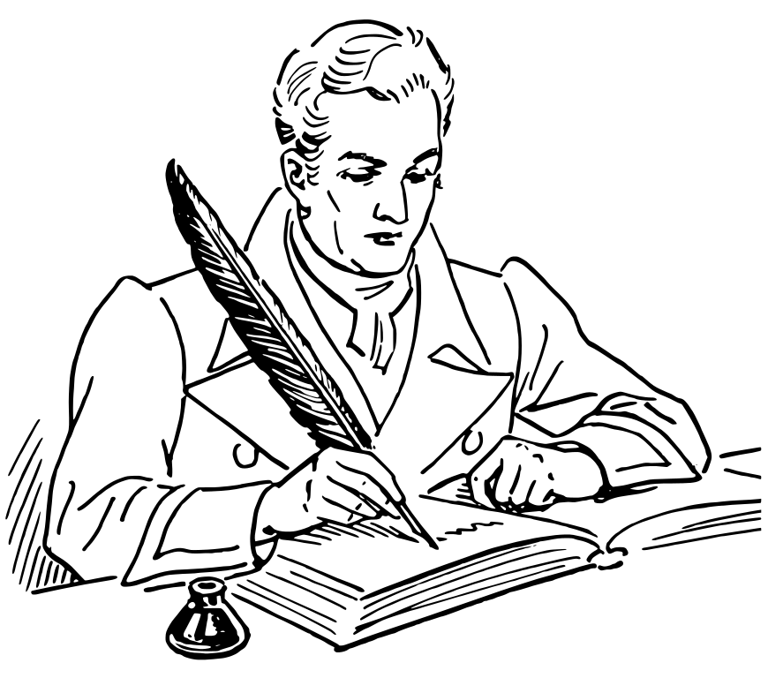
INDEPENDENT WORK:
Students are to write a letter to a student who will be in their seat next year. They will share their understanding of grit, how grit has helped them overcome obstacles they faced in this grade and how grit relates to science in their real lives.

