Slide 1
Does the Community that You Live in Determine Your Happiness?
Grade 3
EDU 509
Samantha Berna
Madison Dodd
Duncan Fraser
Kaitlin Lacasse
Christina Lindo
Kelly McKay
Emily Wolcott

Slide 2
CHAMPS
Conversation - silent, whisper voice, conversation voice
Help - raise your hand, ask a friend, ask your group
Activity - do your own work, work with a group, work with a partner
Movement - stay seated, move with permission, responsible movement
Participation - answer when called on, focus on assignment, all share ideas
Success - Be successful! Be champs!

Slide 3
Lesson 1
What is Happiness?
Share a personal story.

Slide 4
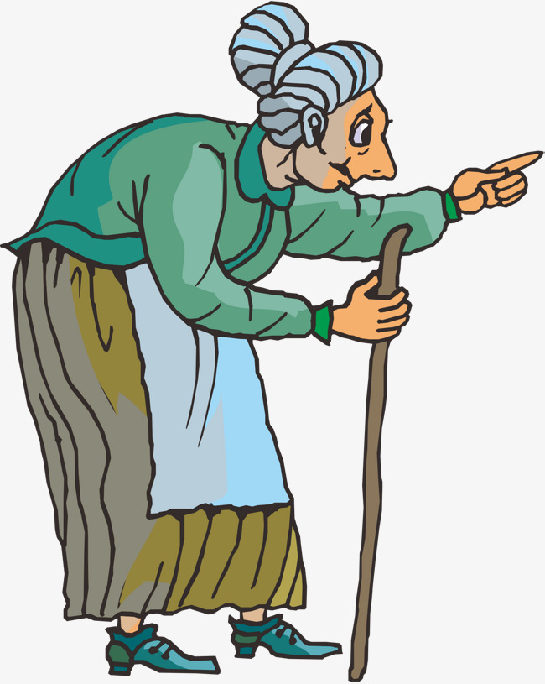
Read the story
The Wise Woman and Her Secret
“You will have to discover it for yourself”

Slide 5
How did Jenny find happiness?
look closely
use all your senses
wonder
curious
take the time

Slide 6
Class
Activity
Write down three things that make you happy.
Share them with your partner.
Compare - which ones are the same?
Contrast - which ones are different?

Slide 7
Independent
Practice
Ask your parents about three things that make them happy.
Draw a picture for each one of them.
Share the pictures with your classmates.

Slide 8
Lesson 2
Bus Tour of Montreal
How does geography affect life in Montreal?
What would you see out your window on a bus tour of Montreal?

Slide 9
CHAMPS
Conversation - silent, whisper voice, conversation voice
Help - raise your hand, ask a friend, ask your group
Activity - do your own work, work with a group, work with a partner
Movement - stay seated, move with permission, responsible movement
Participation - answer when called on, focus on assignment, all share ideas
Success - Be successful! Be champs!

Slide 10
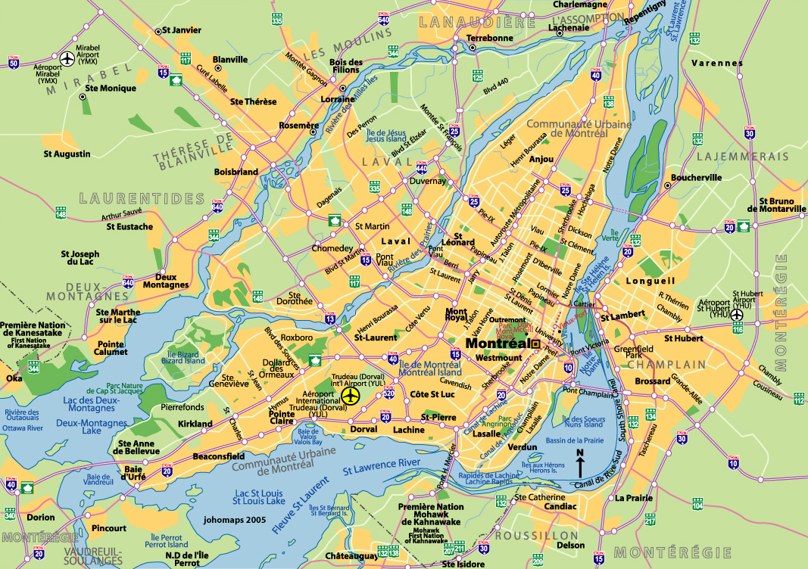
The Five Themes of Geography
Location: Position on The Earth's Surface
Human/Environment Interactions: Shaping the Landscape
Place: Physical and Human Characteristics
Movement: Humans Interacting on the Earth
Regions: How They Form and Change

Slide 11
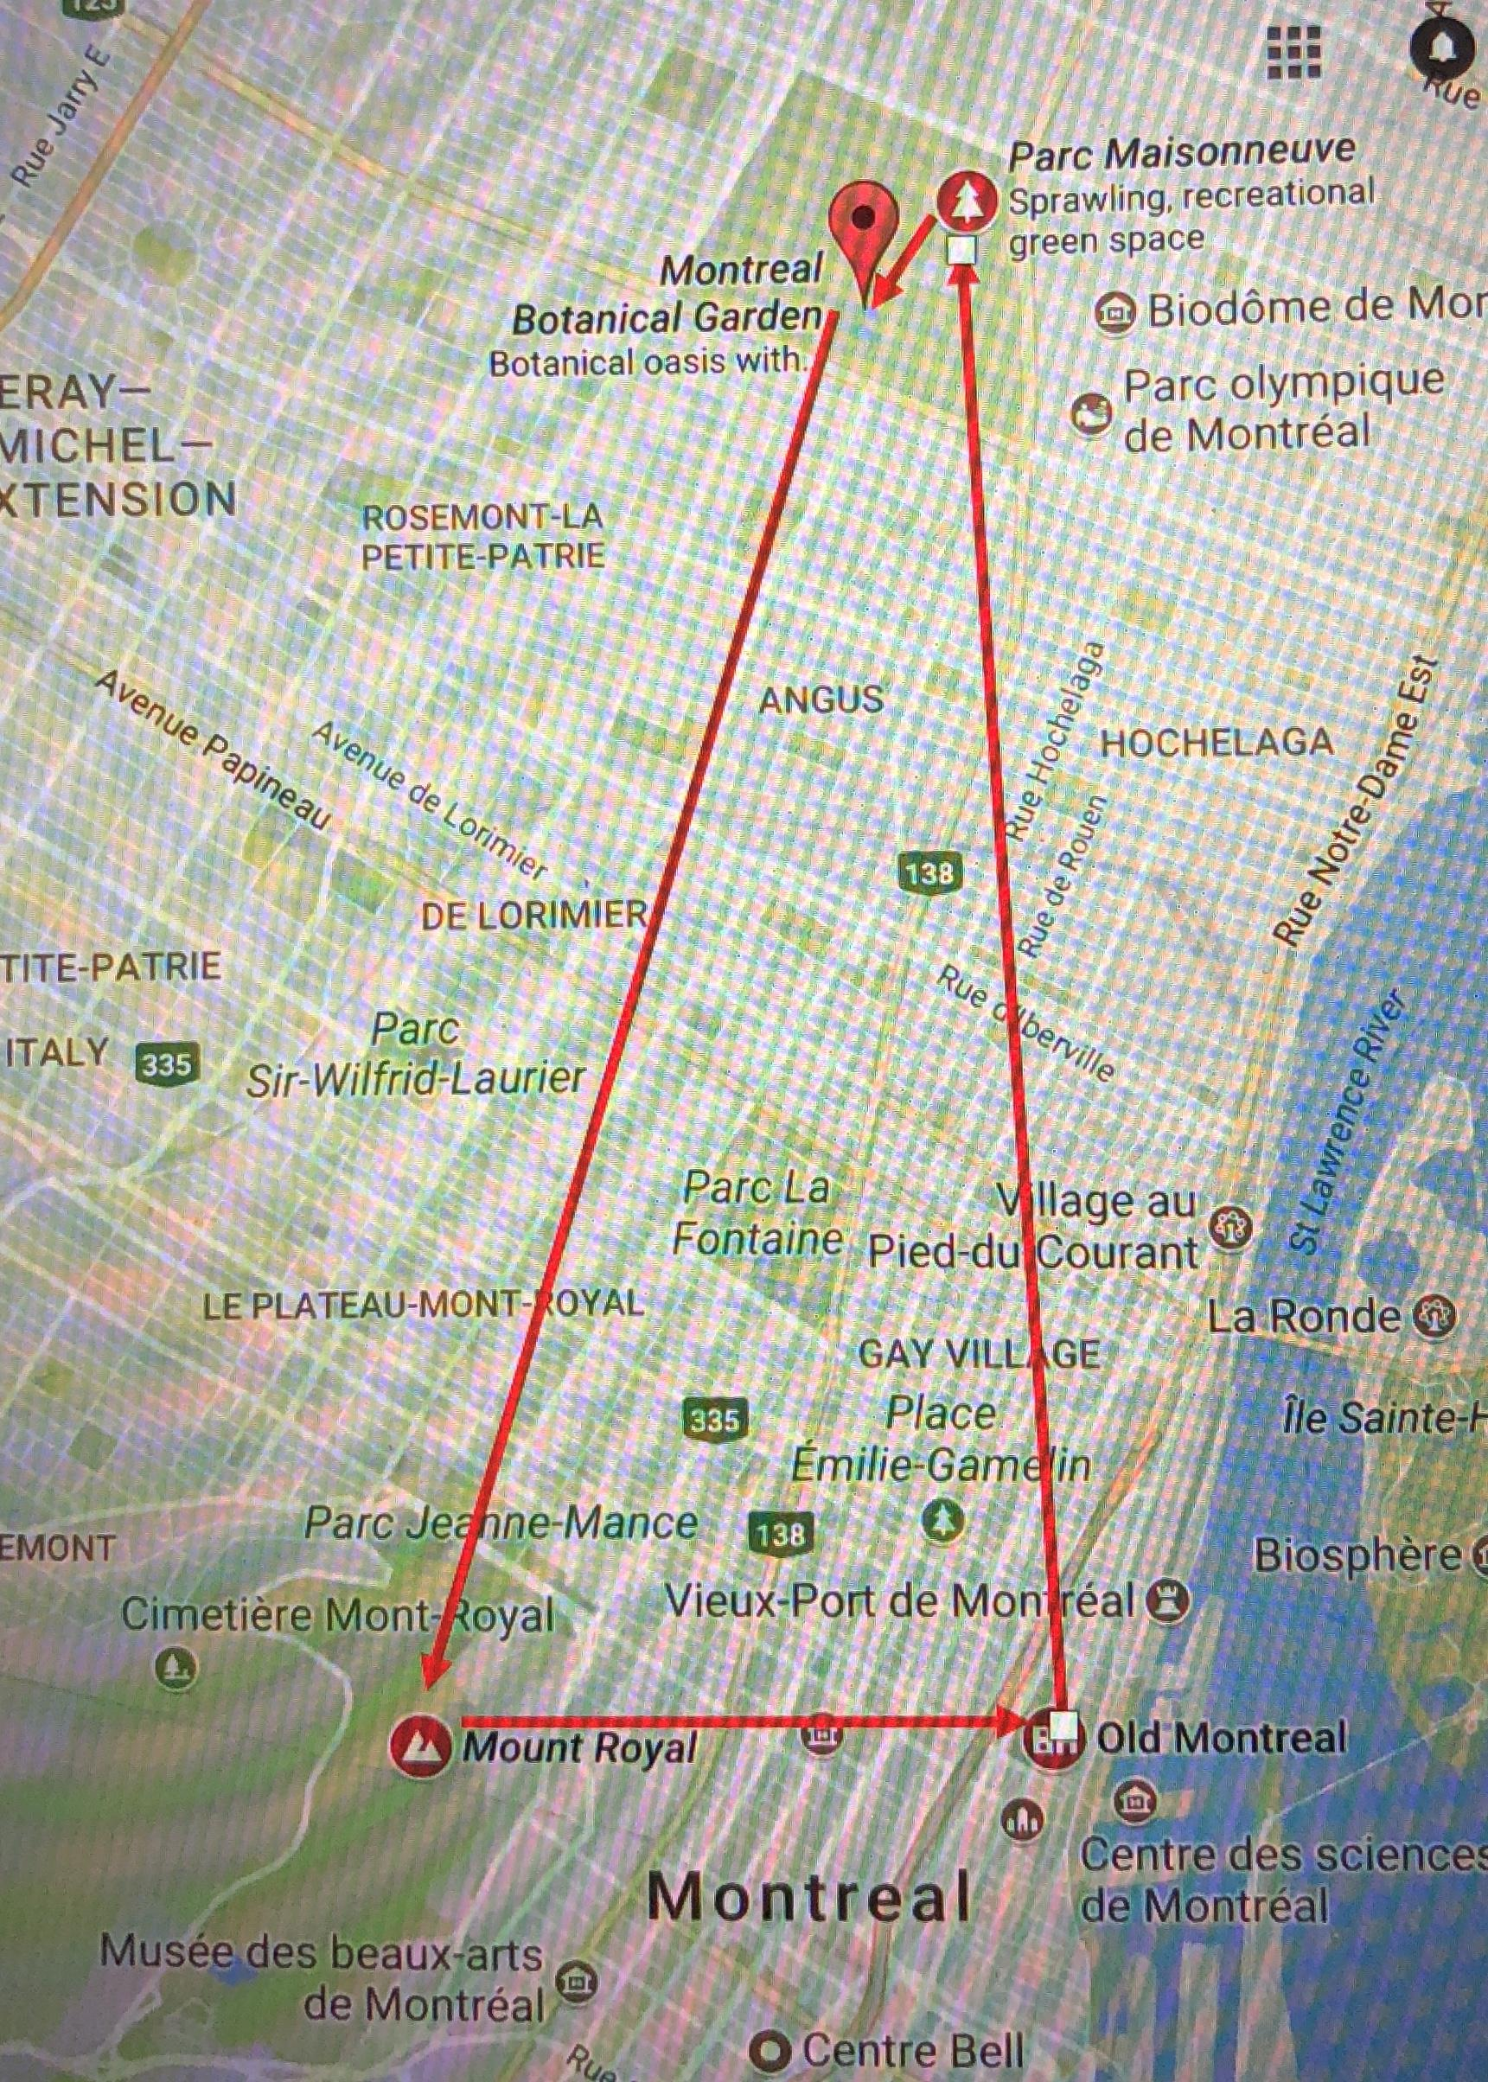
MONTREAL BUS TOUR: ADMIT ONE
Date: April 25, 2018

Slide 12
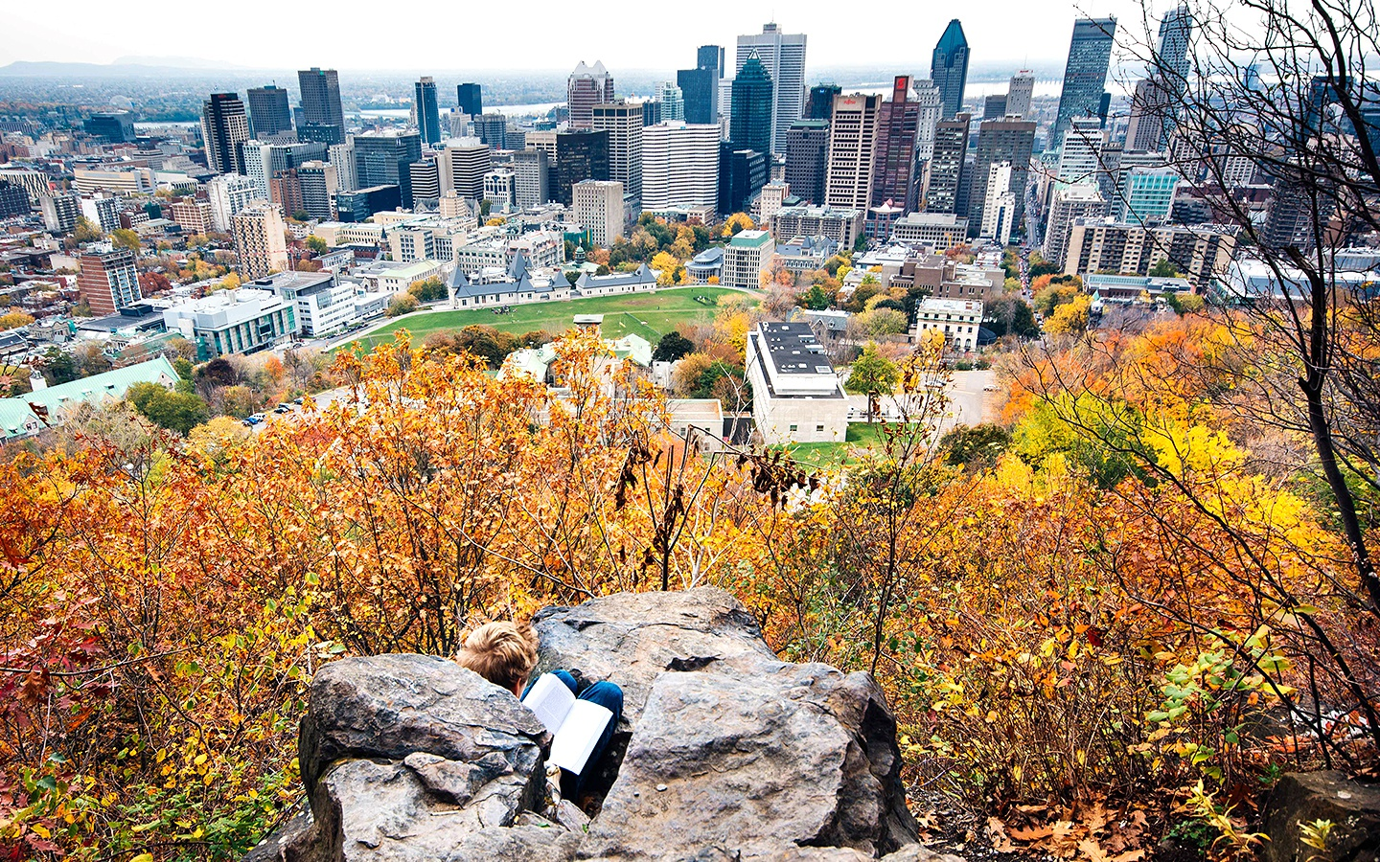

Slide 13
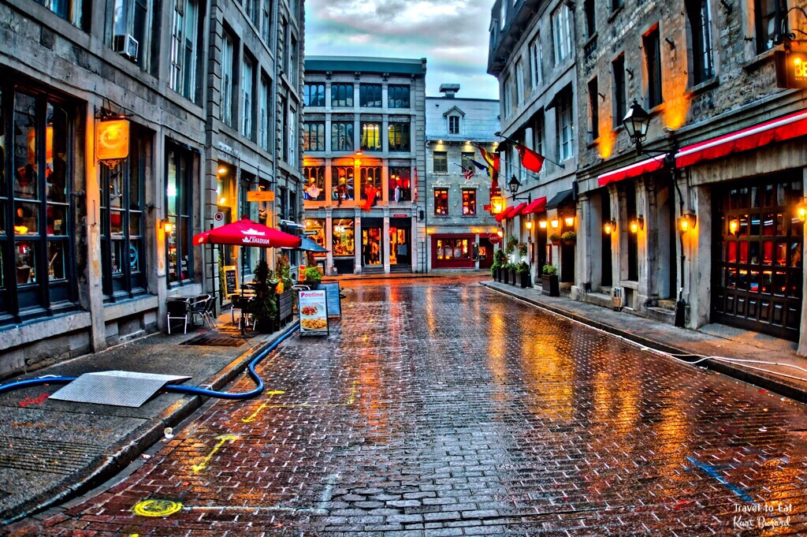

Slide 14
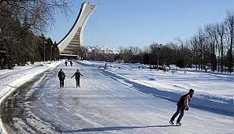
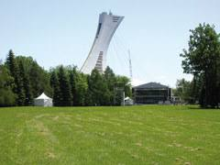

Slide 15
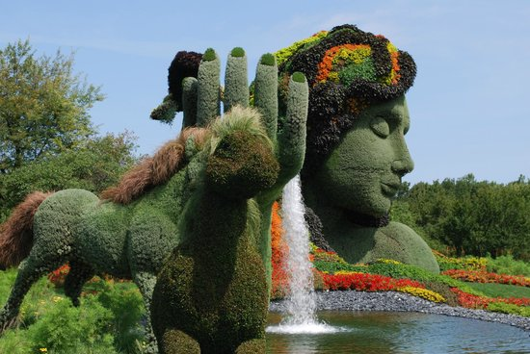

Slide 16
How did Canada Become Canada? What Historical Events have shaped the country?
Time Machine [Lesson 3]

Slide 17
C
Conversation
While time traveling, we must be sure to be quiet so we do not end up in the wrong time! However, once we get to our destination, we can ask questions!
H
Help
If you have a question, don’t be afraid to ask! Raise your hand or write your question down. Make sure to ask your question before we move onto our next stop!
A
Activity
We are going to be traveling through time to find out just what happened in Montreal hundreds of years ago to make it what it is today. While time traveling, we will be safely acting out the scenes that we see!
M
Movement
After partaking in our “Read and Retell” activity with a partner, we will fill our filing cabinets with that information and use it towards performing our Act it Out scene.
P
Participation
Find a group, find a costume and SCENE! You’re just like a movie star, you must Act out what we just learned about from Montreal.
S
Success
After you have become experts in the historical events that shaped Montreal by traveling and acting out the scenes, you will use all that you have learned towards a fun but challenging task!

Slide 18
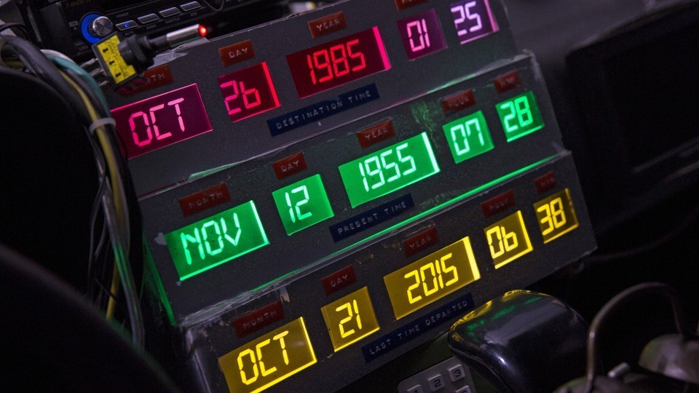
Welcome to Time Travel!
We will be plugging in the dates of three different events on the left.
The French Meeting of Native Americans
The Loss of the Battle of Montreal
The Seceding of Montreal
You will be split into 3 different groups. Each group will be assigned one of the events above. Make sure to pay attention during each stop!

Slide 19
1st Stop
Meeting of the Native Americans
1534

Slide 21
French explorers were giving something to the Native Americans and receiving something = TRADING. Traded fur.
“We Come In Peace” They had friendly gestures, were nice to the Native Americans. Did not come with any weapons.

Slide 22
NEXT STOP
1760
Battle of Montreal

Slide 24
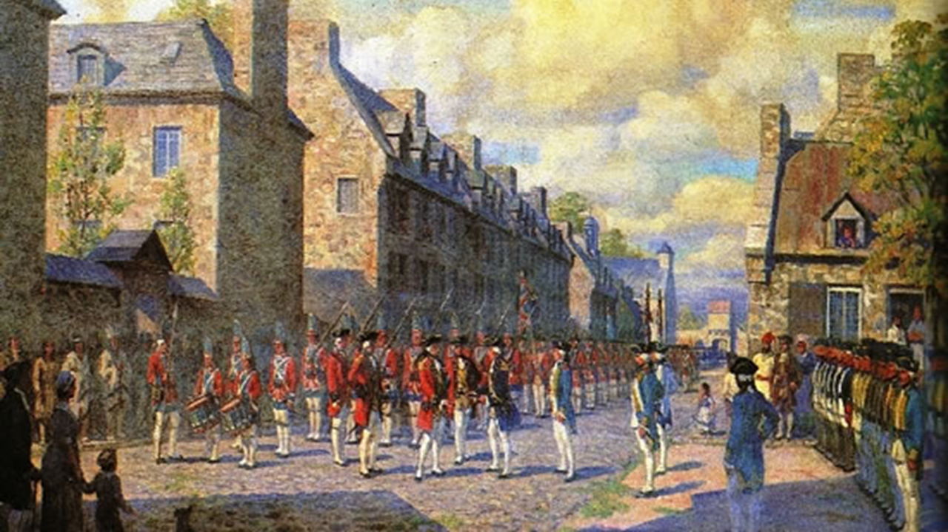
British are in Red, “Redcoats”
The French are lined up along the right hand side
The British (Redcoats) have a lot more soldiers in their army than the French do.
Montreal was surrendered and given to the British (1760)

Slide 25
LAST AND FINAL STOP
1995
SECEDING OF MONTREAL

Slide 27
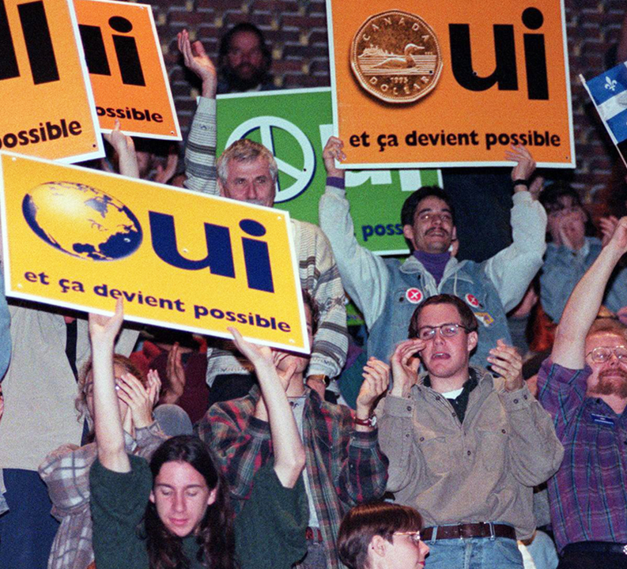
The people in the picture wanted to start their own country because they spoke a different language.
They spoke French.
“Oui” = Yes in French
They wanted to people to vote YES at the election.

Slide 28
WHAM
[Lesson 4]

Slide 29
CHAMPS
Conversation - silent, whisper voice, conversation voice
Help - raise your hand, ask a friend, ask your group
Activity - do your own work, work with a group, work with a partner
Movement - stay seated, move with permission, responsible movement
Participation - answer when called on, focus on assignment, all share ideas
Success - Be successful! Be champs!

Slide 30
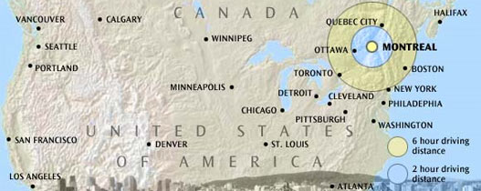
Are the residents of Montreal happier than then residents of Rockville Centre?
History Mystery [Lesson 5]

Slide 32
CHAMPS
Conversation - silent, whisper voice, conversation voice
Help - raise your hand, ask a friend, ask your group
Activity - do your own work, work with a group, work with a partner
Movement - stay seated, move with permission, responsible movement
Participation - answer when called on, focus on assignment, all share ideas
Success - Be successful! Be champs!

Slide 33
Homework Review

Slide 34
How can you think like a historian?
Why do you think it is important to think like this?

Slide 35
Fact vs. Opinion

Slide 36
Fact
Facts can be proved true.
They are true for all people and places.
Facts can be historical or they can be observed.
Facts = True Statements

Slide 37
Opinion
Can’t be proven.
Refer to a particular person’s (or group’s) feelings, thoughts, judgments, or beliefs.
Opinions = Can’t be Proven

Slide 38
People must breathe to live. All people love basketball.
Blue is the best color. I don’t like broccoli.
Today is Wednesday. Weekends are awesome!
Abraham Lincoln was a US president. Pizza tastes great.
Fact or Opinion?

Slide 39
Credibility
Another word for this is believability – how believable a statement is.
“Mr. Fraser is the best!” - Mr. Fraser’s Mom
“December 21st is the shortest day of the year” - US Weather Service
Can we believe everything we read?
Is it possible for some sources to be more credible than others?
Notes:
Sometimes information is presented as a fact, but you can prove it isn’t true or that it is unlikely to be true.

Slide 40
Credibility Cheat Sheet
1. Where did the document come from?
2. Who is the author?
a. Could the author be biased?
3. Is the document believable?
4. Does the document have bias?
5. Are there any mistakes in the document?
Bias means that a person prefers an idea. It prevents the person from being fair.
Notes:
Sometimes information is presented as a fact, but you can prove it isn’t true or that it is unlikely to be true.

Slide 41
Rules
Work as a team.
Keep your voices low.
Ask your team if you have a question.
If they can’t help you, raise your hand.

Slide 42
Jobs
Document Distributor Document Organizer
Group Leader Communicator

Slide 43
Are the Residents of Montreal Happier Than the Residents of
Rockville Centre?

Slide 44
Directions:
A. After reviewing each document, circle which location the document supports (Montreal or Rockville Centre).
B. Circle whether the document is telling you a fact or an opinion.
C. Circle Yes or No, if you think the document is believable or not.
D. Then on the lines provided write down what the document is telling you about that location.
Montreal or Rockville Centre
Fact or Opinion
Is this believable? Yes or No
___________________________________________________________________________________________________________________________________________________________________________________________________________________________________________

Slide 45
Graphic Organizer
Who is Happier?
Montreal | RVC
(Most Convincing) | (Most Convincing)
1. | 1.
2. | 2.
3. | 3.
4. | 4.
(Least Convincing) | (Least Convincing)

Slide 46
Who is Happier?
Montreal | RVC
(Most Convincing) | (Most Convincing)
1. | 1.
2. | 2.
3. | 3.
4. | 4.
(Least Convincing) | (Least Convincing)

Slide 47
Supporting Claim
Directions: After solving the mystery with your group, create a claim that supports your findings from the mystery. Be sure to include at least 3 pieces of evidence that support your answer. Use your document findings worksheet for help!

Slide 48
Are the Residents of Montreal Happier Than the Residents of
Rockville Centre?

Slide 49
Happiness Homework
https://youtu.be/y6Sxv-sUYtM

Slide 50
Lesson 6
Can we make a difference?
Taking Informed Action

Slide 51
CHAMPS
Conversation - silent, whisper voice, conversation voice
Help - raise your hand, ask a friend, ask your group
Activity - do your own work, work with a group, work with a partner
Movement - stay seated, move with permission, responsible movement
Participation - answer when called on, focus on assignment, all share ideas
Success - Be successful! Be champs!

Slide 52
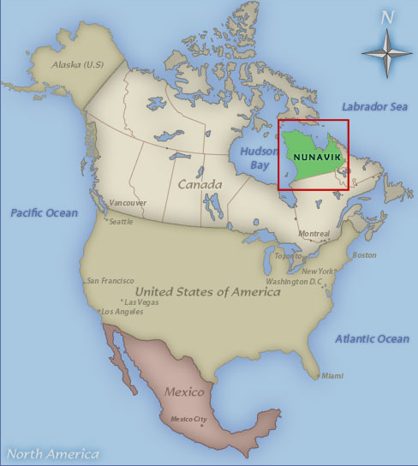
Nunavik Canada

Slide 53
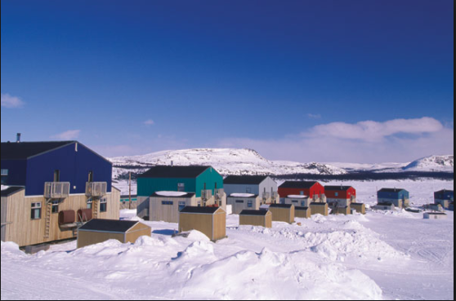
Located 5429 miles away from Montreal in the northern part of Quebec
Population: 12,000 people
14 villages which are mostly Indigenous communities
Lies in both the arctic and subarctic climate zones
Long bitterly cold winters
Summer high= 55 ℉
Winter low= -6 degrees℉
(sea water freezes)
Average temperature is 14℉
Nunavik Canada

Slide 54
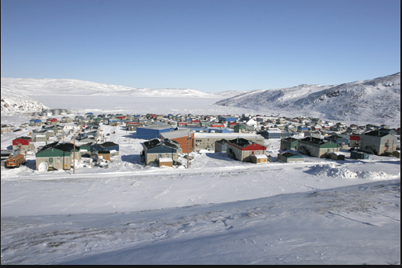
Life in Nunavik

Slide 55
Suggestions for questions to ask:
What do you do for fun?
What is life like in Nunavik?
What makes you happy?
Is there anything about your town that makes you unhappy?

Slide 56
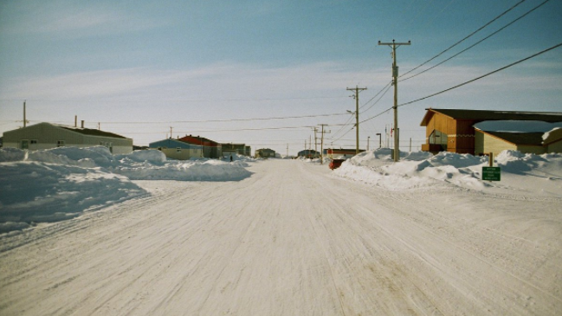
Problems in Nunavik:
Poverty
Depression
Health
Cost of living
Education
Limited Resources
Limited School Supplies
Housing
Youth
Cost of food
Struggle between staying with traditional ways and modernizing

Slide 57
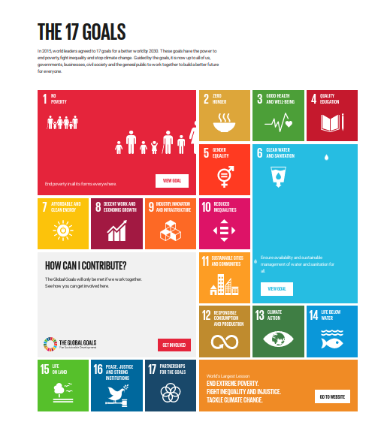
What is informed action?
Informed-”Having or showing knowledge of a particular subject or situation”
Action- “The fact or process of doing something, typically to achieve an aim”
Learning and becoming informed about a situation and taking action to help be a positive change.

Slide 59
Informed Action Project: Supply/ Book Drive
Group 1: Create flyers and posters to publicize the supply drive for the students in Nunavik.
Group 2: Create a short speech, and go to the other classrooms to inform students about the event, and where the books/ donations will be going.
Group 3: Plan the event and collect/ box the items.

Slide 60
Exit Ticket
After today’s lesson, what is your definition of informed action ?
List 3 ways you can make an informed actions in your community

Slide 61
Homework
For homework, students will look at newspaper or magazine, article online and find someone making a difference with an informed action and report about it on FlipGrid

Slide 62
Lesson 7
TDFC and DBQ Teaching
Share a personal story.

Slide 63
CHAMPS
Conversation - silent, whisper voice, conversation voice
Help - raise your hand, ask a friend, ask your group
Activity - do your own work, work with a group, work with a partner
Movement - stay seated, move with permission, responsible movement
Participation - answer when called on, focus on assignment, all share ideas
Success - Be successful! Be champs!

Slide 64
TDFC
Topic 2. Details 3. Follow Ups 4. Clincher

Slide 65
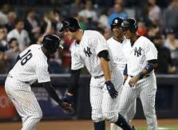
Discuss two reasons the Yankees will win the World Series in 2018

Slide 66
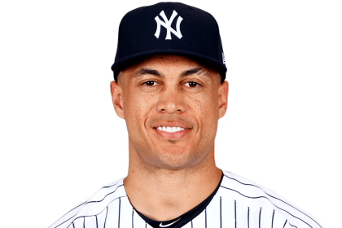
1.They have the best offense in the league and the bullpen
2.NYY picked up Giancarlo Stanton on the offseason and he won National League MVP last year.

Slide 67
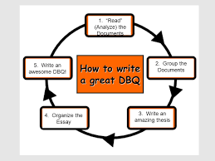
What are the four things we need to create a paragraph for the DBQ?
What is a topic sentence?
What is a follow up to detail?
How do we tie this all together
for the clincher….

Slide 68
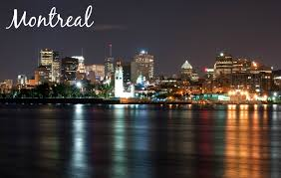
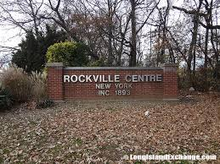
Topic: Are residents of Montreal Canada happier than the residents of Rockville Centre?
VS.

Slide 69
Details
Rockville Centre’s Lady Cyclones women’s soccer has won 17 State Championship titles in the past 25 years.
The Canadians have won 24 Stanley Cups, the most in NHL history.

Slide 70
Follow ups
Montreal: Annual Weather Averages
July is the hottest month in Montreal with an average temperature of 70°F (21°C) and the coldest is January at 16°F (-9°C). The wettest month is August with an average of 100mm of rain.
Rockville Centre: Annual Weather Averages
In Rockville Centre, summers are warm and humid, the winters are very cold and windy, and it is wet and partly cloudy all year round. Over the course of the year, the temperature typically varies between 27°F to 83°F and is rarely below 14°F or above 90°F.

Slide 71
THE CLINCHER!!!!!
Rockville Centre has all four seasons; whereas Montreal is predominantly cold and rainy with a summer high temperature around 55 ℉. Sports can be played in all four seasons both indoor and outdoor. Generally speaking, those that stay active live a longer and healthier life! Lastly, poverty, cost of living/food, and education all are drawbacks to living in Montreal as opposed to the community of Rockville Centre.

