Slide 1
Unit Plan:
Who is happier Ugandans or Americans?

Slide 2
Compelling Question:
What is it that makes us truly happy?
What is Eudemonic Happiness?

Slide 3
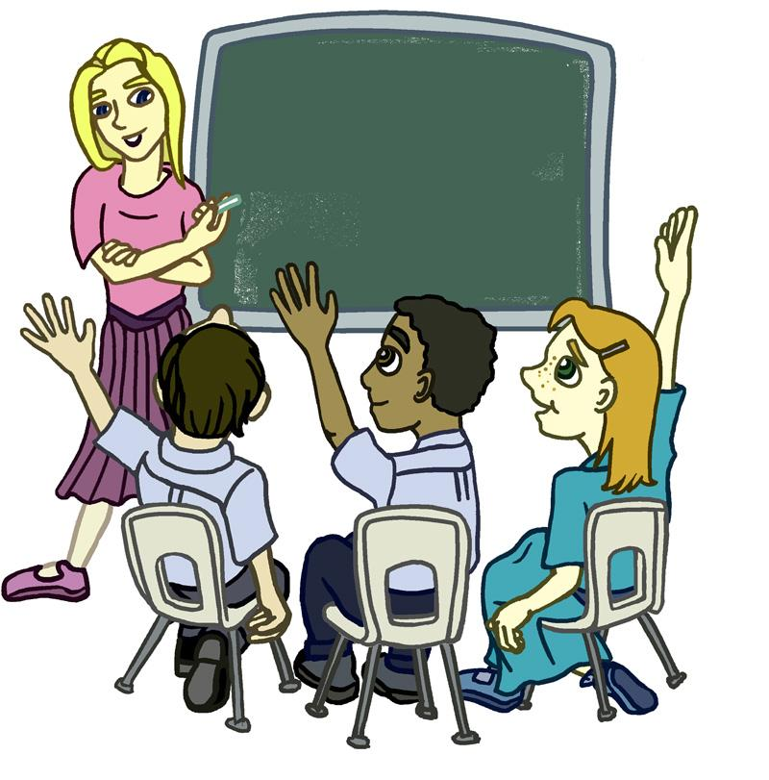
Expectations...
During class discussions, be sure to raise your hand before speaking and do not interrupt others who are speaking.
Remain seated unless told otherwise.
Be kind and respectful of others opinions.

Slide 4
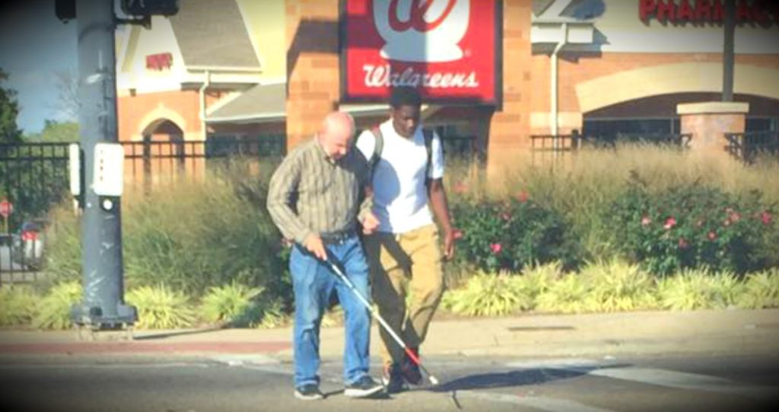
Who is happier….
or
the boy helping the blind man
cross the street
the women shopping

Slide 5
Read “How Full Is Your Bucket?”
Discussion Questions:
What happens when someone is mean to Felix?
What happens when someone is nice to Felix?
What happens when Felix is nice to someone else?
What is Eudemonic Happiness?

Slide 6
What fills and empties your bucket?
On one raindrop write one-two sentence about something that fills your bucket. On the second raindrop write one-two sentence on something that empties your bucket. Drop the raindrops in the corresponding buckets.
Fills
Empties
Notes:
Activity

Slide 7
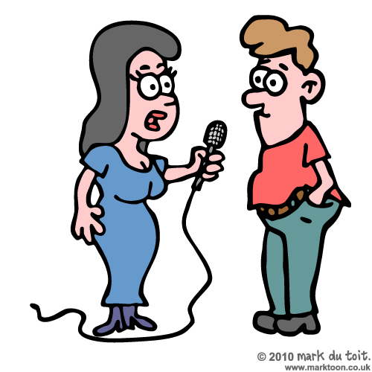
Homework
Interview someone and have them talk about a time that they helped someone else and how it made them feel.

Slide 9
Compelling Question:
Is happiness a choice?

Slide 10
Let’s Get Started!
What message is the author trying to convey?

Slide 11
What is Optimism?
“hopefulness and confidence about the future or the successful outcome of something.”
Having a positive outlook
Looking on the “bright side”

Slide 12
What is Pessimism?
“a tendency to see the worst aspect of things or believe that the worst will happen; a lack of hope or confidence in the future.”
Having a negative outlook

Slide 13
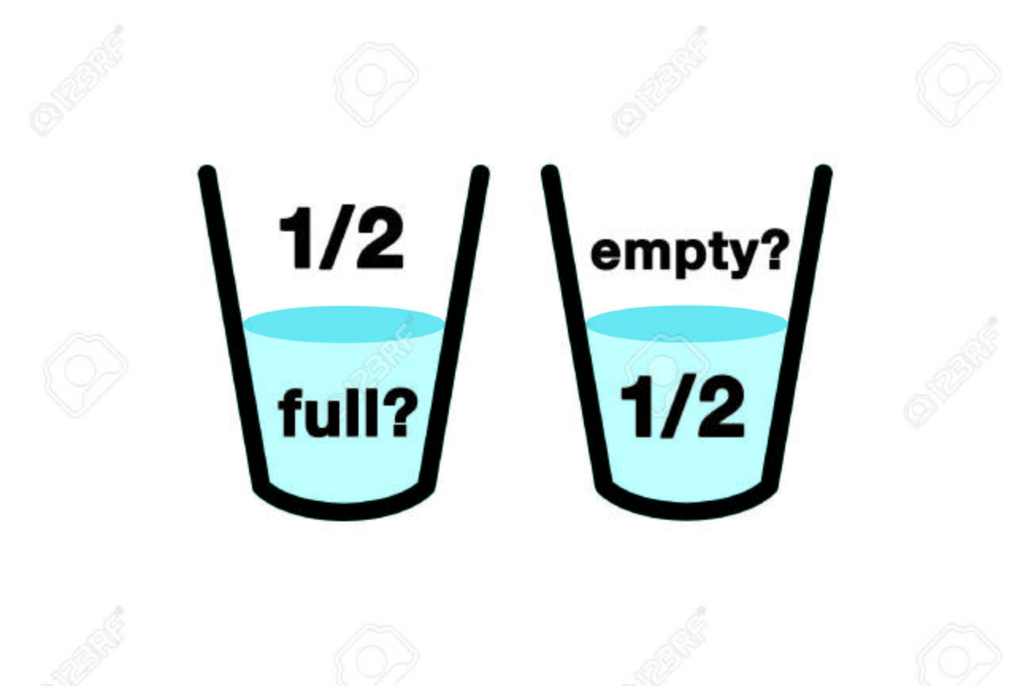
Glass half full vs. Glass half empty
Which view is optimistic? Why?

Slide 14
Pie chart on optimism

Slide 15
Expectations
Be quiet and respectful when your peers are speaking.
Communicate during group work, but please no yelling!
Stay seated unless you are told otherwise.

Slide 16
Activites
Group 1 (T-chart): Scenario Sort! Which scenarios demonstrate optimism and which demonstrate pessimism? Highlight evidence that supports your claim.
Group 2 (Venn diagram): Compare and contrast two characters experiences. What happened to them that was the same? What was different? What was each characters’ outlook?
Group 3 (3 columns): What can you do to be optimistic on a daily, monthly, or yearly basis? Brainstorm some ideas.
Group 4 (Bulleted list): What are some ways to be optimistic? Read this article to find out!
Be prepared to share with the class!

Slide 17
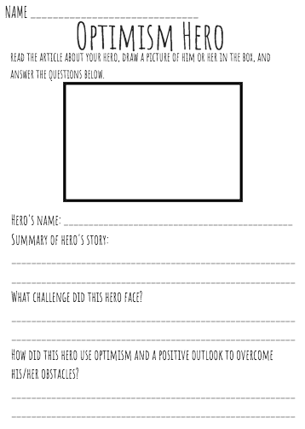
Homework
For homework, you will read an article about an Optimism Hero.
You will draw a picture of this person. Then, you will answer the questions about your hero, his or her challenges, and their optimistic attitude.

Slide 18
Exit Ticket
To demonstrate your knowledge on what you’ve learned today, you will write at least four sentences answering the question:
“Do you think Ugandans can be happy even though most of them are living in poverty?”
Use examples from It’s Okay to Make Mistakes, this presentation, and your group activities!

Slide 19
Bus Tour of Uganda
Presented by: Mr. Lozano and Ms. Merkle

Slide 20
What did you learn about last class?
What makes people happy?

Slide 21
Our Itinerary
Please take some time now to fill out your airplane ticket and name tag.
Please board the plane and prepare for take-off.

Slide 22
Uganda Guessing Game
Where is Uganda located?
How long will it take to get to Uganda?
How many people live in Uganda?
What time is it in Uganda right now?

Slide 23
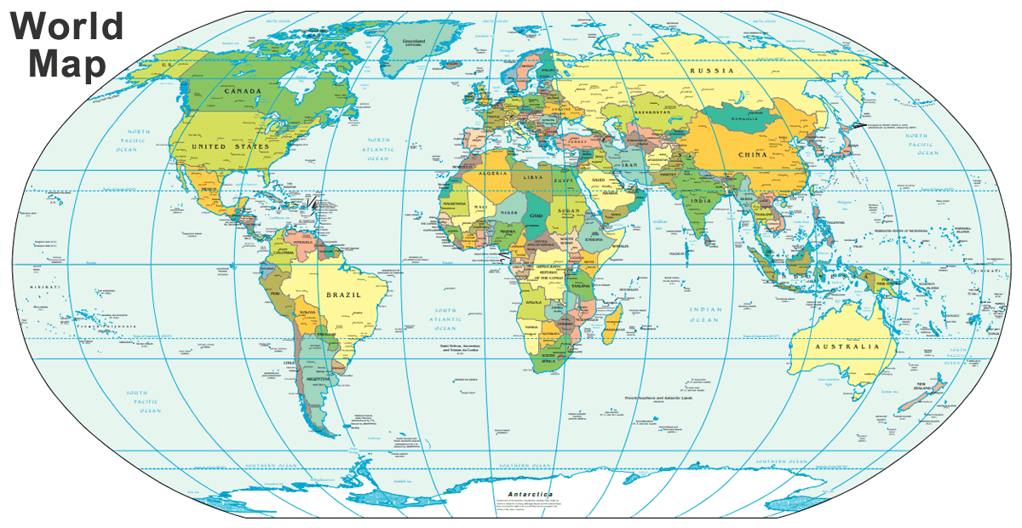
Where is Uganda located?

Slide 24
Bus Safety (CHAMPS)
Please remain seated.
RESPECT others.
Keep hands, feet and belongings to yourself.
Use quiet voices and be courteous.
Follow directions from the guides (the teachers).
Bring only approved items on the bus (pen or pencil and travel itinerary)
Be respectful of the school property and other people’s property.
Please raise your hand before speaking.
If you have any questions or concerns, please communicate with the teachers.

Slide 25
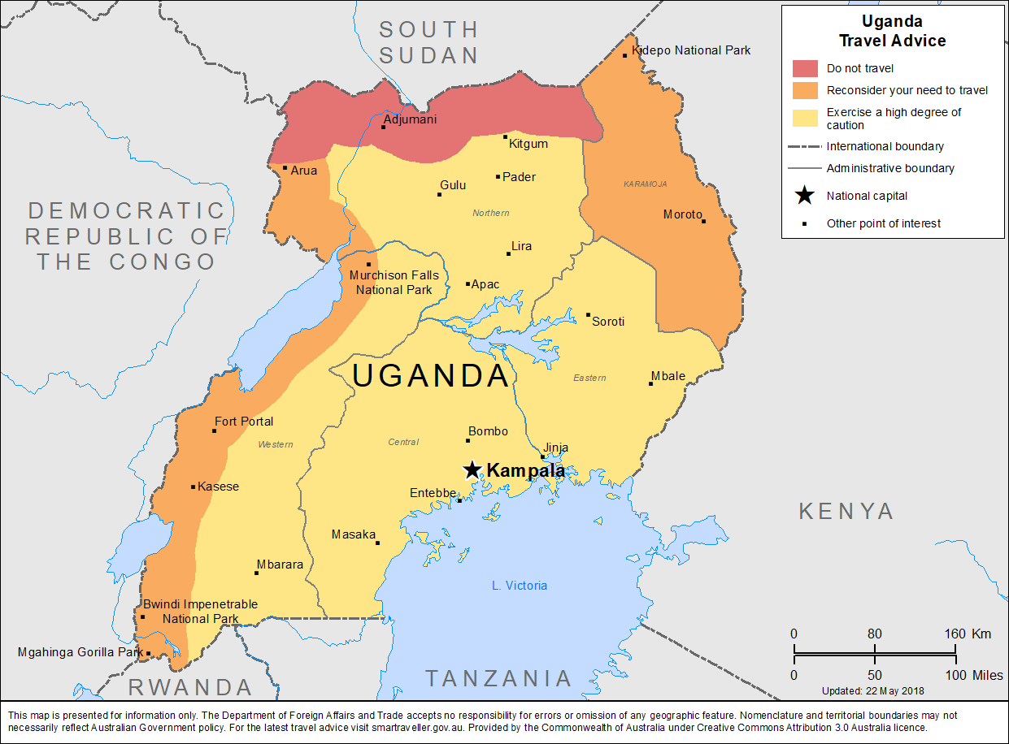

Slide 26
Districts of Uganda
Today we will be covering the Central District of Uganda
Within the Central district we will be visiting...
Entebbe
Kampala - Site visit to the Kasubi Tombs
Queen Elizabeth National Park
*Please complete the skeleton notes provided in your Uganda Trip Itinerary during the visit to each location.*

Slide 27
Arrival to Entebbe ~ Uganda International Airport
Flight from JFK International Airport in NY to Cairo International Airport in Egypt to Entebbe International Airport in Uganda
Total Hours of Flight : 24 hours 45 mins

Slide 28
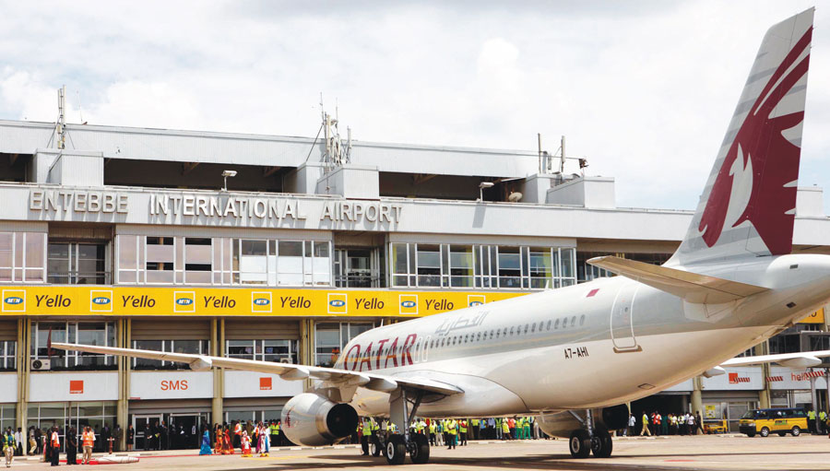

Slide 29
Get Onto the Bus In Entebbe

Slide 30
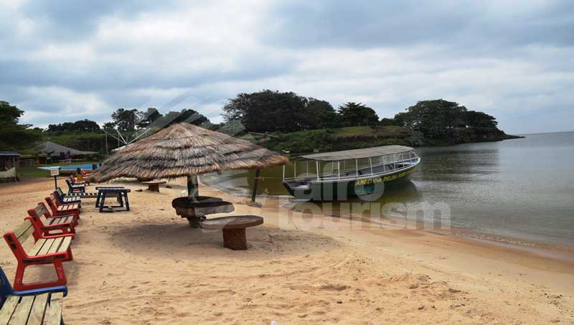
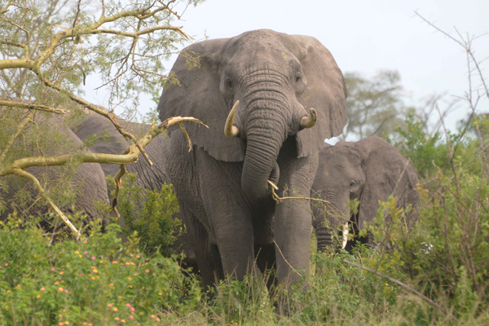
Entebbe
21 miles South of Kampala
Surrounded by Lake Victoria
Home to many beaches including Aero Beach which is extremely populated during weekends during the summertime.
Entebbe botanical gardens protects endangered plant species
The lakeside Uganda Wildlife Education Centre protects native animals

Slide 31
What do we see out the window?
https://www.google.com/maps/place/Entebbe,+Uganda/@0.0801725,32.4496825,3a,75y,243.88h,85.34t/data=!3m8!1e1!3m6!1sAF1QipM9ejqqveFLO_kaAPhIzzqA7Jq4FNPWbDjHDICY!2e10!3e11!6shttps:%2F%2Flh5.googleusercontent.com%2Fp%2FAF1QipM9ejqqveFLO_kaAPhIzzqA7Jq4FNPWbDjHDICY%3Dw203-h100-k-no-pi-0-ya165.81573-ro0-fo100!7i8704!8i4352!4m5!3m4!1s0x177d86b753c20ab3:0xa4a550c375cc2c14!8m2!3d0.0511839!4d32.463708

Slide 32
Bus Takes us to Kampala

Slide 33
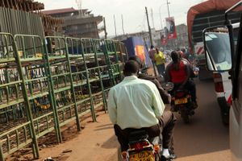
Kampala
Population: 2.5 million. . . The largest city in Uganda!
Fastest method to get around city: Boda bodas
Landmarks: National Theatre, The Uganda Museum, Nommo Art Gallery,
Kasubi Market: one of Kampala’s largest food markets
Would you be excited to drive around on a boda boda?
Which landmark would you most want to visit?

Slide 34
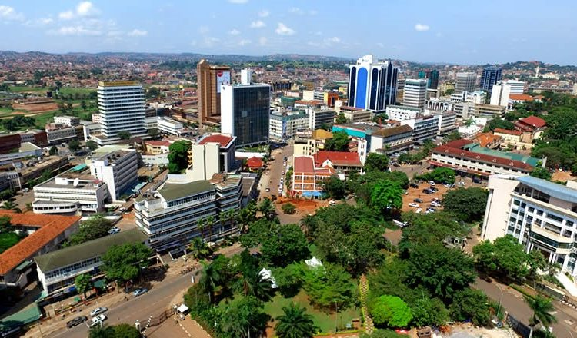

Slide 35
Kasubi Tombs
Active religious site today
Burial ground for the previous four Kabakas (title for the King of the Kingdom of Buganda- subnation of Uganda)
Three main areas- main tomb areas, buildings and graveyards, site used for agricultural purposes
Main tomb areas
Buildings/graveyards
Site used for agricultural purposes
The four Kabakas
Muteesa (1835-1884)
Basamula Mwanga II (1867-1903)
Daudi Chwa II (1896- 1939)
Fredrick Walugembe Mutesa II (1924-1969)

Slide 36
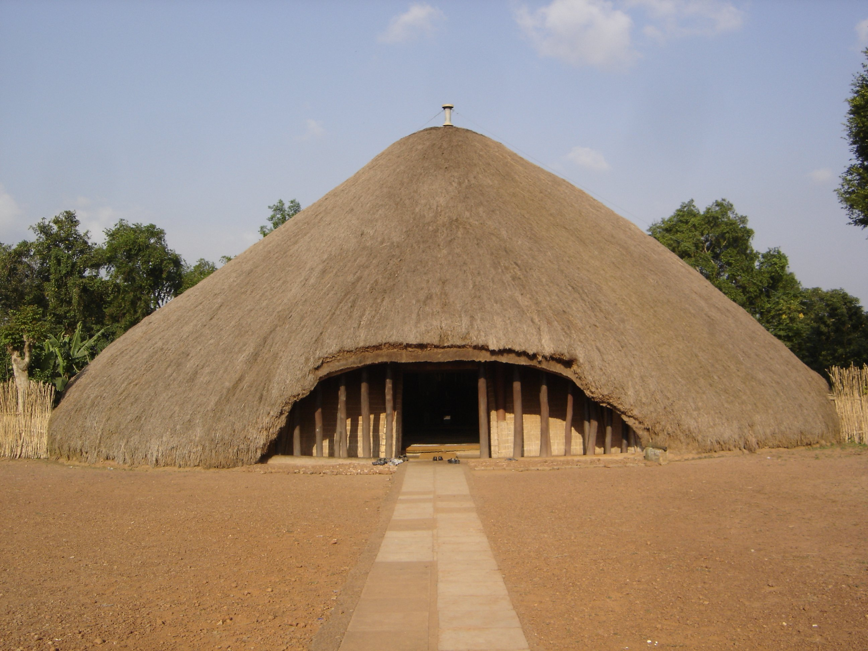
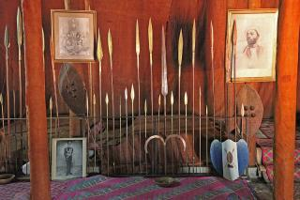
Kasubi Tombs

Slide 37
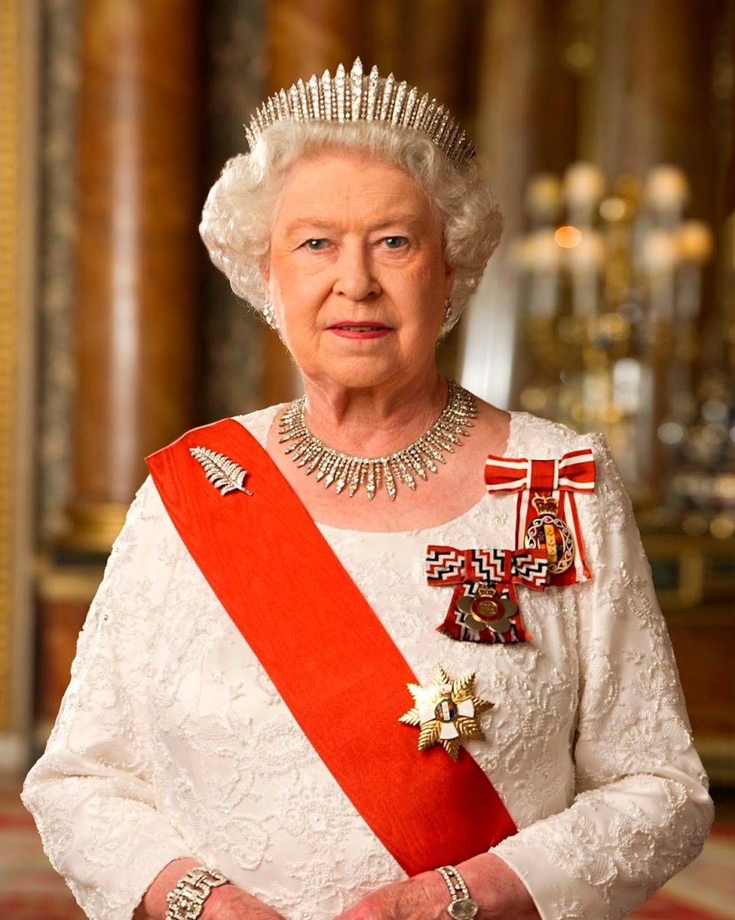
Queen Elizabeth National Park
One of Uganda’s most popular tourist destinations
Founded in 1952 as Kazinga National Park but was renamed two years later to commemorate a visit by Queen Elizabeth II
Contains many different ecosystems- lakes, wetlands, forests,and savannas
Home to over 95 animal species and 600 bird species
Located on the equator- different monuments mark the exact spot where the equator is located.

Slide 38
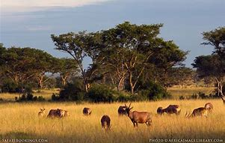
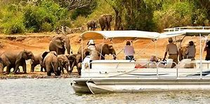
Queen Elizabeth National Park

Slide 39
Queen Elizabeth National Park
https://www.google.com/maps/place/Queen+Elizabeth+National+Park/@-0.1354684,29.9281359,2a,75y,72.02h,92.95t,356.12r/data=!3m6!1e1!3m4!1s1c_XluQO4oqE1QTrD6mAMA!2e0!7i13312!8i6656!4m12!1m6!3m5!1s0x19df489b3ec38175:0x3cfe5a989d13d498!2sQueen+Elizabeth+National+Park!8m2!3d-0.1640716!4d30.0202535!3m4!1s0x19df489b3ec38175:0x3cfe5a989d13d498!8m2!3d-0.1640716!4d30.0202535

Slide 40
Conclusion
Now that we have travelled through Uganda…
Complete the writing section of your Uganda Trip Itinerary
Retrieve your polaroid photo and paste it to the back of your itinerary. Make sure you write where it was taken.

Slide 41
Today we will learn the three main events that shaped Uganda...

Slide 42
The three main events are:
Imperialism
Independence
Dictatorship

Slide 43
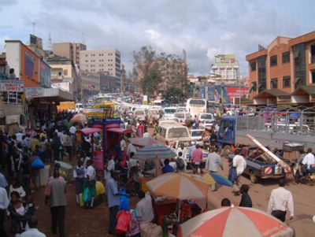
Uganda before independence in 1890

Slide 44
Uganda Today: Kampala

Slide 45
What is a read and retell?
During this activity, we will divide into groups of three and each group will be given a document about specific events that shaped Ugandan history!
You will read the document that has been given to you and write down 5 words you would use too retell the story. Then you will retell the story and your partner will then guess the 5 words you chose to retell the story.
Then you will switch groups so at least one person from each group is all together and you will discuss to the rest of the group what happened in your documents.

Slide 46
Imperialism!
In 1894, Uganda signed several treaties which gave the British rights to begin harvesting cotton in exchange for protection and safety. This resulted in Uganda, together with Buganda, joining the British Sphere of Influence in 1894.
However, the several treaties signed by Ugandan rulers turned out to be a trick by the British in order to allow them to take over Uganda’s natural resources.

Slide 47
Independence
On March 1, 1962, Uganda begins self-government with Benedicto Kiwanuka as prime minister. Then, in October 1962, Uganda is admitted as member State to the United Nations. Uganda gained independence without much struggle because the British were slowly withdrawing their power over Uganda over time. They also encouraged independence and slowly gave back rights to Uganda. Uganda won its independence from Britain on October 9th in 1962 after a long 72 years.

Slide 48
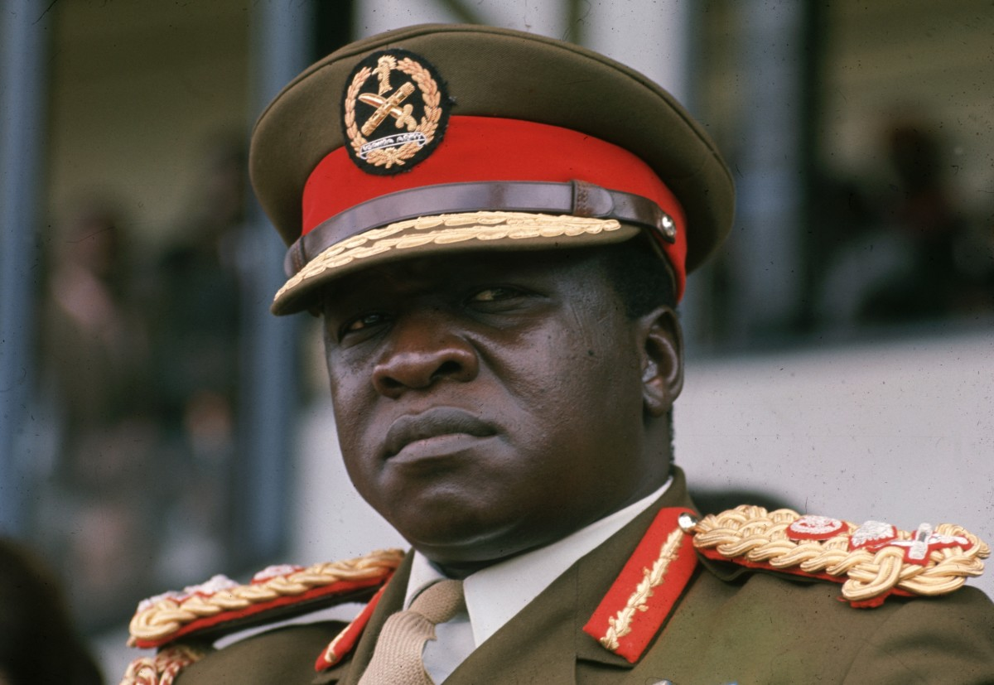
Dictatorship
Ugandan Dictator Yoweri Museveni, once hailed as a freedom fighter and liberator, has been in power since 1986. Museveni’s reign has over time continued to transform into an autocratic leadership, bent on silencing the opposition and suppressing the media in order to maintain a firm grip on his power.

Slide 49
Based on the documents that you have read,
Which event most shaped Ugandan History?

Slide 50
Homework
Students will create a journal entry from the perspective of a person from the time period and historical events, that they were assigned during class, regarding the way the individual must have felt and why based on the documents.

Slide 51
Compelling question:
Which event has most shaped Uganda today?
Ms. Flynn and Ms. Oliver
Lesson 5

Slide 52
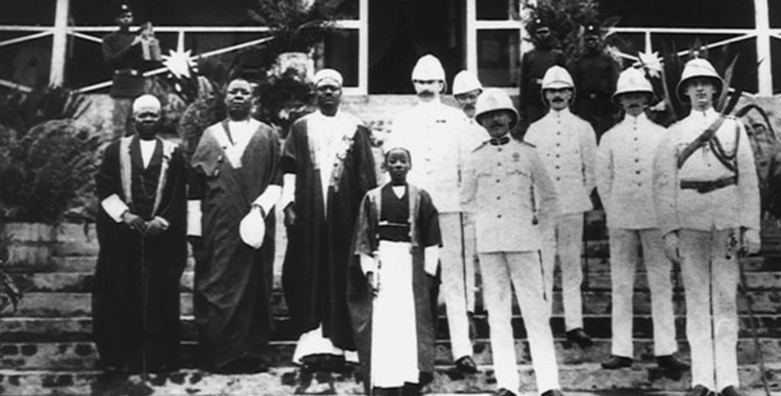
Topics:
Uganda Becoming Independent
European Colonization
Uganda Today (Dictatorship)
“Uganda is under my control and I have the power!”
-Yoweri Museveni
“We tricked the Ugandans and have taken over their natural resources!”
-The British
“We want independence and we will get our independence!”
-Benedicto Kiwanuka

Slide 53
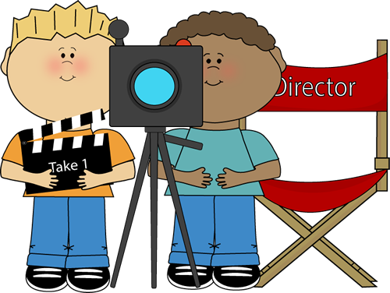
Today we will be doing an Act-It-Out!
What is an Act-it-Out?
We are going to make history come alive!
We will all be bringing an event to life.

Slide 54
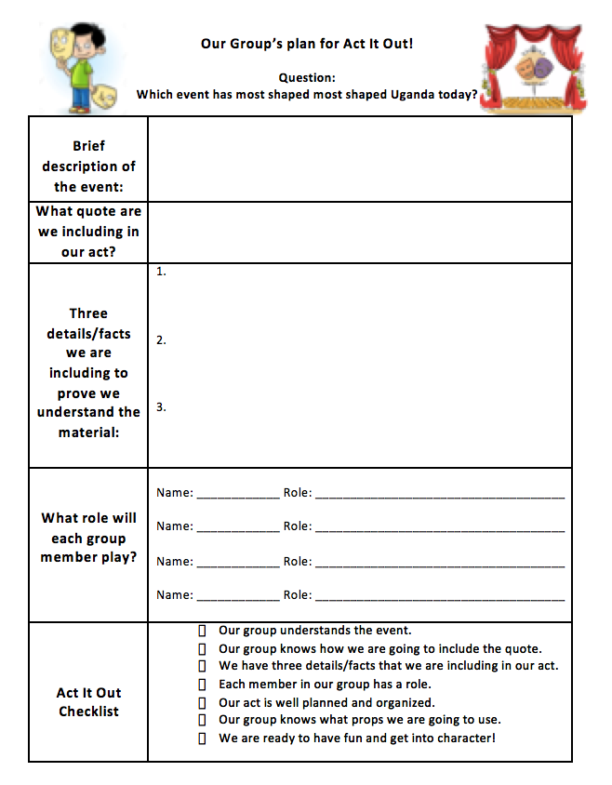

Slide 55
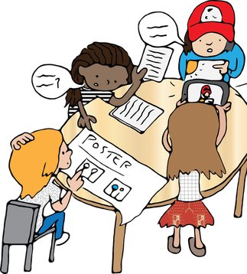
Ms.Flynn’s and Ms.Oliver’s Expectations of you!
2. All ideas are valuable and you should be respectful towards ALL your classmates.
3. Feel free to ask us questions at anytime and most importantly HAVE FUN!
1.You will be working together so we expect that all conversations will be about the topic and remain on task.

Slide 56
Compelling Question:
Is the information we learned about Uganda in the “Act It Out” with Ms.Flynn and Ms. Oliver true?!
Lesson 7:
Ms. Levitt & Ms. Madrid

Slide 57
Classroom Expectations
Champs
Raise your hand to share any thoughts.
Be sure to work diligently at your seats!
Be respectful of each others opinions and ideas

Slide 58
Review SCIM-C
What type of historical document is the source?
What additional evidence beyond the source is necessary?
Summarize
Contextualizing
Inferring
Monitoring
Corroborating
When and where was the source produced?
What similarities and differences between the sources exist?
What is suggested by the source?

Slide 59
To-Do | Doing | Done
Review 4 documents
Review instructions
Review SCIM-C Method

Slide 60
Compelling Question
Are Ugandans happier than Americans?
mS. miritello and ms. dimarco

Slide 61
History Mystery
Today we are going to be detectives!
You are going to get into groups from yesterday where you will get an envelope filled with 9 documents, where you have to decide which are credible and non-credible

Slide 62
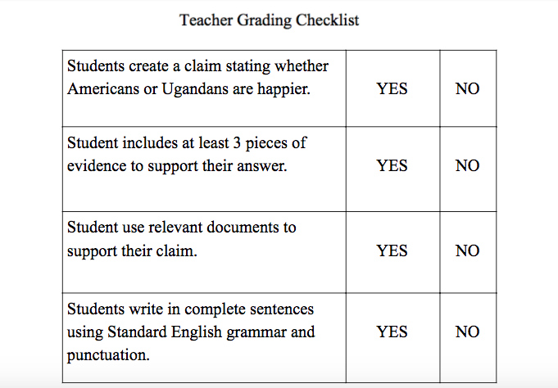
Expectations
Students should be raising their hands and be respectful when classmates are talking/ sharing their opinions.

Slide 63
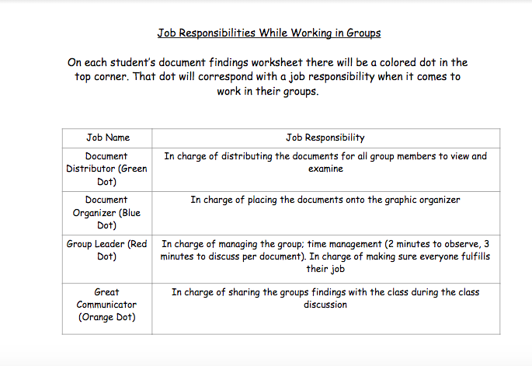
Job responsibilities

Slide 64
Let’s get to work!
Sort through the documents with your document classification sheet
Choose which are most credible and least credible
Discuss with your group who you think is happier
Complete the supporting claims worksheet
Paste the documents on the poster board
Be ready to discuss with the class!

Slide 65
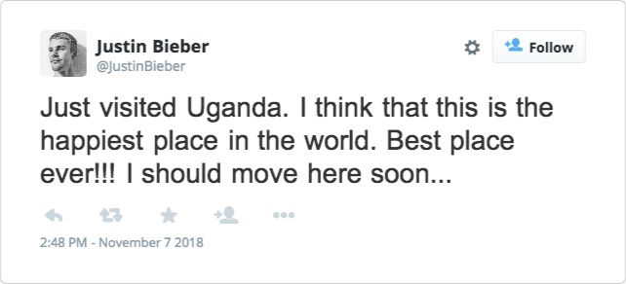
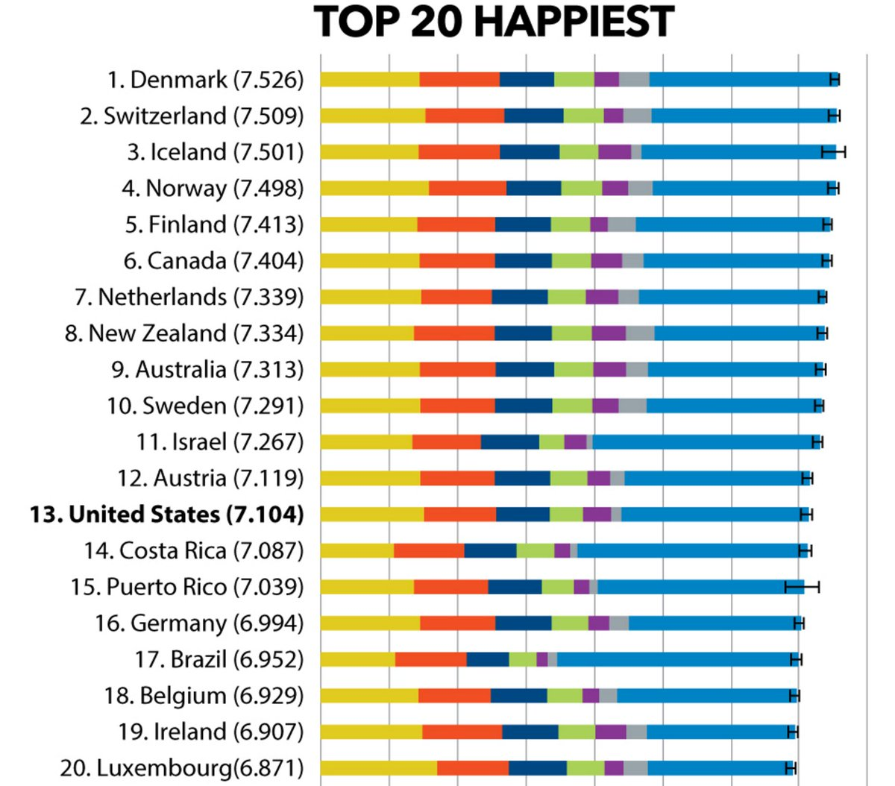
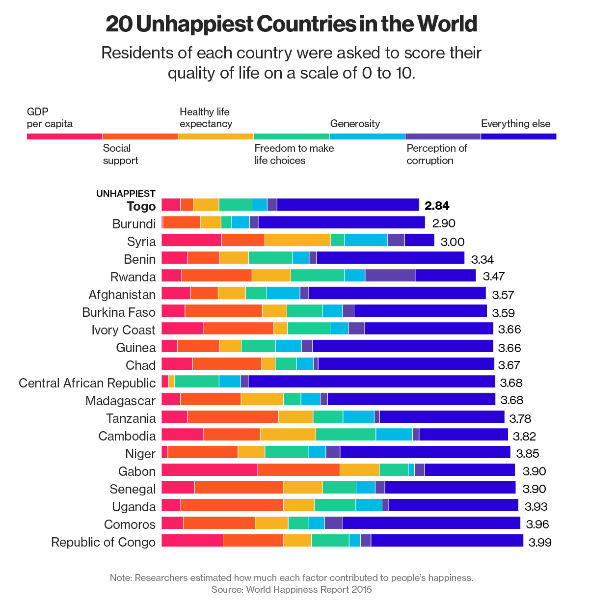
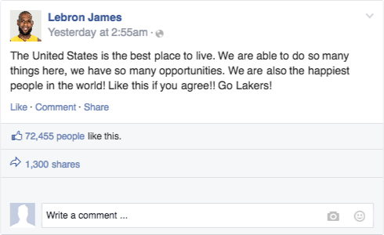
Document examples

Slide 66
Homework
You will be given two questions regarding what happiness means, as well as justifying your claim as to which country is happiest, Uganda or the United States.

Slide 67
Essay in the Air
In what ways is life in Uganda different that life in America? Do these differences indicate that Ugandans are happier?
Ms. Manetta & Ms. Visceglia

Slide 68
FISHBOWL ACTIVITY
Group 1
Students inside of the fishbowl, discuss the documents
Group 2
Students outside of the fishbowl, watch and listen to your fellow peers

Slide 69
ROLES
LEADER TIMEKEEPER NOTE TAKER
FACT CHECKER

Slide 70
Expectations
Remember: we are CHAMPS!
Conversation: We will be respectful and mindful while our peers are speaking
Help: As we share our arguments, we are helping one another shape our ideas
Activity: We are stimulating our brains to make evidence-based arguments
Movement: After one essay in the air, we will switch groups and complete another
Participation: We will all play important roles in our essay in the air
Success: We will successfully stimulate our brains to shape evidence-based arguments

Slide 71
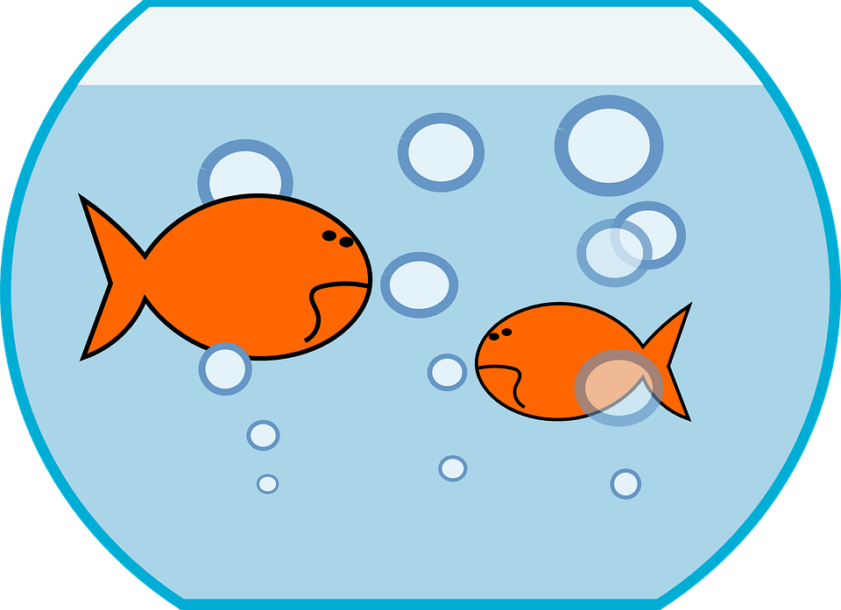
Evaluate
Both during and after the Fishbowl activity ask yourself….
Did I speak enough during the activity ?
Did I successfully complete my role ?
Did my group use all of the documents ?
Did my group successfully answer the BIG question ?

Slide 72
Lesson 9
Compelling Question:
What is Taking Informed
Action?

Slide 73
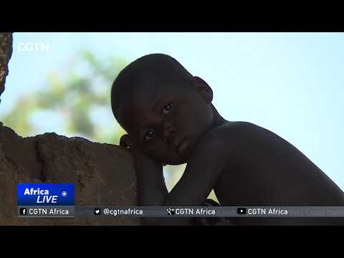

Slide 74
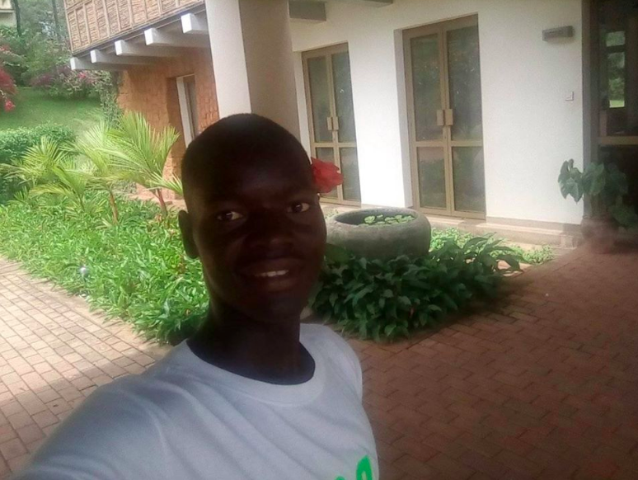
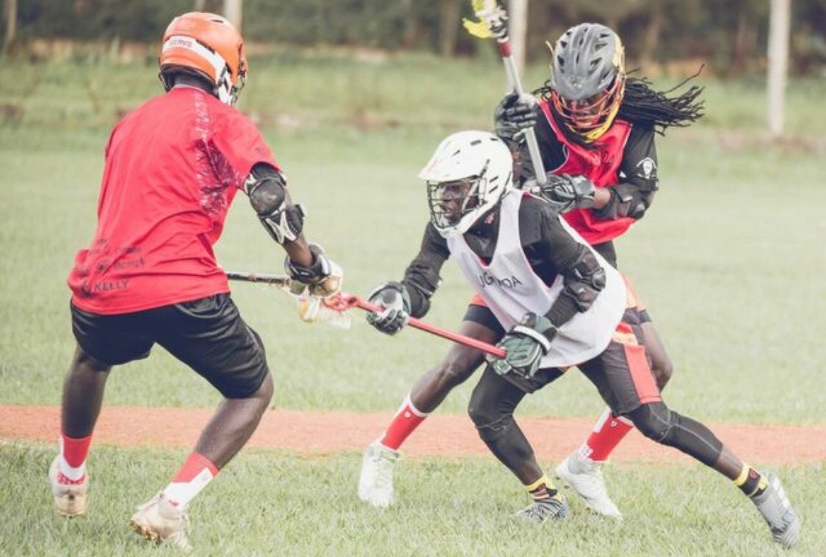
This is Reagan

Slide 75
Brain Storm

Slide 76
What is Informed Action?
It is creating informed citizens and working together collaboratively to understand the importance of historical events, connecting them to current issues and making a difference in a real way.

Slide 77
Taking Informed Action: Group 1
Your group will make informative flyers and posters displaying the needs of the people in Uganda. Assign people to informed action jobs.

Slide 78
Taking Informed Action: Group 2
Your group will plan a fundraiser to raise money and supplies to send to the people in Uganda and Reagan. Assign people to informed action jobs.

Slide 79
Taking Informed Action: Group 3
Your group will create a social media account (Twitter, Instagram, Facebook, etc.) and post pictures and facts about Uganda and poverty there. Assign people to informed action jobs.

Slide 80
Taking Informed Action: Group 4
Your group will create an informational video about the poverty. Assign people to informed action jobs.

Slide 81
Now It's Your Turn!

