Slide 1
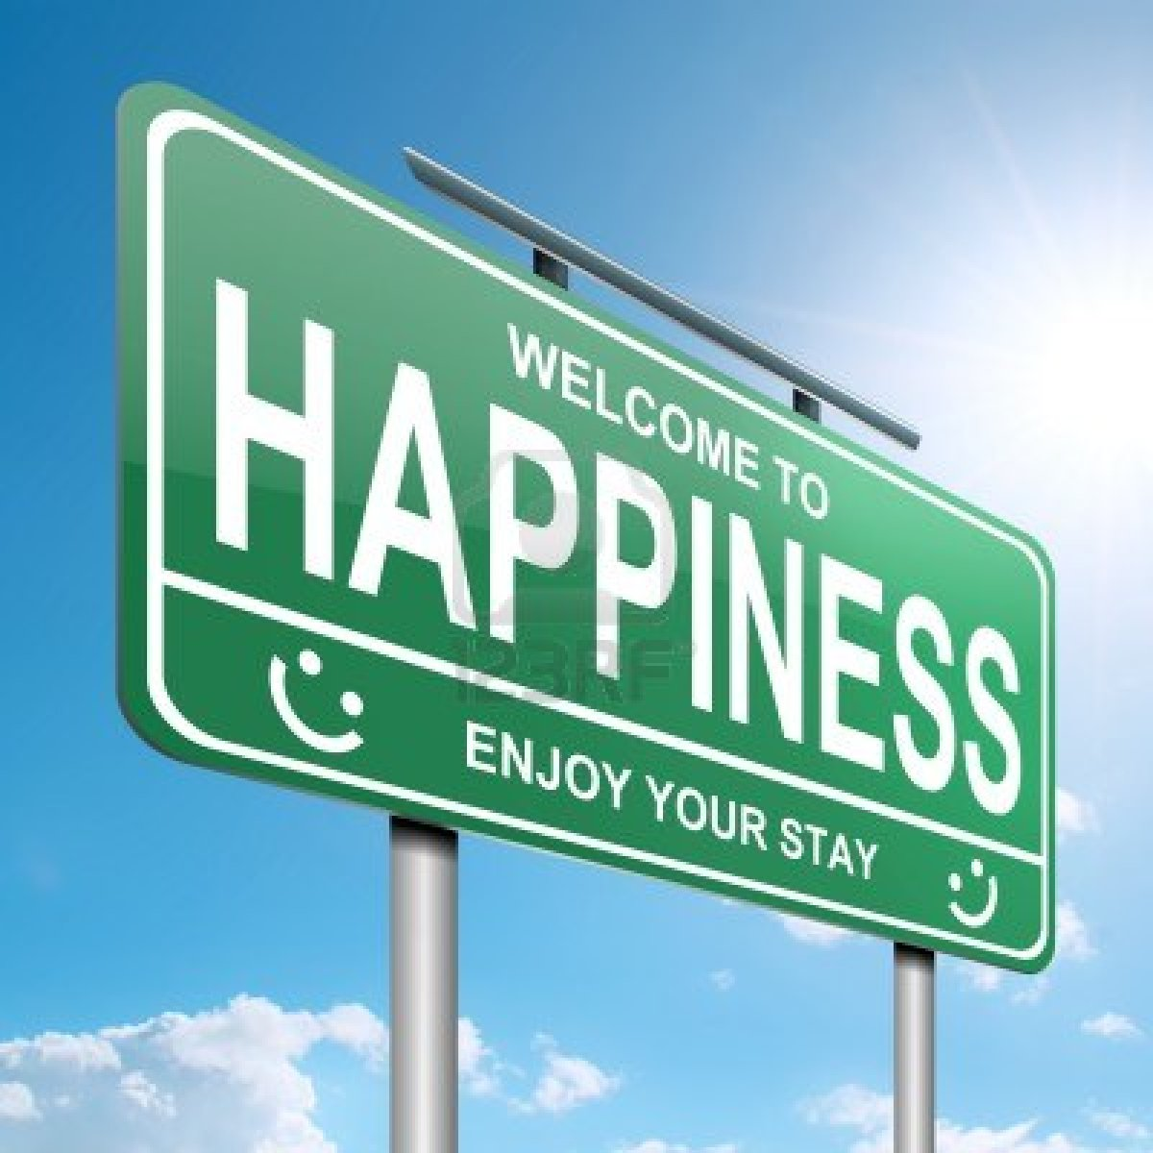
Does Where You Live in the Western Hemisphere Determine Your Happiness?
Grade 5: Katharine Black, Samantha Drexler, Kaitlin Boyle, Diana Pretter,
Ashley Keon, Denise Redfern

Slide 2
Lesson 1: Happiness
“... mankind’s quest for happiness is shaped by the misguided assumption that happiness will come only after a future goal is attained.” (p. 164)
“...mankind’s quest for happiness is shaped by the misguided assumption that happiness will come only after a future goal is attained.” (p.164)
d

Slide 3
Does where you live determine your happiness?

Slide 4
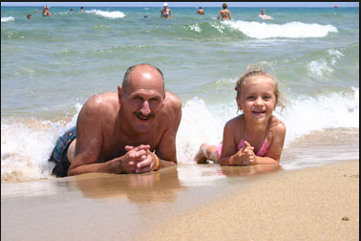
Personal Story
My abuelo defined happiness as Christmas morning as well. Except it was bit different than my own. In his youth my abuelo lived on the beaches of Cuba. His “toys” were the crabs him and his brother picked could find on the shore line. One Christmas his mother told him not to expect any gifts, because Santa couldn’t find them that year. That next morning my grandfather was surprised to find two tiny erasers waiting for him. He cried with happiness. He carried those tiny erasers in his pockets until his first day of high school.
V.S
I defined happiness as Christmas morning. I remember one in particular when I was given a coveted American Girl Doll. I begged my parents day and night for almost a year to purchase the expensive toy. I was beyond happy when I saw my persistence paid off! I played with her for years.

Slide 5
Let’s be CHAMPS today!
C - Conversation: We will be opening the floor to discussions, thoughts and questions. All of us must remain respectful and mindful of others as they speak. When someone is speaking, you are not.
H - Help: If you have ANY questions, please raise your hand. All questions should pertain to the topic at hand and should be appropriate. Please remember to be attentive to others when they speak.
A - Activity: We will have a story worksheet to go along with the read out loud of The Wise Woman and Her Secrets that will follow the discovery to finding happiness. Students will be called on to read their responses out loud and explain their thoughts and feelings.
M - Movement: Students will need to be seated during the lesson. If a student has to use the facilitates or has an emergency they must raise their hand to inform the teacher before being excused.
P - Participation: All students must be participating in the lesson. From the beginning of the lesson (be attentive to the personal story) to the taking of notes on the story worksheet.
S - Success: When students can define what makes one happy and connect happiness to success in their personal lives.

Slide 6
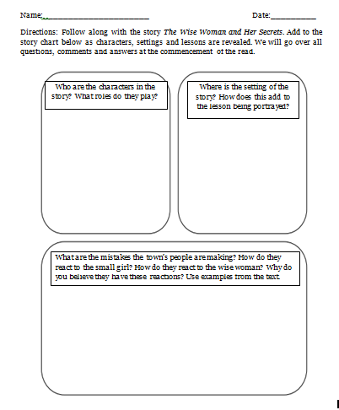
Discovering the Secret to “Happiness”
**Spoiler Alert** The answer is Gratitude (savoring the moment).

Slide 7
Power of Positive Thinking
THINKING QUESTION
In Leon, Nicaragua, most of the city’s inhabitants live below the poverty line. This has forced some residents to live in the rubbish dump, collecting and recycling rubbish for a living. Although these collectors are the poorest of the poor and socially scorned, interviews reveal that over 70% are happy and optimistic about a better future. Do you think the same could be said for those who live in America? Explain.

Slide 8
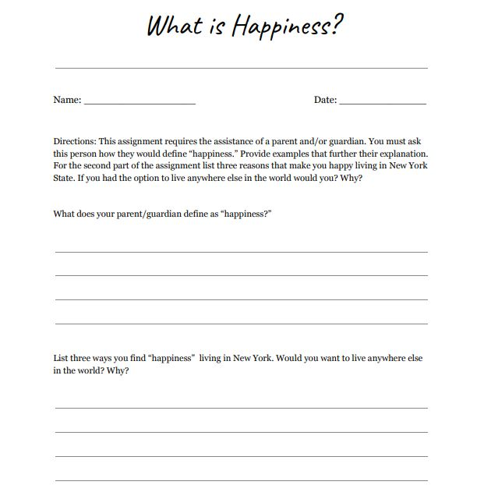
Homework
First question involves parent/guardian participation. Sparks discussion on the topic at hand. Student has the option to share a plethora of information they have just discovered.
Second question acts as a bridge into the next lesson on Mexico. Teacher can use students “why” as a jumping off point for a class discussion on other places people can live.
Notes:
Slide 2 and so on…

Slide 9
List three ways you find happiness living in New York. Would you want to live anywhere else? Why?
Notes:
https://theculturetrip.com/north-america/mexico/articles/the-best-things-to-see-do-in-oaxaca-city/ - cite
https://kids.nationalgeographic.com/explore/countries/mexico/#Mexico-Map-cut.jpg - cite

Slide 10
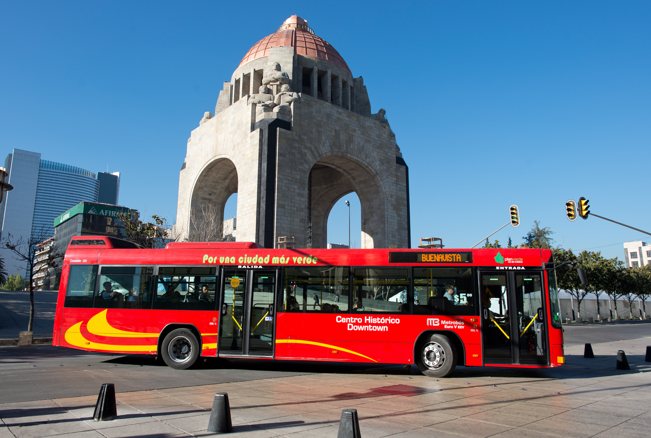
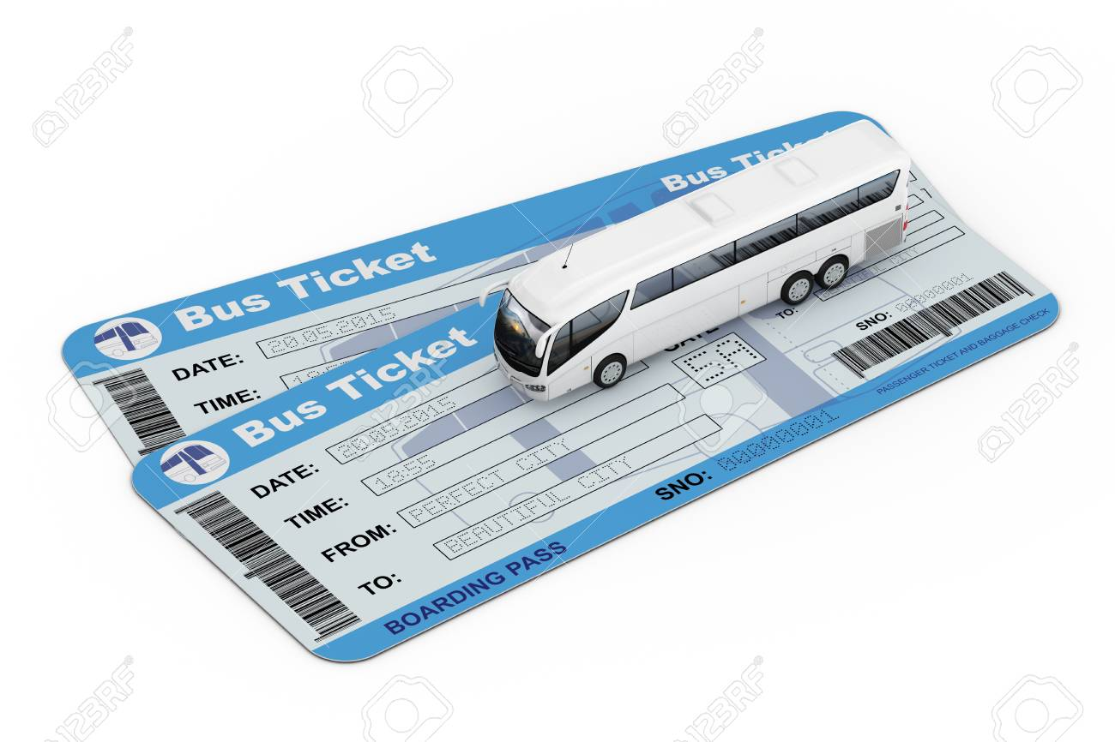
Bus Tour of Mexico Today!

Slide 11
How does the geography of life in Mexico affect life there?

Slide 12
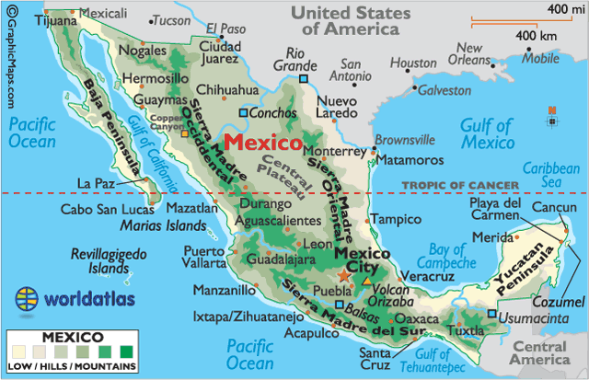
What is Geography?
Five themes of Geography:
Location
Place
Human/Environment Interaction
Movement
Regions
Notes:
What do you think geography involves? Maps/ time zone/ land forms/ etc.
During our bus tour we are going to learn about the geography of Mexico! What is this map showing us about mexico? The hills and mountains- look at the key.

Slide 13
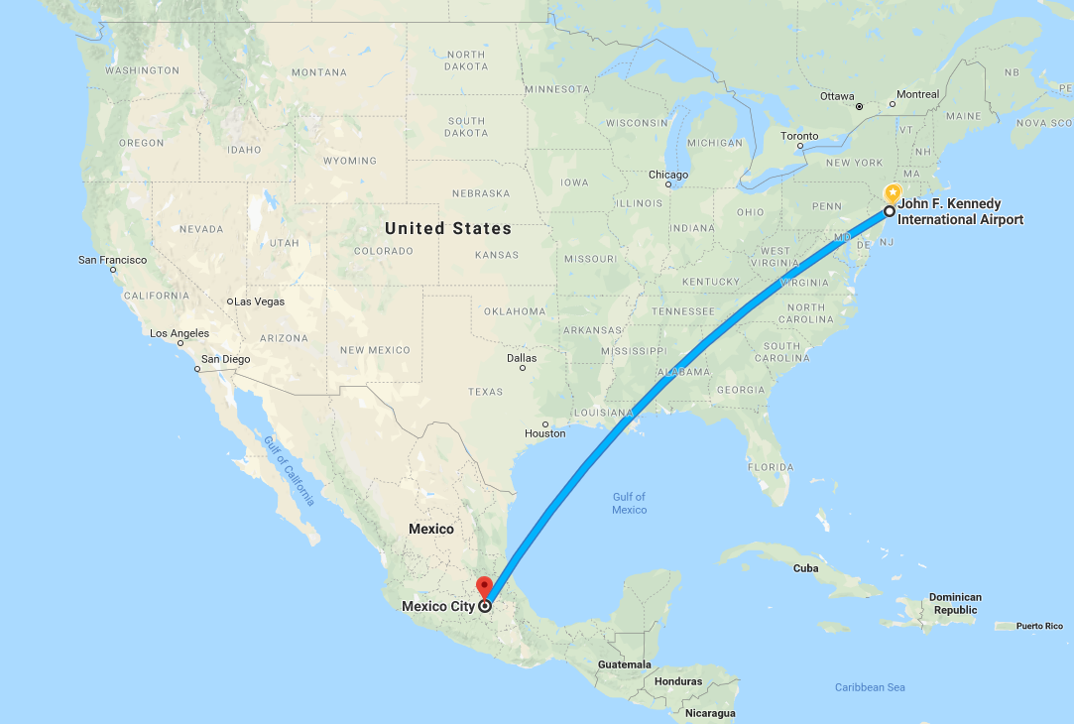
Safe Travels!
Itinerary and Map
1st: 5 hour and 40 minute plane ride
JFK → MEX
2nd: Bus pick-up from Mexico City Airport
3rd: Bus Tour around Mexico
Today we are traveling to:
Mexico City
Yucatan
Oaxaca
Guanajuato
Jalisco
Quintana Roo
4th: Snack and Chat!
Notes:
Wah hah cah
Guana… huato
Halisco
Kintana row

Slide 14
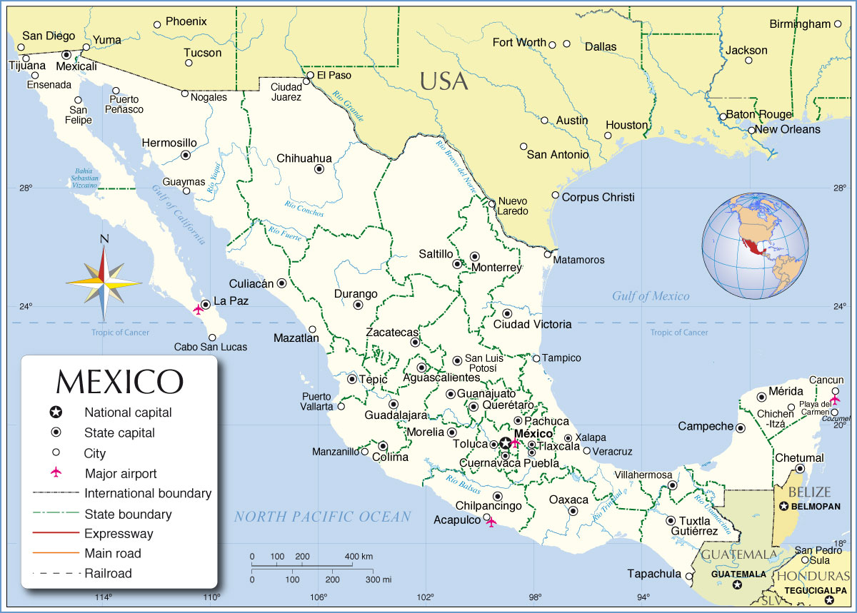
Let’s review our journey through Mexico on the MAP!
4. Guanajuato
2. Yucatan
Mexico City
5. Jalisco
6. Quintana Roo
3.. Oaxaca
Notes:
Print out on big paper with velcro bus picture

Slide 15
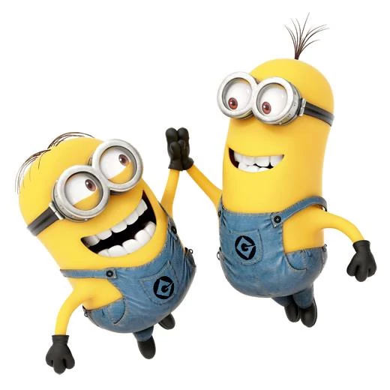
CHAMPS! CHAMPS! CHAMPS!
C - Conversation: Please do not talk during plane/bus ride. There will be multiple opportunities to talk at each stop, AFTER the tour guide is done speaking.
H - Help: If you have ANY questions, please raise your hand and wait to be called on. Write down your questions so you do not forget!
A - Activity: The goal is to fill-up our travel journals during our journey! We will be learning about the geography and culture of Mexico! Make sure to take notes during the ride.
M - Movement: Students riding the plane and bus will be seated at all times! Make sure to keep all body parts in the vehicle! During snack and chat, students will be allowed to get up and move around.
P - Participation: By bus we will visit a couple of cities located in Mexico.
***Think: Would I be happy living in one of the cities we visited? WHY?***
S - Success: Once the tour is over, we are going to write postcard to a friend back home about our experience!

Slide 16
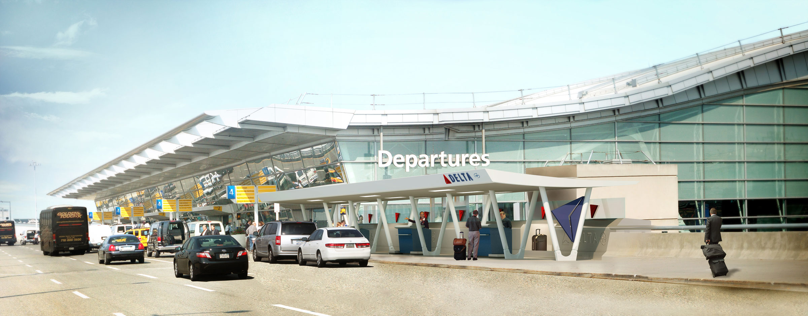
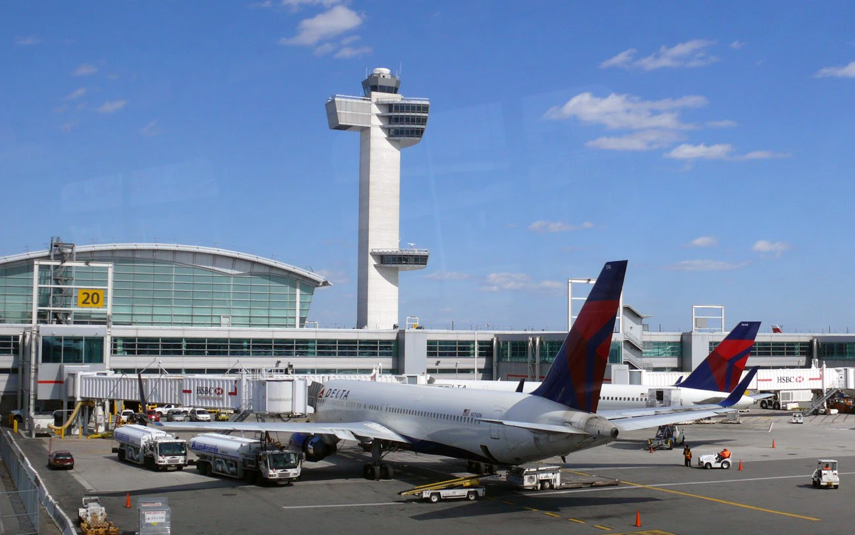
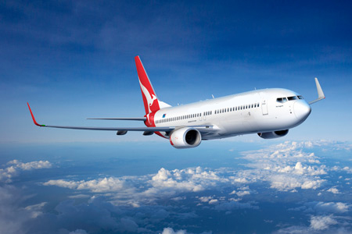
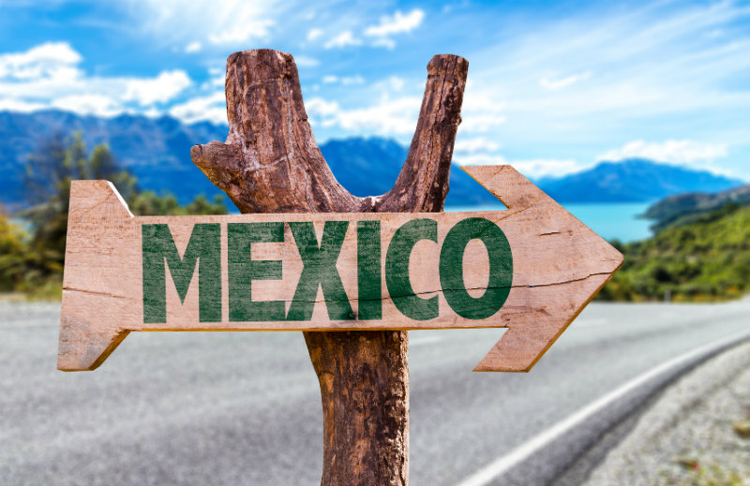
Grab your tickets, we’re off to JFK!

Slide 17
Mexico Fun Facts
. Mexico is 1/5th the size of the United States!
. Located in the Western Hemisphere
. Most cities in Mexico are urban areas
. Mexico has deserts, high mountains, rain forests, and beaches
. The capital is Mexico City
. The borders are Guatemala, Belize, and USA
. Major industries: Oil and Silver
. Divided into 31 States, plus the Federal City (Mexico City)
. 98% speak Spanish
. Currency: Peso
. Over 2 million tourist visit Mexico a year!

Slide 18
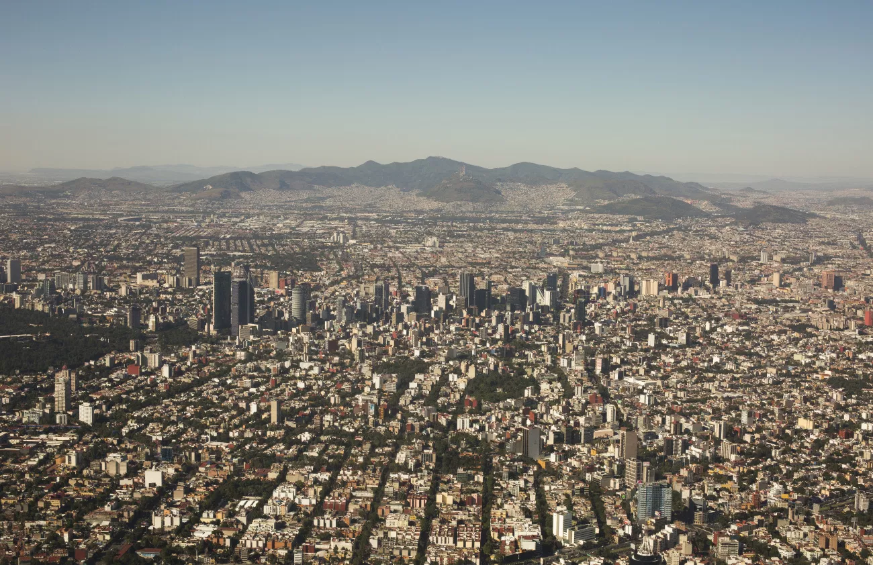
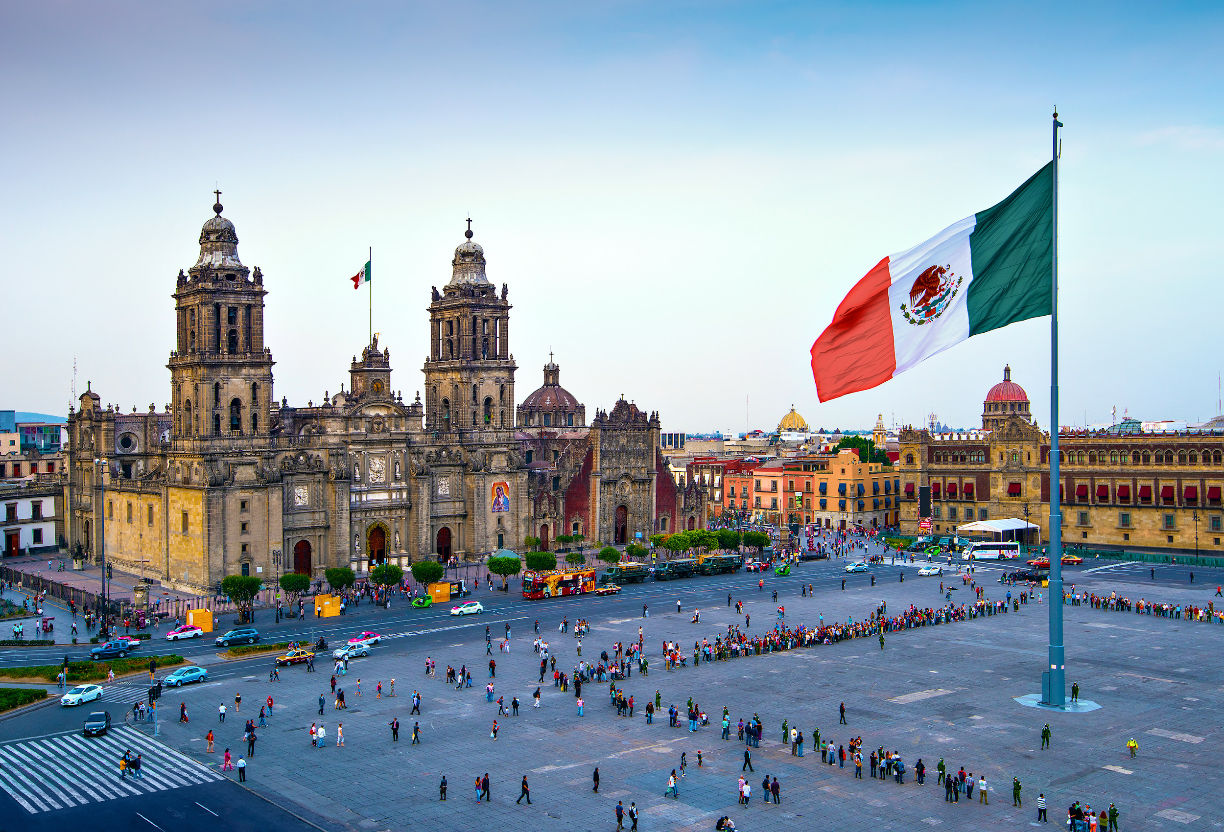
Federal City: Mexico City
*Zócalo: The Birthplace of the Constitution
Where the country’s first constitution was proclaimed in 1813
World’s largest square; holds markets, festivals, parades
A space for gatherings
Metro is located underground
Notes:
Saw- kah law
The beating heart of Mexico City is Zócalo - the Plaza de la Constitución (Constitution Square) - where the country's first constitution was proclaimed in 1813. Measuring some 240 meters in each direction, it's one of the world's largest squares and was laid out almost immediately after the conquest of the former Aztec city of Tenochtitlán on which it stands. In the early colonial period, the square served a variety of purposes, including as a bullfighting arena and market, while today, it's used for festivals, parades, and demonstrations. Dominated by three of the city's most visited tourist attractions - the National Palace, the Metropolitan Cathedral,and the Templo Mayor with its Aztec relics - Zócalo is the perfect place from which to begin exploring this historic city.

Slide 19
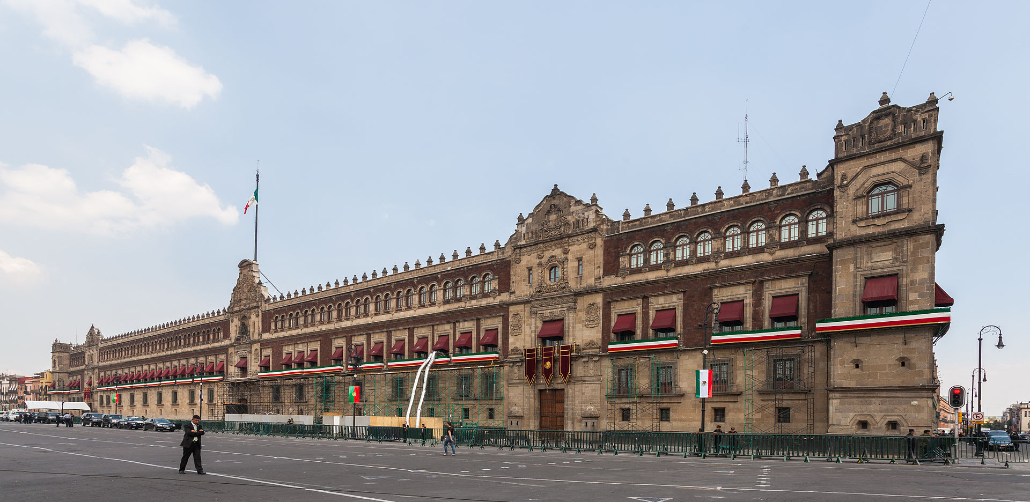
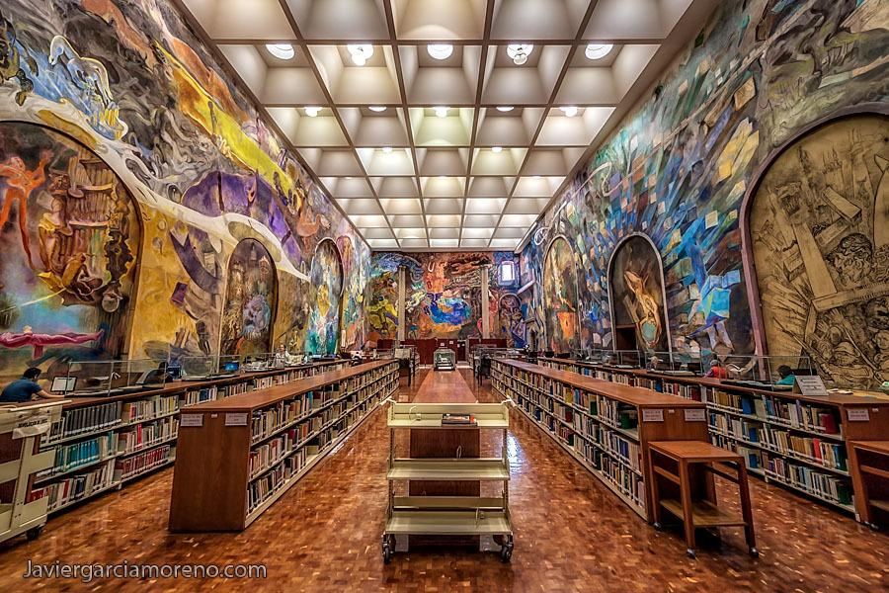
*The National Palace
Holds the residence of the President of Mexico (Enrique Pena Nieto)
One of the oldest buildings in the city
This building houses the freedom bell, that was rung on September 15th, 1810, at the start of the War of Independence.
Inside there are many interesting historical documents to be kept safe
Biblioteca Miguel Lerdo de Tejada, one of the largest and most important libraries in the country.
Notes:
Occupying the east side of Mexico City's main square, Zócalo, the immense National Palace (Palacio Nacional), built of reddish tezontle stone and boasting a 200-meter-long façade, is the official residence of the president. Built on top of an Aztec palace, it was the seat of the Spanish viceroys during the colonial period and has been much altered and enlarged over the years. One of the oldest and finest buildings in the city, it includes such notable features as the Freedom Bell, rung on September 15th, 1810, at the start of the War of Independence (it's rung on the anniversary of this event each year). The palace boasts many handsome rooms laid out around its 14 courtyards, some accessible to visitors, with the most notable being the arcaded Grand Courtyard with its fine frescoes depicting the country's rich history. English language guided tours explore a museum, a number of large halls, and the parliamentary chamber in which the Reform Constitution of 1857 was drawn up (it and the Constitution of 1917 are on display). The National Palace also houses the State Archives, with many interesting historical documents, and the Biblioteca Miguel Lerdo de Tejada, one of the largest and most important libraries in the country.

Slide 20
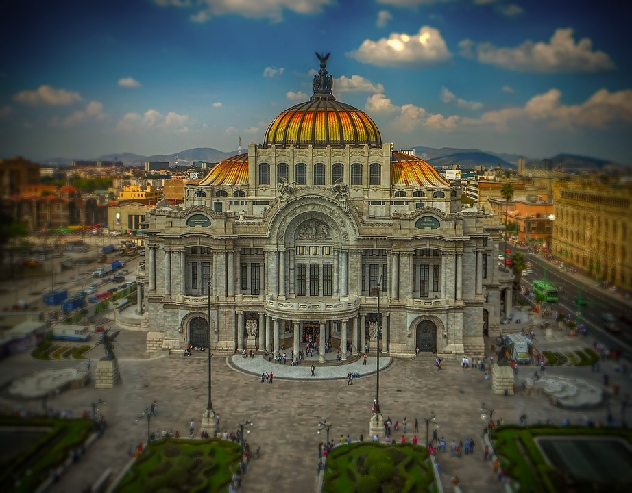
* Palacio de Bellas Artes (Palace of Fine Arts)
Cultural landmark
Massive marble building
Designed by Adamo Boari
Completed in 1934
An opera house and concert hall hosting a variety of traditional and international dance and operatic productions
Notes:
One of Mexico City's most important cultural landmarks, the Palace of Fine Arts (Palacio de Bellas Artes) is an architectural gem. Towering over the adjacent park, this massive marble building - designed by Italian architect Adamo Boari with Art Nouveau and Art Deco influences - was completed in 1934 and is so heavy that it has sunk more than four meters, despite attempts to lighten it by removing part of its huge dome. Now headquarters of the Instituto Nacional de Bellas Artes, the palace serves as an opera house and concert hall hosting a variety of traditional and international dance and operatic productions. Hot Tip: If you're able to see a performance, you'll also be rewarded with a chance to enjoy the building's stunning interior décor and large murals.

Slide 21
*Teotihuacan Pyramids
Teotihuacan is an ancient Mesoamerican city located 30 miles (50 km) northeast of modern-day Mexico City.
Most visited archaeological site in Mexico!
When the Aztecs found the city in the 1400s and named it Teotihuacan (meaning “the place where the gods were created”), the city had been abandoned for centuries. Teotihuacan’s origins, history, and culture largely remain a mystery.
Places many cultural and agricultural influences on the widespread of Mexican Culture
Ongoing search today of what remains are left from the city on this land.
Notes:
Tea o ti jua kan

Slide 22
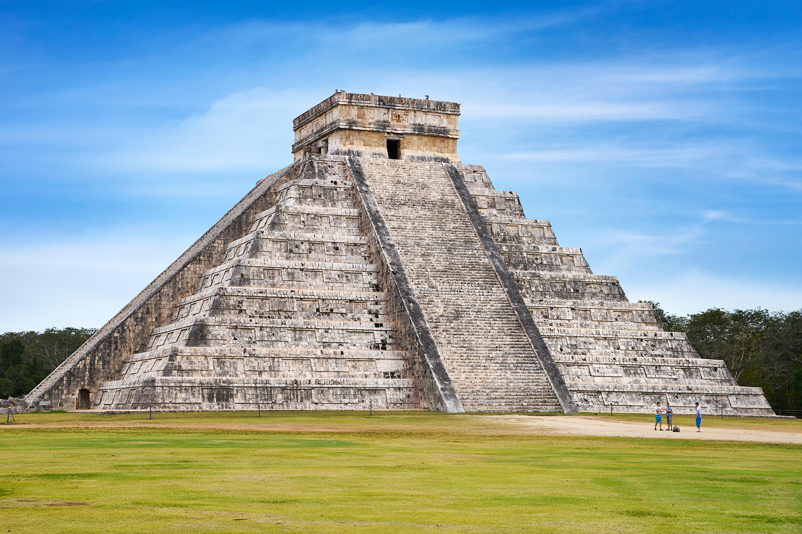
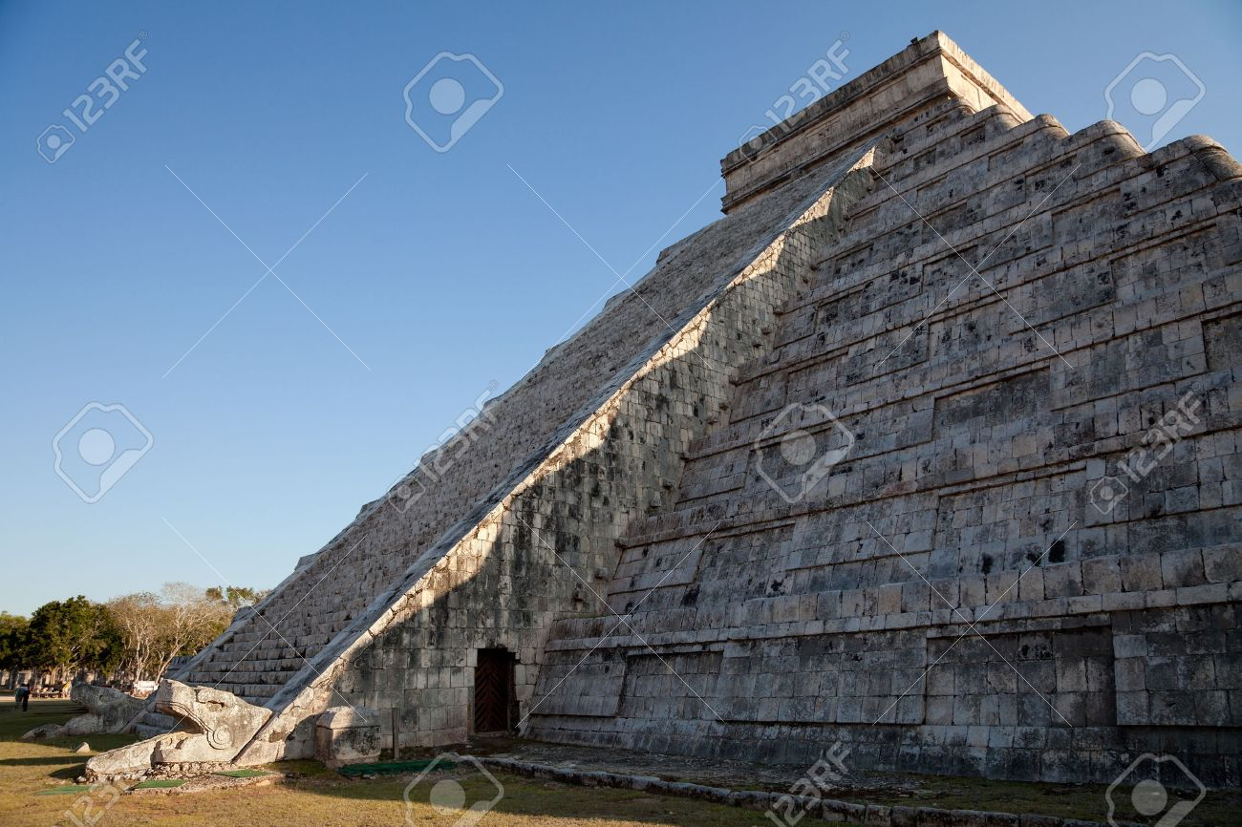
City 2: Yucatan
*Chichen Itza
One of the seven wonders of the world!
Temple of Kukulkan (An ancient Mayan God)
Built by Mayans before the time of Columbus
Between the 800-1200, this location was a center for trading
Twice a year the shadows from the sun setting creates a large snake moving down the staircase
All four sides equal 365 days, one step for each day of the year.
Notes:
You ka taan
According to legend, twice a year when the day and night are in balance, this pyramid dedicated to Kukulcan (or Quetzalcoatl), the feathered serpent god, is visited by its namesake. On the equinox Kukulcan returns to earth to commune with his worshipers, provide blessing for a full harvest and good health before entering the sacred water, bathing in it, and continui
-Mayan’s abondoned the space by 1250,

Slide 23
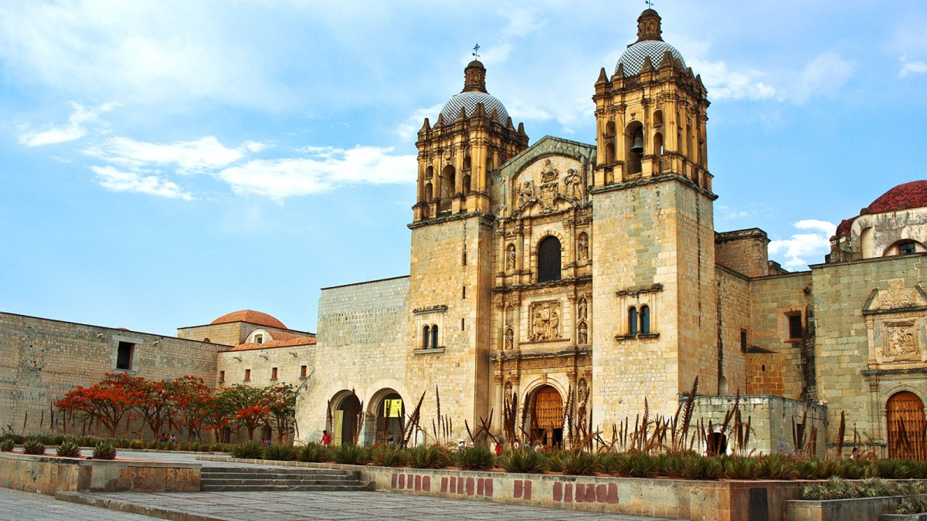
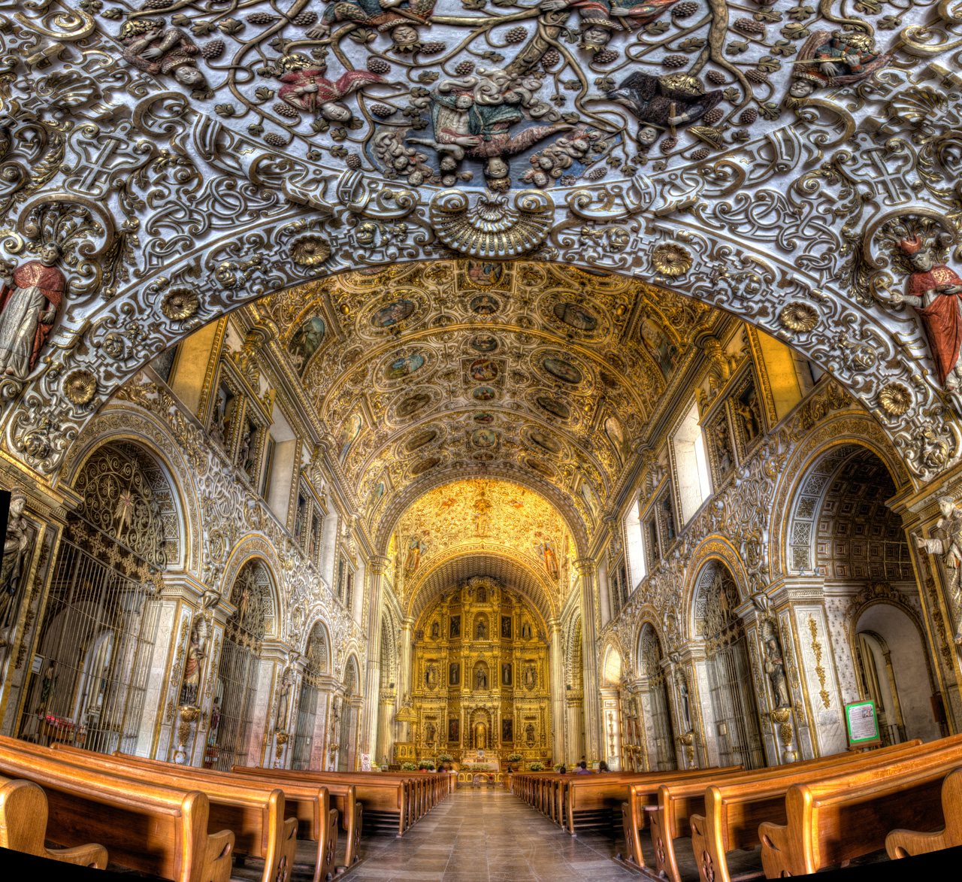
City 3: Oaxaca
*Templo de Santo Domingo
The church, the museum and the ethnobotanical garden
17th Century baroque decoration with intricate gilded wood and gold on the outside.
highly recommended for anyone interested in plants, natural history and culture
Today, they hold mass in English and Spanish.
Notes:
Wah hah cah

Slide 24
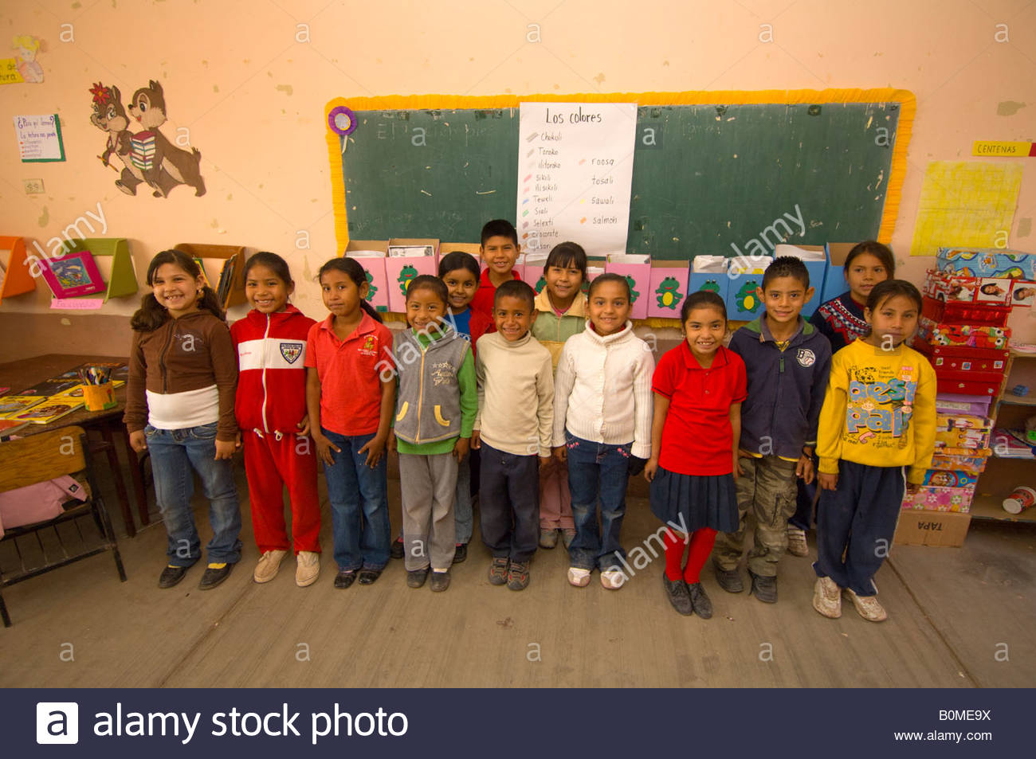
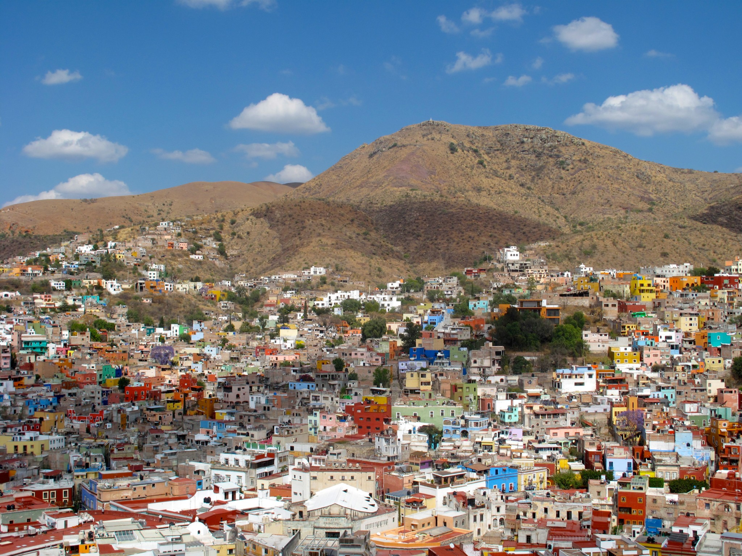
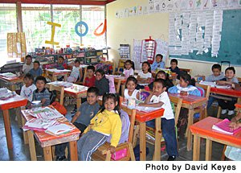
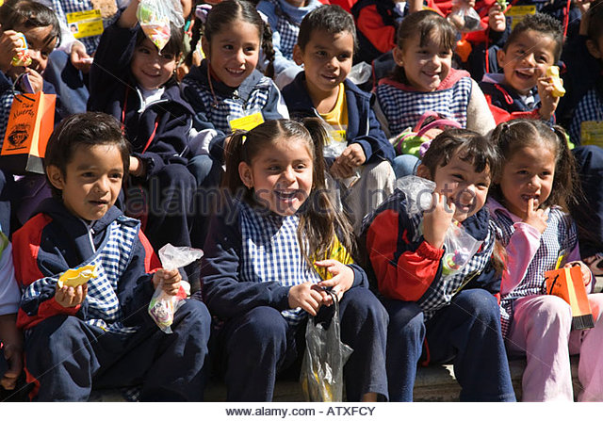
City 4: Guanajuato
*Schools in Mexico
Notes:
Schools in Mexico: there are private and public schools you can attend
Preschool - not mandatory
Primaria School Grade 1-6 (half the day is taught in spanish, the other half in english)
Secundaria School Grade 7-9
Prepatoria 10-12
Universidad not mandatory

Slide 25
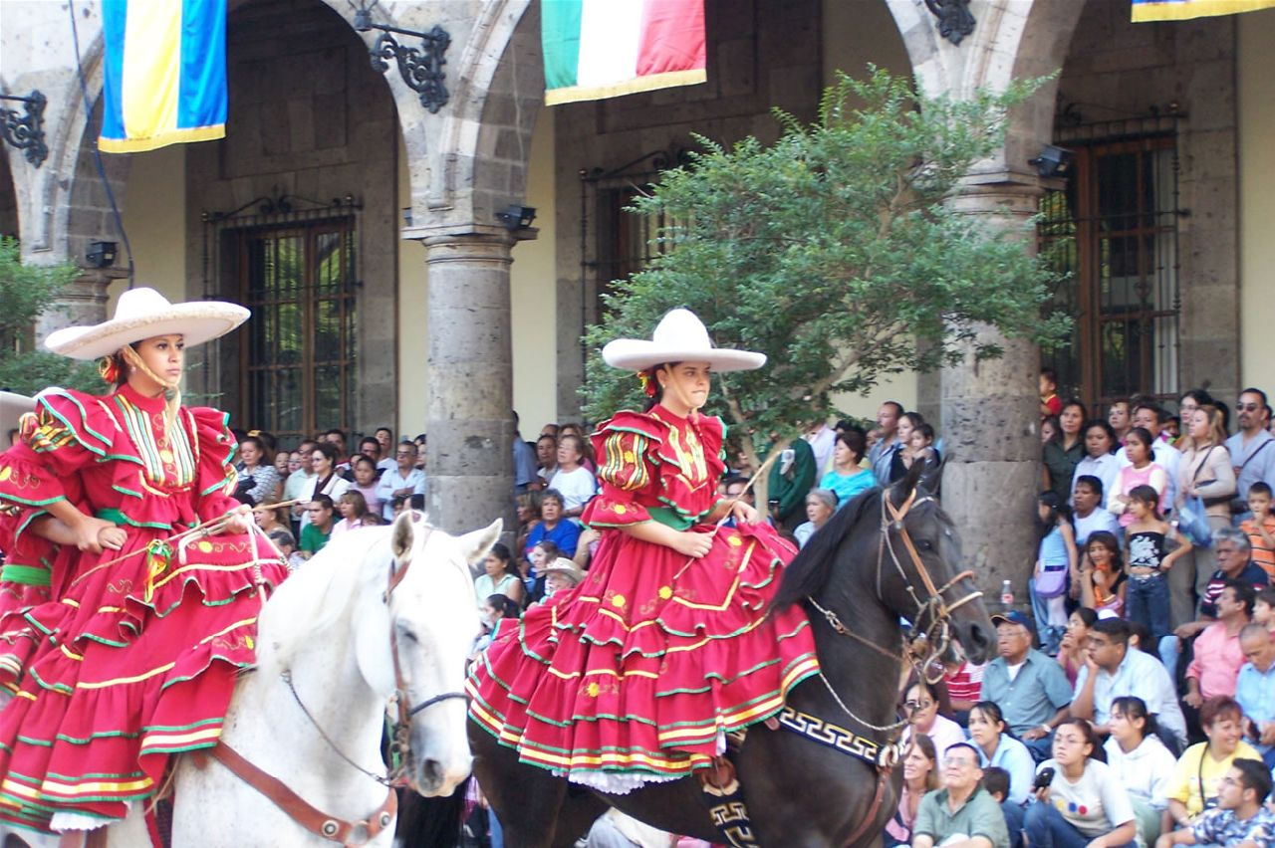
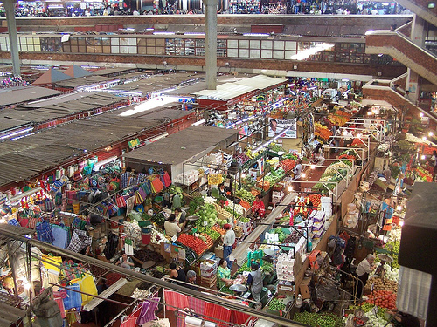
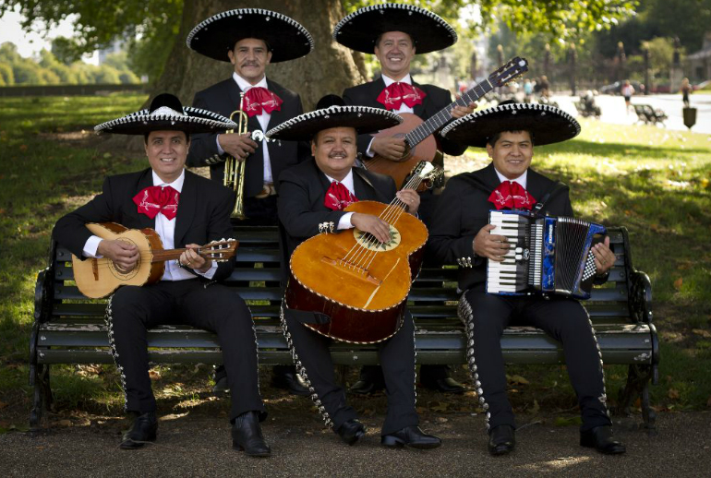
State: Jalisco
City 5: Guadalajara
*San Juan de Dios Market
Largest three-story market
Music, movies, electronics, clothing, shoes and food
Mexico’s 2nd largest city
Where Mariachi music became created
Vibrant variety of music present in this city

Slide 26
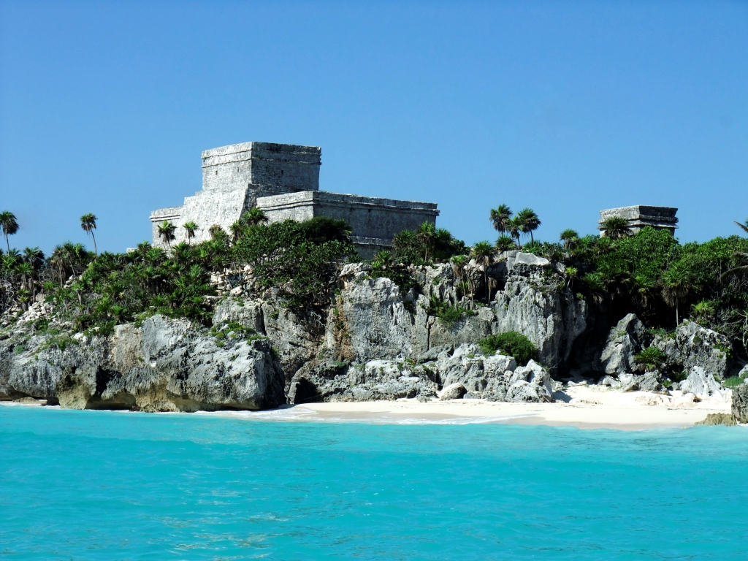
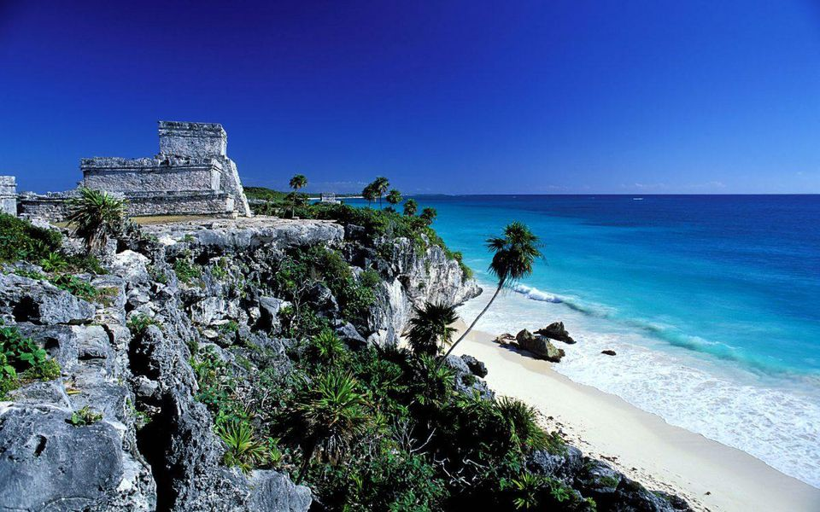
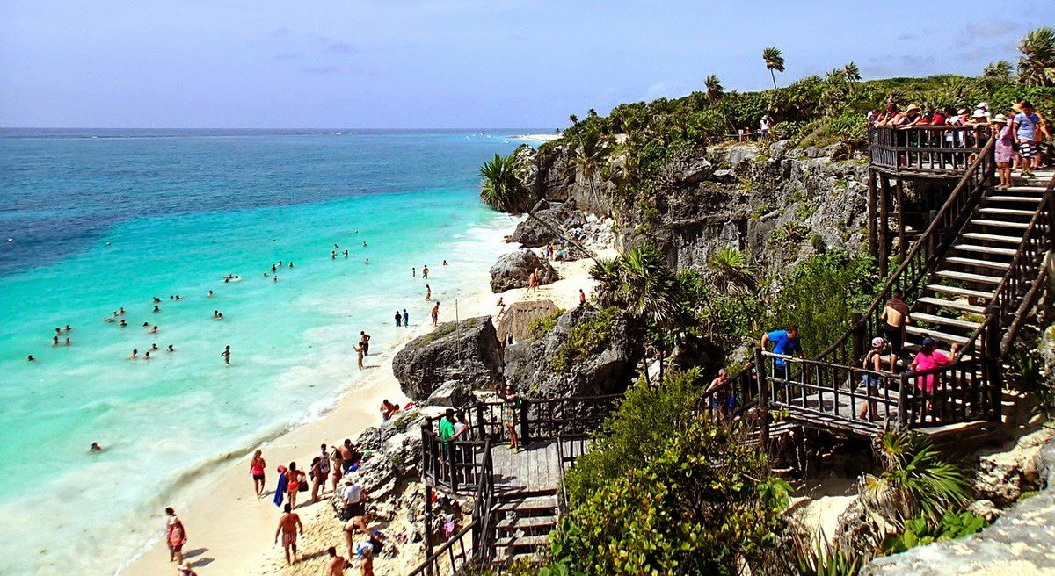
State: Quintana Roo City 6: Tulum
White sand beach
Looks over the caribbean sea
The tower was a lighthouse that guided ships to the port into the Maya Kingdom
“Tulum” means trench or wall in Mayan

Slide 27
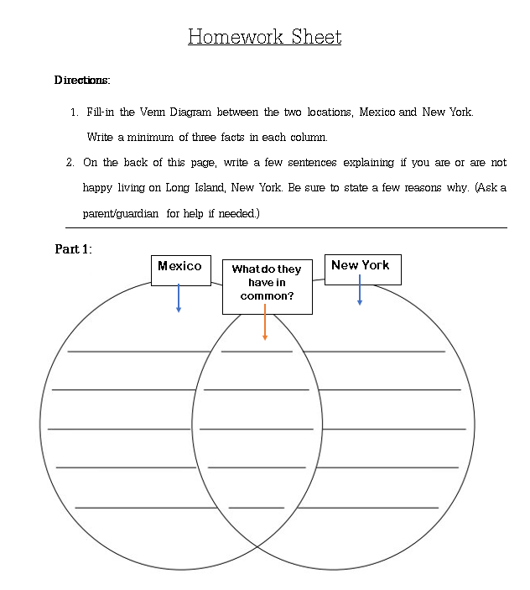
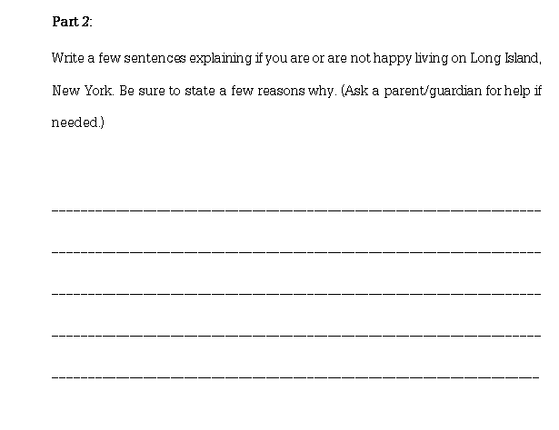
Homework

Slide 28
Time Machine

Slide 29
... RULES...
C-Conversation: While traveling through time, you’ll find that conversation is important in understanding people’s stories. Talk to your neighbors but STAY FOCUSED and ON TASK! The people of the 1500’s don’t know about “Fortnite” and you can’t let them know that you’re from a different time, it could destroy our continuum!
H-Help: If you have a question, you have options! Ask a neighbor. Ask a teacher. Write your question down. See if you can find the answer to your question in the documents given.
A-Activity: WE’RE GOING BACK IN TIME GUYS!!!! Today, we will be operating a very precious piece of scientific equipment: A CEREBRAL TIME MACHINE! While acting out scenes from our time machine experience, we will see what it was like for Mexico to become the country it is today. While interacting, it is important to be aware of our surroundings.
M-Movement: After participating in a “Statement Strategy”, filling the filing cabinet, students will perform a History Alive ‘Act it Out’ scene based on the documents given. Be respectful of your neighbors and have fun!
P- Participation: Grab a mustache, grab a hat, put on some glasses, put on a funny voice and let’s put ourselves in the shoes of the people who helped shape Mexico throughout history! Everyone should have a part in the performance and I will be coming around to ask questions about your document based findings!
S-Success: After you have traveled through time and discussed the issues and events that took place during this journey, you will create a journal entry through the mindset and perspective of the characters you’ve portrayed through your History Alive performance.

Slide 30
Meet Rufus! Rufus the Robot! He’s our Time Travel Guide.
Rufus will be taking us to see:
The Spanish take over the Aztecs.
Mexico winning independence from Spain.
The Mexican War: Signing over lands to the United States.
The border wall.
You will be split up into 4 different groups, each group representing a different historical event throughout our time spent in Mexico!
You will be given important information, which you will read with your group, and a statement to which you will all individually, either agree or disagree, providing an explanation of your response, based on the document.

Slide 31
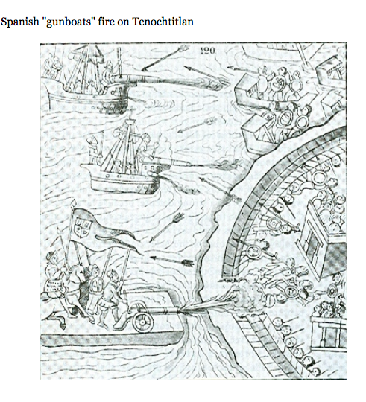
Document 1: The Spanish Take Over the Aztecs: 1521
The siege of Tenochtitlin, the capital of the Aztec Empire, was a decisive event in the Spanish Conquest of Mexico. It occurred in 1521. Although numerous battles were fought between the Aztec Empire and the Spanish led Coalition, it was the siege of Tenochtitlan and the effects of smallpox, that directly led to the downfall of the Aztec civilization and marked the end of the first phase of the Spanish conquest of the Aztec Empire. The smallpox devastated the Aztec population and dealt a severe blow to the Aztec leadership while leaving an an immune Spanish leadership in tact.
Statement:
Tenochtitlan, the capital of the Aztec empire, in what is now the center of Mexico City, peacefully offered their land to the Spanish Coalition. Check one:
Agree____ Disagree____
Document-Based Evidence:
________________________________________________________________________________________________________________________________________________________________________________________________

Slide 32
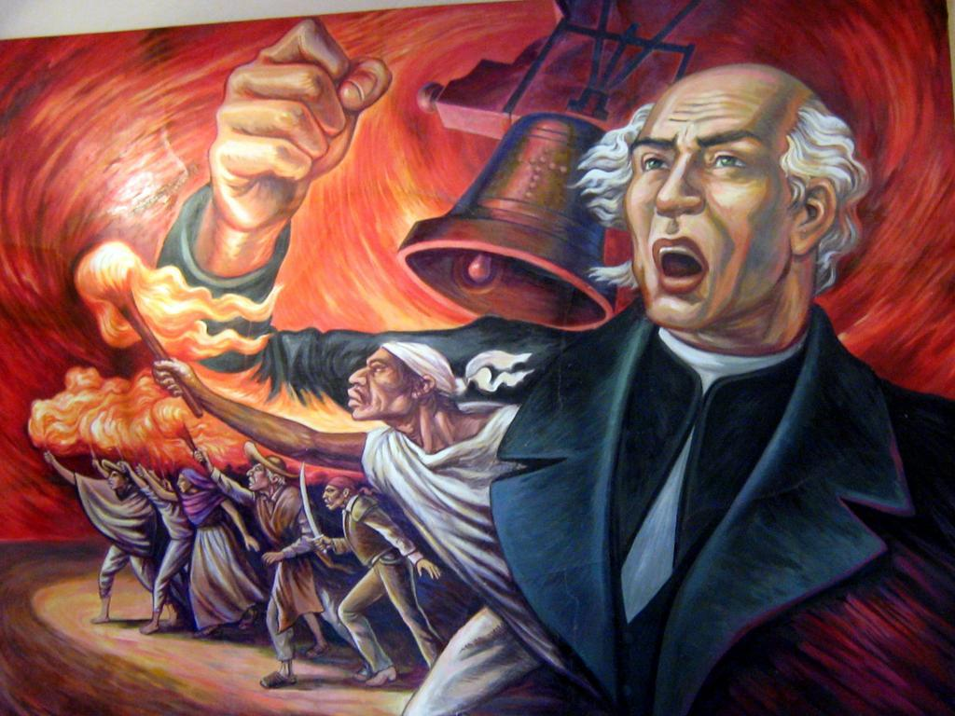
Document 2: Mexico Wins Independence from Spain: 1821
The Cry of Dolores (Grito de Dolores) is a historical event that happened in Mexico in the early morning of September 16, 1810. Roman Catholic priest Miguel Hidalgo y Costilla rang the bell of his church and gave the call to arms that triggered the Mexican War of Independence. Extending from the Grito de Dolores on September 16, 1810, to the entrance of the Army of Three Guarantees led by Agustin de Iturbide to to Mexico City on September 27, 1821, Mexican Independence day, declared in 1821, is celebrated on September 16. In the 1810’s, Mexico was under Spanish control and known as New Spain. The independence movement began to take shape when José Bernardo Gutiérrez de Lara went to the small town of Dolores (now known as Dolores Hidalgo) and asked the local Roman Catholic priest, Miguel Hidalgo, to help initiate an effort to free New Spain from Spanish control.
Statement: If Miguel Hidalgo never rang the bell of his church, Mexico would still be under Spanish control.
Check one:
Agree____ Disagree____
Document-Based Evidence:
______________________________________________________________________________________________________________________________________________________________________________________________________

Slide 33
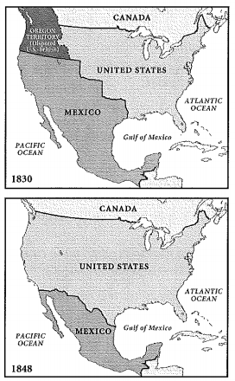
Document 3: Mexican War| Signing Over Lands to the U.S.: 1845-48
After Mexico declared itself free from its mother country, Spain, Mexico was huge. Mexican leaders were aware of the near emptiness of their northern lands, which was not good for their economy. One way to increase the population was to welcome settlers from the United States. For Mexico, this turned out to be a bad idea. Mexico was Catholic, anti-slavery, and wanted to keep Texas under their control. The American settlers were mostly Protestant, pro-slavery, and largely ignored Mexican Authority. It did not take long for these differences to boil into a revolt. Following the bloody encounters at places like the Alamo, the Texans won their independence from Mexico.
Statement: Although there were brutal encounters, Texas’ independence from Mexico and Mexico’s decrease in size, created a ‘happier’ Mexican nation.
Check one:
Agree____ Disagree____
Document-Based Evidence:
_____________________________________________________________________________________________________________________________________________________________________________________________

Slide 34
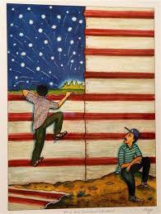
Document 4: The Border Wall: 2018
President Donald J. Trump ran for president on a campaign to limit illegal immigration from Mexico. He promised in his campaign that he would build a wall separating Mexico and the United States, and said Mexico would pay for it. President of Mexico, Enrique Pena Nieto said there is no way that Mexico will ever pay for a wall, as Mexicans, we do not believe in walls. Both leaders are under tremendous pressure from their countries. Conservatives who supported Trump say that if he does not build a wall, he has no chance of being re-elected.
Statement: The United States wants a wall, and Mexico wants a wall as well. Check one:
Agree____ Disagree____
Document-Based Evidence:
________________________________________________________________________________________________________________________________________________________________________________________________

Slide 35
Homework
Write a journal entry:
Express, from the perspective of a character from your statement strategy documents, how you felt during that event and time period. Did you think it was fair? Do you think Mexico became a stronger country because of these events?
In your own words, which historical events helped shape Mexico as a country the most and why do you think it helped shape the country?
Notes:
Slide 2 and so on…

Slide 36
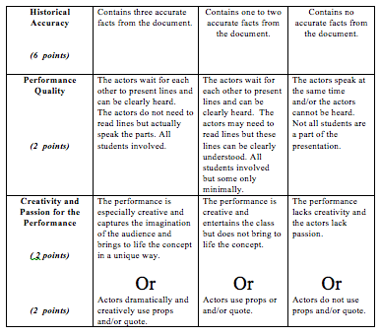
Act it Out
3
2
1
Using the documents from yesterday’s, statement strategy exercise and the quotes you will be given, reconvene with your group members to come up with a scene to portray the specific event in Mexican History that you and your group members explored. Grab some props and costumes and put yourself in the mindset of the people experiencing these events during that time.
For your group to score a maximum of 3 points:
-Include 3 accurate facts or findings from your document.
-Present your lines clearly and do not speak over one another.
-Use the given quote and utilize props throughout your scene.

Slide 37
Document 1: The Spanish Take Over the Aztecs: 1521
“After seventy-five days, Tenochtitlán had finally been subdued by the persistent Spaniards and abandoned by its people. The war with the Mexicans had come to an end. The Aztec empire had crumbled with the destruction of its great and beautiful city. The breaking of the siege of Tenochtitlán marked the beginning of Spanish rule on the mainland of the New World.”
― Irwin R. Blacker, Cortés and the Aztec Conquest

Slide 38
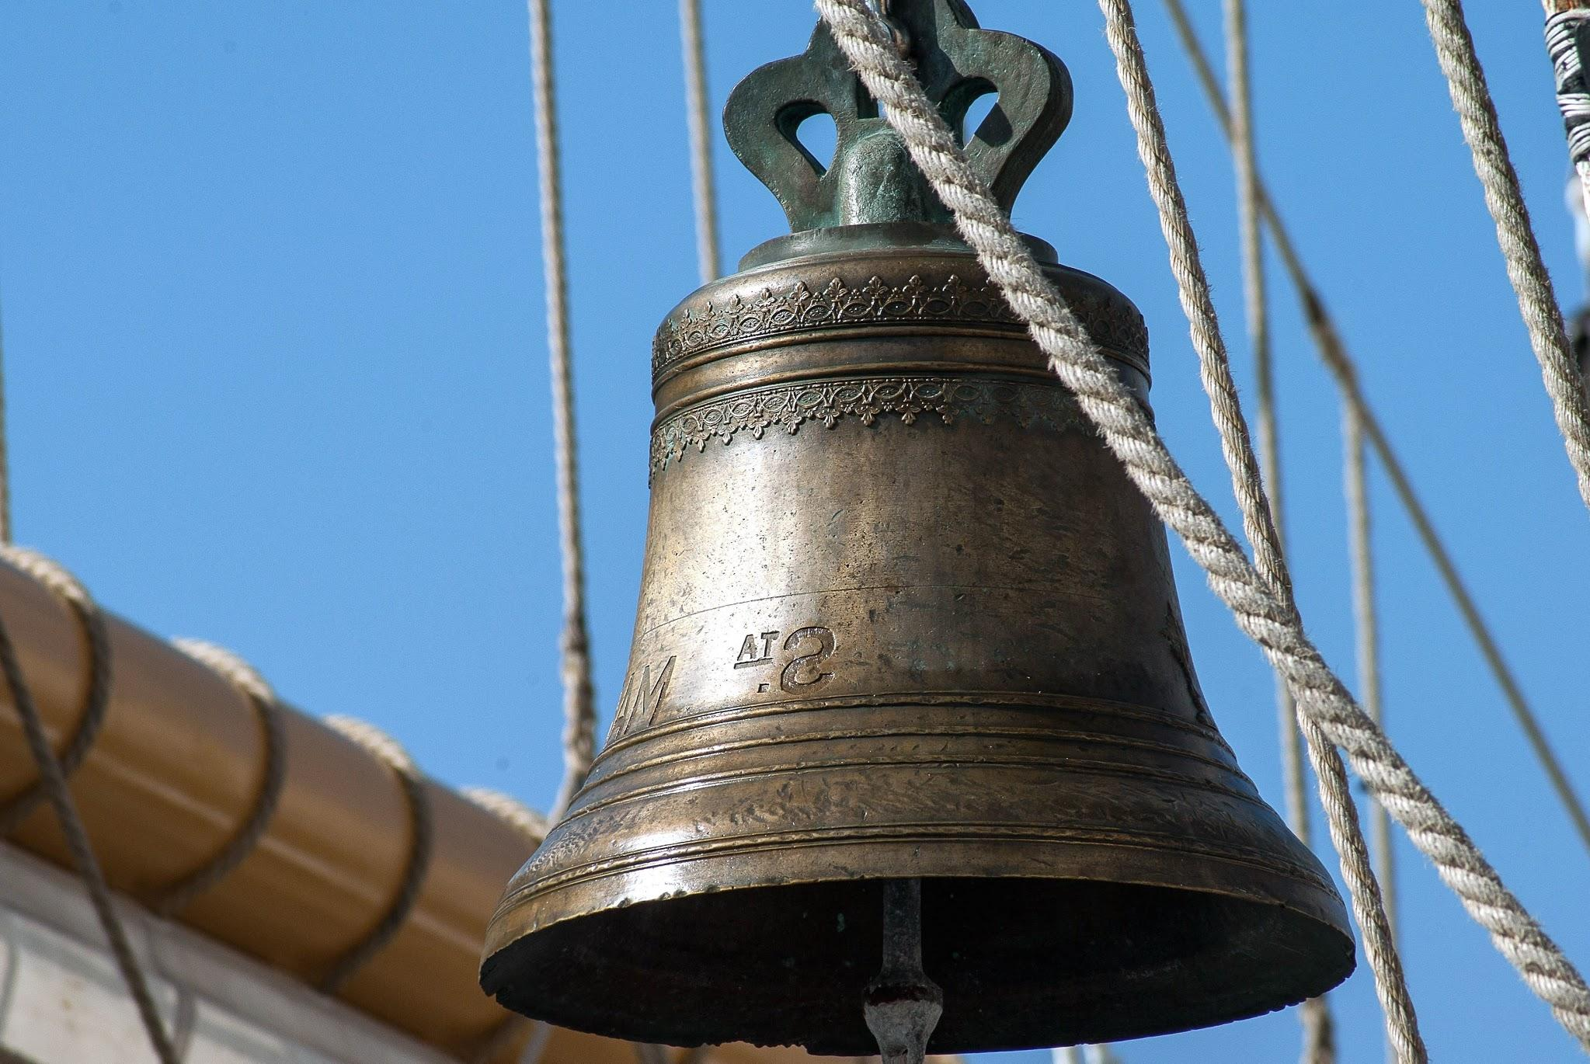
Document 2: Mexico Wins Independence from Spain: 1821
Mexicans from all over the world are all set to celebrate El Grito — the day when Miguel Hidalgo y Costilla, known as the father of Mexican independence, launched the revolution that led to Spain’s departure from Mexico. This day is celebrated with parades, parties, and bell-ringing. On the eve of Sept. 16 each year, Mexico's president rings the bell of the National Palace and repeats the patriotic cry, “¡Viva México!” three times, which literally means "Long live Mexico."

Slide 39
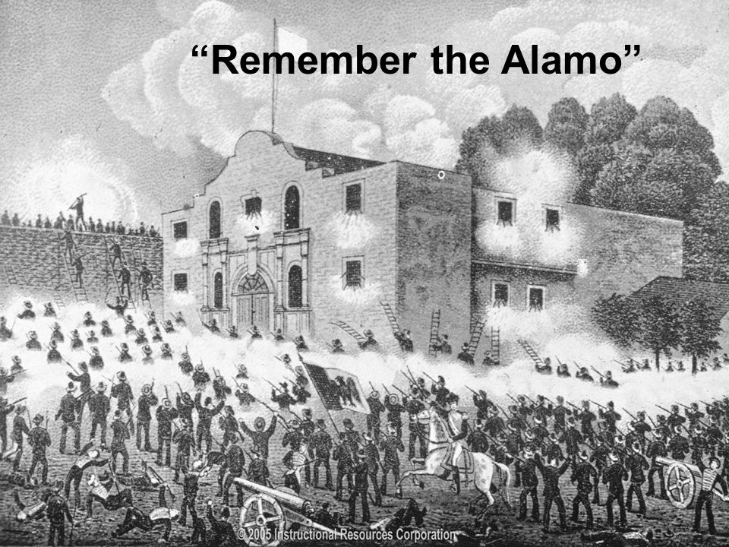
Document 3: Mexican War| Signing Over Lands to the U.S.: 1845-48
Texian soldiers who attacked Santa Anna and his army were the people who said the quote, “Remember the Alamo.” The Alamo was once a Spanish mission that was turned into a battleground for Texas independence. Mexican soldiers, led by Santa Anna, outnumbered, attacked, and defeated the Texans and Tejanos who sought refuge in the mission. The quote, “Remember the Alamo” was the war cry of those soldiers who later attacked and defeated Santa Anna.

Slide 40
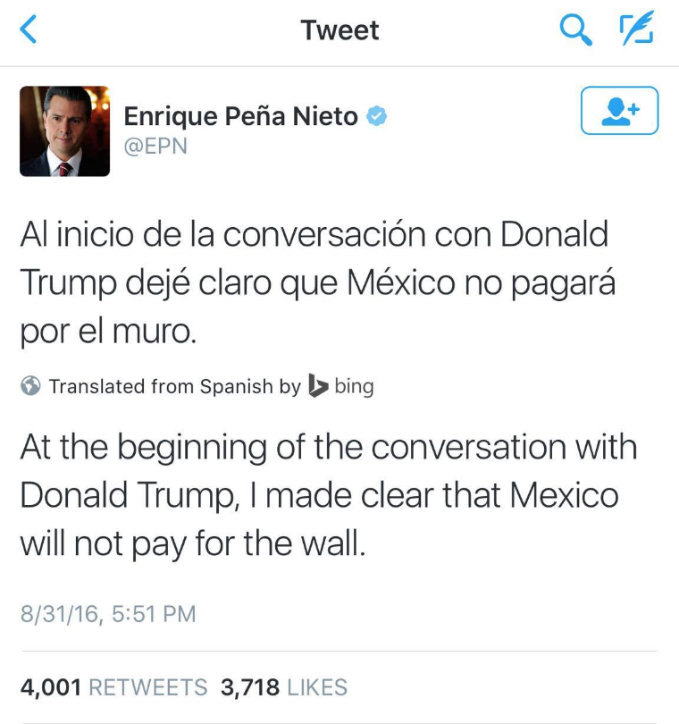
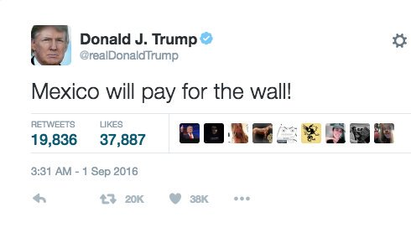
Document 4: The Border Wall: 2018
"I will build a great wall -- and nobody builds walls better than me, believe me --and I'll build them very inexpensively. I will build a great, great wall on our southern border, and I will make Mexico pay for that wall. Mark my words."
-President Trump

Slide 41
Lesson 4: Document Analysis
Let’s Think Like a Historian!
How do we know that what we have learned about Mexico is true?
SCIM-C

Slide 42
CHAMPS! CHAMPS! CHAMPS!
C - Conversation: Let’s talk about this lesson! We need to be respectful of everyone, so if someone else is talking, listen and then raise your hand to add to the conversation!
H - Help: Please do not hesitate to ask me any questions! I am here to help. Please raise your hand, and I will either call on you during our discussion or come to you during our activity.
A - Activity: Our activity today is called Thinking Like a Historian. We will be making a decision on whether we think the history we learned yesterday was valid or not.
M - Movement: We will be moving around the room! When we move we will go quietly, and we need to be careful and watch out for others and things on the floor.
P - Participation: Please participate as much as possible! We are here to have fun and the more you participate, the more fun we are going to have.
S - Success: Once you learn about SCIM-C and the documents you will be Thinking Like a Historian, and therefore you will be successful!

Slide 43
What is SCIM-C?
S- Summarizing
C- Contextualizing
I- Inferring
M- Monitoring
C- Corroborating
Historical Scene Investigation!

Slide 44
Summarizing
SCIM-C
1. What type of historical document is the source?
2. What specific information, details, and/or perspectives does the source provide?
3. What are the subject, audience, and/or purpose of the source?
4. What does the source directly tell us?

Slide 45
Contextualizing
SCIM-C
1. Who produced the source?
2. When, why, and where was the source produced?
3. What was happening locally and globally at the time the source was produced?
4. What summarizing information can place the source in time, space, and place?

Slide 46
Inferring
SCIM-C
1. What is suggested by the source?
2. What conclusions may be drawn from the source?
3. What biases are indicated in the source?
4. What contextualizing information, while not directly evident, may be suggested from the source?

Slide 47
Monitoring
SCIM-C
1. What is missing from the source in terms of evidence that is needed to answer the guiding historical question?
2. What ideas, images, or terms need further defining from the source in order to understand the context or period in which the source was created?
3. How reliable is the source for its intended purpose in answering the historical question?
4. What questions from the previous stages need to be revisited in order to analyze thesource satisfactorily?

Slide 48
Corroborating
SCIM-C
1. What similarities and differences exist between the sources?
2. What factors could account for the similarities and differences?
3. What gaps appear to exist that hinder the final interpretation of the source?
4. What other sources are available that could check, confirm, or oppose the evidence currently marshaled?

Slide 49
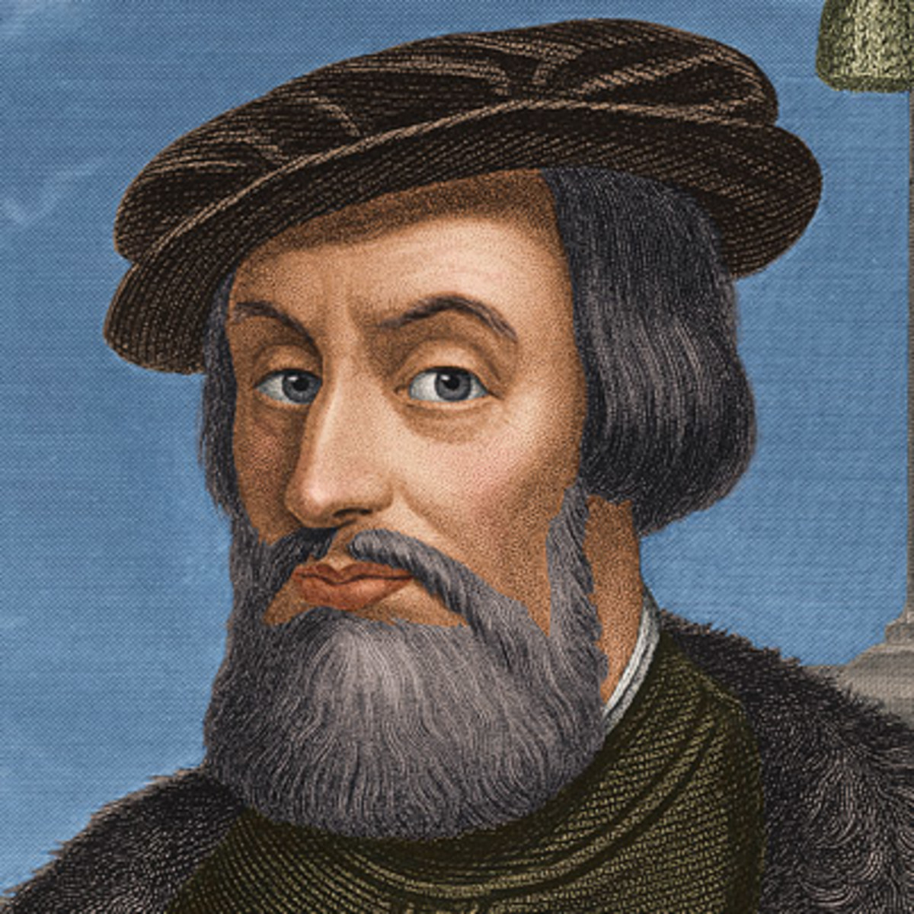
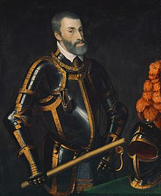
Spanish take over the Aztecs
And so it was done, that after I had put the chiefs in the room, I left them bound up and rode away and we fought so hard that in two hours more than 3,000 men were killed. Finally all the people were driven out of the city in many directions.
-Hernán Cortés’ Second Letter to the King of Spain, Charles V in 1519

Slide 50
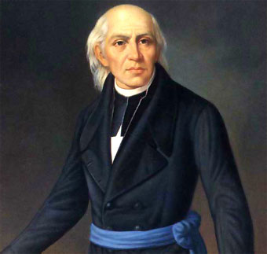
Mexico Wins Independence from Spain
“Come march with us for country and religion…”
-Quote by Miguel Hidalgo from his speech “Cry of Dolores” on September 16, 1810
Background: Hidalgo was a Catholic priest in Dolores, Mexico. He felt that the only way to help his people was to end Spanish control of Mexico. His speech. “Cry of Dolores,” began the War for Independence.
Notes:
Slide 2 and so on…

Slide 51
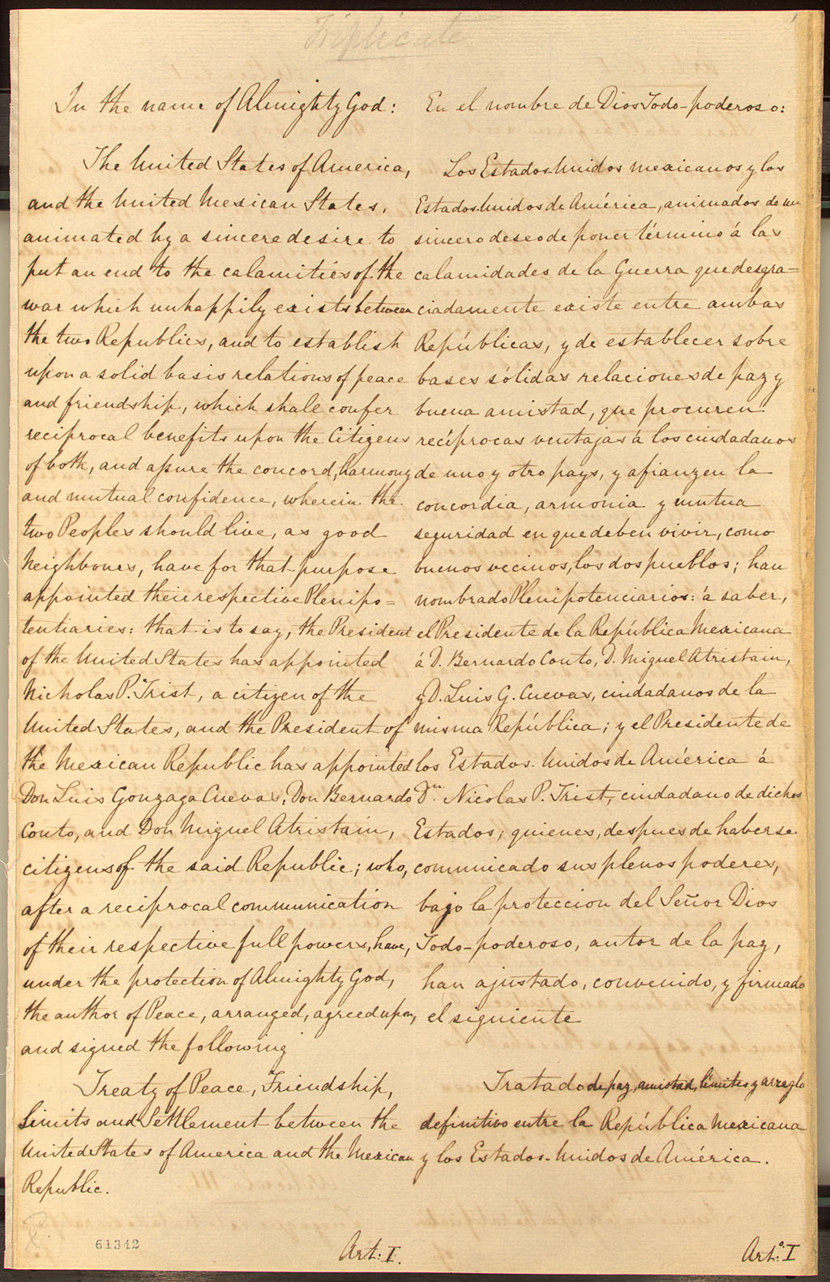
-Mexican War signing over lands to the United States
Mexicans now established (living) in territories previously belonging to Mexico, and which are now within the limits of the United States, as defined by the present treaty, shall be free to continue where they now live, or to remove at any time to the Mexican Republic. Those who shall prefer to remain in the said territories may either retain the title and rights of Mexican citizens, or acquire those of citizens of the United States (they can choose Mexican or American citizenship).
-Article VIII of the Treaty of Guadalupe Hidalgo. This is the peace treaty signed on February 2, 1848 that ended the Mexican-American War

Slide 52
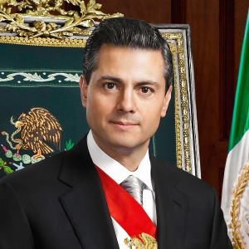
Border Wall
“I will build a great, great wall on our southern border, and I will make Mexico pay for that wall.”
-Quote by Donald Trump, President of the United States of America
“Mexico does not believe in walls. I’ve said it many times before- Mexico will not pay for a wall.”
-Quote by Enrique Peña Nieto, President of Mexico

Slide 53
Homework
Thinking Like a Historian
Directions: Now that you know how to think like a historian, it is your job to see if this document is valid or not! Use the SCIM-C method to help you. Good luck, historian!
In addition to establishing the Rio Grande as the border between the two countries, the territory acquired by the U.S. included what will become the states of Texas, California, Nevada, Utah, most of New Mexico and Arizona, and parts of Colorado and Wyoming. In exchange Mexico received fifteen million dollars in compensation for the territory and the U.S. agreed to assume claims from private citizens of these areas against the Mexican government.
-Treaty of Guadalupe Hidalgo, February 2, 1848
Summarizing: What specific information, details, and/or perspectives does the source provide?
Contextualizing: Why was the source produced? Inferring: What interpretations may be drawn from the source?
Monitoring: What additional evidence beyond the source is necessary?

Slide 54
Lesson 5: History Mystery
Get your detective hats on because it's time to solve a mystery!
“Are Mexicans Happier Than Americans?”

Slide 55
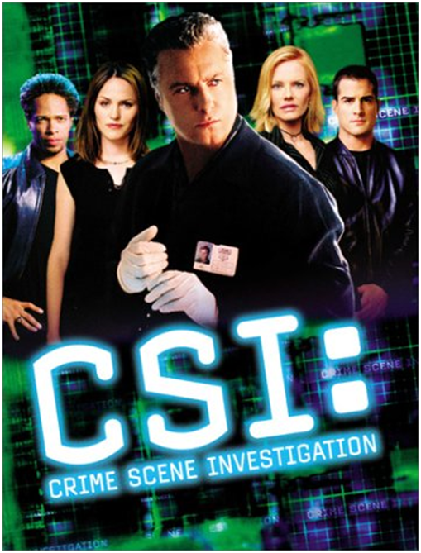
Motivation
What do you see?
What do you notice about what they are wearing?
What do you think
their job is?

Slide 56
Let’s Act Like CHAMPS Today!
C -
H -
A -
M -
P -
S -
Conversation: Please talk only if you raised your hand and have been called on. You will have the opportunity to talk with your group when it comes time to solve the mystery.
Help: If you need assistance raise your hand and I will be right over. While working in your groups ask the other members of your group your questions and see if you can answer it before calling me over.
Activity: Our goal today is to solve the mystery “Are Mexicans happier than Americans?” and write a claim to support our answer.
Movement: Please remain in your seats at all times unless given direction or permission otherwise. You will be given the opportunity to move around when solving the mystery.
Participation: You are expected to participate in class discussions. While working in groups you should offer help to your group. Be sure to fulfill your job responsibility!
Success: Once the mystery is solved, be sure to write your supporting claim to support your successful findings!

Slide 57
Mystery
Notes:
Slide 2 and so on…

Slide 58
Job Responsibilities
Job Name | Job Responsibility
Document Distributor (Green Dot) | In charge of distributing the documents for all group members to view and examine
Document Organizer (Blue Dot) | In charge of placing the documents onto the graphic organizer
Group Leader (Red Dot) | In charge of managing the group; time management (2 minutes to observe, 3 minutes to discuss per document). In charge of making sure everyone fulfills their job
Great Communicator (Orange Dot) | In charge of sharing the groups findings with the class during the class discussion

Slide 59
Mystery Worksheets

Slide 60
Documents
Students will determine Credibility of the documents
Notes:
Slide 2 and so on…

Slide 61
Documents

Slide 62
Evidence Mexico is Happier
Evidence America is Happier
Most credible
Most credible
Students will be asked to place the evidence in the appropriate areas in order to help them solve the compelling question, “Are Mexicans Happier than Americans?”
Least
credible
Least
credible

Slide 63
Homework
Notes:
Slide 2 and so on…

Slide 64
Lesson 6: Writing and DBQ Skills
Are people happier living in America or in Mexico?
Discuss two ways the NY Yankees will the win the World Series in 2018.

Slide 65
CHAMPS! CHAMPS! CHAMPS!
C - Conversation: There will be multiple opportunities for discussion with your classmates. After I am done speaking, I will let you know when you may talk with your partners! Please do not speak over me or any of your friends.
H - Help: If you need any help at all during the lesson, please raise your hand and I will assist you!
A - Activity: Our goal today is to learn how to use TDFC as a writing strategy to apply to a DBQ one day! You will be working with the teacher and fellow students to complete the TDFC.
M - Movement: You may move around once I tell you to. We will be working in small groups of 4 as we try to find details in the documents to use in our pre-writing exercise.
P - Participation: You are expected to participate during discussions! Please speak quietly to one another during small group discussions.
S - Success: Once you have completed all the parts to the TDFC, you will tie it all together to form an essay!

Slide 66
What is TDFC?
Example: Discuss two reasons why the New York Yankees will win the World Series in 2018.
TOPIC
DETAIL
FOLLOW-UP (Support for Detail)
CLINCHER

Slide 67
TDFC: TOPIC
Step 1: Write a Topic Sentence
State your opinion and give the reader a “Sneak peek” at what you will be writing about.
Example:
The New York Yankees will win the World Series in 2018 because of their great players.

Slide 68
TDFC: 1st Details / Follow-up
For each DBQ response, you will need to write two details with follow-ups.
Detail One: Introduce the detail and give a follow-up to give more information about the detail.
Follow-up One: give more information about details
Example:
One of the offensive stars of the NY Yankees is Aaron Judge.
Aaron Judge was unanimously named 2017 AL rookie of the year. He hit 52 home runs.

Slide 69
TDFC: 2nd Detail / Follow-up
Introduce a second detail with a second follow-up.
Example:
Another great player for the Yankees is Gary Sanchez.
Gary Sanchez hit 33 home runs in 2017. He was selected for the All-Star game this year.

Slide 70
TDFC: Clincher
A clincher sentence is a concluding sentence that ties everything together.
Example:
“As you can see, [with all the evidence provided] there is enough talent on the Yankees team to another World Series title.”

Slide 71
TDFC: All Together
The New York Yankees will win the World Series in 2018 because of their great players. One of the offensive stars of the NY Yankees is Aaron Judge. Aaron Judge was unanimously named 2017 AL rookie of the year. He hit 52 home runs. Judge was second in the MLB in home runs. Another great player for the Yankees is Gary Sanchez. Gary Sanchez hit 33 home runs in 2017. He was selected for the All-Star game this year. He is a successful offensive and defensive player. As you can see, there is enough talent on the Yankees team to earn another World Series title.

Slide 72
Are people happier living in America or in Mexico?
Topic Sentence: ____________________________________________________________________________________________________________________________________________________________________________________________________________________________________________________________

Slide 73
Are people happier living in America or in Mexico?
Detail One: ________________________________________________________________________________________________________________________________________________________________________________________________________________________________________________________________________
Follow-up One:
________________________________________________________________________________________________________________________________________________________________________________________________________________________________________________________________________

Slide 74
Homework
Finish completing the TDFC planning sheet to find two more details and follow-ups and to create a clincher sentence to answer the question: “Are people happier living in America or in Mexico?”
Notes:
Slide 2 and so on…

