Slide 1
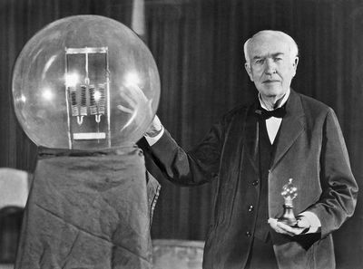
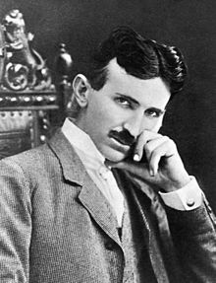
Were the Entrepreneurs and Inventors of the Industrial Revolution Fueled by a Growth Mindset?
Jake DiRico
Taylor Cosci
Laura Napolitano
Nicole Christenson
Joe Nastasi
Will Stiklickas
John Delaney
John Delaney

Slide 2
What is a Growth Mindset?
Jake DiRico

Slide 3
Is it okay to fail?
Turn and talk
My story of failure
Would you consider my failure a success?
“The Girl Who Never Made Mistakes”
Observe Carl’s emotion when he makes mistakes, have you had the same emotion when you made a mistake?
Observe Beatrice's behavior when she almost makes a mistake. Why do you think we are so afraid to make mistakes?

Slide 4
The Growth vs the Fixed Mindset
Growth Mindset- The view that learning is a process that is driven by effort that involves constant growth through trial and error. Failing well Taking responsibility for failure: Blaming NO ONE. Learning valuable lessons from failure Having a positive attitude on failure | Fixed Mindset- Implies that an individual's ability is inborn and fixed. Failing Badly Blaming other or circumstances: Not taking responsibility for failure Not learning valuable lessons from failure: Repeating the same mistake over and over Having negative attitude on failure

Slide 5
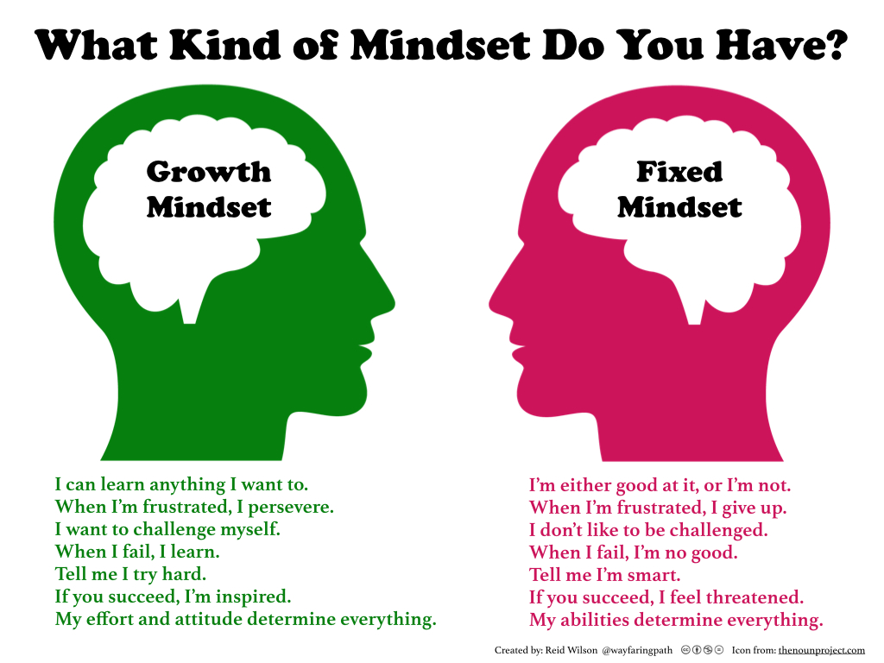

Slide 6
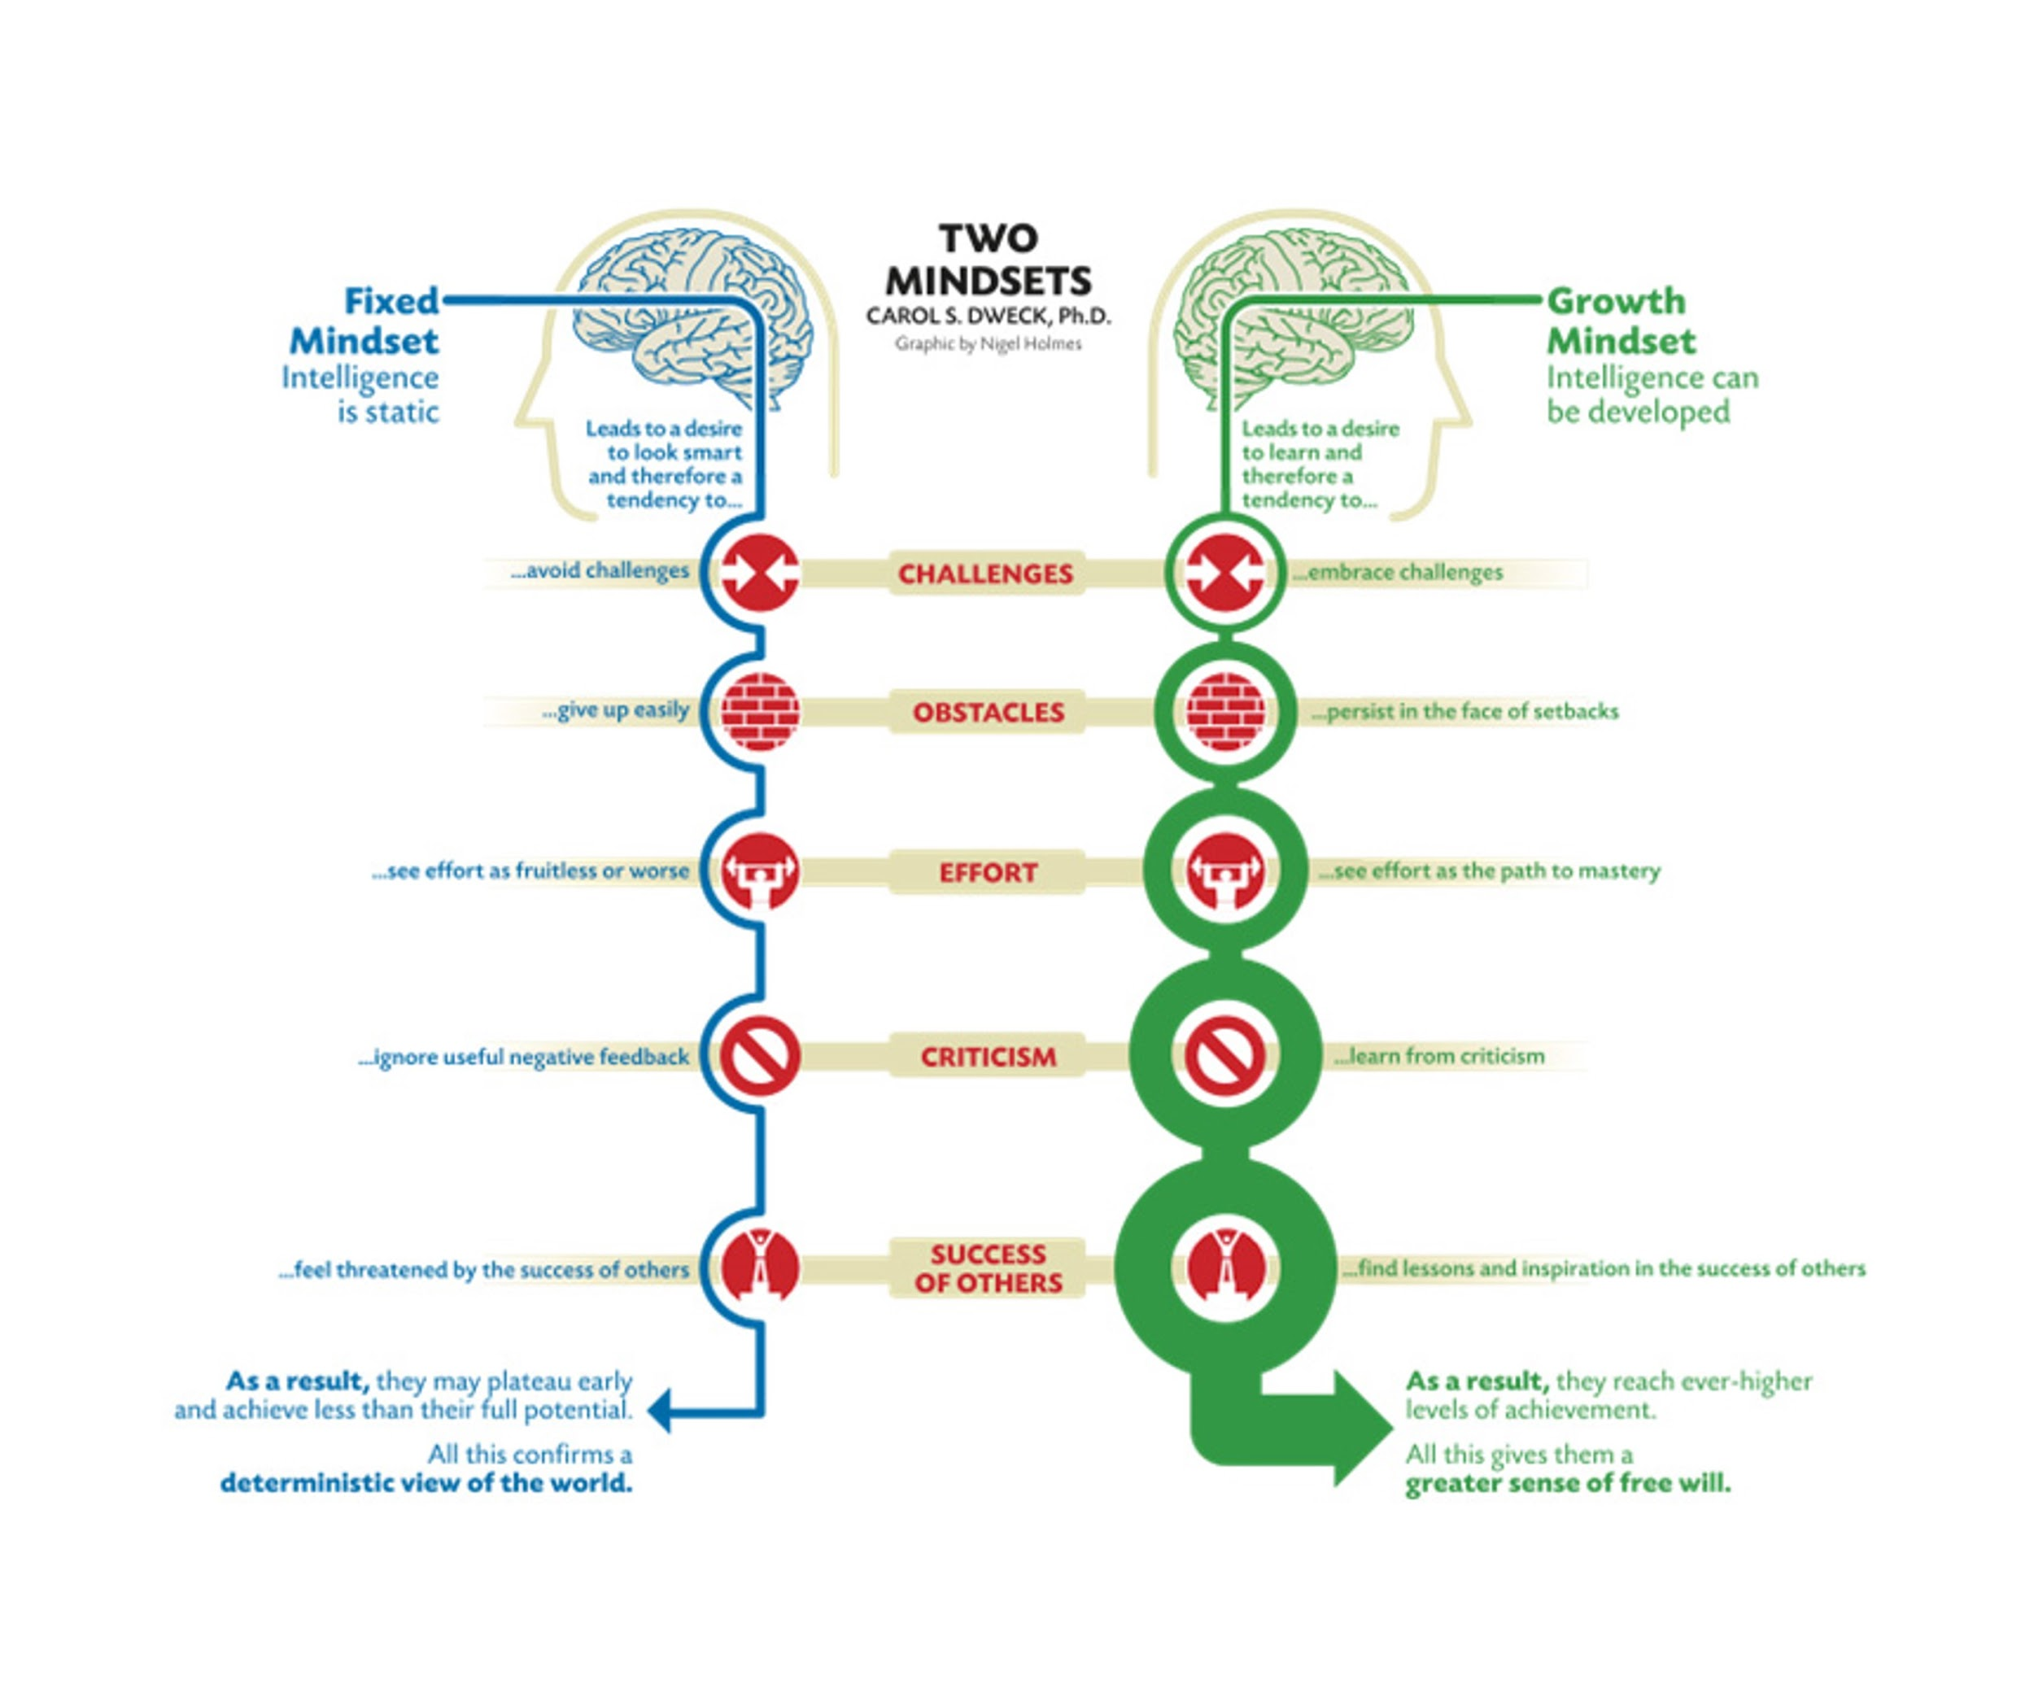

Slide 7
You be the judge: Fixed or Growth Mindset?
https://www.youtube.com/watch?v=UNAMrZr9OWY
Does the first girl believe in failing well?
What could the first girl have done differently to display a growth mindset?
Think of a time you were asked a question you did not know. Did you respond or were you hesitant because of the fear of failure?
Scenarios

Slide 8
Homework
Ask your parent/guardian about a time that they failed.
Determine whether they presented a Growth or Fixed Mindset and why.

Slide 9
Virtual Field Trip/ Statement Strategy
Joseph Nastasi

Slide 10
Context: Mic’d up
https://www.youtube.com/watch?v=2CDkcKBOKl0
4:24 - 4:52
https://www.youtube.com/watch?v=nFeF_yFtssk

Slide 11
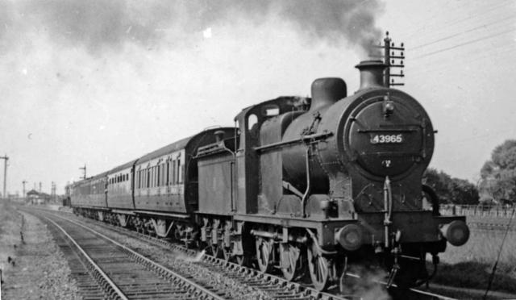

Slide 12
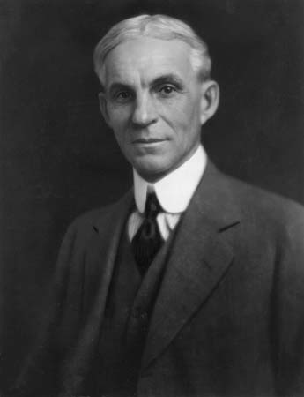
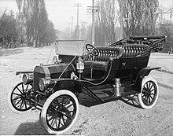
Henry Ford

Slide 13
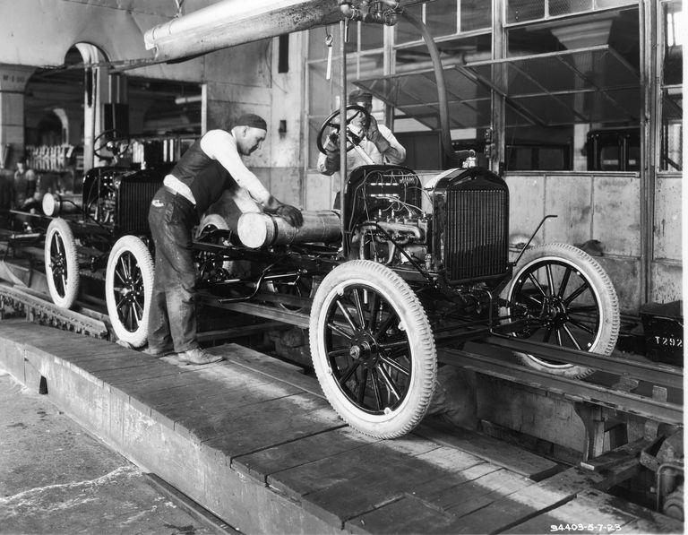

Slide 14
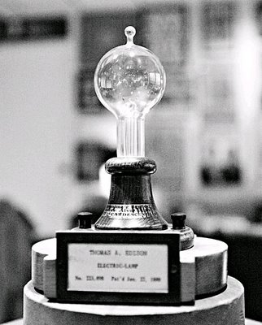
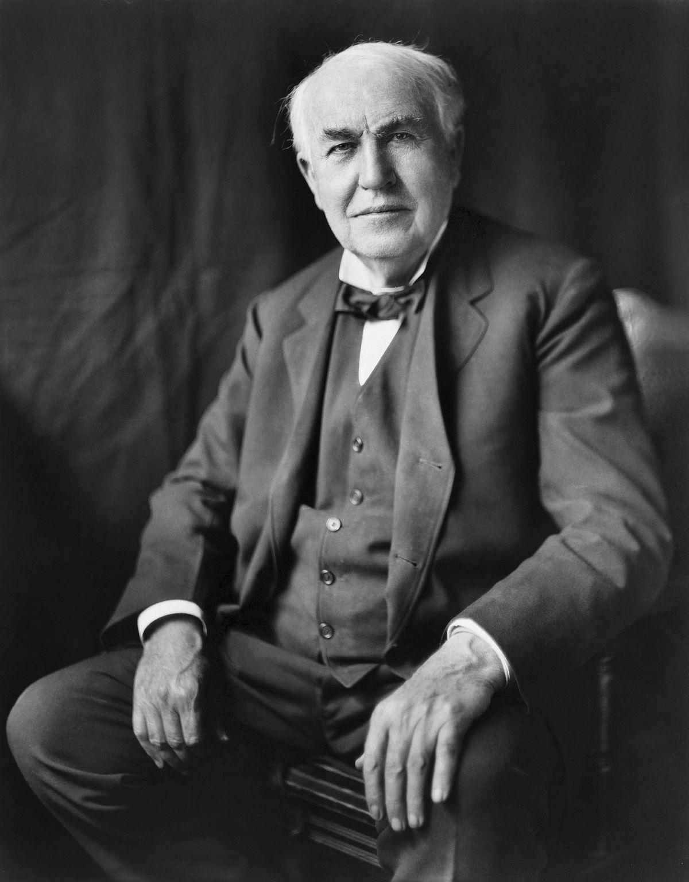
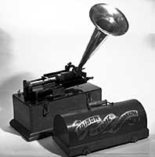
Thomas Edison

Slide 15
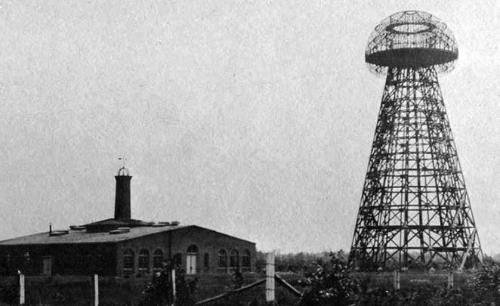
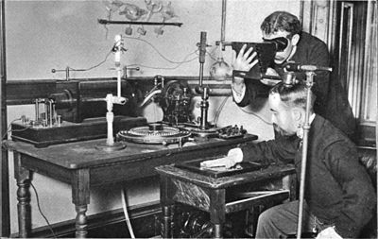
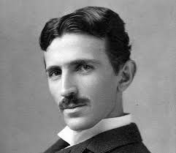
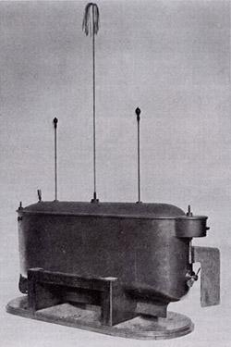
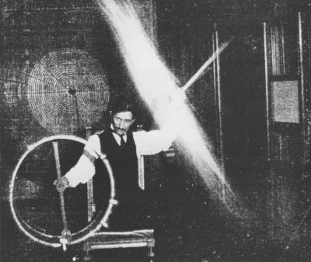
Nikola Tesla

Slide 16
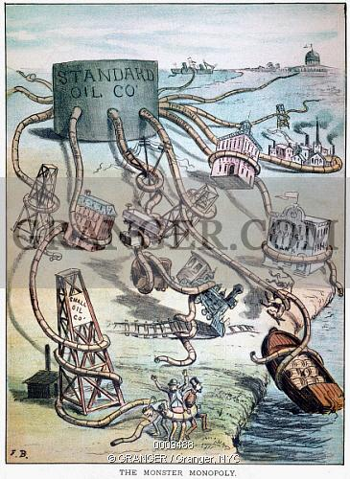
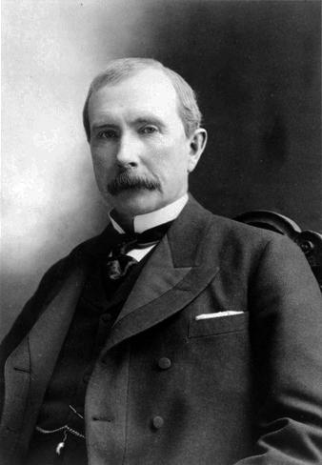
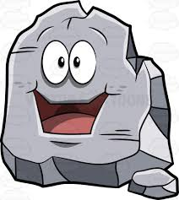
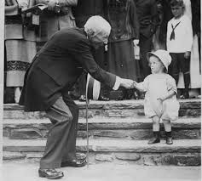
John D Rockefeller

Slide 17
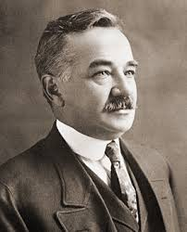
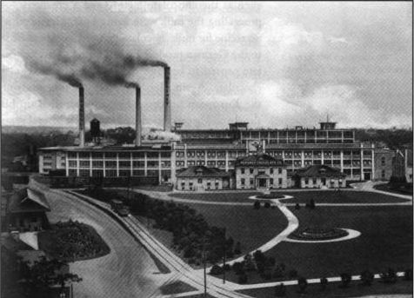
Milton Hershey

Slide 18
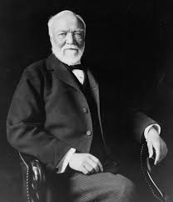
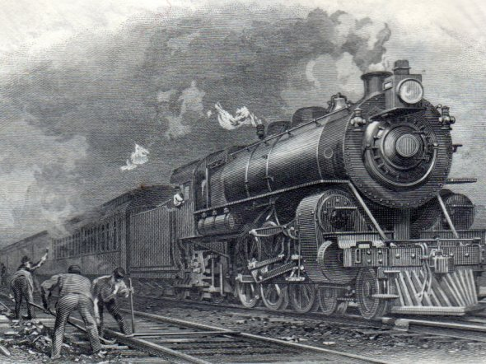
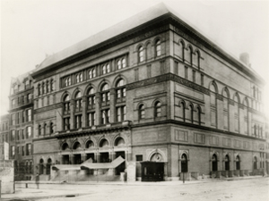
Andrew Carnegie

Slide 19
Reading Like a Historian
Will Stiklackis
Do Now:
Take out homework

Slide 20
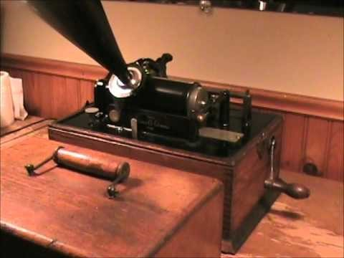

Slide 21
Reading Like a Historian
1. Sourcing: Who wrote the article and what might be the motivation and personal interest.
2. Close Reading (Inferential and Academic): What does the document
actually say and what do the specific words or phrases refer to?
What does the author mean by “popular sovereignty”?
3. Close Reading and Perspective: This is a question that asks the reader to gauge the perspective of the author.
What is the perspective of the author or what would the author do
(application)?
4. Context: This is a question that asks the reader factor in what else is
going at the time of this document and its possible effect on the author.
5. Corroboration: This is a question that asks the reader to gauge
whether the two documents in the question contradict or support one
another by analyzing the information in each document.

Slide 22
Homework:
Create ‘Reading Like a Historian’ questions for the source that was given out.

Slide 23
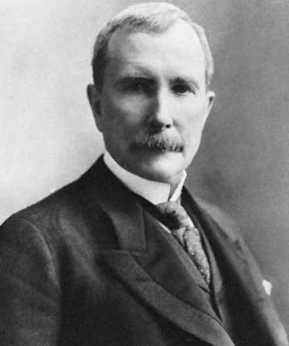
History Mystery
Nicole Christenson

Slide 24
Thinking Like a Historian--Homework
Sourcing: Who wrote this article and what might be the motivation?
Close Reading (Inferential and Academic): What does this document actually say, and what do the specific words or phrases refer to (provide evidence)
Close Reading and Perspective: This is a question that asks the reader to gauge the perspective of the author.
Context: This is a question that asks the reader factor in what else is going on at the time of this document and its possible effect on the author.
Corroboration: This is a question that asks the reader to gauge whether the two documents in the question contradict or support one another by analyzing the information in each document.

Slide 25
The CASE of the BROKEN VASE! An EvanTubeHD Detective Story
https://www.youtube.com/watch?v=m-zgsuwshIU

Slide 26
History Mystery Directions
With your group, analyze the sources in the folder.
Decide whether the source presents Strong Evidence (Credible), Not Credible Evidence, or Not Relevant to Task.
Three Jobs: Recorder, Speaker, and Timekeeper.
Be prepared to justify your answer in a class discussion.
Be sure to use quotes from the source to support your claim.
Does your source have the validity to back up your claim?

Slide 27
In life, we will make many important decisions……
In order to make these decisions/claims we need to:
Seek strong and credible evidence.
Be able to justify our decisions/claims based on this evidence.

Slide 28
Shark Tank Simulation
Taylor Cosci & Laura Napolitano

Slide 29
What is Shark Tank?
Eager entrepreneurs get the chance to bring their dreams to life in this reality show. They present their ideas to “sharks” in the tank- five billionaires looking to invest their money – in hopes of making a business deal.
Notes:
Who knows what an entrepreneur is?
Who knows what an inventor is?

Slide 30
Shark Tank Video Clip:
https://www.youtube.com/watch?v=wmenN7NEdBc

Slide 31
Shark tank shows us the entrepreneurs and inventors of our day…who were the entrepreneurs during the industrial revolution?

Slide 32
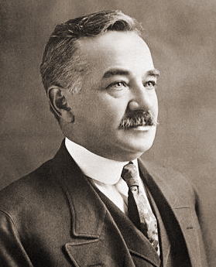
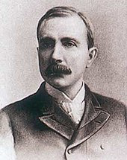
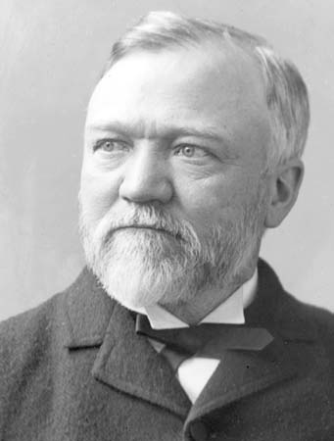
Industrial Revolution: Entrepreneurs
Milton Hershey John D. Rockefeller Andrew Carnegie

Slide 33
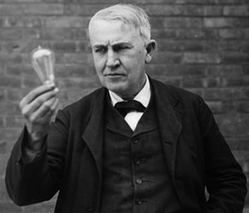
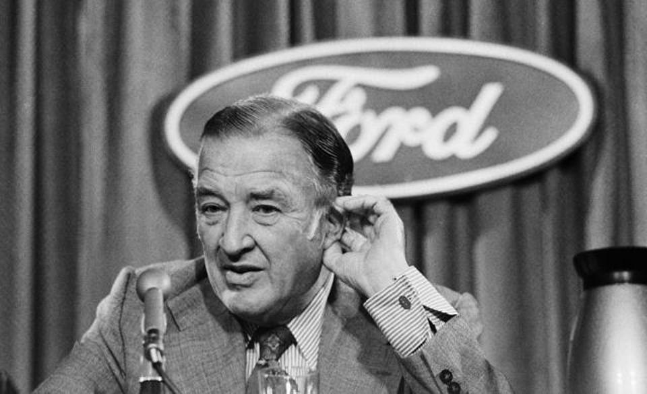
Industrial Revolution: Inventors
Thomas Edison Nikola Tesla Henry Ford

Slide 34
TDFC, For You and Me.
John Delaney
Big shoutout to Dan Keegan

Slide 35
TDFC
Topic Sentence
Details
Follow Ups (Support for Detail)
Clincher

Slide 36
Incorporating the TDFC model
Sample Question:
Discuss two reasons the Yankees will win the World Series in 2018.
Like a Lawyer, you will all be using EVIDENCE to answer the question.

Slide 37
Step 1: Write a Topic Sentence
This is used in a BODY PARAGRAPH
TDFC
State your opinion and give the reader a “Sneak peek” at what you’ll be talking about
Example:
The New York Yankees will win the World Series in 2018 because of their great players.

Slide 38
Write DETAIL 1
TDFC
Introduce the detail
“One of the offensive stars of the NY Yankees is Aaron Judge”
TDFC
FOLLOW UP - Give more information about DETAIL
“Aaron Judge was unanimously named 2017 AL rookie of the year. He hit 52 home runs.”

Slide 39
Write DETAIL 2
TDFC
Introduce another detail - we want to make out argument strong
“Another great player for the Yankees is Gary Sanchez”
TDFC
FOLLOW UP - Give more information about DETAIL
“Gary Sanchez hit 33 home runs in 2017. He was selected for the All-Star game this year. ”

Slide 40
Write Clincher
TDFC
Tie everything you wrote together
“As you can see, [with all the evidence provided] there is enough talent on the Yankees team to earn another World Series title.”

Slide 41
Put it all Together
TDFC
The New York Yankees will win the World Series in 2018 because of their great players. One of the offensive stars of the NY Yankees is Aaron Judge. Aaron Judge was unanimously named 2017 AL rookie of the year. He hit 52 home runs. Judge was second in the MLB in home runs. Another great player for the Yankees is Gary Sanchez. Gary Sanchez hit 33 home runs in 2017. He was selected for the All-Star game this year. He is a successful offensive and defensive player. As you can see, there is enough talent on the Yankees team to earn another World Series title.
*NOTE THE DARK BLUE SENTENCES!* -

Slide 42
New Worksheets! Hurray!
I will hand out the “Inventors TDFC planning sheet” aka the “Industrial Revolution Study TDFC Planning Sheet” and the “DBQ Part B.”
We will work on the Topic Sentence and Detail 1 together

Slide 43
Inventors TDFC Planning Sheet
TOPIC SENTENCE
“Two inventors that displayed a growth mindset were Nikola Tesla and Thomas Edison.”
Like Lawyers - We will support these claims with EVIDENCE

Slide 44
Inventors TDFC Planning Sheet
Detail 1
“Nikola Tesla was very influential as an inventor in the industrial revolution and displayed a growth mindset”
Remember to support these claims with EVIDENCE

Slide 45
Inventors TDFC Planning Sheet
Follow Up 1
Which Document can help us PROVE that Nikola Tesla had a growth mindset?

Slide 46
More Sheets!
I will now hand out the “Double Citations” Worksheet.

Slide 47
Double Citations
The Test graders LOVE it if you cite the evidence twice.
Write:
“According to document___ we see that _______________ (Document ___).”

Slide 48
Double Citations
Now do other other one on your own!

Slide 49
Inventors TDFC Planning Sheet
Follow Up 1
Use document 4 to help us give a follow up to our detail sentence!
Double cite the document to make it awesome

Slide 50
Inventors TDFC Planning Sheet
Follow Up 1
According to document 4, Nikola Tesla was able to overcome many setbacks but still went on to create and invent useful products that we use today, which proves he had a growth mindset (Document 4).

Slide 51
Inventors TDFC Planning Sheet
Follow Up 2
Now you must include outside information you know to create follow up 2.
Who can tell me important information about Tesla?

