Slide 1
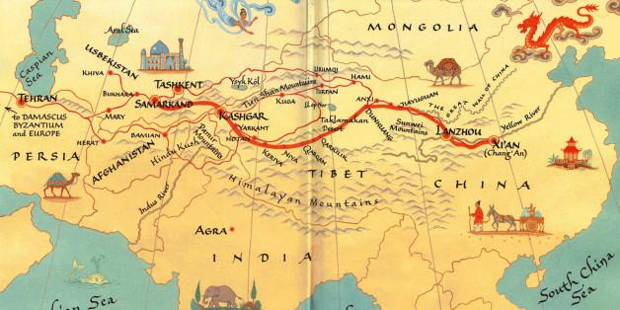
Character Strengths on the Silk Road
Iriana Payamps, Toni Mangione, Nastassja Hines, Megan McManus,
Kaitlin Batik, Gabrielle Morales

Slide 2
Character Strengths

Slide 3
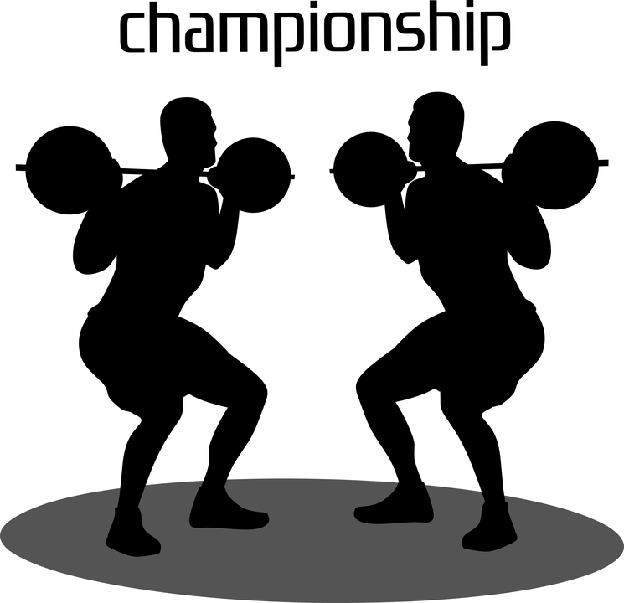
Let us be CHAMPS:
Conversation: Students will participate in a conversation about the book
Help: Students will work together as a team to brainstorm thoughts
Activities: Students will engage in a 360 character strength activity
Movement: Students will move around the room to get to each student's chart
Participation: Students will participate in a conversation with valid reasons for choosing each character strength
Success: Students will successfully complete the activity

Slide 4
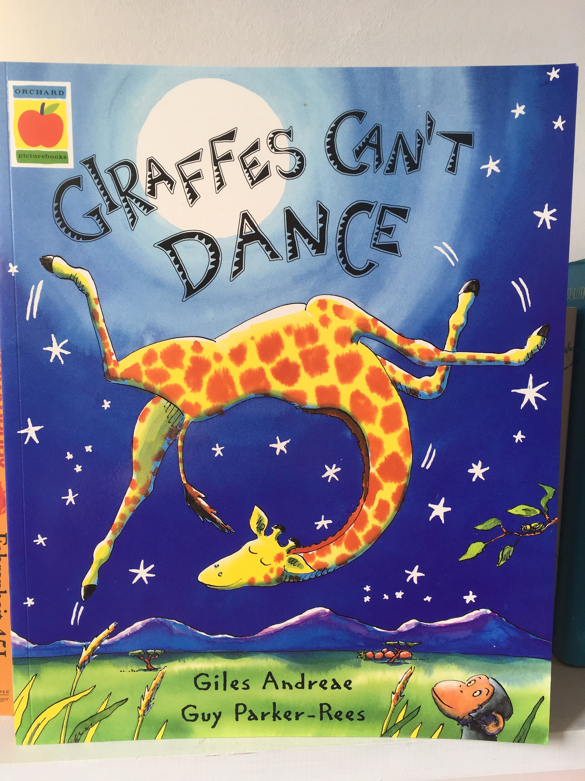
Giraffes Can’t Dance:

Slide 5
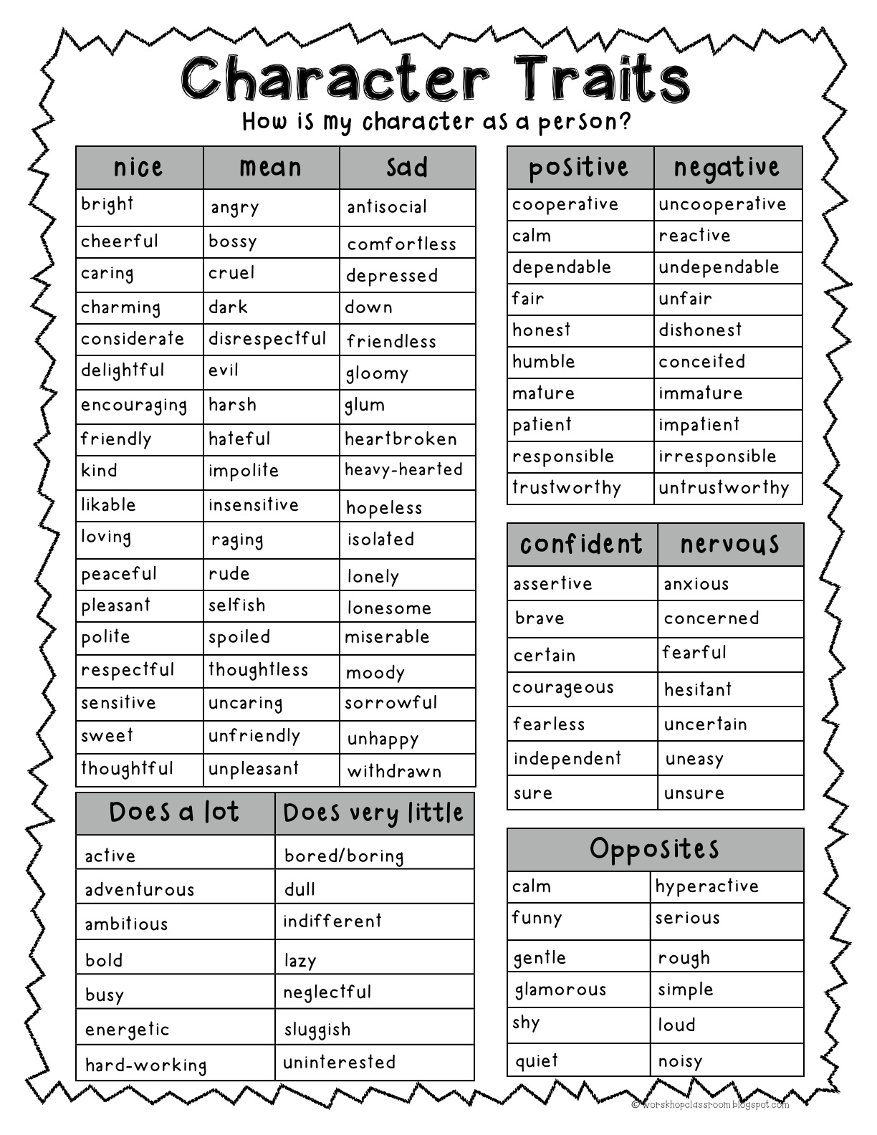
Character strengths are known as a constellation of personal skills, attitudes, values, and mindsets.
What character strength would you use to describe yourself?

Slide 6
Class Discussion

Slide 7
And for homework….

Slide 8
Let's Go on a Field Trip !!!!!!!

Slide 9
BrainPop!
https://www.brainpop.com/socialstudies/famoushistoricalfigures/marcopolo/
Let’s watch a video to discover who Marco Polo was!

Slide 10
Champs!
Conversation: There should be no talking during the virtual field trip, but students will be able to talk and work together for the statement strategy!
Help: If you need help raise your hand and the teacher will help you or you can ask a classmate for help.
Activity: The students will learn about Marco Polo & Ibn Battuta through a virtual field trip.
Movement: Students will carefully move their seats into rows of two for the virtual field trip and stay seated during it!
Participation: Students will participate by doing a turn & talk at the end of the lesson.
Success: Let’s work together to learn something new!

Slide 11
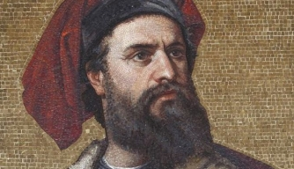

Slide 12
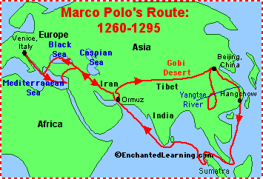

Slide 13
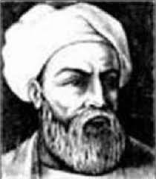

Slide 14
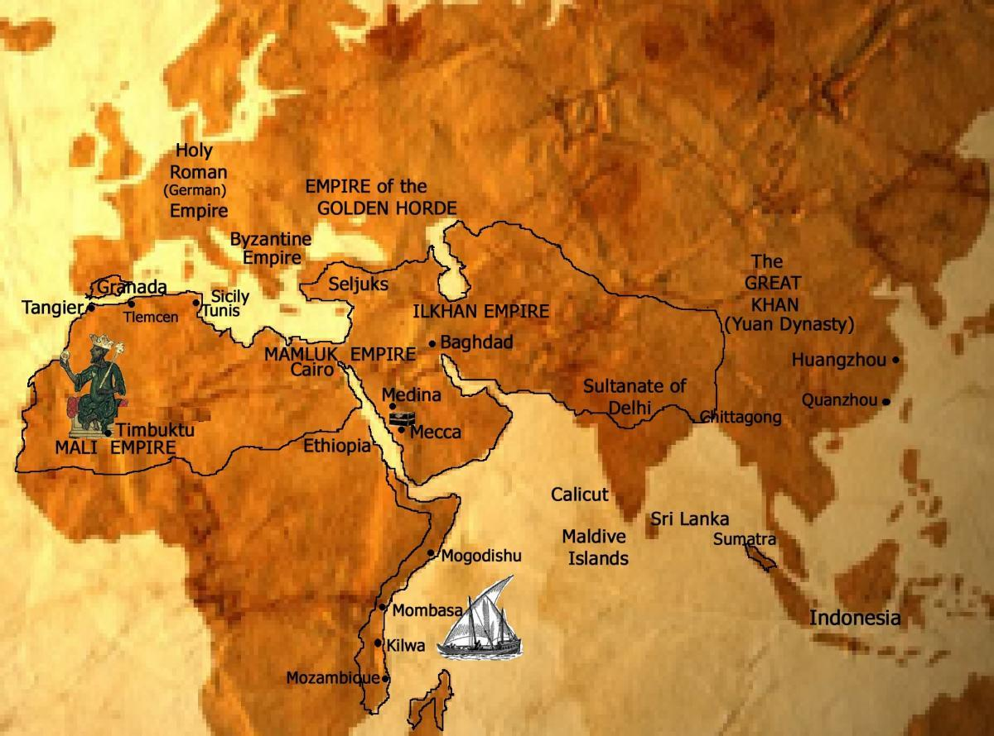

Slide 15
Statement Strategy:
Example:
Marco Polo traveled 24 years along the Silk Road. The Silk Road was made of trade routes between major cities. There were trading posts that went from Eastern Europe to Northern China. It is called the Silk Road because silk cloth was the major export from China.
Statement: The Silk Roads major export was soil.
Agree______ Disagree______
Evidence:__________________________________________________________________________________________________________________________

Slide 16
Homework!
https://www.youtube.com/watch?v=vfe-eNq-Qyg&t=44s
For homework you will watch this video and write a summary on what you have learned from it!

Slide 17
Thinking Like A Historian

Slide 18
How are historians like detectives?

Slide 19
CHAMPS
Conversation: | Students will discuss their ideas as a group during the Thinking Like a Historian activities. Students should focus and stay on topic to complete their worksheets.
Help: | Students can help one another during the group activities or raise their hands when doing their individual work.
Activities: | Today we’ll learn how to Think Like a Historian by analyzing documents to decide whether they are credible sources or not through close reading and contextualization.
Movement: | Students will move around the classroom to enter into their groups for the group activity.
Participation: | Students should all provide their own input in the group activity. Each student is expected to ask and answer questions throughout the lesson.
Success: | If all students participate we can have a successful discussion.

Slide 20
Historical Reading Thinking Questions
Sourcing: | Who wrote the article and what might be the motivation and personal interest. Is there bias?
Close Reading: | What does the document actually say and what do the specific words or phrases refer to.
Close Reading - Perspective: | Gauge the perspective of the author.
Context: | What else is going on at the time of the document and what effects might that have on the author?
Corroboration: | Gauge whether the two documents contradict or support one another by analyzing the information in each document.

Slide 21
“The city is passing great, and has a circuit of some 60 miles; it has merchants of great wealth and an incalculable number of people. Indeed, if the men of this city and of the rest of Manzi had but the spirit of soldiers they would conquer the world; but they are no soldiers at all, only accomplished traders and most skillful craftsmen. There are also in this city many philosophers and leeches, diligent students of nature.”
The Book of Ser Marco Polo: The Venetian Concerning Kingdoms and Marvels of the East, Volumes I and II, translated and edited by Colonel Sir Henry Yule (London: John Murray, 1903)
Let’s Do One Together!

Slide 22
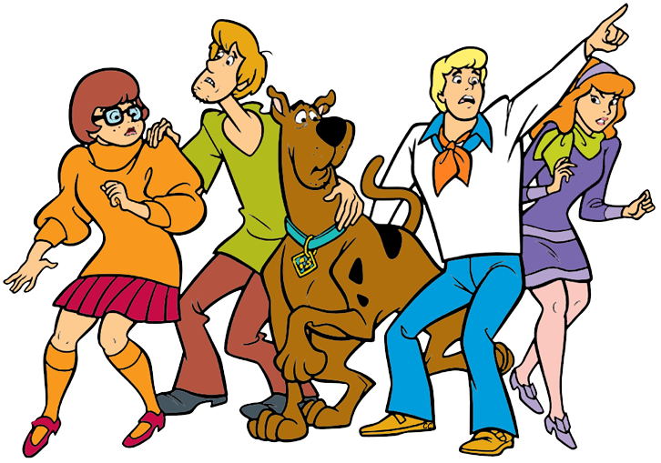
Now it’s your turn!
Get into your groups and try one together.

Slide 23
“I left Tangier, my birthplace, on Thursday, June 14, 1325, being at that time twenty-two years of age, with the intention of making the Pilgrimage to the Holy House at Mecca and the Tomb of the Prophet at Medina. I set out alone, finding no companion to cheer the way with friendly intercourse, and no party of travellers with whom to associate myself. Swayed by an overmastering impulse within me, and a long-cherished desire to visit those glorious sanctuaries, I resolved to quit all my friends and tear myself away from my home. ”
Travels In Asia And Africa, 1325-1354 by Ibn Battuta (P. 43)
Let’s Review!

Slide 24
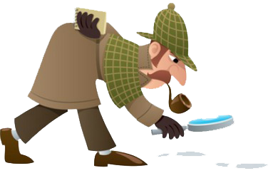
Time to Create your own questions!
After reading the excerpt provided on the worksheet, create your own sourcing, close reading, close reading: perspective, and context questions.
Use your new detective skills and don’t forget...THINK LIKE A HISTORIAN!
For Homework

Slide 25
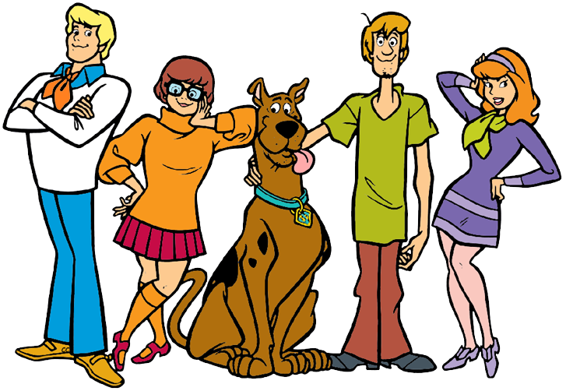
Let’s Solve This Mystery, Gang!
https://www.youtube.com/watch?v=eZXg6Uaxd2k

Slide 26
We are CHAMPS
Conversation: Students will discuss with their table during the History Mystery activity. Talking will be at a LEVEL ONE.
Help: Students will work together and help each other answer the questions.
Activities: Students will participate in a History Mystery activity by sorting through documents provided.
Movement: Students will remain in their seats during this activity.
Participation: Every student is expected to be an active participate during the lesson.
Success: Students will be successful when they determine the character traits depicted in each document.

Slide 27
What is a mystery?
Mystery: something that is difficult or impossible to understand or explain
Nothing is impossible in our classroom!

Slide 28
HISTORY MYSTERY TIME

Slide 29
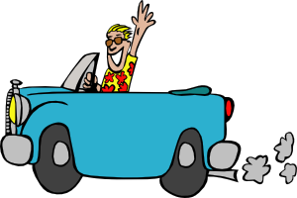
HOMEWORK
Listen to the song “Hit the Road Jack” and
determine how this relates to our lesson today.
https://www.youtube.com/watch?v=OY4jondX6tg

Slide 30
History Alive: Meeting of the Minds

Slide 31
Two Truths and a Lie
Five volunteers will come to the front of the classroom and share two true things and one lie about themselves. The rest of the class will guess which statement is false.

Slide 32
CHAMPS
Conversation: Students will talk to each other during the Meeting of the Minds. Conversation should be about the group’s assigned topic, not personal conversations about other topics.
Help: Students can ask group members for help or raise hand to get help from the teacher.
Activity: Today we will have a “Meeting of the Minds” discussion and use the information we discuss to write a paragraph
Movement: We will move around the room when we are broken into groups and when we form new groups. Stay with your groups during discussions.
Participation: Everyone should share at least one idea in each discussion.
Success: If we cooperate we can have successful discussions!

Slide 33
Round 1 Groups
Group 1: Marco Polo. Be prepared to discuss his travels, the impact of his travels, and the character strengths his travels demonstrate.
Group 2: Ibn Battuta. Be prepared to discuss his travels, the impact of his travels, and the character strengths his travels demonstrate.
Group 3: Historians. Be prepared to discuss evidence that Marco Polo and/or Ibn Battuta may have faked their travels and the character strengths that faking their travels would demonstrate.

Slide 34
Jigsaw
Now that you’re experts in your topic, it’s time to get together and debate!

Slide 35
History is Written Down
Now that you’ve talked to different groups with assigned opinions, you get to decide your own opinion and write a paragraph about it.
Remember to support your opinion with evidence and include information about character strengths!

Slide 36
Let’s Groove!
At home, find a song that you can relate to one of the following:
Exploration
Making Up Stories/Telling Lies
Character Strengths
Share a link to a YouTube video of the song you chose on Twitter with #edu35101 and tell us why you chose it.

Slide 38
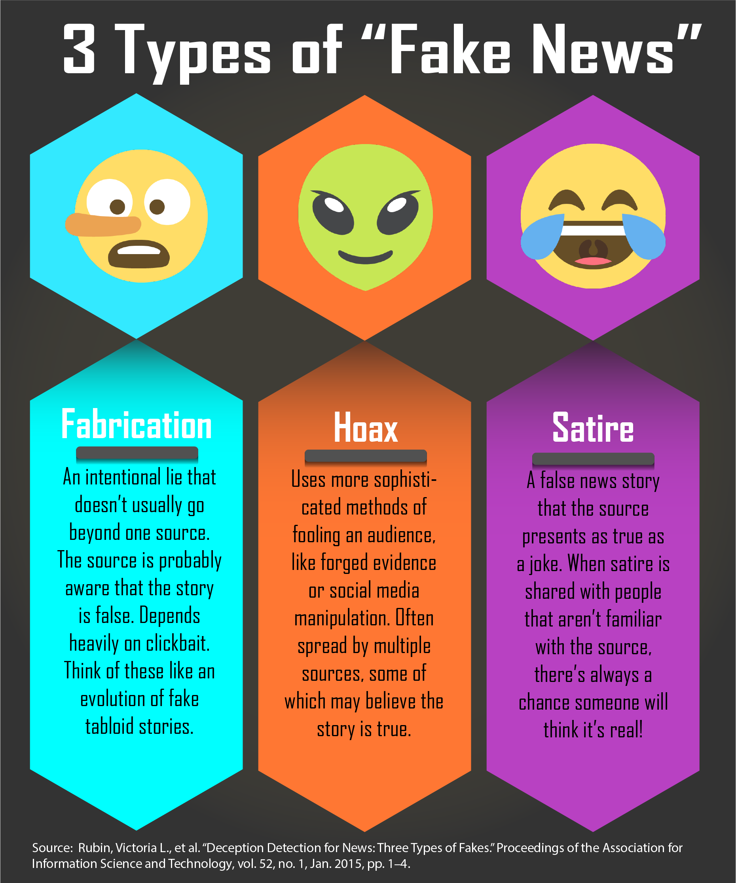
What is Misleading (Fake) News?
False stories that appear to be news and are spread on the internet or using other media (television). These stories become popular very quickly and are viewed by millions of people.
https://www.youtube.com/watch?v=icCdAl6TvNM

Slide 39
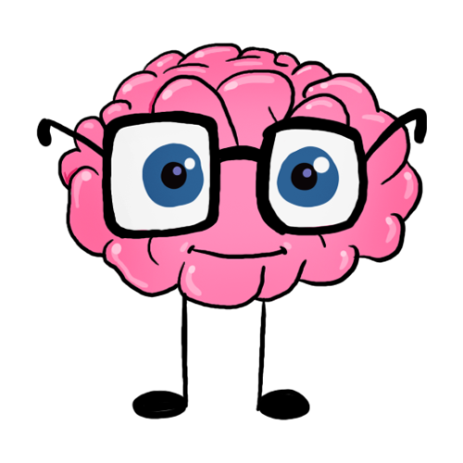
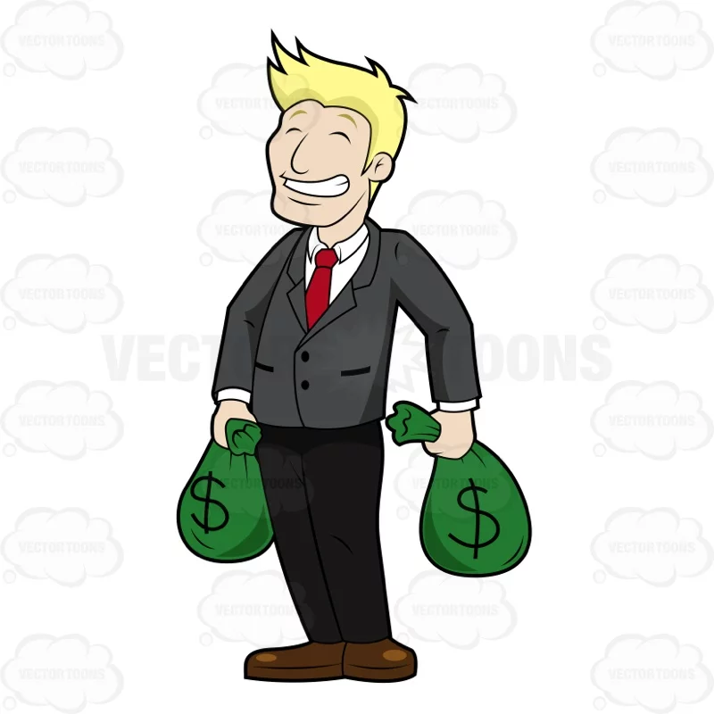
What is the point of Misleading (Fake) News?
MONEY
POLITICS/
POWER
HUMOR/
FUN
MISINFORM
PASSION

Slide 40
We are CHAMPS!
Conversation: Students will be divided into action groups to discuss and collaborate while working on their misleading news projects. Students will be able to use a variety of technology, including cell phones, computers, and tablets. Students must stay on task, engage in no texting or browsing that is off topic. If you are caught then your privilege will be taken away and you must look on with another student.
Help: Students are encouraged to ask questions and for help from both the teacher and the peers in their action groups.
Activities: Students will use their detective skills to find misleading news on social media, as well as collaborate in action groups by creating a medium to inform the public about misleading news.
Movement: Students will move into their assigned action groups and this will be their group until the end of the project.
Participation: Students will be assigned different roles in each group and participate in the collaboration and research of their misleading news projects.
Success: Students will create a commercial, a Twitter account, or a Powerpoint to inform the general public of misleading news!

Slide 41
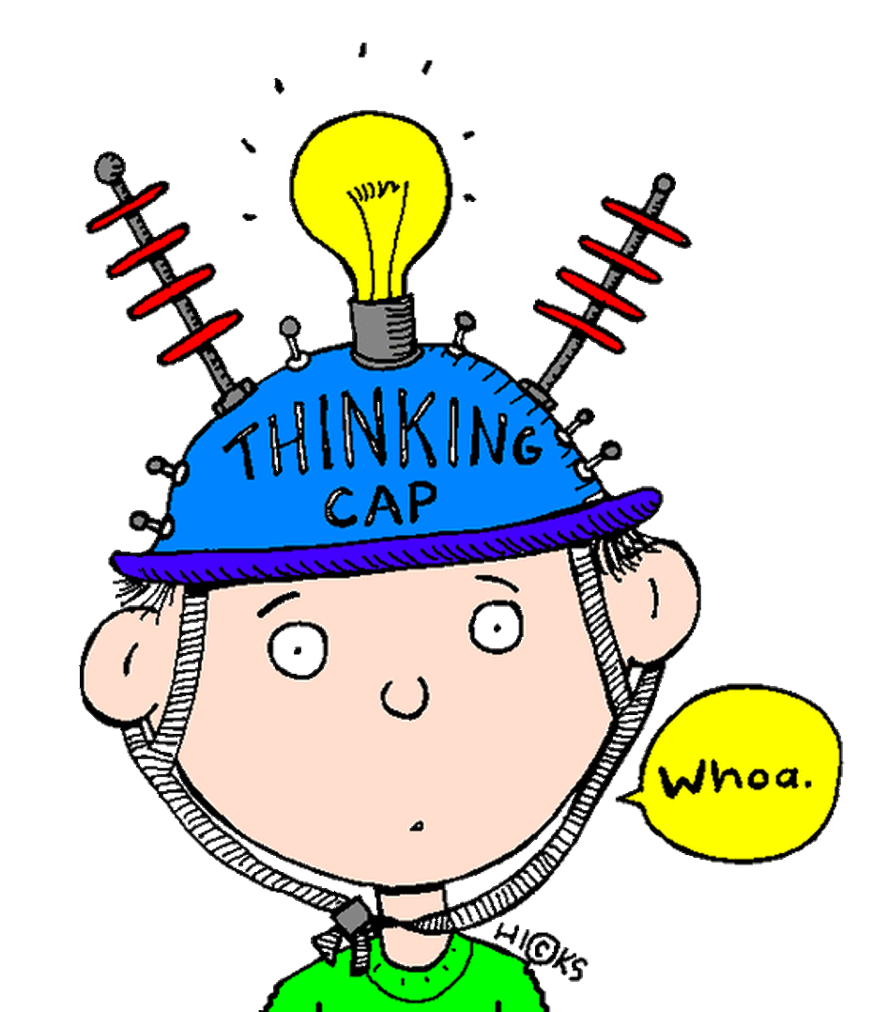
Time for our ACTION groups! How will you inform the public about FAKE NEWS?
https://create.kahoot.it/l/#user/bc312d35-7428-4480-a57c-ad454ae23d00/kahoots/created

