Slide 1
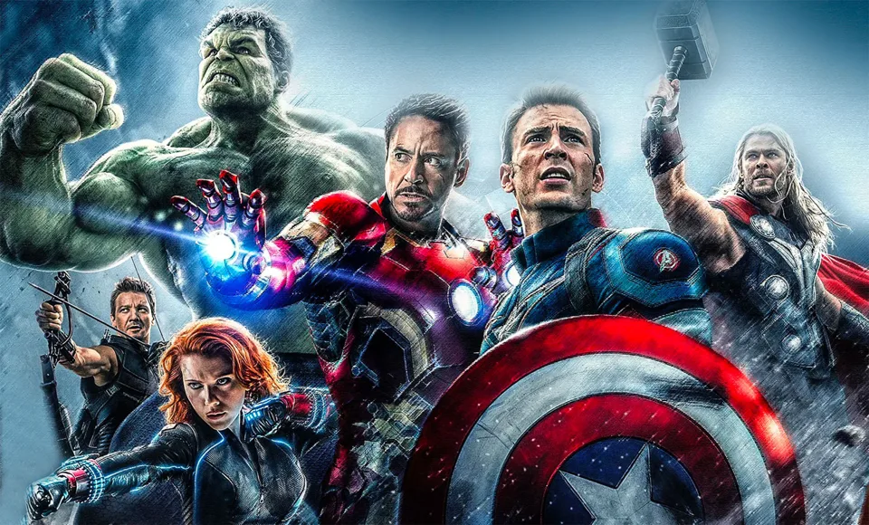
LEADING WITH STRENGTHS & Synergy (Stronger Together)
“We’re all in this together!!”
\

Slide 2
Super Heroes!!
First watch the YouTube clip at the link below of the Fantastic Four:
Fantastic Four Working Together
Click on the Padlet link below and answer the two questions:
Super Heroes Padlet Questions

Slide 3
“Going Places” by Peter and Paul Reynolds
Next, we will be reading a short story called “Going Places”. You can follow along on this YouTube link that will read the story along for you and show you the pictures from it. Think about these questions while watching the story:
"Going Places" by Peter & Paul Reynolds
What were they supposed to build?
What were the reactions of the other kids when they saw what the main characters built?
What did the main characters learn in the end?
What do you think this story is trying to teach you?

Slide 4
Guided Questions *For Parents’ Use*
Right after reading along with the video of “Going Places” by Peter and Paul Reynolds with your child, here are a few questions to ask them:
What is Raphael’s reaction when he sees what Maya had built in her backyard?
What is a strength that Maya has?
Who won the race?
How do the other students react when they see Maya and Raphael’s “go-kart”?
How do you think the other students felt after Maya and Raphael won?
Why do you think Maya and Raphael won the race?
Would you want to be friends with Maya in real life?
Would Maya have won on her own?
Who would you model yourself after: Maya (who saw the potential of the go-kart), Raphael (who thought of combining their strengths to win the race), or the other students (who followed the go-kart instructions as they were written)?

Slide 5
Parents/Guardians/Classmates Super Powers
Click on the link below for a Google Doc where you can either draw a picture OR write a paragraph OR do a FlipGrid video post about your parent’s, guardian’s or classmate’s Super Powers!! What do you believe makes them a superhero?
Super Parents Worksheet
Either download the document or you can Print it and take a picture when you are done.

Slide 6
Synergy
Ms. Erin Keating & Mr. Bill Buith
Click below for the link to today’s worksheets:
Lesson #2 Worksheets

Slide 7
We are Going Places!
Think back to the book we read last week, “Going Places”. Remember Raphael and Maya?
Using the Character Strengths Chart, assign character traits to Raphael and Maya.
(Ex: if you think one of Maya’s strengths is “bravery”, you will put a “M” next to the bravery icon on the chart)
In case you want to refresh your memory:
"Going Places" by Peter & Paul Reynolds

Slide 8
Who are Hamilton and Burr?
Listen to the song excerpts from Hamilton: the Musical below:
Alexander Hamilton
Aaron Burr, Sir
Now that you know a little bit more about Hamilton and Burr, assign them character traits on the Character Strengths Chart
(Ex: If you think the strength “curiosity” fits Hamilton, put an “H” in the same box as Curiosity)

Slide 9
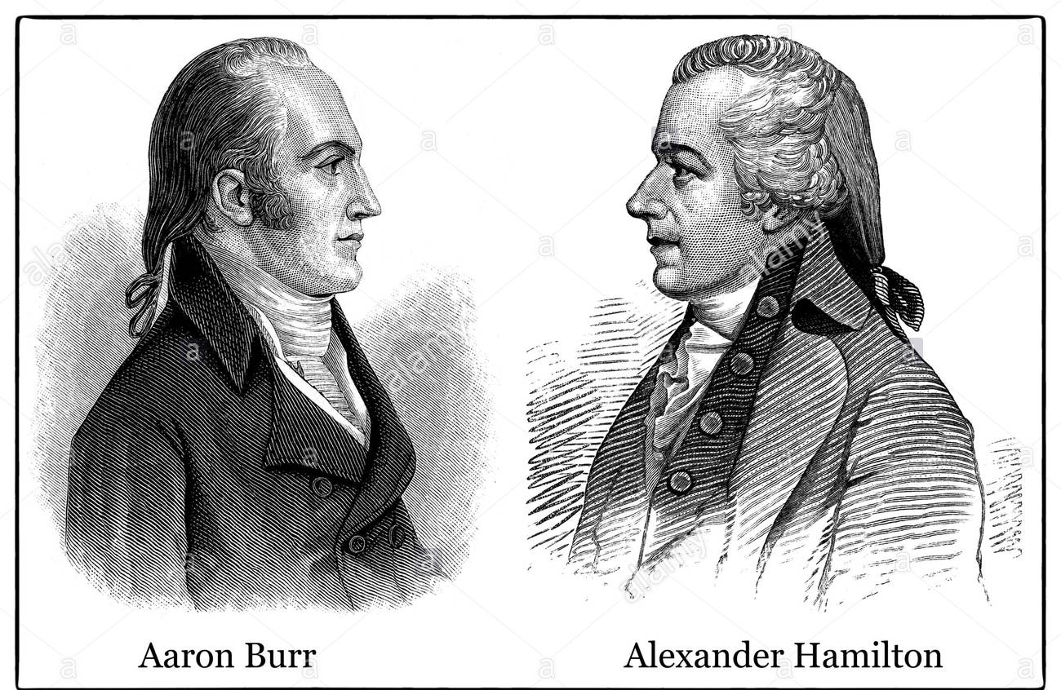
Hamilton vs. Burr
After completing the Character Strengths Chart and assigning Hamilton and Burr different character strengths, pick one of the following:
Choice 1: Fill out the Venn Diagram to compare and contrast the strengths of Hamilton and Burr (see Strengths Standoff Venn Diagram worksheet)
Choice 2: Write a short essay comparing the strengths of Hamilton and Burr (see Strengths Standoff Essay worksheet)
Choice 3: Create a FlipGrid post comparing the strengths of Hamilton and Burr ( access the FlipGrid here )

Slide 10
Superhuman Seventh Graders!!
It’s time to think about your own character strengths!! After learning about the many different character strengths someone can possess, what would be your character strengths? What would be your parents/guardians character strengths? You can use the last worksheet to fill in the muscle person with your character strengths (make it creative!!).
Follow-up activity: Parents can talk to your children about what they believe their character strengths are and why.

Slide 11
Synergy in History: Are our differences our strengths?
By Mr. Bill Buith and Ms. Erin Keating

Slide 12
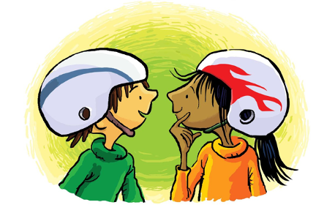
What is Synergy?
Synergy is when we combine our strengths, and ultimately come up with a solution better than what we would have come up with individually.
In Going Places, Raphael and Maya combined their strengths in order to build a better vehicle and win the race.
Science Example: Hydrogen is needed on its own, and oxygen is needed on its own… but combined, you get water, which is the basis for life!!

Slide 13
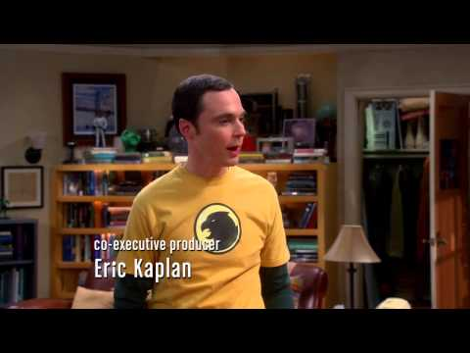
What is compromise?
Compromise is an agreement or settlement of a dispute that is reached by each side making concessions for each other.
Believe it or not, compromise is a large part of our lives.
Decisions, both big and small, are frequently made using compromise.
Here is a perfect example of the importance of compromise from the show, The Big Bang Theory:

Slide 14
Viame.org (University of Pennsylvania)

Slide 15
The people who we study in history are people made up of character strengths and flaws?
(VIAME.ORG—FREE ANALYSIS OF STRENGTHS)

Slide 16
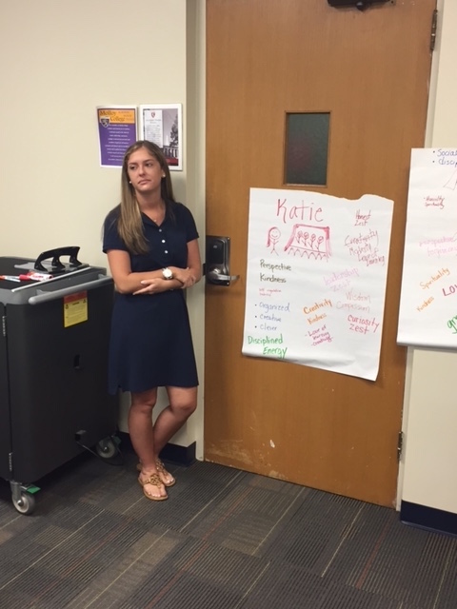
Strengths 360-
Helping Your Students
Discover Their Strengths

Slide 17
Strengths 360: For Next Tuesday ONLINE

Slide 18
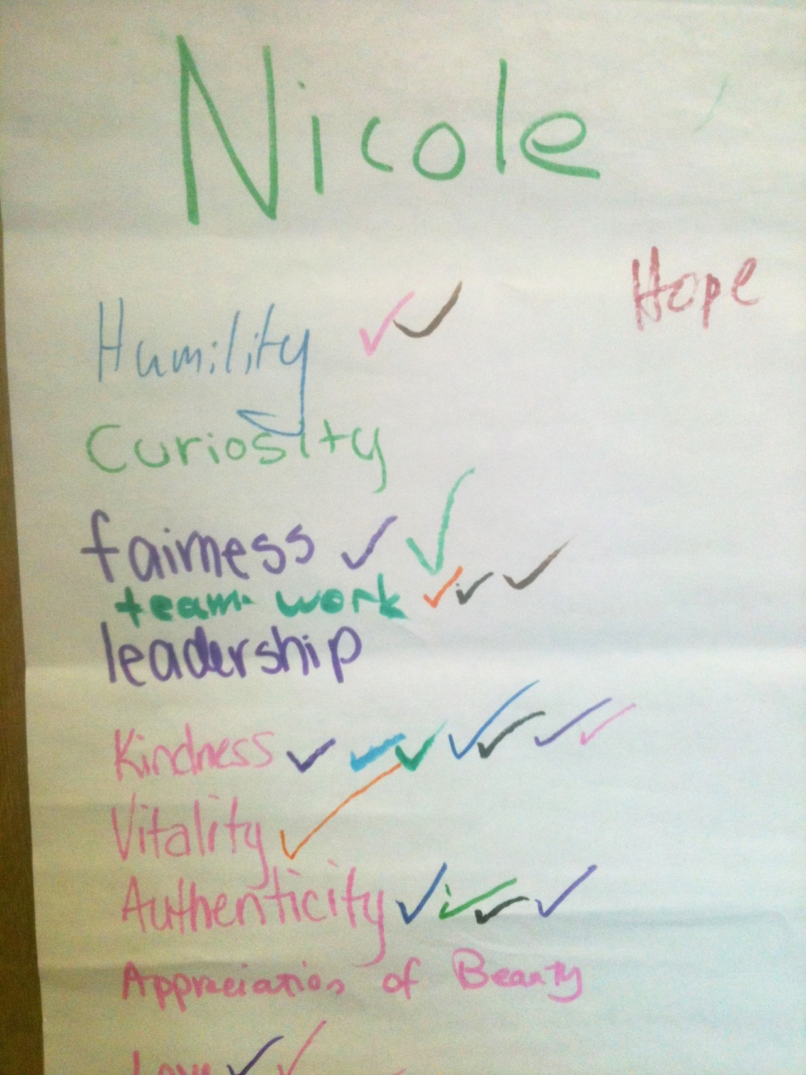

Slide 19
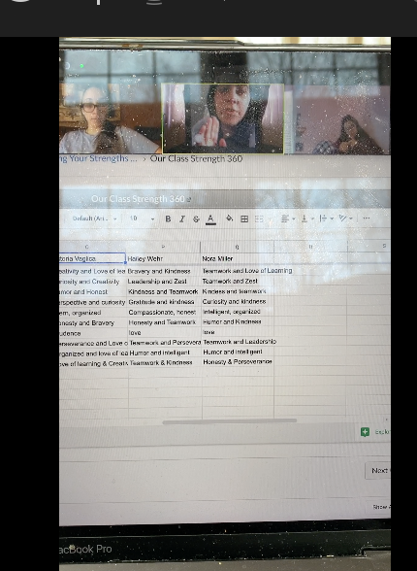
Character Strengths 360 Can Be Done Online

